Slide 1
Application
how to use random forest to fill missing data

Slide 2
How to fill the missing data
predictors
output
For example, given that we have many samples that that can be used to train the model and tell if it rains or not
Temperature | Humidity | Wind Speed | Rain
281.0 | 80.0 | 15.0 | Yes
291.5 | 45.0 | 11.0 | No
294.0 | 70.0 | 13.0 | Yes
278.5 | 65.0 | 5.0 | Yes
283.0 | 75.0 | 8.0 | No
285.6 | 80.0 | X | Yes
However, for one of the samples there is no wind speed being recorded

Slide 3
How to fill the missing data
predictors
output
For example, given that we have many samples that that can be used to train the model and tell if it rains or not
Temperature | Humidity | Wind Speed | Rain
281.0 | 80.0 | 15.0 | Yes
291.5 | 45.0 | 11.0 | No
294.0 | 70.0 | 13.0 | Yes
278.5 | 65.0 | 5.0 | Yes
283.0 | 75.0 | 8.0 | No
285.6 | 80.0 | X | Yes
However, for one of the samples there is no wind speed being recorded
The general idea of this method is that we first “make a guess” about what the missing data would look like and then gradually tune/refine it to a more optimal value.

Slide 4
How to fill the missing data
predictors
output
Temperature | Humidity | Wind Speed | Rain
281.0 | 80.0 | 15.0 | Yes
291.5 | 45.0 | 11.0 | No
294.0 | 70.0 | 13.0 | Yes
278.5 | 65.0 | 5.0 | Yes
283.0 | 75.0 | 8.0 | No
285.6 | 80.0 | X | Yes
Temperature | Humidity | Wind Speed | Rain
281.0 | 80.0 | 15.0 | Yes
294.0 | 70.0 | 13.0 | Yes
278.5 | 65.0 | 5.0 | Yes
Yes
In order to fill the missing “wind speed” data “X”
Step 1: we locate all the rain value with the same “YES”

Slide 5
How to fill the missing data
predictors
output
Temperature | Humidity | Wind Speed | Rain
281.0 | 80.0 | 15.0 | Yes
291.5 | 45.0 | 11.0 | No
294.0 | 70.0 | 13.0 | Yes
278.5 | 65.0 | 5.0 | Yes
283.0 | 75.0 | 8.0 | No
285.6 | 80.0 | X | Yes
Temperature | Humidity | Wind Speed | Rain
281.0 | 80.0 | 15.0 | Yes
294.0 | 70.0 | 13.0 | Yes
278.5 | 65.0 | 5.0 | Yes
Yes
Average wind speed = 11.0
In order to fill the missing “wind speed” data “X”
Step 1: we locate all the rain value with the same “YES”
Step 2: For all the sub-selected dataset, the average wind speed is 11.0, so the initial guess of the missing value is 11.0

Slide 6
How to fill the missing data
predictors
output
Temperature | Humidity | Wind Speed | Rain
281.0 | 80.0 | 15.0 | Yes
291.5 | 45.0 | 11.0 | No
294.0 | 70.0 | 13.0 | Yes
278.5 | 65.0 | 5.0 | Yes
283.0 | 75.0 | 8.0 | No
285.6 | 80.0 | X | Yes
Temperature | Humidity | Wind Speed | Rain
281.0 | 80.0 | 15.0 | Yes
294.0 | 70.0 | 13.0 | Yes
278.5 | 65.0 | 5.0 | Yes
Yes
Average wind speed = 11.0
In order to fill the missing “wind speed” data “X”
Step 1: we locate all the rain value with the same “YES”
Step 2: For all the sub-selected dataset, the average wind speed is 11.0, so the initial guess of the missing value is 11.0
Here is the new dataset with the initial guess of missing data
Temperature | Humidity | Wind Speed | Rain
281.0 | 80.0 | 15.0 | Yes
291.5 | 45.0 | 11.0 | No
294.0 | 70.0 | 13.0 | Yes
278.5 | 65.0 | 5.0 | Yes
283.0 | 75.0 | 8.0 | No
285.6 | 80.0 | 11.0 | Yes

Slide 7
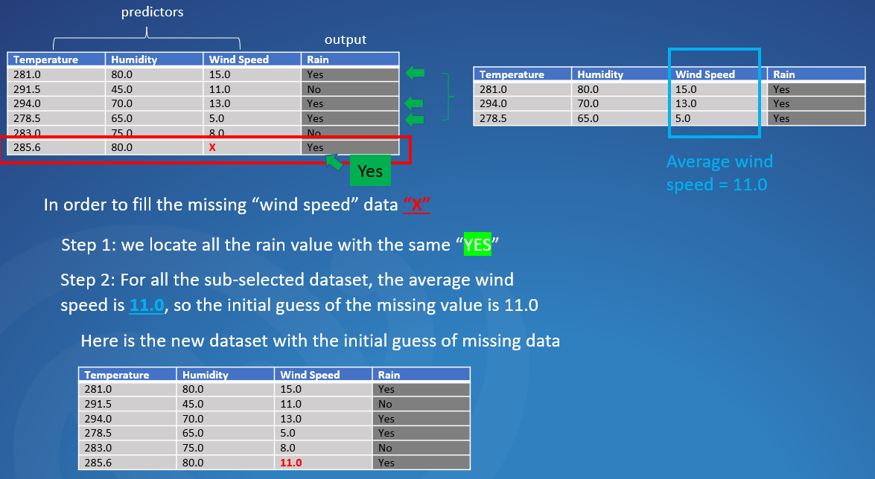
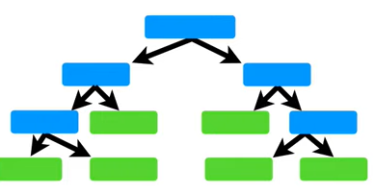
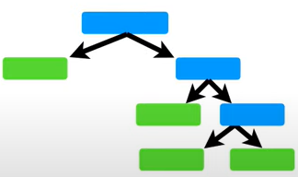
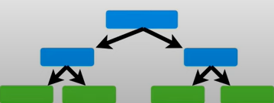
How to fill the missing data
Step 3: So using the new dataset, we are able to create a bunch of random forest trees
……

Slide 8
How to fill the missing data
Step 3: So using the new dataset, we are able to create a bunch of random forest trees
……
Step 4: We run each dataset down through all the trees individually, and locate similar dataset/samples
First dataset
Second dataset
For example, when we use the first tree
Temperature | Humidity | Wind Speed | Rain
281.0 | 80.0 | 15.0 | Yes
291.5 | 45.0 | 11.0 | No
294.0 | 70.0 | 13.0 | Yes
278.5 | 65.0 | 5.0 | Yes
283.0 | 75.0 | 8.0 | No
285.6 | 80.0 | 11.0 | Yes
…….
As you can see, each dataset/sample will end up at one leaf

Slide 9
How to fill the missing data
Step 3: So using the new dataset, we are able to create a bunch of random forest trees
……
Step 4: We run each dataset down through all the trees individually, and locate similar dataset/samples
First dataset
For example, when we use the first tree
4th dataset
Temperature | Humidity | Wind Speed | Rain
281.0 | 80.0 | 15.0 | Yes
291.5 | 45.0 | 11.0 | No
294.0 | 70.0 | 13.0 | Yes
278.5 | 65.0 | 5.0 | Yes
283.0 | 75.0 | 8.0 | No
285.6 | 80.0 | 11.0 | Yes
…….
The first and the 4th dataset ends up at the same leaf, this means that these two dataset are similar

Slide 10
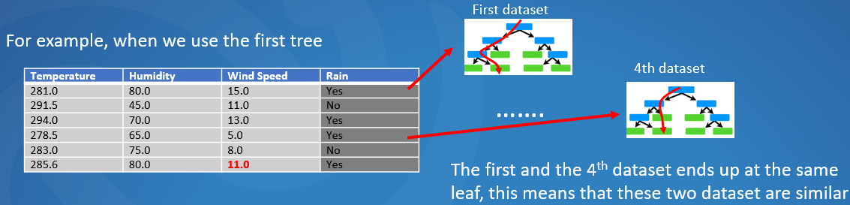
How to fill the missing data
Step 3: So using the new dataset, we are able to create a bunch of random forest trees
……
Step 4: We run each dataset down through all the trees individually, and locate similar dataset/samples
Step 5: we keep track of similar samples using “Proximity matrix”
 | 1 | 2 | 3 | 4 | 5 | 6
1
2
3
4
5
6
It has both rows/columns equal to the number of samples

Slide 11
How to fill the missing data
Step 4: We run each dataset down through all the trees individually, and locate similar dataset/samples
Step 5: we keep track of similar samples using “Proximity matrix”
As for this example, when we go through the first tree, the 1st and 4th dataset are similar, so we have
 | 1 | 2 | 3 | 4 | 5 | 6
1
2
3
4
5
6
1st sample
It has both rows/columns equal to the number of samples
 | 1 | 2 | 3 | 4 | 5 | 6
1
2
3
4
5
6
4th sample
1
We put “1” here to represent the similarity

Slide 12
How to fill the missing data
Step 4: We run each dataset down through all the trees individually, and locate similar dataset/samples
Step 5: we keep track of similar samples using “Proximity matrix”
As for this example, when we go through the first tree, the 1st and 4th dataset are similar, so we have
 | 1 | 2 | 3 | 4 | 5 | 6
1
2
3
4
5
6
It has both rows/columns equal to the number of samples
Similar, this location also represents the same dataset combination, so we put “1” here as well
 | 1 | 2 | 3 | 4 | 5 | 6
1
2
3
4
5
6
1
1
We put “1” here to represent the similarity

Slide 13
How to fill the missing data
Step 4: We run each dataset down through all the trees individually, and locate similar dataset/samples
Step 5: we keep track of similar samples using “Proximity matrix”
As for this example, when we go through the first tree, the 1st and 4th dataset are similar, so we have
 | 1 | 2 | 3 | 4 | 5 | 6
1
2
3
4
5
6
It has both rows/columns equal to the number of samples
 | 1 | 2 | 3 | 4 | 5 | 6
1
2
3
4
5
6
1
Our “Proximity matrix” looks like the left after we go through the first tree
1

Slide 14
How to fill the missing data
Step 5: we keep track of similar samples using “Proximity matrix”
 | 1 | 2 | 3 | 4 | 5 | 6
1 |  |  |  | 1
2
3
4 | 1
5
6
Our “Proximity matrix” looks like the left after we go through the first tree

Slide 15
How to fill the missing data
Step 5: we keep track of similar samples using “Proximity matrix”
 | 1 | 2 | 3 | 4 | 5 | 6
1 |  |  |  | 1
2
3
4 | 1
5
6
Our “Proximity matrix” looks like the left after we go through the first tree
 | 1 | 2 | 3 | 4 | 5 | 6
1 |  |  |  | 2 | 1
2
3 |  |  |  | 1
4 | 2 |  | 1
5 |  |  |  |  |  | 1
6
Our “Proximity matrix” looks like the left after we go through the 2nd tree (sample 1 and sample 4 ended up the same leaf again …)

Slide 16
How to fill the missing data
Step 5: we keep track of similar samples using “Proximity matrix”
 | 1 | 2 | 3 | 4 | 5 | 6
1 |  |  |  | 1
2
3
4 | 1
5
6
Our “Proximity matrix” looks like the left after we go through the first tree
……
 | 1 | 2 | 3 | 4 | 5 | 6
1 |  |  |  | 8 | 1
2 |  |  | 2
3 |  | 2 |  | 3 | 1
4 | 8 |  | 3
5 |  |  | 1 |  |  | 1
6
Ultimately, after gone through all the trees, our “Proximity matrix” looks like the left

Slide 17
How to fill the missing data
Step 5: we keep track of similar samples using “Proximity matrix”
 | 1 | 2 | 3 | 4 | 5 | 6
1 |  |  |  | 1
2
3
4 | 1
5
6
Our “Proximity matrix” looks like the left after we go through the first tree
……
 | 1 | 2 | 3 | 4 | 5 | 6
1 |  |  |  | 0.8
2 |  |  | 0.2
3 |  | 0.2 |  | 0.3 | 0.1
4 | 0.8 |  | 0.3
5 |  |  | 0.1 |  |  | 0.1
6 |  |  |  |  | 0.1
Ultimately, after gone through all the trees, our “Proximity matrix” looks like the left. And we divide the proximity value by the total number of trees (assuming we have 10 trees).

Slide 18
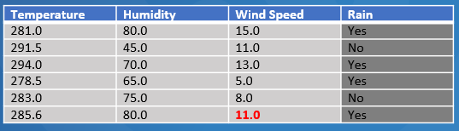
How to fill the missing data
Step 5: we keep track of similar samples using “Proximity matrix”
 | 1 | 2 | 3 | 4 | 5 | 6
1 |  |  |  | 1
2
3
4 | 1
5
6
Our “Proximity matrix” looks like the left after we go through the first tree
……
Now we can use the “Proximity matrix” to make a better guess for the missing value
 | 1 | 2 | 3 | 4 | 5 | 6
1 |  |  |  | 0.8
2 |  |  | 0.2
3 |  | 0.2 |  | 0.3 | 0.1
4 | 0.8 |  | 0.3
5 |  |  | 0.1 |  |  | 0.1
6 |  |  |  |  | 0.1
Ultimately, after gone through all the trees, our “Proximity matrix” looks like the left. And we divide the proximity value by the total number of trees (assuming we have 10 trees).

Slide 19
 | 1 | 2 | 3 | 4 | 5 | 6
1 |  |  |  | 0.8
2 |  |  | 0.2 |  |  | 0.3
3 |  | 0.2 |  | 0.3 | 0.1
4 | 0.8 |  | 0.3
5 |  |  | 0.1 |  |  | 0.1
6 |  | 0.3 |  |  | 0.1
Note that
the proximity matrix is a diagonal matrix,
the shaded area indicate the weight function for different samples against sample 6 (which has the missing value)
Sample 6
Weight function

Slide 20

 | 1 | 2 | 3 | 4 | 5 | 6
1 |  |  |  | 0.8
2 |  |  | 0.2 |  |  | 0.3
3 |  | 0.2 |  | 0.3 | 0.1
4 | 0.8 |  | 0.3
5 |  |  | 0.1 |  |  | 0.1
6 |  | 0.3 |  |  | 0.1
Note that
the proximity matrix is a diagonal matrix,
the shaded area indicate the weight function for different samples against sample 6 (which has the missing value)
Sample 6
Weight function
0.0
0.3
0.1
The weight for sample 1
$$w_{1}=15.0×\frac{0.0}{0.3+0.1}=0.0$$

Slide 21


 | 1 | 2 | 3 | 4 | 5 | 6
1 |  |  |  | 0.8
2 |  |  | 0.2 |  |  | 0.3
3 |  | 0.2 |  | 0.3 | 0.1
4 | 0.8 |  | 0.3
5 |  |  | 0.1 |  |  | 0.1
6 |  | 0.3 |  |  | 0.1
Note that
the proximity matrix is a diagonal matrix,
the shaded area indicate the weight function for different samples against sample 6 (which has the missing value)
Sample 6
Weight function
0.3
0.1
The weight for sample 1
$$w_{1}=15.0×\frac{0.0}{0.3+0.1}=0.0$$
The weight for sample 2
$$w_{2}=11.0×\frac{0.3}{0.3+0.1}=8.25$$

Slide 22


 | 1 | 2 | 3 | 4 | 5 | 6
1 |  |  |  | 0.8
2 |  |  | 0.2 |  |  | 0.3
3 |  | 0.2 |  | 0.3 | 0.1
4 | 0.8 |  | 0.3
5 |  |  | 0.1 |  |  | 0.1
6 |  | 0.3 |  |  | 0.1
Note that
the proximity matrix is a diagonal matrix,
the shaded area indicate the weight function for different samples against sample 6 (which has the missing value)
Sample 6
Weight function
0.3
0.1
The weight for sample 1
$$w_{1}=15.0×\frac{0.0}{0.3+0.1}=0.0$$
The weight for sample 2
$$w_{2}=11.0×\frac{0.3}{0.3+0.1}=8.25$$
……
The weight for sample 5
$$w_{5}=8.0×\frac{0.1}{0.3+0.1}=2.0$$

Slide 23

 | 1 | 2 | 3 | 4 | 5 | 6
1 |  |  |  | 0.8
2 |  |  | 0.2 |  |  | 0.3
3 |  | 0.2 |  | 0.3 | 0.1
4 | 0.8 |  | 0.3
5 |  |  | 0.1 |  |  | 0.1
6 |  | 0.3 |  |  | 0.1
Note that
the proximity matrix is a diagonal matrix,
the shaded area indicate the weight function for different samples against sample 6 (which has the missing value)
Sample 6
Weight function
0.3
0.1
The weight for sample 1
$$w_{1}=15.0×\frac{0.0}{0.3+0.1}=0.0$$
The weight for sample 2
$$w_{2}=11.0×\frac{0.3}{0.3+0.1}=8.25$$
……
The weight for sample 5
$$w_{5}=8.0×\frac{0.1}{0.3+0.1}=2.0$$
The weight for sample 6
$$w_{6}=0.0$$

Slide 24
 | 1 | 2 | 3 | 4 | 5 | 6
1 |  |  |  | 0.8
2 |  |  | 0.2 |  |  | 0.3
3 |  | 0.2 |  | 0.3 | 0.1
4 | 0.8 |  | 0.3
5 |  |  | 0.1 |  |  | 0.1
6 |  | 0.3 |  |  | 0.1
Note that
the proximity matrix is a diagonal matrix,
the shaded area indicate the weight function for different samples against sample 6 (which has the missing value)
Sample 6
Weight function
0.3
0.1
The weight for sample 1
$$w_{1}=15.0×\frac{0.0}{0.3+0.1}=0.0$$
The weight for sample 2
$$w_{2}=11.0×\frac{0.3}{0.3+0.1}=8.25$$
……
The weight for sample 5
$$w_{5}=8.0×\frac{0.1}{0.3+0.1}=2.0$$
The weight for sample 6
$$w_{6}=0.0$$

Slide 25
 | 1 | 2 | 3 | 4 | 5 | 6
1 |  |  |  | 0.8
2 |  |  | 0.2 |  |  | 0.3
3 |  | 0.2 |  | 0.3 | 0.1
4 | 0.8 |  | 0.3
5 |  |  | 0.1 |  |  | 0.1
6 |  | 0.3 |  |  | 0.1
Note that
the proximity matrix is a diagonal matrix,
the shaded area indicate the weight function for different samples against sample 6 (which has the missing value)
Sample 6
Weight function
0.3
0.1
The weight for sample 1
$$w_{1}=15.0×\frac{0.0}{0.3+0.1}=0.0$$
The weight for sample 2
$$w_{2}=11.0×\frac{0.3}{0.3+0.1}=8.25$$
Ultimately, the weighted guess for the missing data is 8.25 + 2.0 = 10.25
……
The weight for sample 5
$$w_{5}=8.0×\frac{0.1}{0.3+0.1}=2.0$$
The weight for sample 6
$$w_{6}=0.0$$

Slide 26
Missing data
x
Simple average
(initial guess)
So we can see that how our guess for the missing data gets tuned
11.0
Weighted average
(2nd guess)
10.25

Slide 27
Missing data
x
Simple average
(initial guess)
So we can see that how our guess for the missing data gets tuned
11.0
Weighted average
(2nd guess)
10.25
Then we do this whole thing again
Revise our guess
Build a random forest,
Run the data through all the trees
Recalculate the proximity matrix
Recalculate the missing data
…….

Slide 28
Missing data
x
Simple average
(initial guess)
So we can see that how our guess for the missing data gets tuned
11.0
Weighted average
(2nd guess)
10.25
Then we do this whole thing again
Revise our guess
Build a random forest,
Run the data through all the trees
Recalculate the proximity matrix
Recalculate the missing data
We do this many times, until the missing value does not change (converged)
…….

