Slide 1
ANN
Densely connected neural network

Slide 2
Inputs: radar data for a domain with only 2 grids at $x_{1}$ and $x_{2}$

Slide 3
Inputs: radar data for a domain with only 2 grids at $x_{1}$ and $x_{2}$
Output: if the location $x_{3}$ is wet or dry

Slide 4
Inputs: radar data for a domain with only 2 grids at $x_{1}$ and $x_{2}$
Output: if the location $x_{3}$ is wet or dry
hidden layers

Slide 5
Inputs: radar data for a domain with only 2 grids at $x_{1}$ and $x_{2}$
Output: if the location $x_{3}$ is wet or dry
hidden layers
When there are so many hidden layers and the connection between each layer becomes very complex ~ and this is so called “deep learning”

Slide 6
radar data for $x_{1}$
radar data for $x_{2}$
Output: if the location $x_{3}$ is wet or dry
Inputs: radar data for a domain with only 2 grids at $x_{1}$ and $x_{2}$
Only one hidden layer in this example

Slide 7
We have four neurons (white and orange) and several synapses
radar data for $x_{1}$
radar data for $x_{2}$
Output: if the location $x_{3}$ is wet or dry
Inputs: radar data for a domain with only 2 grids at $x_{1}$ and $x_{2}$
Only one hidden layer in this example

Slide 8
0.15mm/h
radar data for $x_{1}$
0.3mm/h
radar data for $x_{2}$
Output: if the location $x_{3}$ is wet or dry
Inputs: radar data for a domain with only 2 grids at $x_{1}$ and $x_{2}$
Only one hidden layer in this example

Slide 9

Each synapse contains:
a weight (e.g., $w_{1}$ and $w_{2}$)
and the contribution from previous layer (e.g., 0.15 and 0.3)
0.15mm/h
$$w_{1}×0.15$$
radar data for $x_{1}$
$$w_{2}×0.3$$
0.3mm/h
radar data for $x_{2}$
Output: if the location $x_{3}$ is wet or dry
Inputs: radar data for a domain with only 2 grids at $x_{1}$ and $x_{2}$
Only one hidden layer in this example

Slide 10
Activation function, e.g., sigmoid
$$a=f(w_{1}×0.15+w_{2}×0.3)$$
0.15mm/h
$$w_{1}×0.15$$
radar data for $x_{1}$
$$w_{2}×0.3$$
0.3mm/h
radar data for $x_{2}$
Output: if the location $x_{3}$ is wet or dry
Inputs: radar data for a domain with only 2 grids at $x_{1}$ and $x_{2}$
Only one hidden layer in this example

Slide 11
Activation function
$$a=f(w_{1}×0.15+w_{2}×0.3)$$
In a training dataset, the output is 3.0mm/h
0.15mm/h
$$w_{1}×0.15$$
radar data for $x_{1}$
3.0mm/h
$$w_{2}×0.3$$
0.3mm/h
radar data for $x_{2}$
Output: if the location $x_{3}$ is wet or dry
Inputs: radar data for a domain with only 2 grids at $x_{1}$ and $x_{2}$
Only one hidden layer in this example

Slide 12

During the training, there are 9 synapses and therefore 9 unknown weights to be estimated
0.15mm/h
$$w_{1, (1,1)}$$
$$w_{2, (1,1)}$$
radar data for $x_{1}$
$$w_{1, (2,1)}$$
$$w_{1, (1,2)}$$
3.0mm/h
$$w_{1, (1,3)}$$
$$w_{1, (2,2)}$$
$$w_{2, (2,1)}$$
0.3mm/h
radar data for $x_{2}$
Output: if the location $x_{3}$ is wet or dry
$$w_{2, (3,1)}$$
Inputs: radar data for a domain with only 2 grids at $x_{1}$ and $x_{2}$
$$w_{1, (2,3)}$$
Only one hidden layer in this example

Slide 13
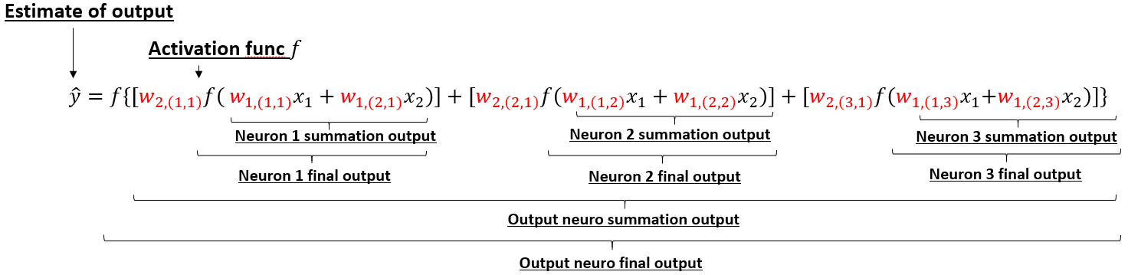
During the training, there are 9 synapses and therefore 9 unknown weights to be estimated
Neuron 1
0.15mm/h
$$w_{1, (1,1)}$$
$$w_{2, (1,1)}$$
radar data for $x_{1}$
$$w_{1, (2,1)}$$
$$w_{1, (1,2)}$$
3.0mm/h
$$w_{1, (1,3)}$$
Neuron 2
$$w_{1, (2,2)}$$
$$w_{2, (2,1)}$$
0.3mm/h
radar data for $x_{2}$
Output: if the location $x_{3}$ is wet or dry
$$w_{2, (3,1)}$$
Inputs: radar data for a domain with only 2 grids at $x_{1}$ and $x_{2}$
$$w_{1, (2,3)}$$
Neuron 3
Only one hidden layer in this example

Slide 14
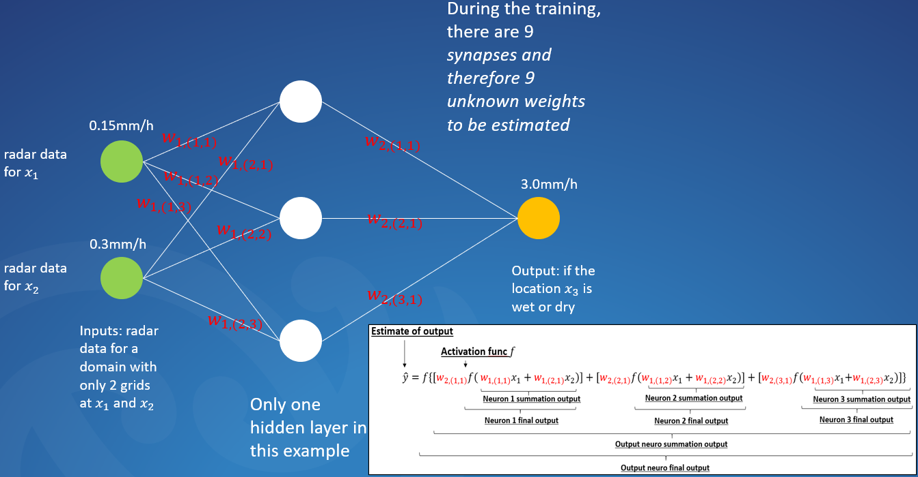











first layer weight
$$J=\sum_{i=1}^{3}{{{\left\{Y−f\left[f\left({XW}_{n}\right)\right]W_{m}\right\}}_{i}}^{2}}$$
second layer weight
$X:$ input layer (m $×$ n)
$W$: weights we want to get
(k $×$ p)
$Y$: output layer
(m $×$ 1)
$f$: activation function
Assuming that we have 3 training datasets, the matrix form of the cost function can be constructed as:
m: the number of training dataset (in this case: 3)
first training dataset
first ground truth
n: the number of input neuros (in this case: 2)
$$X=\left[\begin{matrix}x_{1,1} & x_{1,2} \\ x_{2,1} & x_{2,2} \\ x_{3,1} & x_{3,2}\end{matrix}\right]=\left[\begin{matrix}0.15 & 0.3 \\ 5 & 2.4 \\ 0.5 & 2.0\end{matrix}\right]$$
$$Y=\left[\begin{matrix}y_{1} \\ y_{2} \\ y_{3}\end{matrix}\right]=\left[\begin{matrix}3.0 \\ 0.8 \\ 1.5\end{matrix}\right]$$
k: the number of neuros for previous layer
p: the number of neuros for next layer
$$W_{2}=\left[\begin{matrix}w_{2, (1,1)} \\ w_{2, (2,1)} \\ w_{2, (3,1)}\end{matrix}\right]$$
$$W_{1}=\left[\begin{matrix}w_{1, (1,1)} & w_{1,(1,2)} & w_{1,(1,3)} \\ w_{1,(2,1)} & w_{1,(2,2)} & w_{1,(2,3)}\end{matrix}\right]$$

Slide 15
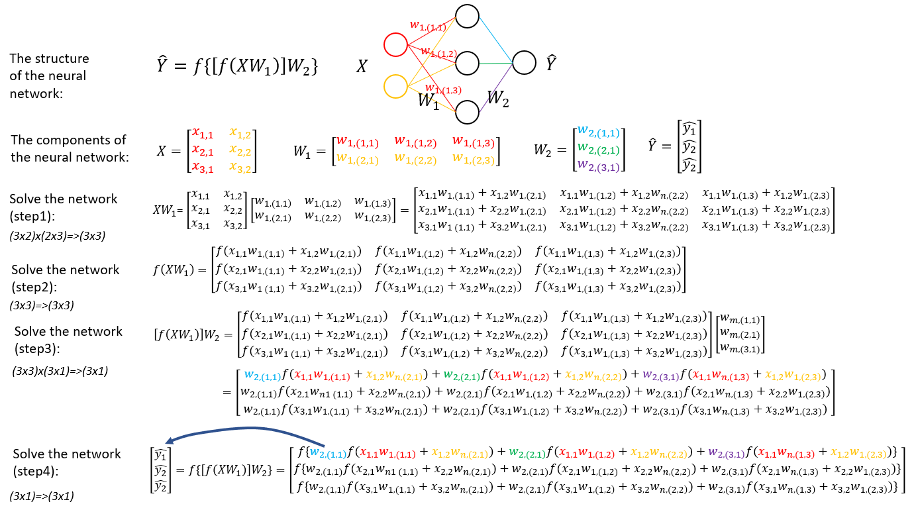
$$J=\sum_{i=1}^{3}{{{\left\{Y−f\left[f\left({XW}_{n}\right)\right]W_{m}\right\}}_{i}}^{2}}$$
$Y$: output layer
$X:$ : input layer
$W$: weights we want to get
$f$: activation function
Assuming that we have 3 training datasets, the matrix form of the cost function can be constructed as:
$$X=\left[\begin{matrix}x_{1,1} & x_{1,2} \\ x_{2,1} & x_{2,2} \\ x_{3,1} & x_{3,2}\end{matrix}\right]=\left[\begin{matrix}0.15 & 0.3 \\ 5 & 2.4 \\ 0.5 & 2.0\end{matrix}\right]$$
$$Y=\left[\begin{matrix}y_{1} \\ y_{2} \\ y_{3}\end{matrix}\right]=\left[\begin{matrix}3.0 \\ 0.8 \\ 1.5\end{matrix}\right]$$
$$W_{1}=\left[\begin{matrix}w_{1, (1,1)} & w_{1,(1,2)} & w_{1,(1,3)} \\ w_{1,(2,1)} & w_{1,(2,2)} & w_{1,(2,3)}\end{matrix}\right]$$
$$W_{2}=\left[\begin{matrix}w_{2, (1,1)} \\ w_{2, (2,1)} \\ w_{2, (3,1)}\end{matrix}\right]$$

Slide 16
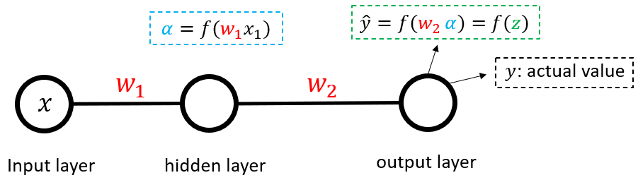








The gradient is derived from backward (that’s why we call it backpropagation) so first let us look at $W_{2}$,
(1) the gradient of $W_{2}$ is $\frac{∂J}{∂W_{2}}$, which can be represented as:
$$\frac{∂J}{∂w}=\frac{∂{\left(y−\hat{y}\right)}^{2}}{∂w}$$
(2) let’s multiple ½ to the gradient $\frac{∂{(y_{i}−\hat{y_{i}})}^{2}}{∂w}$ to make it simpler, so the power rule gives us:
$$\frac{∂J}{∂w}=\frac{∂\frac{1}{2}{\left(y−\hat{y}\right)}^{2}}{∂w}=\frac{∂\left(y−\hat{y}\right)}{∂w}$$
(3) Then we apply the chain rule “$\frac{df(x)}{dx}=\frac{df(x)}{df}\frac{df}{dx}$” to the derivation:
$$\frac{∂J}{∂w}=\frac{∂\left(y−\hat{y}\right)}{∂w}=−\left(y−\hat{y}\right)\frac{∂\left(\hat{y}\right)}{∂w}$$
(4) Since $\hat{y}$ is the function of the activation function, $\hat{y}=f(z)$ then:
$$\frac{∂J}{∂w}=\frac{∂\left(y−\hat{y}\right)}{∂w}=−\left(y−\hat{y}\right)\frac{∂\left(\hat{y}\right)}{∂w}=−\left(y−\hat{y}\right)f^{′}(z)\frac{∂\left(z\right)}{∂w}$$
Where $z=w_{2 }α$, where $α$ is the value from the upstream layer from the last layer (as Figure 2.14).
(5) Since $z=w_{2 }α$ and $α$ is the function of $w_{1 }$, so $\frac{∂\left(z\right)}{∂w}=w_{2 }\frac{∂\left(α\right)}{∂w_{1 }}$
$$\frac{∂J}{∂w}=−\left(y−\hat{y}\right)f^{′}(z)\frac{∂\left(z\right)}{∂w}=−\left(y−\hat{y}\right)f^{′}(w_{2 }α)w_{2 }\frac{∂α}{∂w_{1}}$$
(6) we also have ${α=f(w}_{1}x)$, let us assume $β=w_{1}x$. therefore
$$\frac{∂J}{∂w_{n}}=−\left(y−\hat{y}\right)f^{′}(w_{2 }α)w_{2 }\frac{∂α}{∂w_{1}}=−\left(y−\hat{y}\right)f^{′}(w_{2 }α)w_{2 }f^{′}(w_{1 }x)w_{1 }x$$
Where ${α=f(w}_{1}x)$:
$$\frac{∂J}{∂w}=−\left(y−\hat{y}\right)w_{1 }w_{2}f^{′}[w_{2 }f\left(w_{1}x\right)]f^{′}[w_{1 }x]x$$
In this case, there are two variables (or weights) $w_{1}$ and $w_{1}$ to be solved, therefore we can write the total gradient in the format as:
$$\frac{∂J}{∂w}=\frac{∂J}{∂w_{1}}+\frac{∂J}{∂w_{2}}$$
Where “$J$” is the error of the estimated state, e.g.,
In the most optimal situation, which we can find the gradient equals to zero, with the known $x$ and $y$ in the training process, we can easily get the weights for $w_{1}$ and $w_{2}$ ~ this process is called the optimal interpolation method.
After the minimization of the above cost function, we can get the optimal combination of $W$, and this combination then is used to do the prediction following the procedure described in Figure 2.12
Truth
Estimated state
The purpose is to get the minimum “$J$”, and the dependent variable is weight “$w$”, and the minimum “$J$” happens when the gradient $\frac{∂J}{∂w}=0$ (or close to zero)
$$J$$
$$\frac{∂J}{∂w}=0$$
$$w$$

Slide 17
