Slide 1
Decision Tree
How to avoid overfitting

Slide 2
Low pressure | High Temperature | High humidity | Wind Speed | Rain
No | No | No | 10.0 | No
Yes | Yes | Yes | 30.0 | Yes
Yes | Yes | No | 20.0 | No
Yes | No | Yes | 50.0 | No
No | No | Yes | 70.0 | Yes
Wind Speed > 25.0
In this example, if we start from root with “wind speed < 25.0”, there is only one “no-rain” sample for us to use. The model can be easily overfitted
No
Yes
No
Not rain
High Temp
No
Yes
Yes
……
Not rain
rain

Slide 3
Low pressure | High Temperature | High humidity | Wind Speed | Rain
No | No | No | 10.0 | No
Yes | Yes | Yes | 30.0 | Yes
Yes | Yes | No | 20.0 | No
Yes | No | Yes | 50.0 | No
No | No | Yes | 70.0 | Yes
Wind Speed > 25.0
In this example, if we start from root with “wind speed < 25.0”, there is only one “no-rain” sample for us to use. The model can be easily overfitted (since very few case for this leaf, it is difficult to have confidence for this level of split for future data …)
No
Yes
No
Not rain
High Temp
No
Yes
Yes
……
Not rain
rain

Slide 4
Low pressure | High Temperature | High humidity | Wind Speed | Rain
No | No | No | 10.0 | No
Yes | Yes | Yes | 30.0 | Yes
Yes | Yes | No | 20.0 | No
Yes | No | Yes | 50.0 | No
No | No | Yes | 70.0 | Yes
Wind Speed > 25.0
In this example, if we start from root with “wind speed < 25.0”, there is only one “no-rain” sample for us to use. The model can be easily overfitted (since very few case for this leaf, it is difficult to have confidence for this level of split for future data …)
No
Yes
No
Not rain
High Temp
No
Yes
Yes
……
In order to address this, we can limit how deep (how many levels) the decision tree want to go. For example, if we can require it must have at least 4 samples in the level for the tree to grow
Not rain
rain

Slide 5
Wind Speed > 25.0
Wind Speed > 25.0
No
Yes
No
Yes
Rain
Yes: 0; No: 1
Not rain
Rain
Yes: 2; No: 2
4 cases
High Temp
No
Yes
……
……
For example, in the hidden step before we go to “High Temp” for our next level. We have a leaf “Rain” with 4 total cases, and apparently this will be the last level we can go given the constrain we put here
Not rain
rain
In order to address this, we can limit how deep (how many levels) the decision tree want to go. For example, if we can require it must have at least 4 cases in the level for the tree to grow

Slide 6
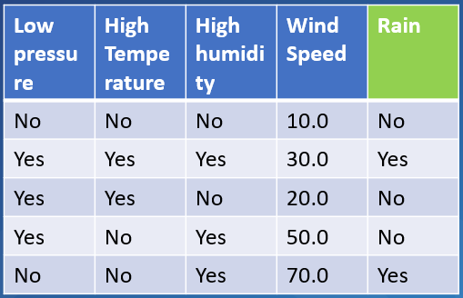
Wind Speed > 25.0
Wind Speed > 25.0
Wind Speed > 25.0
No
Yes
No
Yes
No
Yes
Rain
Yes: 0; No: 1
Rain
Yes: 0; No: 1
Rain
Yes: 2, No: 2
Not rain
Rain
Yes: 2; No: 2
4 cases
High Temp
Final output
(rain chance)
50%
0%
No
Yes
……
……
So here we see that by limiting the number of levels (only one level) the tree can grow, we get less determinant output
For example, in the hidden step before we go to “High Temp” for our next level. We have a leaf “Rain” with 4 total cases, and apparently this will be the last level we can go given the constrain we put here
Not rain
rain
In order to address this, we can limit how deep (how many levels) the decision tree want to go. For example, if we can require it must have at least 4 cases in the level for the tree to grow

Slide 7
Wind Speed > 25.0
Wind Speed > 25.0
Wind Speed > 25.0
No
Yes
No
Yes
No
Yes
Rain
Yes: 0; No: 1
Rain
Yes: 0; No: 1
Rain
Yes: 2, No: 2
Not rain
Rain
Yes: 2; No: 2
4 cases
High Temp
Final output
(rain chance)
50%
0%
No
Yes
……
……
So here we see that by limiting the number of levels (only one level) the tree can grow, we get less determinant output
For example, in the hidden step before we go to “High Temp” for our next level. We have a leaf “Rain” with 4 total cases, and apparently this will the last level we can go given the constrain we put here
Not rain
rain
In reality, we can split training/testing dataset and do a bunch of cross-validations to determine how deep we want our tree to grow
In order to address this, we can limit how deep (how many levels) the decision tree want to go. For example, if we can require it must have at least 4 cases in the level for the tree to grow

