Slide 1
Decision Tree
Regression

Slide 2
Regression tree vs classification tree
Low pressure | High Temperature | High humidity | Wind Speed | Rain
No | No | No | 10.0 | No
Yes | Yes | Yes | 30.0 | Yes
Yes | Yes | No | 20.0 | No
Yes | No | Yes | 50.0 | No
No | No | Yes | 70.0 | Yes
Low pressure | High Temperature | High humidity | Wind Speed | Rain amount
No | No | No | 10.0 | 0.1
Yes | Yes | Yes | 30.0 | 0.3
Yes | Yes | No | 20.0 | 1.0
Yes | No | Yes | 50.0 | 2.1
No | No | Yes | 70.0 | 0.7
classification tree
Regression tree
Discrete data
Continuous data

Slide 3
Regression tree vs classification tree
Regression tree is a type of decision tree
In regression tree, each leaf represents a numeric value
3.1
2.7
……

Slide 4
Regression tree vs classification tree
Regression tree is a type of decision tree
In regression tree, each leaf represents a numeric value
3.1
2.7
……
In Classification tree, each leaf represents a Yes/No, or True/False, or some other discrete category
Eat a meal
Yes
Eat a snack
No
……
……

Slide 5
Regression tree workflow
Similar to classification tree, regression tree is built from top down
Let’s assume that we have only one predictors, which is drug dosage, and the target is drug effective ratio
Dosage | Drug effect.
10 | 58
20 | 60
35 | 57
5 | 44
… | …

Slide 6
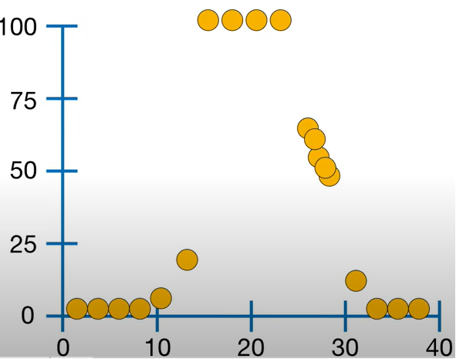
Regression tree workflow
Similar to classification tree, regression tree is built from top down
Let’s assume that we have only one predictors, which is drug dosage, and the target is drug effective ratio
Dosage | Drug effect.
10 | 58
20 | 60
35 | 57
5 | 44
… | …
We can plot it out as
Drug effect.
Dosage

Slide 7
Regression tree workflow
Similar to classification tree, regression tree is built from top down
Let’s assume that we have only one predictors, which is drug dosage, and the target is drug effective ratio
Step 1: let’s look at the first two data points (smallest two values)
Drug effect.
Dosage

Slide 8
Regression tree workflow
Similar to classification tree, regression tree is built from top down
Let’s assume that we have only one predictors, which is drug dosage, and the target is drug effective ratio
Step 1: let’s look at the first two data points (smallest two values), The average is 3.
The average is 3
Drug effect.
Dosage

Slide 9
Regression tree workflow
Similar to classification tree, regression tree is built from top down
Let’s assume that we have only one predictors, which is drug dosage, and the target is drug effective ratio
Step 1: let’s look at the first two data points (smallest two values), The average is 3.
Now we can build a simple tree based on if the dosage is smaller than 3
The average is 3
Drug effect.
Dosage < 3
0
Dosage
The average drug effect. is 0

Slide 10
Regression tree workflow
Similar to classification tree, regression tree is built from top down
Let’s assume that we have only one predictors, which is drug dosage, and the target is drug effective ratio
Step 1: let’s look at the first two data points (smallest two values), The average is 3.
Now we can build a simple tree based on if the dosage is smaller than 3
The average is 3
Drug effect.
Dosage < 3
0
33.8
Dosage
The average drug effect. Is 38.8

Slide 11
Regression tree workflow
Similar to classification tree, regression tree is built from top down
Let’s assume that we have only one predictors, which is drug dosage, and the target is drug effective ratio
Step 1: let’s look at the first two data points (smallest two values), The average is 3.
Now we can build a simple tree based on if the dosage is smaller than 3
The average is 3
Drug effect.
Dosage < 3
0
33.8
Step 2: let’s estimate how accurate this tree is
Dosage

Slide 12
Regression tree workflow
Similar to classification tree, regression tree is built from top down
Let’s assume that we have only one predictors, which is drug dosage, and the target is drug effective ratio
Step 1: let’s look at the first two data points (smallest two values), The average is 3.
Now we can build a simple tree based on if the dosage is smaller than 3
The average is 3
Drug effect.
Dosage < 3
0
33.8
Step 2: let’s estimate how accurate this tree is
Dosage
We go through all the points in the graph in the graph with the tree above, the error for this tree is 27468.5

Slide 13
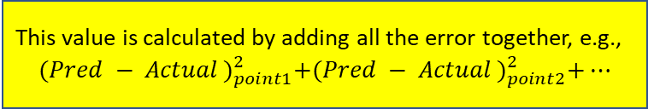
Regression tree workflow
Similar to classification tree, regression tree is built from top down
Let’s assume that we have only one predictors, which is drug dosage, and the target is drug effective ratio
Step 1: let’s look at the first two data points (smallest two values), The average is 3.
Now we can build a simple tree based on if the dosage is smaller than 3
The average is 3
Drug effect.
Dosage < 3
0
33.8
This value is calculated by adding all the error together, e.g.,
$${(Pred − Actual )}_{point1}^{2}+{(Pred − Actual )}_{point2}^{2}+…$$
Step 2: let’s estimate how accurate this tree is
Dosage
We go through all the points in the graph in the graph with the tree above, the error for this tree is 27468.5

Slide 14
Regression tree workflow
Similar to classification tree, regression tree is built from top down
Let’s assume that we have only one predictors, which is drug dosage, and the target is drug effective ratio
Step 3: then we can move to the next 2 points, and use the average there as the new root threshold, which is 5
The average is 3
Drug effect.
The average is 5
Dosage

Slide 15
Regression tree workflow
Similar to classification tree, regression tree is built from top down
Let’s assume that we have only one predictors, which is drug dosage, and the target is drug effective ratio
Step 3: then we can move to the next 2 points, and use the average there as the new root threshold, which is 5
Then we can get a new error, which is 23763.2
The average is 3
Drug effect.
The average is 37.5
The average is 5
Dosage

Slide 16
Regression tree workflow
Similar to classification tree, regression tree is built from top down
Let’s assume that we have only one predictors, which is drug dosage, and the target is drug effective ratio
By repeating the above steps, we can get a series of root node threshold, and the corresponding errors
For example
Threshold 3
27468.5
Drug effect.
Threshold 5
23763.2
Threshold 8
……
……
Dosage

Slide 17
Regression tree workflow
Similar to classification tree, regression tree is built from top down
Let’s assume that we have only one predictors, which is drug dosage, and the target is drug effective ratio
14.5
By repeating the above steps, we can get a series of root node threshold, and the corresponding errors
The dosage threshold of 14.5 has the smallest error, and it will be used to build our actual tree
Drug effect.
Dosage

Slide 18
Regression tree workflow
Similar to classification tree, regression tree is built from top down
Let’s assume that we have only one predictors, which is drug dosage, and the target is drug effective ratio
14.5
By repeating the above steps, we can get a series of root node threshold, and the corresponding errors
The dosage threshold of 14.5 has the smallest error, and it will be used to build our actual tree
Drug effect.
Dosage < 14.5
?
?
In summary, we split the data into two groups by finding the threshold that give us the smallest sum of squared residuals (errors)
Dosage

Slide 19
Regression tree workflow
Similar to classification tree, regression tree is built from top down
Let’s assume that we have only one predictors, which is drug dosage, and the target is drug effective ratio
On the left side, We can further split this by repeating the above procedures, if we want to
14.5
By repeating the above steps, we can get a series of root node threshold, and the corresponding errors
The dosage threshold of 14.5 has the smallest error, and it will be used to build our actual tree
Drug effect.
Dosage < 14.5
?
?
Dosage
We can further split the left and right node by using the same method (e.g., split and go through data 2 by 2 …)

Slide 20
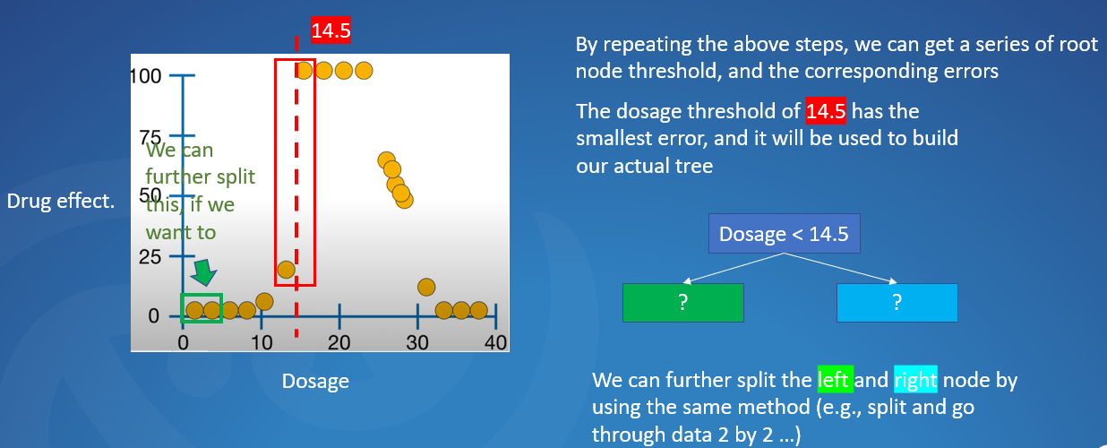
Regression tree workflow
Similar to classification tree, regression tree is built from top down
Let’s assume that we have only one predictors, which is drug dosage, and the target is drug effective ratio
However, we may not want to do so (in order to avoid over-fitting). Usually we can constrain how many data points still being left and decide if we still want to further split the tree …

Slide 21
Regression tree workflow
Similar to classification tree, regression tree is built from top down
Let’s assume that we have only one predictors, which is drug dosage, and the target is drug effective ratio
However, we may not want to do so (in order to avoid over-fitting). Usually we can constrain how many datapoints still being left and decide if we still want to further split the tree …
For example, on the left side of “dosage < 14.5”, we still have 6 points

Slide 22
Regression tree workflow
Similar to classification tree, regression tree is built from top down
Let’s assume that we have only one predictors, which is drug dosage, and the target is drug effective ratio
However, we may not want to do so (in order to avoid over-fitting). Usually we can constrain how many datapoints still being left and decide if we still want to further split the tree …
For example, on the left side of “dosage < 14.5”, we still have 6 points
If the condition says that we stop splitting when the “minimum data points == 6”, then we stop splitting

Slide 23
Regression tree workflow
Similar to classification tree, regression tree is built from top down
Let’s assume that we have only one predictors, which is drug dosage, and the target is drug effective ratio
However, we may not want to do so (in order to avoid over-fitting). Usually we can constrain how many datapoints still being left and decide if we still want to further split the tree …
For example, on the left side of “dosage < 14.5”, we still have 6 points
If the condition says that we stop splitting when the “minimum data points == 6”, then we stop splitting
If the condition says that we stop splitting when the “minimum data points == 4”, then we can keep splitting further (since we still have more than 4 data points …) …

Slide 24
Regression tree workflow
Similar to classification tree, regression tree is built from top down
For multiple predictors, it is the similar process, we basically go through the predictor one by one, and calculate their best threshold, and compare the errors, respectively. Then decide which one to be used as the root node …
Dosage | Drug effect.
10 | 58
20 | 60
35 | 57
5 | 44
… | …
Dosage |  | Drug effect.
10 | … | 58
20 | … | 60
35 | … | 57
5 | … | 44
… |  | …

