Slide 1
Random Forest
how it works

Slide 2
The traditional decision tree is good at dealing with the data used to create it, but not good for any new data. The good thing is that “random forest” is as easy as the traditional decision tree, and has a vast improvement in terms of accuracy
So how can we create a “random forest”

Slide 3
So how can we create a “random forest”
Step 1 create a bootstrap dataset
First step is that we need to create an bootstrapped dataset from the original dataset
Original dataset
Low pressure | High Temperature | High humidity | Wind Speed | Rain
No | No | No | 10.0 | No
Yes | Yes | Yes | 30.0 | Yes
Yes | Yes | No | 20.0 | No
Yes | No | Yes | 50.0 | No
No | No | Yes | 70.0 | Yes

Slide 4
So how can we create a “random forest”
Step 1 create a bootstrap dataset
First step is that we need to create an bootstrapped dataset from the original dataset
Original dataset
Low pressure | High Temperature | High humidity | Wind Speed | Rain
No | No | No | 10.0 | No
Yes | Yes | Yes | 30.0 | Yes
Yes | Yes | No | 20.0 | No
Yes | No | Yes | 50.0 | No
No | No | Yes | 70.0 | Yes
Low pressure | High Temperature | High humidity | Wind Speed | Rain
Yes | Yes | Yes | 30.0 | Yes
Yes | No | Yes | 50.0 | No
No | No | No | 10.0 | No
No | No | No | 10.0 | No
For example in this case, the first row gets selected twice, while the 3rd and last row are not selected at all
To create a bootstrap dataset with the same predictors as the original dataset, we just randomly select samples here

Slide 5
So how can we create a “random forest”
Step 1 create a bootstrap dataset
First step is that we need to create an bootstrapped dataset from the original dataset
Original dataset
Low pressure | High Temperature | High humidity | Wind Speed | Rain
No | No | No | 10.0 | No
Yes | Yes | Yes | 30.0 | Yes
Yes | Yes | No | 20.0 | No
Yes | No | Yes | 50.0 | No
No | No | Yes | 70.0 | Yes
Low pressure | High Temperature | High humidity | Wind Speed | Rain
Yes | Yes | Yes | 30.0 | Yes
Yes | No | Yes | 50.0 | No
No | No | No | 10.0 | No
No | No | No | 10.0 | No
For example in this case, the first row gets selected twice, while the 3rd and last row are not selected at all (we are allowed to pick the same sample more than once …)
To create a bootstrap dataset with the same predictors as the original dataset, we just randomly select samples here

Slide 6
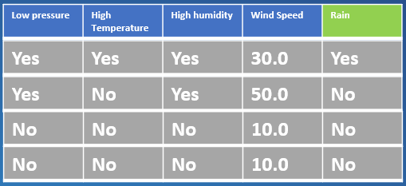
So how can we create a “random forest”
Step 2 create decision tree using the bootstrapped dataset with only subset of predictors
Bootstrapped dataset
For example, instead of considering all four predictors to figure out which one should be the “root” node, we only consider two here ~ “high temp” and “wind speed” (these are selected randomly )
High Temperature | Wind Speed | Rain
Yes | 30.0 | Yes
No | 50.0 | No
No | 10.0 | No
No | 10.0 | No

Slide 7
So how can we create a “random forest”
Step 2 create decision tree using the bootstrapped dataset with only subset of predictors
Bootstrapped dataset
For example, instead of considering all four predictors to figure out which one should be the “root” node, we only consider two here ~ “high temp” and “wind speed” (these are selected randomly )
High Temperature | Wind Speed | Rain
Yes | 30.0 | Yes
No | 50.0 | No
No | 10.0 | No
No | 10.0 | No
If “Wind Speed > 25” has the smallest Gini and is selected as the root node, we can construct the tree as
Wind Speed > 25.0
……

Slide 8
So how can we create a “random forest”
Step 2 create decision tree using the bootstrapped dataset with only subset of predictors
Bootstrapped dataset
For example, instead of considering all four predictors to figure out which one should be the “root” node, we only consider two here ~ “high temp” and “wind speed” (these are selected randomly )
High Temperature | Wind Speed | Rain
Yes | 30.0 | Yes
No | 50.0 | No
No | 10.0 | No
No | 10.0 | No
If “Wind Speed > 25” has the smallest Gini and is selected as the root node, we can construct the tree as
Next step we need to figure out which predictor is to be used for the next level of tree
Wind Speed > 25.0
???
……

Slide 9
So how can we create a “random forest”
Step 2 create decision tree using the bootstrapped dataset with only subset of predictors
Next step we need to figure out which predictor is to be used for the next level of tree
Wind Speed > 25.0
???
Since the wind speed is chose, so we have 3 remaining predictors can be considered
……
used

Slide 10
So how can we create a “random forest”
Step 2 create decision tree using the bootstrapped dataset with only subset of predictors
Then we randomly select two predictors from the remaining predictors, and build the tree as usual
used

Slide 11
So how can we create a “random forest”
Step 2 create decision tree using the bootstrapped dataset with only subset of predictors
Then we randomly select two predictors from the remaining predictors, and build the tree as usual
used
For example, we if we randomly select low pressure and high temp, and high temp has a smaller Gini, then the next level of leaf will be built based on “high temp”
Wind Speed > 25.0
High temp
……

Slide 12
So how can we create a “random forest”
Step 2 create decision tree using the bootstrapped dataset with only subset of predictors
Then we randomly select two predictors from the remaining predictors, and build the tree as usual
used
So we just build the tree iteratively like this, until we are not able to split the tree anymore !
For example, we if we randomly select low pressure and high temp, and high temp has a smaller Gini, then the next level of leaf will be built based on “high temp”
Wind Speed > 25.0
Wind Speed > 25.0
High temp
High temp
……

Slide 13
So how can we create a “random forest”
Step 2 create decision tree using the bootstrapped dataset with only subset of predictors
Wind Speed > 25.0
High temp
Step 1:Making a new bootstrapped dataset
Step 2: select random predictors from the bootstrapped data and make trees
Then we just use the same technology to build many independent/random trees
Ideally, you do this 100’s times

Slide 14
So how can we create a “random forest”
Step 3 Create many “random” trees
Wind Speed > 25.0
High temp
Step 1:Making a new bootstrapped dataset
Step 2: select random predictors from the bootstrapped data and make trees
Then we just use the same technology to build many independent/random trees
- Ideally, you do this 100’s times
- By doing this we will have a variety of trees, and the variety is what makes RF so robust

Slide 15
So how can we create a “random forest”
Step 4 How we use RF
Low pressure | High Temperature | High humidity | Wind Speed | Rain
No | Yes | No | 40.0 | ?
Assuming that this is the dataset for testing, we want to know whether it will rain or not

Slide 16
So how can we create a “random forest”
Step 4 How we use RF
Low pressure | High Temperature | High humidity | Wind Speed | Rain
No | Yes | No | 40.0 | ?
Assuming that this is the dataset for testing, we want to know whether it will rain or not
So we take the test data, run it through the first tree we made

Slide 17
So how can we create a “random forest”
Step 4 How we use RF
Low pressure | High Temperature | High humidity | Wind Speed | Rain
No | Yes | No | 40.0 | ?
Assuming that this is the dataset for testing, we want to know whether it will rain or not
So we take the test data, run it through the first tree we made
The first tree says “YES”
(It will rain)

Slide 18
So how can we create a “random forest”
Step 4 How we use RF
Low pressure | High Temperature | High humidity | Wind Speed | Rain
No | Yes | No | 40.0 | ?
Assuming that this is the dataset for testing, we want to know whether it will rain or not
So we take the test data, run it through the first tree we made
The first tree says “YES”
(It will rain)
So we take the test data, run it through the second tree we made
The second tree says “YES”

Slide 19
So how can we create a “random forest”
Step 4 How we use RF
Low pressure | High Temperature | High humidity | Wind Speed | Rain
No | Yes | No | 40.0 | ?
Assuming that this is the dataset for testing, we want to know whether it will rain or not
So we take the test data, run it through the first tree we made
The first tree says “YES”
(It will rain)
So we take the test data, run it through the second tree we made
The second tree says “YES”
So we take the test data, run it through the 3rd tree we made
The 3rd tree says “YES”

Slide 20
So how can we create a “random forest”
Step 4 How we use RF
Low pressure | High Temperature | High humidity | Wind Speed | Rain
No | Yes | No | 40.0 | ?
Assuming that this is the dataset for testing, we want to know whether it will rain or not
So we take the test data, run it through the first tree we made
The first tree says “YES”
(It will rain)
So we take the test data, run it through the second tree we made
The second tree says “YES”
So we take the test data, run it through the 3rd tree we made
The 3rd tree says “NO”
……
So we take the test data, run it through the n’rd tree we made
The n’rd tree says “NO”

Slide 21
So how can we create a “random forest”
Step 4 How we use RF
Low pressure | High Temperature | High humidity | Wind Speed | Rain
No | Yes | No | 40.0 | ?
Assuming that this is the dataset for testing, we want to know whether it will rain or not
So we take the test data, run it through the first tree we made
The first tree says “YES”
(It will rain)
So we take the test data, run it through the second tree we made
The second tree says “YES”
So we take the test data, run it through the 3rd tree we made
The 3rd tree says “NO”
……
So we take the test data, run it through the n’rd tree we made
The n’rd tree says “NO”
After running the dataset through all the “random” trees, we see which option gets more votes, e.g.,
Rain: YES | Rain: NO
15 | 3

Slide 22
So how can we create a “random forest”
Step 4 How we use RF
Low pressure | High Temperature | High humidity | Wind Speed | Rain
No | Yes | No | 40.0 | ?
Assuming that this is the dataset for testing, we want to know whether it will rain or not
So we take the test data, run it through the first tree we made
The first tree says “YES”
(It will rain)
So we take the test data, run it through the second tree we made
The second tree says “YES”
So we take the test data, run it through the 3rd tree we made
The 3rd tree says “NO”
……
So we take the test data, run it through the n’rd tree we made
The n’rd tree says “NO”
After running the dataset through all the “random” trees, we see which option gets more votes, e.g.,
Rain: YES | Rain: NO
15 | 3
In this case, Rain: YES gets more votes, so the prediction will be “YES”

Slide 23
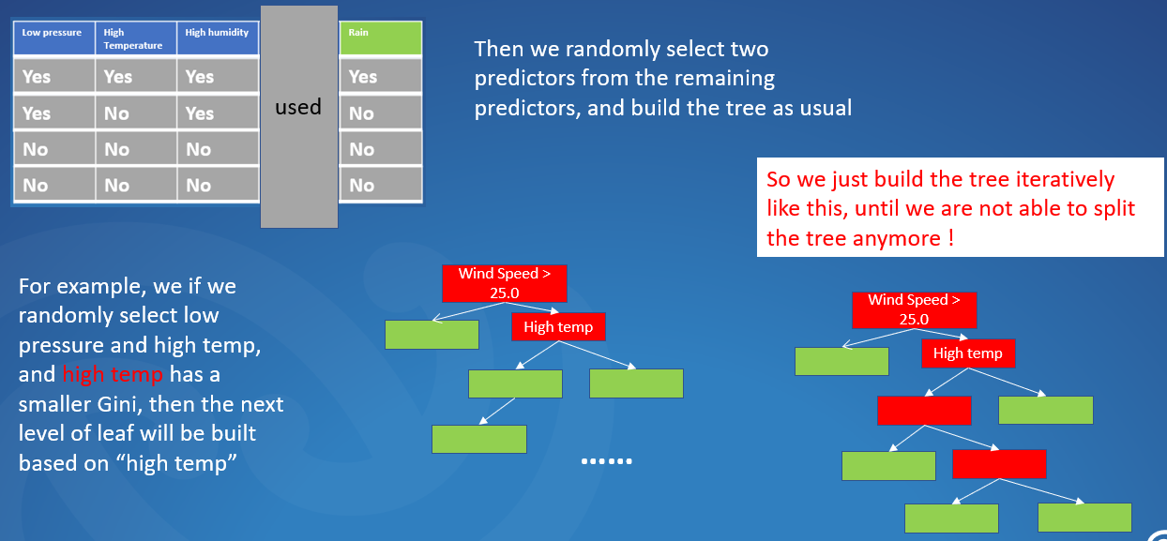
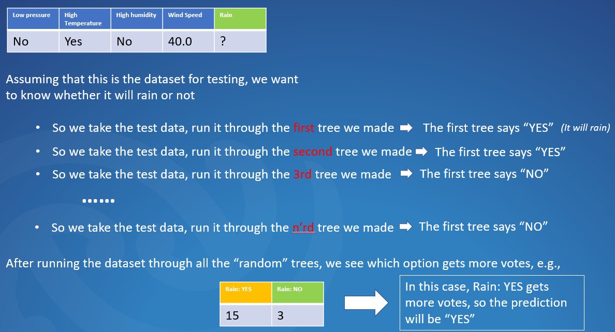
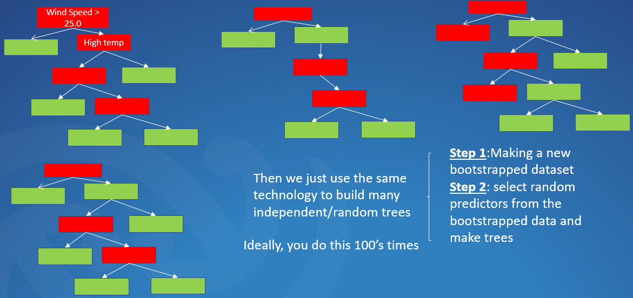
So how can we create a “random forest”
Using aggregation to get the decision
Bootstrapping the data
Bootstrapping the data + Using AGGregation to get the decision = BAGGING

Slide 24
Decision Tree
Random forest: how to evaluate RF

