Slide 1
Bias and variance
And how they are related to under/over fitting
Sijin Zhang

Slide 2
What are bias and variance

Slide 3
What are bias and variance
Bias and variance are two ways to describe the machine learning model and it’s error (e.g., squared error)

Slide 4

What are bias and variance
Bias and variance are two ways to describe the machine learning model and it’s error (e.g., squared error)
 |  | Variance
 |  | Low | High
Bias | Low
 | High

Slide 5
What are bias and variance
Bias and variance are two ways to describe the machine learning model and it’s error (e.g., squared error)
 |  | Variance
 |  | Low | High
Bias | Low
 | High
Usually means that we are making a pretty good prediction

Slide 6
What are bias and variance
Bias and variance are two ways to describe the machine learning model and it’s error (e.g., squared error)
 |  | Variance
 |  | Low | High
Bias | Low
 | High
Usually means that we are making a pretty good prediction
Very bad case, if we have both high bias and high variance

Slide 7
What are bias and variance
Bias and variance are two ways to describe the machine learning model and it’s error (e.g., squared error)
x | y
Assuming we have a dataset, with one predictor, and one target

Slide 8
What are bias and variance
Bias and variance are two ways to describe the machine learning model and it’s error (e.g., squared error)
x | y
If we take all datapoints from the dataset, we have the fitted line in red
y
Assuming we have a dataset, with one predictor, and one target
A good fitted line
x

Slide 9
What are bias and variance
Bias and variance are two ways to describe the machine learning model and it’s error (e.g., squared error)
x | y
If we take a subset of data points from the dataset, we have the fitted line in yellow
y
Assuming we have a dataset, with one predictor, and one target
A good fitted line
fitted line with 1st subset
x

Slide 10
What are bias and variance
Bias and variance are two ways to describe the machine learning model and it’s error (e.g., squared error)
x | y
If we take another subset of data points from the dataset, we have the fitted line in yellow
fitted line with 2nd subset
y
Assuming we have a dataset, with one predictor, and one target
A good fitted line
fitted line with 1st subset
x

Slide 11
What are bias and variance
Bias and variance are two ways to describe the machine learning model and it’s error (e.g., squared error)
x | y
If we take the last subset of data points from the dataset, we have the fitted line in blue
fitted line with 2nd subset
y
Assuming we have a dataset, with one predictor, and one target
A good fitted line
fitted line with 1st subset
fitted line with 3rd subset
x

Slide 12
What are bias and variance
Bias and variance are two ways to describe the machine learning model and it’s error (e.g., squared error)
x | y
In some areas, the fitted lines from subsets of data do good job
fitted line with 2nd subset
y
Assuming we have a dataset, with one predictor, and one target
A good fitted line
fitted line with 1st subset
fitted line with 3rd subset
x

Slide 13
What are bias and variance
Bias and variance are two ways to describe the machine learning model and it’s error (e.g., squared error)
x | y
fitted line with 2nd subset
So the model has a small bias
y
Assuming we have a dataset, with one predictor, and one target
A good fitted line
fitted line with 1st subset
fitted line with 3rd subset
x

Slide 14
What are bias and variance
Bias and variance are two ways to describe the machine learning model and it’s error (e.g., squared error)
x | y
fitted line with 2nd subset
So the model has a small bias
y
Assuming we have a dataset, with one predictor, and one target
A good fitted line
fitted line with 1st subset
fitted line with 3rd subset
x
While in other areas, the model is pretty bad

Slide 15
What are bias and variance
Bias and variance are two ways to describe the machine learning model and it’s error (e.g., squared error)
x | y
fitted line with 2nd subset
So the model has a small bias
y
Assuming we have a dataset, with one predictor, and one target
A good fitted line
fitted line with 1st subset
fitted line with 3rd subset
x
So the model has large bias

Slide 16
What are bias and variance
Bias and variance are two ways to describe the machine learning model and it’s error (e.g., squared error)
x | y
In some areas, when the dataset change, model prediction does not change much
fitted line with 2nd subset
So the model has a small bias
y
Assuming we have a dataset, with one predictor, and one target
A good fitted line
fitted line with 1st subset
fitted line with 3rd subset
x
So the model has large bias

Slide 17
What are bias and variance
Bias and variance are two ways to describe the machine learning model and it’s error (e.g., squared error)
x | y
fitted line with 2nd subset
So the model has a small bias
So the model has small variance
y
Assuming we have a dataset, with one predictor, and one target
A good fitted line
fitted line with 1st subset
fitted line with 3rd subset
x
So the model has large bias

Slide 18
What are bias and variance
Bias and variance are two ways to describe the machine learning model and it’s error (e.g., squared error)
x | y
fitted line with 2nd subset
So the model has a small bias
So the model has small variance
y
Assuming we have a dataset, with one predictor, and one target
A good fitted line
fitted line with 1st subset
fitted line with 3rd subset
So the model has large variance
x
So the model has large bias

Slide 19
What are bias and variance
Bias and variance are two ways to describe the machine learning model and it’s error (e.g., squared error)
x | y
fitted line with 2nd subset
So the model has a small bias
So the model has small variance
In a word,
the model is great if it has:
Small bias + small variance
The model is horrible if it has:
Large bias + large variance
y
Assuming we have a dataset, with one predictor, and one target
A good fitted line
fitted line with 1st subset
fitted line with 3rd subset
So the model has large variance
x
So the model has large bias

Slide 20
What are bias and variance
Bias and variance are two ways to describe the machine learning model and it’s error (e.g., squared error)
x | y
fitted line with 2nd subset
So the model has a small bias
So the model has small variance
In a word,
the model is great if it has:
Small bias + small variance
The model is horrible if it has:
Large bias + large variance
y
Assuming we have a dataset, with one predictor, and one target
A good fitted line
fitted line with 1st subset
fitted line with 3rd subset
x
Any ensemble method (e.g., bagging) would be a great way to reduce variance
So the model has large variance
So the model has large bias

Slide 21
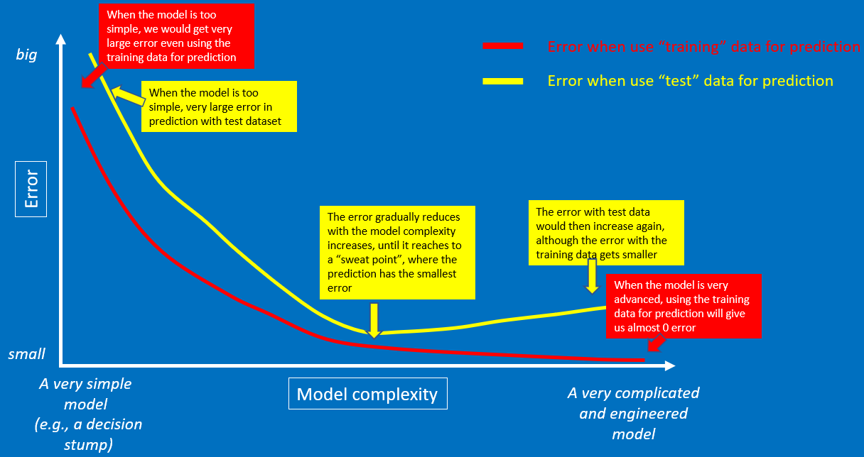
How bias and variance are related to under and overfitting
Remember this graph, which represents the relationships between model complexity and:
Error when using “training” data for prediction
Error when using “test” data for prediction

Slide 22
How bias and variance are related to under and overfitting
big
Error when use “training” data for prediction
Error when use “test” data for prediction
e.g., a LR model will give big bias
Error
e.g., a xgboost model will give low bias
With the model become more complicated, usually we can reduce the model bias
small
A very simple model
Model complexity
A very complicated and engineered model
(e.g., a decision stump)

Slide 23
How bias and variance are related to under and overfitting
big
Error when use “training” data for prediction
Error when use “test” data for prediction
Error
With the model become more complicated, usually we would increase the model variance
With the model become more complicated, usually we can reduce the model bias
small
A very simple model
Model complexity
A very complicated and engineered model
(e.g., a decision stump)

Slide 24
How bias and variance are related to under and overfitting
big
Error when use “training” data for prediction
Error when use “test” data for prediction
e.g., a LR model will give low variance (with different subsets, we may end up with similar fitted line)
Error
With the model become more complicated, usually we would increase the model variance
With the model become more complicated, usually we can reduce the model bias
small
A very simple model
Model complexity
A very complicated and engineered model
(e.g., a decision stump)

Slide 25
How bias and variance are related to under and overfitting
big
Error when use “training” data for prediction
Error when use “test” data for prediction
e.g., a xgboost model will give large variance (with different subsets, we may end up with quite different fitted line)
e.g., a LR model will give low variance (with different subsets, we may end up with similar fitted line)
Error
With the model become more complicated, usually we would increase the model variance
With the model become more complicated, usually we can reduce the model bias
small
A very simple model
Model complexity
A very complicated and engineered model
(e.g., a decision stump)

Slide 26
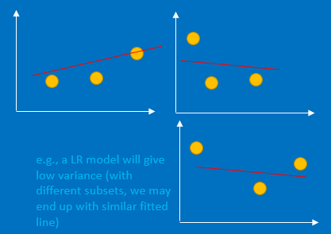
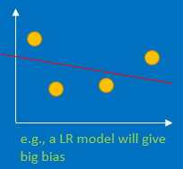
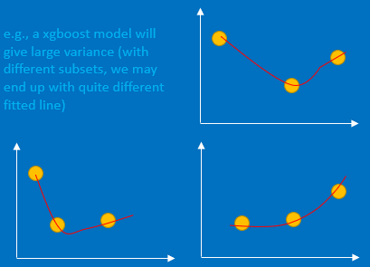
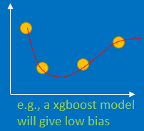
How bias and variance are related to under and overfitting
big
Error when use “training” data for prediction
Error when use “test” data for prediction
Error
With the model become more complicated, usually we would increase the model variance
With the model become more complicated, usually we can reduce the model bias
small
A very simple model
Model complexity
A very complicated and engineered model
(e.g., a decision stump)

Slide 27
How bias and variance are related to under and overfitting
big
Error when use “training” data for prediction
Error when use “test” data for prediction
A poor fitted model, but very stable (not sensitive to additional or test data)
Error
With the model become more complicated, usually we would increase the model variance
With the model become more complicated, usually we can reduce the model bias
small
A very simple model
Model complexity
A very complicated and engineered model
(e.g., a decision stump)

Slide 28
How bias and variance are related to under and overfitting
big
Error when use “training” data for prediction
A well fitted model, but not stable (sensitive to additional or test data)
Error when use “test” data for prediction
A poor fitted model, but very stable (not sensitive to additional or test data)
Error
With the model become more complicated, usually we would increase the model variance
With the model become more complicated, usually we can reduce the model bias
small
A very simple model
Model complexity
A very complicated and engineered model
(e.g., a decision stump)

Slide 29
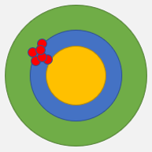
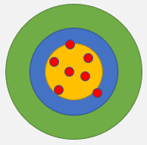
How bias and variance are related to under and overfitting
big
Error when use “training” data for prediction
A well fitted model, but not stable (sensitive to additional or test data)
Error when use “test” data for prediction
A poor fitted model, but very stable (not sensitive to additional or test data)
Error
With the model become more complicated, usually we would increase the model variance
With the model become more complicated, usually we can reduce the model bias
small
A very simple model
Model complexity
A very complicated and engineered model
(e.g., a decision stump)

Slide 30
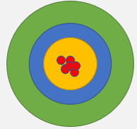
How bias and variance are related to under and overfitting
big
Error when use “training” data for prediction
A well fitted model, but not stable (sensitive to additional or test data)
Error when use “test” data for prediction
A poor fitted model, but very stable (not sensitive to additional or test data)
Error
With the model become more complicated, usually we would increase the model variance
With the model become more complicated, usually we can reduce the model bias
small
A very simple model
We want our model sits here: a good balance of low bias + low variance
Model complexity
A very complicated and engineered model
(e.g., a decision stump)

