Slide 1
Bagging

Slide 2
Bagging
Low pressure | High Temperature | High humidity | Wind Speed | Rain
No | No | No | 10.0 | No
Yes | Yes | Yes | 30.0 | Yes
Yes | Yes | No | 20.0 | No
Yes | No | Yes | 50.0 | No
No | No | Yes | 70.0 | Yes
Assuming that we have the above data

Slide 3
Bagging
Low pressure | High Temperature | High humidity | Wind Speed | Rain
No | No | No | 10.0 | No
Yes | Yes | Yes | 30.0 | Yes
Yes | Yes | No | 20.0 | No
Yes | No | Yes | 50.0 | No
No | No | Yes | 70.0 | Yes
Low pressure | High Temperature | High humidity | Wind Speed | Rain
Yes | Yes | Yes | 30.0 | Yes
Yes | No | Yes | 50.0 | No
No | No | No | 10.0 | No
No | No | No | 10.0 | No
Not selected
Not selected
To create a bootstrap dataset with the same predictors as the original dataset, we just randomly select samples here
Assuming that we have the above data
For example in this case, the first row gets selected twice, while the 3rd and last row are not selected at all

Slide 4
Bagging
Low pressure | High Temperature | High humidity | Wind Speed | Rain
No | No | No | 10.0 | No
Yes | Yes | Yes | 30.0 | Yes
Yes | Yes | No | 20.0 | No
Yes | No | Yes | 50.0 | No
No | No | Yes | 70.0 | Yes
Low pressure | High Temperature | High humidity | Wind Speed | Rain
Yes | Yes | Yes | 30.0 | Yes
Yes | No | Yes | 50.0 | No
No | No | No | 10.0 | No
No | No | No | 10.0 | No
High Temperature | Wind Speed | Rain
Yes | 30.0 | Yes
No | 50.0 | No
No | 10.0 | No
No | 10.0 | No
Not selected
Not selected
To create a bootstrap dataset with the same predictors as the original dataset, we just randomly select samples here
Furthermore, instead of considering all four predictors, we only consider two here ~ “high temp” and “wind speed” (usually they are selected randomly )
Assuming that we have the above data
For example in this case, the first row gets selected twice, while the 3rd and last row are not selected at all

Slide 5
Bagging
Low pressure | High Temperature | High humidity | Wind Speed | Rain
No | No | No | 10.0 | No
Yes | Yes | Yes | 30.0 | Yes
Yes | Yes | No | 20.0 | No
Yes | No | Yes | 50.0 | No
No | No | Yes | 70.0 | Yes
Low pressure | High Temperature | High humidity | Wind Speed | Rain
Yes | Yes | Yes | 30.0 | Yes
Yes | No | Yes | 50.0 | No
No | No | No | 10.0 | No
No | No | No | 10.0 | No
High Temperature | Wind Speed | Rain
Yes | 30.0 | Yes
No | 50.0 | No
No | 10.0 | No
No | 10.0 | No
Not selected
Not selected
To create a bootstrap dataset with the same predictors as the original dataset, we just randomly select samples here
Furthermore, instead of considering all four predictors, we only consider two here ~ “high temp” and “wind speed” (usually they are selected randomly )
Assuming that we have the above data
For example in this case, the first row gets selected twice, while the 3rd and last row are not selected at all
By “randomly” repeat the above process, we can have many bootstrapped dataset

Slide 6
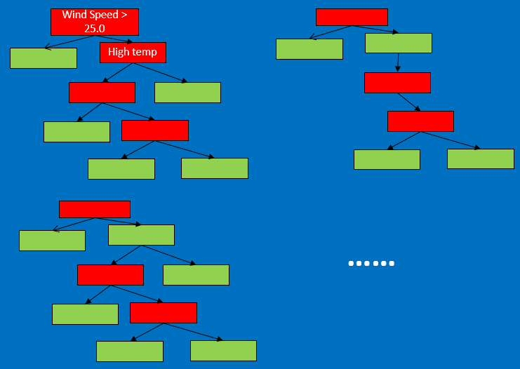
Bagging
Low pressure | High Temperature | High humidity | Wind Speed | Rain
No | No | No | 10.0 | No
Yes | Yes | Yes | 30.0 | Yes
Yes | Yes | No | 20.0 | No
Yes | No | Yes | 50.0 | No
No | No | Yes | 70.0 | Yes
Low pressure | High Temperature | High humidity | Wind Speed | Rain
Yes | Yes | Yes | 30.0 | Yes
Yes | No | Yes | 50.0 | No
No | No | No | 10.0 | No
No | No | No | 10.0 | No
High Temperature | Wind Speed | Rain
Yes | 30.0 | Yes
No | 50.0 | No
No | 10.0 | No
No | 10.0 | No
Not selected
Not selected
To create a bootstrap dataset with the same predictors as the original dataset, we just randomly select samples here
Furthermore, instead of considering all four predictors, we only consider two here ~ “high temp” and “wind speed” (usually they are selected randomly )
Assuming that we have the above data
For example in this case, the first row gets selected twice, while the 3rd and last row are not selected at all
By “randomly” repeat the above process, we can have many bootstrapped dataset
We can grow many trees out of these randomly bootstrapped dataset (e.g., random forest)

Slide 7
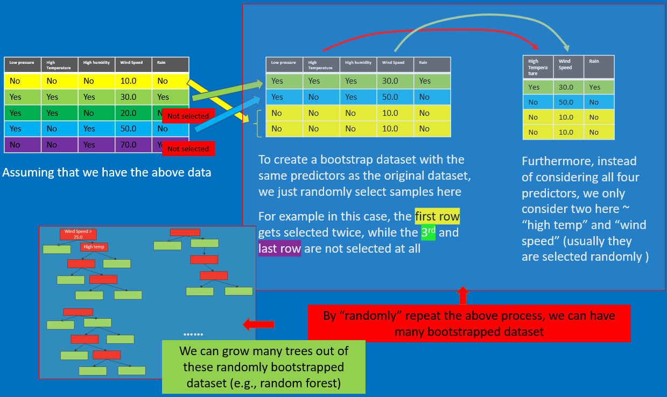
Bagging
Then we have a testing data
Low pressure | High Temperature | High humidity | Wind Speed | Rain
No | Yes | No | 40.0 | ?
Bootstrapping

Slide 8
Bagging
Then we have a testing data
Low pressure | High Temperature | High humidity | Wind Speed | Rain
No | Yes | No | 40.0 | ?
So we take the test data, run it through the first tree we made
The first tree says “YES”
(It will rain)
Bootstrapping

Slide 9
Bagging
Then we have a testing data
Low pressure | High Temperature | High humidity | Wind Speed | Rain
No | Yes | No | 40.0 | ?
So we take the test data, run it through the first tree we made
The first tree says “YES”
(It will rain)
We take the test data, run it through the 2nd tree we made
The 2nd tree says “YES”
(It will rain)
Bootstrapping

Slide 10
Bagging
Then we have a testing data
Low pressure | High Temperature | High humidity | Wind Speed | Rain
No | Yes | No | 40.0 | ?
So we take the test data, run it through the first tree we made
The first tree says “YES”
(It will rain)
We take the test data, run it through the 2nd tree we made
The 2nd tree says “YES”
(It will rain)
……
We take the test data, run it through the nth tree we made
The nth tree says “NO”
(It won’t rain)
Bootstrapping

Slide 11
Bagging
Then we have a testing data
Low pressure | High Temperature | High humidity | Wind Speed | Rain
No | Yes | No | 40.0 | ?
So we take the test data, run it through the first tree we made
The first tree says “YES”
(It will rain)
We take the test data, run it through the 2nd tree we made
The 2nd tree says “YES”
(It will rain)
……
We take the test data, run it through the nth tree we made
The nth tree says “NO”
(It won’t rain)
Bootstrapping
After running the dataset through all the “random” trees, we see which option gets more votes, e.g.,
Rain: YES | Rain: NO
15 | 3

Slide 12
Bagging
Then we have a testing data
Low pressure | High Temperature | High humidity | Wind Speed | Rain
No | Yes | No | 40.0 | ?
So we take the test data, run it through the first tree we made
The first tree says “YES”
(It will rain)
We take the test data, run it through the 2nd tree we made
The 2nd tree says “YES”
(It will rain)
……
We take the test data, run it through the nth tree we made
The nth tree says “NO”
(It won’t rain)
Bootstrapping
After running the dataset through all the “random” trees, we see which option gets more votes, e.g.,
Rain: YES | Rain: NO
15 | 3
Final output: YES

Slide 13
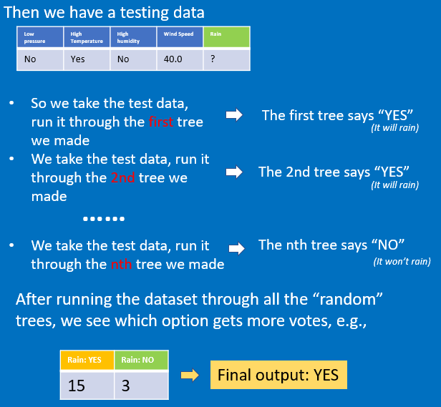
Bagging
Bootstrapping
Aggregation

Slide 14
Bagging
Bootstrapping
Aggregation
Bootstrapping the data + Using AGGregation to get the decision = BAGGING

