Slide 1
Boosting

Slide 2
A classic boosting method is adaboost, here we use it as an example to explain what is boosting

Slide 3
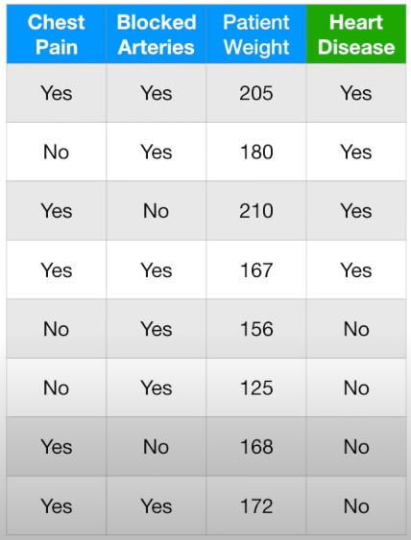
A classic boosting method is adaboost, here we use it as an example to explain what is boosting
Assuming we have the above dataset

Slide 4
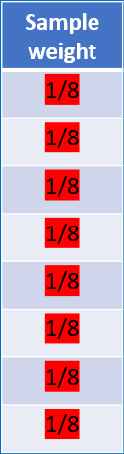
A classic boosting method is adaboost, here we use it as an example to explain what is boosting
Step 1: we give weights for each sample (e.g., as an initial guess, it can be $\frac{1}{total samples}$)
Assuming we have the above dataset

Slide 5
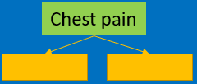
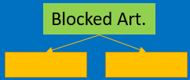




A classic boosting method is adaboost, here we use it as an example to explain what is boosting
Step 1: we give weights for each sample (e.g., as an initial guess, it can be $\frac{1}{total samples}$)
Step 2: determine the “root” tree
we go through each feature, grow trees and calculate “weighted Gini index”
$${Gini}_{w,cp}=0.47$$
$${Gini}_{w,ba}=0.5$$
$${Gini}_{w,pw}=0.2$$
Assuming we have the above dataset

Slide 6
A classic boosting method is adaboost, here we use it as an example to explain what is boosting
Step 1: we give weights for each sample (e.g., as an initial guess, it can be $\frac{1}{total samples}$)
Step 2: determine the “root” tree
we go through each feature, grow trees and calculate “weighted Gini index”
$${Gini}_{w,cp}=0.47$$
$${Gini}_{w,ba}=0.5$$
$${Gini}_{w,pw}=0.2$$
Assuming we have the above dataset

Slide 7
A classic boosting method is adaboost, here we use it as an example to explain what is boosting
Step 1: we give weights for each sample (e.g., as an initial guess, it can be $\frac{1}{total samples}$)
Step 2: determine the “root” tree
we go through each feature, grow trees and calculate “weighted Gini index”
Patient weight has the smallest Gini, therefore it will be used as the “root/first tree”
$${Gini}_{w,cp}=0.47$$
$${Gini}_{w,ba}=0.5$$
$${Gini}_{w,pw}=0.2$$
Assuming we have the above dataset

Slide 8
A classic boosting method is adaboost, here we use it as an example to explain what is boosting
Step 1: we give weights for each sample (e.g., as an initial guess, it can be $\frac{1}{total samples}$)
Step 2: determine the “root” tree
Step 3: determine how much the above tree will contribute to the final results
Assuming we have the above dataset

Slide 9
A classic boosting method is adaboost, here we use it as an example to explain what is boosting
Step 1: we give weights for each sample (e.g., as an initial guess, it can be $\frac{1}{total samples}$)
Step 2: determine the “root” tree
Step 3: determine how much the above tree will contribute to the final results
Calculating the weighted prediction error for the tree, which is 0.125 (see Adaboost tutorial for the details)
Assuming we have the above dataset

Slide 10
A classic boosting method is adaboost, here we use it as an example to explain what is boosting
Step 1: we give weights for each sample (e.g., as an initial guess, it can be $\frac{1}{total samples}$)
Step 2: determine the “root” tree
Step 3: determine how much the above tree will contribute to the final results
Calculating the weighted prediction error for the tree, which is 0.125 (see Adaboost tutorial for the details)
Calculating the “amount of say” for the tree, which is 0.97 (see Adaboost tutorial for the details)
Assuming we have the above dataset

Slide 11
A classic boosting method is adaboost, here we use it as an example to explain what is boosting
Step 1: we give weights for each sample (e.g., as an initial guess, it can be $\frac{1}{total samples}$)
Step 2: determine the “root” tree
Step 3: determine how much the above tree will contribute to the final results (“amount of say”)
Calculating the weighted prediction error for the tree, which is 0.125 (see Adaboost tutorial for the details)
Calculating the “amount of say” for the tree, which is 0.97 (see Adaboost tutorial for the details)
Step 4: Update the sample weight depending on the “amount of say”
Assuming we have the above dataset

Slide 12
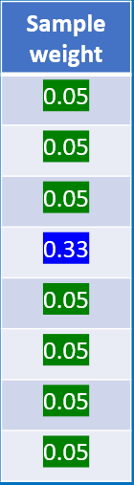
A classic boosting method is adaboost, here we use it as an example to explain what is boosting
Step 1: we give weights for each sample (e.g., as an initial guess, it can be $\frac{1}{total samples}$)
Step 2: determine the “root” tree
Step 3: determine how much the above tree will contribute to the final results (“amount of say”)
Calculating the weighted prediction error for the tree, which is 0.125 (see Adaboost tutorial for the details)
Calculating the “amount of say” for the tree, which is 0.97 (see Adaboost tutorial for the details)
Step 4: Update the sample weight depending on the “amount of say”
Assuming we have the above dataset

Slide 13
A classic boosting method is adaboost, here we use it as an example to explain what is boosting
Step 1: we give weights for each sample (e.g., as an initial guess, it can be $\frac{1}{total samples}$)
Step 2: determine the “root” tree
Step 3: determine how much the above tree will contribute to the final results (“amount of say”)
Calculating the weighted prediction error for the tree, which is 0.125 (see Adaboost tutorial for the details)
Calculating the “amount of say” for the tree, which is 0.97 (see Adaboost tutorial for the details)
Step 4: Update the sample weight depending on the “amount of say”
Assuming we have the above dataset
Step 5: Go back to “step 2”, using the updated weight, and repeat the processes between “step 2” and “step4”

Slide 14
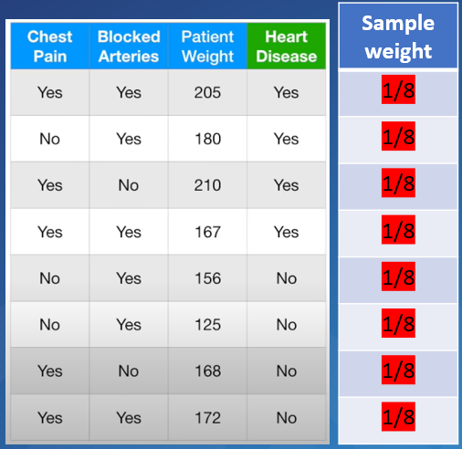
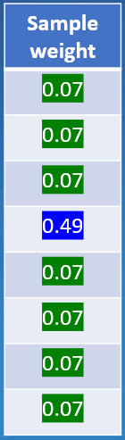
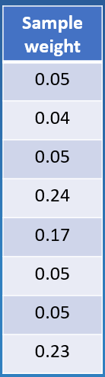
A classic boosting method is adaboost, here we use it as an example to explain what is boosting
Step 1: we give weights for each sample (e.g., as an initial guess, it can be $\frac{1}{total samples}$)
Step 2: determine the “root” tree
Step 3: determine how much the above tree will contribute to the final results (“amount of say”)
Calculating the weighted prediction error for the tree, which is 0.125 (see Adaboost tutorial for the details)
Calculating the “amount of say” for the tree, which is 0.97 (see Adaboost tutorial for the details)
Step 4: Update the sample weight depending on the “amount of say”
Assuming we have the above dataset
Step 5: Go back to “step 2”, using the updated weight, and repeat the processes between “step 2” and “step4”
……
Every time repeat this process, we will get
updated “sample weights”
A new tree
The “amount of say” for the tree
Initial dataset
(and assumed weights)
Amount of say: 0.97
Amount of say: 0.52
1st tree
2nd tree

Slide 15
A classic boosting method is adaboost, here we use it as an example to explain what is boosting
Step 1: we give weights for each sample (e.g., as an initial guess, it can be $\frac{1}{total samples}$)
Step 2: determine the “root” tree
Step 3: determine how much the above tree will contribute to the final results (“amount of say”)
Calculating the weighted prediction error for the tree, which is 0.125 (see Adaboost tutorial for the details)
Calculating the “amount of say” for the tree, which is 0.97 (see Adaboost tutorial for the details)
Step 4: Update the sample weight depending on the “amount of say”
Assuming we have the above dataset
Step 5: Go back to “step 2”, using the updated weight, and repeat the processes between “step 2” and “step4”
……
Every time repeat this process, we will get
updated “sample weights”
A new tree
The “amount of say” for the tree
Initial dataset
(and assumed weights)
Amount of say: 0.97
Amount of say: 0.52
We stop this iterative processes until the “amount of say” is small enough
1st tree
2nd tree

Slide 16

A classic boosting method is adaboost, here we use it as an example to explain what is boosting
Step 1: we give weights for each sample (e.g., as an initial guess, it can be $\frac{1}{total samples}$)
Step 2: determine the “root” tree
Step 3: determine how much the above tree will contribute to the final results (“amount of say”)
Calculating the weighted prediction error for the tree, which is 0.125 (see Adaboost tutorial for the details)
Calculating the “amount of say” for the tree, which is 0.97 (see Adaboost tutorial for the details)
Step 4: Update the sample weight depending on the “amount of say”
Assuming we have the above dataset
Step 5: Go back to “step 2”, using the updated weight, and repeat the processes between “step 2” and “step4”
When we have a testing data

Slide 17




A classic boosting method is adaboost, here we use it as an example to explain what is boosting
Step 1: we give weights for each sample (e.g., as an initial guess, it can be $\frac{1}{total samples}$)
Step 2: determine the “root” tree
Step 3: determine how much the above tree will contribute to the final results (“amount of say”)
Calculating the weighted prediction error for the tree, which is 0.125 (see Adaboost tutorial for the details)
Calculating the “amount of say” for the tree, which is 0.97 (see Adaboost tutorial for the details)
Step 4: Update the sample weight depending on the “amount of say”
Assuming we have the above dataset
Step 5: Go back to “step 2”, using the updated weight, and repeat the processes between “step 2” and “step4”
$$w_{1}$$
+
$$w_{2}$$
$$w_{n}$$
When we have a testing data
We use the testing data to go through all the trees

Slide 18
A classic boosting method is adaboost, here we use it as an example to explain what is boosting
Step 1: we give weights for each sample (e.g., as an initial guess, it can be $\frac{1}{total samples}$)
Step 2: determine the “root” tree
Step 3: determine how much the above tree will contribute to the final results (“amount of say”)
Calculating the weighted prediction error for the tree, which is 0.125 (see Adaboost tutorial for the details)
Calculating the “amount of say” for the tree, which is 0.97 (see Adaboost tutorial for the details)
Step 4: Update the sample weight depending on the “amount of say”
Assuming we have the above dataset
Step 5: Go back to “step 2”, using the updated weight, and repeat the processes between “step 2” and “step4”
$$w_{1}$$
+
$$w_{2}$$
$$w_{n}$$
When we have a testing data
We use the testing data to go through all the trees
When the tree output is “YES”, we take it as “1”.
When the tree output is “NO”, we take it as “0”

Slide 19
A classic boosting method is adaboost, here we use it as an example to explain what is boosting
Step 1: we give weights for each sample (e.g., as an initial guess, it can be $\frac{1}{total samples}$)
Step 2: determine the “root” tree
Step 3: determine how much the above tree will contribute to the final results (“amount of say”)
Calculating the weighted prediction error for the tree, which is 0.125 (see Adaboost tutorial for the details)
Calculating the “amount of say” for the tree, which is 0.97 (see Adaboost tutorial for the details)
Step 4: Update the sample weight depending on the “amount of say”
Assuming we have the above dataset
Step 5: Go back to “step 2”, using the updated weight, and repeat the processes between “step 2” and “step4”
$$w_{1}$$
+
$$w_{2}$$
$$w_{n}$$
When we have a testing data
We use the testing data to go through all the trees
When the tree output is “YES”, we take it as “1”.
When the tree output is “NO”, we take it as “0”
The tree output is multiplied by the “amount of say” $w_{i}$

Slide 20
A classic boosting method is adaboost, here we use it as an example to explain what is boosting
Step 1: we give weights for each sample (e.g., as an initial guess, it can be $\frac{1}{total samples}$)
Step 2: determine the “root” tree
Step 3: determine how much the above tree will contribute to the final results (“amount of say”)
Calculating the weighted prediction error for the tree, which is 0.125 (see Adaboost tutorial for the details)
Calculating the “amount of say” for the tree, which is 0.97 (see Adaboost tutorial for the details)
Step 4: Update the sample weight depending on the “amount of say”
Assuming we have the above dataset
Step 5: Go back to “step 2”, using the updated weight, and repeat the processes between “step 2” and “step4”
$$w_{1}$$
+
$$w_{2}$$
$$w_{n}$$
When we have a testing data
We use the testing data to go through all the trees
When the tree output is “YES”, we take it as “1”.
When the tree output is “NO”, we take it as “0”
The tree output is multiplied by the “amount of say” $w_{i}$
If the final result is larger than zero, then we say the final result is “YES”

Slide 21
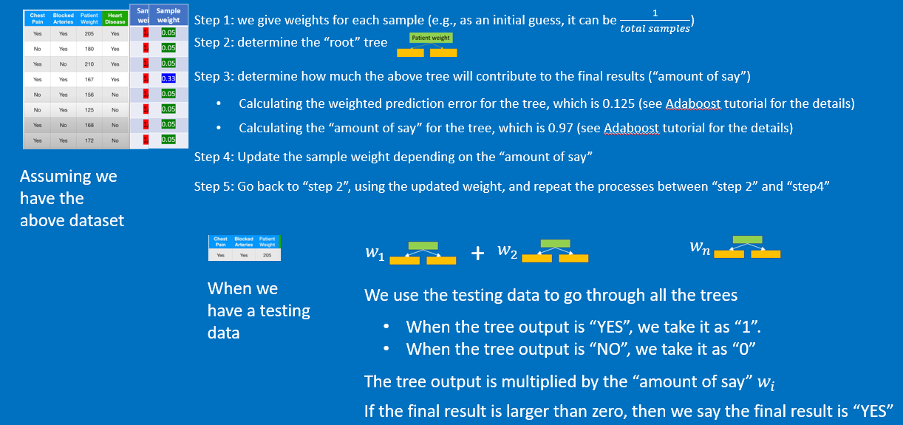
A classic boosting method is adaboost, here we use it as an example to explain what is boosting
What is boosting ?
Boosting is an ensemble learning method that combines a set of weak learners into a strong learner to minimize training errors.
In boosting, the sample data is fitted with a model and then trained sequentially—that is, each model tries to compensate for the weaknesses of its predecessor (so models are interconnected).
With each iteration, the weak rules from each individual classifier are combined to form one, strong prediction rule.

Slide 22
A classic boosting method is adaboost, here we use it as an example to explain what is boosting
Final combined tree
Individual tree
What is boosting ?
Boosting is an ensemble learning method that combines a set of weak learners into a strong learner to minimize training errors.
In boosting, the sample data is fitted with a model and then trained sequentially—that is, each model tries to compensate for the weaknesses of its predecessor (so models/trees are interconnected).
With each iteration, the weak rules from each individual classifier are combined to form one, strong prediction rule.

