Slide 1
Stacking

Slide 2
feature1 | feature2 | feature3 | prediction
Assuming that we have the above training dataset (e.g., 14 samples, 3 features)

Slide 3

Step 1: Split training data to $n$ folds
feature1 | feature2 | feature3 | prediction
Assuming that we have the above training dataset (e.g., 14 samples, 3 features)

Slide 4
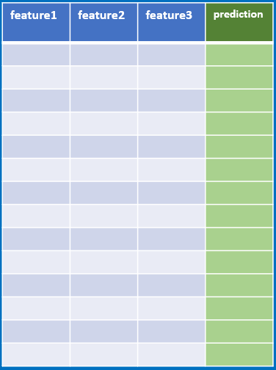

Step 1: Split training data to $k$ folds
In this case let’s assume $k$=3, so the training data will be split to 3 subset
feature1 | feature2 | feature3 | prediction
subset1
subset2
subset3
Assuming that we have the above training dataset (e.g., 14 samples, 3 features)

Slide 5
Step 1: Split training data to $k$ folds
In this case let’s assume $k$=3, so the training data will be split to 3 subset
Fold 1:
training data:
Testing data:
subset1
subset2
feature1 | feature2 | feature3 | prediction
subset1
subset3
We can use 2 subsets for training and 1 subset for testing
subset2
subset3
Assuming that we have the above training dataset (e.g., 14 samples, 3 features)

Slide 6
Step 1: Split training data to $k$ folds
In this case let’s assume $k$=3, so the training data will be split to 3 subset
Fold 1:
training data:
Testing data:
subset1
subset2
feature1 | feature2 | feature3 | prediction
subset1
subset3
We can use 2 subsets for training and 1 subset for testing
subset2
Fold 2:
training data:
Testing data:
subset1
subset3
subset2
subset3
Assuming that we have the above training dataset (e.g., 14 samples, 3 features)

Slide 7
Step 1: Split training data to $k$ folds
In this case let’s assume $k$=3, so the training data will be split to 3 subset
Fold 1:
training data:
Testing data:
subset1
subset2
feature1 | feature2 | feature3 | prediction
subset1
subset3
We can use 2 subsets for training and 1 subset for testing
subset2
Fold 2:
training data:
Testing data:
subset1
subset3
subset2
subset3
Fold 3:
training data:
Testing data:
subset2
subset3
subset1
Assuming that we have the above training dataset (e.g., 14 samples, 3 features)

Slide 8
Step 1: Split training data to $k$ folds
In this case let’s assume $k$=3, so the training data will be split to 3 subset
Fold 1:
training data:
Testing data:
subset1
subset2
feature1 | feature2 | feature3 | prediction
subset1
subset3
We can use 2 subsets for training and 1 subset for testing
subset2
Fold 2:
training data:
Testing data:
subset1
subset3
subset2
subset3
Fold 3:
training data:
Testing data:
subset2
subset3
subset1
Step 2: train models and make prediction
Assuming that we have the above training dataset (e.g., 14 samples, 3 features)

Slide 9
Step 1: Split training data to $k$ folds
In this case let’s assume $k$=3, so the training data will be split to 3 subset
Fold 1:
training data:
Testing data:
subset1
subset2
feature1 | feature2 | feature3 | prediction
subset1
subset3
We can use 2 subsets for training and 1 subset for testing
subset2
Fold 2:
training data:
Testing data:
subset1
subset3
subset2
subset3
Fold 3:
training data:
Testing data:
subset2
subset3
subset1
Step 2: train models and make prediction
For each fold, we have training data and testing data
Assuming that we have the above training dataset (e.g., 14 samples, 3 features)

Slide 10
Step 1: Split training data to $k$ folds
In this case let’s assume $k$=3, so the training data will be split to 3 subset
Fold 1:
training data:
Testing data:
subset1
subset2
feature1 | feature2 | feature3 | prediction
subset1
subset3
We can use 2 subsets for training and 1 subset for testing
subset2
Fold 2:
training data:
Testing data:
subset1
subset3
subset2
subset3
Fold 3:
training data:
Testing data:
subset2
subset3
subset1
Step 2: train models and make prediction
For each fold, we have training data and testing data.
For example, for Fold1, we train 3 models: RF, AdaBoost and LR
RF
subset1
AB
subset2
LR
Assuming that we have the above training dataset (e.g., 14 samples, 3 features)

Slide 11
Step 1: Split training data to $k$ folds
In this case let’s assume $k$=3, so the training data will be split to 3 subset
Fold 1:
training data:
Testing data:
subset1
subset2
feature1 | feature2 | feature3 | prediction
subset1
subset3
We can use 2 subsets for training and 1 subset for testing
subset2
Fold 2:
training data:
Testing data:
subset1
subset3
subset2
subset3
Fold 3:
training data:
Testing data:
subset2
subset3
subset1
Step 2: train models and make prediction
For each fold, we have training data and testing data.
For example, for Fold1, we train 3 models: RF, AdaBoost and LR
RF
Pred(RF)
subset1
AB
Pred(AF)
subset2
LR
Pred(AF)
Assuming that we have the above training dataset (e.g., 14 samples, 3 features)
subset3
Then we apply testing data to the trained model and get the prediction

Slide 12
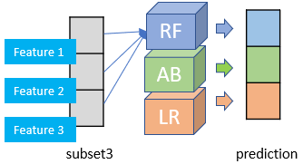
Step 1: Split training data to $k$ folds
In this case let’s assume $k$=3, so the training data will be split to 3 subset
Fold 1:
training data:
Testing data:
subset1
subset2
feature1 | feature2 | feature3 | prediction
subset1
subset3
We can use 2 subsets for training and 1 subset for testing
subset2
Fold 2:
training data:
Testing data:
subset1
subset3
subset2
subset3
Fold 3:
training data:
Testing data:
Note that the predictions here are a matrix, for example, if subset3 only have one sample, then we have
subset2
subset3
subset1
Step 2: train models and make prediction
For each fold, we have training data and testing data.
For example, for Fold1, we train 3 models: RF, AdaBoost and LR
RF
Pred(RF)
subset1
AB
Pred(AF)
subset2
LR
Pred(AF)
Assuming that we have the above training dataset (e.g., 14 samples, 3 features)
subset3
Then we apply testing data to the trained model and get the prediction

Slide 13
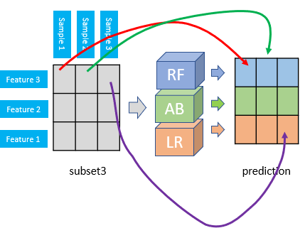
Step 1: Split training data to $k$ folds
In this case let’s assume $k$=3, so the training data will be split to 3 subset
Fold 1:
training data:
Testing data:
subset1
subset2
feature1 | feature2 | feature3 | prediction
subset1
subset3
We can use 2 subsets for training and 1 subset for testing
subset2
Fold 2:
training data:
Testing data:
subset1
subset3
subset2
subset3
Fold 3:
training data:
Testing data:
Note that the predictions here are a matrix, for example, if subset3 only have one sample, then we have
subset2
subset3
subset1
Step 2: train models and make prediction
For each fold, we have training data and testing data.
For example, for Fold1, we train 3 models: RF, AdaBoost and LR
RF
Pred(RF)
if subset3 have 3 sample, then we have the prediction as
subset1
AB
Pred(AF)
subset2
LR
Pred(AF)
Assuming that we have the above training dataset (e.g., 14 samples, 3 features)
subset3
Then we apply testing data to the trained model and get the prediction

Slide 14
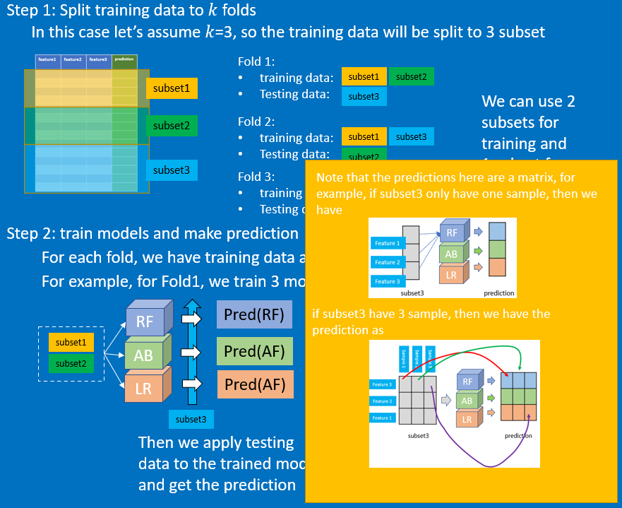
Step 3: we go through “step 2” for the rest fold2 and fold3, and we “stack” the predictions together
stacked predictions
From
fold 1
From
fold 2
From
fold 3

Slide 15
Step 3: we go through “step 2” for the rest fold2 and fold3, and we “stack” the predictions together
stacked predictions
From
fold 1
From
fold 2
From
fold 3
Step 4: Then we attach the “truth” from the testing dataset to the predictions
Prediction from RF
Prediction from AB
Prediction from LR
truth

Slide 16
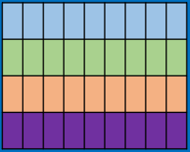
Step 3: we go through “step 2” for the rest fold2 and fold3, and we “stack” the predictions together
stacked predictions
From
fold 1
From
fold 2
From
fold 3
Step 4: Then we attach the “truth” from the testing dataset to the predictions
Three features correspond to three models: RF, AB and LR
Prediction from RF
Prediction from AB
Prediction from LR
truth
“truth”
Different samples

Slide 17
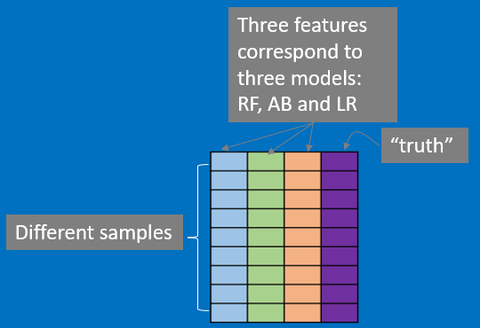
Step 3: we go through “step 2” for the rest fold2 and fold3, and we “stack” the predictions together
stacked predictions
From
fold 1
From
fold 2
From
fold 3
Step 4: Then we attach the “truth” from the testing dataset to the predictions
Step 5: We can use another model to “train” this new dataset
Final model

Slide 18
Step 3: we go through “step 2” for the rest fold2 and fold3, and we “stack” the predictions together
stacked predictions
From
fold 1
From
fold 2
From
fold 3
Step 4: Then we attach the “truth” from the testing dataset to the predictions
Step 5: We can use another model to “train” this new dataset
So if we have new testing data,
first it will go through RF, AB and LR as usual
Then we will have a prediction containing three individual predictions
These 3 predictions will be treated as a completely new dataset, and being used in the “final” model to make the “final prediction”
Final model

