Slide 1
AdaBoost

Slide 2
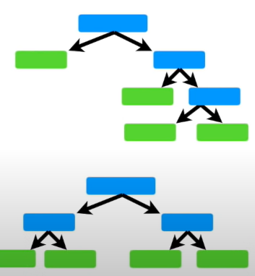
Difference between random forest and Adaboost
In RF, each time you grow a tree, the tree is a full size tree

Slide 3
Difference between random forest and Adaboost
In RF, each time you grow a tree, the tree is a full size tree
Some tree might be bigger than others, but there is no pre-defined tree depth

Slide 4
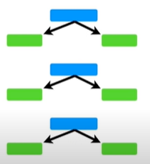
Difference between random forest and Adaboost
In RF, each time you grow a tree, the tree is a full size tree
In Adaboost, each time you grow a tree, the tree is just a node and two leaves
Some tree might be bigger than others, but there is no pre-defined tree depth

Slide 5
Difference between random forest and Adaboost
In RF, each time you grow a tree, the tree is a full size tree
In Adaboost, each time you grow a tree, the tree is just a node and two leaves
Some tree might be bigger than others, but there is no pre-defined tree depth
A tree with just one node and 2 leaves is called a “stump”

Slide 6
Difference between random forest and Adaboost
In RF, each time you grow a tree, the tree is a full size tree
In Adaboost, each time you grow a tree, the tree is just a node and two leaves
Some tree might be bigger than others, but there is no pre-defined tree depth
A tree with just one node and 2 leaves is called a “stump”
So Adaboost is really a “forest of stumps” rather than trees

Slide 7
Difference between random forest and Adaboost
In RF, each time you grow a tree, the tree is a full size tree
In Adaboost, each time you grow a tree, the tree is just a node and two leaves
Some tree might be bigger than others, but there is no pre-defined tree depth
A tree with just one node and 2 leaves is called a “stump”
So Adaboost is really a “forest of stumps” rather than trees
In RF, each tree has an equal vote on the final classification

Slide 8
Difference between random forest and Adaboost
In RF, each time you grow a tree, the tree is a full size tree
In Adaboost, each time you grow a tree, the tree is just a node and two leaves
Some tree might be bigger than others, but there is no pre-defined tree depth
A tree with just one node and 2 leaves is called a “stump”
So Adaboost is really a “forest of stumps” rather than trees
In RF, each tree has an equal vote on the final classification
In Adaboost, some stumps get more say in the final classification/regression than others

Slide 9
Difference between random forest and Adaboost
In RF, each time you grow a tree, the tree is a full size tree
In Adaboost, each time you grow a tree, the tree is just a node and two leaves
Some tree might be bigger than others, but there is no pre-defined tree depth
A tree with just one node and 2 leaves is called a “stump”
So Adaboost is really a “forest of stumps” rather than trees
In RF, each tree has an equal vote on the final classification
In Adaboost, some stumps get more say in the final classification/regression than others
In RF, each tree is made independently of the others

Slide 10
Difference between random forest and Adaboost
In RF, each time you grow a tree, the tree is a full size tree
In Adaboost, each time you grow a tree, the tree is just a node and two leaves
Some tree might be bigger than others, but there is no pre-defined tree depth
A tree with just one node and 2 leaves is called a “stump”
So Adaboost is really a “forest of stumps” rather than trees
In RF, each tree has an equal vote on the final classification
In Adaboost, some stumps get more say in the final classification/regression than others
In RF, each tree is made independently of the others (so it does not matter which tree you grow first …)

Slide 11
Difference between random forest and Adaboost
In RF, each time you grow a tree, the tree is a full size tree
In Adaboost, each time you grow a tree, the tree is just a node and two leaves
Some tree might be bigger than others, but there is no pre-defined tree depth
A tree with just one node and 2 leaves is called a “stump”
So Adaboost is really a “forest of stumps” rather than trees
In RF, each tree has an equal vote on the final classification
In Adaboost, some stumps get more say in the final classification/regression than others
In RF, each tree is made independently of the others (so it does not matter which tree you grow first …)
In Adaboost, the order of growing trees are important

Slide 12
Difference between random forest and Adaboost
In RF, each time you grow a tree, the tree is a full size tree
In Adaboost, each time you grow a tree, the tree is just a node and two leaves
Some tree might be bigger than others, but there is no pre-defined tree depth
A tree with just one node and 2 leaves is called a “stump”
So Adaboost is really a “forest of stumps” rather than trees
In RF, each tree has an equal vote on the final classification
In Adaboost, some stumps get more say in the final classification/regression than others
In RF, each tree is made independently of the others (so it does not matter which tree you grow first …)
In Adaboost, the order of growing trees are important (e.g., the errors of the 1st tree affects how the 2nd tree would be made )

Slide 13
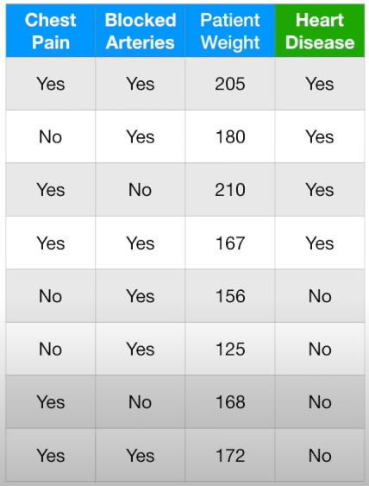
How to build a Adaboost
First, let’s look at the above example dataset

Slide 14
How to build a Adaboost
First, let’s look at the above example dataset
We want to use AdaBoost to predict if a patient has “Heart Disease” depending on:
“Chest pain”
“Blocked Arteries”
“Patient Weight”

Slide 15
How to build a Adaboost
Step 1: giving each sample a weight that indicates how important they are
Sample weight
?
?
?
?
?
?
?
?
First, let’s look at the above example dataset
We want to use AdaBoost to predict if a patient has “Heart Disease” depending on:
“Chest pain”
“Blocked Arteries”
“Patient Weight”

Slide 16

How to build a Adaboost
Step 1: giving each sample a weight that indicates how important they are
Sample weight
1/8
1/8
1/8
1/8
1/8
1/8
1/8
1/8
At the start, all the samples get the same weight: $\frac{1}{total samples}$, in this case, it is 1/8, which means all the samples are equally important
First, let’s look at the above example dataset
We want to use AdaBoost to predict if a patient has “Heart Disease” depending on:
“Chest pain”
“Blocked Arteries”
“Patient Weight”

Slide 17
How to build a Adaboost
Step 1: giving each sample a weight that indicates how important they are
Sample weight
1/8
1/8
1/8
1/8
1/8
1/8
1/8
1/8
Step 2: grow our first “stump”
First, let’s look at the above example dataset
We want to use AdaBoost to predict if a patient has “Heart Disease” depending on:
“Chest pain”
“Blocked Arteries”
“Patient Weight”

Slide 18
How to build a Adaboost
Step 1: giving each sample a weight that indicates how important they are
Sample weight
1/8
1/8
1/8
1/8
1/8
1/8
1/8
1/8
Step 2: grow our first “stump”
This is done by finding the variable (Chest pain, Blocked arteries and patient weight) that does the best job to indicate “heart disease”
First, let’s look at the above example dataset
We want to use AdaBoost to predict if a patient has “Heart Disease” depending on:
“Chest pain”
“Blocked Arteries”
“Patient Weight”

Slide 19
How to build a Adaboost
Step 1: giving each sample a weight that indicates how important they are
Sample weight
1/8
1/8
1/8
1/8
1/8
1/8
1/8
1/8
Step 2: grow our first “stump”
This is done by finding the variable (Chest pain, Blocked arteries and patient weight) that does the best job to indicate “heart disease”
We use Gini-index to do this (like any other decision tree method)
First, let’s look at the above example dataset
We want to use AdaBoost to predict if a patient has “Heart Disease” depending on:
“Chest pain”
“Blocked Arteries”
“Patient Weight”

Slide 20
How to build a Adaboost
Step 1: giving each sample a weight that indicates how important they are
Sample weight
1/8
1/8
1/8
1/8
1/8
1/8
1/8
1/8
Step 2: grow our first “stump”
This is done by finding the variable (Chest pain, Blocked arteries and patient weight) that does the best job to indicate “heart disease”
We use Gini-index to do this (like any other decision tree method)
For the “Chest Pain”, when “Heart Disease==true”, three samples are correctly labelled, while two are not
Chest Pain
YES
First, let’s look at the above example dataset
Correct: 3; Wrong: 2
We want to use AdaBoost to predict if a patient has “Heart Disease” depending on:
“Chest pain”
“Blocked Arteries”
“Patient Weight”

Slide 21
How to build a Adaboost
Step 1: giving each sample a weight that indicates how important they are
Sample weight
1/8
1/8
1/8
1/8
1/8
1/8
1/8
1/8
Step 2: grow our first “stump”
This is done by finding the variable (Chest pain, Blocked arteries and patient weight) that does the best job to indicate “heart disease”
We use Gini-index to do this (like any other decision tree method)
For the “Chest Pain”, when “Heart Disease==true”, three samples are correctly labelled, while two are not
For the “Chest Pain”, when “Heart Disease==false”, 2 samples are correctly labelled, while 1 are not
Chest Pain
First, let’s look at the above example dataset
We want to use AdaBoost to predict if a patient has “Heart Disease” depending on:
“Chest pain”
“Blocked Arteries”
“Patient Weight”
YES
NO
Correct: 3; Wrong: 2
Correct: 2; Wrong: 1

Slide 22
How to build a Adaboost
Step 1: giving each sample a weight that indicates how important they are
Sample weight
1/8
1/8
1/8
1/8
1/8
1/8
1/8
1/8
Step 2: grow our first “stump”
This is done by finding the variable (Chest pain, Blocked arteries and patient weight) that does the best job to indicate “heart disease”
We use Gini-index to do this (like any other decision tree method)
Chest Pain
Then we can calculate the “weighted” Gini-index for “Chest Pain”
YES
NO
Correct: 3; Wrong: 2
Correct: 2; Wrong: 1
First, let’s look at the above example dataset
We want to use AdaBoost to predict if a patient has “Heart Disease” depending on:
“Chest pain”
“Blocked Arteries”
“Patient Weight”

Slide 23
How to build a Adaboost
Step 1: giving each sample a weight that indicates how important they are
Sample weight
1/8
1/8
1/8
1/8
1/8
1/8
1/8
1/8
Step 2: grow our first “stump”
This is done by finding the variable (Chest pain, Blocked arteries and patient weight) that does the best job to indicate “heart disease”
We use Gini-index to do this (like any other decision tree method)
Chest Pain
Then we can calculate the “weighted” Gini-index for “Chest Pain”
YES
NO
Correct: 3; Wrong: 2
Correct: 2; Wrong: 1
Note that here all the sample weight is the same, so when we calculate the Gini they can be cancelled
First, let’s look at the above example dataset
We want to use AdaBoost to predict if a patient has “Heart Disease” depending on:
“Chest pain”
“Blocked Arteries”
“Patient Weight”

Slide 24

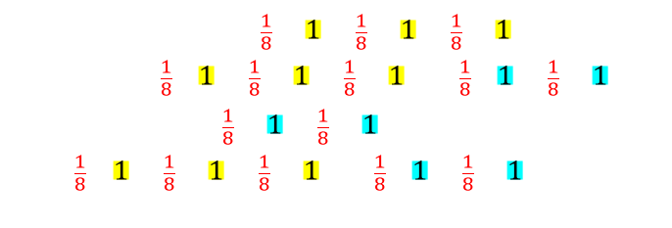
How to build a Adaboost
Step 1: giving each sample a weight that indicates how important they are
Sample weight
1/8
1/8
1/8
1/8
1/8
1/8
1/8
1/8
Step 2: grow our first “stump”
This is done by finding the variable (Chest pain, Blocked arteries and patient weight) that does the best job to indicate “heart disease”
We use Gini-index to do this (like any other decision tree method)
Chest Pain
Then we can calculate the “weighted” Gini-index for “Chest Pain”
YES
NO
Correct: 3; Wrong: 2
Correct: 2; Wrong: 1
Note that here all the sample weight is the same, so when we calculate the Gini they can be cancelled
First, let’s look at the above example dataset
$$G=1−{\left[ \frac{\frac{1}{8}×1+\frac{1}{8}×1+\frac{1}{8}×1}{(\frac{1}{8}×1+\frac{1}{8}×1+\frac{1}{8}×1)+(\frac{1}{8}×1+\frac{1}{8}×1)}\right]}^{2}$$
$$−{\left[ \frac{\frac{1}{8}×1+\frac{1}{8}×1}{(\frac{1}{8}×1+\frac{1}{8}×1+\frac{1}{8}×1)+(\frac{1}{8}×1+\frac{1}{8}×1)}\right]}^{2}=0.47$$
We want to use AdaBoost to predict if a patient has “Heart Disease” depending on:
“Chest pain”
“Blocked Arteries”
“Patient Weight”

Slide 25

How to build a Adaboost
Step 1: giving each sample a weight that indicates how important they are
Sample weight
1/8
1/8
1/8
1/8
1/8
1/8
1/8
1/8
Step 2: grow our first “stump”
This is done by finding the variable (Chest pain, Blocked arteries and patient weight) that does the best job to indicate “heart disease”
We use Gini-index to do this (like any other decision tree method)
Chest Pain
Then we can calculate the “weighted” Gini-index for “Chest Pain”
YES
NO
Correct: 3; Wrong: 2
Correct: 2; Wrong: 1
Note that here all the sample weight is the same, so when we calculate the Gini they can be cancelled
First, let’s look at the above example dataset
$${Gini}_{Chest−pain}=0.47$$
We want to use AdaBoost to predict if a patient has “Heart Disease” depending on:
“Chest pain”
“Blocked Arteries”
“Patient Weight”

Slide 26
How to build a Adaboost
Step 1: giving each sample a weight that indicates how important they are
Sample weight
1/8
1/8
1/8
1/8
1/8
1/8
1/8
1/8
Step 2: grow our first “stump”
This is done by finding the variable (Chest pain, Blocked arteries and patient weight) that does the best job to indicate “heart disease”
We use Gini-index to do this (like any other decision tree method)
Chest Pain
Then we can calculate the “weighted” Gini-index for “Chest Pain”
YES
NO
Correct: 3; Wrong: 2
Correct: 2; Wrong: 1
Note that here all the sample weight is the same, so when we calculate the Gini they can be cancelled
First, let’s look at the above example dataset
$${Gini}_{Chest−pain}=0.47$$
We want to use AdaBoost to predict if a patient has “Heart Disease” depending on:
“Chest pain”
“Blocked Arteries”
“Patient Weight”
Then we can calculate the Gini-index for all the predictors

Slide 27



How to build a Adaboost
Step 1: giving each sample a weight that indicates how important they are
Sample weight
1/8
1/8
1/8
1/8
1/8
1/8
1/8
1/8
Step 2: grow our first “stump”
This is done by finding the variable (Chest pain, Blocked arteries and patient weight) that does the best job to indicate “heart disease”
We use Gini-index to do this (like any other decision tree method)
$${Gini}_{Chest−pain}=0.47$$
$${Gini}_{Blocked Arteries}=0.5$$
$${Gini}_{Patient Weight}=0.2$$
First, let’s look at the above example dataset
We want to use AdaBoost to predict if a patient has “Heart Disease” depending on:
“Chest pain”
“Blocked Arteries”
“Patient Weight”

Slide 28
How to build a Adaboost
Step 1: giving each sample a weight that indicates how important they are
Sample weight
1/8
1/8
1/8
1/8
1/8
1/8
1/8
1/8
Step 2: grow our first “stump”
This is done by finding the variable (Chest pain, Blocked arteries and patient weight) that does the best job to indicate “heart disease”
We use Gini-index to do this (like any other decision tree method)
$${Gini}_{Chest−pain}=0.47$$
$${Gini}_{Blocked Arteries}=0.5$$
The Gini-index for “patient weight” is the lowest, so there is where we start growing “stumps”
$${Gini}_{Patient Weight}=0.2$$
First, let’s look at the above example dataset
We want to use AdaBoost to predict if a patient has “Heart Disease” depending on:
“Chest pain”
“Blocked Arteries”
“Patient Weight”

Slide 29
How to build a Adaboost
Step 1: giving each sample a weight that indicates how important they are
Sample weight
1/8
1/8
1/8
1/8
1/8
1/8
1/8
1/8
Step 2: grow our first “stump”
This is done by finding the variable (Chest pain, Blocked arteries and patient weight) that does the best job to indicate “heart disease”
We use Gini-index to do this (like any other decision tree method)
$${Gini}_{Chest−pain}=0.47$$
$${Gini}_{Blocked Arteries}=0.5$$
The Gini-index for “patient weight” is the lowest, so there is where we start growing “stumps”
$${Gini}_{Patient Weight}=0.2$$
Patient Weight > 176
First, let’s look at the above example dataset
We want to use AdaBoost to predict if a patient has “Heart Disease” depending on:
“Chest pain”
“Blocked Arteries”
“Patient Weight”
YES
NO
Correct: 3; Wrong: 0
Correct: 4; Wrong: 1

Slide 30
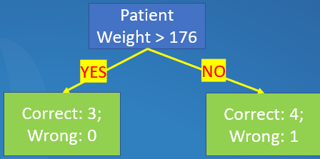
How to build a Adaboost
Step 1: giving each sample a weight that indicates how important they are
Sample weight
1/8
1/8
1/8
1/8
1/8
1/8
1/8
1/8
Step 2: grow our first “stump”
Step 3: We need to determine how much this stump will say in the final results
First, let’s look at the above example dataset
We want to use AdaBoost to predict if a patient has “Heart Disease” depending on:
“Chest pain”
“Blocked Arteries”
“Patient Weight”

Slide 31
How to build a Adaboost
Step 1: giving each sample a weight that indicates how important they are
Sample weight
1/8
1/8
1/8
1/8
1/8
1/8
1/8
1/8
Step 2: grow our first “stump”
Step 3: We need to determine how much this stump will say in the final results
Step 3.1: This is defined by the error of this “stump”
First, let’s look at the above example dataset
We want to use AdaBoost to predict if a patient has “Heart Disease” depending on:
“Chest pain”
“Blocked Arteries”
“Patient Weight”

Slide 32
How to build a Adaboost
Step 1: giving each sample a weight that indicates how important they are
Sample weight
1/8
1/8
1/8
1/8
1/8
1/8
1/8
1/8
Step 2: grow our first “stump”
Step 3: We need to determine how much this stump will say in the final results
Step 3.1: This is defined by the error of this “stump”
This stump makes one error ~ for one sample, it “predicts” that the patient should not have disease but in fact he/she does
First, let’s look at the above example dataset
We want to use AdaBoost to predict if a patient has “Heart Disease” depending on:
“Chest pain”
“Blocked Arteries”
“Patient Weight”

Slide 33
How to build a Adaboost
Step 1: giving each sample a weight that indicates how important they are
Sample weight
1/8
1/8
1/8
1/8
1/8
1/8
1/8
1/8
Step 2: grow our first “stump”
Step 3: We need to determine how much this stump will say in the final results
Step 3.1: This is defined by the error of this “stump”
This stump makes one error ~ for one sample, it “predicts” that the patient should not have disease but in fact he/she does
First, let’s look at the above example dataset
We want to use AdaBoost to predict if a patient has “Heart Disease” depending on:
“Chest pain”
“Blocked Arteries”
“Patient Weight”
the “total error” for this “stump” is: “weights” x “wrong prediction”

Slide 34
How to build a Adaboost
Step 1: giving each sample a weight that indicates how important they are
Sample weight
1/8
1/8
1/8
1/8
1/8
1/8
1/8
1/8
Step 2: grow our first “stump”
Step 3: We need to determine how much this stump will say in the final results
Step 3.1: This is defined by the error of this “stump”
This stump makes one error ~ for one sample, it “predicts” that the patient should not have disease but in fact he/she does
First, let’s look at the above example dataset
We want to use AdaBoost to predict if a patient has “Heart Disease” depending on:
“Chest pain”
“Blocked Arteries”
“Patient Weight”
the “total error” for this “stump” is: “weights” x “wrong prediction”
In this case it is 1/8 x 1 = 1/8

Slide 35
How to build a Adaboost
Step 1: giving each sample a weight that indicates how important they are
Sample weight
1/8
1/8
1/8
1/8
1/8
1/8
1/8
1/8
Step 2: grow our first “stump”
Step 3: We need to determine how much this stump will say in the final results
Step 3.1: This is defined by the error of this “stump”
This stump makes one error ~ for one sample, it “predicts” that the patient should not have disease but in fact he/she does
First, let’s look at the above example dataset
We want to use AdaBoost to predict if a patient has “Heart Disease” depending on:
“Chest pain”
“Blocked Arteries”
“Patient Weight”
the “total error” for this “stump” is: “weights” x “wrong prediction”
In this case it is 1/8 x 1 = 1/8
Because all the weights are added up to 1, so “total error” will always be between 0 (prefect “stump”) and 1

Slide 36

How to build a Adaboost
Step 1: giving each sample a weight that indicates how important they are
Sample weight
1/8
1/8
1/8
1/8
1/8
1/8
1/8
1/8
Step 2: grow our first “stump”
Step 3: We need to determine how much this stump will say in the final results
Step 3.1: Total error for first “stump” = 1/8
Step 3.2: The amount of “say” for first “stump” is
$$Amount of say=\frac{1}{2}log⁡(\frac{1−total error}{total error})$$
First, let’s look at the above example dataset
We want to use AdaBoost to predict if a patient has “Heart Disease” depending on:
“Chest pain”
“Blocked Arteries”
“Patient Weight”

Slide 37
How to build a Adaboost
Step 1: giving each sample a weight that indicates how important they are
Sample weight
1/8
1/8
1/8
1/8
1/8
1/8
1/8
1/8
Step 2: grow our first “stump”
Step 3: We need to determine how much this stump will say in the final results
Step 3.1: Total error for first “stump” = 1/8
Step 3.2: The amount of “say” for first “stump” is
$$Amount of say=\frac{1}{2}log⁡(\frac{1−total error}{total error})$$
In this case it is 0.97
First, let’s look at the above example dataset
We want to use AdaBoost to predict if a patient has “Heart Disease” depending on:
“Chest pain”
“Blocked Arteries”
“Patient Weight”

Slide 38
How to build a Adaboost
Step 1: giving each sample a weight that indicates how important they are
Sample weight
1/8
1/8
1/8
1/8
1/8
1/8
1/8
1/8
Step 2: grow our first “stump”
Step 3: We need to determine how much this stump will say in the final results. In this case the “amount of say” is 0.97
Step 4: Update sample weights
First, let’s look at the above example dataset
We want to use AdaBoost to predict if a patient has “Heart Disease” depending on:
“Chest pain”
“Blocked Arteries”
“Patient Weight”

Slide 39
How to build a Adaboost
Step 1: giving each sample a weight that indicates how important they are
Sample weight
1/8
1/8
1/8
1/8
1/8
1/8
1/8
1/8
Step 2: grow our first “stump”
Step 3: We need to determine how much this stump will say in the final results. In this case the “amount of say” is 0.97
Step 4: Update sample weights
In the first stump, this sample is not correctly labelled, so we need to increase its “importance” (by increasing its sample weight) so the next stump can pay more attention on it
First, let’s look at the above example dataset
We want to use AdaBoost to predict if a patient has “Heart Disease” depending on:
“Chest pain”
“Blocked Arteries”
“Patient Weight”

Slide 40


How to build a Adaboost
Step 1: giving each sample a weight that indicates how important they are
Sample weight
1/8
1/8
1/8
1/8
1/8
1/8
1/8
1/8
Step 2: grow our first “stump”
Step 3: We need to determine how much this stump will say in the final results. In this case the “amount of say” is 0.97
Step 4: Update sample weights
New sample weight to be increased to $W_{new}=W_{old}×e^{amount of say}$
In this case it is
$$W_{new}=\frac{1}{8}×e^{0.97}=0.33$$
First, let’s look at the above example dataset
We want to use AdaBoost to predict if a patient has “Heart Disease” depending on:
“Chest pain”
“Blocked Arteries”
“Patient Weight”

Slide 41
How to build a Adaboost
Step 1: giving each sample a weight that indicates how important they are
Sample weight
1/8
1/8
1/8
0.33
1/8
1/8
1/8
1/8
Step 2: grow our first “stump”
Step 3: We need to determine how much this stump will say in the final results. In this case the “amount of say” is 0.97
Step 4: Update sample weights
New sample weight to be increased to $W_{new}=W_{old}×e^{amount of say}$
In this case it is
$$W_{new}=\frac{1}{8}×e^{0.97}=0.33$$
First, let’s look at the above example dataset
We want to use AdaBoost to predict if a patient has “Heart Disease” depending on:
“Chest pain”
“Blocked Arteries”
“Patient Weight”

Slide 42
How to build a Adaboost
Step 1: giving each sample a weight that indicates how important they are
Sample weight
1/8
1/8
1/8
0.33
1/8
1/8
1/8
1/8
Step 2: grow our first “stump”
Step 3: We need to determine how much this stump will say in the final results. In this case the “amount of say” is 0.97
Step 4: Update sample weights
Now we need to reduce the rest sample weights (the samples are correctly labelled)
First, let’s look at the above example dataset
We want to use AdaBoost to predict if a patient has “Heart Disease” depending on:
“Chest pain”
“Blocked Arteries”
“Patient Weight”

Slide 43

How to build a Adaboost
Step 1: giving each sample a weight that indicates how important they are
Sample weight
1/8
1/8
1/8
0.33
1/8
1/8
1/8
1/8
Step 2: grow our first “stump”
Step 3: We need to determine how much this stump will say in the final results. In this case the “amount of say” is 0.97
Step 4: Update sample weights
Now we need to reduce the rest sample weights (the samples are correctly labelled)
The formula to decrease the sample weight is:
$$W_{new}=W_{old}×e^{−amount of say}$$
First, let’s look at the above example dataset
We want to use AdaBoost to predict if a patient has “Heart Disease” depending on:
“Chest pain”
“Blocked Arteries”
“Patient Weight”

Slide 44
How to build a Adaboost
Step 1: giving each sample a weight that indicates how important they are
Sample weight
1/8
1/8
1/8
0.33
1/8
1/8
1/8
1/8
Step 2: grow our first “stump”
Step 3: We need to determine how much this stump will say in the final results. In this case the “amount of say” is 0.97
Step 4: Update sample weights
Now we need to reduce the rest sample weights (the samples are correctly labelled)
The formula to decrease the sample weight is:
$$W_{new}=W_{old}×e^{−amount of say}$$
First, let’s look at the above example dataset
We want to use AdaBoost to predict if a patient has “Heart Disease” depending on:
“Chest pain”
“Blocked Arteries”
“Patient Weight”
In this case the new weights are 0.05

Slide 45
How to build a Adaboost
Step 1: giving each sample a weight that indicates how important they are
Sample weight
0.05
0.05
0.05
0.33
0.05
0.05
0.05
0.05
Step 2: grow our first “stump”
Step 3: We need to determine how much this stump will say in the final results. In this case the “amount of say” is 0.97
Step 4: Update sample weights
The increased sample weight is 0.33
The decreased sample weight is 0.05
First, let’s look at the above example dataset
We want to use AdaBoost to predict if a patient has “Heart Disease” depending on:
“Chest pain”
“Blocked Arteries”
“Patient Weight”

Slide 46
How to build a Adaboost
Step 1: giving each sample a weight that indicates how important they are
Sample weight
0.05
0.05
0.05
0.33
0.05
0.05
0.05
0.05
Step 2: grow our first “stump”
Step 3: We need to determine how much this stump will say in the final results. In this case the “amount of say” is 0.97
Step 4: Update sample weights
The increased sample weight is 0.33
The decreased sample weight is 0.05
The we normalize the sample weights so they can be added up to 1.0
First, let’s look at the above example dataset
We want to use AdaBoost to predict if a patient has “Heart Disease” depending on:
“Chest pain”
“Blocked Arteries”
“Patient Weight”

Slide 47
How to build a Adaboost
Step 1: giving each sample a weight that indicates how important they are
Sample weight
0.07
0.07
0.07
0.49
0.07
0.07
0.07
0.07
Step 2: grow our first “stump”
Step 3: We need to determine how much this stump will say in the final results. In this case the “amount of say” is 0.97
Step 4: Update sample weights
The normalized increased sample weight is 0.49
The normalized decreased sample weight is 0.07
First, let’s look at the above example dataset
We want to use AdaBoost to predict if a patient has “Heart Disease” depending on:
“Chest pain”
“Blocked Arteries”
“Patient Weight”

Slide 48
How to build a Adaboost
Step 1: giving each sample a weight that indicates how important they are
Sample weight
0.07
0.07
0.07
0.49
0.07
0.07
0.07
0.07
Step 2: grow our first “stump”
Step 3: We need to determine how much this stump will say in the final results. In this case the “amount of say” is 0.97
Step 4: Update sample weights
The normalized increased sample weight is 0.49
The normalized decreased sample weight is 0.07
Step 5: Then we can grow the second tree but using the updated sample weight
First, let’s look at the above example dataset
We want to use AdaBoost to predict if a patient has “Heart Disease” depending on:
“Chest pain”
“Blocked Arteries”
“Patient Weight”

Slide 49
How to build a Adaboost
Step 1: giving each sample a weight that indicates how important they are
Sample weight
0.07
0.07
0.07
0.49
0.07
0.07
0.07
0.07
Step 2: grow our first “stump”
Step 3: We need to determine how much this stump will say in the final results. In this case the “amount of say” is 0.97
Step 4: Update sample weights
The normalized increased sample weight is 0.49
The normalized decreased sample weight is 0.07
Step 5: Then we can grow the second tree but using the updated sample weight
First, let’s look at the above example dataset
We want to use AdaBoost to predict if a patient has “Heart Disease” depending on:
“Chest pain”
“Blocked Arteries”
“Patient Weight”
……

Slide 50
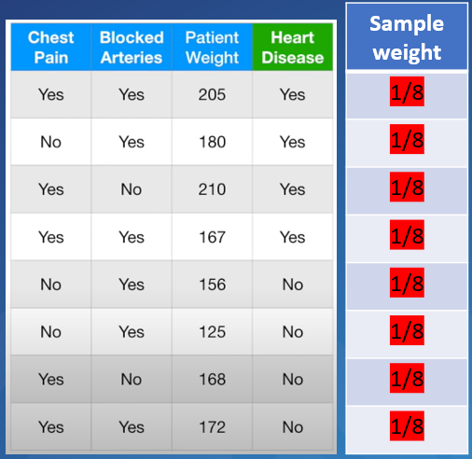
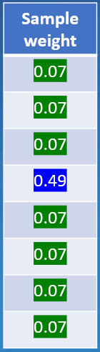
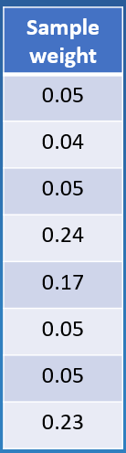
How to use a Adaboost
So from last step, we’ve created many “stumps”, each has the “amount of say”
……
Initial dataset
(and assumed weights)
First stump
2nd stump
Amount of say: 0.97
Amount of say: 0.52

Slide 51
How to use a Adaboost
So from last step, we’ve created many “stumps”, each has the “amount of say”
……
Initial dataset
(and assumed weights)
First stump
2nd stump
Amount of say: 0.97
Amount of say: 0.52
When the test data coming in, we use the test data to go through all the created “stumps”

Slide 52
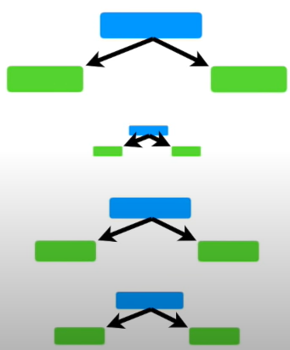
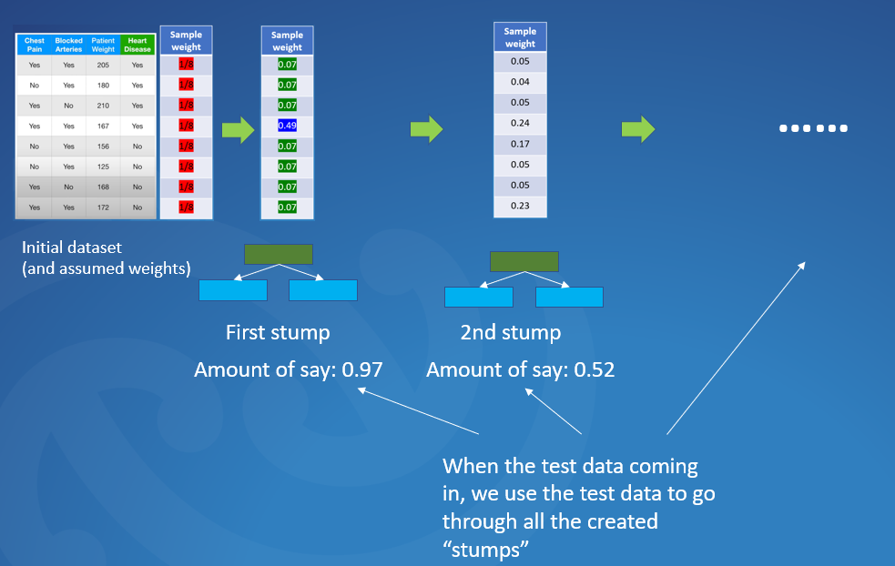
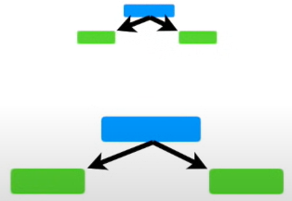
How to use a Adaboost
So from last step, we’ve created many “stumps”, each has the “amount of say”
Some “stumps” will give “heart disease==False”
Some “stumps” will give “heart disease==True”

Slide 53
How to use a Adaboost
So from last step, we’ve created many “stumps”, each has the “amount of say”
These are “amount of say” for each “stumps”
These are “amount of say” for each “stumps”
0.93
0.27
0.23
0.55
0.61
0.5
Some “stumps” will give “heart disease==False”
Some “stumps” will give “heart disease==True”

Slide 54
How to use a Adaboost
So from last step, we’ve created many “stumps”, each has the “amount of say”
These are “amount of say” for each “stumps”
These are “amount of say” for each “stumps”
0.93
0.27
0.23
0.55
0.61
0.5
Some “stumps” will give “heart disease==False”
Some “stumps” will give “heart disease==True”
Total of “amount of say”
2.13
0.88

Slide 55
How to use a Adaboost
So from last step, we’ve created many “stumps”, each has the “amount of say”
These are “amount of say” for each “stumps”
These are “amount of say” for each “stumps”
0.93
0.27
0.23
0.55
0.61
0.5
Some “stumps” will give “heart disease==False”
Some “stumps” will give “heart disease==True”
Patients has heart disease has higher “amount of say”
Total of “amount of say”
2.13
0.88

Slide 56
How to use a Adaboost
So from last step, we’ve created many “stumps”, each has the “amount of say”
These are “amount of say” for each “stumps”
These are “amount of say” for each “stumps”
0.93
0.27
0.23
0.55
0.61
0.5
Some “stumps” will give “heart disease==False”
Some “stumps” will give “heart disease==True”
Patients has heart disease has higher “amount of say”
So the classification result is “heart disease==True”
Total of “amount of say”
2.13
0.88

