Slide 1
Generative Adversarial Network
Adapted from https://speech.ee.ntu.edu.tw/~tlkagk/courses_MLDS18.html

Slide 2
Introduction

Slide 3
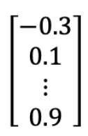
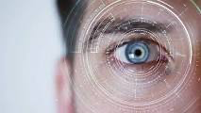
Introduction
Purpose of GAN
Giving a vector (a list of values), GAN can produce a very realistic image or a series of words
GAN
Good morning, I’m GAN.

Slide 4
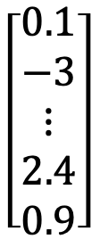
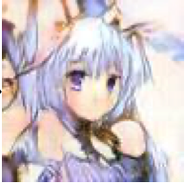
Introduction
Purpose of GAN
Each element of the vector represents some features of the outputs
GAN

Slide 5
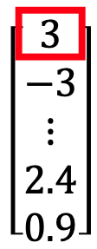
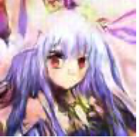
Introduction
Purpose of GAN
Each element of the vector represents some features of the outputs
GAN
Short Hair
For example, if we change the first element of the vector from 0.1 to 3, it gives us long hair in the output picture
GAN
Long Hair

Slide 6
Introduction
Basic structure of GAN
A GAN model contains two components:
Generator
Discriminator
Generator
Giving a vector (a list of values), GAN can produce a very realistic image or a series of words
Discriminator
Good morning, I’m GAN.
GAN

Slide 7
Introduction
Basic structure of GAN
A GAN model contains two components:
Generator
Discriminator
Responsible for creating images
Generator
Giving a vector (a list of values), GAN can produce a very realistic image or a series of words
Discriminator
Good morning, I’m GAN.
GAN

Slide 8
Introduction
Basic structure of GAN
A GAN model contains two components:
Generator
Discriminator
Responsible for creating images
Generator
Giving a vector (a list of values), GAN can produce a very realistic image or a series of words
Discriminator
Good morning, I’m GAN.
Responsible for evaluating the generated images
GAN

Slide 9
Basic GAN

Slide 10

Basic GAN
Basic structure of GAN
Step 1a, the Generator (v1) has random parameters, so it will create a very bad image (many noises)
VE
C
T
O
R
Generator
(v1)

Slide 11
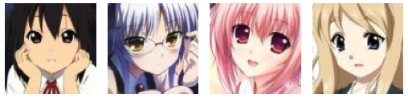
Basic GAN
Step 1a, the Generator (v1) has random parameters, so it will create a very bad image (many noises)
VE
C
T
O
R
Generator
(v1)
Discriminator
(v1)
Step 1b, the Discriminator (v1) will evaluate the similarity between the real images and the Generator produced image, and tell the differences
Real images from training dataset

Slide 12
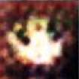
Basic GAN
Basic structure of GAN
Step 1a, the Generator (v1) has random parameters, so it will create a very bad image (many noises)
Step 2a, the Generator (v2) is set up based on v1, but incorporate the differences told by the Discriminator (v1)
VE
C
T
O
R
Generator
(v1)
Generator
(v2)
E.g., the Discriminator (v1) may notice that the real image has color while the image from the Generator (v1) does not.
Discriminator
(v1)
Step 1b, the Discriminator (v1) will evaluate the similarity between the real images and the Generator produced image, and tell the differences
Real images from training dataset

Slide 13
Basic GAN
Basic structure of GAN
Step 1a, the Generator (v1) has random parameters, so it will create a very bad image (many noises)
Step 2a, the Generator (v2) is set up based on v1, but incorporate the differences told by the Discriminator (v1)
VE
C
T
O
R
Generator
(v1)
Generator
(v2)
E.g., the Discriminator (v1) may notice that the real image has color while the image from the Generator (v1) does not.
Discriminator
(v1)
Discriminator
(v2)
Step 2b, the Discriminator (v2) will evaluate the similarity between the real images and the Generator (v2) produced image, and tell the differences
Step 1b, the Discriminator (v1) will evaluate the similarity between the real images and the Generator produced image, and tell the differences
Real images from training dataset

Slide 14
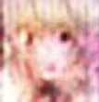
Basic GAN
Basic structure of GAN
Step 1a, the Generator (v1) has random parameters, so it will create a very bad image (many noises)
Step 2a, the Generator (v2) is set up based on v1, but incorporate the differences told by the Discriminator (v1)
Step 3a, the Generator (v3) is set up based on v2, but incorporate the differences told by the Discriminator (v2)
VE
C
T
O
R
Generator
(v1)
Generator
(v2)
Generator
(v3)
E.g., the Discriminator (v1) may notice that the real image has color while the image from the Generator (v1) does not.
E.g., the Discriminator (v2) may notice that the real image has a mouth while the image from the Generator (v2) does not.
Discriminator
(v1)
Discriminator
(v2)
Step 2b, the Discriminator (v2) will evaluate the similarity between the real images and the Generator (v2) produced image, and tell the differences
Step 1b, the Discriminator (v1) will evaluate the similarity between the real images and the Generator produced image, and tell the differences
Real images from training dataset

Slide 15
Basic GAN
Basic structure of GAN
Step 1a, the Generator (v1) has random parameters, so it will create a very bad image (many noises)
Step 2a, the Generator (v2) is set up based on v1, but incorporate the differences told by the Discriminator (v1)
Step 3a, the Generator (v3) is set up based on v2, but incorporate the differences told by the Discriminator (v2)
VE
C
T
O
R
Generator
(v1)
Generator
(v2)
Generator
(v3)
E.g., the Discriminator (v1) may notice that the real image has color while the image from the Generator (v1) does not.
E.g., the Discriminator (v2) may notice that the real image has a mouth while the image from the Generator (v2) does not.
Generator and Discriminator evolves step-by-step iteratively, until we get a satisfied image
……
Discriminator
(v1)
Discriminator
(v2)
Step 2b, the Discriminator (v2) will evaluate the similarity between the real images and the Generator (v2) produced image, and tell the differences
Step 1b, the Discriminator (v1) will evaluate the similarity between the real images and the Generator produced image, and tell the differences
Real images from training dataset

Slide 16
Basic GAN
Basic structure of GAN
Step 1a, the Generator (v1) has random parameters, so it will create a very bad image (many noises)
Step 2a, the Generator (v2) is set up based on v1, but incorporate the differences told by the Discriminator (v1)
Step 3a, the Generator (v3) is set up based on v2, but incorporate the differences told by the Discriminator (v2)
VE
C
T
O
R
Generator
(v1)
Generator
(v2)
Generator
(v3)
E.g., the Discriminator (v1) may notice that the real image has color while the image from the Generator (v1) does not.
E.g., the Discriminator (v2) may notice that the real image has a mouth while the image from the Generator (v2) does not.
Generator and Discriminator evolves step-by-step iteratively, until we get a satisfied image
……
Discriminator
(v1)
Discriminator
(v2)
Step 2b, the Discriminator (v2) will evaluate the similarity between the real images and the Generator (v2) produced image, and tell the differences
Step 1b, the Discriminator (v1) will evaluate the similarity between the real images and the Generator produced image, and tell the differences
Real images from training dataset

Slide 17
Basic GAN
How each iterate works in GAN
Step 1: Fix the Generator, and train the discriminator (update its parameters)
Generator
VE
C
T
O
R
VE
C
T
O
R
VE
C
T
O
R
Generator
Giving the generator a bunch of random vectors, so it will produce a bunch of bad images
Some images are sampled from real images
From the training dataset, there are many real images
?
Discriminator
So the Discriminator parameters need to be updated to make:
Images from generator are labelled as 0.0
Real images are labelled as 1.0
We can consider this as a regression problem to solve.
Labeled as 0.0
Discriminator
Labeled as 1.0

Slide 18
Basic GAN
How each iterate works in GAN
Step 2: Fix the Discriminator, and train the Generator (update its parameters)
Generator
VE
C
T
O
R
Generator
Discriminator
?
?
Then this image will be evaluated by the discriminator (we just updated it in Step 1)
Discriminator will give the image a score, the higher the score, the more closer to the real image
Giving the generator a vector, through the generator it will produce an image
Discriminator
So we will tune the parameters of the generator to make the score as high as possible

Slide 19
An Example

Slide 20
We have many real images like the below:
……
The matrix to contain the image is only 2x2:
We also have many images (2x2) only contains noises, e.g.,
……
So the noisey 2x2 image is not “backlash + diagonal” …
So the image is represented as something like below
……
So the 2x2 image is sort of “backlash + diagonal” …

Slide 21
Some values are assigned to the 2x2 images
0.8 | 0.2
0.0 | 0.9
0.8 | 0.1
0.0 | 0.6
0.5 | 0.0
0.1 | 0.9
Real
……
0.1 | 0.2
0.0 | 0.9
0.8 | 0.8
0.0 | 0.6
0.2 | 1.0
0.1 | 0.8
Fake
……

Slide 22
Step 1: Building discriminator
Bigger value
The value distribution can be anything
0.8 | 0.1
0.0 | 0.6
0.8 | 0.8
0.0 | 0.6
For this particular example, the real image has bigger values along the diagonal axis, while for the fake image, anything could happen …
Real
Bigger value
Fake
In order to distinguish “real” and “fake”, we can learn the criteria in the model, e.g., we hope to have sth like below:
So for this example, we have
Real
0.8 + 0.6 - 0.1 - 0.0 = 1.3
x1 | x2
x3 | x4
x1 + x4 - x2 - x3
Fake
0.8 + 0.6 - 0.8 - 0.0 = 0.6
The higher value from the index, the higher possibility that the image is real. We can set a threshold to say if an image is real or not !

Slide 23
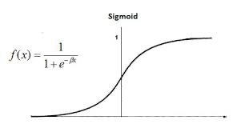
Step 1: Building discriminator
Assuming that we have a one neuron, single layer neural network
Then the output of neuron will go through an activation function (e.g., Sigmoid function)
In discriminator there is a threshold (e.g., 0.5, in this case), 0.76 is larger than 0.5, so the discriminator will say it is a real image
0.8
0.1
0.0
0.6
bias
w1
wb
0.8 | 0.1
0.0 | 0.6
w2
F [(w1*x1 + w4*x4 + w2*x2 + w3*x3) + wb*bias]
w3
Real
w4
(w1*x1 + w4*x4 + w2*x2 + w3*x3) + wb*bias
1.2
0.76
Vectorize the image
w1=1, w2=-1, w3=-1, w4=1
wb=-1, bias=1.0
E.g., how to distinguish real & fake is learnt as “weights” in the neural network:
(1*0.8 + 1*0.6+ (-1)*0.1 + (-1)*0.0) + (-1)*1.0 = 1.2
x1 | x2
x3 | x4
x1 + x4 - x2 - x3

Slide 24
Step 1: Building discriminator
Similarly, if a fake image goes through the neural network
Then the output of neuron will go through an activation function (e.g., Sigmoid function)
In discriminator there is a threshold (e.g., 0.5, in this case), 0.41 is less than 0.5, so the discriminator will say it is a fake image
0.8
0.8
0.0
0.6
bias
w1
wb
0.8 | 0.8
0.0 | 0.6
w2
F [(w1*x1 + w4*x4 + w2*x2 + w3*x3) + wb*bias]
w3
Fake
w4
(w1*x1 + w4*x4 + w2*x2 + w3*x3) + wb*bias =
(1*0.8 + 1*0.6+ (-1)*0.8 + (-1)*0.0) + (-1)*1.0 = -0.4
-0.4
0.41
Vectorize the image

Slide 25
Step 2: Building generator
Assuming that we have a 4 neurons (since the output will have 4 pixels), single layer neural network
w1
F(w1*0.7)
F(w1*0.7) | F(w2*0.7)
F(w3*0.7) | F(w4*0.7)
N1
This image will be evaluated by discriminator, and the weights (e.g., w1 etc.) will be trained via backpropagation
w2
F(w2*0.7)
0.7
N2
w3
F(w3*0.7)
w4
N3
From a random value (e.g., a noise)
F(w4*0.7)
N4
After the activation function, we have the outputs as:
N1: F(0.7*1.0) = 0.67
N2: F(0.7*-1.0) = -0.33
N3: F(0.7*-1.0) = -0.33
N4: F(0.7*1.0) = 0.67
The neuro output then will be:
N1: 0.7*1.0 = 0.7
N2: 0.7*-1.0 = -0.7
N3: 0.7*-1.0 = -0.7
N4: 0.7*1.0 = 0.7
Let’s assuming:
w1=1, w2=-1, w3=-1, w4=1

Slide 26
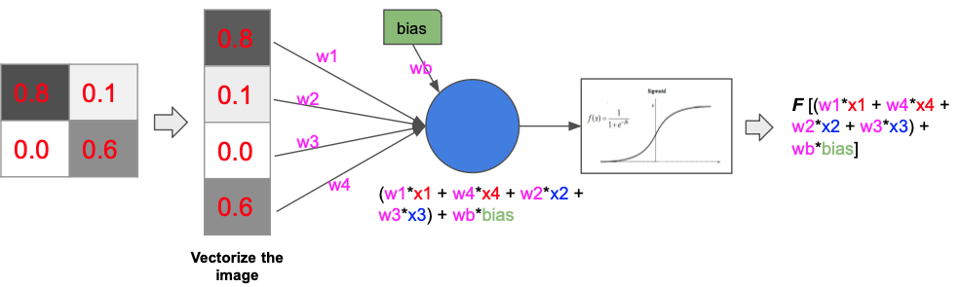
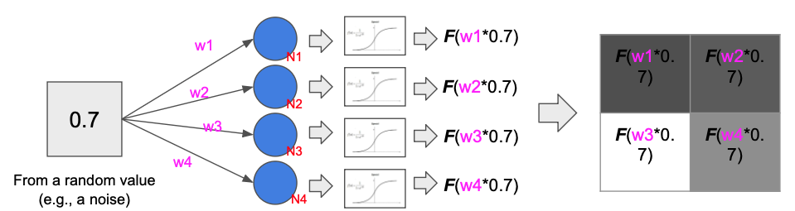
An overview for this simple model
Step 1: train Discriminator, and hope to make “score” between real image and the generated one as big as possible (so for the generated image, the score should be as small as possible)
Discrimator
Real image
Generator
Step 2: train Generator, and hope to make the “score” for the generated image as big as possible
GAN generated image

Slide 27
Conditional GAN

Slide 28
Conditional GAN
Training dataset
VE
C
T
O
R
GAN
Traditional GAN
The user input a random vector, the model will produce an image similar to the ones in training dataset
Training dataset
CONDITION
VE
C
T
O
R
GAN
Conditional GAN
The user input a random vector and a conditional vector, the model will produce an image similar to the ones (with the required conditions) in training dataset

Slide 29
Conditional GAN
Responsible for creating images
Generator
Traditional GAN
Discriminator
Responsible for evaluating the generated images
Random
vector

Slide 30
Conditional GAN
Responsible for creating images
Generator
Traditional GAN
Discriminator
Responsible for evaluating the generated images
Random
vector
Responsible for creating images
Generator
Conditional GAN
Discriminator
Responsible for evaluating the generated images, and see if it meets conditions
Conditions
Random
vector

Slide 31
Conditional GAN
Responsible for creating images
Generator
Discriminator
Random
vector
Conditions
Responsible for evaluating the generated images, and see if it meets conditions
Conditional GAN

Slide 32
Conditional GAN
Responsible for creating images
If the generated image is close to a real image, and matches to the condition, we assign it a high value
+
Y
= 1.0
Generator
If the generated image is far away from a real image, even it matches to the condition, we assign it a low value
+
Y
= 0.0
Discriminator
If the generated image is close to a real image, but it does not match to the condition, we assign it a low value
Random
vector
+
N
= 0.0
Conditions
Responsible for evaluating the generated images, and see if it meets conditions
Conditional GAN
Training dataset has (labels + images)

Slide 33
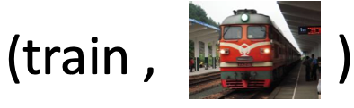
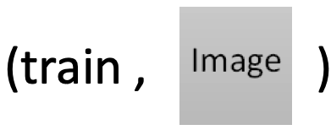
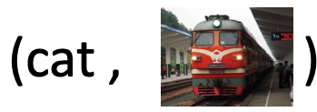
Conditional GAN
Responsible for creating images
If the generated image is close to a real image, and matches to the condition, we assign it a high value
+
Y
= 1.0
Generator
If the generated image is far away from a real image, even it matches to the condition, we assign it a low value
+
Y
= 0.0
Discriminator
If the generated image is close to a real image, but it does not match to the condition, we assign it a low value
Random
vector
+
N
= 0.0
Conditions
Responsible for evaluating the generated images, and see if it meets conditions
Conditional GAN
Right label + real image = high score
Right label + bad image = low score
Wrong label + real image = low score
Training dataset has (labels + images)
For example, if the condition is a label “train”

Slide 34
Unsupervised GAN

Slide 35
Unsupervised GAN
Generator
+
Conditional GAN
Discriminator
Random
vector
Conditions
Training dataset has (labels + images)
For conditional GAN, training dataset must be labelled
Generator
Unsupervised GAN
+
Discriminator
Input
Training dataset
For Unsupervised GAN, training dataset does not have labels. When you give the input, the GAN model will output something similar to the ones in the Training dataset automatically

Slide 36
Unsupervised GAN
Generator
+
Conditional GAN
Discriminator
Random
vector
Conditions
Training dataset has (labels + images)
For conditional GAN, training dataset must be labelled
So in the unsupervised GAN, there are two bunch of data: data1 and data2. The machine will learn how to convert data1 to data2 automatically.
Generator
Unsupervised GAN
+
Discriminator
Input
Training dataset
For Unsupervised GAN, training dataset does not have labels. When you give the input, the GAN model will output something similar to the ones in the Training dataset automatically

Slide 37
Unsupervised GAN
Generator
+
Conditional GAN
Discriminator
Random
vector
Conditions
Training dataset has (labels + images)
For conditional GAN, training dataset must be labelled
So in the unsupervised GAN, there are two bunch of data: data in domain 1 and domain 2. The machine will learn how to convert data1 to data2 automatically.
Generator
Unsupervised GAN
+
Discriminator
Input
Training dataset
For Unsupervised GAN, training dataset does not have labels. When you give the input, the GAN model will output something similar to the ones in the Training dataset automatically

Slide 38
Unsupervised GAN
In unsupervised GAN’s training dataset, we have many data in Domain 1, and many data in Domain 2
Domain 1
Domain 2
Generator
Through the training process, we hope to find parameters for the GAN model that we can convert data from Domain 1 to Domain 2 (essentially we want to find the relationship between Domain 1 and Domain 2)
?
Discriminator

Slide 39
Unsupervised GAN
Method 1
Step 1a, the Generator (v1) has random parameters, so it will create a very bad image (many noises)
Generator
(v1)
Domain 1
Discriminator
(v1)
Step 1b, the Discriminator (v1) will evaluate the similarity between the data from domain 2 and the Generator produced image, and tell the differences

Slide 40
Unsupervised GAN
Method 1
Step 1a, the Generator (v1) has random parameters, so it will create a very bad image (many noises)
Step 2a, the Generator (v2) is set up based on v1, but incorporate the differences told by the Discriminator (v1)
Generator
(v1)
Generator
(v2)
Domain 1
E.g., the Discriminator (v1) may notice that the data (domain 2) has color while the image from the Generator (v1) does not.
Discriminator
(v1)
Discriminator
(v2)
Step 2b, the Discriminator (v2) will evaluate the similarity between the data from domain 2 and the Generator (v2) produced image, and tell the differences
Step 1b, the Discriminator (v1) will evaluate the similarity between the data from domain 2 and the Generator produced image, and tell the differences

Slide 41
Unsupervised GAN
Method 1
Step 1a, the Generator (v1) has random parameters, so it will create a very bad image (many noises)
Step 2a, the Generator (v2) is set up based on v1, but incorporate the differences told by the Discriminator (v1)
Generator
(v1)
Generator
(v2)
Generator and Discriminator evolves step-by-step iteratively, until generator can convert the data from Domain 1 to sth like the one in Domain 2
Domain 1
E.g., the Discriminator (v1) may notice that the data (domain 2) has color while the image from the Generator (v1) does not.
……
Discriminator
(v1)
Discriminator
(v2)
Step 2b, the Discriminator (v2) will evaluate the similarity between the data from domain 2 and the Generator (v2) produced image, and tell the differences
Step 1b, the Discriminator (v1) will evaluate the similarity between the data from domain 2 and the Generator produced image, and tell the differences

Slide 42
Unsupervised GAN
Method 1
The problem for this method is that:
If there are many interactive steps, the output produced by the GAN model could have little connection to the original input data (e.g., if Domain 1 and Domain 2 has big difference, over interaction, the features of Domain1 could loss gradually)
Step 1a, the Generator (v1) has random parameters, so it will create a very bad image (many noises)
Step 2a, the Generator (v2) is set up based on v1, but incorporate the differences told by the Discriminator (v1)
Generator
(v1)
Generator
(v2)
Generator and Discriminator evolves step-by-step iteratively, until generator can convert the data from Domain 1 to sth like the one in Domain 2
Domain 1
E.g., the Discriminator (v1) may notice that the data (domain 2) has color while the image from the Generator (v1) does not.
……
Discriminator
(v1)
Discriminator
(v2)
Step 2b, the Discriminator (v2) will evaluate the similarity between the data from domain 2 and the Generator (v2) produced image, and tell the differences
Step 1b, the Discriminator (v1) will evaluate the similarity between the data from domain 2 and the Generator produced image, and tell the differences

Slide 43
Unsupervised GAN
Method 2: cycle GAN
The purpose is to convert data from Domain 1 to Domain 2, but we have two generators:
First, it is a regular generator to convert Domain 1 to Domain 2
Generator 1
Domain 1
Domain 2
Generator 1
(convert Domain 1 data to Domain 2)

Slide 44
Unsupervised GAN
Method 2: cycle GAN
The purpose is to convert data from Domain 1 to Domain 2, but we have two generators:
Then we use the generated data, and convert it back to Domain 1 using another generator
First, it is a regular generator to convert Domain 1 to Domain 2
Generator 1
Generator 2
Domain 1
Domain 2
Domain 1
Generator 1
(convert Domain 1 data to Domain 2)
Generator 2
(convert Domain 2 data to Domain 1)

Slide 45
Unsupervised GAN
Method 2: cycle GAN
The purpose is to convert data from Domain 1 to Domain 2, but we have two generators:
We need to train both generators to make sure the input of Generator 1 and output of Generator 2 are as close as possible
Generator 1
Generator 2
Domain 1
Domain 2
Domain 1
Generator 1
(convert Domain 1 data to Domain 2)
Generator 2
(convert Domain 2 data to Domain 1)

Slide 46
Unsupervised GAN
Method 2: cycle GAN
The purpose is to convert data from Domain 1 to Domain 2, but we have two generators:
We need to train both generators to make sure the input of Generator 1 and output of Generator 2 are as close as possible
Generator 1
Generator 2
Domain 1
Domain 2
Domain 1
Generator 1
(convert Domain 1 data to Domain 2)
Generator 2
(convert Domain 2 data to Domain 1)
Discriminator
In the Cycle GAN, the Discriminator (v1) will evaluate the similarity between
the real data from domain 2 and
the Generator produced image,
and tell the differences

Slide 47
Unsupervised GAN
Method 2: cycle GAN
The purpose is to convert data from Domain 1 to Domain 2, but we have two generators:
We need to train both generators to make sure the input of Generator 1 and output of Generator 2 are as close as possible
Generator 1
Generator 2
Domain 1
Domain 2
Domain 1
Generator 1
(convert Domain 1 data to Domain 2)
Generator 2
(convert Domain 2 data to Domain 1)
Compared to method 1, the method 2 can better keep the feature from the Domain 1 (e.g., the “Domain 2” produced from “Generator 1” must contain enough information of the input “Domain 1”, otherwise it cannot be reverted back using “Generator 2”)
Discriminator
In the Cycle GAN, the Discriminator (v1) will evaluate the similarity between
the real data from domain 2 and
the Generator produced image,
and tell the differences

