Slide 1
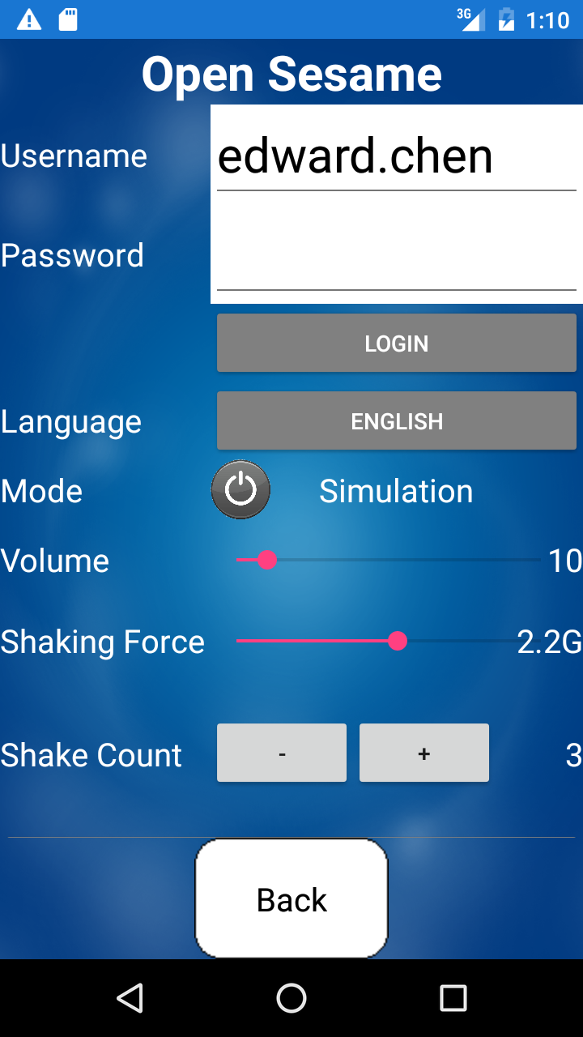
Back
Open Sesame
Username
Password
Forgot Password?
LOGIN
EN
繁
简
Notes:
Version 3 – Changed color of Username & Password to light teal
“Open Sesame” Font = Script MT Bold
All Other English Text Font= Roboto
Dark Blue (Background) = 37, 64, 97
Teal (Username, Password, Login Button) = 75, 172, 198
Light Blue (Active Button) = 97, 214, 255
Gray (Inactive Button) = 127, 127, 127

Slide 2
Back
Settings
Language
English
ON
Simulation
OFF
Shake
ON
Number of Shakes
3
Shaking Force
2.2G
Notes:
Version 3 – Deleted some gray areas; Extended & thinned gray line
“English”, “OFF”, and “ON” Font = Roboto Medium
All Other Font = Roboto
Dark Blue (Top Bar Background) = 37, 64, 97
Super Light Gray (Gray Background Area) = 242, 242, 242
Very Light Gray (Thin Lines) = 217, 217, 217
Light Gray (Thin Adjust Bar) = 191, 191, 191
Gray (Off Button Background) = 166, 166, 166
Teal (English Button Background, Thin Adjust Bar) = 75, 172, 198
Light Green (On Button) = 146, 208, 80

Slide 3
Back
Settings
ON
Volume
10
Log Out
Reset Default Settings
Notes:
Version 3 - Deleted some gray area; Extended & thinned gray line
All Fonts = Roboto
Dark Blue (Top Bar Background) = 37, 64, 97
Super Light Gray (Gray Background Area) = 242, 242, 242
Very Light Gray (Thin Lines) = 217, 217, 217
Light Gray (Thin Adjust Bar) = 191, 191, 191
Teal (Thin Adjust Bar) = 75, 172, 198
Red (Log Out Text) = 146, 0, 0

Slide 4

Back
About
Open Sesame
Version: 3.0.0
Copyright © 2016
Chinese Bible Church of Maryland
All rights reserved
www.cbcm.org
This product is a Mobile App designed for the church members of the Chinese Bible Church of Maryland.
Developer: CBCM Computer Ministry
ON
Notes:
Version 3 – Deleted some gray area; Changed font for “Open Sesame”
“Open Sesame” Font = Script MT Bold
All Other Font = Roboto
Dark Blue (Top Bar Background) = 37, 64, 97
Super Light Gray (Gray Background Area) = 242, 242, 242

Slide 5

Open Sesame
Notes:
Version 3 = Moved Door Slightly Left
“Open Sesame” Font = Script MT Bold
Dark Teal (Background) = 33, 89, 104
Medium Light Blue (Door) = 142, 180, 227
Dark Blue (Door Knob) = 37, 64, 97

Slide 6


Back
Open Sesame
i
Grant Access
Unlock 3 min
Notes:
Version 3 – Top “Grant Access” Go Up & Thinner Border Lines
“Open Sesame” Font = Script MT Bold
All Other Font = Roboto Medium
Medium Light Blue (Door) = 142, 180, 227
Dark Blue (Background, Door Knob) = 37, 64, 97

Slide 7


Back
Open Sesame
i
Grant Access
Unlock 3 min
Lock
Unlock
Notes:
Version 3 – New Administrator Page
“Open Sesame” Font = Script MT Bold
All Other Font = Roboto Medium
Medium Light Blue (Door) = 142, 180, 227
Dark Blue (Background, Door Knob) = 37, 64, 97

