Slide 1
bulletinvestigatR
an extensible and interactive tool for bulletxtrctr users
Wangqian (Will) Ju
Nov. 19

Slide 2
Outline
Background
x3ptools & bulletxtrctr
purpose of the App
App Demo
Discussion

Slide 3
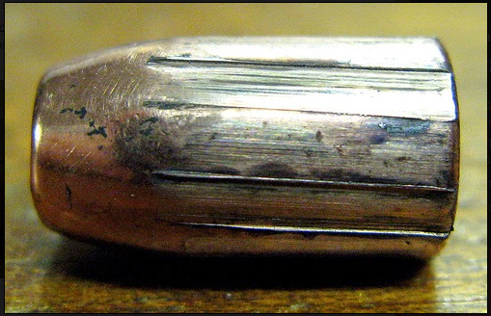
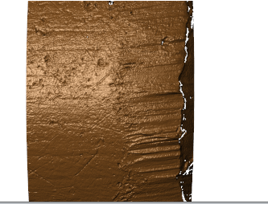
Background - x3ptools & bulletxtrctr
Main question: how can we compare two bullets?
the same gun barrel -> similar marks on bullets
so we can compare those marks
striations in Land Engraved Area (LEA)
essentially some ups and downs :)

Slide 4
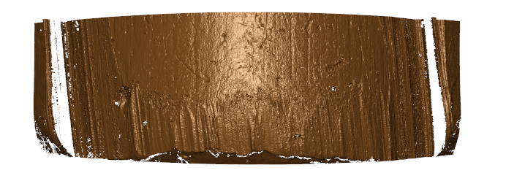
Background - x3ptools & bulletxtrctr
How to obtain those marks?
3D scans saved in x3p files
https://sctyner.github.io/OpenForSciR/bullets.html
pre-process these x3p files (the scan data)
convert from meters to microns?
rotate?
flip?
down-sample?
...
depends on your data
But eventually =============>

Slide 5
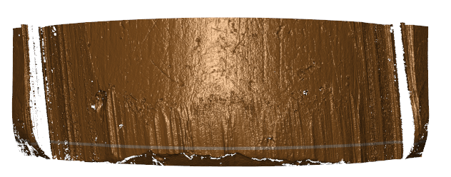
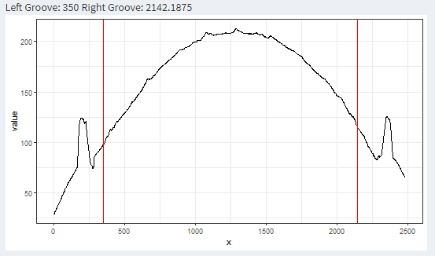
Background - x3ptools & bulletxtrctr
crosscut
groove
How to obtain those marks?
find a position for a crosscut
bulletxtrctr::x3p_crosscut_optimize
compute ccdata (crosscut data)
bulletxtrctr::x3p_crosscut
identify and chop grooves
bulletxtrctr::cc_locate_grooves
chop

Slide 6
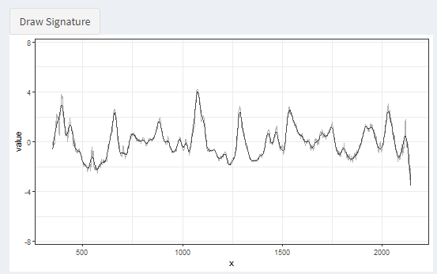
Background - x3ptools & bulletxtrctr
How to obtain those marks?
bulletxtrctr::cc_get_signature(ccdata, grooves, ...)

Slide 7
Background - Purpose of the App
In many times, this workflow works well and generates desired results
But a few times,
the identified groove locations could be better
the obtained crosscut value was ...
or there is something wrong with the bullet itself...

Slide 8
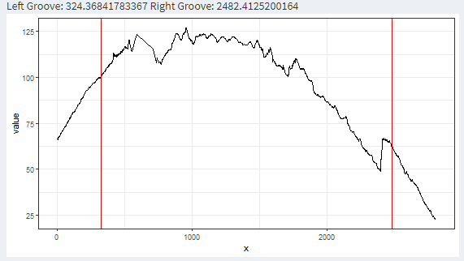
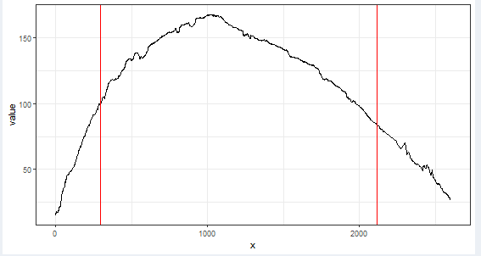
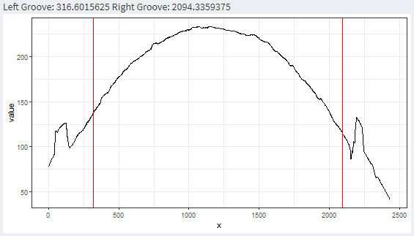
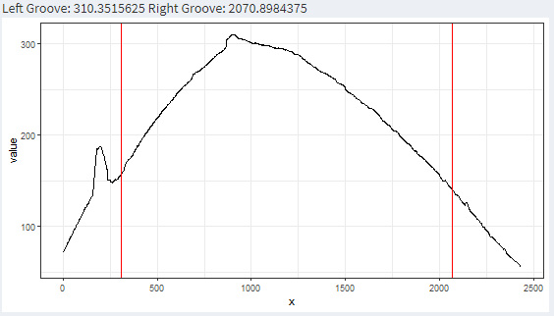
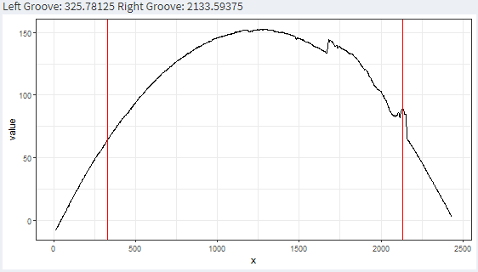
Background - Purpose of the App

Slide 9
Background - Purpose of the App
We want to know: what is going on
(and what if I want to use your methods but not familiar with R :))))?)

Slide 10
App Demo

Slide 11
App Demo
main purpose
reproducibility
extensibility
collaboration

Slide 12
Discussion
UI design
some drop-down icons that provides detailed instruction
...
Clone and try
https://github.com/willju-wangqian/bulletInvestigatoR
wju at iastate.edu

Slide 13
Shiny Development
Shiny Gallery: https://shiny.rstudio.com/gallery/
Shiny Articles: https://shiny.rstudio.com/articles/
Dr. Lyu (Annie)'s post: https://annielyu.com/2020/02/04/viscover-shiny/
Dean Attali: https://deanattali.com/blog/advanced-shiny-tips/
...

Slide 14
Thank you!
Good luck on your work/finals!

