Slide 1
bulletinvestigatR
an extensible and interactive tool for bulletxtrctr users
Wangqian (Will) Ju
Nov. 19

Slide 2
Download and Try
https://github.com/willju-wangqian/bulletinvestigatR
forppt.R
install required libraries
ui.R, server.R, global.R

Slide 3
Outline
Background
x3ptools & bulletxtrctr
purpose of the App
App Demo
Discussion

Slide 4
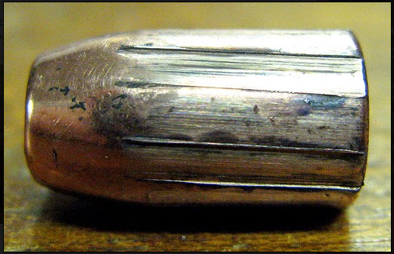
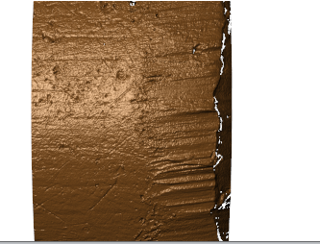
Background - x3ptools & bulletxtrctr
Main question: how can we compare two bullets?
the same gun barrel -> similar marks on bullets
so we can compare those marks
striations in Land Engraved Area (LEA)
essentially some ups and downs :)

Slide 5
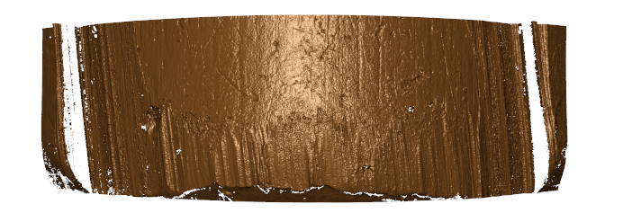
Background - x3ptools & bulletxtrctr
How to obtain those marks?
3D scans saved in x3p files
https://sctyner.github.io/OpenForSciR/bullets.html
pre-process these x3p files (the scan data)
convert from meters to microns?
rotate?
flip?
down-sample?
...
depends on your data
But eventually =============>

Slide 6
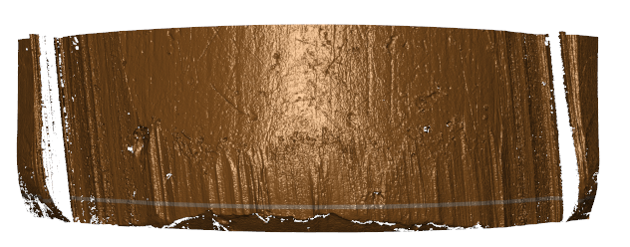
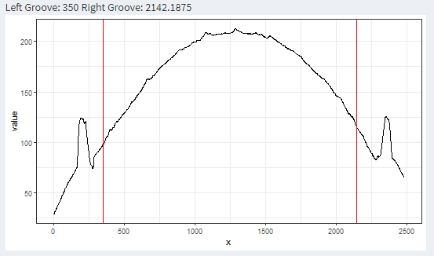
Background - x3ptools & bulletxtrctr
crosscut
groove
How to obtain those marks?
find a position for a crosscut
bulletxtrctr::x3p_crosscut_optimize
compute ccdata (crosscut data)
bulletxtrctr::x3p_crosscut
identify and chop grooves
bulletxtrctr::cc_locate_grooves
chop

Slide 7
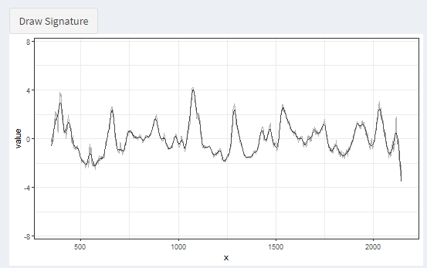
Background - x3ptools & bulletxtrctr
How to obtain those marks?
bulletxtrctr::cc_get_signature(ccdata, grooves, ...)

Slide 8
Background - Purpose of the App
In many times, this workflow works well and generates desired results
But a few times,
the identified groove locations could be better
the obtained crosscut value was ...
or there is something wrong with the bullet itself...

Slide 9
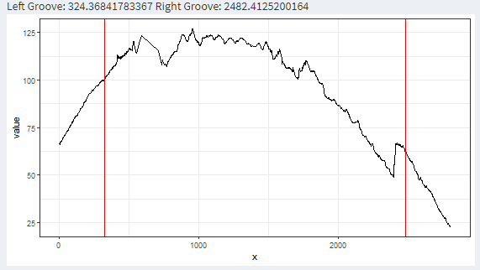
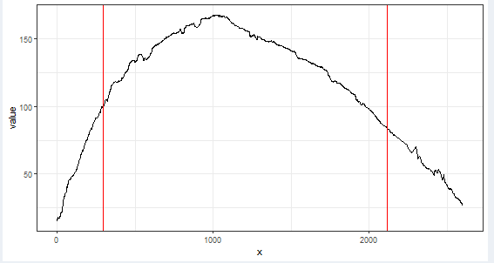
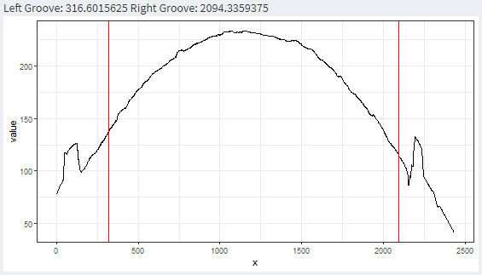
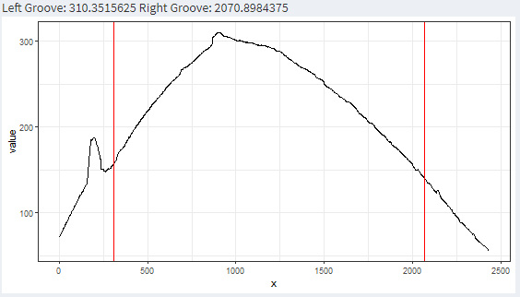
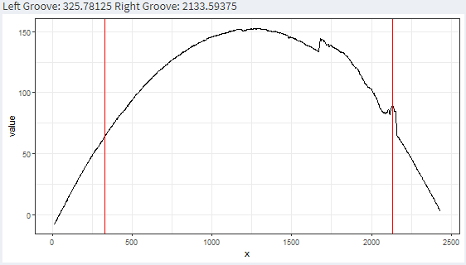
Background - Purpose of the App

Slide 10
Background - Purpose of the App
We want to know: what is going on
(and what if I want to use your methods but not familiar with R :))))?)

Slide 11
App Demo

Slide 12
App Demo
Can we
start with x3p files?
call x3ptool & bulletxtrctr functions in the app?
see the codes? save the codes?
save my work and distribute it to others?
customize or add more functionalities to the app?

Slide 13
App Demo
main purpose
reproducibility
extensibility
collaboration

Slide 14
Discussion
UI design
some drop-down icons that provides detailed instruction
...
Clone and try
https://github.com/willju-wangqian/bulletInvestigatoR
wju at iastate.edu

Slide 15
Shiny Development
Shiny Gallery: https://shiny.rstudio.com/gallery/
Shiny Articles: https://shiny.rstudio.com/articles/
Dr. Lyu (Annie)'s post: https://annielyu.com/2020/02/04/viscover-shiny/
Dean Attali: https://deanattali.com/blog/advanced-shiny-tips/
...

Slide 16
Thank you!
Good luck on your work/finals!

