Slide 1
Terminal Password Manager
CSCE A101 Final Project
John Zetterman

Slide 2
Introduction
My project is a terminal-based password manager.
The code is written in Python. It is a TUI (Terminal User Interface) using the Textual framework. It uses SQLite3 to store relational data. It uses bcrypt and Fernet for hashing and encryption operations.
The application allows a user to create, update, delete, and retrieve login credentials.

Slide 3
Major Components

Slide 4
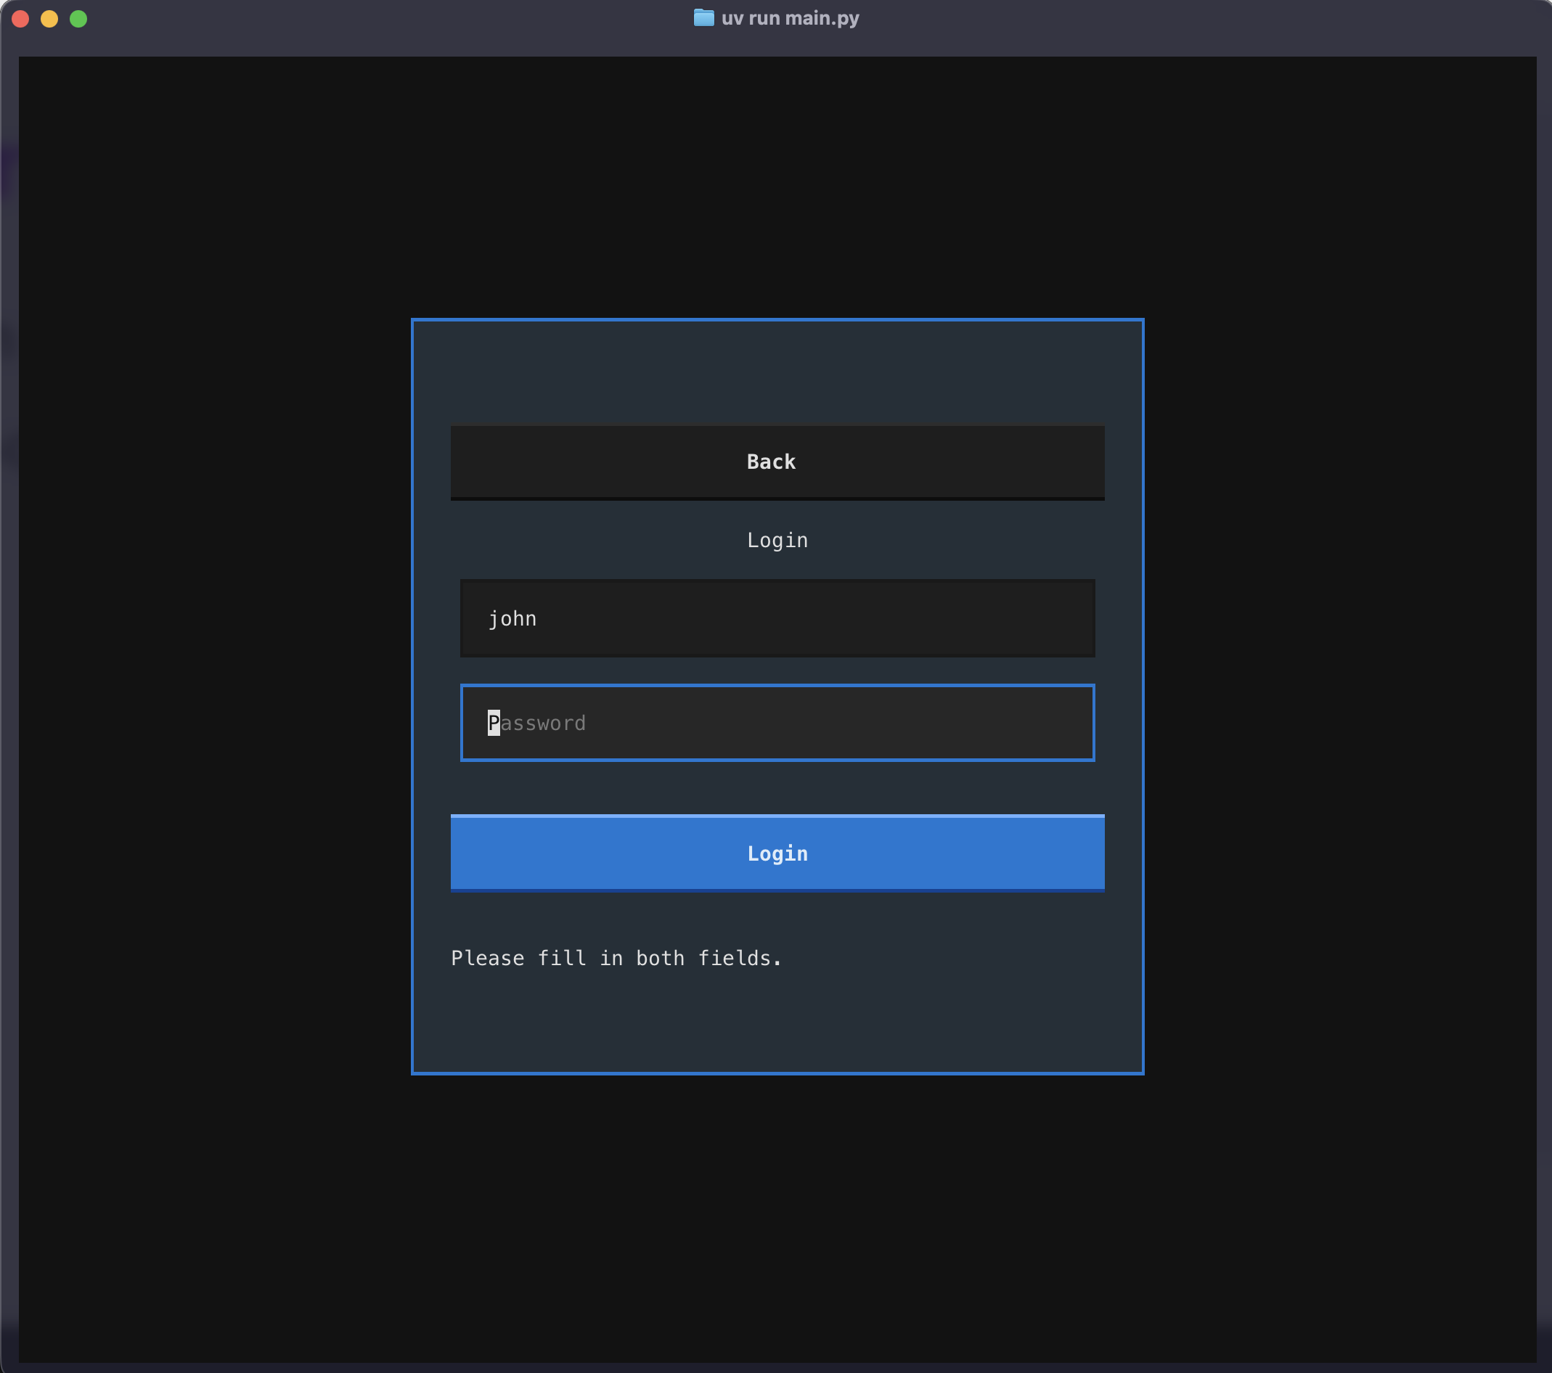
Login Screens
The login screen serves dual purposes.
If the user entered doesn’t already
exist it will create the user for you and
log the user in.
If the user does exist, it will prompt for
the password and log the user in.
It provides context messages to let the
user know if the passwords don’t match
or are incorrect.
Login Screen

Slide 5
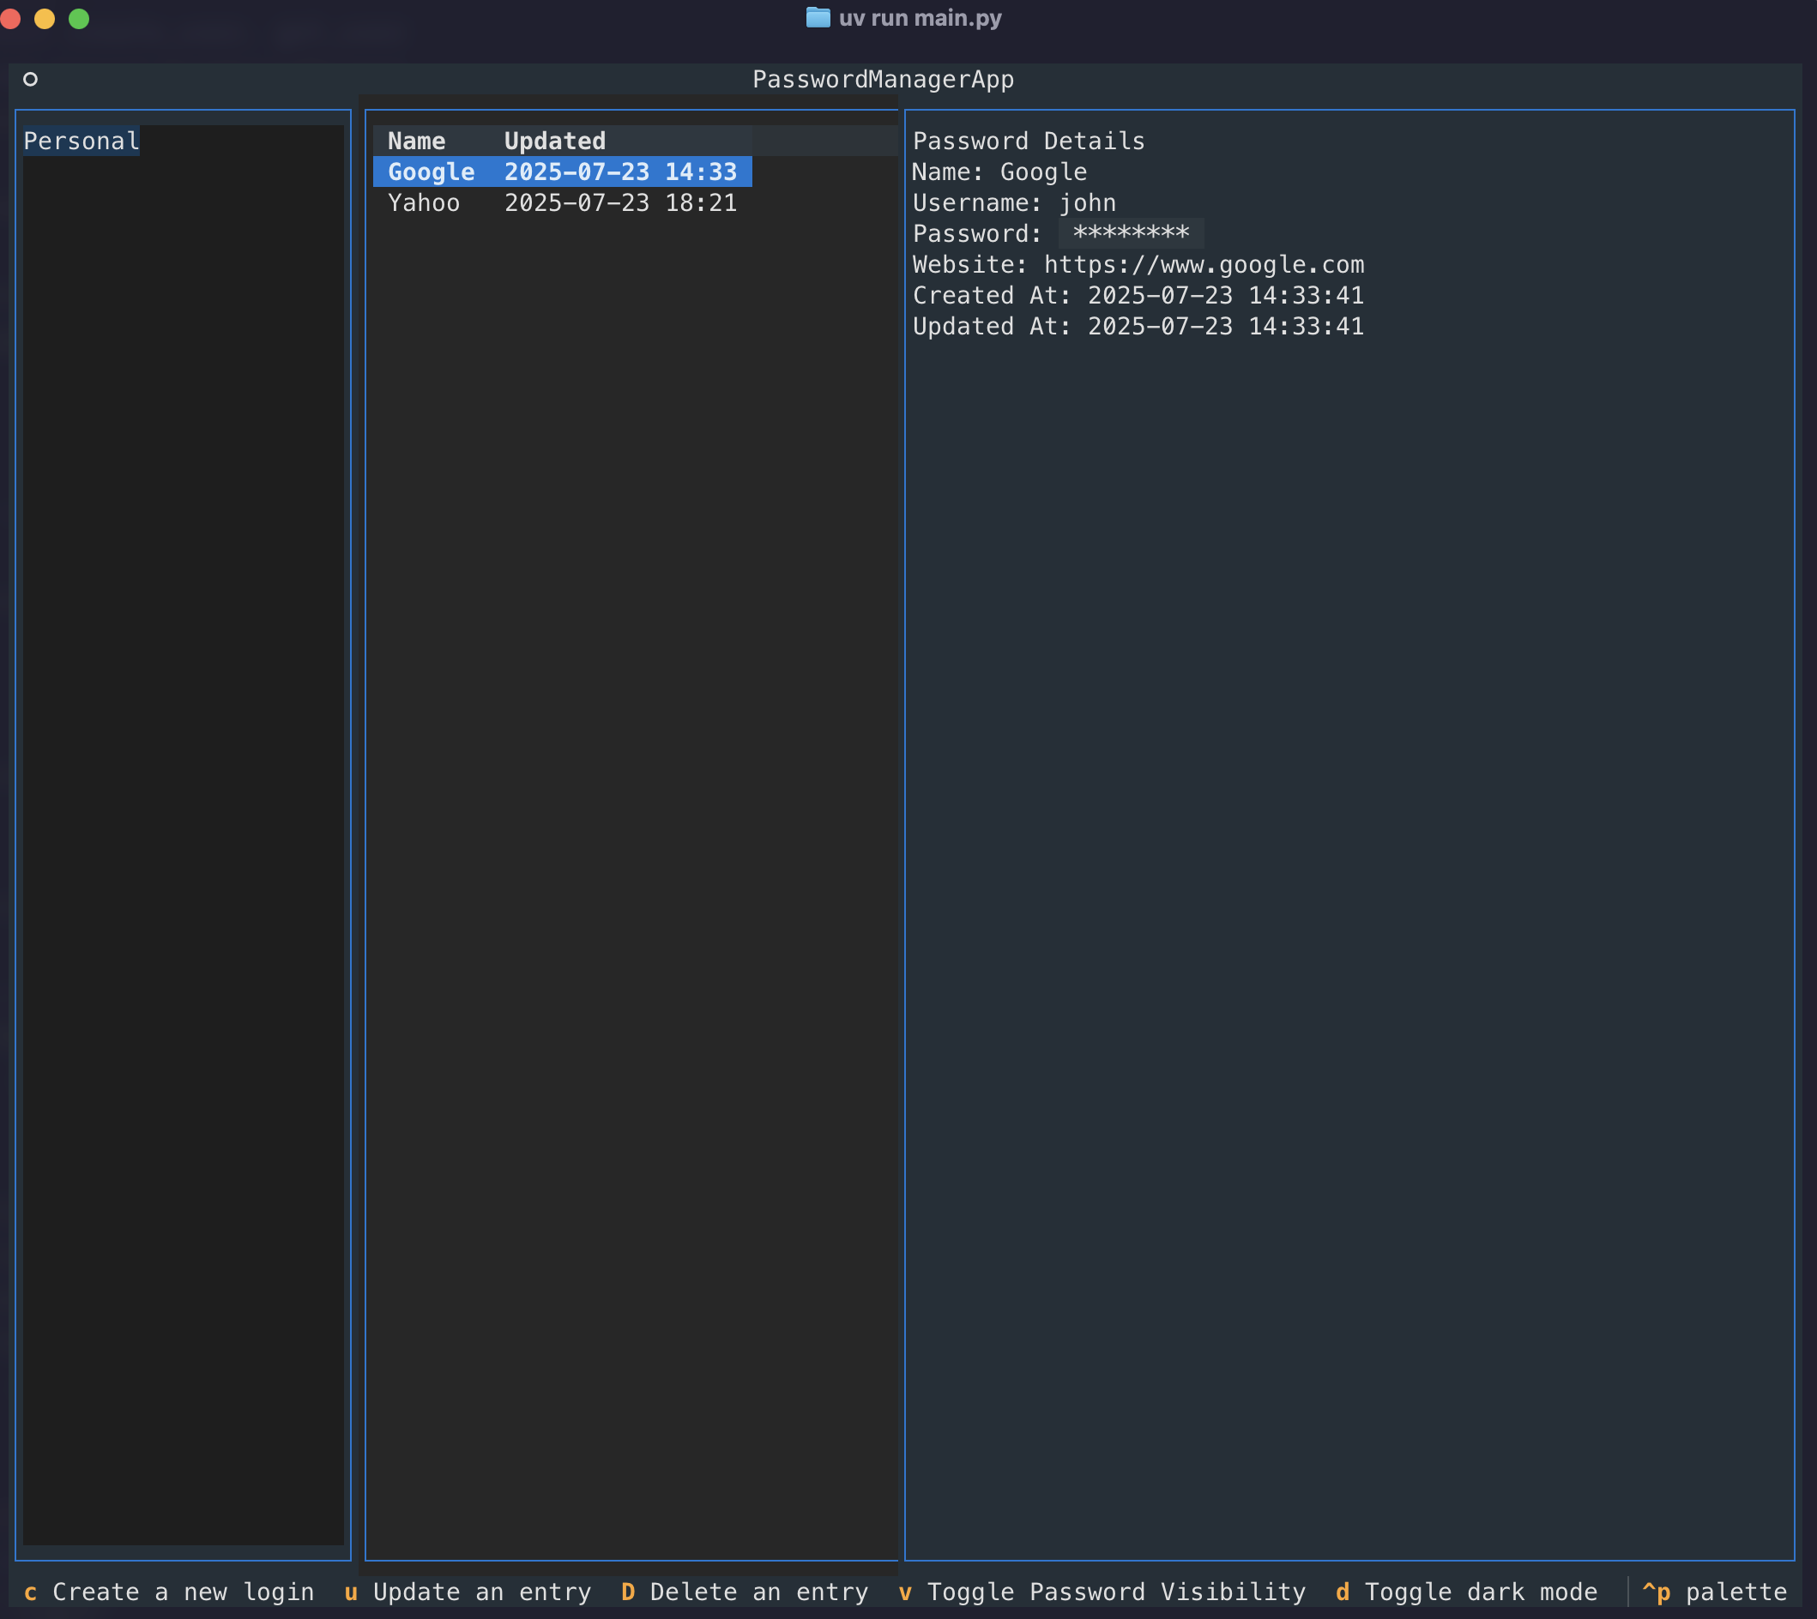
Dashboard Screen
The dashboard screen is structured in
three columns, the vault list, the login
list, and the login details.
The interface allows the user to create
a new vault or login. It allows the user
to update or delete a credential. It also
allows the user to toggle the visibility of
the password and copy it to the system
clipboard.
Caption

Slide 6
Modals

Slide 7
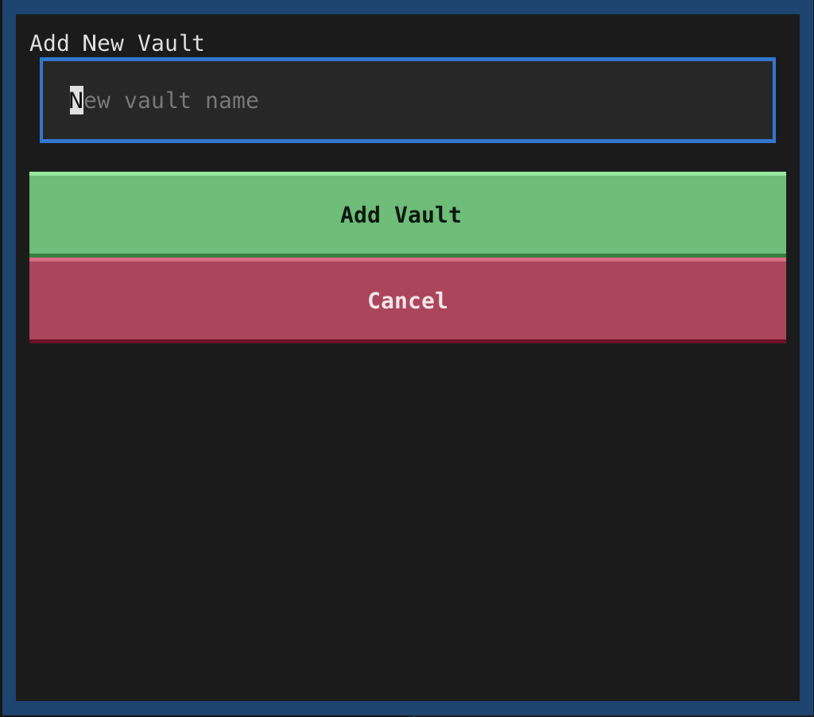
New Vault Modal
The new vault modal is a popup within
the application that allows the user to
create a new password vault.
Add New Vault Dialog

Slide 8
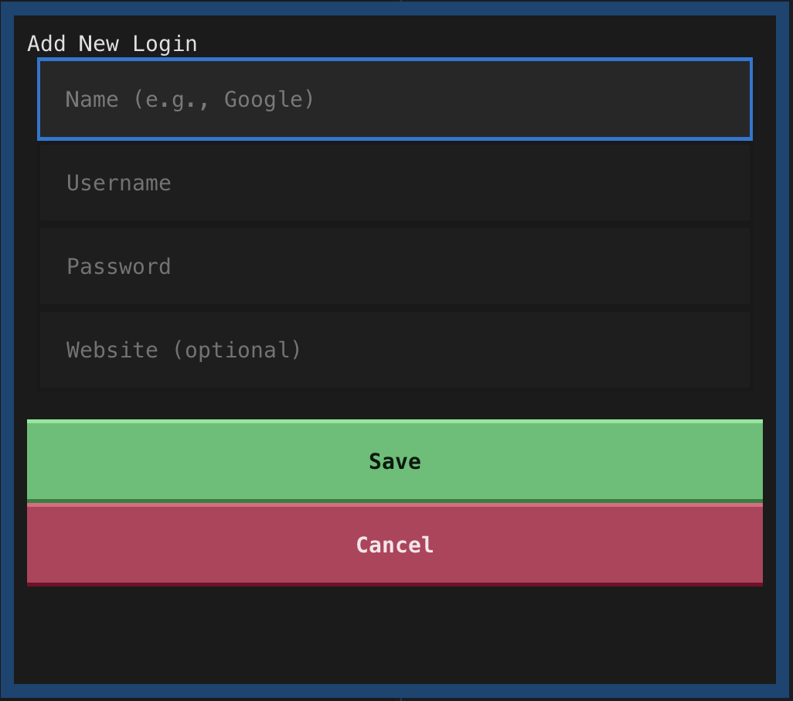
New Login Modal
The new login modal is a popup within
the application that allows the user to
create a new login credential.
Add New Login Dialog

Slide 9
Keyboard Actions

Slide 10
Login Actions
Actions can be taken by using a number of
built-in keyboard shortcuts. Available actions
are Create, Update, Delete login entries. Toggle
Password Visibility and Toggle Dark mode are
global shortcuts.
Login Actions

Slide 11
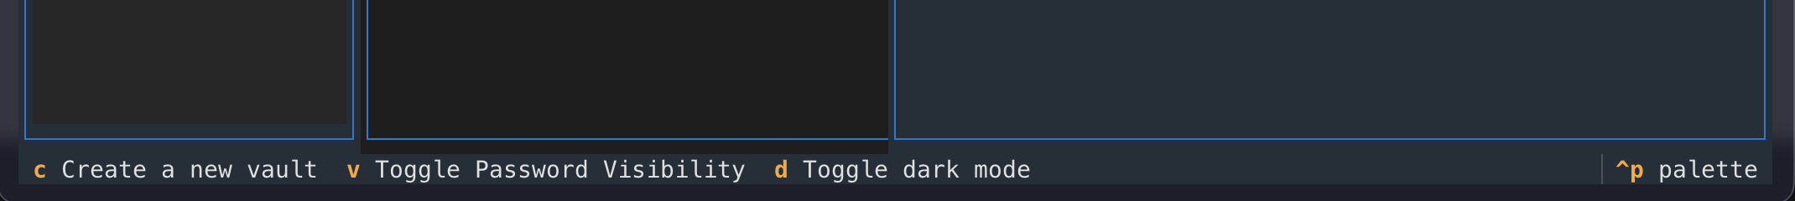
Vault Actions
Actions can be taken by using a number
of built-in keyboard shortcuts. Available
vault actions are create a vault.
Vault Actions

