Slide 1
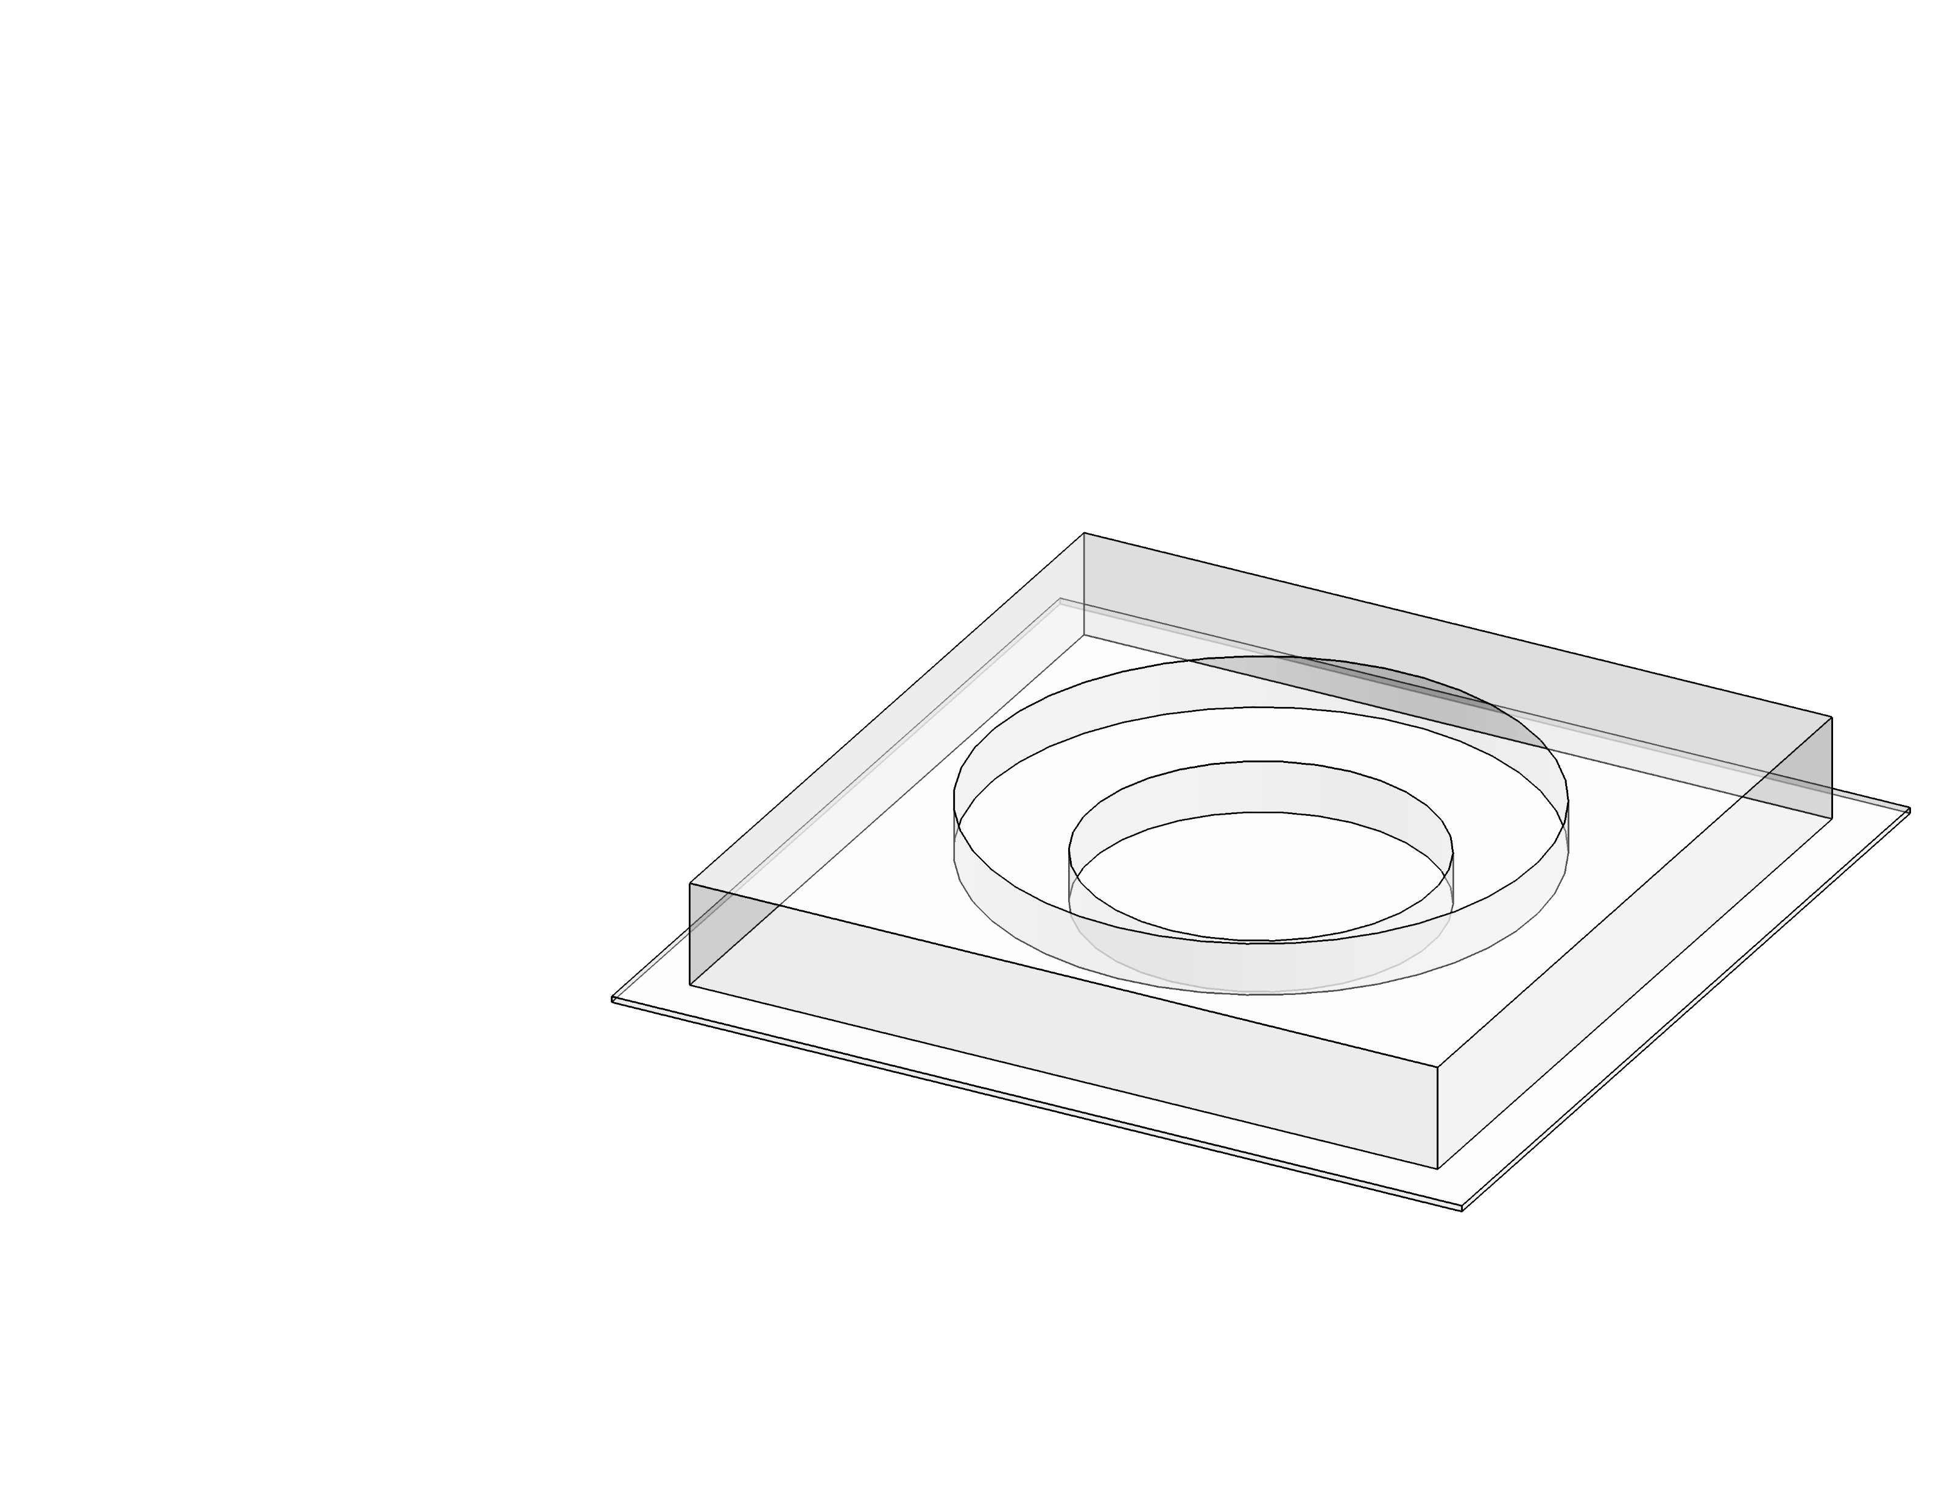
Ejection
Collection
SRS imaging
Target detection
Galvo mirror pin-point
AOM ‘ON’
For phenotypic / genomic analysis
For cell recultivation

