Slide 1
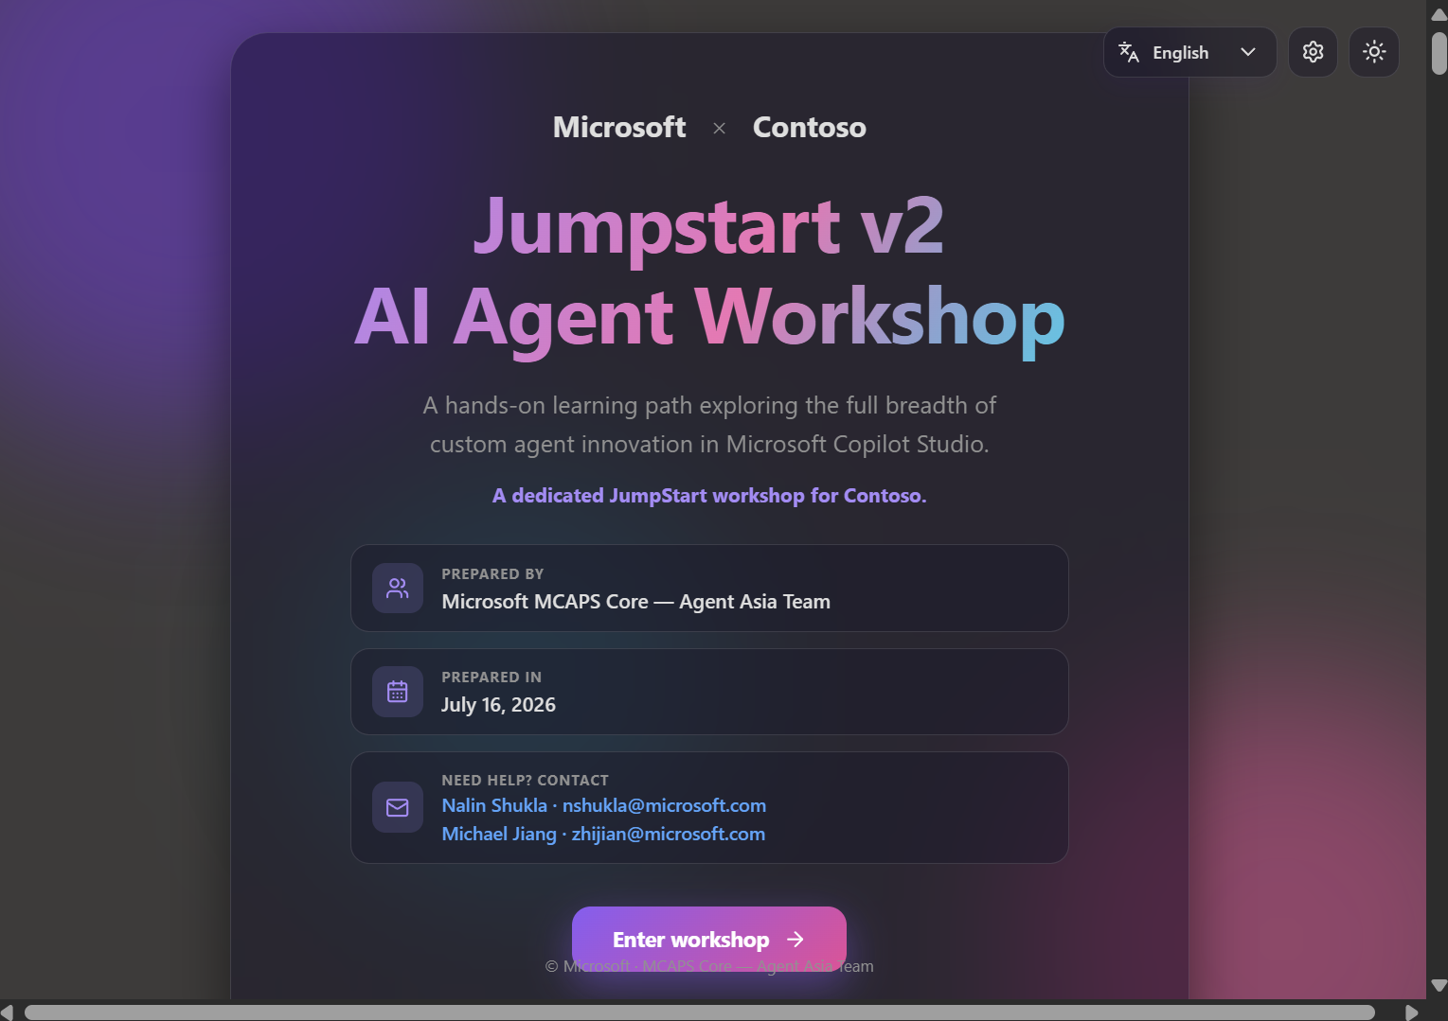
● Microsoft Copilot Studio
AI Agent Workshop
by Microsoft Agent GBB
A hands-on, self-guided, multilingual lab experience for building the full breadth of custom agents in Microsoft Copilot Studio.
Microsoft MCAPS Core — Agent Asia Team · July 16, 2026
6 guided labs
29 steps
8 languages
1 shareable link
LIVE WORKSHOP
aka.ms/ai-agent-jumpstart-v2

Slide 2
🎬 The one-liner
A workshop that runs itself — learners just press play ▶️
JumpStart v2 turns a slide-and-demo session into a living, do-it-yourself lab app. Attendees open one link, pick their language, and build real agents step by step — while you facilitate instead of babysit.
🧪
👣
6
29
hands-on labs
guided steps
Self-paced, browser-based, zero install
🌍
🔁
Every step is copy-ready and screenshot-guided
8
∞
Works for internal enablement and customer workshops
languages
reuse, any customer

Slide 3
🧭 The learning path
Six labs, from first agent to real-time voice 🎙️
01
🤖
02
🗂️
03
📝
Meet the Agent Maker
Bring in business context
Evidence-based RFP
Build a grounded, multilingual agent with Microsoft.com + Microsoft Learn MCP.
Dataverse MCP, reusable Skills, Memory, and a CoWork customer-360 workflow.
Work IQ + Microsoft IQ generate sourced RFP/RFI responses across Office.
04
🔌
05
📨
06
🎙️
Connect specialist agents
Multi-agent email Workflow
Real-time voice agent
ServiceNow knowledge + tickets, connected agents, Teams & M365 Copilot.
Classify inbound email, route to the right agent, personalized reply.
Classic agent + real-time voice, multilingual, tested live in the Test window.

Slide 4
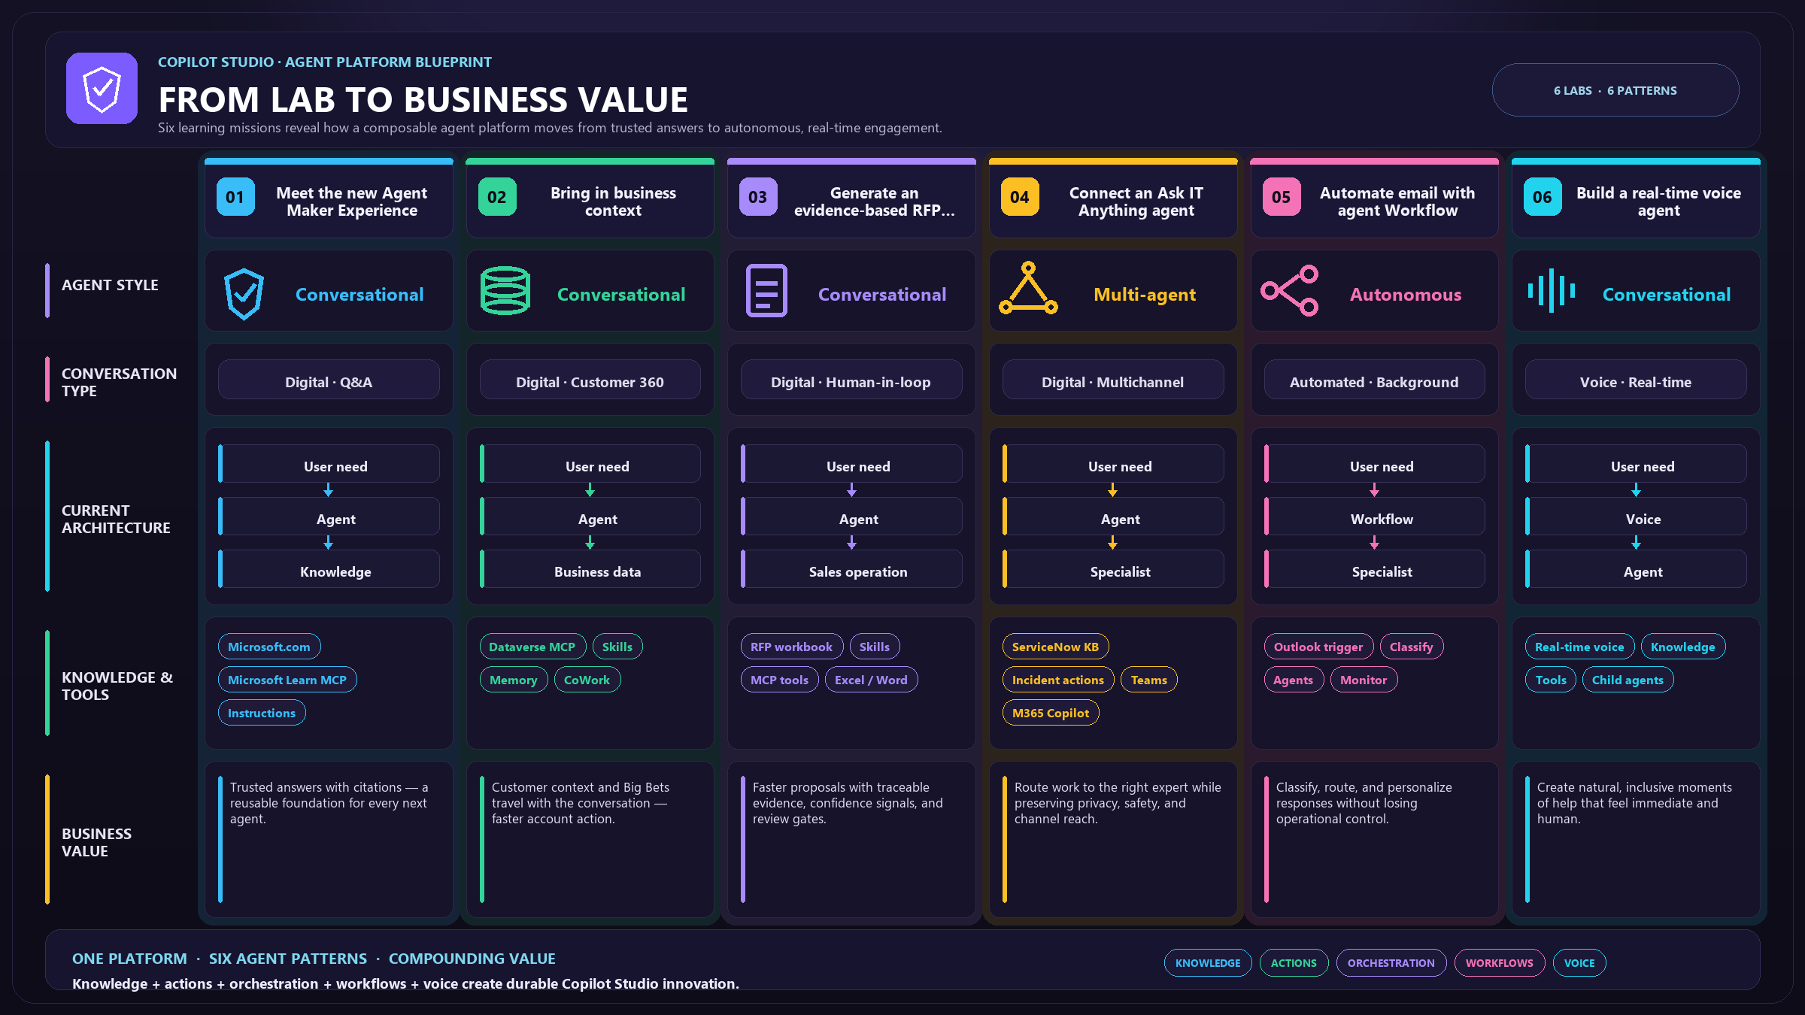

Slide 5
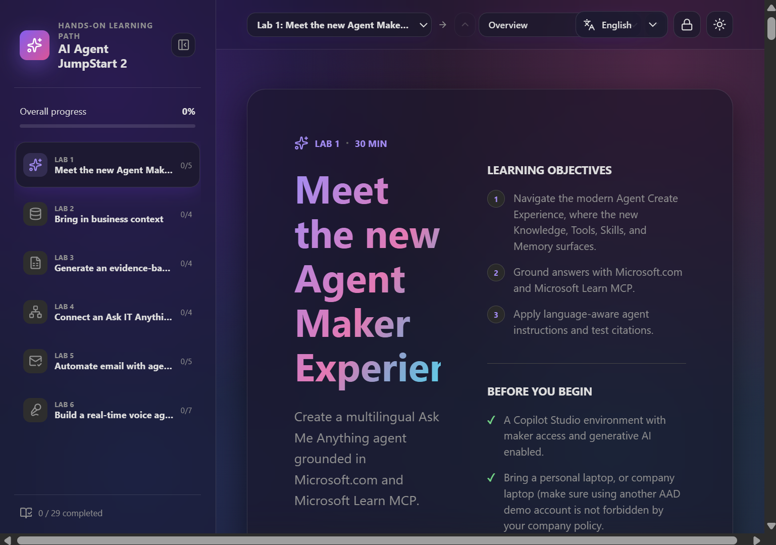
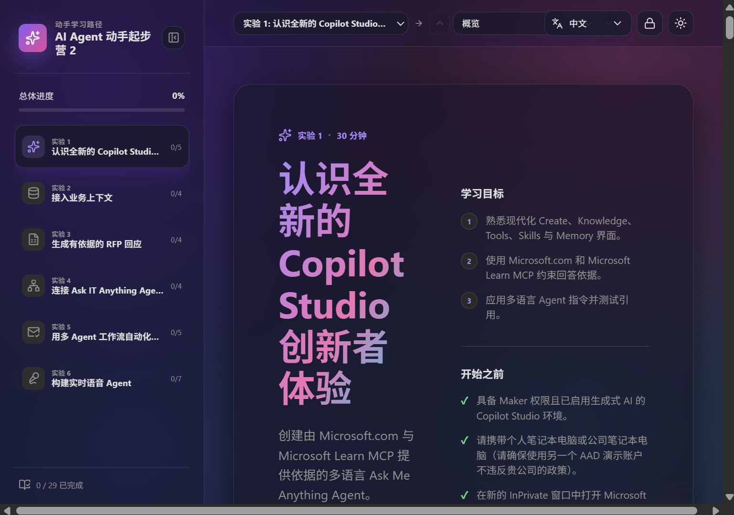
Unique feature 01
Multilingual by design
One click switches the entire experience — cover, labs, instructions, and UI — between English, 简体中文, 廣東話 (香港), 繁體中文 (台灣), 日本語, 한국어, ไทย, and हिन्दी.
Product names, prompts & tool names stay in English on purpose
Copy-ready prompts never get "lost in translation"
Screenshots fall back to English automatically
EN
简体中文
廣東話
繁體中文
日本語
한국어
ไทย
हिन्दी

Slide 6
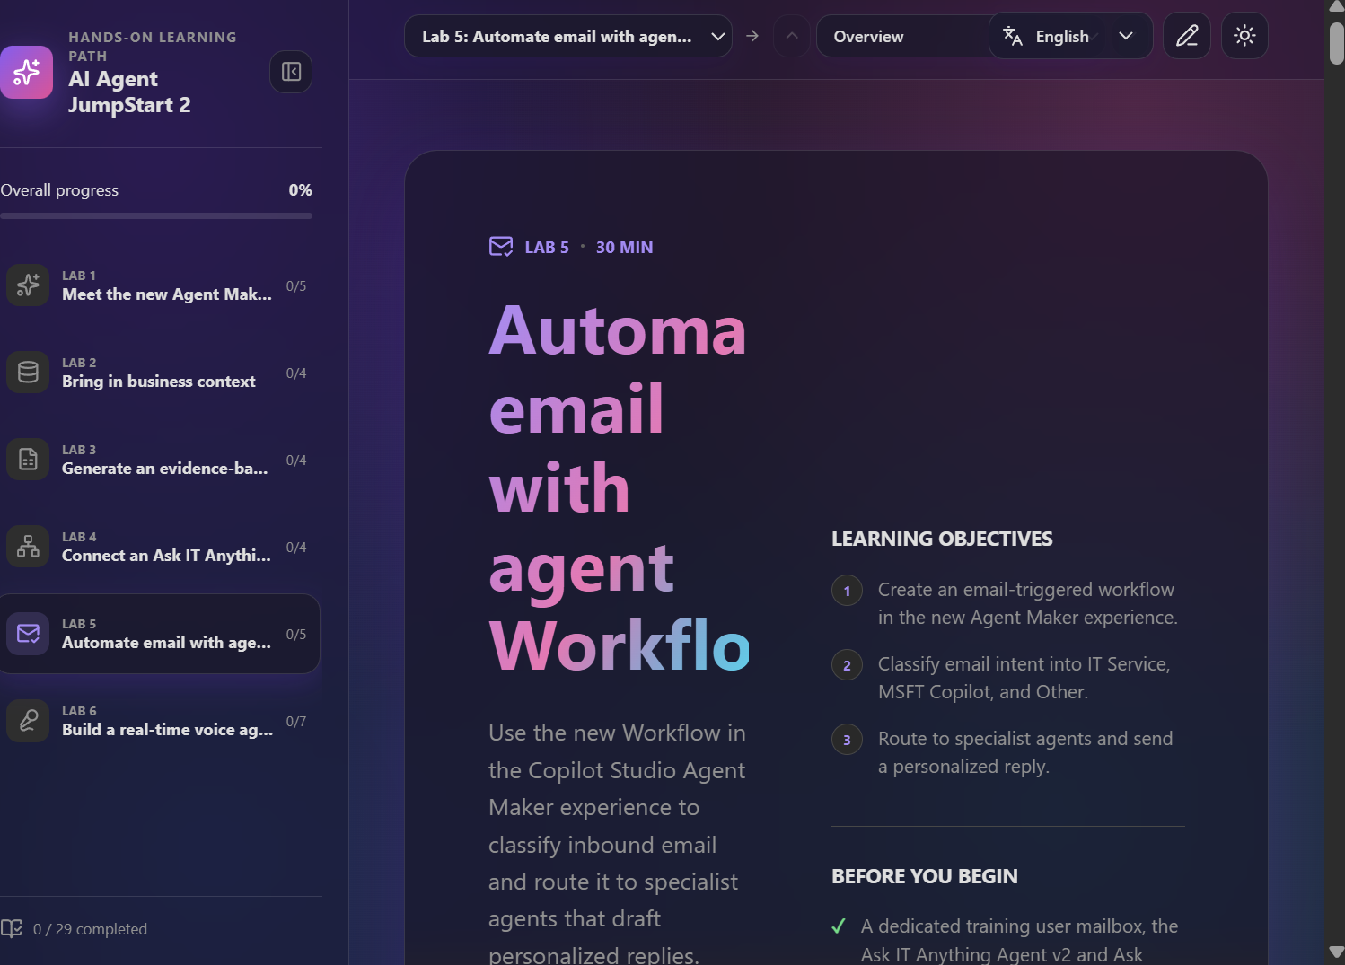
Unique feature 02
A learn-by-doing UX that's actually joyful
◆
Markdown-rich steps
Headings, tables, callouts & highlights render beautifully.
◆
Copy-ready prompts
Every instruction is one click to clipboard.
◆
Progress tracking
Per-step completion across all 29 steps, saved locally.
◆
Fireworks on completion
A celebratory burst rewards every finished step.
◆
Glass UI, light & dark
Modern frosted-glass design, theme-aware everywhere.

Slide 7
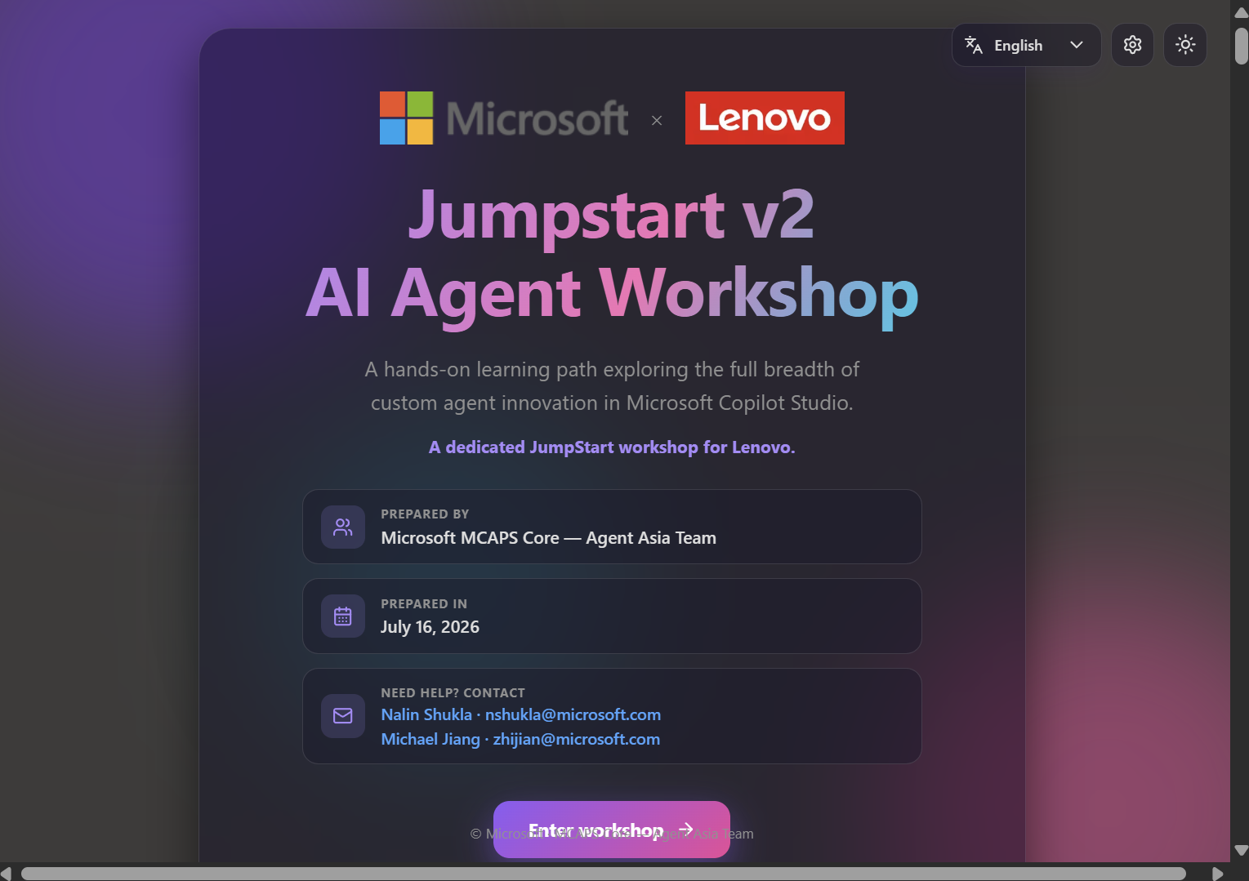
Unique feature 03
Co-brand a dedicated workshop in seconds
◇
Microsoft × Customer
Set a customer name or logo — the cover instantly co-brands.
◇
Save & reuse
Workshop history: save, retrieve, and quick-search past setups.
◇
Logos by URL or upload
Self-contained — no external image hosting needed.
◇
Password-gated
Only facilitators can change branding — same gate as edit mode.

Slide 8
Unique feature 04
Publish once — everyone sees it
1
2
3
4
Configure locally
→
Apply & commit
→
Auto-deploy
→
Everyone sees it
Set branding & edit lab content in the maker view.
Branding & content ship as branding.json + labs.json.
GitHub Actions builds & publishes to GitHub Pages on every push.
Attendees open the live URL — same content, same brand.
No per-user setup. The published files are the single source of truth for every visitor.

Slide 9
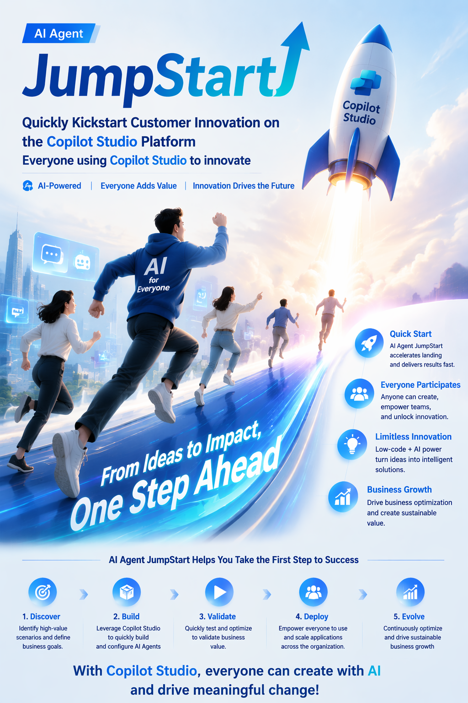
⚡ JumpStart V2
From Lab to Impact
⚡
Fast Start
Open one link and go — zero install, zero setup.
🙌
Self-Serve & Self-Paced
Attendees drive their own journey while you facilitate.
📋
Copy & Build
Copy-ready prompts turn each step into a real, working agent.
🌍
Multilingual Ready
Eight languages, one shareable link.
🚀
From Lab to Impact
Ship agents that deliver real business value — fast.

Slide 10
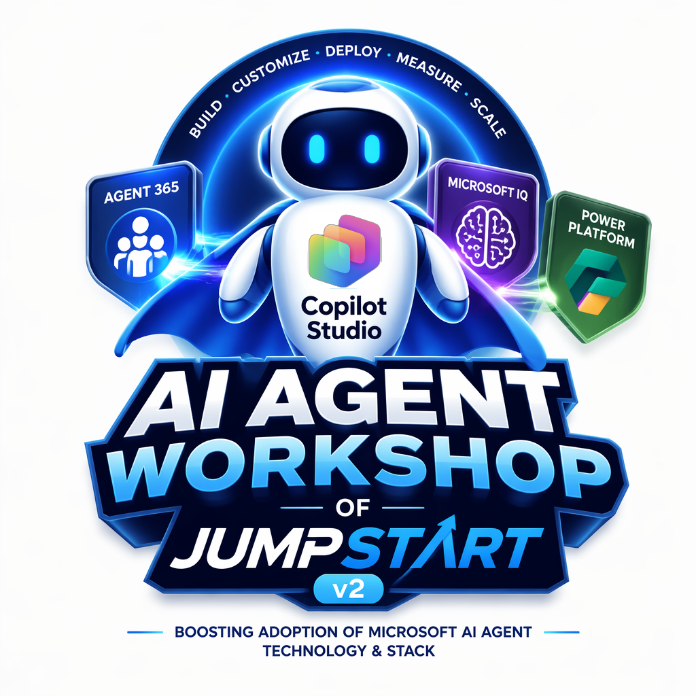

● Ready when you are
Bring AI Agent Workshop to your next customer workshop
Internal enablement or external customer event — co-brand it, share the link, and let attendees build real agents hands-on.
Michael Jiang
zhijian@microsoft.com
Microsoft MCAPS Core — Agent Asia Team
LIVE WORKSHOP
aka.ms/ai-agent-workshop-v2
With thanks to the contribution of AI Agent Workshop v-Team
Nalin Shukla
Scott Berry
Steve Ng
Anand Ponnusamy

