Slide 1
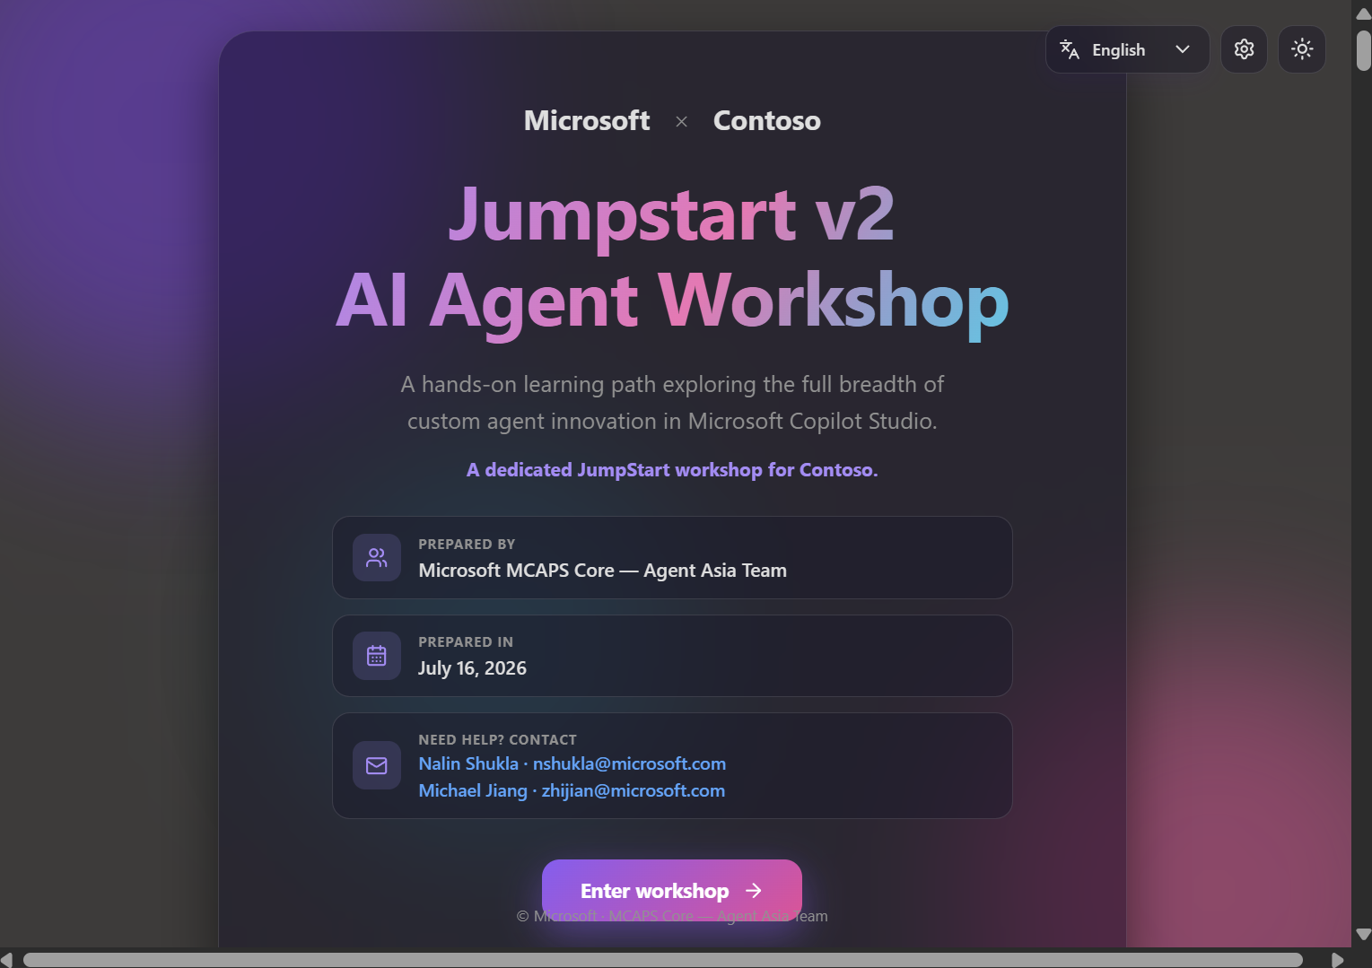
● Microsoft Copilot Studio
AI Agent JumpStart
Workshop v2
A hands-on, self-guided, multilingual lab experience for building the full breadth of custom agents in Microsoft Copilot Studio.
Microsoft MCAPS Core — Agent Asia Team · July 16, 2026
6 guided labs
29 steps
6 languages
1 shareable link

Slide 2
🎬 THE ONE-LINER
A workshop that runs itself — learners just press play ▶️
JumpStart v2 turns a slide-and-demo session into a living, do-it-yourself lab app. Attendees open one link, pick their language, and build real agents step by step — while you facilitate instead of babysit.
🧪
👣
6
29
hands-on labs
guided steps
Self-paced, browser-based, zero install
🌍
🔁
Every step is copy-ready and screenshot-guided
6
∞
Works for internal enablement and customer workshops
languages
reuse, any customer

Slide 3
🧭 THE LEARNING PATH
Six labs, from first agent to real-time voice 🎙️
01
🤖
02
🗂️
03
📝
Meet the Agent Maker
Bring in business context
Evidence-based RFP
Build a grounded, multilingual agent with Microsoft.com + Microsoft Learn MCP.
Dataverse MCP, reusable Skills, Memory, and a CoWork customer-360 workflow.
Work IQ + Microsoft IQ generate sourced RFP/RFI responses across Office.
04
🔌
05
📨
06
🎙️
Connect specialist agents
Multi-agent email Workflow
Real-time voice agent
ServiceNow knowledge + tickets, connected agents, Teams & M365 Copilot.
Classify inbound email, route to the right agent, personalized reply.
Classic agent + real-time voice, multilingual, tested live in the Test window.

Slide 4
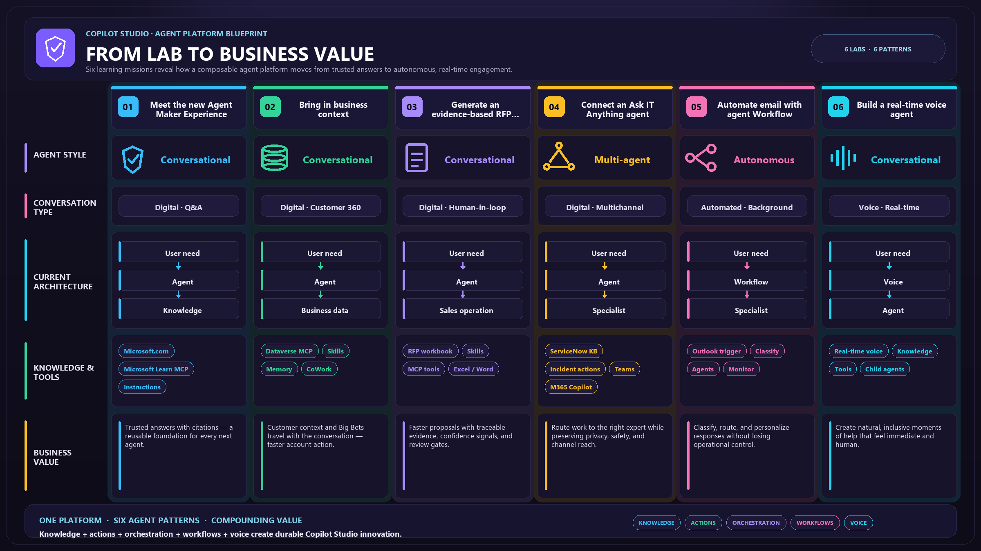

Slide 5
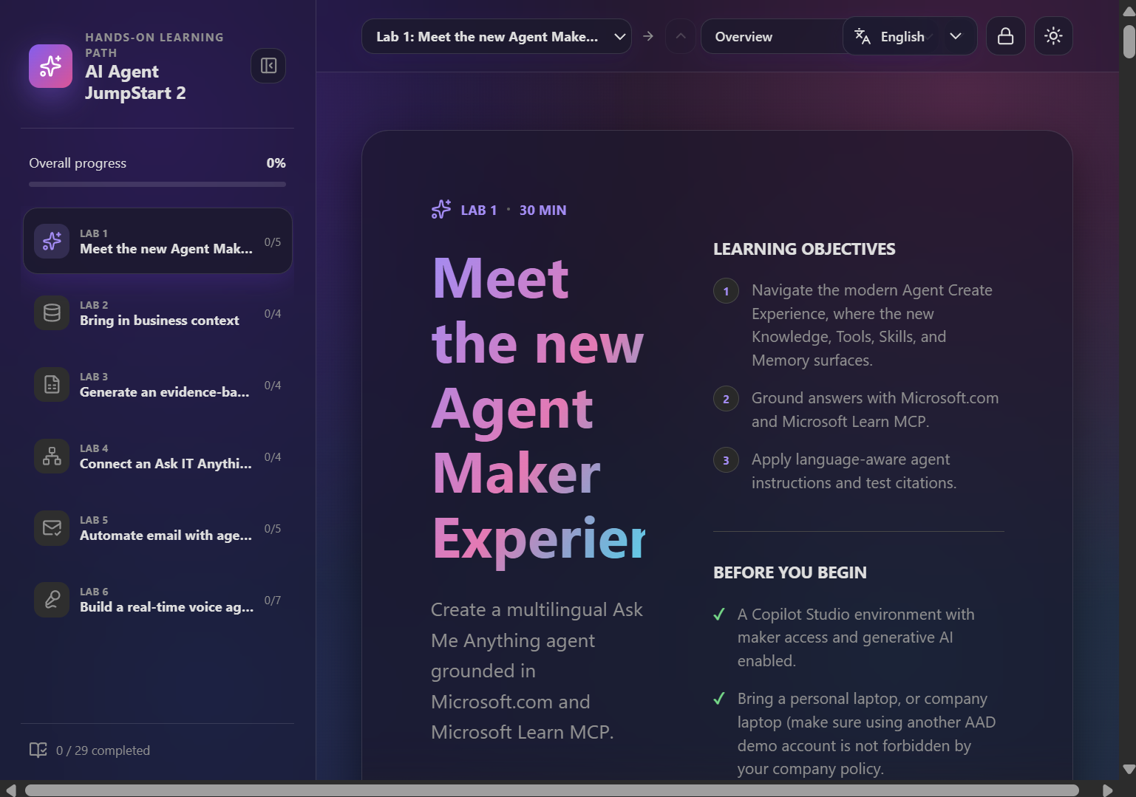
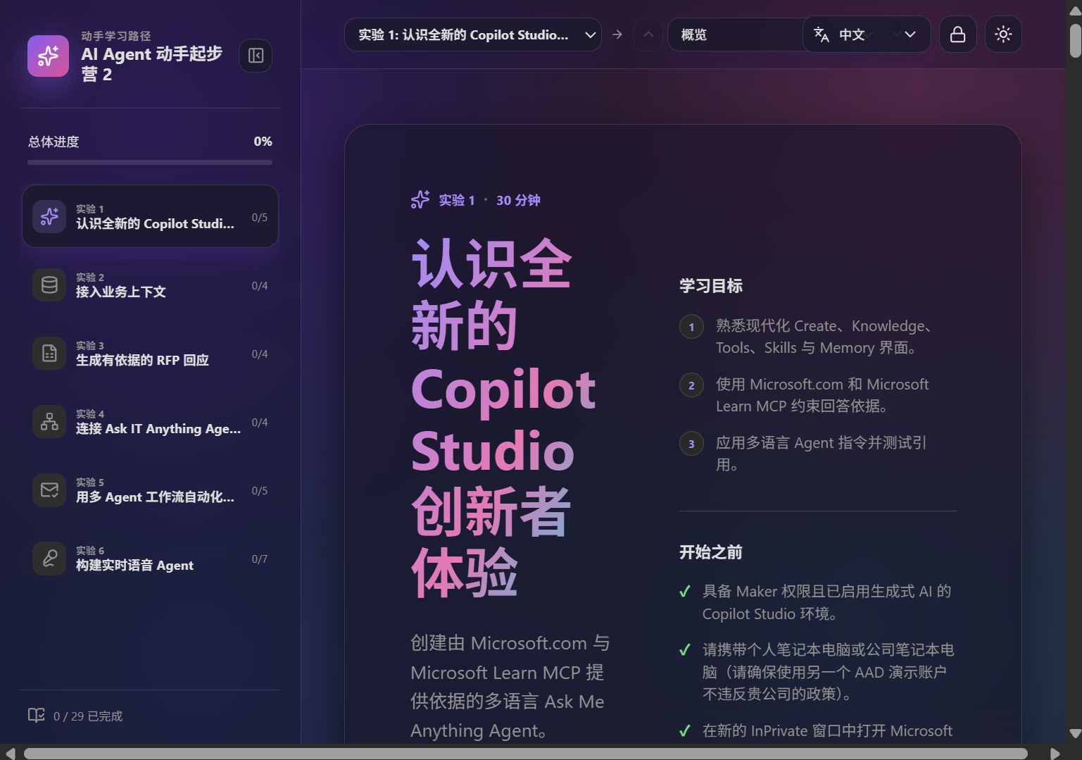
UNIQUE FEATURE 01
Multilingual by design
One click switches the entire experience — cover, labs, instructions, and UI — between English, 中文, 日本語, 한국어, ไทย, and हिन्दी.
Product names, prompts & tool names stay in English on purpose
Copy-ready prompts never get "lost in translation"
Screenshots fall back to English automatically
EN
中文
日本語
한국어
ไทย
हिन्दी

Slide 6
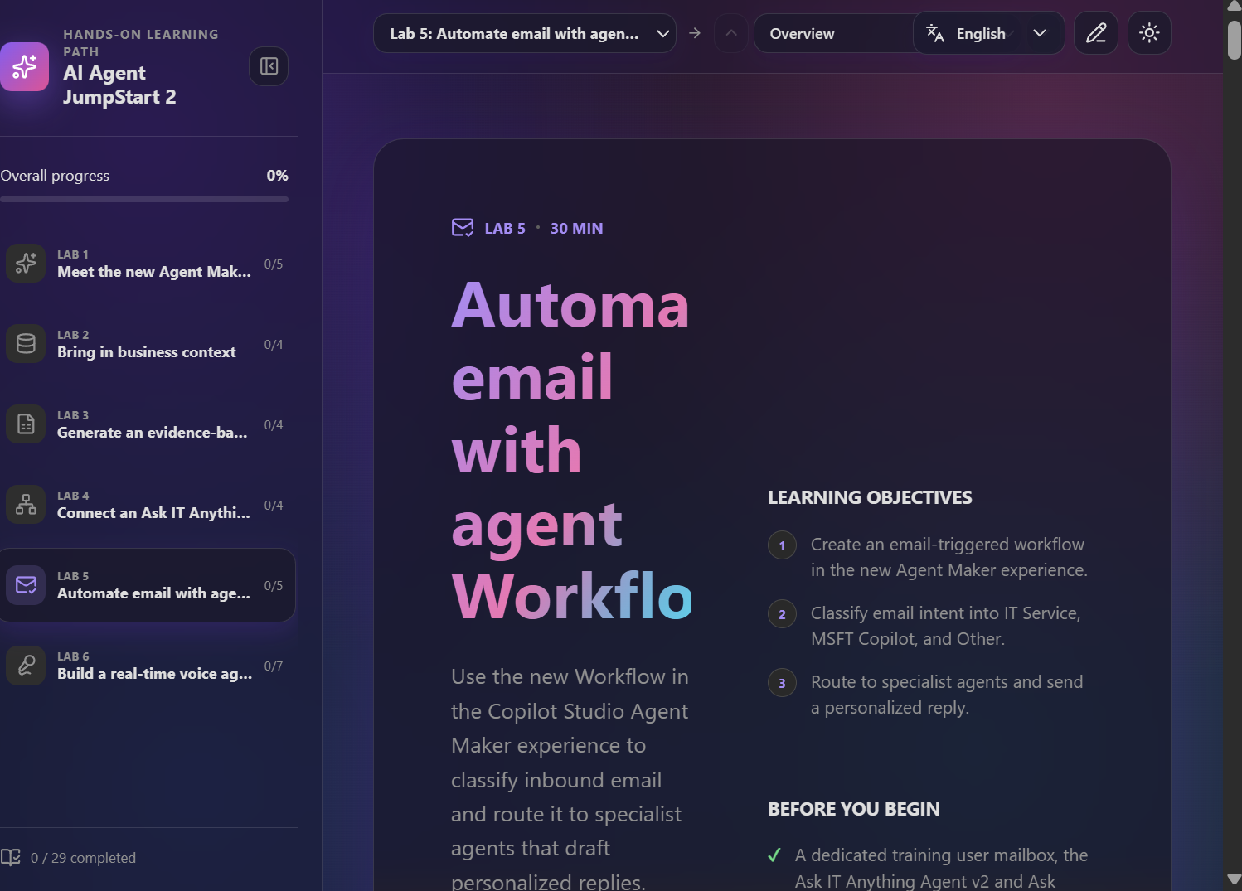
UNIQUE FEATURE 02
A learn-by-doing UX that's actually joyful
◆
Markdown-rich steps
Headings, tables, callouts & highlights render beautifully.
◆
Copy-ready prompts
Every instruction is one click to clipboard.
◆
Progress tracking
Per-step completion across all 29 steps, saved locally.
◆
Fireworks on completion
A celebratory burst rewards every finished step.
◆
Glass UI, light & dark
Modern frosted-glass design, theme-aware everywhere.

Slide 7
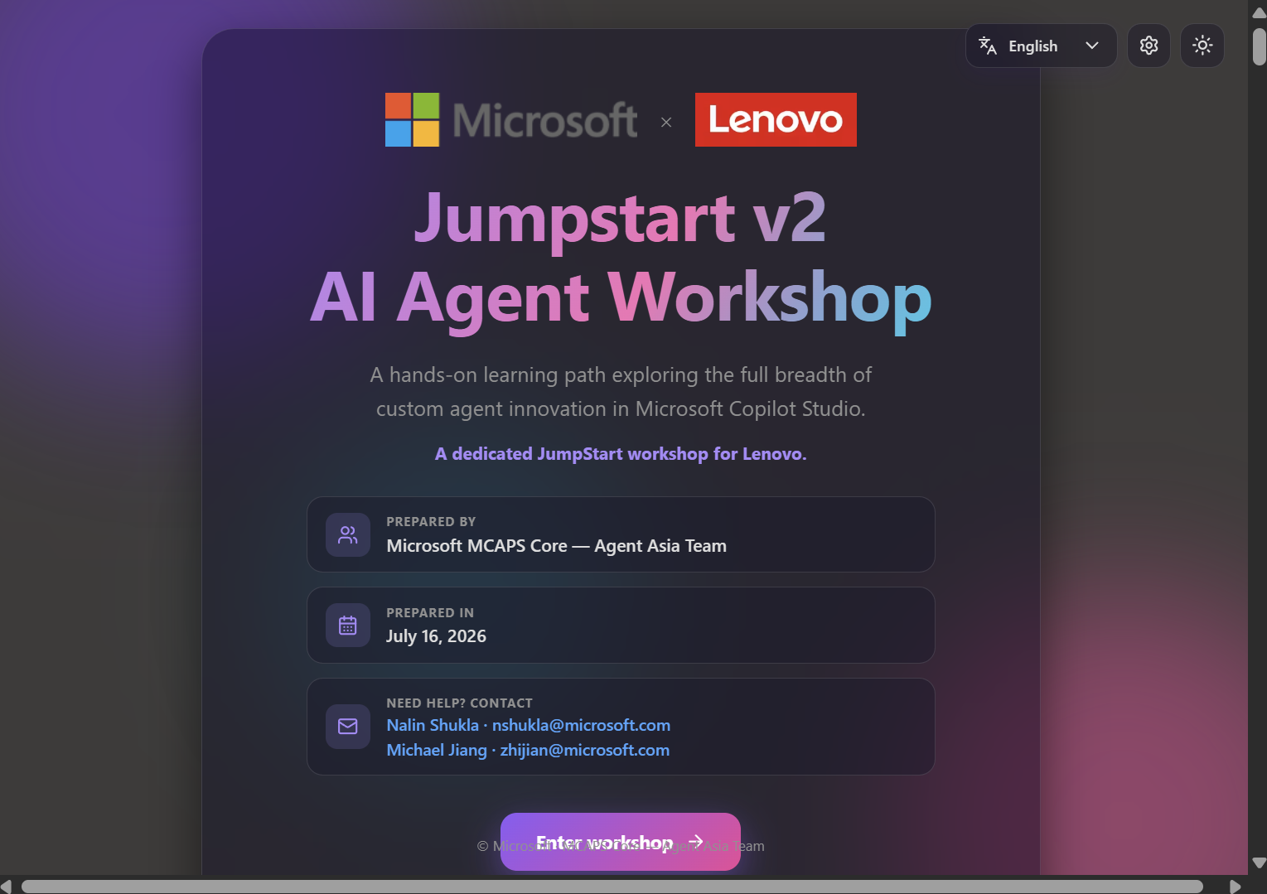
UNIQUE FEATURE 03
Co-brand a dedicated workshop in seconds
◇
Microsoft × Customer
Set a customer name or logo — the cover instantly co-brands.
◇
Save & reuse
Workshop history: save, retrieve, and quick-search past setups.
◇
Logos by URL or upload
Self-contained — no external image hosting needed.
◇
Password-gated
Only facilitators can change branding — same gate as edit mode.

Slide 8
UNIQUE FEATURE 04
Publish once — everyone sees it
1
2
3
4
Configure locally
→
Apply & commit
→
Auto-deploy
→
Everyone sees it
Set branding & edit lab content in the maker view.
Branding & content ship as branding.json + labs.json.
GitHub Actions builds & publishes to GitHub Pages on push.
Attendees open the live URL — same content, same brand.
No per-user setup. The published files are the single source of truth for every visitor.

Slide 9
FOR YOUR ATTENDEES
Running it is three steps
1
2
3
Open the link
Pick a language
Enter & build
One URL, any modern browser. No install, no sign-in to start.
Switch to EN / 中文 / 日本語 / 한국어 / ไทย / हिन्दी on the cover.
Work lab by lab, copy prompts, track progress, celebrate.
LIVE WORKSHOP
https://jzh24516.github.io/ai-agent-jumpstart-2/

Slide 10

● Ready when you are
Bring JumpStart v2 to your
next customer workshop
Internal enablement or external customer event — co-brand it, share the link, and let attendees build real agents hands-on.
Michael Jiang
Michael Jiang
zhijian@microsoft.com
Microsoft MCAPS Core — Agent Asia Team
Microsoft MCAPS Core — Agent Asia Team

