Slide 1
MA615 Berry Presentation
Jinzhe Zhang

Slide 2
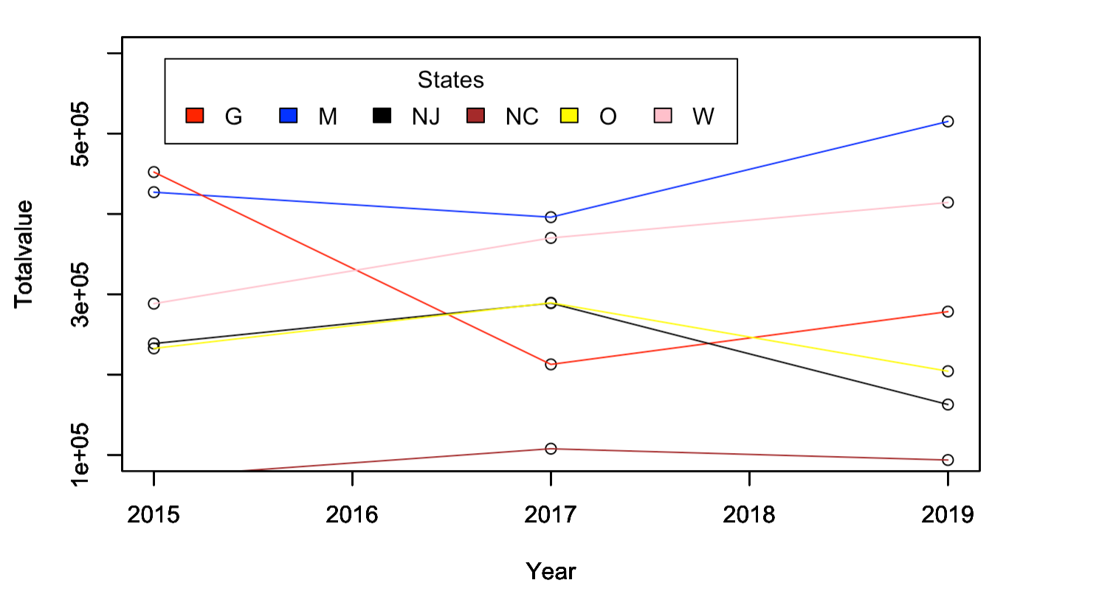
The Total Value of States
From this plot, it is clear that the MICHIGAN state nearly have the most valuable berries in those years with the chemical

Slide 3
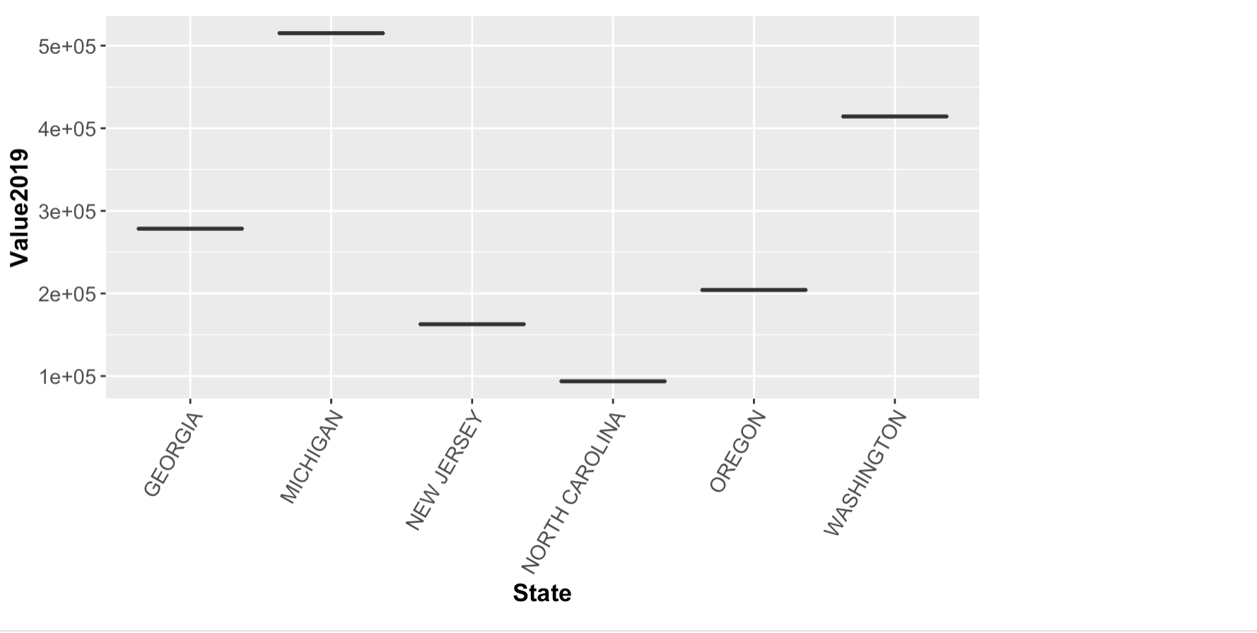
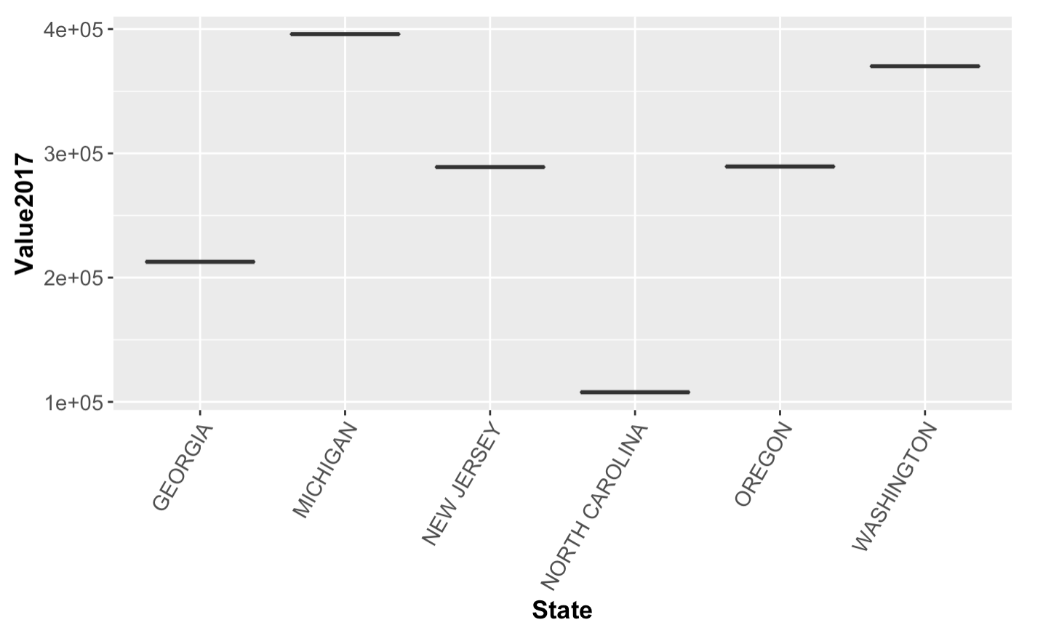
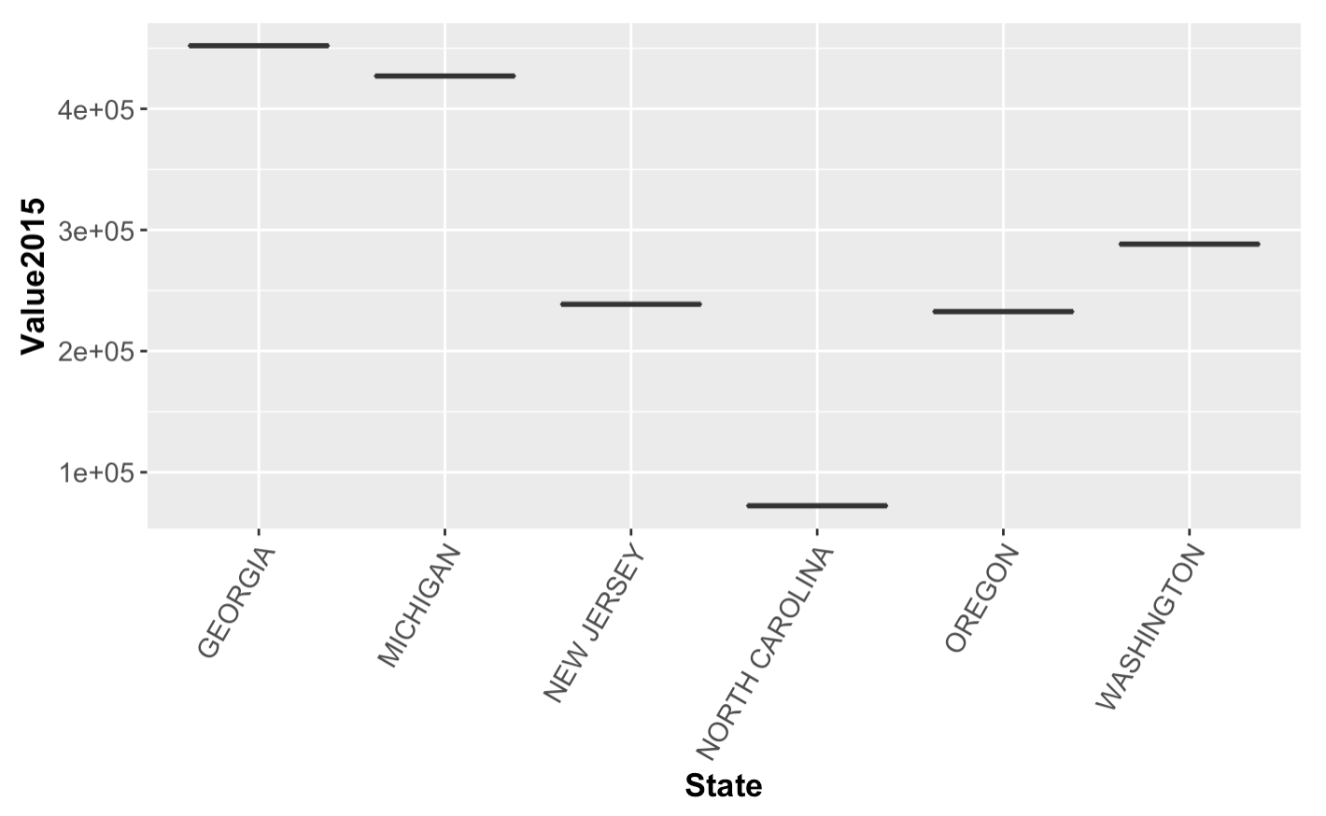
Total Value of Every State in 2019,2017,2015

