Slide 1
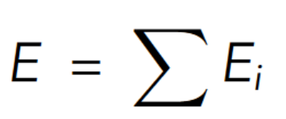
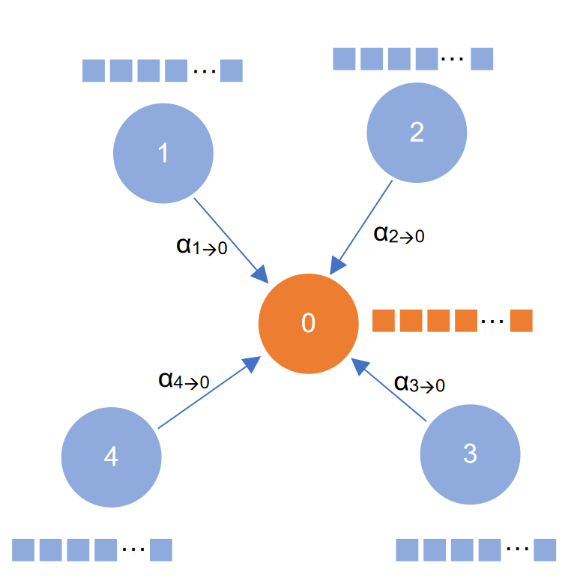
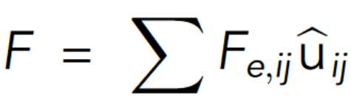
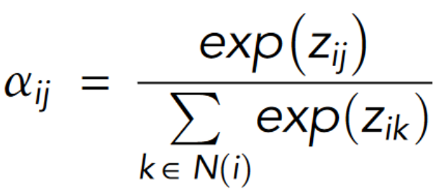
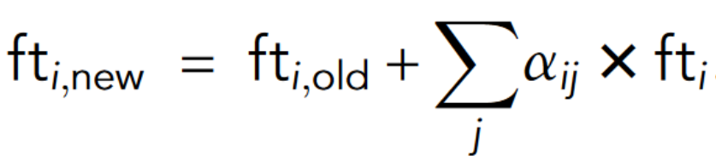
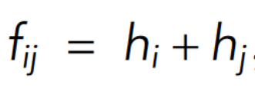
Introduction

Slide 2
Introduction
agat
data
model
app
lib
default_parameters
cata
BuildDatabase
LoadDataset
Fit
ensembles
adsorbate_poscar
high_throughput
HtAds
HtDftAds
ReadGraphs
concat_graphs
PotentialModel
optimizers
exceptions
hp_dft
CrystalGraph
select_graphs_random
Layer
calculators
AddAtoms
file_lib
calculator
AseGraphTorch
model_lib
train
Arrow: nested code
White font: Object
Black font: file
Gray font: function
Dark gray: variable
atomic_feature

