Slide 1
IQVIA Predictive Analytics Overview
Hui Jin, January 2018

Slide 2
What is Predictive Analytics?
Why is it the Perfect Time for Predictive Analytics?
What are the Real-World Applications of Predictive Analytics?
What is Machine Learning?
How we learn it?
Q&A

Slide 3
What is Predictive Analytics?
Why is it the Perfect Time for Predictive Analytics?
What are the Real-World Applications of Predictive Analytics?
What is Machine Learning?
How we learn it?
Q&A

Slide 4
The shift to big data as well as advances in technology and new methods are fueling an expansion into advanced analytics
Prescriptive Analytics E.g., How to achieve the best outcome? What actions to maximize impact?
Predictive Analytics
E.g., What are the predictors of outcome? What is the likely outcome?
Degrees of insight
Advanced Analytics
(Emerging)
Traditional Analytics
(Most Prevalent)
Diagnostic Analytics
E.g., What is the root cause? Why did it happen?
Descriptive Analytics/Reporting
E.g., What is happening? How many, how often, where?
Sophistication of Solution

Slide 5
What is Predictive Analytics
1
2
3
What is Predictive Analytics?
How does Predictive Analytics provide value?
When is Predictive Analytics most effective?
Variety of statistical techniques:
Modeling, machine learning, and big data mining
Analyzes current/historical facts:
Insight to drivers of current events
Predicts future or unknown events
Identifies key drivers from a dynamic market event:
Predicts likelihood of an event
Enables proactive response prior to the event
For decisions driving key outcomes with:
Uncertainty OR
High-level of complexity

Slide 6



What sorts of techniques does predictive analytics use?
DECISION THEORY: Decision-trees are created to find the optimal boundary between uncertain outcomes
SIGNAL PROCESSING: Hidden associations are detected as ‘signals’
in noisy data
ARTIFICIAL NEURAL NETWORKS: Associations in the data are simulated as biological processes
These advanced methods are highly flexible, able to capture complex patterns in large data and complement traditional statistical approaches

Slide 7
What is Predictive Analytics?
Why is it the Perfect Time for Predictive Analytics?
What are the Real-World Applications of Predictive Analytics?
What is Machine Learning?
How we learn it?
Q&A

Slide 8
Perfect Time for Predictive Analytics
Real-World Data
Technology
Rich RWD is becoming ever more available and complex covering patient symptomatology, diagnoses, treatment history, lab tests, etc.
Advances in server infrastructure are creating new opportunities for faster processing of petabytes of data
Predictive Algorithms
Discovery of new analytical methods, such as pattern recognition, can exploit often complex, subtle patterns in the data to uncover new insights

Slide 9
The full spectrum of Real-World Data
RWD is PATIENT-level data
Clinical Outcome Assessments
Lab/biomarkers data
Mortality data
Wearables
Consumer data
Social media data
Registries
Pharmacy data
Electronic medical and health records
Hospital data
Patient Reported
Data
Claims data
Prospective and enriched studies
Notes:
数据最重要，feature决定了模型的最终好坏，不同的算法只是不断逼近结果

Slide 10
What is Predictive Analytics?
Why is it the Perfect Time for Predictive Analytics?
What are the Real-World Applications of Predictive Analytics?
What is Machine Learning?
How we learn it?
Q&A

Slide 11
Key areas where we see predictive analytics adding significant value in Pharma
Disease Detection
Identify un-diagnosed patients by analyzing medical utilization patterns, ultimately leading to the identification of new patients eligible for treatment in specific disease areas
Trigger Alerts for line of therapy transition & disease progression
Proactively predict upcoming line of therapy transition and identify target populations for treatment
1
2
Predictions for non-adherence
Identify key drivers of non-adherence to
guide targeted adherence strategy;
identify patients who are most likely to
prematurely discontinue therapy
Treatment response profiling
Proactively predict treatment response for individual patients and identify most effective therapies for treatment
3
4

Slide 12
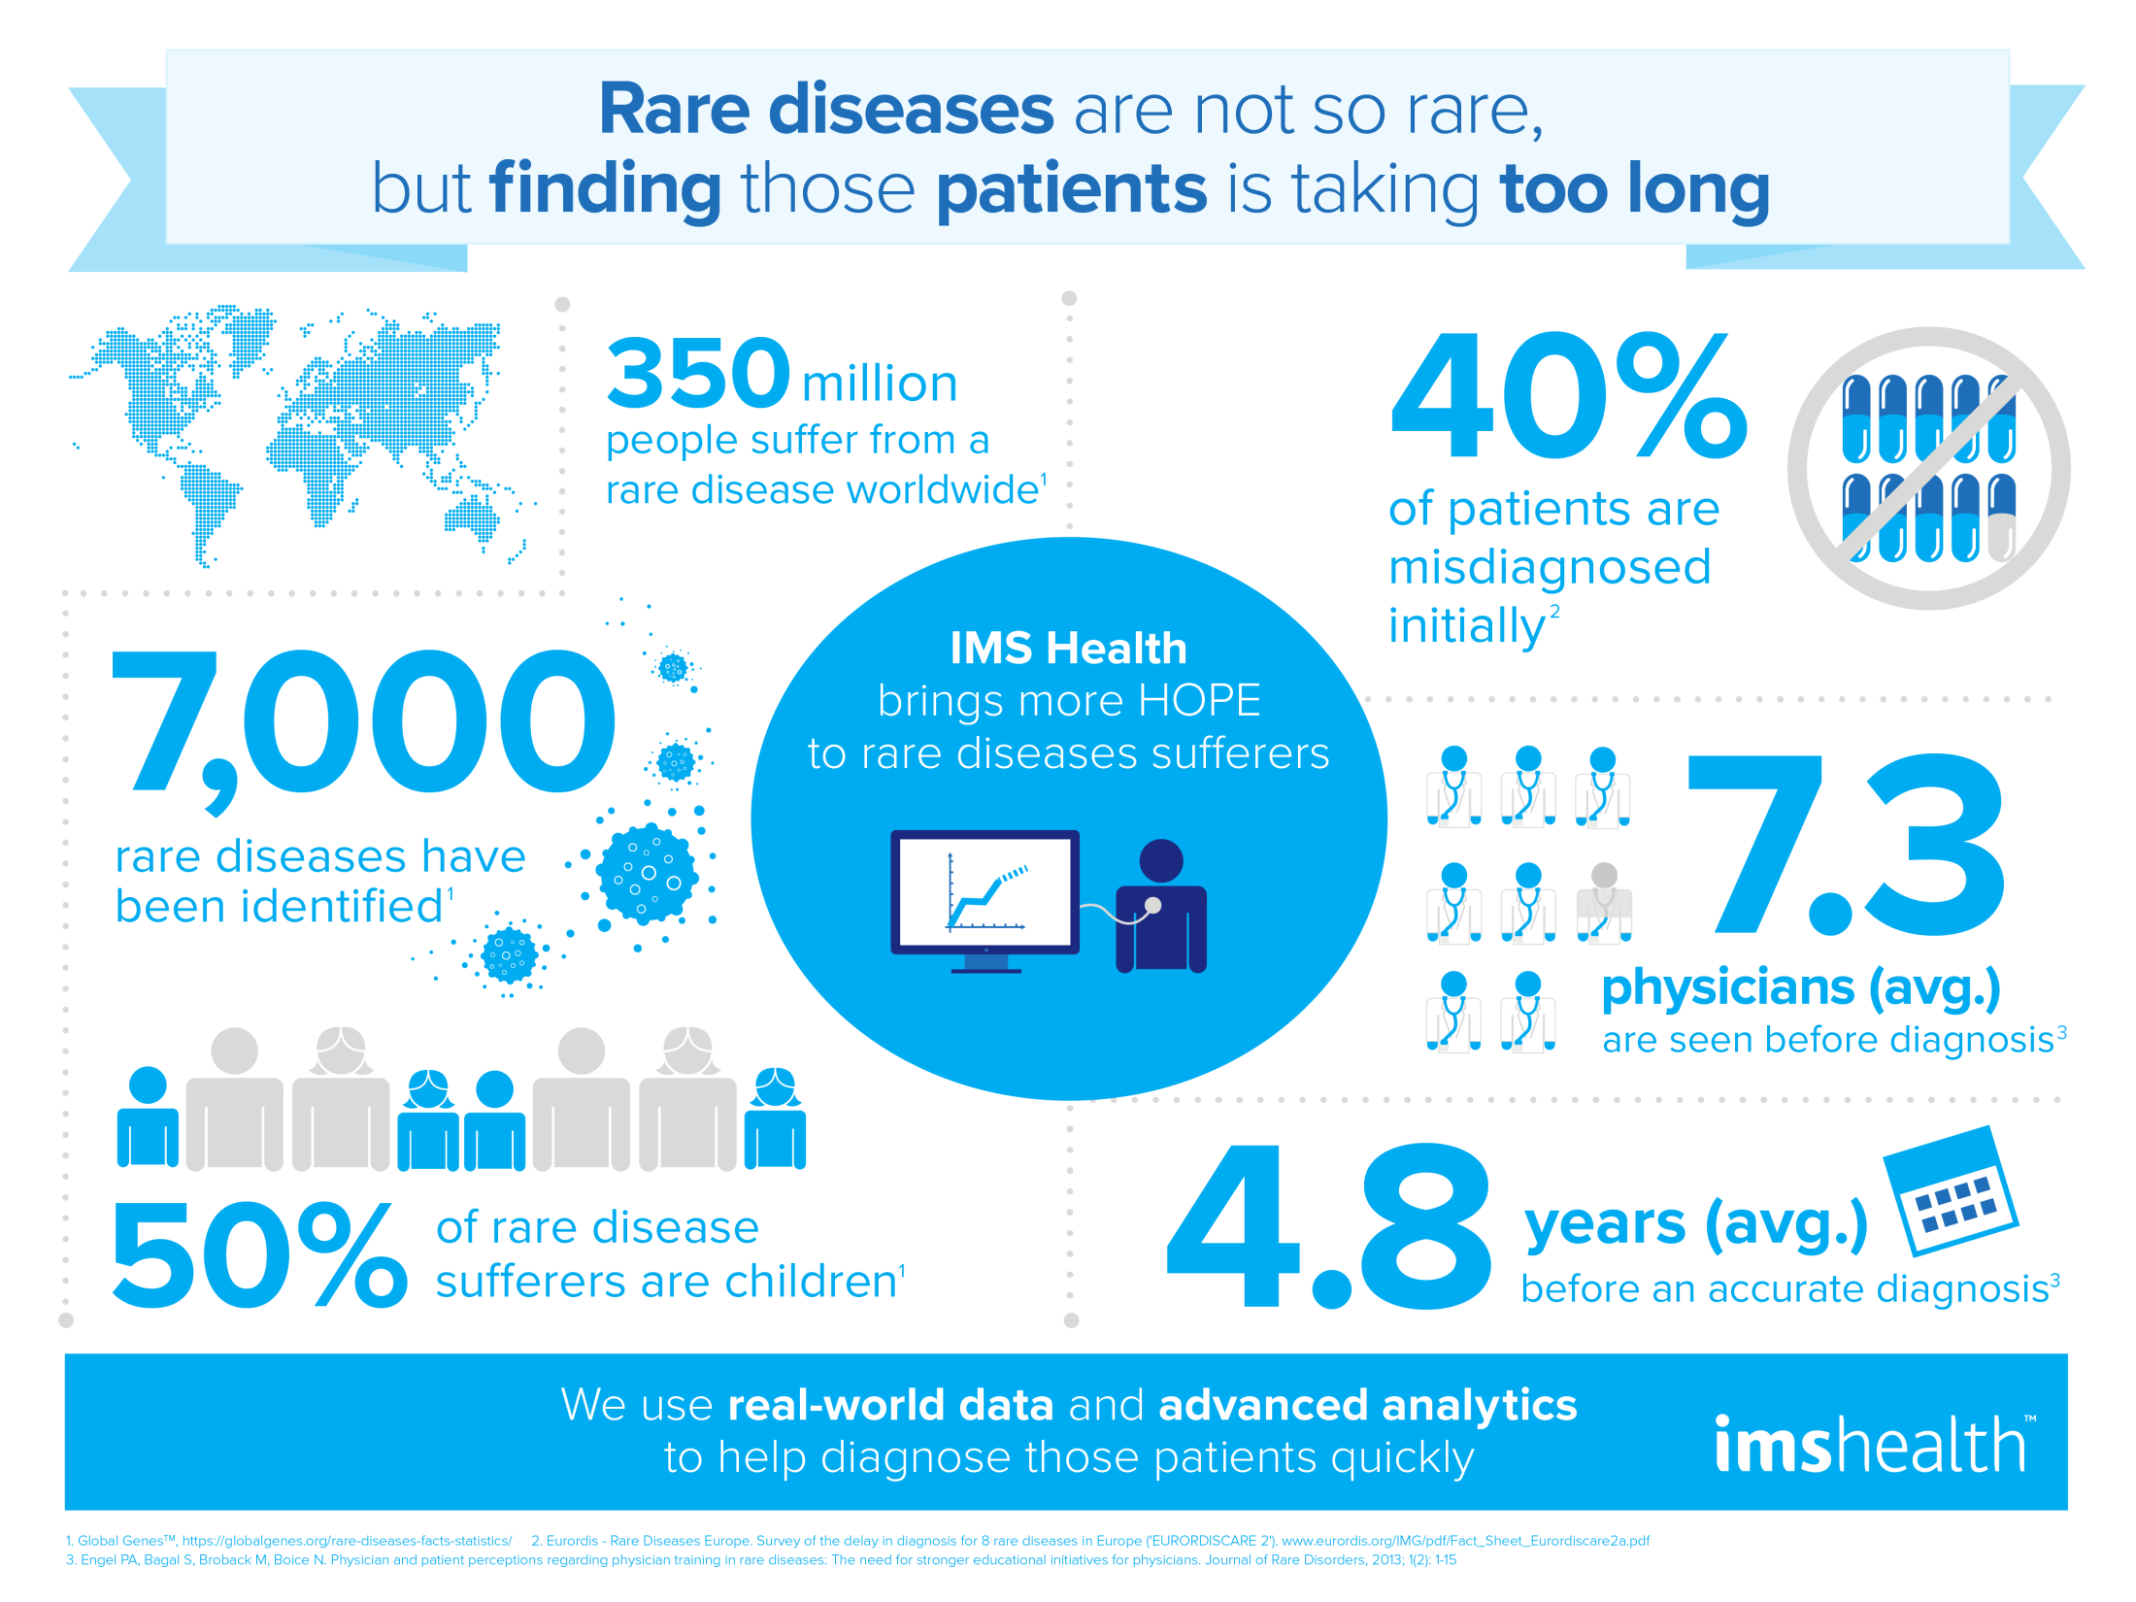

Slide 13
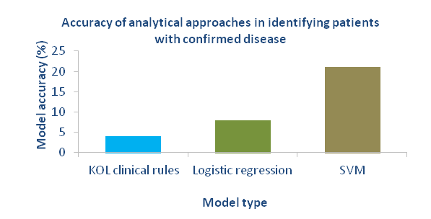
Case Study: Using predictive analytics to find patients with a rare oncology disease
Situation
Solution
A client has a product for a rare multi-system disease in oncology
The disease has diverse symptomatology and low physician awareness resulting in under/late diagnosis and low market penetration
A predictive algorithm could help find undiagnosed patients through e.g. identifying physicians with potentially undiagnosed patients
This could lead to improved patient outcomes and increased sales.
IQVIA carried out a proof of concept study to:
Develop an algorithm based on linked primary and specialist care data
Assess whether machine learning methods were more accurate than traditional statistical approaches
Data covered ~5m patients, ~350 were diagnosed with the disease
Three analytical approaches were assessed:
KOL clinical rules approach
Logistic regression – classical statistical method
Support Vector Machine (SVM) – Machine learning model
Result
Results indicate that an algorithm may be highly effective in accelerating time to diagnosis
The machine learning model (SVM) performed very well:
~2.5 times better than logistic regression
~5 times better than KOL rules
300 times better than random
A physician target program for salesforce engagement is currently being evaluated which would flag physicians treating potentially undiagnosed patients.
Test sample for assessing model accuracy comprised 50 patients with confirmed disease and 70,000 without (prevalence = 0.07%). Accuracy equals Predicted Positive Value (PPV) at 50% Sensitivity.

Slide 14
What is Predictive Analytics?
Why is it the Perfect Time for Predictive Analytics?
What are the Real-World Applications of Predictive Analytics?
What is Machine Learning?
How we learn it?
Q&A

Slide 15
AI, ML and DL Are Not Exactly the Same, They Have Overlap
Artificial Intelligence
Machine Learning
Deep Learning

Slide 16
DS, ML and AI cannot be Interchangeable
Data Science is a Discipline, Which Produces Insights
Machine Learning is an Approach, Which Produces Predictions
Artificial Intelligence is An Objective, Which Produces Actions

Slide 17
Some Philosophy You Should Know before Diving into Machine Learning
No Free Lunch Theorem
There is no one model that works best for every problem
Occam’s Razor
Entia non sunt multiplicanda praeter necessitatem
More things should not be used than are necessary.
Ensemble Learning
Bagging
Frequentism vs. Bayesian
Parameters

Slide 18
An Overview of Machine Learning
Definition:
"A computer program is said to learn from experience E with respect to some class of tasks T and performance measure P, if its performance at tasks in T, as measured by P, improves with experience E“
----Tom M. Mitchell
Statistical learning deals with the problem of finding a predictive function based on data. It will make data-driven predictions or decisions.
Types of tasks
Supervised learning: the data contain example input (x) and their desired output (y), the goal is to learn a general rule to predict output from input
Unsupervised learning: the data do not contain output (y) to the learning algorithm, let the algorithm find structure by the input, the goal is to discover hidden pattern in data.

Slide 19
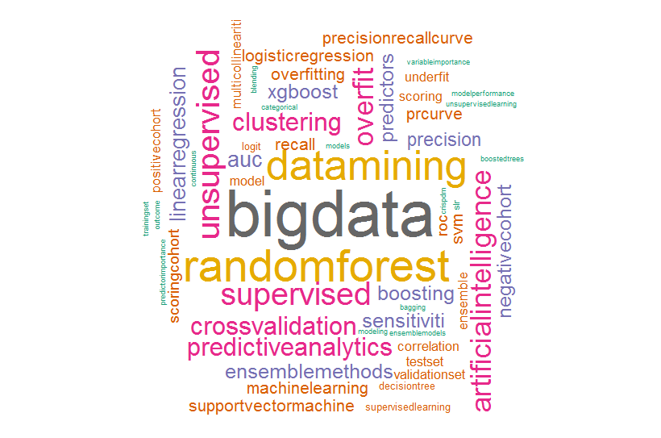
Machine Learning Buzz Words

Slide 20
Supervised Learning
Hypothesis
For input X and output Y, there exists a joint probability distribution P(X, Y), but the specific definition of P(X, Y) could be unknown, the training set and test set are i.i.d. generated from P(X, Y).
Model types
Probability models: learn a conditional probability distribution P(Y|X)
Non-probability models : learn a decision function: Y= f(x)
Procedure
Model
(x₁, y₁), (x₂, y₂),…,(x_{N}, y_{N})
Learning system
P̂(Y|X)
Y = f̂(X)
x_{N+1}
y_{N+1}
Predictive system

Slide 21
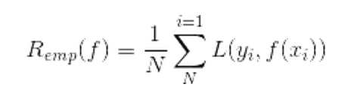

Methodology of Supervised Learning
Methodology
Model: probability model or non-probability model?
A probability model will return a probability, a non-probability model will return a real value generating from the decision function
Strategy: criteria to select optimum model
Empirical risk minimization (ERM): the learning algorithm should choose the model that minimizes the empirical risk, which is the average of the loss function on the training set:
Maximum likelihood estimation is an example of ERM. Sometimes ERM would lead to overfitting
Structural risk minimization (SRM): based on empirical risk, add a new penalty term into the risk function; the optimum model would be the one lead to minimized structural risk. The penalty term , J(f), reflects the complexity of the model, the more complicated the model is, the bigger the penalty term is. λ ≥ 0 is the coefficient.
LASSO is an example of SRM. SRM could fix the overfitting.
Notes:
Overfitting joke, how, zzzzz, are, zzzzzz, you, zzzz

Slide 22
Classification Problem
Definition
When we predict qualitative outputs, this kind of problem is called classification problem. It could be binary classification ({0,1}), or multi-classification){1,2,3,…})
Using supervised learning algorithm to learn a probability model or a decision function, it is called ‘classifier’.
Applying this ‘classifier’ on the test set to get the new label is called ‘prediction’, the output is called ‘class’.
Procedure
Model
(x₁, y₁), (x₂, y₂),…,(x_{N}, y_{N})
Learning system
P̂(Y|X)
Y = f̂(X)
x_{N+1}
y_{N+1}
Classification system

Slide 23
What is Predictive Analytics?
Why is it the Perfect Time for Predictive Analytics?
What are the Real-World Applications of Predictive Analytics?
What is Machine Learning?
How we learn it?
Q&A

Slide 24
From Theory to Practice
“All knowledge is, in final analysis, history.
All sciences are, in the abstract, mathematics.
All judgements are, in their rationale, statistics.”
--’Statistics and Truth: Putting Chance to Work’ C.R. Rao
Book
The Element of Statistical Learning
An Introduction to Statistical Learning with R
Pattern Recognition and Machine Learning
Advanced in R
Programming Tools
R
RStudio
\\bejvfps01\GTO Stats AA\Public\hjin\R_and_ML_Training
Notes:
“在终极的分析中，一切知识都是历史；
在抽象的意义下，一切科学都是数学；
在理性的世界里，所有的判断都是统计学。”

Slide 25
What is Predictive Analytics?
Why is it the Perfect Time for Predictive Analytics?
What are the Real-World Applications of Predictive Analytics?
What is Machine Learning?
Q&A

Slide 26
Questions?
Thanks for Your Listening!

