Slide 1
NDWx Training for Advance Analytics
Anfisa Kaydak, Syed Ahamed
November 2017

Slide 2
Agenda
NDWx Training
Ndwx overview
Data Lakes
NDWx access
NDWx architecture
US9 Data Load Flow
NDWx data assets
RX data
DX data
Overview of CDC
Overview of PH
Quick Count Marts
Dimensions and more.
NDWx Roadmap
NDWx Data Dictionary
Impala commands
Impala hints
Sample SQL
Sample KSH file
Sqoop
-> Import
-> Export
Demo on Jupyter
Hands-On

Slide 3
NDWx overview
Integrated Data
NDWx goals
Data co-located (US+ International)
Scalable distributed platform
Immutable and Change data capture enabled
*Integrated reference data (RDS)
US9 - US Data Lake
AT9 - Austria Data Lake
BR9 - Brazil Data Lake
JP9 - Japan Data Lake
PL9 - Poland Data Lake
DE9 - Germany Data Lake
ES9 - Spain Data Lake
IT9 - Italy Data Lake
PH9 - Philippines Data Lake
FR9 - France Data Lake
NDW
NDW
NDW
NDW
NDWx

Slide 4
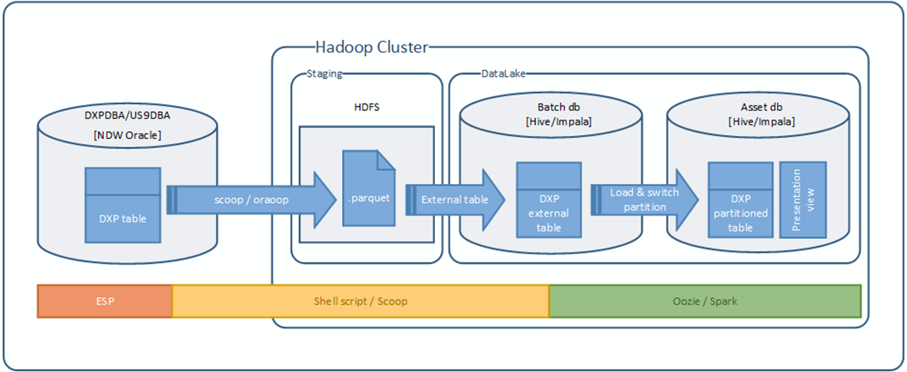
NDWx architecture
US9 Data Load flow
Data loaded over the weekend.
Sources are: NDW, MF, PRI.
Published in prod_df2_us9 database.
Load status can be checked by querying v_ndwx_load_status

Slide 5
US9 data assets
PROD_DF2_US9 database
RX – from 201001
DX – from 201001
DXP – from 201001
MDM (NDW, DDD, XPO)
DDD – from 200401
NNW – from 201001
Remittance (from 2001)
PRI (under development)
P+ (under development)
All Scripts EMR (under development)
CDM (planned in 2018)
MHA (Q1 2018)

Slide 6
NDWx architecture
Data Process flow
Data Loaded to “batch database” into temporary tables
Data published in “CDC” assets. CDC (Change Data Capture) -view of records “at any point of time”.
Snapshot table representing “current view of data” refreshed.
Final public view will get repointed to most recent snapshot (via A/B switch).
Batch load
CDC table
Snapshot table
A/B switch

Slide 7
NDWx architecture
Batch load
CDC table
Snapshot table
A/B switch
US9 data load
Delta gathering.
“Delta” data will be loaded to batch database.
Each week NDWx ETL creates “new delta” batch based on following fields:
ndw_load_dt correct_dt
update_dt dedup_dt.
Ongoing weekly job loads all transactions where any of the dates above within most recent week (weekly delta). All corrections are included into weekly delta automatically.
RX and DX data synced over the weekend, and new week is available on Monday.***still working on tuning schedule
Confluence page NDWx Architecture
https://jiraims.rm.imshealth.com/wiki/display/NDWXONE/NDWx+Architecture+and+Dataflow

Slide 8
NDWx architecture
Batch load
CDC table
Snapshot table
A/B switch
US9 data load
CDC table load.
CDC (Change Data Capture) process applies temporal updates (Publish effective and expiry timestamp) .
CDC tables partitioned by week_id and sub-partitioned by actived/expired.
CDC tables recommended to use for investigation purposes only.
Claim_id | Week_id | Month_id | Effective date from | Effective date to | Active record
123456789 | 20170519 | 201705 | 2017-05-23 | 2017-06-01 | History record
123456789 | 20170519 | 201705 | 2017-06-01 | 3000-01-01 | Yes
987654321 | 20170519 | 201705 | 2017-05-23 | 3000-01-01 | Yes

Slide 9
NDWx architecture
Batch load
CDC table
Snapshot table
A/B switch
US9 data load
Weekly Snapshot.
To avoid expensive shuffle operations during data extraction we are re-creating snapshot of the data on weekly basics.
Snapshot table is de-normalized, and consist of most common transactional and dimensional attributes .
Transaction will be joined with most recent dimensions (supplier, payer, provider, product, patient) and persist on the disc.
Snapshot table is partitioned by week_id.

Slide 10
NDWx architecture
Batch load
CDC table
Snapshot table
A/B switch
US9 data load
24/7 access to the data
2 sets of snapshot tables will be maintained - table A (active) and table B (inactive).
User view on a top of the snapshot will be pointed to Active Table.
Weekly snapshot will be populated into Inactive table first.
When new weekly snapshot created, table will be renamed to “active”, and last week snapshot will be renamed to be inactive.
This technique provides 24/7 data availability.

Slide 11
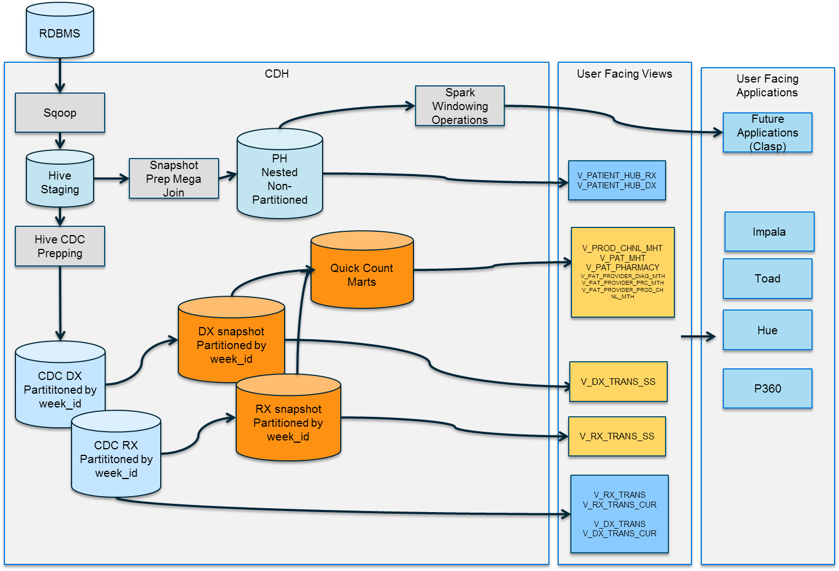
NDWx data assets
US9 Data Flow

Slide 12
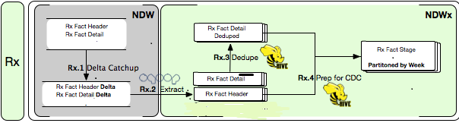
NDWx Data assets
RX data
RX Update runs on a weekly schedule (Sat midnight). It contains only the changes made since the last load (default lookback for RX is 18 months).
RX data will be stored in:
RX CDC table (combines RX Header and RX Details)
V_RX_TRANS – all records, current and expired,
V_RX_TRANS_CUR – only current records
RX action table V_RX_TRANS_ACTION
RX ancillary table V_RX_TRANS_ANCILLARY
RX SS (RX header) V_RX_TRANS_SS (recommended for ad-hoc studies)

Slide 13
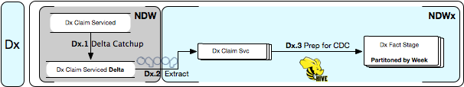
NDWx Data assets
DX data
DX Update runs on a weekly schedule (Thursday morning). It contains only the changes made since the last load (default lookback is 24 months).
DX data will be stored in:
DX CDC table (DX CLAIM SERVICE) V_DX_TRANS, V_DX_TRANS_CUR
DX CLAIM (under development) tbd
DX SS (DX claim service) V_DX_TRANS_SS
https://jiraims.rm.imshealth.com/wiki/display/NDWXONE/NDW#NDW-PatientHub

Slide 14
NDWx data assets
Quick Counts Marts
“Quick Counts” marts are tables with aggregated RX, DX raw and projected metrics (similar to Patient Mart on NDW).
Patient Eligibility
v_pat_strt_dt
v_pat_mth
RX quick count marts
v_pat_provider_prod_chnl_mth (raw count, NPA and XPO)
v_pat_pharmacy_prod_chnl_mth
v_prod_chnl_mth(new on NDWx, see next page for detail)
DX quick count marts
v_pat_provider_prc_mth
v_pat_provider_diag_mth

Slide 15
NDWx data assets
MDM stream (NDW dimensions)
v_ama_med_schl v_ama_mpa v_ama_pe v_ama_top v_calendar v_data_typ v_daw_prod_sel v_diag_mkt v_diagnosis v_dx_pln_seq_nbr_brdg v_mkt v_ndwx_load_status v_pat_excl v_patient v_pay_typ v_pep_wk v_pharmacy v_pharmacy_lkp
v_place_of_svc v_plan v_plan_lv v_pln_xfer v_prc_mkt v_prfsn_typ v_procedure v_prod_mkt v_product v_provider v_provider_lkp v_provider_restr v_specialty v_specialty_npa v_st v_supplier v_zip v_zip3

Slide 16
NDWx data assets
And more…
PEP weekly panel
v_pep_pat_wk_bitmap
v_pep_store_wk_panel
NPA/XPO views
v_nnw_npa_projd
v_nnw_xpo_projd
Access per request:
DDD data
AllScripts EMR
DDD/XPO dimensions
DXP (DX Projected) panels
v_dxp_projtn_natn21
v_dxp_projtn_natn_uso
v_dxp_projtn_pnl_natn21
v_dxp_projtn_pnl_natn_uso
v_dxp_prov_tier_natn21
v_dxp_prov_tier_natn_uso

Slide 17
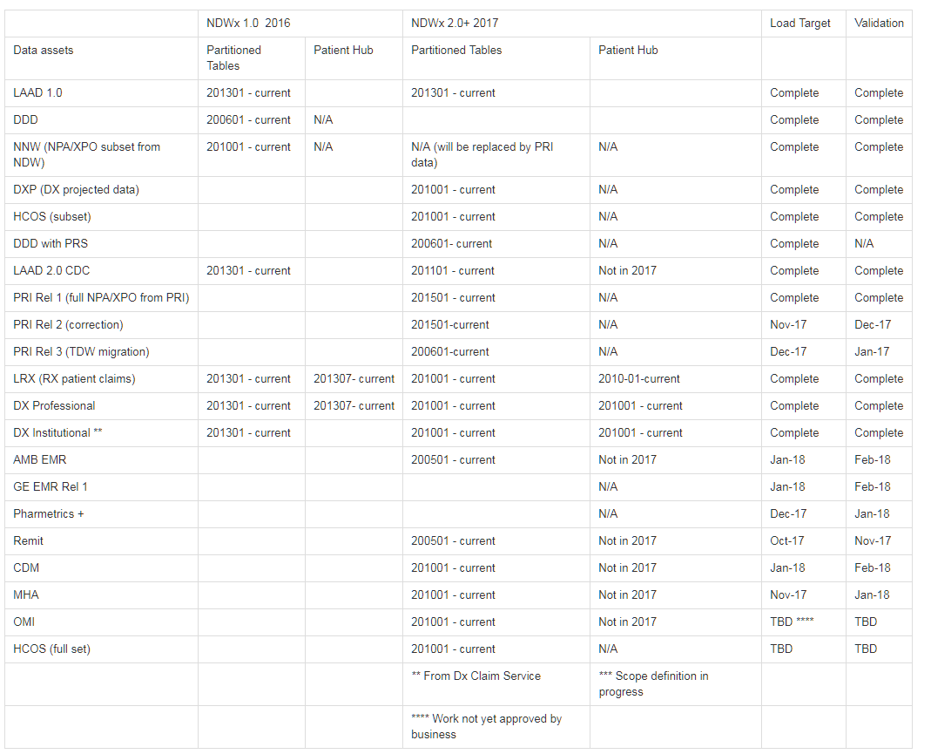
NDWx roadmap
Confluence page
https://jiraims.rm.imshealth.com/wiki/pages/viewpage.action?pageId=191607572

Slide 18
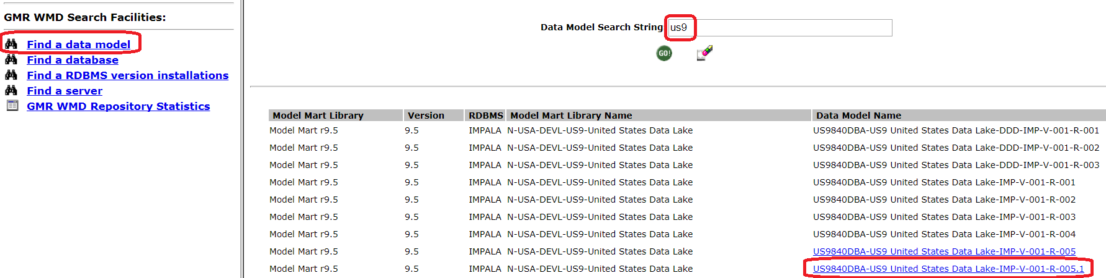
NDWx Data Dictionary
GMR
Click on Find a data model
Enter ‘us9’ in Data Model Search String and click GO!
Select most recent version/release of: US9840DBA-US9 United States Data Lake-IMP

Slide 19
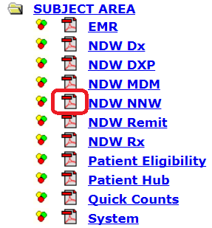
NDWx Data Dictionary
GMR
Organized by Subject Area
Click on Adobe PDF icon to display entity relationship diagram
Click on subject area name to explore views

Slide 20

NDWx Data Dictionary
Confluence
Organized by Subject Area
Additional meta data
Owner / data steward
Security groups
Page-level security available
View / edit restrictions by subject area
Notifications via page watching
Click on

Slide 21
NDWx Data Dictionary
Additional Resources
NDW to NDWx Mapping
FTPA Object List

Slide 22
Questions?

Slide 23
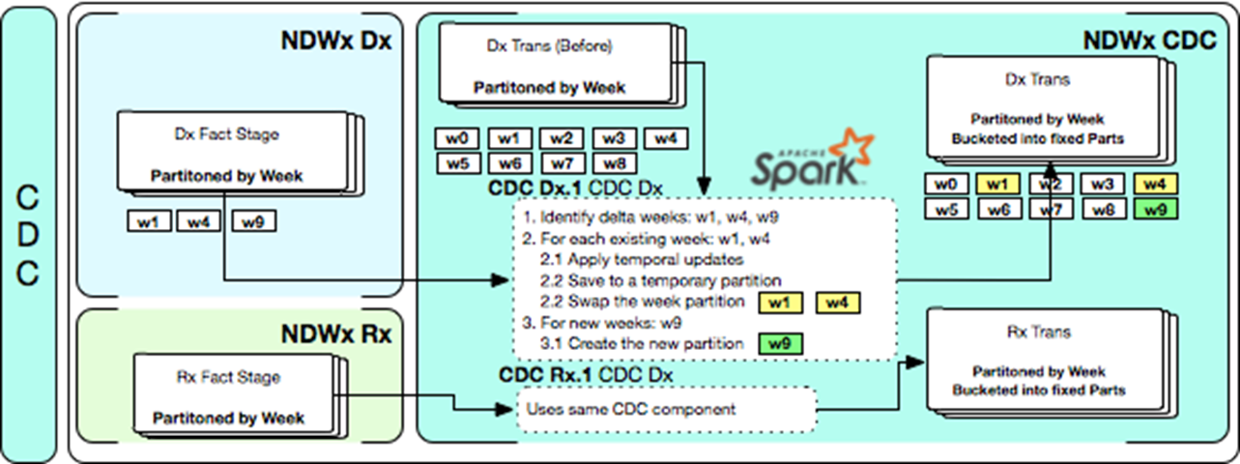
NDWx Data assets
CDC – deep dive
V_RX_TRANS – returns all versions of record (RX header and Details combined)
V_RX_TRANS_CUR – returns only “current” version of record
V_DX_TRANS – returns all versions of record (DX CLAIM SERVICE)
V_DX_TRANS_CUR – returns only “current” version of record

Slide 24
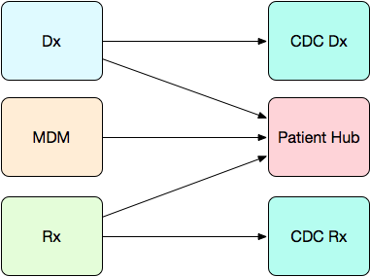
NDWx Data Assets
PH (Patient Hub)
CREATE TABLE patient_hub (
patient_id BIGINT
,pat_gender_cd STRING
,pat_brth_yr_nbr SMALLINT
,pat_elig_map STRING
,dx_vst_cmplx ARRAY<STRUCT<
vst_id: STRING
..
,billing_provider_id: BIGINT --(attribute of v_provider)
,rendering_provider_id: BIGINT --(attribute of v_provider)
,referring_provider_id: BIGINT --(attribute of v_provider)
,facility_provider_id: BIGINT --(attribute of v_provider)
,pri_spcl_cd: STRING --(attribute of v_provider)
,provider_zip: STRING --(attribute of v_provider)
...
>>
,rx_trans_cmplx ARRAY<STRUCT<
claim_id: DECIMAL(38,0)
..
,product_id: INT --(attribute of v_product)
...
,mkted_prod_nm: STRING --(attribute of v_product)
,supplier_id: BIGINT --(attribute of v_supplier)
,supplier_ndw_status_cd: STRING--(attribute of v_supplier)
,supplier_nm: STRING --(attribute of v_supplier)
...
>>
)
STORED AS PARQUET
TBLPROPERTIES('PARQUET.COMPRESS'='SNAPPY')
;
PH has 1 records per patient ID. PH is not partitioned by sorted by patients (1 HDFS file will have bucket of patients).
RX and DX claims in PH are denormalized, and major dimensional attributes appended to the claim.
PH re-created every week to reflect all dimensional changes
RX and DX claims presented as nested structures within 1 patient record.
PH is not recommended for Impala use (db stats are not supported on nested structures).

Slide 25
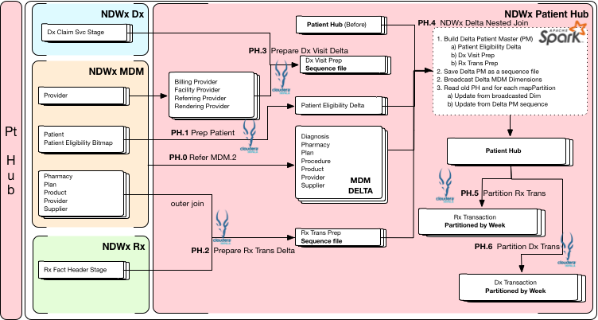
NDWx data assets
PH – deep dive

Slide 26

Impala

Slide 27
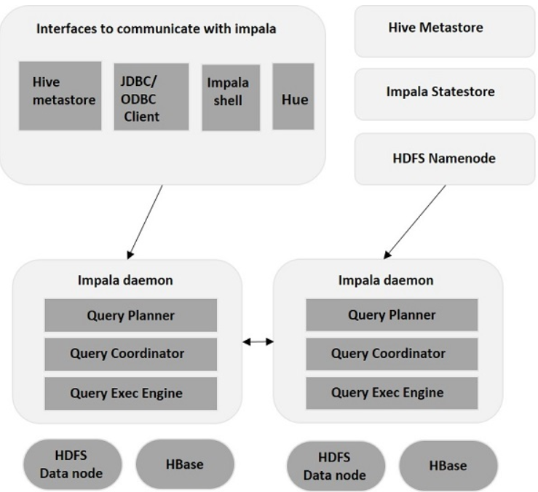
Impala
What is Impala?
Impala is a MPP (Massive Parallel Processing) SQL query engine for processing huge volumes of data that is stored in Hadoop cluster. It is an open source software which is written in C++ and Java.

Slide 28
Impala Interfaces
You can use impala shell to interact with impala
Staring the Shell
$ impala-shell
Connecting to a another Impala daemon unlike about command which connects to localhost
$ impala-shell --ssl -k -i cdts10hdcu08d.rxcorp.com:25003
Getting the list of command line arguments
$ impala-shell -help

Slide 29


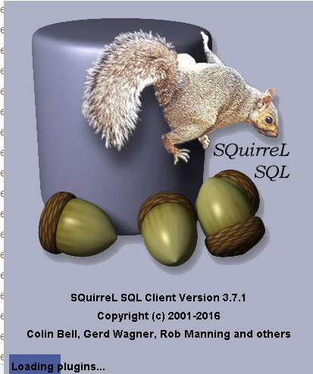
How to connect to Impala
Available GUI
Hue
HUE stands for Hadoop User Experience
HUE is a Browser way of interacting with Hadoop
SQuirreL
The SQuirreL SQL Client is a database administration tool.
It provides an editor that offers code completion and syntax highlighting for standard SQL.
MobaXterm and Putty
MobaXterm is your ultimate toolbox for remote computing. It has both network tools and also Unix commands.

Slide 30
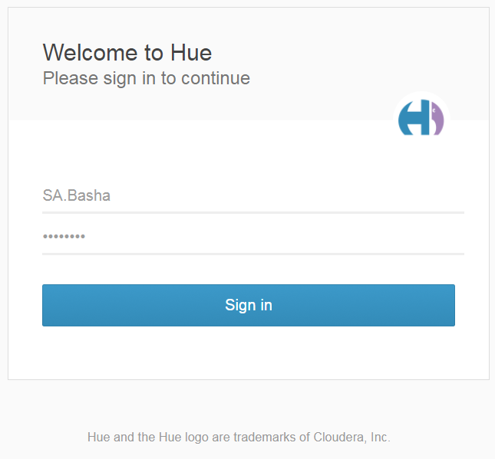
HUE
URL:
https://cdts10hdbe01d.rxcorp.com:8888
Username
Password

Slide 31
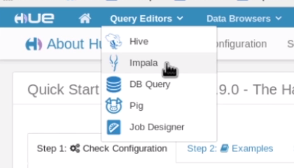
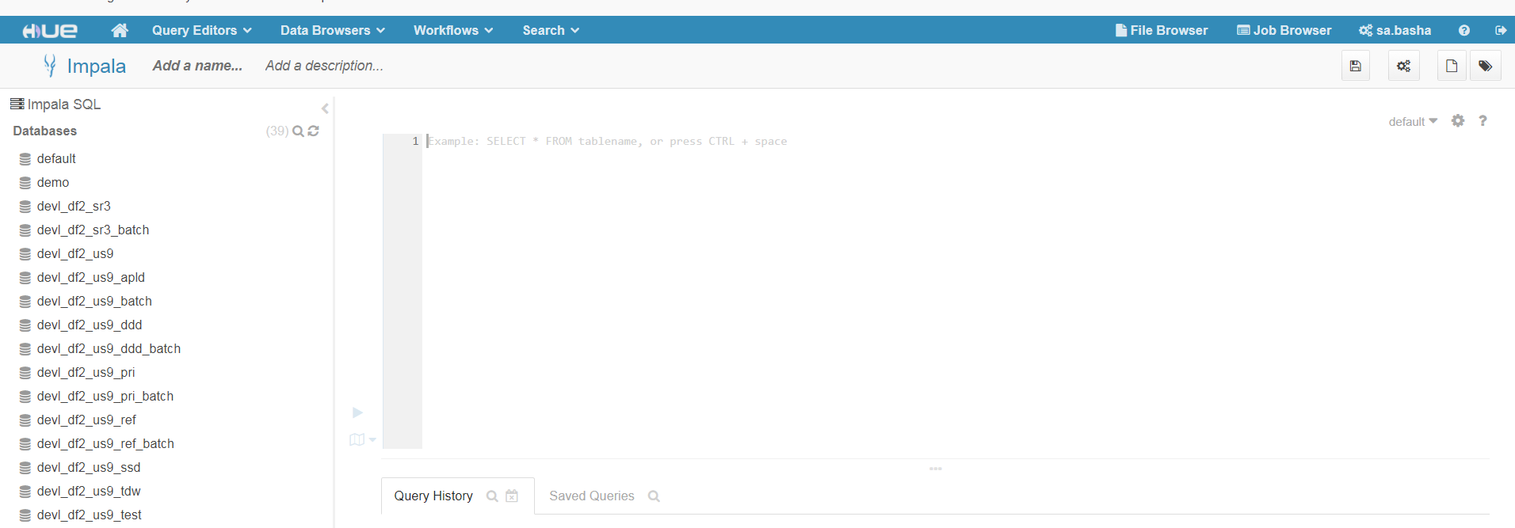
Steps to Start Impala Browser:
List of Databases
Query Area

Slide 32
Basic Impala commands
Show databases; This will show all the databases available in the Server.
Use [database]; This is use to SELECT a particular database to work with.
Show tables; This will show all the available tables in the database.
Show column stats [table]; This will show the column stats of a particular table.
Explain [sql]; This command will show the EXPLAIN PLAN of a SQL statement.
Describe [table]; This will show the structure of a table.
Refresh [table]; This commands is used to reflect changes in impala which were
made in hive
Do not run “invalidate metadata”!! (only run if you create new table)
https://www.cloudera.com/documentation/enterprise/5-8-x/topics/impala_langref.html

Slide 33
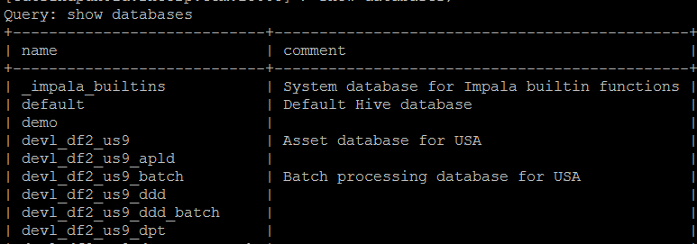

Basic Impala commands (CONTD….)
Once you get connected to Impala, it is required to View databases which are accessible to user:
To SELECT a particular database:

Slide 34
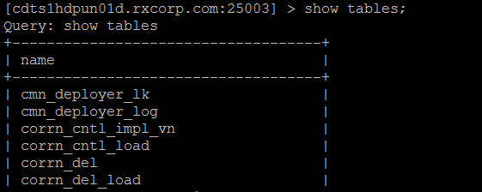
Basic Impala commands (CONTD….)
To show all the available Tables in a particular database;
To show the Structure of the Table:
DESCRIBE <TABLENAME>

Slide 35
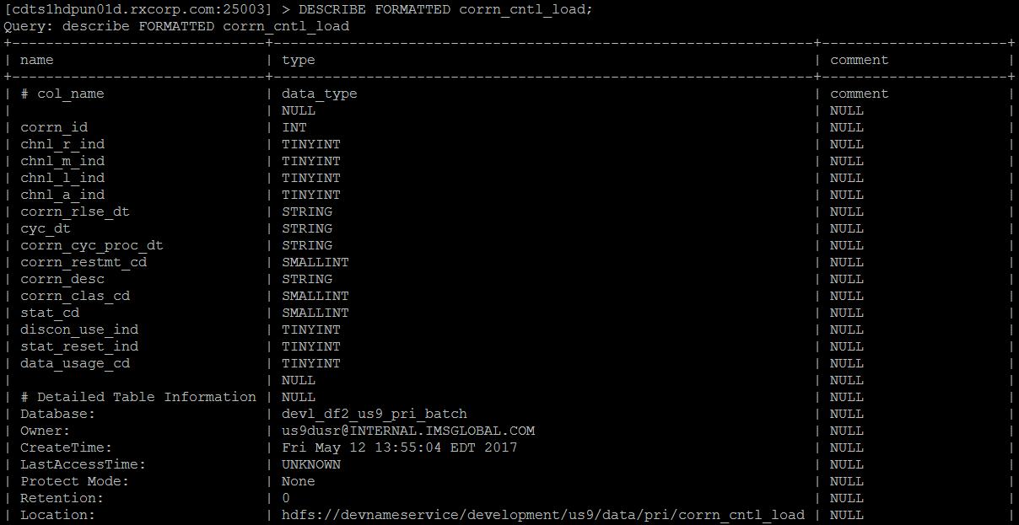
Basic Impala commands (CONTD….)
DESCRIBE FORMATTED command

Slide 36
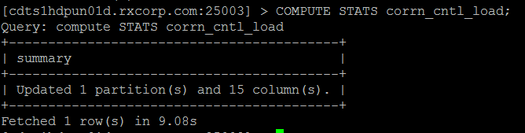
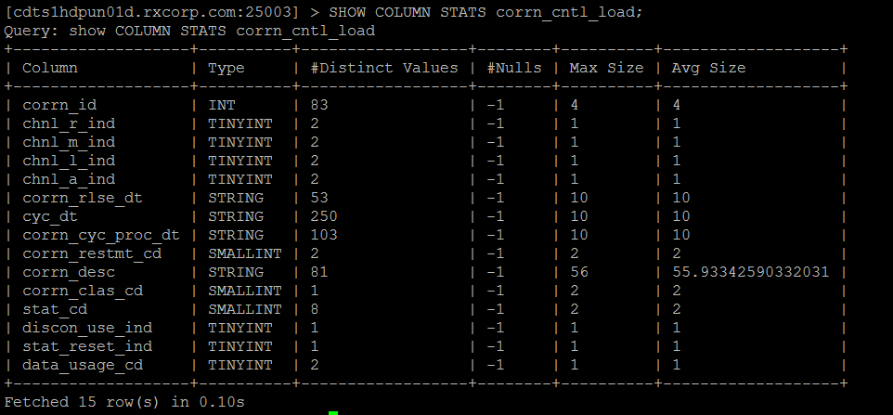
Basic Impala commands (CONTD….)
COMPUTE STATS Command
SHOW TABLE STATS Command
SHOW COLUMNS STATS Command

Slide 37
Demo By Instructor
Demo on Connecting using impala-shell
Demo on Connecting using Hue and Run sample Queries

Slide 38
Exercise 1
Impala Basic Shell commands
1. Start Putty at Edge Node:cdts10hdbe01d and login to impala demon using below details :
UserName:
Password:
Host: cdts1hdpun01d.rxcorp.com
Port: 25003
2. Use your favorite Web Browser to Login and connect to Hue using the below details:
URL: https://cdts10hdbe01d.rxcorp.com:8888/accounts/login/?next=/
3. Type below commands in the impala-shell and capture the output
help
version
history
tip
4. List all the available databases in the above connection and Select devl_df2_us9_dpt database.
5. List all the available tables in the devl_df2_us9_dpt database.
6. Explore other commands and exit the impala-shell

Slide 39
CREATE TABLE
Tables are the primary containers for data in Impala. They have the familiar row and column layout similar to other database systems, plus some features such as partitioning often associated with higher-end data warehouse systems.
Two Types :
Internal tables are managed by Impala, and use directories inside the designated Impala work area.
External tables use arbitrary HDFS directories,
where the data files are typically shared between
different Hadoop components.

Slide 40
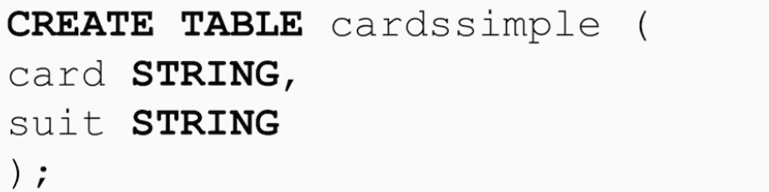
INTERNAL TABLES
This is the default table type which we create from CREATE TABLE statement.
Impala will create a HDFS directory with the table name for each table.
HDFS directory will be in /user/hive/warehouse/<tablename>

Slide 41
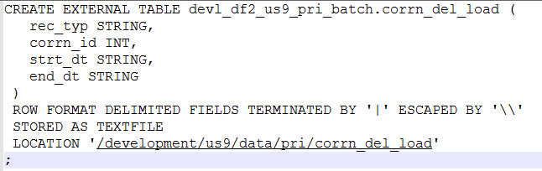
EXTERNAL TABLES
This is not the default table type which we create from CREATE EXTERNAL TABLE statement.
Tables which are outside the /user/hive/warehouse are called EXTERNAL tables.
EXTERNAL table’s data is not deleted during the table DROP.

Slide 42
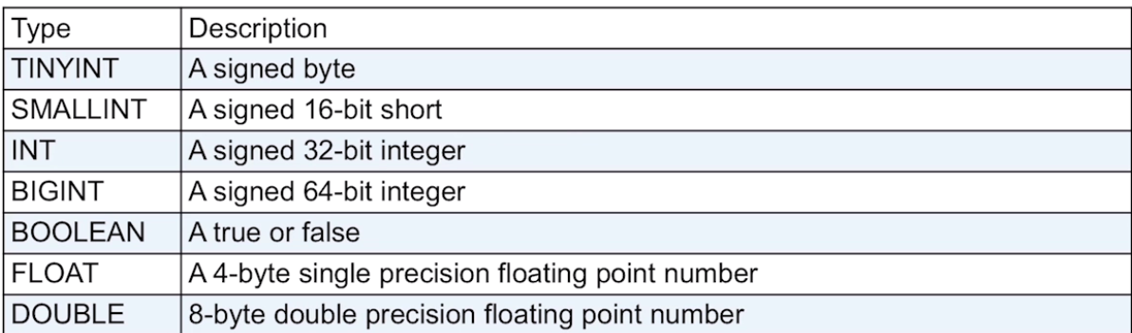
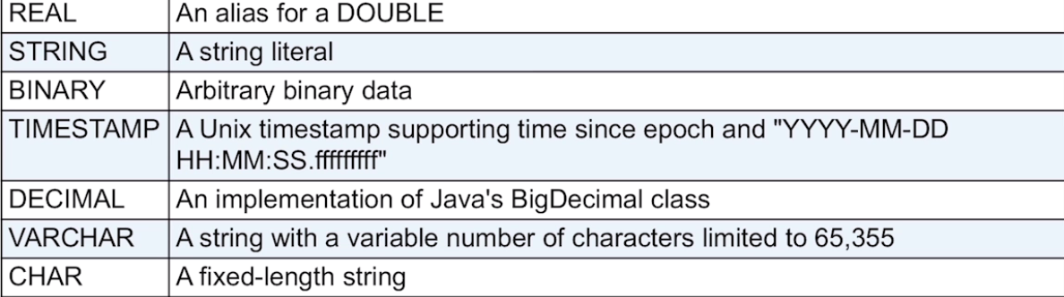
Data Types

Slide 43

INSERT
INSERT Statement of Impala has two clauses − into and overwrite.
Syntax:
To INSERT data into an employee table of structure:
insert into tablename (column1, column2, column3,...columnN)
values (value1, value2, value3,...valueN);
The overwritten records will be permanently deleted from the table.
Following is the syntax of using the overwrite clause.

Slide 44
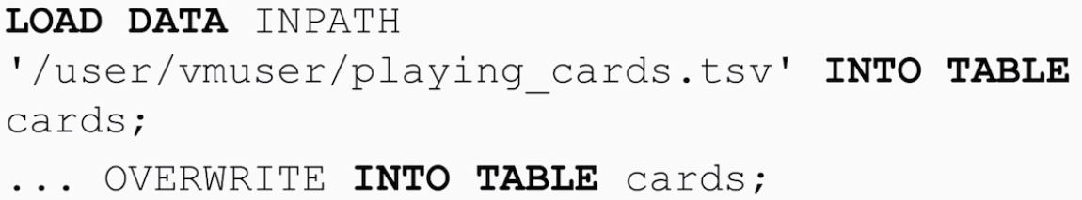
LOADING Data into Table
Data can be inserted into a table directly with out the INSERT statement using
Two different Ways:
Using Hadoop fs command.
2. Using Hadoop HDFS Command

Slide 45
Demo By Instructor
Demo on Creating tables.
Demo on Loading data to EXTERNAL table.

Slide 46
Sample queries
List all the available market and number of product_id’s:
select PROD_MKT.mkt_nm,count( PRODUCT.product_id ) from V_PRODUCT PROD
INNER JOIN V_PROD_MKT MKT
ON( PROD.product_id= MKT.product_id)
group by 1
order by 1
;
List all the number of product_id for a particular market:
select count(*) from V_PRODUCT PROD
INNER JOIN V_PROD_MKT MKT
ON( PROD.product_id= MKT.product_id
AND mkt_nm='HYPERTENSION');

Slide 47
Sample queries
Check if there are any duplicate product_id for particular market:
select PRODUCT.product_id, count(*) from V_PRODUCT PRODUCT
INNER JOIN V_PROD_MKT PROD_MKT
ON(
PRODUCT.product_id=PROD_MKT.product_id)
where mkt_nm='HYPERTENSION'
GROUP BY 1
HAVING COUNT(*) > 1;
List number of records for a particular market:-
SELECT COUNT(*) FROM V_RX_TRANS_SS RX_TRANS
INNER JOIN V_PRODUCT PRODUCT
ON ( RX_TRANS.ndc= PRODUCT.ndc )
INNER JOIN V_PROD_MKT PROD_MKT
ON(PRODUCT.PRODUCT_ID=PROD_MKT.PRODUCT_ID)
where RX_TRANS.week_id=20100101
and mkt_nm='HYPERTENSION'

Slide 48
Sample queries
List the number of GOOD CLAIMS for a particular market across all the weeks:
SELECT WEEK_ID,COUNT(*) FROM V_RX_TRANS_SS RX_TRANS
INNER JOIN V_PRODUCT PRODUCT
ON (RX_TRANS.ndc= PRODUCT.ndc )
INNER JOIN V_PROD_MKT PROD_MKT
ON(PRODUCT.PRODUCT_ID=PROD_MKT.PRODUCT_ID)
where
PROD_MKT.mkt_nm='HYPERTENSION'
AND FINAL_STATUS in ('C','O','V')
group by 1 order by 1;

Slide 49
Exercise 2
On CREATE and LOADING data
Login to impala database “prod_df2_us9_DPT” or “devl_df2_us9_DPT” and Create an EXTERNAL table MARKET_LOAD_<EMPID> based on below structure and verify it.
+---------+--------+
| name | type |
+---------+--------+
| act_ind | string |
| mkt_cd | string |
| mkt_id | string |
| mkt_nm | string |
+----------+--------+
2. Load the attached csv file into MARKET_LOAD_<EMPID> table.
3. Count the records loaded in the MARKET_LOAD_<EMPID> table. And list all the market names
starting whose second letter is ‘i’
4. GENERATE STATS on the table created.
5. DROP the table MARKET_LOAD_<EMPID>.

Slide 50
Sample Korn Shell Script file
Korn shell script provide a great flexibility of combining shell commands and impala-shell commands and execute them.
We can use –f option of impala-shell commands to pass the sql file as an argument to impala for executing.
Below is code snippet:
impala-shell --ssl -k -i cdts1hdpun01d.rxcorp.com: 25003 -B -f <sqlfilename.sql>
Below is a sample korn shell for listing all the tables from devl_df2_us9_batch database which has “load” string in them.

Slide 51
Demo By Instructor
Demo on Sample Shell Commands
Demo on Running sample Korn Shell script
Demo on Connecting to Cloudera Manager and show below:
See Running Queries
Kill long running Queries
See EXPLAIN PLAN graphically.

Slide 52
Impala Hints
The Impala SQL dialect supports query hints, for fine-tuning the inner workings of queries.
Hints are most often used for the most resource-intensive kinds of Impala queries:
Join queries involving large tables, where intermediate result sets are transmitted across the network to evaluate the join conditions.
Inserting into partitioned Parquet tables, where many memory buffers could be allocated on each host to hold intermediate results for each partition.
BROADCAST :Makes that join operation use the "broadcast" technique that sends the
entire contents of the right-hand table to all nodes involved in processing
the join.
SHUFFLE : Makes that join operation use the "partitioned" technique, which divides up corresponding rows from both tables using a hashing algorithm, sending
subsets of the rows to other nodes for processing.
https://www.cloudera.com/documentation/enterprise/5-9-x/topics/impala_hints.html

Slide 53
Exercise 3
On Shell Scripts
Write a shell script to display the count of product_id for market name =“GLAUCOMA”.
Write a shell script to display the number of transactions in V_RX_TRANS view for week_id=“20170407”.
Write a shell script to compute stats on all the tables ending with “_load”.

Slide 54


Contact us at quintilesims.com
Notes:
QuintilesIMS creating solutions for you to drive healthcare forward
Thank you

