Slide 1
BI sharing and ML software intro
March 31, 2017

Slide 2
Agenda
Introduction to BI IPF project
Background
Data and Preprocess
Modelling
Results
R skills and packages
Customized caret
mlR
Funtional
Spark
Git

Slide 3
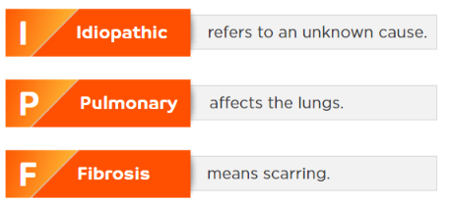
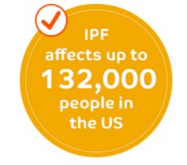
Background of BI IPF project
Idiopathic Pulmonary Fibrosis (IPF) is a relative rare condition which had no approval treatments options until OFEV launched in 2014
IPF is difficult to diagnose and has been frequently misdiagnosed in the past. IPF may present the same way as some heart or lung diseases, such as Asthma or COPD.
IMS will build a predictive model that will be used to find IPF patients. This will be accomplished by profiling IPF patients, building a predictive model to find pre-IPF patients and subsequently linking these patients to the HCPs in a position to diagnose them

Slide 4
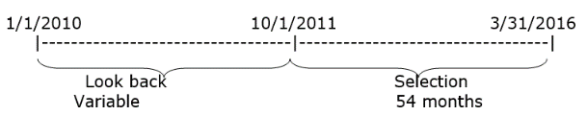
Data and Preprocess
Data source:
Prescription data(LRx)
IMS Dx medical claims
BI SPP data(The Rx transactions from specialty pharmacy feed provided by BI for OFEV product. We will be able to link the patients from this data to IMS Patient ids using the encrypted patient keys).
Study period

Slide 5
Data and Preprocess (cont.1)
Cohort selection
IPF patient cohort: (N=8574)
Patients treated with OFEV using BI SPP Data
Patients treated with OFEV or Esbriet in IMS LRx data
Patients diagnosed with IPF since Oct 2011
First exposure date: earliest date of IPF diagnosis or IPF treatment (Rx or procedure) back to Jan 2010
Non-IPF patient cohort: (N=8574*200)
Patients should have at least 1 claim for the Predictor variables
Patients should exist in both LRx and Dx data
Patient should have similar lookback period as IPF patient
Etc..
Scoring sample: (N~26M)
Patients should have at least 1 claim for the Predictor variables
Patients should exist in both LRx and Dx data
Patients with Index date (calculated as latest of Rx and Dx date available) within most recent 24 months.
Etc..

Slide 6
Data and Preprocess (cont.1)
Features
Patient ID (primary key)
Age
Gender
Available lookback period
Rx/Dx flag
Rx/Dx date
Average Rx/Dx
Etc..
Preprocess
Imputation (with 0)
Capping (max(p99_ipf, p99_nonipf))
Create 4 count variables ( for Symptoms, Procedures, Respiratory Comorbidities, Non-Respiratory Comorbidities)
Create 2 simple interaction terms
Create sequential variables
Standardization

Slide 7


Modelling
Improved Performance? Yes
Improved Performance? No
Decision Tree
Logistic Regression
Random Forest
Improved Performance? Yes
Logistic Regression
with Interactions
Improved Performance? Yes
2 Stage Logistic Regression with Interactions

Slide 8
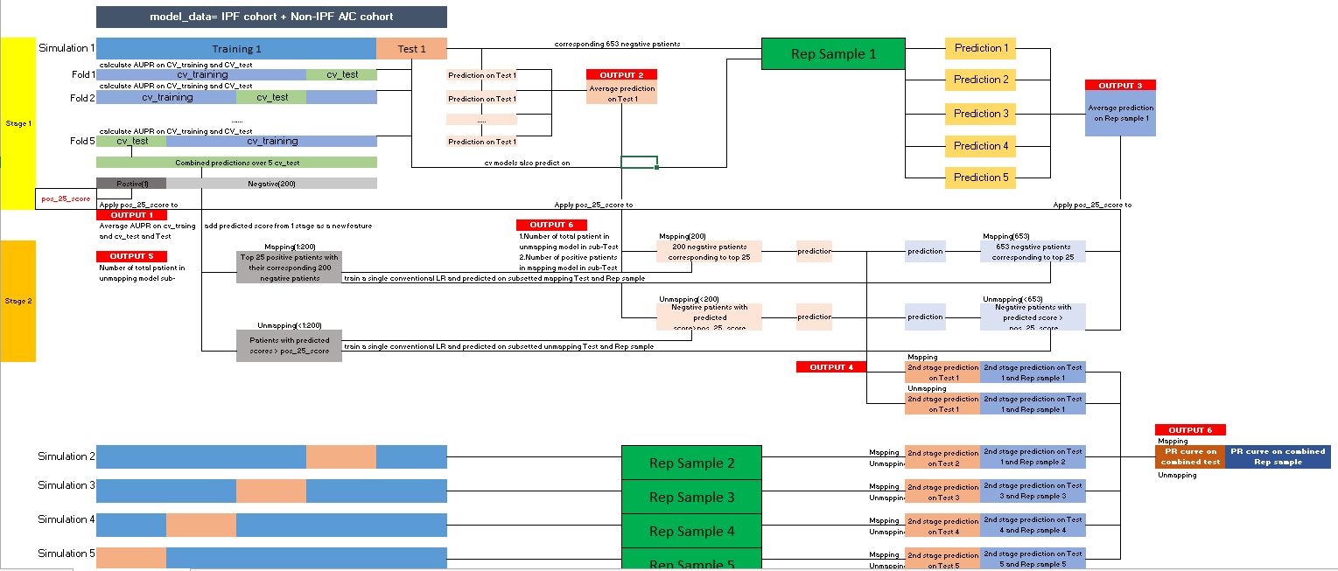
Modelling
Detailed workflow

Slide 9
Results
2 Stage Logistic Regression model resulted in much greater performance than all other tested models, notably achieving a precision of 13.7% at 5% recall
~13.7% Precision at 5% Recall
If the goal is to find 5% of IPF patients, roughly every 7th patient will be identified correctly
~8.5% Precision at 10% Recall
If the goal is to find 10% of IPF patients, roughly every 12th patient will be identified correctly
Precision
Of all patients who were flagged, what % actually have the rare disease?
~4.5% Precision at 20% Recall
If the goal is to find 20% of IPF patients, roughly every 22nd patient will be identified correctly
Recall
What % of actual rare disease patients were flagged by the model?

Slide 10
Agenda
Introduction to BI IPF project
Background
Data and Preprocess
Modelling
Results
R skills and packages
Customized caret
mlR
Functional
Spark
Git

Slide 11
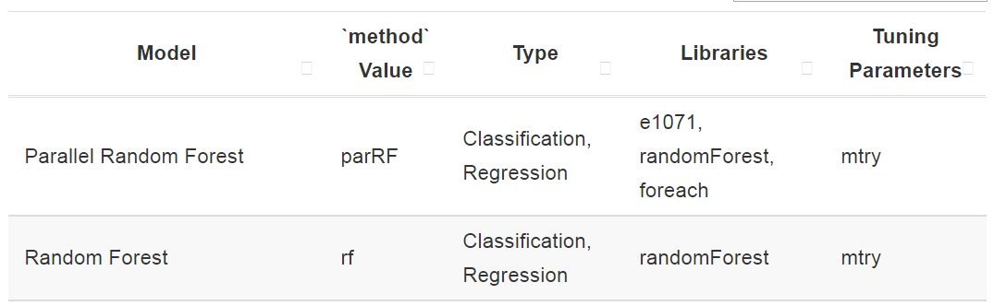
Customize caret
Caret package is a set of functions that attempt to streamline the process for creating predictive models.
Caret package: http://topepo.github.io/caret/index.html
However the build-in tuning parameters are not enough for us, e.g.
Adding more parameters: see Notebook

Slide 12
Customize caret
Sometimes we need to use the metrics other than AUC, AUPR or MSE, so we have to define the metrics to select best model by ourselves in caret.
See Notebook

Slide 13
mlr package
Website: https://mlr-org.github.io/mlr-tutorial/release/html/
See Notebook

Slide 14
Functional
R, at its heart, is a functional programming (FP) language. This means that it provides many tools for the creation and manipulation of functions
----Hadley Wickham, “Advanced R”
See examples in Notebook

Slide 15
Agenda
Introduction to BI IPF project
Background
Data and Preprocess
Modelling
Results
R skills and packages
Customized caret
mlR
Functional
Spark
Git

Slide 16
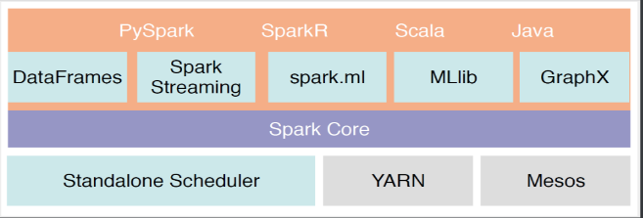
Spark
Simple review:
is a fast and general engine for large-scale data processing.
Framework for distributed processing
In-memory, fault tolerant data structures
Flexiable APIs in Scala, Java, Python and R
Cluster manager deploy on:
Standalone
YARN(Yet Another Resource Negotiator)
Mesos

Slide 17
Spark on AWS
AWS(Amazon Web Services)
AWS EMR(Elastic MapReduce)
EC2(Amazon Elastic Compute Cloud)
Instance is the virtual computing environment; we can see it as a host/server in cloud
Instance types: different types provide various configuration of CPU, memory, storage, network capacity and even purpose. See all the types in http://aws.amazon.com/ec2/instance-types/.
Cluster is a set of virtual servers running on EC2 instances, i.e. a cluster of instances.
Amazon S3(Simple Storage Service) is storage for the Internet. we can read in the data from S3 bucket to cluster by Spark directly, the data would be deployed as distributing data automatically on all of the slave nodes.
Node: we define 2 roles for the virtual servers(instances):a. master node: manage the cluster, do not run tasks; b. slave node: only run tasks.

Slide 18
Our current cluster
Connect by PuTTY
Observed from Chrome
Transfer data by Cloudberry/WinSCP
See example in notebook and Pycharm

Slide 19
Install standalone Spark and run in Pycharm
All of the softwares are in \\bejvfps01\GTO Stats AA\Public\hjin\Standalone_Spark
Installation:
JDK: Install it on your laptop and make sure the path of java JDK is in your PATH variable. E.g. C:\Program Files\Java\jre1.8.0_121
Spark: unzip it to a folder like “C:\spark”
Add environment variables: please add these variables to your PATH, PYTHONPATH variables:
PATH :
C:\spark\spark-2.0.2-bin-hadoop2.7\bin;
C:\spark\spark-2.0.2-bin-hadoop2.7\python;
C:\spark\spark-2.0.2-bin-hadoop2.7\python\lib\pyspark.zip;
C:\spark\spark-2.0.2-bin-hadoop2.7\python\lib;
C:\spark\spark-2.0.2-bin-hadoop2.7\python\pyspark\;
C:\Java\jdk1.7.0_79\bin
PYTHONPATH:
C:\spark\spark-2.0.2-bin-hadoop2.7\python;
C:\spark\spark-2.0.2-bin-hadoop2.7\python\lib\py4j-0.10.3-src.zip

Slide 20
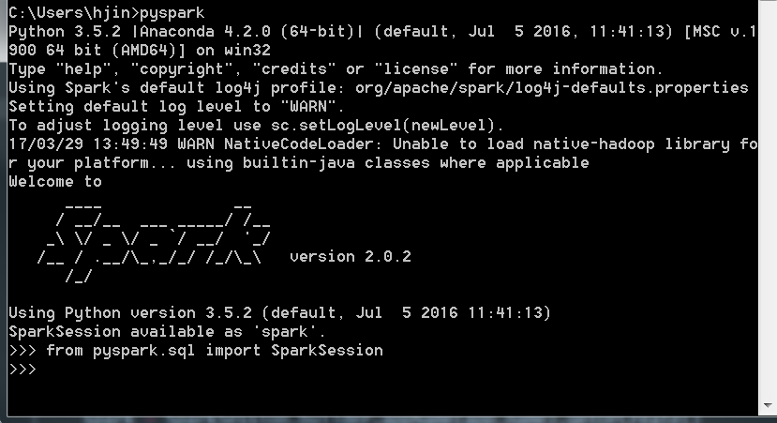
Install standalone Spark and run in Pycharm
Now the standalone mode of Spark should be okay on your laptop, enter `pyspark` in cmd to launch a pyspark-shell to test.
And we can observe the Spark job in localhost:4040

Slide 21
Install standalone Spark and run in Pycharm
In Pycharm, it would be a little bit tricky, you should:
Create a new project in Pycharm
Open Run > Edit Configuration, add a new python configuration, name it and select the script you would like to run.
In the Environment Variable option, add 2 variables
PYTHONPATH=C:\spark\spark-2.0.2-bin-hadoop2.7\python;C:\spark\spark-2.0.2-bin-hadoop2.7\python\lib\py4j-0.10.3-src.zip
SPARK_HOME=C:\spark\spark-2.0.2-bin-hadoop2.7
Open Setting > Project > Interpreter Structure, add below to the content root
C:\spark\spark-2.0.2-bin-hadoop2.7\python\lib\py4j-0.10.3-src.zip
C:\spark\spark-2.0.2-bin-hadoop2.7\python\lib\pyspark.zip
Then you should be fine to run Pyspark code from Pycharm, see example

Slide 22
Agenda
Introduction to BI IPF project
Background
Data and Preprocess
Modelling
Results
R skills and packages
Customized caret
mlR
Functional
Spark
Git

Slide 23
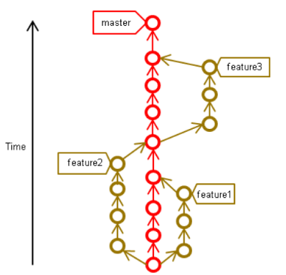
Simple intro to Git
Git is for synchronizing and tracking collaborative projects
Install:
Git from https://git-scm.com/
TortoiseGit
Typical structure on one computer
Useful command
Git init
Git clone
Git remote
Git add
Git commit
Gitk
Git branch
Git checkout
Git merge
Git pull/push

Slide 24
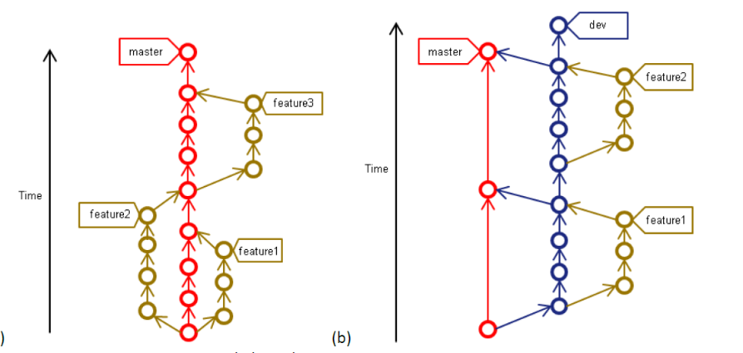
Simple intro to Git
Git branch

Slide 25
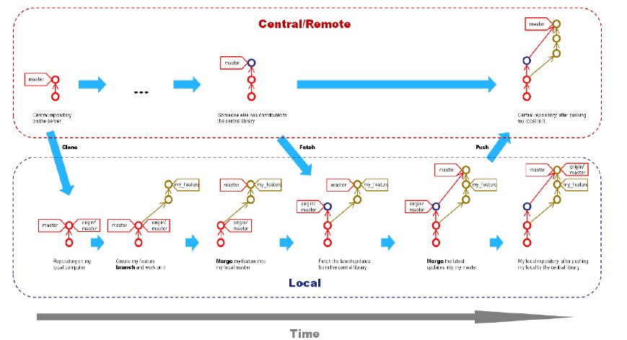
Simple intro to Git
Workflow using Git with local and central repo

Slide 26
The end, Q&A time.
Thanks for watching!!

