Slide 1
PAQC
Research agenda and prioritization
18th December 2017
Frederik Dieleman, Daniel Homola

Slide 2
Aims and overview
Implemented QC
Configuration of QC pipeline
Reports

Slide 3
Aims
Make a Python package that standardizes and automates the quality checking process of data files
Has to work with data tables from BDF, SQL and CSV
Has to be modular, flexible, maintainable
Has to be easy to configure, and learn
Has to generate useful reports that are easy to work with
Has to work on servers without graphical user interface
Has to be as quick as possible

Slide 4
PAQC
Written in Python 3, heavily relying on pandas
Contains ~50 QC functions
19 general QC functions
25+ ETL process specific QC functions
5 comparison QC functions
Unit tested
PAQC has 120+ unit tests, ensuring that the implemented QC functions do what they say on the tin
Adding new functionality to the package cannot break old functionality
Documented with Sphinx
Ensures documentation is always up to date, searchable and maintained automatically
Version controlled on GitLab with master and dev branch

Slide 5
Implemented QCs
Overview of all the implemented tests is available in paqc/data/overview_QC.xlsx:
ID | Test data | Test description | Parameters
1 | General | Testing if all column names of dataframe have no special characters and no spaces. They should only contain letters, numbers and underscores.
 | General | Make sure date columns are all in the same format. This is not a QC, but ensured when the data is loaded in.
22 | CP01 | Dataset has only patients in it who meet at least one of the selection criteria listed in CC01_CP
23 | CP01 | INDEX_DT should be strictly before the Disease_FRST_EXP_DT | diseasefirstexp_col='diseasefirstexp_dt'
24 | CP01 | Checks that all stratification and custom criteria dates are always between and including the INDEX_DATE and LOOKBACK_DATE.
25 | CS02 | Dataset has NO patients in listed in CP01, check with patient_id | path_file_cp01='data/cp01.csv' pat_id_col_cp01='patient_id'

Slide 6
The two main datetime related tests rely on their parameters to create specific QCs
ID | Test data | Test description | Parameters
9 | General | General function to compare chosen date columns with one other date column, it tests if columns_a are </<=/>=/> column_b, where the comparison operator is defined by the parameter comparison. | keys_columns_a=('first_exp_date_cols') comparison='>' key_column_b='lookback_date_col' axis=0
10 | General | General function to compare the first_exp_date and last_exp_date columns of chosen criteria (CC01_CP, CC02_CP, CC03_CP, with one other date column. | lvl1_desc=1 comparison='>' key_column_b='lookback_date_col' axis=0

Slide 7
Compare QCs are used to check the changes of a new data pull with the previous one
ID | Test data | Test description | Parameters
46 | Compare | Two dataframes have the same columns and they are in the same order. If not, report which column is present only in A and which one in B.
47 | Compare | Two dataframes have the same number of rows and patient IDs are in the same order. If not, report which row is present only in A and which one in B.
48 | Compare | Make sure that the columns that were supposed to remain intact (including the patient ID and label columns) are identical between the two versions. | ls_colnames=()
49 | Compare | For each column that has changed calculate and report the min, median, mean and max values and the percentage of zeros and missing in both files. Furthermore add two more columns that can be used for ranking this table and order the table by the first by default: - Difference in number of non-missing values
50 | Compare | Check if the percentage of missing and zero values across the classes are the same in both files within an X% error rate. | max_fraction_diff=0.1

Slide 8
Overview
User defined configuration file (YAML)
BDF – Hadoop tables
SQL - Legacy ETL pipeline
CSV files
Check and parse config file
Load data using the connectors
Execute QC functions on data files sequentially (pandas)
Generate report (HTML)
Save data into feather format (Python, R compatible)

Slide 9
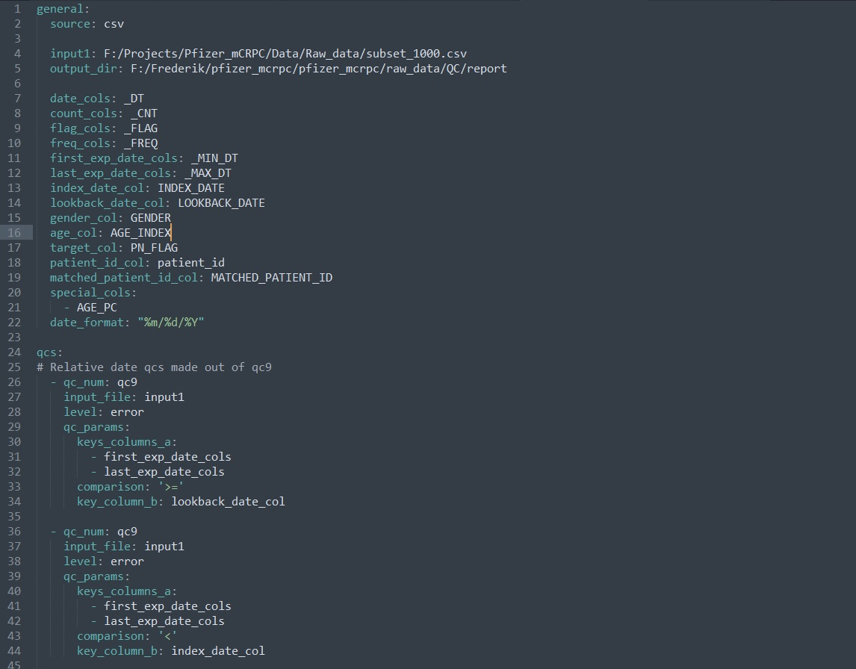
Config files are written in YAML

Slide 10
Reports are generated in HTML and CSV
HTML files are self contained and information rich
All data and JavaScript are in there
They can be sent around or saved for later
CSV version are for servers without a browser or GUI

