Slide 1
Asynchronous Advantage Actor-Critic (A3C)
Asynchronous: In A3C there is a global network, and multiple worker agents which each have their own set of network parameters. Each of these agents interacts with it’s own copy of the environment at the same time as the other agents are interacting with their environments.
Actor-Critic: Network will estimate both a value function V(s) (how good a certain state is to be in) and a policy π(s) (a set of action probability outputs)
Advantage: taking a certain action leads to higher expected return than average
Discounted Reward: R = γ(r)
Advantage: A = Q(s,a) - V(s)
Advantage Estimate: A = R - V(s)

Slide 2
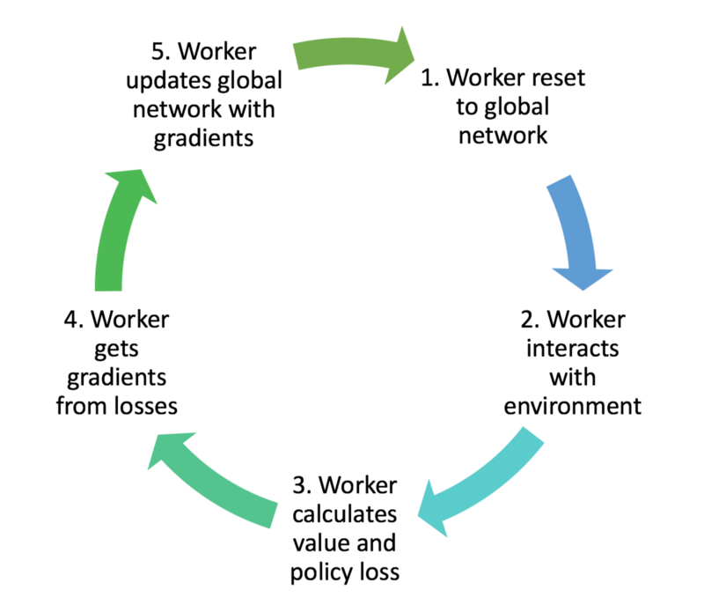
Asynchronous

Slide 3
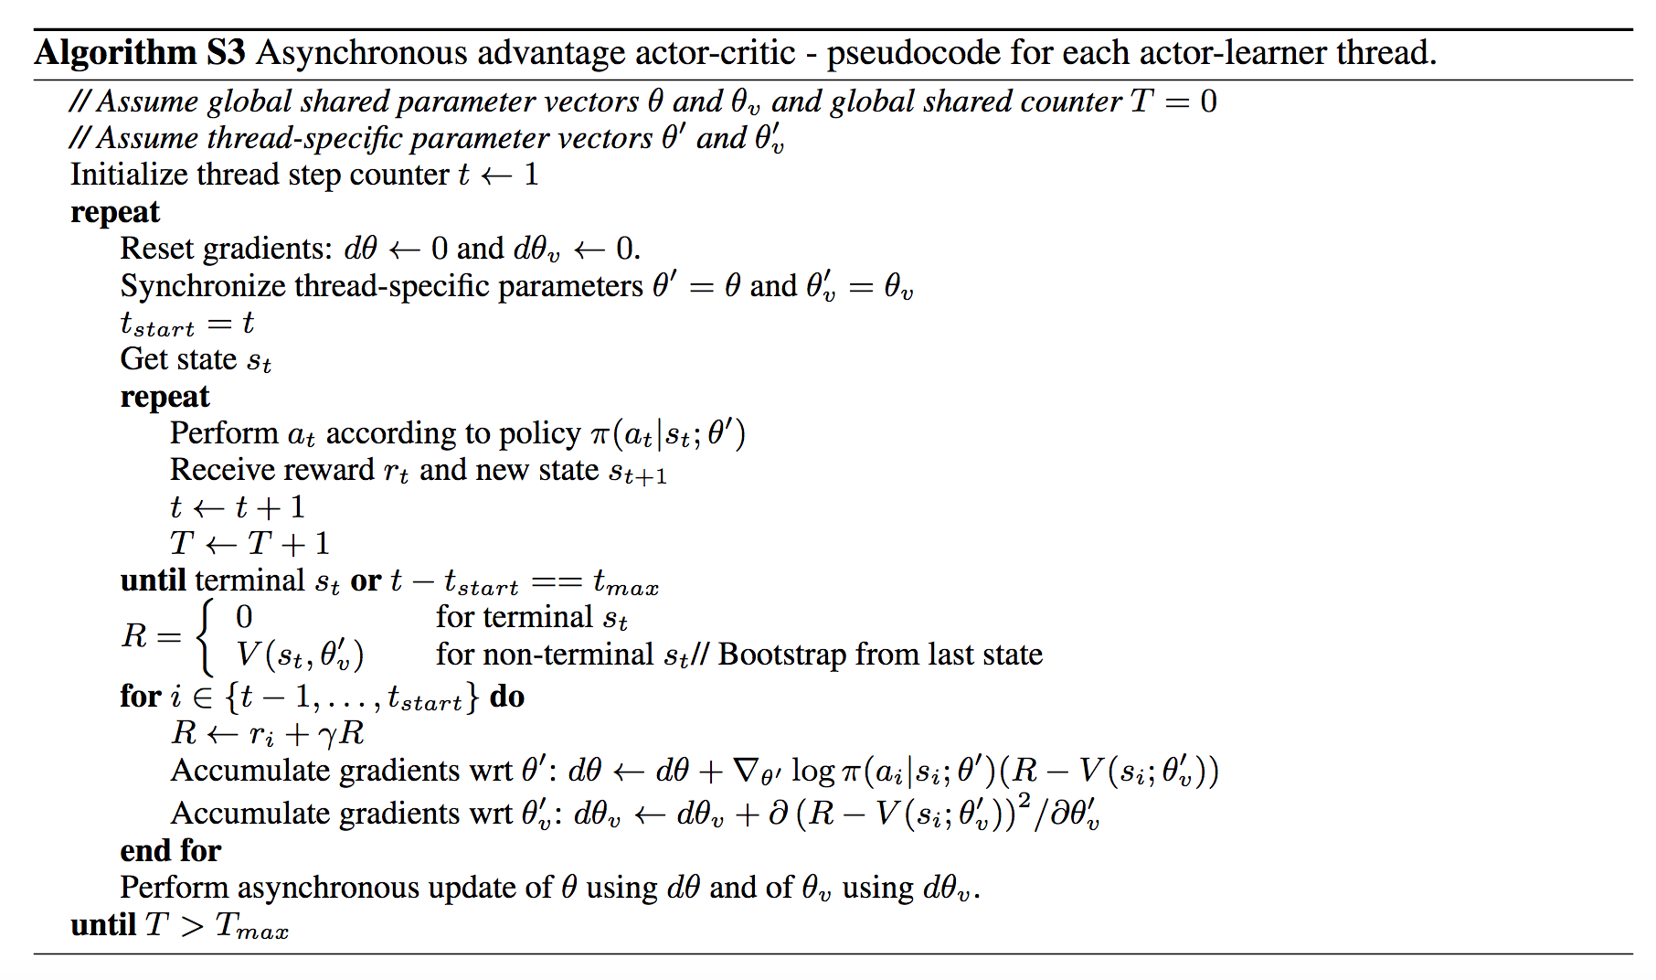

Slide 4
A3C network configuration
Input | 84 x 84 x 4
First Convolutional Layer + MaxPooling | 32 filters of size 42 x 42
Second Convolutional Layer + MaxPooling | 64 filters of size 21 x 21
Third Convolutional Layer + MaxPooling | 64 filters of size 10 x 10
Fully Connected Layer and Output Layer | Two separate fully-connected layers. One for value function, one for policy. 512 hidden units, 1 output for value function, num of action for policy

Slide 5
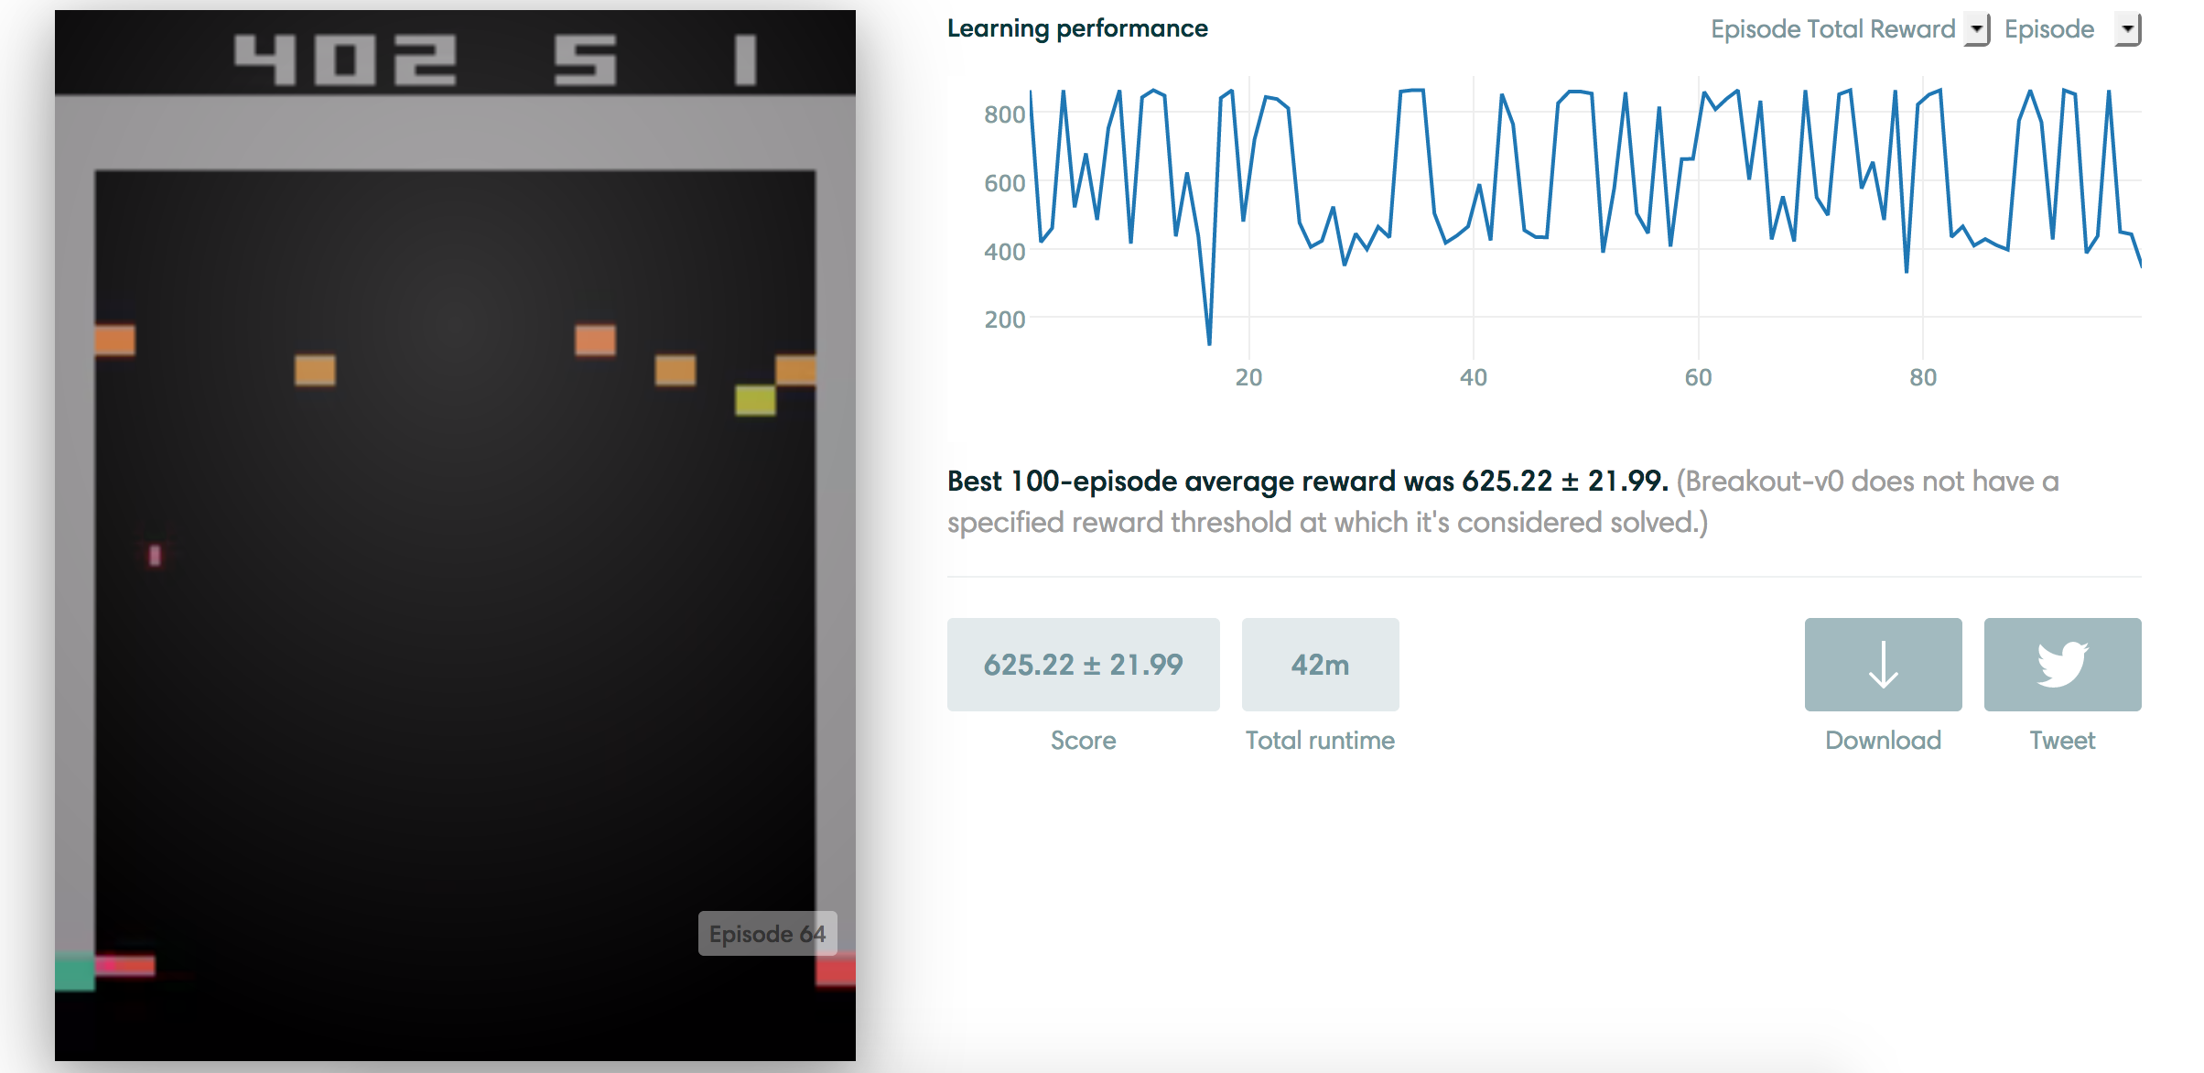
Breakout with A3C

Slide 6
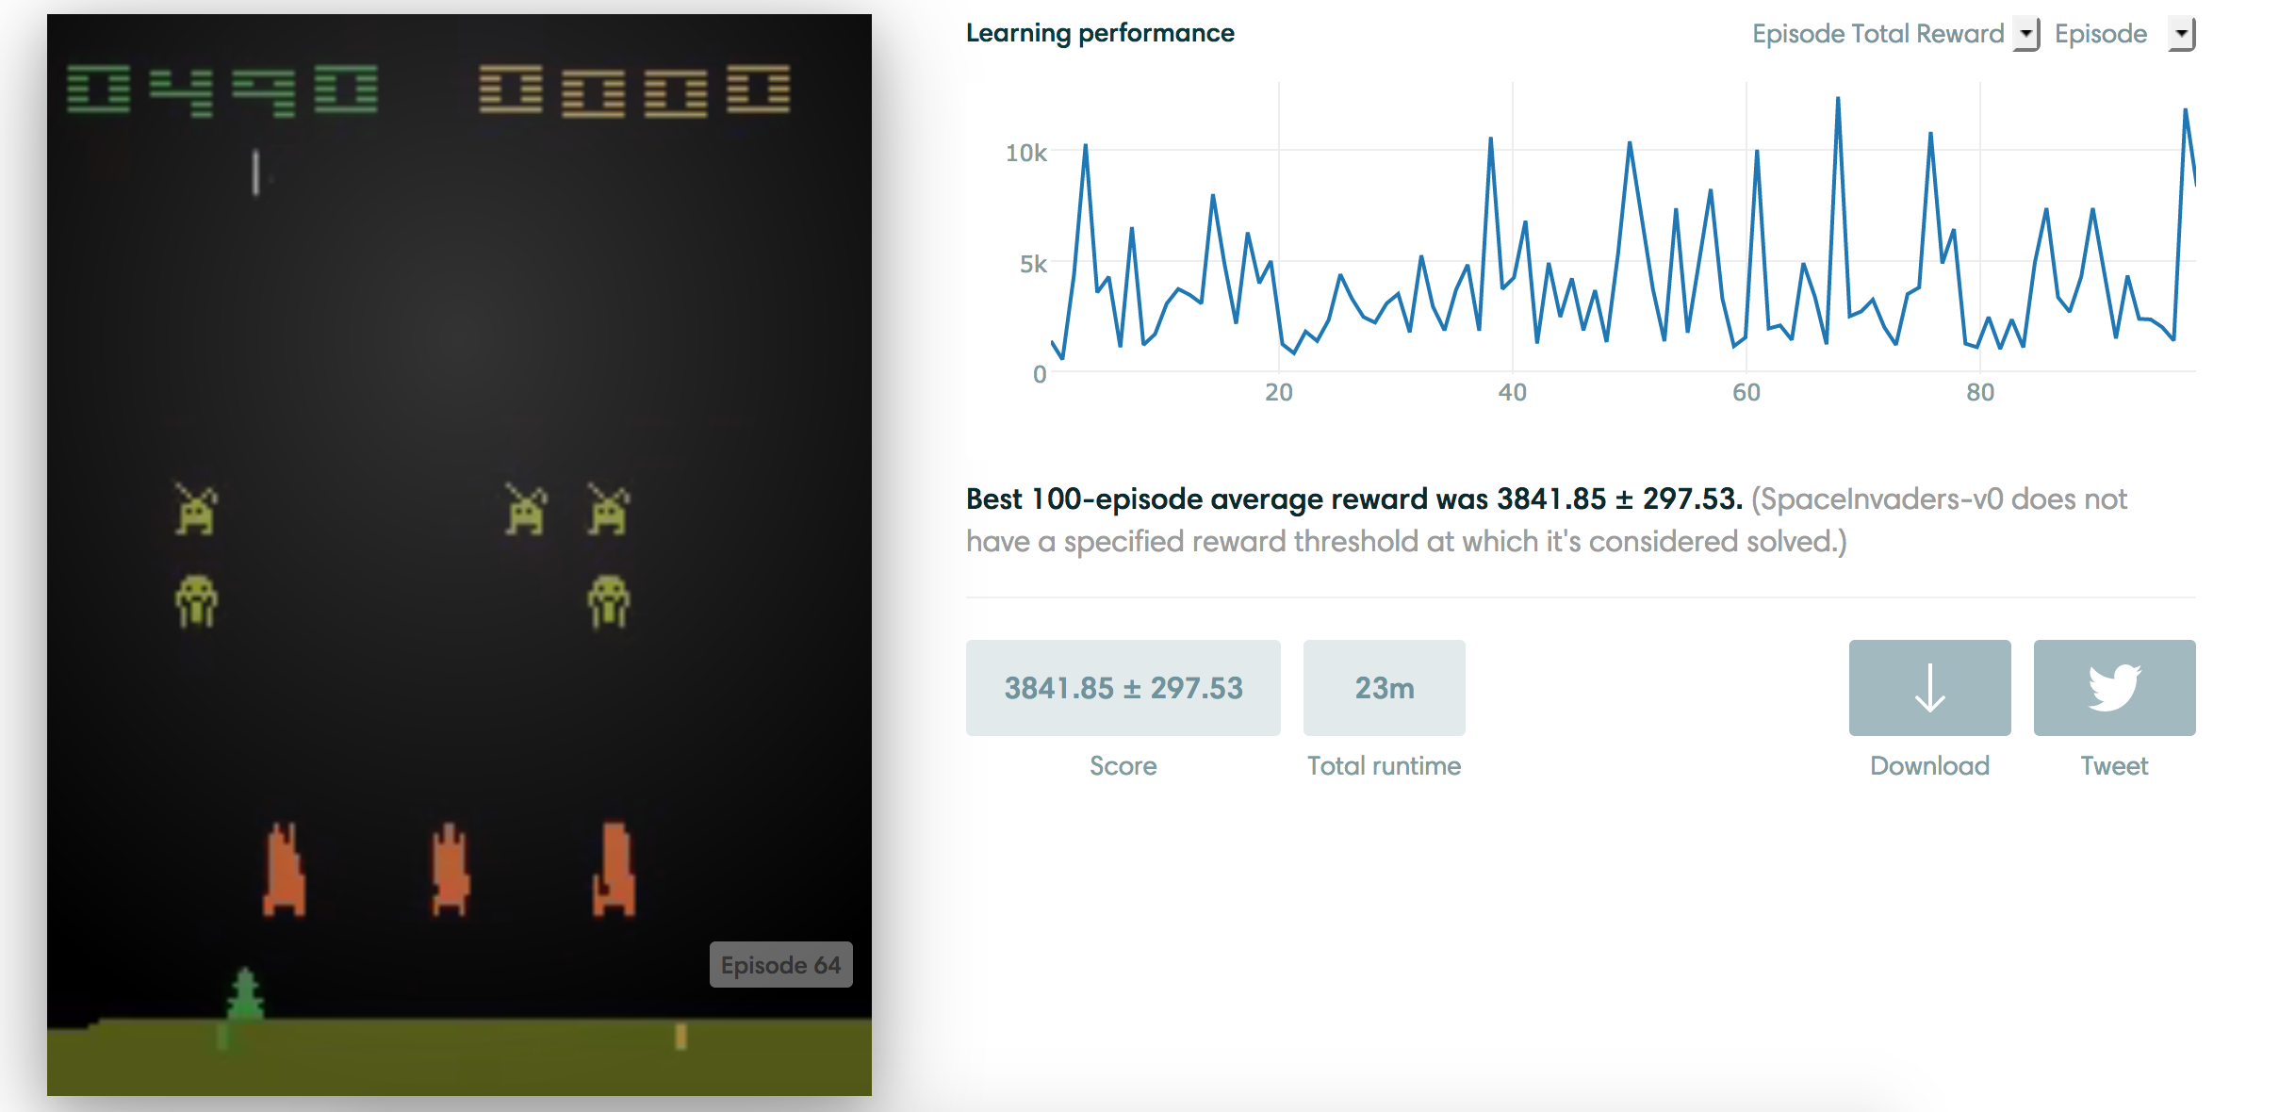
Space invader with A3C

