Slide 1
Overview of Information Retrieval and Organization
CSC 575
Intelligent Information Retrieval

Slide 2
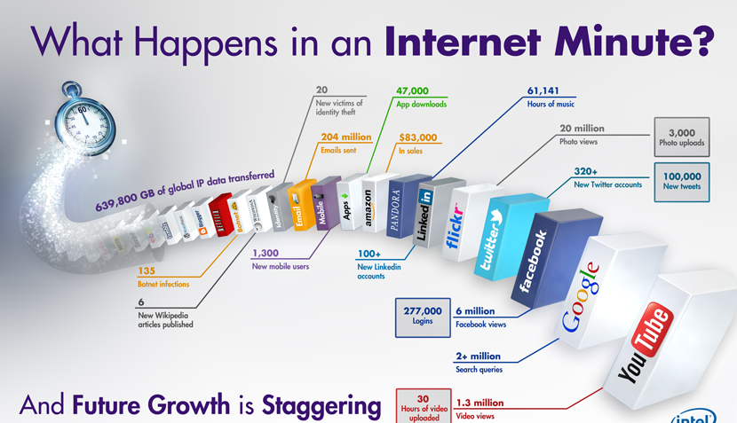
Source: Intel

Slide 3
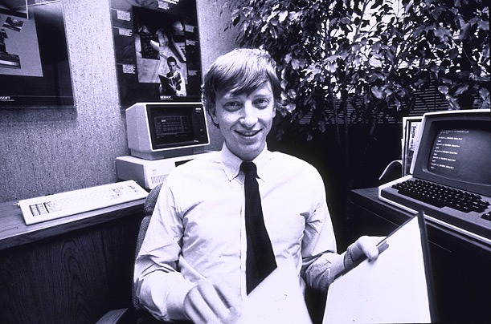
How much information?
Google: ~100 PB a day; 3+ million servers (15 Exabytes stored)
Wayback Machine has ~9 PB + 100 TB/month
Facebook: ~300 PB of user data + 500 TB/day
YouTube: ~1000 PB video storage + 4 billion views/day
CERN’s Large Hydron Collider generates 15 PB a year
640K ought to be enough for anybody.

Slide 4
Information Overload
“The greatest problem of today is how to teach people to ignore the irrelevant, how to refuse to know things, before they are suffocated. For too many facts are as bad as none at all.” (W.H. Auden)

Slide 5
Information Retrieval
Information Retrieval (IR) is finding material (usually documents) of an unstructured nature (usually text) that satisfies an information need from within large collections (usually stored on computers).
Most prominent example: Web Search Engines

Slide 6
Web Search System
Web
Spider/Crawler
Document
corpus
IR
System
Query String
1. Page1
2. Page2
3. Page3
.
.
Ranked
Documents

Slide 7
IR v. Database Systems
Emphasis on effective, efficient retrieval of unstructured (or semi-structured) data
IR systems typically have very simple schemas
Query languages emphasize free text and Boolean combinations of keywords
Matching is more complex than with structured data (semantics is less obvious)
easy to retrieve the wrong objects
need to measure the accuracy of retrieval
Less focus on concurrency control and recovery (although update is very important).

Slide 8
IR on the Web vs. Classsic IR
Input: publicly accessible Web
Goal: retrieve high quality pages that are relevant to user’s need
static (text, audio, images, etc.)
dynamically generated (mostly database access)
What’s different about the Web:
heterogeneity
lack of stability
high duplication
high linkage
lack of quality standard

Slide 9
Profile of Web Users
Make poor queries
short (about 2 terms on average)
imprecise queries
sub-optimal syntax (80% of queries without operator)
Wide variance in:
needs and expectations
knowledge of domain
Impatience
85% look over one result screen only
78% of queries not modified

Slide 10
Web Search Systems
General-purpose search engines
Direct: Google, Yahoo, Bing, Ask.
Meta Search: WebCrawler, Search.com, etc.
Hierarchical directories
Yahoo, and other “portals”
databases mostly built by hand
Specialized Search Engines
Personalized Search Agents
Social Tagging Systems

Slide 11
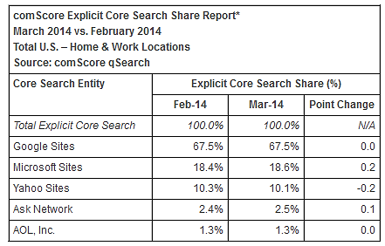
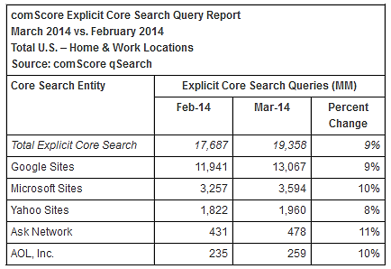
Web Search by the Numbers

Slide 12
Web Search by the Numbers
91% of users say they find what they are looking for when using search engines
73% of users stated that the information they found was trustworthy and accurate
66% of users said that search engines are fair and provide unbiased information
55% of users say that search engine results and search engine quality has gotten better over time
93% of online activities begin with a search engine
39% of customers come from a search engine (Source: MarketingCharts)
Over 100 billion searches being each month, globally
82.6% of internet users use search
70% to 80% of users ignore paid search ads and focus on the free organic results (Source: UserCentric)
18% of all clicks on the organic search results come from the number 1 position (Source: SlingShot SEO)
Source: Pew Internet: Search Engine Usage 2012

Slide 13
Key Issues in Information Lifecycle
Creation
Active
Authoring
Modifying
Using
Creating
Organizing
Indexing
Retention/
Mining
Accessing
Filtering
Storing
Retrieval
Semi-Active
Discard
Distribution
Networking
Utilization
Disposition
Searching
Inactive

Slide 14
Key Issues in Information Lifecycle
Organizing and Indexing
What types of data/information/meta-data should be collected and integrated?
Types of organization? Indexing?
Storing and Retrieving
How and where is information stored?
How is information recovered from storage?
How to find needed information?
Accessing/Filtering Information
How to select desired (or relevant) information?
How to locate that information in storage?

Slide 15
Cognitive (Human) Aspects IR
Satisfying an “Information Need”
types of information needs
specifying information needs (queries)
the process of information access
search strategies
“sensemaking”
Relevance
Modeling the User

Slide 16
Cognitive (Human) Aspects IR
Three phases:
Asking of a question
Construction of an answer
Assessment of the answer
Part of an iterative process

Slide 17
Question Asking
Person asking = “user”
In a frame of mind, a cognitive state
Aware of a gap in their knowledge
May not be able to fully define this gap
Paradox of IR:
If user knew the question to ask, there would often be no work to do.
“The need to describe that which you do not know in order to find it” Roland Hjerppe
Query
External expression of this ill-defined state

Slide 18
Question Answering
Say question answerer is human.
Can they translate the user’s ill-defined question into a better one?
Do they know the answer themselves?
Are they able to verbalize this answer?
Will the user understand this verbalization?
Can they provide the needed background?
What if answerer is a computer system?

Slide 19
Why Don’t Users Get What They Want?
Example:
User Need
Need to get rid of mice in the basement
Translation
Problem
User Request
What’s the best way to trap mice?
Query to IR
System
mouse trap
Polysemy
Synonymy
Results
Computer supplies, software, etc.

Slide 20
Assessing the Answer
How well does it answer the question?
Complete answer? Partial?
Background Information?
Hints for further exploration?
How relevant is it to the user?
Relevance Feedback
for each document retrieved
user responds with relevance assessment
binary: + or -
utility assessment (between 0 and 1)

Slide 21
Information Retrieval as a Process
Text Representation (Indexing)
given a text document, identify the concepts that describe the content and how well they describe it
Representing Information Need (Query Formulation)
describe and refine info. needs as explicit queries
Comparing Representations (Retrieval)
compare text and query representations to determine which documents are potentially relevant
Evaluating Retrieved Text (Feedback)
present documents to user and modify query based on feedback

Slide 22
Information Retrieval as a Process
Information Need
Document Objects
Representation
Representation
Query
Indexed Objects
Comparison
Relevant?
Evaluation/Feedback
Retrieved Objects

Slide 23
Keyword Search
Simplest notion of relevance is that the query string appears verbatim in the document.
Slightly less strict notion is that the words in the query appear frequently in the document, in any order (bag of words).

Slide 24
Problems with Keywords
May not retrieve relevant documents that include synonymous terms.
“restaurant” vs. “café”
“PRC” vs. “China”
May retrieve irrelevant documents that include ambiguous terms.
“bat” (baseball vs. mammal)
“Apple” (company vs. fruit)
“bit” (unit of data vs. act of eating)

Slide 25
Query Languages
A way to express the question (information need)
Types:
Boolean
Natural Language
Stylized Natural Language
Form-Based (GUI)
Spoken Language Interface
Others?

Slide 26
Ordering/Ranking of Retrieved Documents
Pure Boolean retrieval model has no ordering
Query is a Boolean expression which is either satisfied by the document or not
e.g., “information” AND (“retrieval” OR “organization”)
In practice:
order chronologically
order by total number of “hits” on query terms
Most systems use “best match” or “fuzzy” methods
vector-space models with tf.idf
probabilistic methods
Pagerank
What about personalization?

Slide 27
Example: Basic Retrieval Process
Sec. 1.1
Which plays of Shakespeare contain the words Brutus AND Caesar but NOT Calpurnia?
One could grep all of Shakespeare’s plays for Brutus and Caesar, then strip out lines containing Calpurnia?
Why is that not the answer?
Slow (for large corpora)
NOT Calpurnia is non-trivial
Other operations (e.g., find the word Romans near countrymen) not feasible
Ranked retrieval (best documents to return)
Later lectures
Notes:
Grep is line-oriented; IR is document oriented.

Slide 28
Term-document incidence
Sec. 1.1
1 if play contains word, 0 otherwise
Brutus AND Caesar BUT NOT Calpurnia

Slide 29
Incidence vectors
Sec. 1.1
Basic Boolean Retrieval Model
we have a 0/1 vector for each term
to answer query: take the vectors for Brutus, Caesar and Calpurnia (complemented) ➔ bitwise AND
110100 AND 110111 AND 101111 = 100100
The more general Vector-Space Model
allows for weights other that 1 and 0 for term occurrences
provides the ability to do partial matching with query key words

Slide 30
IR System Operations
Information
need
Collections
Pre-process
text input
Parse
Query
Index
Rank
Reformulated
Query
Re-Rank

Slide 31
IR System Architecture
User Interface
Text
User
Need
Text Operations
Logical View
User
Feedback
Query
Operations
Indexing
Database
Manager
Inverted
file
Query
Searching
Index
Text
Database
Ranked
Docs
Ranking
Retrieved
Docs

Slide 32
IR System Components
Text Operations forms index words (tokens).
Stopword removal
Stemming
Indexing constructs an inverted index of word to document pointers.
Searching retrieves documents that contain a given query token from the inverted index.
Ranking scores all retrieved documents according to a relevance metric.

Slide 33
IR System Components (continued)
User Interface manages interaction with the user:
Query input and document output.
Relevance feedback.
Visualization of results.
Query Operations transform the query to improve retrieval:
Query expansion using a thesaurus.
Query transformation using relevance feedback.

Slide 34
Organization/Indexing Challenges
Sec. 1.1
Consider N = 1 million documents, each with about 1000 words.
Avg 6 bytes/word including spaces/punctuation
6GB of data in the documents.
Say there are M = 500K distinct terms among these.
500K x 1M matrix has half-a-trillion 0’s and 1’s (so, practically we can’t build the matrix)
But it has no more than one billion 1’s
i.e., matrix is extremely sparse
What’s a better representation?
We only record the 1 positions (“sparse matrix representation”)

Slide 35
Inverted index
Sec. 1.2
For each term t, we must store a list of all documents that contain t.
Identify each by a docID, a document serial number
Brutus
1
2
4
11
31
45
173
174
Caesar
1
2
4
5
6
16
57
132
Calpurnia
2
31
54
101
What happens if the word Caesar is added to document 14? What about repeated words?
More on Inverted Indexes Later!

Slide 36

Inverted index construction
Sec. 1.2
Documents to
be indexed
Friends, Romans, countrymen.
Tokenizer
Token stream
Friends
Romans
Countrymen
Linguistic modules
Modified tokens
friend
roman
countryman
Indexer
friend
2
4
roman
1
2
Inverted index
countryman
13
16
Notes:
Document icons from free icon set: http://www.icojoy.com/articles/44/

Slide 37
Initial stages of text processing
Tokenization
Cut character sequence into word tokens
Deal with “John’s”, a state-of-the-art solution
Normalization
Map text and query term to same form
You want U.S.A. and USA to match
Stemming
We may wish different forms of a root to match
authorize, authorization
Stop words
We may omit very common words (or not)
the, a, to, of

Slide 38
Some Features of Modern IR Systems
Relevance Ranking
Natural language (free text) query capability
Boolean or proximity operators
Term weighting
Query formulation assistance
Visual browsing interfaces
Query by example
Filtering
Distributed architecture

Slide 39
Intelligent IR
Taking into account the meaning of the words used.
Taking into account the context of the user’s request.
Adapting to the user based on direct or indirect feedback (search personalization).
Taking into account the authority and quality of the source.
Taking into account semantic relationships among objects (e.g., concept hierarchies, ontologies, etc.)
Intelligent IR interfaces
Information filtering agents

Slide 40
Other Intelligent IR Tasks
Automated document categorization
Automated document clustering
Information filtering
Information routing
Recommending information or products
Information extraction
Information integration
Question answering
Social Network Analysis

Slide 41
Information System Evaluation
IR systems are often components of larger systems
Might evaluate several aspects:
assistance in formulating queries
speed of retrieval
resources required
presentation of documents
ability to find relevant documents
Evaluation is generally comparative
system A vs. system B, etc.
Most common evaluation: retrieval effectiveness.

Slide 42
Measuring user happiness
Sec. 8.6.2
Issue: who is the user we are trying to make happy?
Depends on the setting
Web engine:
User finds what s/he wants and returns to the engine
Can measure rate of return users
User completes task – search as a means, not end
See Russell http://dmrussell.googlepages.com/JCDL-talk-June-2007-short.pdf
Web site: user finds what s/he wants and/or buys
User selects search results
Measure time to purchase, or fraction of searchers who become buyers?

Slide 43
Happiness: elusive to measure
Sec. 8.1
Most common proxy: relevance of search results
But how do you measure relevance?
Relevance measurement requires 3 elements:
A benchmark document collection
A benchmark suite of queries
A usually binary assessment of either Relevant or Nonrelevant for each query and each document
Some work on more-than-binary, but not the standard

Slide 44
Standard relevance benchmarks
Sec. 8.2
TREC - National Institute of Standards and Technology (NIST) has run a large IR test bed for many years
Reuters and other benchmark doc collections used
“Retrieval tasks” specified
sometimes as queries
Human experts mark, for each query and for each doc, Relevant or Nonrelevant
or at least for subset of docs that some system returned for that query

Slide 45
Unranked retrieval evaluation: Precision and Recall
Sec. 8.3
Precision: fraction of retrieved docs that are relevant = P(relevant | retrieved)
Recall: fraction of relevant docs that are retrieved
= P(retrieved | relevant)
Precision P = tp/(tp + fp)
Recall R = tp/(tp + fn)
 | Relevant | Nonrelevant
Retrieved | tp | fp
Not Retrieved | fn | tn

Slide 46
Retrieved vs. Relevant Documents
High Recall
Retrieved
High Precision
Relevant

Slide 47
Retrieved vs. Relevant Documents
High Recall
Retrieved
High Precision
Relevant

Slide 48
Evaluating ranked results
Sec. 8.4
Evaluation of ranked results:
The system can return any number of results
By taking various numbers of the top returned documents (levels of recall), the evaluator can produce a precision-recall curve
Averaging over queries
A precision-recall graph for one query isn’t a very sensible thing to look at
You need to average performance over a whole bunch of queries

Slide 49
Precision/Recall Curves
There is a tradeoff between Precision and Recall
So measure Precision at different levels of Recall
precision
x
x
x
x
recall

Slide 50
Precision/Recall Curves
Difficult to determine which of these two hypothetical results is better:
precision
x
x
x
x
recall

Slide 51
Difficulties in using precision/recall
Sec. 8.3
Should average over large document collection/query ensembles
Need human relevance assessments
People aren’t reliable assessors
Assessments have to be binary
Nuanced assessments?
Heavily skewed by collection/authorship
Results may not translate from one domain to another

