Slide 1
Indexing and Document Analysis
CSC 575
Intelligent Information Retrieval

Slide 2
Indexing
Indexing is the process of transforming items (documents) into a searchable data structure
creation of document surrogates to represent each document
requires analysis of original documents
simple: identify meta-information (e.g., author, title, etc.)
complex: linguistic analysis of content
The search process involves correlating user queries with the documents represented in the index

Slide 3
What should the index contain?
Database systems index primary and secondary keys
This is the hybrid approach
Index provides fast access to a subset of database records
Scan subset to find solution set
IR Problem:
Can’t predict the keys that people will use in queries
Every word in a document is a potential search term
IR Solution: Index by all keys (words)

Slide 4
Index Terms or “Features”
The index is accessed by the atoms of a query language
The atoms are called “features” or “keys” or “terms”
Most common feature types:
Words in text
N-grams (consecutive substrings) of a document
Manually assigned terms (controlled vocabulary)
Document structure (sentences & paragraphs)
Inter- or intra-document links (e.g., citations)
Composed features
Feature sequences (phrases, names, dates, monetary amounts)
Feature sets (e.g., synonym classes, concept indexing)

Slide 5
Indexing Languages
An index is constructed on the basis of an indexing language or vocabulary
The vocabulary may be controlled or uncontrolled
Controlled: limited to a predefined set of index terms
Uncontrolled: allows the use of any terms fitting some broad criteria
Indexing may be done manually or automatically
Manual or human indexing:
Indexers decide which keywords to assign to document based on controlled vocabulary (e.g. index for a book)
Significant cost on large data sets
Automatic indexing:
Indexing program decides which words, phrases or other features to use from text of document
This is what typical search engines need to do

Slide 6

Inverted Index Construction
Sec. 1.2
Documents to
be indexed
Friends, Romans, countrymen.
Tokenizer
Token stream
Friends
Romans
Countrymen
Linguistic modules
Modified tokens
friend
roman
countryman
Indexer
friend
2
4
roman
1
2
Inverted index
countryman
13
16
Notes:
Document icons from free icon set: http://www.icojoy.com/articles/44/

Slide 7
Indexer steps: Token sequence
Sec. 1.2
Sequence of (Modified token, Document ID) pairs.
Doc 1
Doc 2
I did enact Julius
Caesar I was killed
i’ the Capitol;
Brutus killed me.
So let it be with
Caesar. The noble
Brutus hath told you
Caesar was ambitious

Slide 8
Indexer steps: Sort
Sec. 1.2
Sort by terms
And then docID
Core indexing step

Slide 9
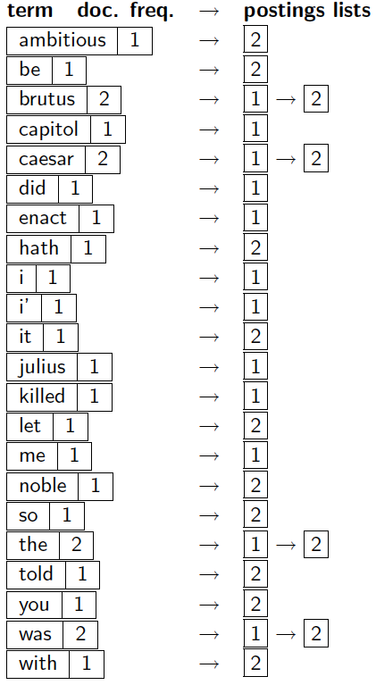
Indexer steps: Dictionary & Postings
Sec. 1.2
Multiple term entries in a single document are merged.
Split into Dictionary and Postings
Doc. frequency information is added.
Why frequency?
Will discuss later.

Slide 10
Where do we pay in storage?
Sec. 1.2
Lists of docIDs
Terms and counts
IR system implementation
How do we index efficiently?
How much storage do we need?
Pointers

Slide 11
Query processing: AND
Sec. 1.3
Consider processing the query: Brutus AND Caesar
Locate Brutus in the Dictionary;
Retrieve its postings.
Locate Caesar in the Dictionary;
Retrieve its postings.
“Merge” the two postings (intersect the document sets)
Walk through the two postings simultaneously -- linear in the total number of postings entries
2
4
8
16
32
64
128
Brutus
1
2
3
5
8
13
21
34
Caesar
If the list lengths are x and y, the merge takes O(x+y) operations.
Crucial: postings sorted by docID.

Slide 12
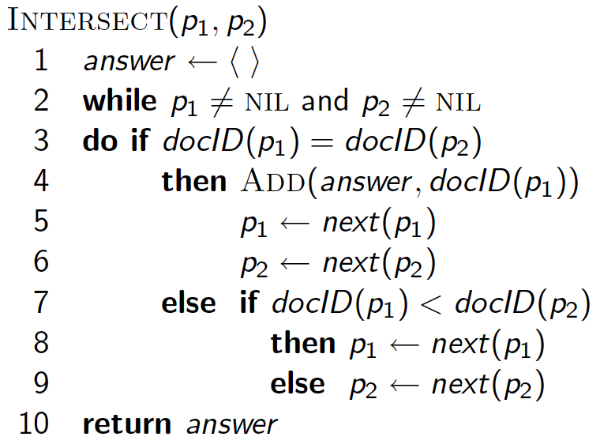
Intersecting two postings lists (a “merge” algorithm)

Slide 13
Boolean Queries
Sec. 1.3
What about other Boolean operations?
Exercise: Adapt the merge for the queries:
Brutus AND NOT Caesar
Brutus OR NOT Caesar
What about an arbitrary Boolean formula?
(Brutus OR Caesar) AND NOT (Antony OR Cleopatra)

Slide 14
Basic Automatic Indexing
Parse documents to recognize structure
e.g. title, date, other fields
Scan for word tokens (Tokenization)
lexical analysis using finite state automata
numbers, special characters, hyphenation, capitalization, etc.
languages like Chinese need segmentation since there is not explicit word separation
record positional information for proximity operators
Stopword removal
based on short list of common words such as “the”, “and”, “or”
saves storage overhead of very long indexes
can be dangerous (e.g. “Mr. The”, “and-or gates”)

Slide 15
Basic Automatic Indexing
Stem words
morphological processing to group word variants such as plurals
better than string matching (e.g. comput*)
can make mistakes but generally preferred
Weight words
using frequency in documents and database
frequency data is independent of retrieval model
Optional
phrase indexing / positional indexing
thesaurus classes / concept indexing

Slide 16
Tokenization: Lexical Analysis
The stream of characters must be converted into a stream of tokens
Tokens are groups of characters with collective significance/meaning
This process must be applied to both the text stream (lexical analysis) and the query string (query processing).
Often it also involves other preprocessing tasks such as, removing extra white-space, conversion to lowercase, date conversion, normalization, etc.
It is also possible to recognize stop words during lexical analysis
Lexical analysis is costly
as much as 50% of the computational cost of compilation
Three approaches to implementing a lexical analyzer
use an ad hoc algorithm
use a lexical analyzer generators, e.g., the UNIX lex tool, programming libraries, such as NLTK (Natural Lang. Tool Kit fro Python), etc.
write a lexical analyzer as a finite state automata

Slide 17
Lexical analysis and stop words
Information
need
Collections
Pre-process
text input
Parse
Query
Index
Rank
Result
Sets

Slide 18
Lexical Analysis (lex Example)
> more convert
%%
[A-Z] putchar (yytext[0]+'a'-'A');
and|or|is|the|in putchar ('*');
[ ]+$ ;
[ ]+ putchar(' ');
> lex convert
>
> cc lex.yy.c -ll -o convert
>
> convert
THE maN IS gOOd or BAD and hE is IN trouble
* man * good * bad * he * * trouble
>
convert is a lex command file. It converts all uppercase letters with lower case, and removes, selected stop words, and extra whitespace.

Slide 19
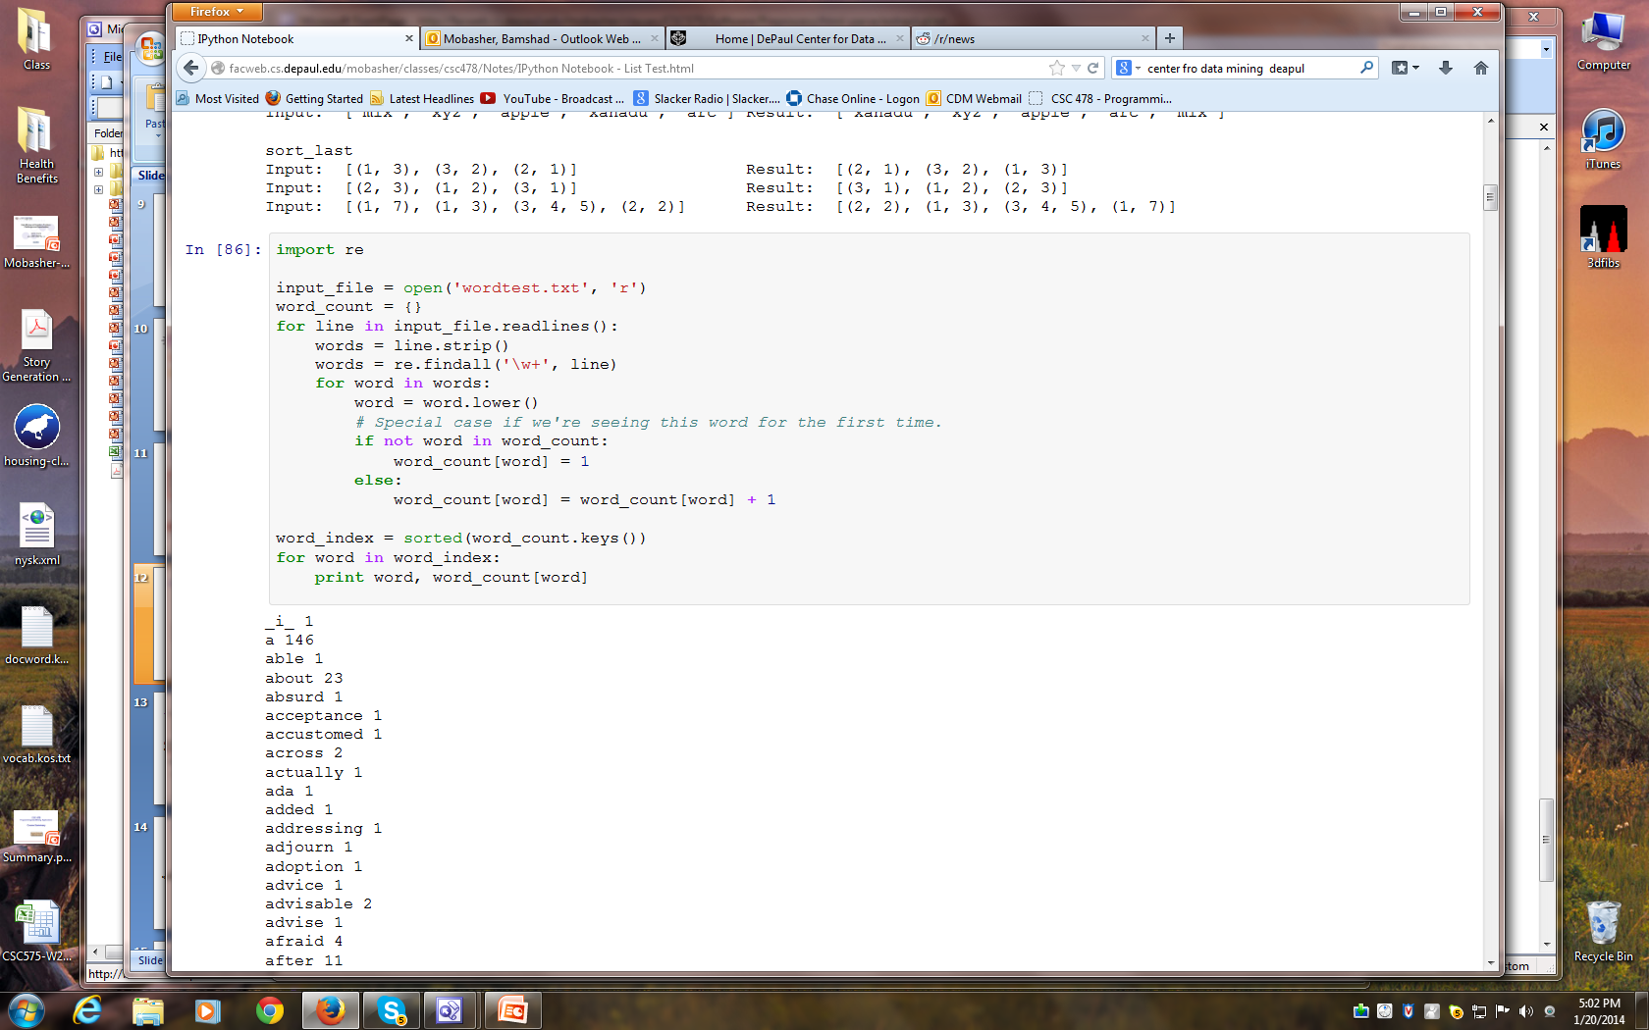
Lexical Analysis (Python Example)

Slide 20
Finite State Automata
FSA’s are abstract machines that “recognize” regular expressions
represented as a directed graph where vertices represent states and edges represent transitions (on scanning a symbol)
a string of symbols that leaves the machine in a final state is recognized by the machine (as a token)
initial
state
a final
state
c
0
b
1
2
c
b
a
b
0
a
1
a,b
2
3
FSA that recognizes 3 words:
“b”
“aa”
“ab”
FSA that recognizes words:
“b”, “bc”,“bcc”,”bab”,”babcc”
“bababccc”, etc.
It recognizes the regular expression
( b (ab)* c c* | b (ab)* )

Slide 21
Finite State Automata (Example)
Letter,
digit
This is an FSA that recognizes tokens for a simple query language involving simple words (starting with a letter) and operators &, |, ^, and parentheses for grouping them.
Individual symbols are characterized as “character classes” (possibly an associative array with keys corresponding to ASCII symbols and values corresponding to character classes).
In the query processing (or parsing) phase Lexical analyzer continuously scans the query string (or text stream) and returns the next token.
The FSA itself is represented as a table with rows and table entries corresponding to states, and columns corresponding to symbols.
1
letter
(
2
)
3
space
&
4
0
|
5
^
eos
6
other
7
8

Slide 22
Finite State Automata (Exercise)
Construct a finite state automata for the following regular expressions:
b*a(b|ab)b*
All real numbers
e.g., 1.23, 0.4, .32
0
a
1
b
3
b
b
a
b
2
.
digit
0
1
2
digit
digit

Slide 23
Finite State Automata (Exercise)
letter, digit, space
>
<
/
H
3
4
5
6
7
1
letter, digit, space
1
<
H
2
>
0
1
2
8
9
<
/
H
2
>
3
10
11
12
13
14
letter, digit, space
>
<
/
H
3
15
16
17
18
19

Slide 24
Issues with Tokenization
Finland’s capital →
Finland? Finlands? Finland’s?
Hewlett-Packard → Hewlett and Packard as two tokens?
State-of-the-art: break up hyphenated sequence.
co-education ?
the hold-him-back-and-drag-him-away-maneuver ?
It’s effective to get the user to put in possible hyphens
San Francisco: one token or two? How do you decide it is one token?

Slide 25
Tokenization: Numbers
3/12/91 Mar. 12, 1991
55 B.C.
B-52
100.2.86.144
Often, don’t index as text.
But often very useful: think about things like looking up error codes/stacktraces on the web
(One answer is using n-grams as index terms)
Will often index “meta-data” separately
Creation date, format, etc.

Slide 26
Tokenization: Normalization
Need to “normalize” terms in indexed text as well as query terms into the same form
We want to match U.S.A. and USA
We most commonly implicitly define equivalence classes of terms
e.g., by deleting periods in a term
e.g., converting to lowercase
e.g., deleting hyphens to form a term
anti-discriminatory, antidiscriminatory

Slide 27
Stop words
Sec. 2.2.2
Idea: exclude from the dictionary the list of words with little semantic content: a, and, or , how, where, to, ….
They tend to be the most common words: ~30% of postings for top 30 words
But the trend is away from doing this:
Good compression techniques means the space for including stop words in a system is very small
Good query optimization techniques mean you pay little at query time for including stop words
You need them for:
Phrase queries: “King of Denmark”
Various titles, etc.: “Let it be”, “To be or not to be”
“Relational” queries: “flights to London”
Google ignores common words and characters such as where, the, how, and other digits and letters which slow down your search without improving the results.” (Though you can explicitly ask for them to remain.)
Notes:
Nevertheless: “Google ignores common words and characters such as where, the, how, and other digits and letters which slow down your search without improving the results.” (Though you can explicitly ask for them to remain.)

Slide 28
Thesauri and soundex
Handle synonyms and homonyms
Hand-constructed equivalence classes
e.g., car = automobile
color = colour
Rewrite to form equivalence classes
Index such equivalences
When the document contains automobile, index it under car as well (usually, also vice-versa)
Or expand query?
When the query contains automobile, look under car as well

Slide 29
Soundex
Traditional class of heuristics to expand a query into phonetic equivalents
Language specific – mainly for names
Understanding Classic SoundEx Algorithms
http://www.creativyst.com/Doc/Articles/SoundEx1/SoundEx1.htm#Top

Slide 30
Stemming and Morphological Analysis
Goal: “normalize” similar words by reducing them to their roots before indexing
Morphology (“form” of words)
Inflectional Morphology
E.g,. inflect verb endings
Never change grammatical class
dog, dogs
Derivational Morphology
Derive one word from another,
Often change grammatical class
build, building; health, healthy

Slide 31
Porter’s Stemming Algorithm
Sec. 2.2.4
Commonest algorithm for stemming English
Results suggest it’s at least as good as other stemming options
Conventions + 5 phases of reductions
phases applied sequentially
each phase consists of a set of commands
sample convention: Of the rules in a compound command, select the one that applies to the longest suffix.

Slide 32
Porter’s Stemming Algorithm
Based on a measure of vowel-consonant sequences
measure m for a stem is [C](VC)^{m}[V] where C is a sequence of consonants and V is a sequence of vowels (including “y”) ( [ ] indicates optional )
m=0 (tree, by), m=1 (trouble, oats, trees, ivy), m=2 (troubles, private)
Some Notation:
*<X> --> stem ends with letter X
*v* --> stem contains a vowel
*d --> stem ends in double consonant
*o --> stem ends with a cvc sequence where the final
consonant is not w, x, y
Algorithm is based on a set of condition action rules
old suffix --> new suffix
rules are divided into steps and are examined in sequence
Good average recall and precision

Slide 33
Porter’s Stemming Algorithm
A selection of rules from Porter’s algorithm:

Slide 34
Porter’s Stemming Algorithm
The algorithm:
1. apply step 1a to word
2. apply step 1b to stem
3. If (2nd or 3rd rule of step 1b was used)
apply step 1b1 to stem
4. apply step 1c to stem
5. apply step 2 to stem
6. apply step 3 to stem
7. apply step 4 to stem
8. apply step 5a to stem
9. apply step 5b to stem

Slide 35
Stemming Example
Original text:
marketing strategies carried out by U.S. companies for their agricultural chemicals, report predictions for market share of such chemicals, or report market statistics for agrochemicals, pesticide, herbicide, fungicide, insecticide, fertilizer, predicted sales, market share, stimulate demand, price cut, volume of sales
Porter stemmer results:
market strateg carr compan agricultur chemic report predict market share chemic report market statist agrochem pesticid herbicid fungicid insecticid fertil predict sale stimul demand price cut volum sale

Slide 36
Problems with Stemming
Lack of domain-specificity and context can lead to occasional serious retrieval failures
Stemmers are often difficult to understand and modify
Sometimes too aggressive in conflation
e.g. “policy”/“police”, “university”/“universe”, “organization”/“organ” are conflated by Porter
Miss good conflations
e.g. “European”/“Europe”, “matrices”/“matrix”, “machine”/“machinery” are not conflated by Porter
Produce stems that are not words or are difficult for a user to interpret
e.g. “iteration” produces “iter” and “general” produces “gener”
Corpus analysis can be used to improve a stemmer or replace it

Slide 37
Other stemmers
Sec. 2.2.4
Other stemmers exist:
Lovins stemmer
http://www.comp.lancs.ac.uk/computing/research/stemming/general/lovins.htm
Single-pass, longest suffix removal (about 250 rules)
Paice/Husk stemmer
Snowball
Full morphological analysis (lemmatization)
At most modest benefits for retrieval

Slide 38
N-grams and Stemming
N-gram: given a string, n-grams for that string are fixed length consecutive overlapping) substrings of length n
Example: “statistics”
bigrams: st, ta, at, ti, is, st, ti, ic, cs
trigrams: sta, tat, ati, tis, ist, sti, tic, ics
N-grams can be used for conflation (stemming)
measure association between pairs of terms based on unique n-grams
the terms are then clustered to create “equivalence classes” of terms.
N-grams can also be used for indexing
index all possible n-grams of the text (e.g., using inverted lists)
max no. of searchable tokens: |Σ|^{n}, where Σ is the alphabet
larger n gives better results, but increases storage requirements
no semantic meaning, so tokens not suitable for representing concepts
can get false hits, e.g., searching for “retail” using trigrams, may get matches with “retain detail” since it includes all trigrams for “retail”

Slide 39
N-grams and Stemming (Example)
“statistics”
bigrams: st, ta, at, ti, is, st, ti, ic, cs
7 unique bigrams: at, cs, ic, is, st, ta, ti
“statistical”
bigrams: st, ta, at, ti, is, st, ti, ic, ca, al
8 unique bigrams: al, at, ca, ic, is, st, ta, ti
Now use Dice’s coefficient to compute “similarity” for pairs of words”
where A is no. of unique bigrams in first word, B is no. of unique bigrams in second word, and C is no. of unique shared bigrams. In this case,
(2*6)/(7+8) = .80.
Now we can form a word-word similarity matrix (with word similarities as entries). This matrix is s used to cluster similar terms.
2C
S =
A + B

Slide 40
N-gram indexes
Sec. 3.2.2
Enumerate all n-grams occurring in any term
e.g., from text “April is the cruelest month” we get bigrams:
$ is a special word boundary symbol
Maintain a second inverted index from bigrams to dictionary terms that match each bigram.
$a, ap, pr, ri, il, l$, $i, is, s$, $t, th, he, e$, $c, cr, ru, ue, el, le, es, st, t$, $m, mo, on, nt, h$

Slide 41
Bigram index example
Sec. 3.2.2
The n-gram index finds terms based on a query consisting of n-grams (here n=2).
$m
mace
madden
mo
among
amortize
on
along
among

Slide 42
Using N-gram Indexes
Sec. 3.2.2
Wild-Card Queries
Query mon* can now be run as
$m AND mo AND on
Gets terms that match AND version of wildcard query
But we’d enumerate moon. Must post-filter terms against query
Surviving enumerated terms are then looked up in the term-document inverted index.
Spell Correction
Enumerate all the n-grams in the query
Use the n-gram index (wild-card search) to retrieve all lexicon terms matching any of the query n-grams
Threshold based on matching n-grams and present to user as alternatives
Can use Dice or Jaccard coefficients

Slide 43
Content Analysis
Automated indexing relies on some form of content analysis to identify index terms
Content analysis: automated transformation of raw text into a form that represent some aspect(s) of its meaning
Including, but not limited to:
Automated Thesaurus Generation
Phrase Detection
Categorization
Clustering
Summarization

Slide 44
Techniques for Content Analysis
Statistical
Single Document
Full Collection
Linguistic
Syntactic
analyzing the syntactic structure of documents
Semantic
identifying the semantic meaning of concepts within documents
Pragmatic
using information about how the language is used (e.g., co-occurrence patterns among words and word classes)
Knowledge-Based (Artificial Intelligence)
Hybrid (Combinations)
Generally rely of the statistical properties of text such as term frequency and document frequency

Slide 45
Statistical Properties of Text
Zipf’s Law models the distribution of terms in a corpus:
How many times does the kth most frequent word appears in a corpus of size N words?
Important for determining index terms and properties of compression algorithms.
Heap’s Law models the number of words in the vocabulary as a function of the corpus size:
What is the number of unique words appearing in a corpus of size N words?
This determines how the size of the inverted index will scale with the size of the corpus .

Slide 46
Statistical Properties of Text
Token occurrences in text are not uniformly distributed
They are also not normally distributed
They do exhibit a Zipf distribution
What Kinds of Data Exhibit a
Zipf Distribution?
Words in a text collection
Library book checkout patterns
Incoming Web page requests (Nielsen)
Outgoing Web page requests (Cunha & Crovella)
Document Size on Web (Cunha & Crovella)
Length of Web page references (Cooley, Mobasher, Srivastava)
Item popularity in E-Commerce
frequency
rank

Slide 47
Zipf Distribution
The product of the frequency of words (f) and their rank (r) is approximately constant
Rank = order of words in terms of decreasing frequency of occurrence
Main Characteristics
a few elements occur very frequently
many elements occur very infrequently
frequency of words in the text falls very rapidly
where N is the total number of term occurrences

Slide 48
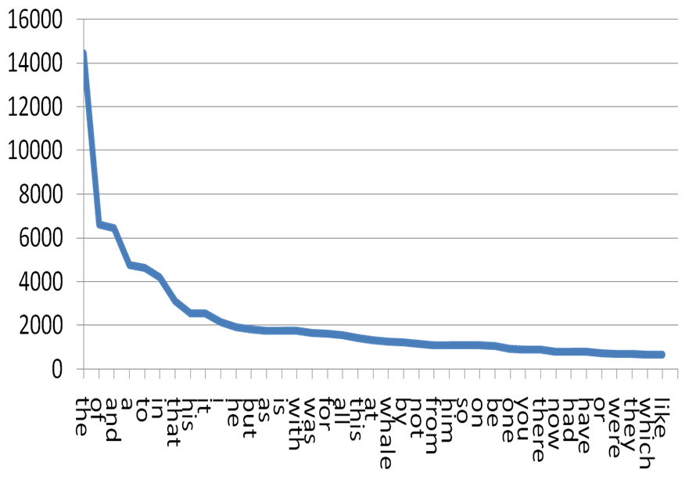
Word Distribution
Frequency vs. rank for all words in Moby Dick
Notes:
Heavy tail: many rare events.

Slide 49
Example of Frequent Words
Frequencies from 336,310 documents in the 1 GB TREC Volume 3 Corpus
125,720,891 total word occurrences
508,209 unique words

Slide 50
A More Standard Collection
Government documents, 157734 tokens, 32259 unique
8164 the
4771 of
4005 to
2834 a
2827 and
2802 in
1592 The
1370 for
1326 is
1324 s
1194 that
973 by
969 on
915 FT
883 Mr
860 was
855 be
849 Pounds
798 TEXT
798 PUB
798 PROFILE
798 PAGE
798 HEADLINE
798 DOCNO
1 ABC
1 ABFT
1 ABOUT
1 ACFT
1 ACI
1 ACQUI
1 ACQUISITIONS
1 ACSIS
1 ADFT
1 ADVISERS
1 AE

Slide 51
Zipf’s Law and Indexing
The most frequent words are poor index terms
they occur in almost every document
they usually have no relationship to the concepts and ideas represented in the document
Extremely infrequent words are poor index terms
may be significant in representing the document
but, very few documents will be retrieved when indexed by terms with the frequency of one or two
Index terms in between
a high and a low frequency threshold are set
only terms within the threshold limits are considered good candidates for index terms

Slide 52
Resolving Power
Zipf (and later H.P. Luhn) postulated that the resolving power of significant words reached a peak at a rank order position half way between the two cut-offs
Resolving Power: the ability of words to discriminate content
Resolving power of
significant words
frequency
The actual cut-off
are determined by
trial and error, and
often depend on the
specific collection.
rank
upper
cut-off
lower
cut-off

Slide 53
Vocabulary vs. Collection Size
How big is the term vocabulary?
That is, how many distinct words are there?
Can we assume an upper bound?
Not really upper-bounded due to proper names, typos, etc.
In practice, the vocabulary will keep growing with the collection size.

Slide 54
Heap’s Law
Given:
M is the size of the vocabulary.
T is the number of distinct tokens in the collection.
Then:
M = kT^{b}
k, b depend on the collection type:
typical values: 30 ≤ k ≤ 100 and b ≈ 0.5
in a log-log plot of M vs. T, Heaps’ law predicts a line with slope of about ½.

Slide 55
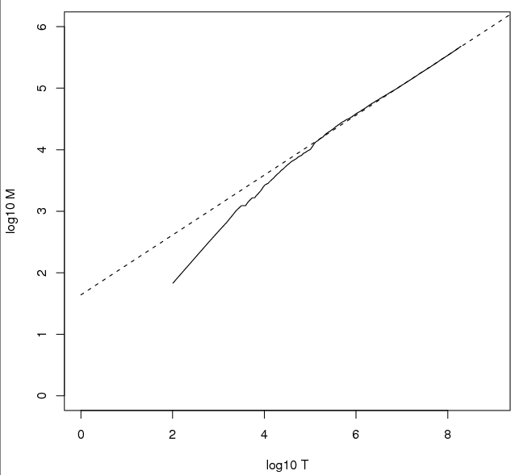
Heap’s Law Fit to Reuters RCV1
For RCV1, the dashed line
log₁₀M = 0.49 log₁₀T + 1.64 is the best least squares fit.
Thus, M = 10^{1.64}T^{0.49} so k = 10^{1.64} ≈ 44 and b = 0.49.
For first 1,000,020 tokens:
Law predicts 38,323 terms;
Actually, 38,365 terms.
⇒ Good empirical fit for RCV1!

Slide 56
Collocation (Co-Occurrence)
Co-occurrence patterns of words and word classes reveal significant information about how a language is used
pragmatics
Used in building dictionaries (lexicography) and for IR tasks such as phrase detection, query expansion, etc.
Co-occurrence based on text windows
typical window may be 100 words
smaller windows used for lexicography, e.g. adjacent pairs or 5 words
Typical measure is the expected mutual information measure (EMIM)
compares probability of occurrence assuming independence to probability of co-occurrence.

Slide 57
Statistical Independence vs. Dependence
How likely is a red car to drive by given we’ve seen a black one?
How likely is word W to appear, given that we’ve seen word V?
Color of cars driving by are independent (although more frequent colors are more likely)
Words in text are (in general) not independent (although again more frequent words are more likely)

Slide 58
Probability of Co-Occurrence
Compute for a window of words
a b c d e f g h i j k l m n o p
w1
w11
w21

Slide 59
Lexical Associations
Subjects write first word that comes to mind
doctor/nurse; black/white (Palermo & Jenkins 64)
Text Corpora yield similar associations
One measure: Mutual Information (Church and Hanks 89)
If word occurrences were independent, the numerator and denominator would be equal (if measured across a large collection)

Slide 60
Interesting Associations with “Doctor” (AP Corpus, N=15 million, Church & Hanks 89)

Slide 61
Un-Interesting Associations with “Doctor” (AP Corpus, N=15 million, Church & Hanks 89)
These associations were likely to happen because the non-doctor words shown here are very common and therefore likely to co-occur with any noun.

