Slide 1
Clustering Techniques and IR
CSC 575
Intelligent Information Retrieval

Slide 2
Clustering Techniques and IR
Today
Clustering Problem and Applications
Clustering Methodologies and Techniques
Applications of Clustering in IR

Slide 3
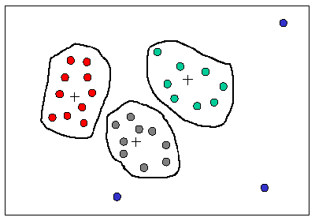
What is Clustering?
Clustering is a process of partitioning a set of data (or objects) in a set of meaningful sub-classes, called clusters
Helps users understand the natural grouping or structure in a data set
Cluster:
a collection of data objects that are “similar” to one another and thus can be treated collectively as one group
but as a collection, they are sufficiently different from other groups

Slide 4
Clustering in IR
Objective of Clustering
assign items to automatically created groups based on similarity or association between items and groups
also called “automatic classification”
“The art of finding groups in data.” -- Kaufmann and Rousseu
Clustering in IR
automatic thesaurus generation by clustering related terms
automatic concept indexing (concepts are clusters of terms)
automatic categorization of documents
information presentation and browsing
query generation and search refinement

Slide 5
Applications of Clustering
Clustering has wide applications in Pattern Recognition
Spatial Data Analysis:
create thematic maps in GIS by clustering feature spaces
detect spatial clusters and explain them in spatial data mining
Image Processing
Market Research
Information Retrieval
Document or term categorization
Information visualization and IR interfaces
Web Mining
Cluster Web usage data to discover groups of similar access patterns
Web Personalization

Slide 6
Clustering Methodologies
Two general methodologies
Partitioning Based Algorithms
Hierarchical Algorithms
Partitioning Based
divide a set of N items into K clusters (top-down)
Hierarchical
agglomerative: pairs of items or clusters are successively linked to produce larger clusters
divisive: start with the whole set as a cluster and successively divide sets into smaller partitions

Slide 7
Clustering Algorithms
Similarity Measures and Features
most clustering algorithms are based on some measure of similarity (or distance) between items
in IR these measures could be based on co-occurrence of terms, citations, or hyperlinks in documents
terms can be clustered based on documents in which they co-occur, or based on lexical or semantic similarity measures
clustering requires the selection of features over which similarity among items is computed
in document clustering, features are generally some or all of the terms in the collection
often a small number of features must be selecting because many clustering algorithms break down in a “high-dimensional” space
similarity measures among the items can be represented as a symmetric similarity matrix, in which each entry is the similarity value between two items

Slide 8
Distance or Similarity Measures
Measuring Distance
In order to group similar items, we need a way to measure the distance between objects (e.g., records)
Note: distance = inverse of similarity
Often based on the representation of objects as “feature vectors”
An Employee DB
Term Frequencies for Documents
Which objects are more similar?

Slide 9
Distance or Similarity Measures
Pearson Correlation
Works well in case of user ratings (where there is at least a range of 1-5)
Not always possible (in some situations we may only have implicit binary values, e.g., whether a user did or did not select a document)
Alternatively, a variety of distance or similarity measures can be used
Common Distance Measures:
Manhattan distance:
Euclidean distance:
Cosine similarity:

Slide 10
Clustering Similarity Measures
In vector-space model any of the similarity measures discussed before can be used in clustering
Dice’s Coefficient
Simple Matching
Cosine Coefficient
Jaccard’s Coefficient

Slide 11
Distance (Similarity) Matrix
Similarity (Distance) Matrix
based on the distance or similarity measure we can construct a symmetric matrix of distance (or similarity values)
(i, j) entry in the matrix is the distance (similarity) between items i and j
Note that d_{ij} = d_{ji} (i.e., the matrix is symmetric. So, we only need the lower triangle part of the matrix.
The diagonal is all 1’s (similarity) or all 0’s (distance)

Slide 12
Example: Term Similarities in Documents
Suppose we want to cluster terms that appear in a collection of documents with different frequencies
We need to compute a term-term similarity matrix
For simplicity we use the dot product as similarity measure (note that this is the non-normalized version of cosine similarity)
Example:
Each term can be viewed as a vector of term frequencies (weights)
N = total number of dimensions (in this case documents)
w_{ik} = weight of term i in document k.
Sim(T1,T2) = <0,3,3,0,2> * <4,1,0,1,2>
0x4 + 3x1 + 3x0 + 0x1 + 2x2 = 7

Slide 13
Similarity Matrix - Example
Term-Term
Similarity Matrix

Slide 14
Similarity Thresholds
A similarity threshold is used to mark pairs that are “sufficiently” similar
The threshold value is application and collection dependent
Using a threshold value of 10 in the previous example

Slide 15
Graph Representation
The similarity matrix can be visualized as an undirected graph
each item is represented by a node, and edges represent the fact that two items are similar (a one in the similarity threshold matrix)
T1
T3
T5
T4
T2
If no threshold is used, then
matrix can be represented as
a weighted graph
T7
T6
T8

Slide 16
Graph-Based Clustering Algorithms
If we are interested only in threshold (and not the degree of similarity or distance), we can use the graph directly for clustering
Clique Method (complete link)
all items within a cluster must be within the similarity threshold of all other items in that cluster
clusters may overlap
generally produces small but very tight clusters
Single Link Method
any item in a cluster must be within the similarity threshold of at least one other item in that cluster
produces larger but weaker clusters
Other methods
star method - start with an item and place all related items in that cluster
string method - start with an item; place one related item in that cluster; then place anther item related to the last item entered, and so on

Slide 17
Graph-Based Clustering Algorithms
Clique Method
a clique is a completely connected subgraph of a graph
in the clique method, each maximal clique in the graph becomes a cluster
T1
T3
Maximal cliques (and therefore the clusters) in the previous example are:
{T1, T3, T4, T6}
{T2, T4, T6}
{T2, T6, T8}
{T1, T5}
{T7}
Note that, for example, {T1, T3, T4} is also a clique, but is not maximal.
T5
T4
T2
T7
T6
T8

Slide 18
Graph-Based Clustering Algorithms
Single Link Method
selected an item not in a cluster and place it in a new cluster
place all other similar item in that cluster
repeat step 2 for each item in the cluster until nothing more can be added
repeat steps 1-3 for each item that remains unclustered
T1
T3
In this case the single link method produces only two clusters:
{T1, T3, T4, T5, T6, T2, T8}
{T7}
Note that the single link method does not allow overlapping clusters, thus partitioning the set of items.
T5
T4
T2
T7
T6
T8

Slide 19
Clustering with Existing Clusters
The notion of comparing item similarities can be extended to clusters themselves, by focusing on a representative vector for each cluster
cluster representatives can be actual items in the cluster or other “virtual” representatives such as the centroid
this methodology reduces the number of similarity computations in clustering
clusters are revised successively until a stopping condition is satisfied, or until no more changes to clusters can be made
Partitioning Methods
reallocation method - start with an initial assignment of items to clusters and then move items from cluster to cluster to obtain an improved partitioning
Single pass method - simple and efficient, but produces large clusters, and depends on order in which items are processed
Hierarchical Agglomerative Methods
starts with individual items and combines into clusters
then successively combine smaller clusters to form larger ones
grouping of individual items can be based on any of the methods discussed earlier

Slide 20
Partitioning Algorithms: Basic Concept
Partitioning method: Construct a partition of a database D of n objects into a set of k clusters
Given a k, find a partition of k clusters that optimizes the chosen partitioning criterion
Global optimal: exhaustively enumerate all partitions
Heuristic methods: k-means and k-medoids algorithms
k-means (MacQueen’67)
Each cluster is represented by the center of the cluster
k-medoids (Kaufman & Rousseeuw’87):
Each cluster is represented by one of the objects in the cluster

Slide 21
K-Means Algorithm
The basic algorithm (based on reallocation method):
1. Select K initial clusters by (possibly) random assignment of some items to clusters and compute each of the cluster centroids.
2. Compute the similarity of each item x_{i} to each cluster centroid and (re-)assign each item to the cluster whose centroid is most similar to x_{i}.
3. Re-compute the cluster centroids based on the new assignments.
4. Repeat steps 2 and 3 until three is no change in clusters from one iteration to the next.
Example: Clustering Documents
Initial (arbitrary) assignment:
C1 = {D1,D2},
C2 = {D3,D4},
C3 = {D5,D6}
Cluster Centroids

Slide 22
Example: K-Means
Now compute the similarity (or distance) of each item with each cluster, resulting a cluster-document similarity matrix (here we use dot product as the similarity measure).
For each document, reallocate the document to the cluster to which it has the highest similarity (shown in red in the above table). After the reallocation we have the following new clusters. Note that the previously unassigned D7 and D8 have been assigned, and that D1 and D6 have been reallocated from their original assignment.
C1 = {D2,D7,D8}, C2 = {D1,D3,D4,D6}, C3 = {D5}
This is the end of first iteration (i.e., the first reallocation). Next, we repeat the process for another reallocation…

Slide 23
Example: K-Means
Now compute new cluster centroids using the original document-term matrix
C1 = {D2,D7,D8}, C2 = {D1,D3,D4,D6}, C3 = {D5}
This will lead to a new cluster-doc similarity matrix similar to previous slide. Again, the items are reallocated to clusters with highest similarity.
New assignment →
C1 = {D2,D6,D8}, C2 = {D1,D3,D4}, C3 = {D5,D7}
Note: This process is now repeated with new clusters. However, the next iteration in this example
Will show no change to the clusters, thus terminating the algorithm.

Slide 24
K-Means Algorithm
Strength of the k-means:
Relatively efficient: O(tkn), where n is # of objects, k is # of clusters, and t is # of iterations. Normally, k, t << n
Often terminates at a local optimum
Weakness of the k-means:
Applicable only when mean is defined; what about categorical data?
Need to specify k, the number of clusters, in advance
Unable to handle noisy data and outliers
Variations of K-Means usually differ in:
Selection of the initial k means
Dissimilarity calculations
Strategies to calculate cluster means

Slide 25
Single Pass Method
The basic algorithm:
1. Assign the first item T₁ as representative for C₁
2. for item T_{i} calculate similarity S with centroid for each existing cluster
3. If S_{max} is greater than threshold value, add item to corresponding cluster and recalculate centroid; otherwise use item to initiate new cluster
4. If another item remains unclustered, go to step 2
See: Example of Single Pass Clustering Technique
This algorithm is simple and efficient, but has some problems
generally does not produce optimum clusters
order dependent - using a different order of processing items will result in a different clustering

Slide 26
Hierarchical Clustering Algorithms
Two main types of hierarchical clustering
Agglomerative:
Start with the points as individual clusters
At each step, merge the closest pair of clusters until only one cluster (or k clusters) left
Divisive:
Start with one, all-inclusive cluster
At each step, split a cluster until each cluster contains a point (or there are k clusters)
Traditional hierarchical algorithms use a similarity or distance matrix
Merge or split one cluster at a time

Slide 27
Hierarchical Algorithms
Use distance matrix as clustering criteria
does not require the no. of clusters as input, but needs a termination condition
Step 0
Step 1
Step 2
Step 3
Step 4
Agglomerative
a
ab
b
abcde
c
cd
d
cde
e
Divisive
Step 4
Step 3
Step 2
Step 1
Step 0

Slide 28
Hierarchical Agglomerative Clustering
HAC starts with unclustered data and performs successive pairwise joins among items (or previous clusters) to form larger ones
this results in a hierarchy of clusters which can be viewed as a dendrogram
useful in pruning search in a clustered item set, or in browsing clustering results
A B C D E F G H I

Slide 29
Hierarchical Agglomerative Clustering
Some commonly used HACM methods
Single Link: at each step join most similar pairs of objects that are not yet in the same cluster
Complete Link: use least similar pair between each cluster pair to determine inter-cluster similarity - all items within one cluster are linked to each other within a similarity threshold
Group Average (Mean): use average value of pairwise links within a cluster to determine inter-cluster similarity (i.e., all objects contribute to inter-cluster similarity)
Ward’s method: at each step join cluster pair whose merger minimizes the increase in total within-group error sum of squares (based on distance between centroids) - also called the minimum variance method

Slide 30
Hierarchical Agglomerative Clustering
Basic procedure
1. Place each of N documents into a class of its own.
2. Compute all pairwise document-document similarity coefficients
Total of N(N-1)/2 coefficients
3. Form a new cluster by combining the most similar pair of current clusters i and j
(use one of the methods described in the previous slide, e.g., complete link, Ward’s, etc.);
update similarity matrix by deleting the rows and columns corresponding to i and j;
calculate the entries in the row corresponding to the new cluster i+j.
4. Repeat step 3 if the number of clusters left is great than 1.

Slide 31
Clustering Application: Discovery of Content Profiles
Content Profiles
Goal: automatically group together pages which partially deal with similar concepts
Method:
identify concepts by clustering features (keywords) based on their common occurrences among pages (can also be done using association discovery or correlation analysis)
cluster centroids represent pages in which features in the cluster appear frequently
Content profiles are derived from centroids after filtering out low-weight page in each centroid
The weight of a page in a profile represents the degree to which features in the corresponding cluster appear in that page.

Slide 32
Keyword-Based Representation
Mining tasks can be performed on either of these matrices…
Keyword weights can be:
Binary (as in this example)
Raw (or normalized) term frequency
TF x IDF

Slide 33
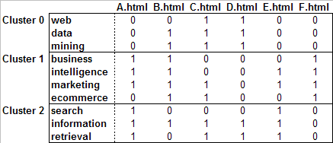
Content Profiles – An Example
Filtering threshold = 0.5
PROFILE 0 (Cluster Size = 3)
--------------------------------------------------------------------------------------------------------------
1.00 C.html (web, data, mining)
1.00 D.html (web, data, mining)
0.67 B.html (data, mining)
PROFILE 1 (Cluster Size = 4)
-------------------------------------------------------------------------------------------------------------
1.00 B.html (business, intelligence, marketing, ecommerce)
1.00 F.html (business, intelligence, marketing, ecommerce)
0.75 A.html (business, intelligence, marketing)
0.50 C.html (marketing, ecommerce)
0.50 E.html (intelligence, marketing)
PROFILE 2 (Cluster Size = 3)
-------------------------------------------------------------------------------------------------------------
1.00 A.html (search, information, retrieval)
1.00 E.html (search, information, retrieval)
0.67 C.html (information, retrieval)
0.67 D.html (information, retireval)

Slide 34
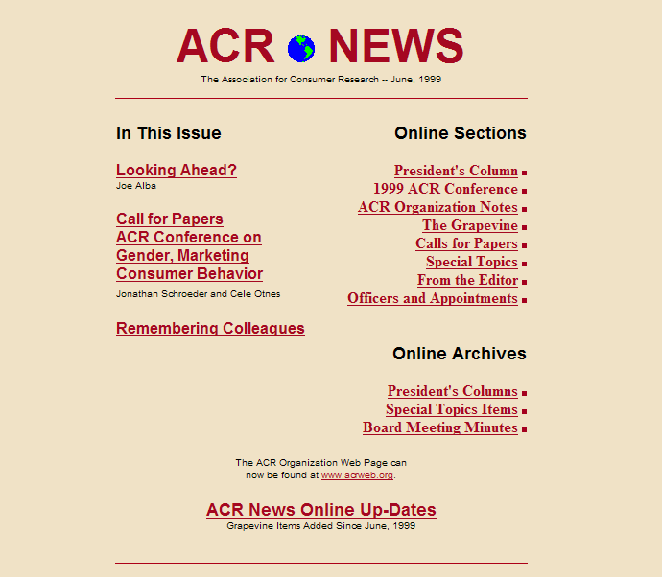
Example: Assoc. for Consumer Research (ACR)

Slide 35
How Content Profiles Are Generated
1. Extract important features
(e.g., word stems) from each
document:
2. Build a global dictionary of all features
(words) along with relevant statistics
Total Documents = 41
Feature-id Doc-freq Total-freq Feature
0 6 44 1997
1 12 59 1998
2 13 76 1999
3 8 41 2000
… … … …
123 26 271 confer
124 9 24 consid
125 23 165 consum
… … … …
439 7 45 psychologi
440 14 78 public
441 11 61 publish
… … … …
549 1 6 vision
550 3 8 volunt
551 1 9 vot
552 4 23 vote
553 3 17 web
… … … …

Slide 36
How Content Profiles Are Generated
3. Construct a document-word matrix with normalized tf-idf weights
4. Now we can perform clustering on word (or documents) using one of the
techniques described earlier (e.g., k-means clustering on features).

Slide 37
How Content Profiles Are Generated
Examples of feature (word) clusters obtained using k-means:
CLUSTER 0
----------
anthropologi
anthropologist
appropri
associ
behavior
...
CLUSTER 4
----------
consum
issu
journal
market
psychologi
special
CLUSTER 10
----------
ballot
result
vot
vote
...
CLUSTER 11
----------
advisori
appoint
committe
council
...
5. Content profiles are now generated from feature clusters based on centroids of
each cluster (similar to usage profiles, but we have words instead of users/sessions).

Slide 38
Scatter/Gather
Cutting, Pedersen, Tukey & Karger 92, 93, Hearst & Pedersen 95
Cluster-based browsing technique for large text collections
Cluster sets of documents into general “themes”, like a table of contents
Display the contents of the clusters by showing topical terms and typical titles
The user may then select (gather) clusters that seem interesting
These clusters can then be re-clustered (scattered) to reveal more fine-grained clusters of documents
With each successive iteration of scattering and gathering, the clusters become smaller and more detailed, eventually bottoming out at the level of individual documents
Clustering and re-clustering is entirely automated
Originally used to give collection overview
Evidence suggests more appropriate for displaying retrieval results in context

Slide 39
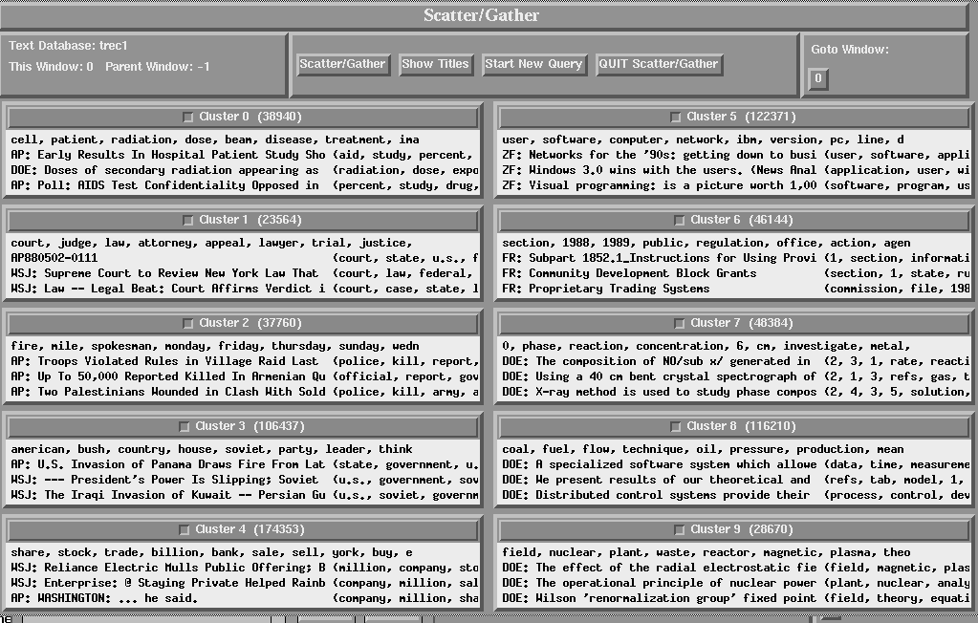
Scatter/Gather Interface

Slide 40
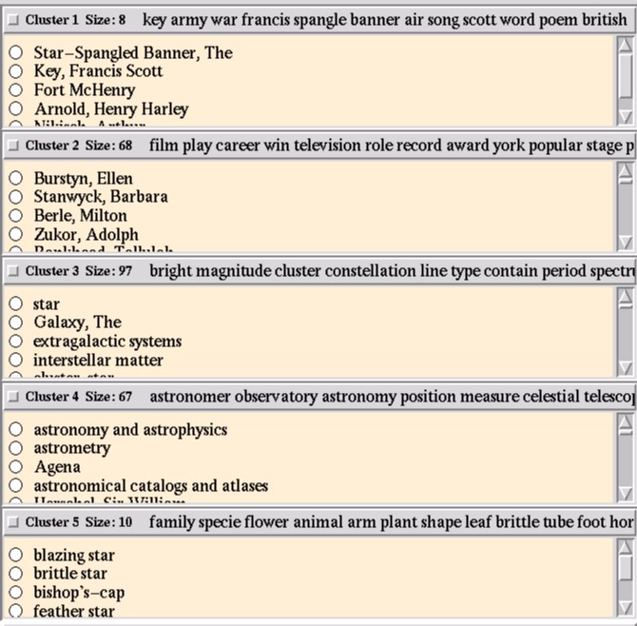
Scatter/Gather Clusters

Slide 41
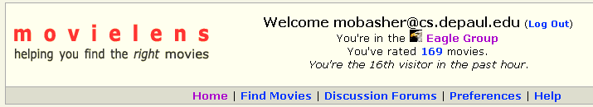
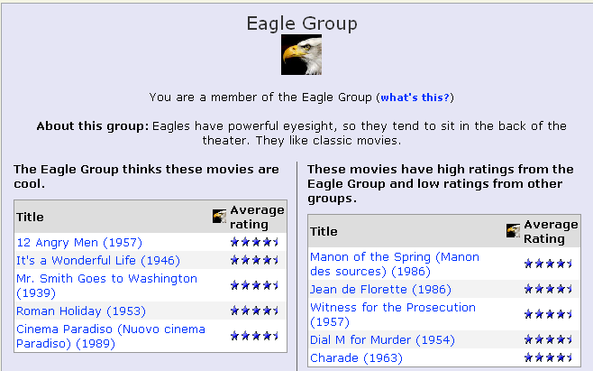
Clustering and Collaborative Filtering :: clustering based on ratings: movielens

Slide 42
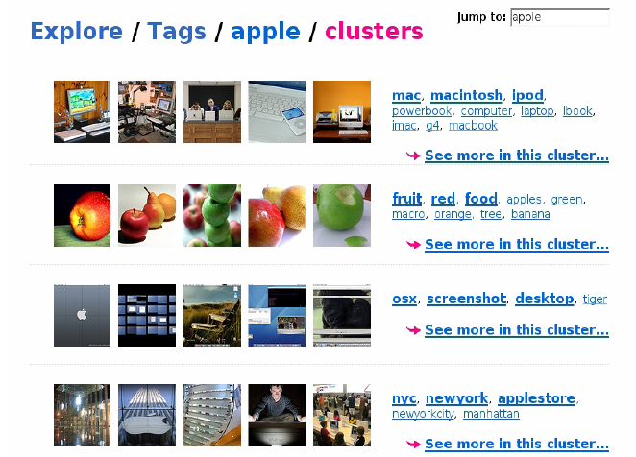
Clustering and Collaborative Filtering :: tag clustering example

Slide 43
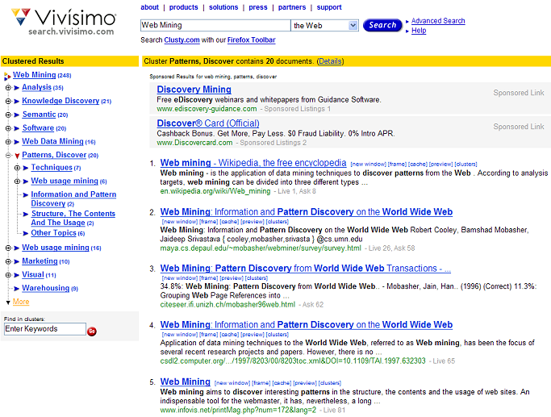
Hierarchical Clustering :: example – clustered search results
Can drill down within clusters to view sub-topics or to view the relevant subset of results

