Slide 1
Intelligent IR on the World Wide Web
CSC 575
Intelligent Information Retrieval

Slide 2
Intelligent IR on the World Wide Web
Web IR versus Classic IR
Web Spiders and Crawlers
Citation/hyperlink Indexing and Analysis
Intelligent Agents for the Web
Intelligent Information Retrieval

Slide 3
IR on the Web vs. Classsic IR
Input: publicly accessible Web
Goal: retrieve high quality pages that are relevant to user’s need
  static (text, audio, images, etc.)
  dynamically generated (mostly database access)
What’s different about the Web:
  large volume
  distributed data
  Heterogeneity of the data
  lack of stability
  high duplication
  high linkage
  lack of quality standard
Intelligent Information Retrieval

Slide 4
Search Engine Early History
In 1990, Alan Emtage of McGill Univ. developed Archie (short for “archives”)
  Assembled lists of files available on many FTP servers.
  Allowed regex search of these file names.
In 1993, Veronica and Jughead were developed to search names of text files available through Gopher servers.
In 1993, early Web robots (spiders) were built to collect URL’s:
  Wanderer
  ALIWEB (Archie-Like Index of the WEB)
  WWW Worm (indexed URL’s and titles for regex search)
In 1994, Stanford grad students David Filo and Jerry Yang started manually collecting popular web sites into a topical hierarchy called Yahoo.
Intelligent Information Retrieval

Slide 5
Search Engine Early History
In early 1994, Brian Pinkerton developed WebCrawler as a class project at U Wash.
  Eventually became part of Excite and AOL
A few months later, Fuzzy Maudlin, a grad student at CMU developed Lycos
  First to use a standard IR system
  First to index a large set of pages
In late 1995, DEC developed Altavista
  Used a large farm of Alpha machines to quickly process large numbers of queries
  Supported Boolean operators, phrases in queries.
In 1998, Larry Page and Sergey Brin, Ph.D. students at Stanford, started Google
  Main advance was use of link analysis to rank results partially based on authority.
Intelligent Information Retrieval

Slide 6


Web Search
Web
Spider
Document
corpus
IR
System
Query String
1. Page1
2. Page2
3. Page3
.
.
Ranked
Documents
Intelligent Information Retrieval

Slide 7
Spiders (Robots/Bots/Crawlers)
Start with a comprehensive set of root URL’s from which to start the search.
Follow all links on these pages recursively to find additional pages.
Index all novel found pages in an inverted index as they are encountered.
May allow users to directly submit pages to be indexed (and crawled from).
Intelligent Information Retrieval

Slide 8
Search Strategy Trade-Off’s
Breadth-first search strategy explores uniformly outward from the root page but requires memory of all nodes on the previous level (exponential in depth). Standard spidering method.
Depth-first search requires memory of only depth times branching-factor (linear in depth) but gets “lost” pursuing a single thread.
Both strategies implementable using a queue of links (URL’s).
Intelligent Information Retrieval

Slide 9
Avoiding Page Duplication
Must detect when revisiting a page that has already been spidered (web is a graph not a tree).
Must efficiently index visited pages to allow rapid recognition test.
  Tree indexing (e.g. trie)
  Hashtable
Index page using URL as a key.
  Must canonicalize URL’s (e.g. delete ending “/”)
  Not detect duplicated or mirrored pages.
Index page using textual content as a key.
  Requires first downloading page.
Intelligent Information Retrieval

Slide 10
Spidering Algorithm
Initialize queue (Q) with initial set of known URL’s.
Until Q empty or page or time limit exhausted:
Pop URL, L, from front of Q.
If L is not an HTML page (.gif, .jpeg, .ps, .pdf, .ppt…)
continue loop.
If already visited L, continue loop.
Download page, P, for L.
If cannot download P (e.g. 404 error, robot excluded)
continue loop.
Index P (e.g. add to inverted index or store cached copy).
Parse P to obtain list of new links N.
Append N to the end of Q.
Intelligent Information Retrieval

Slide 11
Queueing Strategy
How new links added to the queue determines search strategy.
FIFO (append to end of Q)
  gives breadth-first search.
LIFO (add to front of Q)
  gives depth-first search.
Heuristically ordering the Q gives a “focused crawler” that directs its search towards “interesting” pages.
  May be able to use standard AI search algorithms such as Best-first search, A*, etc.
Intelligent Information Retrieval

Slide 12
Restricting Spidering
Restrict spider to a particular site.
  Remove links to other sites from Q.
Restrict spider to a particular directory.
  Remove links not in the specified directory.
Obey page-owner restrictions
  robot exclusion protocol
Intelligent Information Retrieval

Slide 13
Anchor Text Indexing
Extract anchor text (between <a> and </a>) of each link:
  Anchor text is usually descriptive of the document to which it points.
  Add anchor text to the content of the destination page to provide additional relevant keyword indices.
  Used by Google:
    <a href=“http://www.microsoft.com”>Evil Empire</a>
    <a href=“http://www.ibm.com”>IBM</a>
Helps when descriptive text in destination page is embedded in image logos rather than in accessible text.
Many times anchor text is not useful:
  “click here”
Increases content more for popular pages with many in-coming links, increasing recall of these pages.
May even give higher weights to tokens from anchor text.
Intelligent Information Retrieval

Slide 14
Multi-Threaded Spidering
Bottleneck is network delay in downloading individual pages.
Best to have multiple threads running in parallel each requesting a page from a different host.
Distribute URL’s to threads to guarantee equitable distribution of requests across different hosts to maximize through-put and avoid overloading any single server.
Early Google spider had multiple coordinated crawlers with about 300 threads each, together able to download over 100 pages per second.
Intelligent Information Retrieval

Slide 15
Directed/Focused Spidering
Sort queue to explore more “interesting” pages first.
Two styles of focus:
  Topic-Directed
  Link-Directed
Intelligent Information Retrieval

Slide 16
Topic-Directed Spidering
Assume desired topic description or sample pages of interest are given.
Sort queue of links by the similarity (e.g. cosine metric) of their source pages and/or anchor text to this topic description.
Preferentially explores pages related to a specific topic.
Intelligent Information Retrieval

Slide 17
Link-Directed Spidering
Monitor links and keep track of in-degree and out-degree of each page encountered.
Sort queue to prefer popular pages with many in-coming links (authorities).
Sort queue to prefer summary pages with many out-going links (hubs).
Intelligent Information Retrieval

Slide 18
Keeping Spidered Pages Up to Date
Web is very dynamic: many new pages, updated pages, deleted pages, etc.
Periodically check spidered pages for updates and deletions:
  Just look at header info (e.g. META tags on last update) to determine if page has changed, only reload entire page if needed.
Track how often each page is updated and preferentially return to pages which are historically more dynamic.
Preferentially update pages that are accessed more often to optimize freshness of more popular pages.
Intelligent Information Retrieval

Slide 19
Quality and the WWW
The Case for Connectivity Analysis
Basic Idea: mine hyperlink information on the Web
Assumptions:
  links often connect related pages
  a link between pages is a “recommendation”
Approaches
  classic IR: co-citation analysis (a.k.a. “bibliometrics”)
  connectivity-based ranking (e.g., GOOGLE)
  HITS - hypertext induced topic search
Intelligent Information Retrieval

Slide 20
Co-Citation Analysis
Has been around since the 50’s (Small, Garfield, White & McCain)
Used to identify core sets of
  authors, journals, articles for particular fields of study
Main Idea:
  Find pairs of papers that cite third papers
  Look for commonalities
  http://www.garfield.library.upenn.edu/papers/mapsciworld.html
Intelligent Information Retrieval

Slide 21
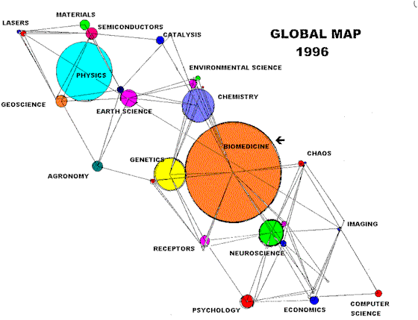
Co-citation analysis (From Garfield 98)
The Global Map of Science, based on co-citation clustering:
Size of the circle represents number of papers published in the area;
Distance between circles represents the level of co-citation between the fields;
By zooming in, deeper levels in the hierarchy can be exposed.
Intelligent Information Retrieval

Slide 22
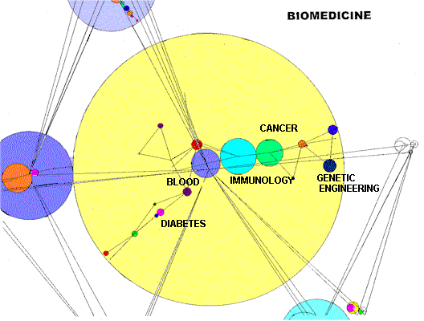
Co-citation analysis (From Garfield 98)
Zooming in on biomedicine, specialties including cardiology, immunology, etc., can be viewed.
Intelligent Information Retrieval

Slide 23
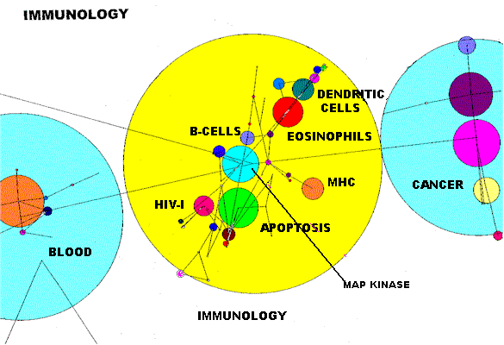
Co-citation analysis (From Garfield 98)
Intelligent Information Retrieval

Slide 24
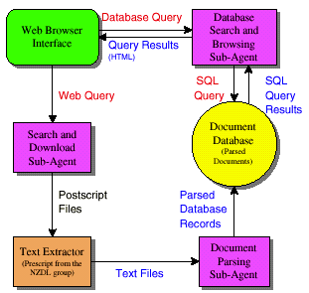
CiteSeer: A Web Agent for Citation Analysis
(Bollacker, Lawrence, Giles - 1998)
http://citeseer.ist.psu.edu/
The CiteSeer agent consists of
three main components:
(i) sub-agent to automatically
locate and acquire publications,
(ii) document parser and
database creator,
(iii) browser interface which
supports search by keyword
and browsing by citation links.
Intelligent Information Retrieval

Slide 25
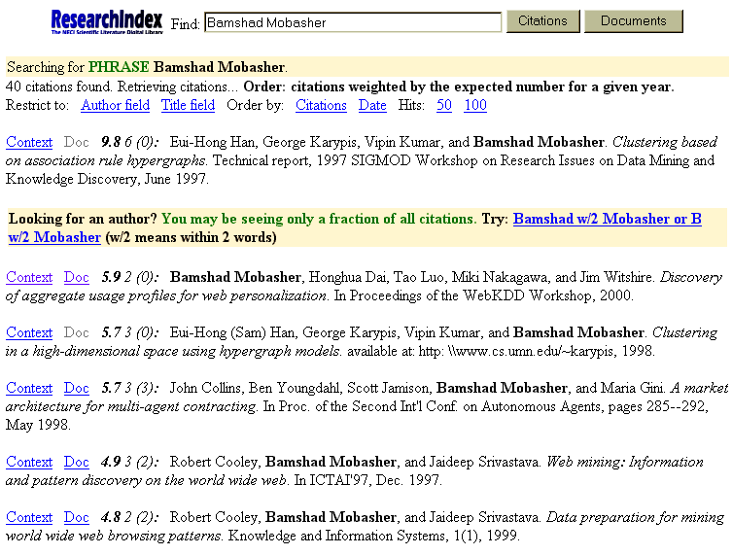
CiteSeer: A Web Agent for Citation Analysis

Slide 26
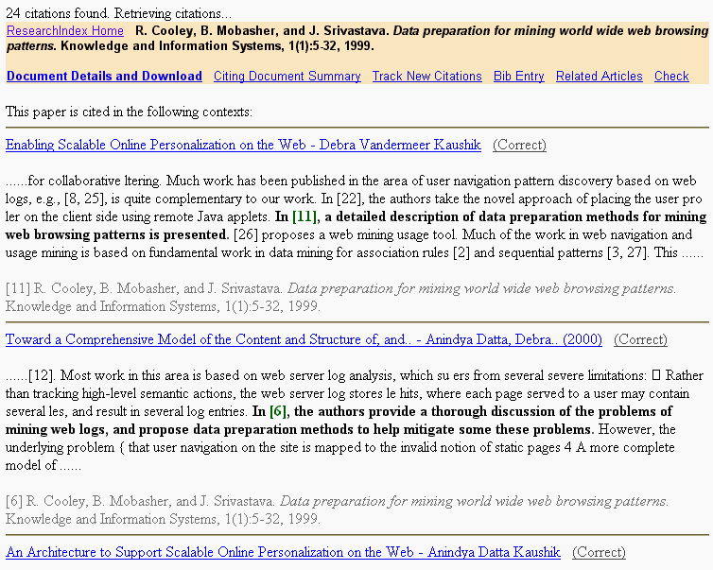
CiteSeer: A Web Agent for Citation Analysis

Slide 27
Citations vs. Links
Web links are a bit different than citations:
  Many links are navigational.
  Many pages with high in-degree are portals not content providers.
  Not all links are endorsements.
  Company websites don’t point to their competitors.
  Citations to relevant literature is enforced by peer-review.
Authorities
  pages that are recognized as providing significant, trustworthy, and useful information on a topic.
  In-degree (number of pointers to a page) is one simple measure of authority.
  However in-degree treats all links as equal. Should links from pages that are themselves authoritative count more?
Hubs
  index pages that provide lots of useful links to relevant content pages (topic authorities).
Intelligent Information Retrieval

Slide 28
Hypertext Induced Topic Search
Basic Idea: look for “authority” and “hub” web pages (Kleinberg 98)
  authority: definitive content for a topic
  hub: index links to good content
  The two distinctions tend to blend
Procedure:
  Issue a query on a term, e.g. “java”
  Get back a set of documents
  Look at the inlink and outlink patterns for the set of retrieved documents
  Perform statistical analysis to see which patterns are the most dominant ones
Technique was initially used in IBM’s CLEVER system
  can find some good starting points for some topics
  doesn’t solve the whole search problem!
  doesn’t make explicit use of content (so may result in “topic drift” from original query)
Intelligent Information Retrieval

Slide 29
Hypertext Induced Topic Search
Intuition behind the HITS algorithm
  Authority comes from in-edges
  Being a good hub comes from out-edges
Mutually re-enforcing relationship
  Better authority comes from in-edges of good hubs
  Being a better hub comes from out-edges of to good authorities
A good authority is a page that is pointed to by many good hubs.
A good hub is a page that points to many good authorities.
Together they tend to form a bipartite graph
Hubs
Authorities
Intelligent Information Retrieval

Slide 30
HITS Algorithm
Computes hubs and authorities for a particular topic specified by a normal query.
  1. First determine a set of relevant pages for the query called the base set (base subgraph) S.
    For a specific query Q, let the set of documents returned by a standard search engine be called the root set R. Initialize S to R.
    Add to S all pages pointed to by any page in R.
    Add to S all pages that point to any page in R.
  Analyze the link structure of the web subgraph defined by S to find authority and hub pages in this set.
S
R
Intelligent Information Retrieval

Slide 31
HITS – Some Considerations
Base Limitations
  To limit computational expense:
    Limit number of root pages to the top 200 pages retrieved for the query.
    Limit number of “back-pointer” pages to a random set of at most 50 pages returned by a “reverse link” query.
  To eliminate purely navigational links:
    Eliminate links between two pages on the same host.
  To eliminate “non-authority-conveying” links:
    Allow only m (m ≅ 4−8) pages from a given host as pointers to any individual page.
Authorities and In-Degree
  Even within the base set S for a given query, the nodes with highest in-degree are not necessarily authorities (may just be generally popular pages like Yahoo or Amazon).
  True authority pages are pointed to by a number of hubs (i.e. pages that point to lots of authorities).
Intelligent Information Retrieval

Slide 32
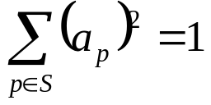
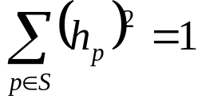
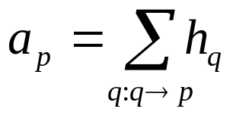
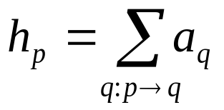
HITS: Iterative Algorithm
Use an iterative algorithm to slowly converge on a mutually reinforcing set of hubs and authorities.
Maintain for each page p ∈ S:
  Authority score: a_{p} (vector a)
  Hub score: h_{p} (vector h)
Initialize all a_{p} = h_{p} = 1
Maintain normalized scores:
Authorities are pointed to by lots of good hubs:
Hubs point to lots of good authorities:
Intelligent Information Retrieval

Slide 33
Illustrated Update Rules
1
4
a₄ = h₁ + h₂ + h₃
2
3
5
h₄ = a₅ + a₆ + a₇
4
6
7
Intelligent Information Retrieval

Slide 34
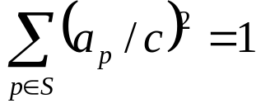

HITS Iterative Algorithm
Initialize for all p ∈ S: a_{p} = h_{p} = 1
For i = 1 to k:
For all p ∈ S: (update auth. scores)
For all p ∈ S: (update hub scores)
For all p ∈ S: a_{p}= a_{p}/c c:
For all p ∈ S: h_{p}= h_{p}/c c:
(normalize a)
(normalize h)
Intelligent Information Retrieval

Slide 35
HITS Example
B
D
First Iteration
C
A
D A C B E
A: [0.0, 0.0, 2.0, 2.0, 1.0]
E
D A C B E
H: [4.0, 5.0, 0.0, 0.0, 0.0]
Normalize: divide each vector by its norm (square root of the sum of the squares)
D A C B E
Norm A: [0.0, 0.0, 0.67, 0.67.0, 0.33]
D A C B E
Norm H: [0.62, 0.78, 0.0, 0.0, 0.0]
Intelligent Information Retrieval

Slide 36
HITS Algorithm
Let HUB[v] and AUTH[v] represent the hub and authority values associated with a vertex v
Repeat until HUB and AUTH vectors converge
  Normalize HUB and AUTH
  HUB[v] := Σ AUTH[u_{i}] for all u_{i} with Edge(v, u_{i})
  AUTH[v] := Σ HUB[w_{i}] for all u_{i} with Edge(w_{i}, v)
w₁
u₁
v
w₂
u₂
A
H
...
...
w_{k}
u_{k}
Intelligent Information Retrieval

Slide 37
Convergence
Algorithm converges to a fix-point if iterated indefinitely.
Define A to be the adjacency matrix for the subgraph defined by S.
  A_{ij} = 1 for i ∈ S, j ∈ S iff i→j
Authority vector, a, converges to the principal eigenvector of A^{T}A
Hub vector, h, converges to the principal eigenvector of AA^{T}
In practice, 20 iterations produces fairly stable results.
Intelligent Information Retrieval

Slide 38
HITS Results
Authorities for query: “Java”
  java.sun.com
  comp.lang.java FAQ
Authorities for query “search engine”
  Yahoo.com
  Excite.com
  Lycos.com
  Altavista.com
Authorities for query “Gates”
  Microsoft.com
  roadahead.com
In most cases, the final authorities were not in the initial root set generated using Altavista. Authorities were brought in from linked and reverse-linked pages and then HITS computed their high authority score.
Intelligent Information Retrieval

Slide 39
HITS: Other Applications
Finding Similar Pages Using Link Structure
  Given a page, P, let R (the root set) be t (e.g. 200) pages that point to P.
  Grow a base set S from R.
  Run HITS on S.
  Return the best authorities in S as the best similar-pages for P.
  Finds authorities in the “link neighbor-hood” of P.
Similar Pages to “honda.com”:
  - toyota.com
  - ford.com
  - bmwusa.com
  - saturncars.com
  - nissanmotors.com
  - audi.com
  - volvocars.com
Intelligent Information Retrieval

Slide 40
HITS: Other Applications
HITS for Clustering
  An ambiguous query can result in the principal eigenvector only covering one of the possible meanings.
  Non-principal eigenvectors may contain hubs & authorities for other meanings.
  Example: “jaguar”:
    Atari video game (principal eigenvector)
    NFL Football team (2nd non-princ. eigenvector)
    Automobile (3rd non-princ. eigenvector)
  An application of Principle Component Analysis (PCA)
Intelligent Information Retrieval

Slide 41
HITS: Problems and Solutions
Some edges are wrong (not “recommendations”)
  multiple edges from the same author
  automatically generated
  spam
Solution: weight edges to limit influence
Topic Drift
  Query: jaguar AND cars
  Result: pages about cars in general
Solution: analyze content and assign topic scores to
nodes
Intelligent Information Retrieval

Slide 42
Modified HITS Algorithm
Let HUB[v] and AUTH[v] represent the hub and authority values associated with a vertex v
Repeat until HUB and AUTH vectors converge
  Normalize HUB and AUTH
  HUB[v] := Σ AUTH[u_{i}] . TopicScore[u_{i}] . Weight(v, u_{i})
  for all u_{i} with Edge(v, u_{i})
  AUTH[v] := Σ HUB[w_{i}] . TopicScore[w_{i}] . Weight(w_{i}, v)
  for all u_{i} with Edge(w_{i}, v)
Topic score is determined based on similarity measure between the query and the documents
Intelligent Information Retrieval

Slide 43
PageRank
Alternative link-analysis method used by Google (Brin & Page, 1998).
Does not attempt to capture the distinction between hubs and authorities.
Ranks pages just by authority.
Applied to the entire Web rather than a local neighborhood of pages surrounding the results of a query.
Intelligent Information Retrieval

Slide 44
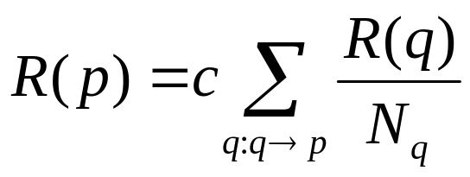
Initial PageRank Idea
Just measuring in-degree (citation count) doesn’t account for the authority of the source of a link.
Initial page rank equation for page p:
  N_{q} is the total number of out-links from page q.
  A page, q, “gives” an equal fraction of its authority to all the pages it points to (e.g. p).
  c is a normalizing constant set so that the rank of all pages always sums to 1.
Intelligent Information Retrieval

Slide 45
Initial PageRank Idea
Can view it as a process of PageRank “flowing” from pages to the pages they cite.
.1
.08
.05
.05
.03
.09
.08
.03
.03
.03
Intelligent Information Retrieval

Slide 46
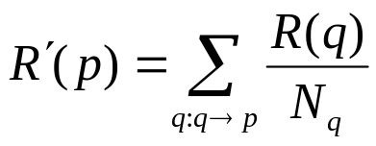
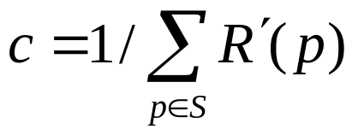
Initial PageRank Algorithm
Iterate rank-flowing process until convergence:
    Let S be the total set of pages.
    Initialize ∀p∈S: R(p) = 1/|S|
    Until ranks do not change (much) (convergence)
  For each p∈S:
  For each p∈S: R(p) = cR´(p) (normalize)
Intelligent Information Retrieval

Slide 47
Sample Stable Fixpoint
0.4
0.2
0.2
0.2
0.2
0.4
0.4
Intelligent Information Retrieval

Slide 48
Linear Algebra Version
Treat R as a vector over web pages.
Let A be a 2-d matrix over pages where
  A_{vu}= 1/N_{u} if u→ v else A_{vu}= 0
Then R = cAR
R converges to the principal eigenvector of A.
Intelligent Information Retrieval

Slide 49
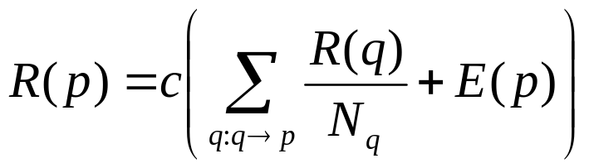
Problem with Initial Idea
A group of pages that only point to themselves but are pointed to by other pages act as a “rank sink” and absorb all the rank in the system.
Solutions: Rank Score
  Introduce a “rank source” E that continually replenishes the rank of each page, p, by a fixed amount E(p).
Intelligent Information Retrieval

Slide 50
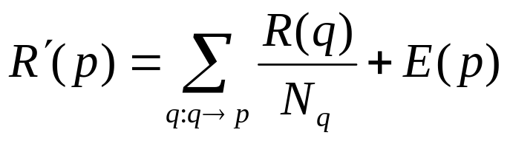
PageRank Algorithm
Let S be the total set of pages.
Let ∀p∈S: E(p) = α/|S| (for some 0<α<1, e.g. 0.15)
Initialize ∀p∈S: R(p) = 1/|S|
Until ranks do not change (much) (convergence)
For each p∈S:
For each p∈S: R(p) = cR´(p) (normalize)
Intelligent Information Retrieval

Slide 51
PageRank Example
B
A C B
Initial R: [0.33, 0.33, 0.33]
A
α = 0.3
First Iteration Only:
C
R’(C): R(A)/2 + R(B)/1 + 0.3/3
R’(B): R(A)/2 + 0.3/3
R’(A): 0.3/3
before
normalization:
A C B
R’: [0.1, 0.595, 0.27]
Normalization factor:
1/[R’(A)+R’(B)+R’(C)] = 1/0.965
after
normalization:
A C B
R: [0.104, 0.617, 0.28]
Intelligent Information Retrieval

Slide 52
Random Surfer Model
PageRank can be seen as modeling a “random surfer” that starts on a random page and then at each point:
  With probability E(p) randomly jumps to page p.
  Otherwise, randomly follows a link on the current page.
R(p) models the probability that this random surfer will be on page p at any given time.
“E jumps” are needed to prevent the random surfer from getting “trapped” in web sinks with no outgoing links.
Intelligent Information Retrieval

Slide 53
Speed of Convergence
Early experiments on Google used 322 million links.
PageRank algorithm converged (within small tolerance) in about 52 iterations.
Number of iterations required for convergence is empirically O(log n) (where n is the number of links).
Therefore calculation is quite efficient.
Intelligent Information Retrieval

Slide 54
Google Ranking
Complete Google ranking includes (based on university publications prior to commercialization).
  Vector-space similarity component.
  Keyword proximity component.
  HTML-tag weight component (e.g. title preference).
  PageRank component.
Details of current commercial ranking functions are trade secrets.
Intelligent Information Retrieval

Slide 55
Personalized PageRank
PageRank can be biased (personalized) by changing E to a non-uniform distribution.
Restrict “random jumps” to a set of specified relevant pages.
For example, let E(p) = 0 except for one’s own home page, for which E(p) = α
This results in a bias towards pages that are closer in the web graph to your own homepage.
Similar personalization can be achieved by setting E(p) for only pages p that are part of the user’s profile.
Intelligent Information Retrieval

Slide 56
PageRank-Biased Spidering
Use PageRank to direct (focus) a spider on “important” pages.
Compute page-rank using the current set of crawled pages.
Order the spider’s search queue based on current estimated PageRank.
Intelligent Information Retrieval

Slide 57
Link Analysis Conclusions
Link analysis uses information about the structure of the web graph to aid search.
It is one of the major innovations in web search.
It is the primary reason for Google’s success.
Intelligent Information Retrieval

Slide 58
Behavior-Based Ranking
Emergence of large-scale search engines allow for mining aggregate behavior analysis to improving ranking.
Basic Idea:
  For each query Q, keep track of which docs in the results are clicked on
  On subsequent requests for Q, re-order docs in results based on click-throughs.
  Relevance assessment based on
    Behavior/usage
    vs. content
Intelligent Information Retrieval

Slide 59
Query-doc popularity matrix B
Docs
j
q
Queries
B_{qj} = number of times doc j
clicked-through on query q
When query q issued again, order docs by B_{qj} values.
Intelligent Information Retrieval
Notes:
Naïve implementation

Slide 60
Vector space implementation
Maintain a term-doc popularity matrix C
  as opposed to query-doc popularity
  initialized to all zeros
Each column represents a doc j
  If doc j clicked on for query q, update C_{j}← C_{j} +ε q (here q is viewed as a vector).
On a query q’, compute its cosine proximity to C_{j} for all j.
Combine this with the regular text score.
Intelligent Information Retrieval

Slide 61
Issues
Normalization of C_{j} after updating
Assumption of query compositionality
  “white house” document popularity derived from “white” and “house”
Updating - live or batch?
Basic assumption:
  Relevance can be directly measured by number of click throughs
  Valid?
Intelligent Information Retrieval

