Slide 1


Handling Slice Permutations Variability in Tensor Recovery
Jingjing Zheng^{1,2}, Xiaoqin Zhang^{*,2}, Wengzhe Wang², Xianta Jiang¹
¹Memorial University, ²Wenzhou University

Slide 2
Content
Background of Tensor Methods
Mathematical Preliminaries
Motivation: Slice Permutations Variability
Slice Permutations Invariance and Slice Permutations Variability in Tensor Recovery
Experiments
Conclusion

Slide 3
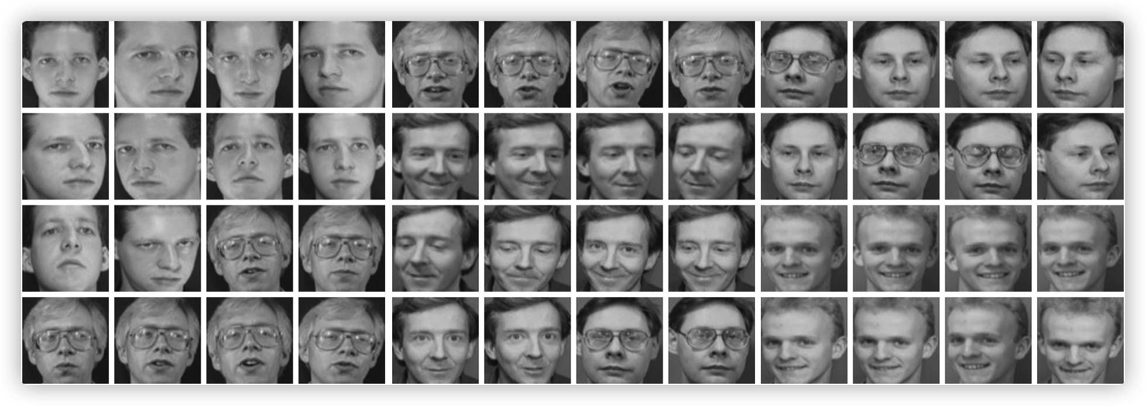


Dimension Curse
Basic assumption ：Natural signals often lie in or near lie in some low-mensional subspaces or manifolds.
How to extract the intrinsic low-dimensional structure of high-dimensional data？
$$n_{1}$$
$$n_{1}$$
PCA¹(Principal component analysis):
1. Svante Wold, Kim Esbensen, and Paul Geladi. Principal component analysis. Chemometrics & Intelligent Laboratory Systems, 2(1):37–52, 1987.

Slide 4


From matrix to tensor
512
512
3
Matrix low rankness
Tensor low rankness
How to define the rank of a tensor?

Slide 5
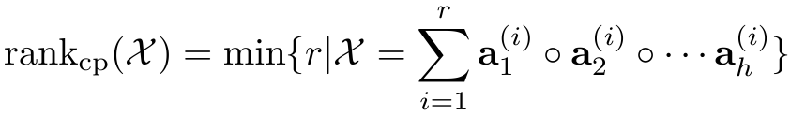












Tensor rank
CP rank²: the minimum number of rank-one decompositions (CP (CANDECOMP/PARAFAC) decomposition) of the given tensor as the rank of tensor (CP rank).
$$a_{1}^{\left(1\right)}$$
$$a_{1}^{\left(2\right)}$$
$$a_{1}^{\left(r\right)}$$
$$α_{1}$$
$$a_{2}^{\left(1\right)}$$
$$α_{2}$$
$$a_{2}^{\left(2\right)}$$
$$α_{r}$$
$$a_{2}^{\left(r\right)}$$
=
+
+
……
+
$$a_{3}^{\left(1\right)}$$
$$a_{3}^{\left(2\right)}$$
$$a_{3}^{\left(r\right)}$$
2. Kolda, T. G.; and Bader, B. W. 2009. Tensor decompositions and applications. SIAM Review, 51(3): 455–500.

Slide 6
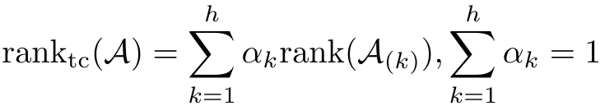
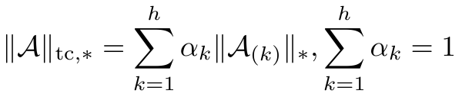












Tensor rank
Tucker rank³: the sum of the ranks of the different unfolding matrices as the rank of the tensor.
$$n_{3}$$
$$n_{3}$$
$$n_{1}$$
$$n_{2}$$
$$n_{2}$$
$$n_{2}$$
$$n_{1}$$
$$n_{2}$$
$${\text{A}}_{\left(1\right)}$$
$$n_{1}$$
$$n_{3}$$
The weighted sum of nuclear norm （SNN）
$$n_{2}$$
$$n_{2}$$
$$n_{3}$$
$$n_{3}$$
$$n_{3}$$
$$n_{1}$$
$${\text{A}}_{\left(\text{2}\right)}$$
$$n_{2}$$
$$n_{3}$$
$$n_{2}$$
$$n_{3}$$
$$n_{1}$$
$$n_{1}$$
$$n_{1}$$
$${\text{A}}_{\left(3\right)}$$
$$n_{1}$$
3. Gandy, S.; Recht, B.; and Yamada, I. 2011. Tensor comple tion and low-n-rank tensor recovery via convex optimization. Inverse Problems, 27(2): 025010.

Slide 7









Tensor rank
Tensor tubal rank⁴:Assume is the t-SVD of , tensor tubal rank of is defined as the number of non-zero singular tubes of .
$$n_{3}$$
$$n_{3}$$
$$n_{3}$$
$$n_{3}$$
=
*
*
$$n_{2}$$
$$n_{1}$$
$$n_{1}$$
$$n_{1}$$
$$n_{2}$$
$$n_{2}$$
$$n_{1}$$
$$n_{2}$$
4. M. E. Kilmer, K. Braman, N. Hao, and R. C. Hoover, Third-order tensors as operators on matrices: A theoretical and computational framework with applications in imaging. SIAM J. Matrix Anal. Appl.,
vol. 34, no. 1, pp. 148–172, Jan. 2013.

Slide 8
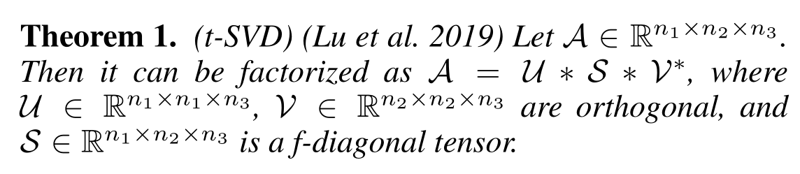

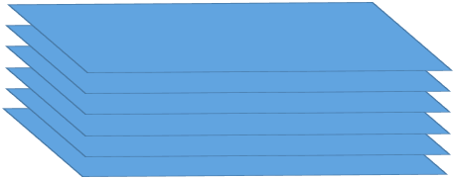



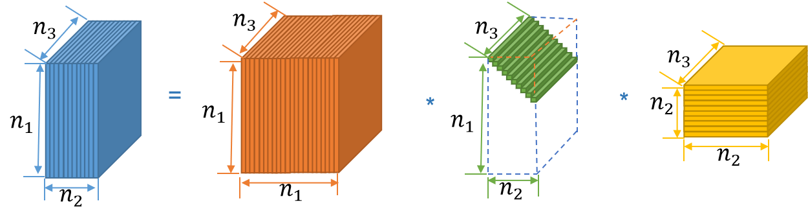
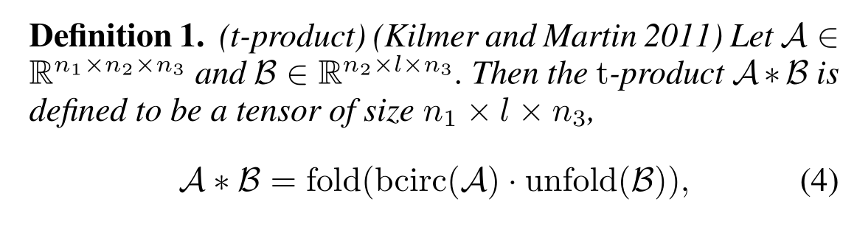
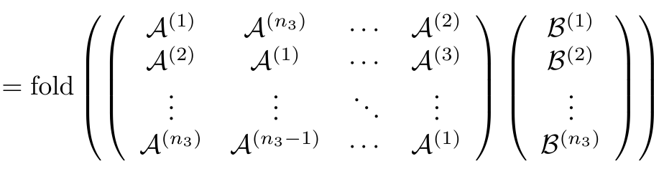
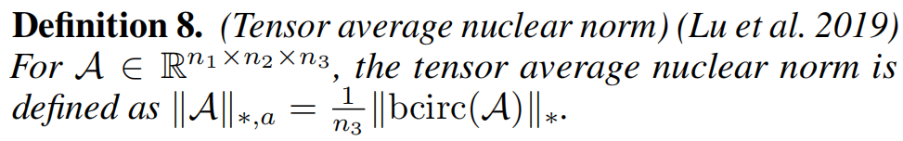
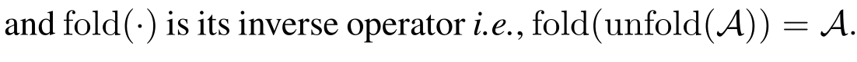
Mathematical Preliminarie: tensor-tensor product, tensor tubal rank, and tensor nuclear norm
Horizontal slice
Lateral slice
Frontal slice
5. Lu, C.; Feng, J.; Chen, Y.; Liu, W.; Lin, Z.; and Yan, S. 2019. Tensor robust principal component analysis with a new tensor nuclear norm. IEEE Transactions on Pattern Analysis and Machine Intelligence, 42(4): 925–938.

Slide 9
Motivation: a reasonal hypothesis for matrix recovery and tensor recovery
Column (or row) permutation invariance: column (or row) permutation on matrix Y (rearrange the data squence) should not affect matrix recovery results.
Or
Colunm permutation invariance
Row permutation invariance

Slide 10
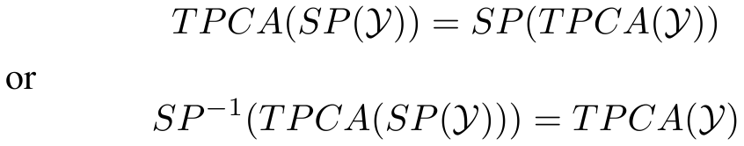

Motivation: a reasonal hypothesis for matrix recovery and tensor recovery
Slice permutations invariance: slice permutations on tensor Y should not affect tensor recovery results.
Horizontal SPI
Lateral SPI
Frontal SPI

Slide 11
Motivation: a reasonal hypothesis for matrix recovery and tensor recovery
Column (or row) permutation invariance: column (or row) permutation on matrix Y (rearrange the data squence) should not affect matrix recovery results.
√
Or
Colunm permutation invariance
Row permutation invariance

Slide 12
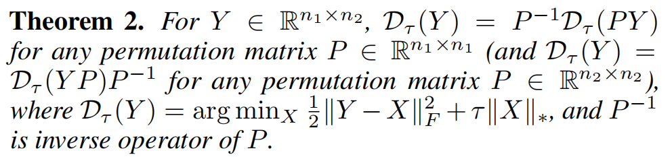
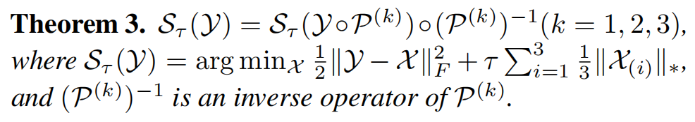
SPI of Nuclear Norm
SPI of SNN (the weighted sum of nuclear norm)

Slide 13
Motivation: a reasonal hypothesis for matrix recovery and tensor recovery
Slice permutations invariance: slice permutations on tensor Y should not affect tensor recovery results.
×
Horizontal SPI
Lateral SPI
Frontal SPI

Slide 14
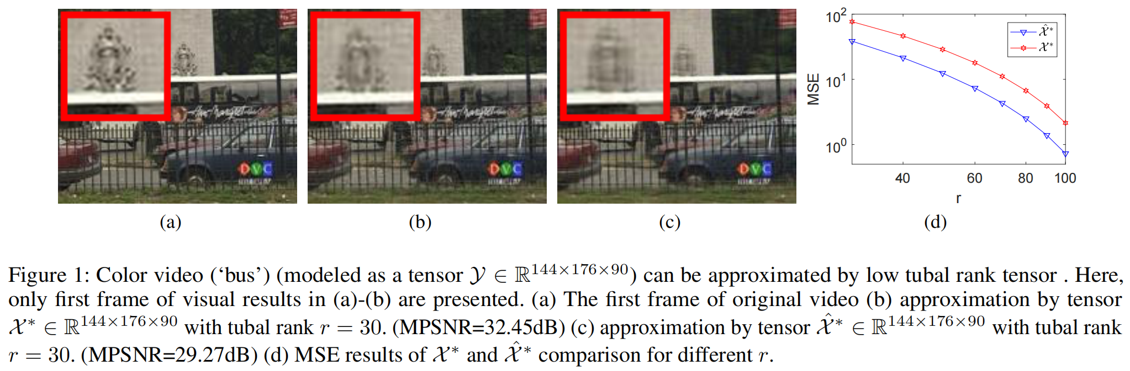

Slide 15
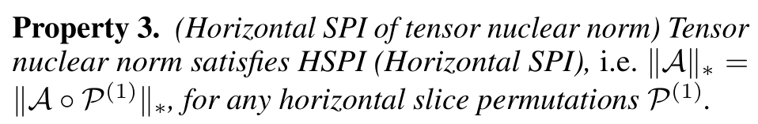
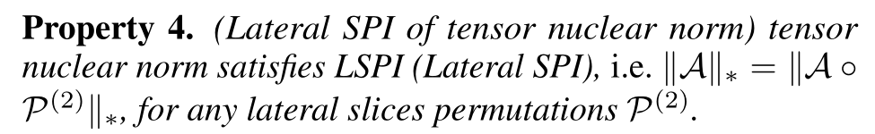
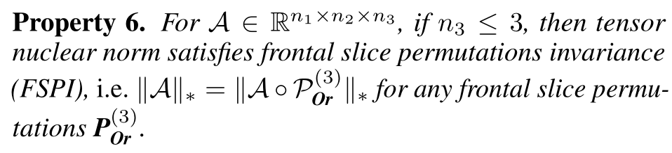
SPI of tensor nuclear norm:
Horizontal SPI
Lateral SPI
Frontal SPI

Slide 16
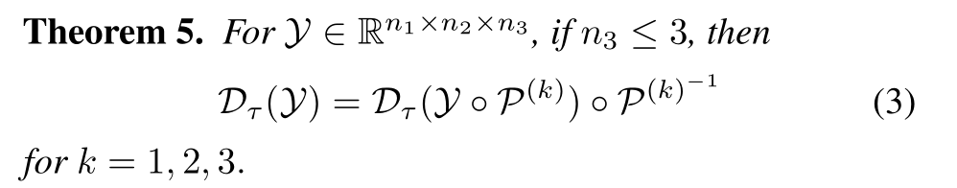
SPI of tensor recovery for some special case:
SPI of tensor recovery for color image (n₃=3) is true!

Slide 17
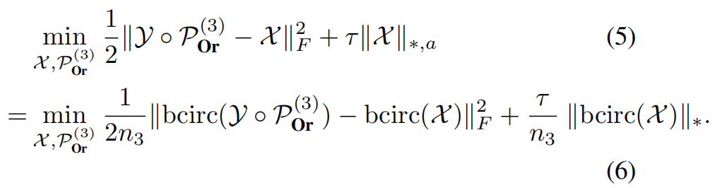
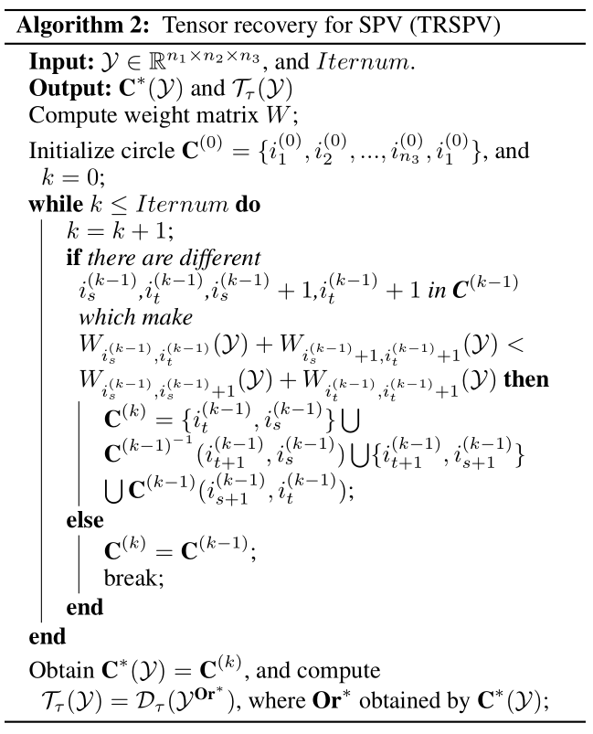
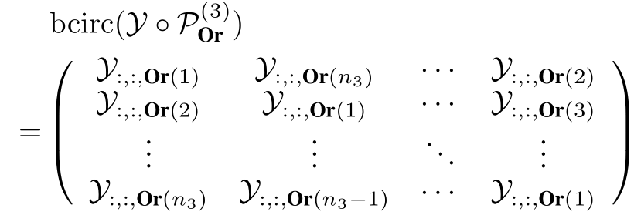
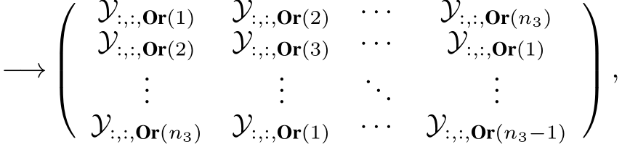
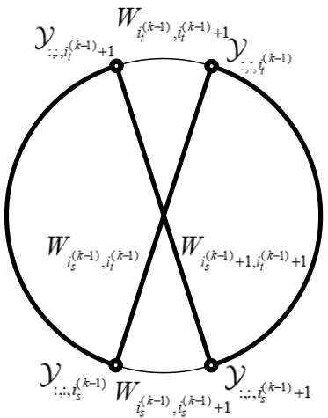
Tensor principal component analysis for SPV:
⁶ Bondy J A, Murty U S R. Graph theory with applications[M]. London: Macmillan, 1976.

Slide 18
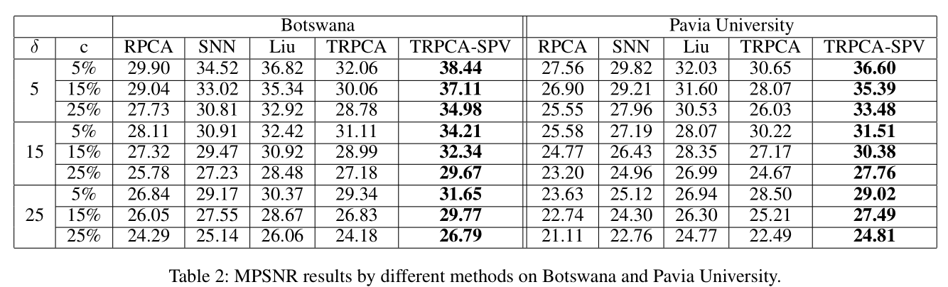
Experiments: image sequence recovery

Slide 19
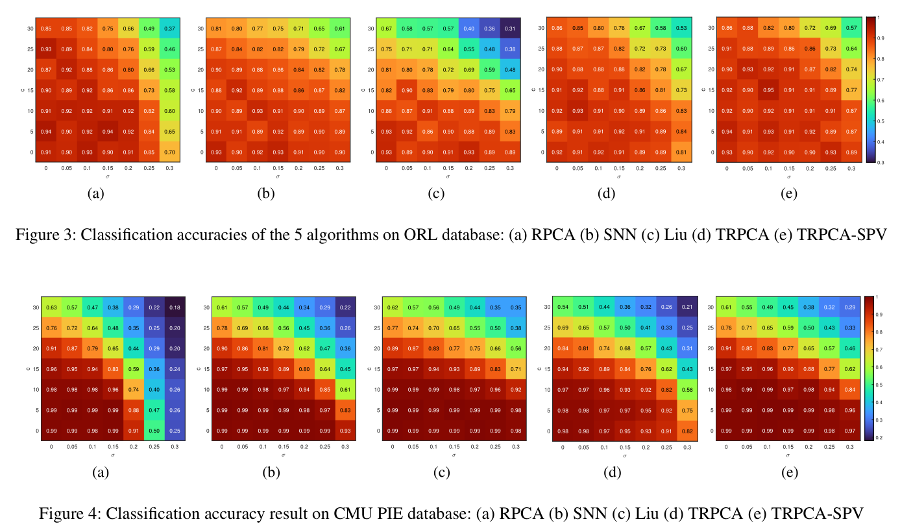
Experiments: image classification

Slide 20
Conclusion
Study SPV and Slice Permutations Invariance (SPI) of tensor recovery theoretically and experimentally for the first time. We prove that the tensor recovery algorithm has SPI property under certain conditions.
When the conditions are not met, to make tensor recovery more stable for slice permutations on data tensor, we propose a tensor recovery algorithm for SPV (TRSPV) to solve it.

Slide 21
References
1. Svante Wold, Kim Esbensen, and Paul Geladi. Principal component analysis. Chemometrics & Intelligent Laboratory Systems, 2(1):37–52, 1987.
2. Kolda, T. G.; and Bader, B. W. 2009. Tensor decompositions and applications. SIAM Review, 51(3): 455–500.
3. Gandy, S.; Recht, B.; and Yamada, I. 2011. Tensor comple tion and low-n-rank tensor recovery via convex optimization. Inverse Problems, 27(2): 025010.
4. M. E. Kilmer, K. Braman, N. Hao, and R. C. Hoover, Third-order tensors as operators on matrices: A theoretical and computational framework with applications in imaging. SIAM J. Matrix Anal. Appl.,
vol. 34, no. 1, pp. 148–172, Jan. 2013.
5. Lu, C.; Feng, J.; Chen, Y.; Liu, W.; Lin, Z.; and Yan, S. 2019. Tensor robust principal component analysis with a new tensor nuclear norm. IEEE Transactions on Pattern Analysis and Machine Intelligence, 42(4): 925–938.
6. Bondy J A, Murty U S R. Graph theory with applications[M]. London: Macmillan, 1976.

Slide 22
Thanks!

