Slide 1
Dynamic Graph Neural Networks for Sequential Recommendation
TCSS 556 Spring 2022
John Zhou

Slide 2
Agenda
Introduction
Related Work
Preliminaries
Methodology
Experiment and Result

Slide 3
Introduction
Problem of sequential recommendation
Modeling user preference from his historical sequence
Existing works
Several collaborative filtering method
Mainly focus on static user-item interaction
Ignore the rich historical sequential information of users.

Slide 4
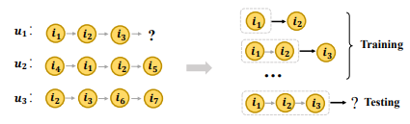
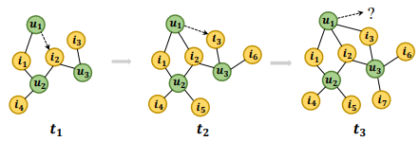
Introduction
Recent approaches
Achieved compelling result, such as Markov-chain, RNN-based models, CNN-based models
Con: only model users’ interests within their own sequences and ignore the dynamic collaborative signals among different user sequences.
Result: Insufficient to explore user’s preference.

Slide 5
Related Work
Sequential Recommendation
predict the next item based on users’ historical interaction sequences.
Dynamic Graph Neural Networks
Graph neural networks have been employed to address lots of problems.
Some of them have the frequency changed graph data, s.t social network and recommendation system.
Neural network with dynamic graph can learn dynamically from the graph data and generate better inference result.

Slide 6

Preliminaries
Sequential Recommendation
$U$ represent the set of users
$I$ represent the set of items
$S^{u}=(i_{1},i_{2},i_{3},i_{4},….,i_{k})$, where $i \text{∈} I$and $u$∈$U$.

Slide 7
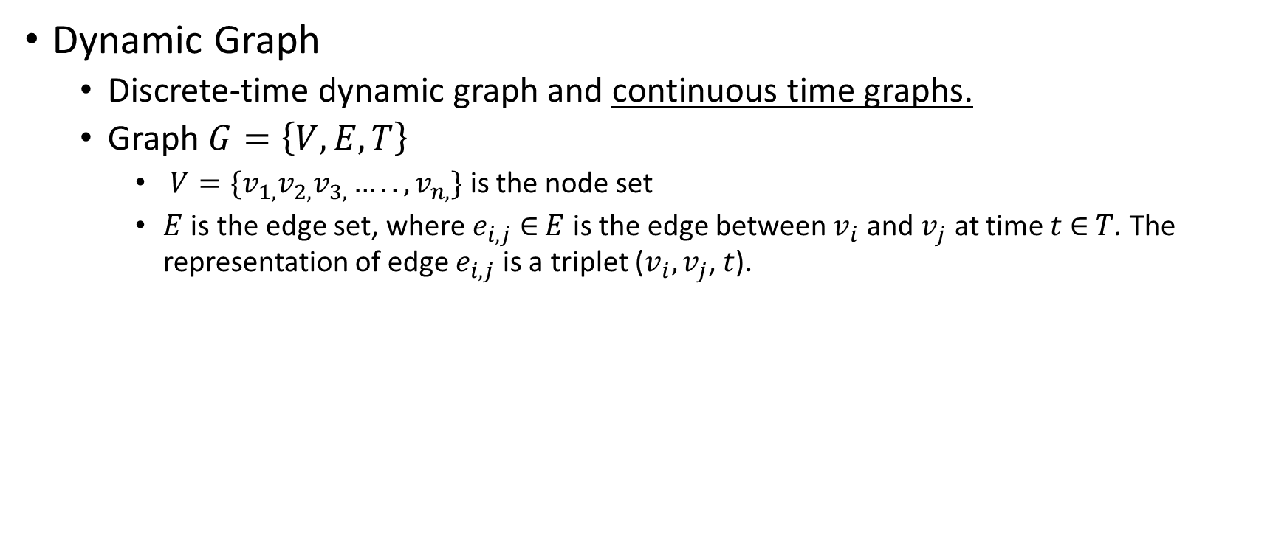
Preliminaries
Dynamic Graph
Discrete-time dynamic graph and continuous time graphs.
Graph $G=\left\{V, E, T\right\}$
$V=\{v_{1,}v_{2,}v_{3,}…..,v_{n,}\}$ is the node set
$E$ is the edge set, where $e_{i,j}$ $\text{∈}$ $E$ is the edge between $v_{i}$ and $v_{j}$ at time $t$ $\text{∈}$ $T$. The representation of edge $e_{i,j}$ is a triplet ($v_{i},v_{j}$, $t$).

Slide 8
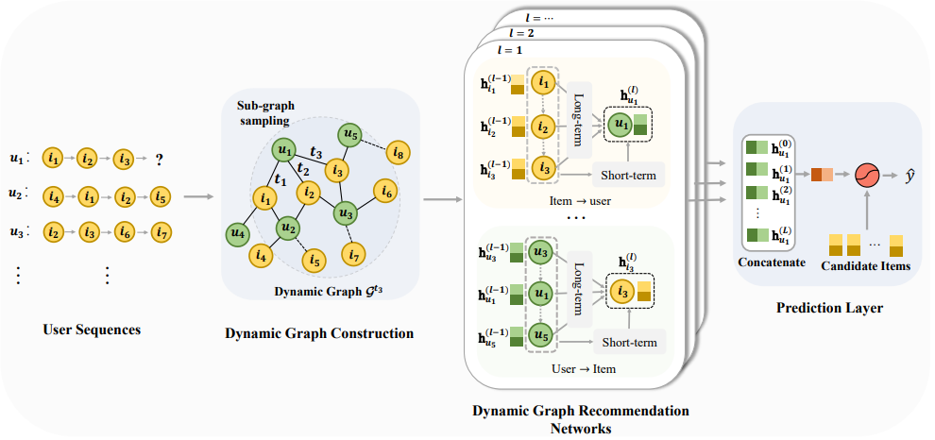
Methodology
Consists of components:
Dynamic Graph Construction
Sub-graph Sampling
Dynamic Graph Recommendation Networks
Prediction Layers

Slide 9
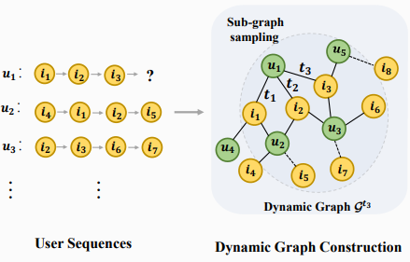
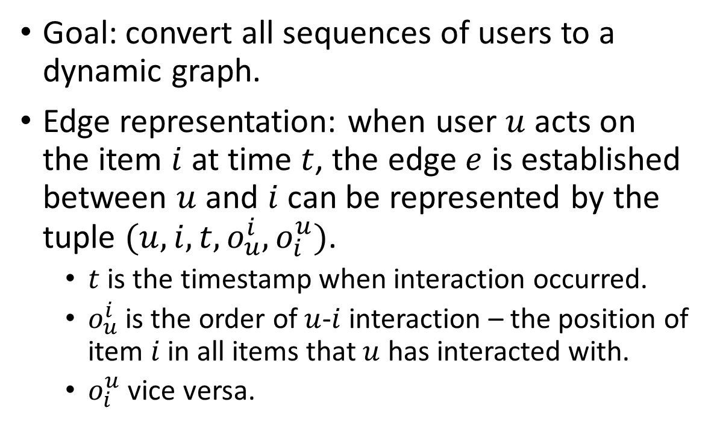
Methodology - Dynamic Graph Construction
Goal: convert all sequences of users to a dynamic graph.
Edge representation: when user $u$ acts on the item $i$ at time $t$, the edge $e$ is established between $u$ and $i$ can be represented by the tuple $(u,i,t,o_{u}^{i},o_{i}^{u})$.
$t$ is the timestamp when interaction occurred.
$o_{u}^{i}$ is the order of $u$-$i$ interaction – the position of item $i$ in all items that $u$ has interacted with.
$o_{i}^{u}$ vice versa.

Slide 10
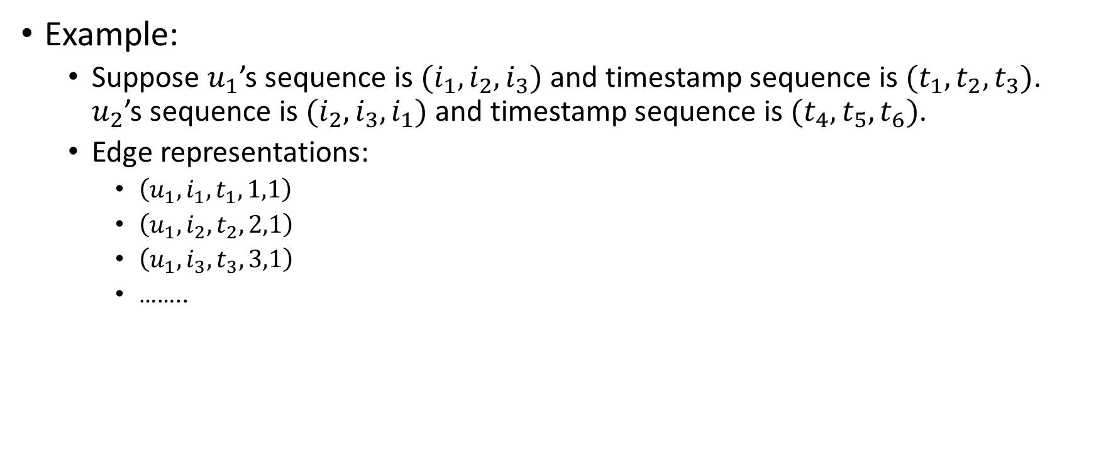
Methodology - Dynamic Graph Construction
Example:
Suppose $u_{1}$’s sequence is $(i_{1},i_{2},i_{3})$ and timestamp sequence is $(t_{1},t_{2},t_{3})$. $u_{2}$’s sequence is $(i_{2},i_{3},i_{1})$ and timestamp sequence is $(t_{4},t_{5},t_{6})$.
Edge representations:
$\left(u_{1},i_{1},t_{1},1,1\right)$
$\left(u_{1},i_{2},t_{2},2,1\right)$
$\left(u_{1},i_{3},t_{3},3,1\right)$
……..

Slide 11
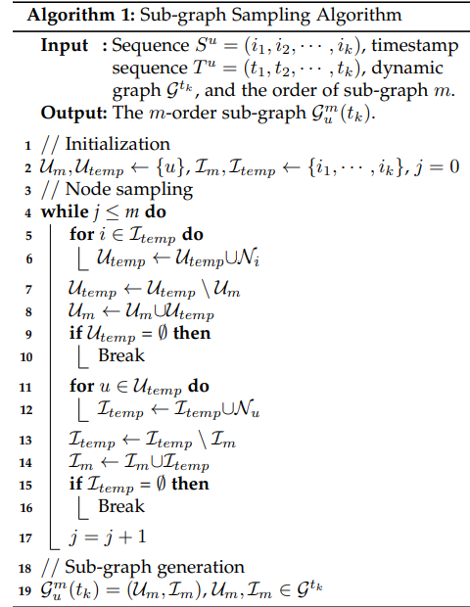
Methodology - Sub-graph Sampling
Goal: extract sub-graphs which contain user’s sequence and its related sequences. Thus, reduce the computational cost.

Slide 12
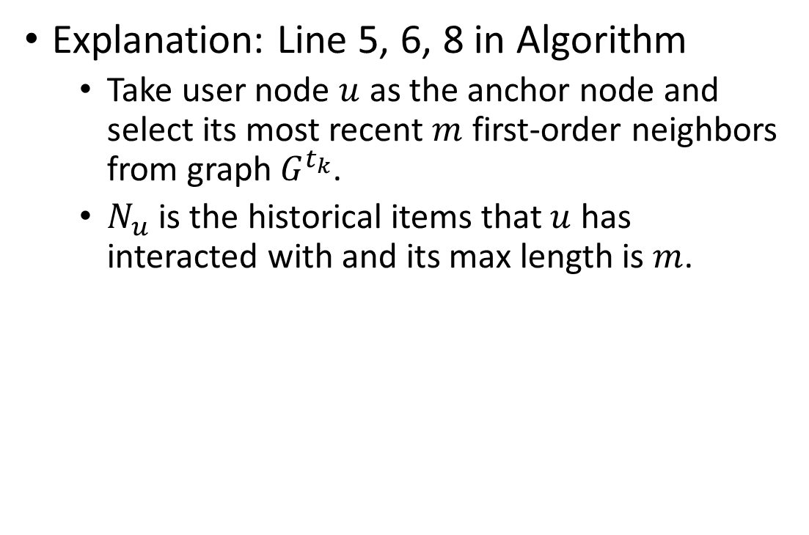
Methodology - Sub-graph Sampling
Explanation: Line 5, 6, 8 in Algorithm
Take user node $u$ as the anchor node and select its most recent $m$ first-order neighbors from graph$G^{t_{k}}$.
$N_{u}$ is the historical items that $u$ has interacted with and its max length is $m$.

Slide 13

Methodology - Sub-graph Sampling
Explanation: Line 11, 12, 14 in Algorithm
For each item $i$ in $N_{u}$, each $i$(written as $N_{i}$) will be used as an anchor node to sample the set of users who have interacted with them.

Slide 14
Methodology - Sub-graph Sampling
Explanation: Line 7, 13 in Algorithm
Record user and item nodes that have been used to be anchor node to avoid repeated sampling.

Slide 15
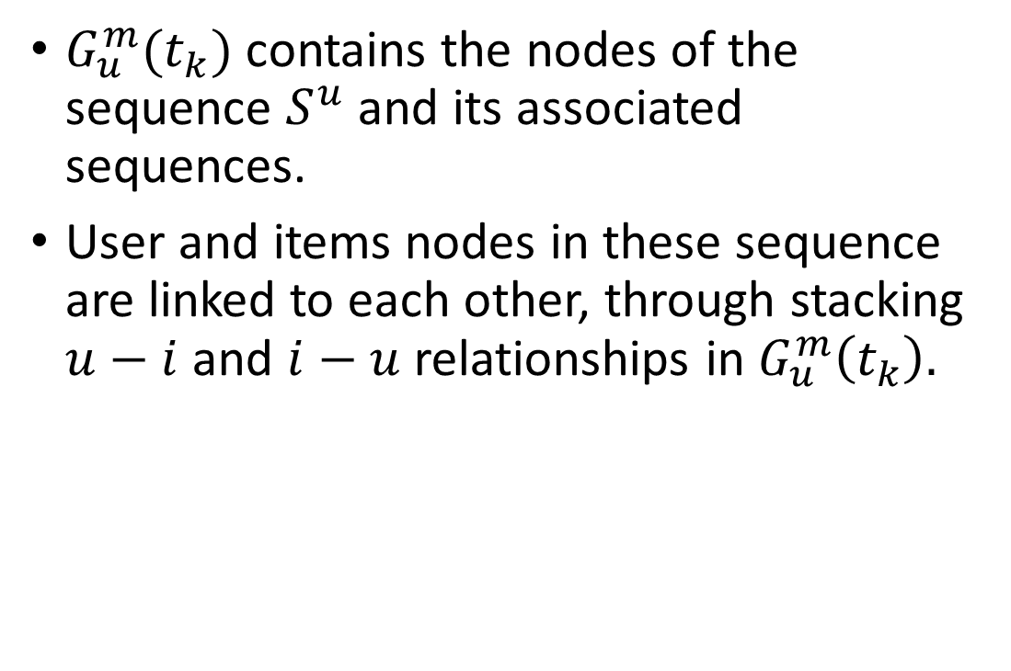
Methodology - Sub-graph Sampling
$G_{u}^{m}(t_{k})$ contains the nodes of the sequence $S^{u}$ and its associated sequences.
User and items nodes in these sequence are linked to each other, through stacking $u−i$ and $i−u$ relationships in $G_{u}^{m}\left(t_{k}\right).$

Slide 16
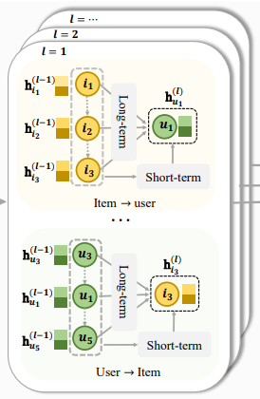
Methodology - Dynamic Graph Recommendation Networks
Goal: encode each user preference from the sub-graph.
Consists of message propagation and node updating components.
Outputs from previous step: From item to user, From user to item.

Slide 17
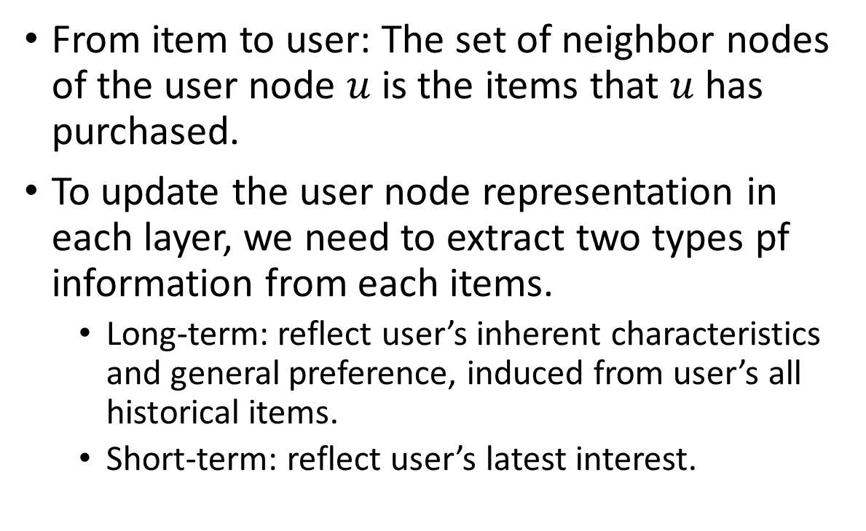
Methodology - Dynamic Graph Recommendation Networks
From item to user: The set of neighbor nodes of the user node $u$ is the items that $u$ has purchased.
To update the user node representation in each layer, we need to extract two types pf information from each items.
Long-term: reflect user’s inherent characteristics and general preference, induced from user’s all historical items.
Short-term: reflect user’s latest interest.

Slide 18
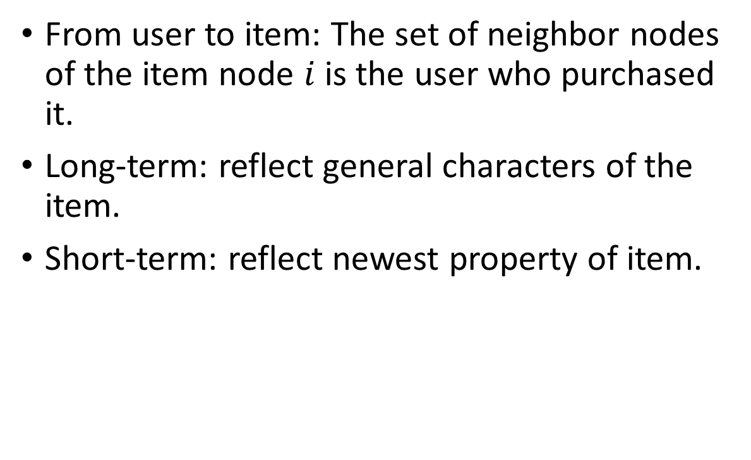
Methodology - Dynamic Graph Recommendation Networks
From user to item: The set of neighbor nodes of the item node $i$ is the user who purchased it.
Long-term: reflect general characters of the item.
Short-term: reflect newest property of item.

Slide 19
Methodology - Dynamic Graph Recommendation Networks
Message Propagation
Encoding long-term and short-term information.

Slide 20
Methodology - Dynamic Graph Recommendation Networks
Long-term Information:
To capture the long-term information of each node from its neighbors, graph neural networks and recurrent neural network.
Furthermore, an order-aware attention mechanism was designed.

Slide 21
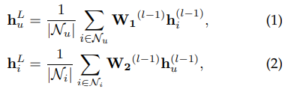
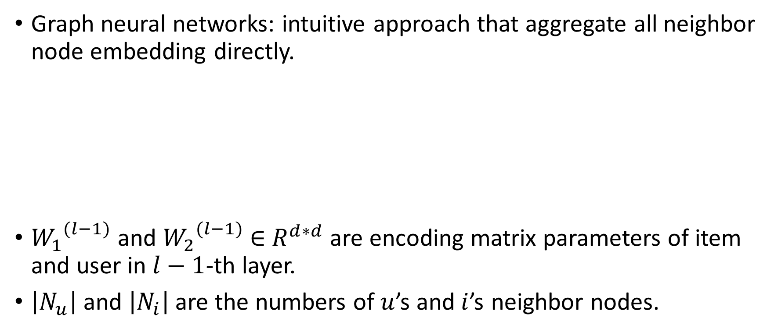
Methodology - Dynamic Graph Recommendation Networks
Graph neural networks: intuitive approach that aggregate all neighbor node embedding directly.
${W_{1}}^{(l−1)}$ and ${W_{2}}^{(l−1)}$ ∈ $R^{d∗d}$ are encoding matrix parameters of item and user in $l−1$-th layer.
$\left|N_{u}\right|$ and $\left|N_{i}\right|$ are the numbers of $u$’s and$i$’s neighbor nodes.

Slide 22

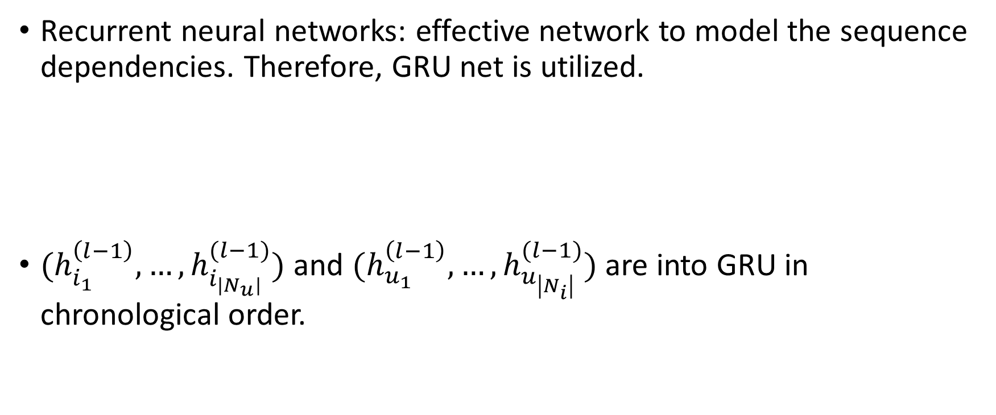
Methodology - Dynamic Graph Recommendation Networks
Recurrent neural networks: effective network to model the sequence dependencies. Therefore, GRU net is utilized.
$(h_{i_{1}}^{\left(l−1\right)},…,h_{i_{\left|N_{u}\right|}}^{(l−1)})$ and $(h_{u_{1}}^{\left(l−1\right)},…,h_{u_{\left|N_{i}\right|}}^{(l−1)})$ are into GRU in chronological order.

Slide 23

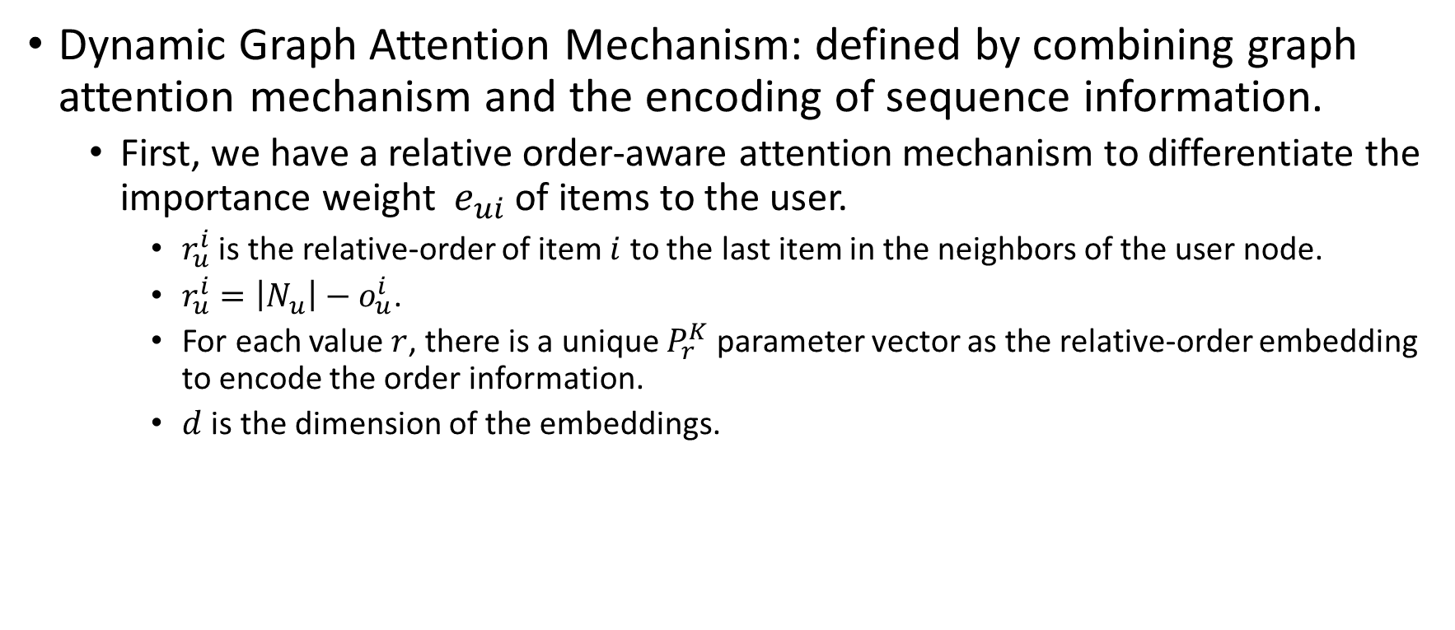
Methodology - Dynamic Graph Recommendation Networks
Dynamic Graph Attention Mechanism: defined by combining graph attention mechanism and the encoding of sequence information.
First, we have a relative order-aware attention mechanism to differentiate the importance weight $e_{ui}$ of items to the user.
$r_{u}^{i}$ is the relative-order of item $i$ to the last item in the neighbors of the user node.
$r_{u}^{i}=\left|N_{u}\right|−o_{u}^{i}$.
For each value $r$, there is a unique $P_{r}^{K}$ parameter vector as the relative-order embedding to encode the order information.
$d$ is the dimension of the embeddings.

Slide 24

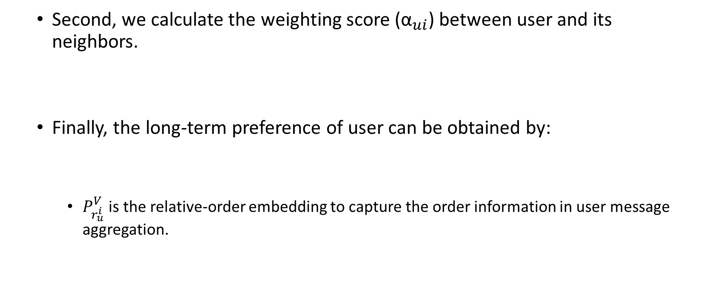
Methodology - Dynamic Graph Recommendation Networks
Second, we calculate the weighting score (${\text{α}}_{ui}$) between user and its neighbors.
Finally, the long-term preference of user can be obtained by:
$P_{r_{u}^{i}}^{V}$ is the relative-order embedding to capture the order information in user message aggregation.

Slide 25

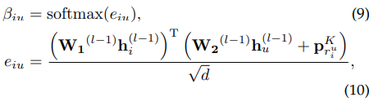

Methodology - Dynamic Graph Recommendation Networks
Similarly, the long-term character of item can be obtained by:
$r_{u}^{i}=\left|N_{u}\right|−o_{u}^{i}$.
$P_{r_{i}^{u}}^{V}$ is the relative-order embedding to capture the order information in item message aggregation.

Slide 26
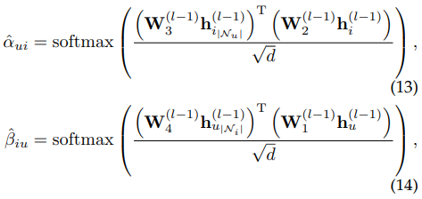

Methodology - Dynamic Graph Recommendation Networks
Short-term Information:
Attention mechanism is used to model the explicit effectiveness between last interaction with historical interactions.

Slide 27

Methodology - Dynamic Graph Recommendation Networks
Node updating
Aggregate the long-term embedding, short-term embedding, and the previous layer embedding to update the node’s representation of $G_{u}^{m}(t_{k})$.
User node updating, and item node updating.

Slide 28


Methodology - Dynamic Graph Recommendation Networks
User node updating:
Item node updating:

Slide 29
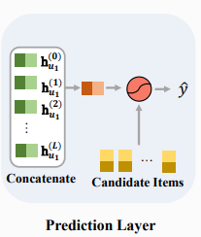

Methodology – Prediction Layer
Goal: determine the items that user may interact with next.
Outputs from previous step: multiple embedding $\{h_{u}^{\left(0\right)},h_{u}^{\left(1\right)},…,h_{u}^{(L)}\}$ of $u$ node.

Slide 30


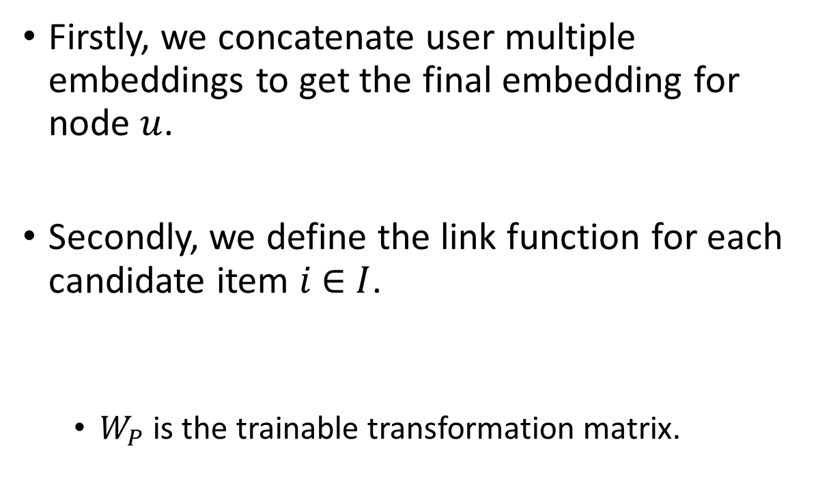
Methodology – Prediction Layer
Firstly, we concatenate user multiple embeddings to get the final embedding for node $u$.
Secondly, we define the link function for each candidate item $i$ ∈ $I$.
$W_{P}$ is the trainable transformation matrix.

Slide 31

Methodology – Prediction Layer
Then we can generate the score vector of $u$ for each candidate item, where $S_{u}=(S_{u1},S_{u2},…,S_{u\left|I\right|})$
The normalized vector of user $u$’s score for candidate item is calculated by:

Slide 32

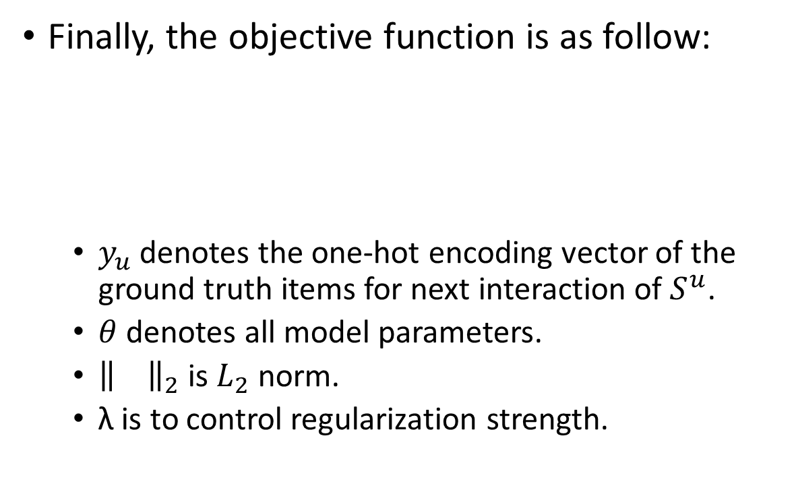
Methodology – Prediction Layer
Finally, the objective function is as follow:
$y_{u}$ denotes the one-hot encoding vector of the ground truth items for next interaction of $S^{u}$.
$θ$ denotes all model parameters.
${\left\|\right\|}_{2}$ is $L_{2}$ norm.
λ is to control regularization strength.

Slide 33
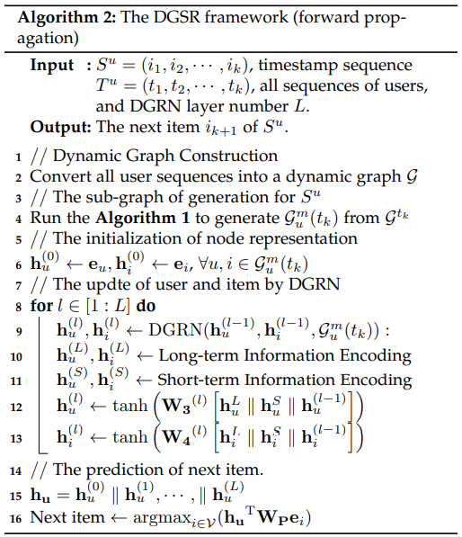
Methodology – Overall framework

Slide 34
Experiment and Result
Three real world dataset: Amazon-CDs, Amazon-Games, Amazon-Beauty.
Baselines: BPR-MF, FPMC, GRU4Rec+, Caser, SASRec, SR-GNN, HGN, TiSASRec, HyperRec
Evaluation Metrics: Hit@K, NDCG@K

Slide 35
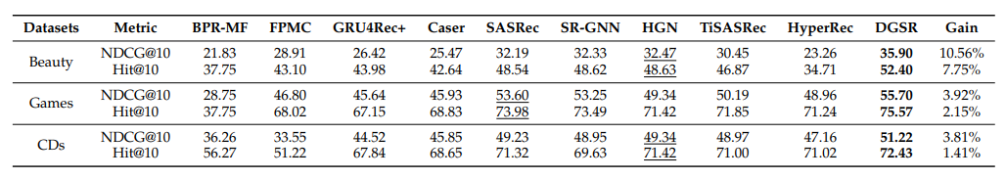
Question 1:
The results shows that DGSR on those three different datasets achieve best performance comparing with the other baseline methods.

Slide 36
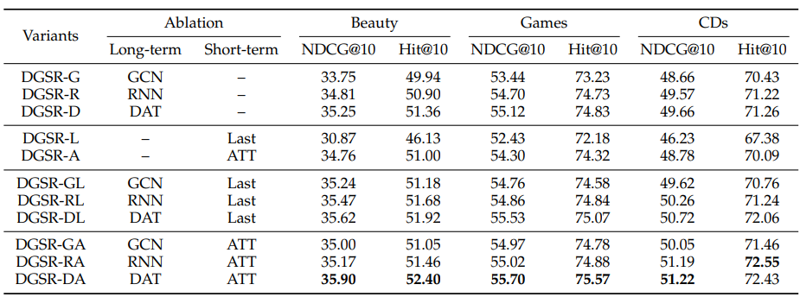
Question 2:
The experiment conducts 11 variants of DGSR with combination of components in long-term and short-term. The result shows that DGSR-DA has the best performance.

Slide 37
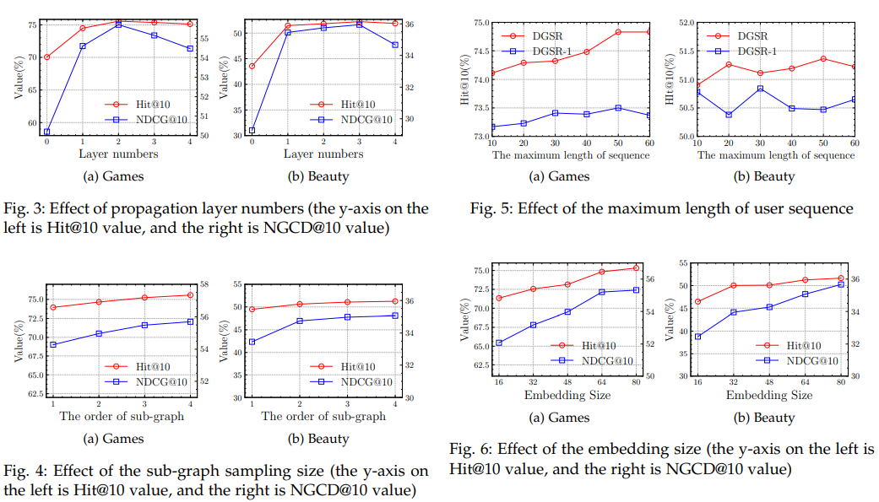
Question 3:
While the numbers of DGRN layer increase, the model performance is more stable.
While the sub-graph sampling size increase, the model performance tends to be stable.
Increasing the maximum sequence length can improve the performance of the model. But blindly increasing will bring noise and cause the performance to degrade.
The performance will increase with the increased embedding size.

