Slide 1
Operation Sleep Enough!
Jiebin (Alex) Zhu
MBC 638 Fall 2020

Slide 2
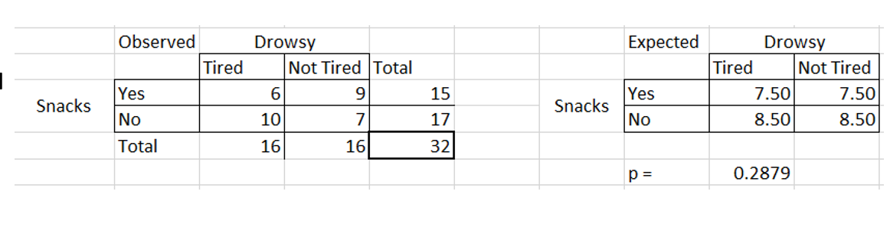

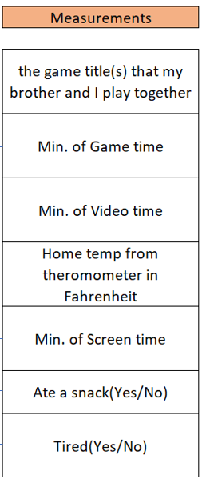
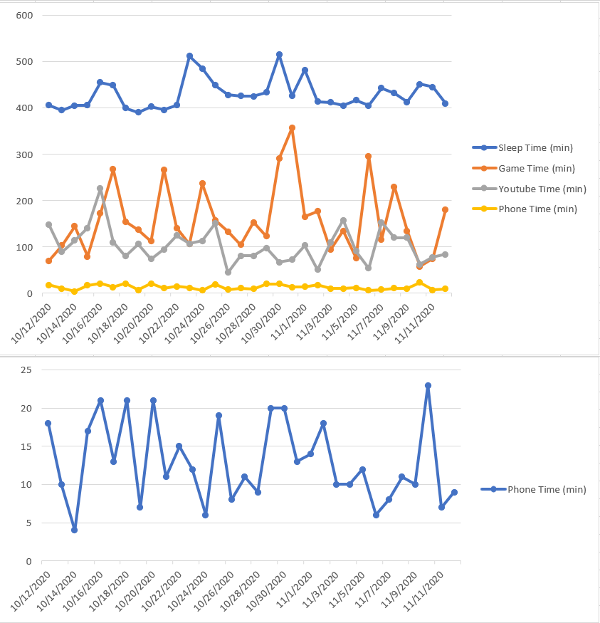
Process Improvement Project – More Sleep Per night
DEFINE (Oct)
Problem Statement: Insufficient sleep per night (<480 mins) because I don’t have a fixed sleeping schedule (i.e. sleeping before a certain time). It makes me feel weak and tired the day after.
Business Impact: Directly affects my health (increased risk for cardiovascular disease) and indirectly affects my work (loss of 25% of my productivity), medical cost for cardiovascular disease treatment and 25% of my annual salary as a cost for this problem total would be roughly $36,500.
MEASURE (Oct-Nov)
ANALYZE (Nov-Dec)
IMPROVE (Dec)
Chi Square Test
Game Time & Video Time
/Day
Collected 32 data points
Mean/Median Pretty Close
No proof that snacking before bed makes me feel drowsier
It seems that Gaming takes up a lot of my time, so I want to limit myself up to 120 mins of game time and also up to 90 mins of video time per day. Since I tend to wake up around 8:30AM everyday, this is an effective way for me to conserve time and spend them on sleeping.
>= 480Mins Sleep time only 4 times
Everything recorded on Google Sheets App
CONTROL (Jan – Onwards)
In psychology, there’s something called conditioning. For each night I meet my requirement, I will reward myself with 5 fancy pieces of Ferrero Rocher Chocolate (for the next day, obviously) since I love that so much. If I don’t make the target, I’ll have to eat 2 pouches of sour patch kids (I hate sour candies a lot). This will help ensure that my improvement I am making can stay for the future.
Looks like I play too much games most nights and taking up a lot of my time
SQL = 1.2
Video takes up a lot when game time is low
Sample Size Calculation = 18
Very low. Captured 40 Defects/64 Defects

Slide 3
What’s going on?
I have a trouble with having a fixed sleeping schedule that I will feel really lazy and unproductive the day after a night with terrible sleep. By terrible sleep, I mean turning and tossing on the bed for a long period of time because I am having trouble falling asleep and/or not getting the number of hours of sleep I should be getting. After waking up from a night of bad sleep I will feel weak and not in a mood to do anything. I know when my body doesn’t feel healthy enough, and now that’s definitely the time and I need some changes. Therefore, I need to fix my problem of not having a fixed sleeping schedule and increase my sleep quality.
The process that I am trying to work on is getting more sleep.

Slide 4
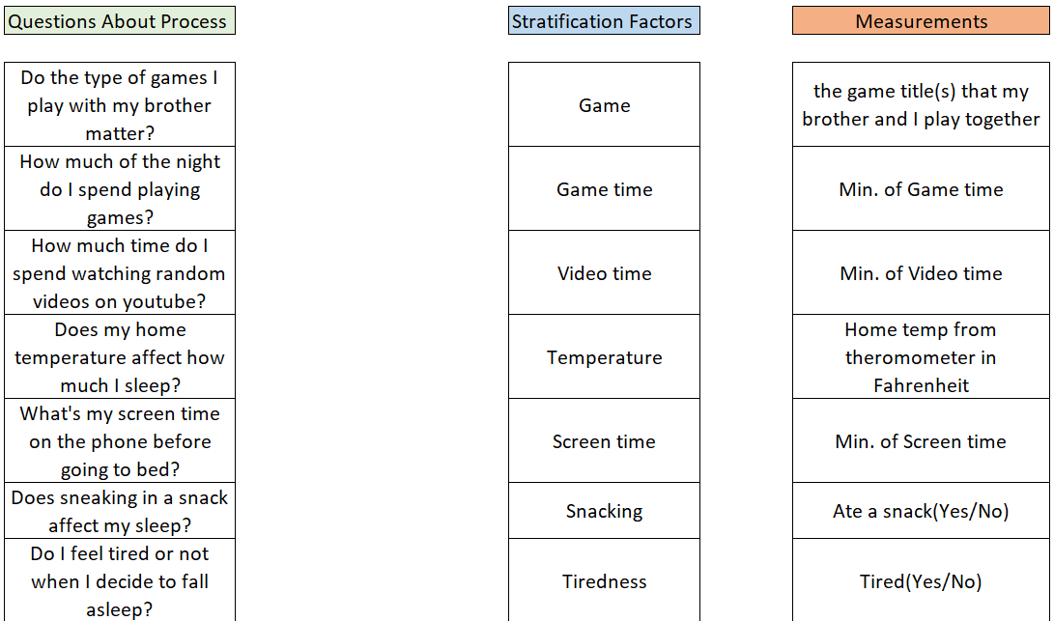
Data Stratification Tree
Min. of Sleep time
(Output Y)

Slide 5
Data Collection Method
NOTE: When I mention “phone” I mean the Google Sheets App.
All the Time Related: Every night I will always record a “start” time and an “end” time for my gaming, YouTube, and phone activities. Most importantly I also do the same to track my sleep right before I put my phone away and fall asleep for the night. I will also reach for my phone to input the time that I woke up the first thing I do after opening my eyes in the morning. I will have everything transferred into excel during the daytime (usually during the afternoon) and do some manual calculation of how much time I’ve spent on each activity (turning them into minutes)
Temperature: Before heading to bed I check the temperature from the thermometer in my house and record it on my phone.
Snacks/Game Title/Tiredness: This is a pretty easy one because I will input the discrete data in my phone
Snacks – If I eat something then I immediately type in Yes, or else by default it’ll be No
Game Title – I will type the game title immediately after starting the game (I typically play one game per night so it makes it easier to keep track)
Tiredness – Before I go to sleep, if I feel tired I input Tired. If not, then I put in Not Tired.

Slide 6
SQL
In my project, since my goal is to try and obtain at least 8 hours (480mins) of sleep per night, the definition of a defect would be any night that I receive under 480 mins of sleep then that would be considered a defect. Also, if I sleep too late (after 1:30AM) then that will also be considered a defect because it also will affect my health if I sleep at a later time.
The main measure of my data is continuous because it measures time.
1. Defect opportunities per unit: D = 2
2. Units produced per 32 days: U = 32
3. Total possible defects per 32 days: D × U = 64
4. Total actual defects for that 32 days: A = 12 (after 1:30AM) + 28 (below 480mins) = 40
5. Defects per million opportunities (DPMO): DPMO = 40/64 = 0.625 0.625 * 1,000,000 = 625,000
6. SQL value (from SQL table): SQL = 1.2

Slide 7
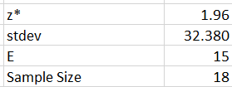

Sample Size Calculation
I wanted a 95% confidence level here so the z* score is 1.96, and the standard deviation is staying as is. However, for margin of error I want it to be 15, because there are only 60 mins in an hour. I think being able to identify change per quarter hour is a nice margin of error to have.
Then I calculated the sample size I should obtain for my project and got 18 as my sample size. It may seem really small for the 32 sample size (around a month of data) I already have, but it’s because my output (y) is pretty consistent throughout my 32 samples. In this case with the 32 samples I currently have, it will suffice for a 95% confidence level calculation moving forward.

Slide 8
Measure of Central Tendency
From my data that I measured regarding my sleep time; on average I do not sleep for more than 480 mins per night. There doesn’t seem to be any outliers from my dataset that can affect the average greatly because that can be explained when comparing it with the median. These two numbers are pretty close to each other. The mode in this case shows that out of my 32 data points I sleep for 406 mins the most.
Conclusion: On average I don’t sleep enough per night and will have to use other tools to analyze if there’s a variable that’s affecting that.

Slide 9
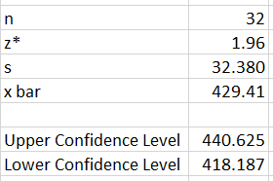



Confidence Interval
I tried to use my data set to predict what the population mean would be for the average sleep time an adult gets. I believe that the reason my intervals are pretty close to each other is due to my very consistent sleep time. There aren’t a lot of variabilities, resulting in a pretty small sample standard deviation.
Conclusion: I am 95% confident that population mean sleep time for me is between 418.2 minutes and 440.1 minutes. It seems like my data is telling me I don’t sleep enough, and I need a way of figuring out how to get more sleep per night. I think I might have to limit my nighttime activities so I can sleep earlier, which will give me more time to sleep.

Slide 10
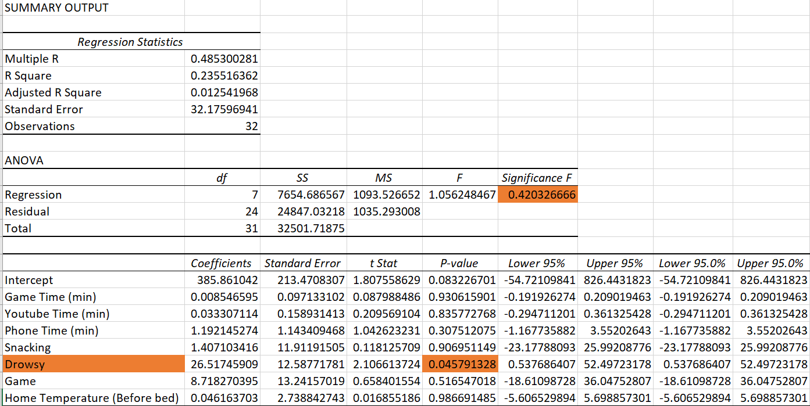
Linear Regression Analysis
I ran a linear regression analysis to determine if I can find a way to explain and perhaps predict when I can have 480 mins of sleep.
I like to point out that only 1 value here is statistically significant and that is “Drowsy”. It makes sense logically because when I go bed feeling sleepy then I will tend to sleep longer. Nothing else statistically prove
Conclusion: Unfortunately, this Linear regression doesn’t work out the way I wanted because my overall p value is not below .05 for a 95% confidence. More data is needed to improve my regression.

Slide 11
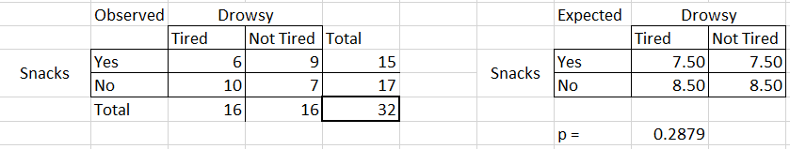
Chi Square Test
From my previous slide on regression, I wanted to take a closer look into that one variable that was statistically significant, Drowsy.
I wanted to see if one of my other categorical variable is causing me to feel more tired before going to bed. The best thing I could think of was “Snacks” because I think food coma is a real thing.
However in this case, after running the Chi Square test I obtained a P value of .2879
Conclusion: Because of obtaining a P value of .2879 I can statistically tell with a confidence level of 95%, that Snacks and Drowsy don’t have a relationship. In my case, food coma isn’t a real thing and it isn’t the reason why I am feeling tired before going to bed

Slide 12
Run Chart
That huge spike is due to daylight saving and was my excuse of playing for another 60 mins
Overall, from this Run Chart I can tell how different my sleeping time is between weekdays and weekends. Those big blue spikes are the weekends, meaning I typically sleep more during the weekends. I’ve only slept over 480 minutes 4 times though. Pretty disappointed, but I can see that I need a lot of work here.
Seems like I tend to spend more time in watching videos on days with really short game time.
Conclusion: It looks like I will have to limit the amount of time I spend on gaming/watching videos because I will tend to spend so much of my night gaming away or watching YouTube videos rather than sleeping early.
This is a zoomed in version of my Phone time before bed

Slide 13
Conclusion
I think from my data analysis, I have a pretty consistent sleep time (~430mins). After using several tools to analyze my current process flow, it appears that I am either leaving out some major variables or need to collect more data to find the input (X) that’s affecting my output (Y) the most. After looking at the run chart, it appears that I am sacrificing way too much of my potential sleep time into gaming.
On nights that I don’t play games for a longer period of time, I will tend to spend more time on watching YouTube videos. My next step to improve my current process is to limit myself to a strict amount of game time and video time per night, such as setting a goal to playing for less than 120mins per night and watching for less than 90 mins per night. I am hoping that if I play/watch less then I can have more time to sleep. I will continue to measure the same data for another month to see if this solution will help me obtain more sleep time. If this does, then as a control measure, I want to provide a method by making sure this process of limiting game time and watch time sticks. That method is to use something called conditioning in psychology. If I can limit myself to playing/watching below that time I will reward myself with 5 pieces of very delicious Ferrero Rocher chocolate (I LOVE this chocolate), and if I don’t, I will punish myself by eating 2 pouches of sour patch kids (I HATE sour candies).

