Slide 1
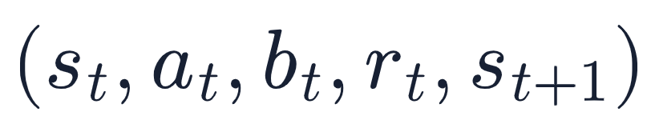





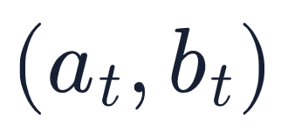


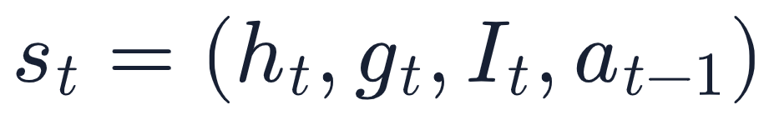



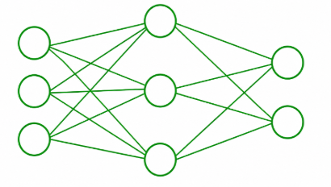
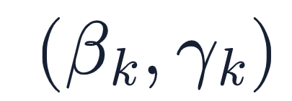

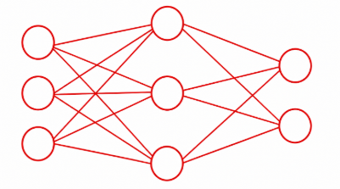

Adversarial wireless environment
Lyapunov step-size controller
Jammer
Field direction
Curvature direction
Rx
Tx
Communication-aware Lyapunov merit
Transmitter policy
Local second-order drift model
(channel selection)
Adaptive update module
select adaptively
by two-variable box QP
Jammer policy
(attack-channel selection)
Same-state rate test
Joint policy update:

