Slide 1
Let me tell you a story about the residuals
Aka, do we see fragments from the annihilations????

Slide 2
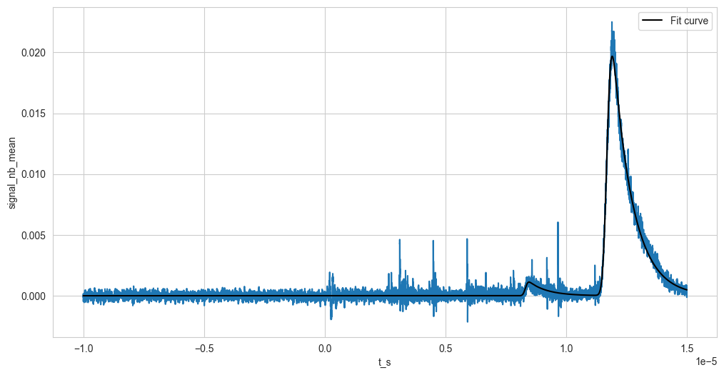
Marco and Fredrik went through the trouble of fitting the averaged spectrum from seven runs of the argon campaign. They got similar results from which we can conclude that we have some ionised ⁴⁰Ar inside the trap, but also we see things that match ⁴He²⁺ and ⁴He¹⁺. The ⁴He²⁺ is especially annoying as any signal from the fragments is expected to be within this peak.
That’s why Georgy suggested looking into residuals (meaning what is left if we remove the baseline from the data).
⁴He¹⁺
⁴He²⁺

Slide 3
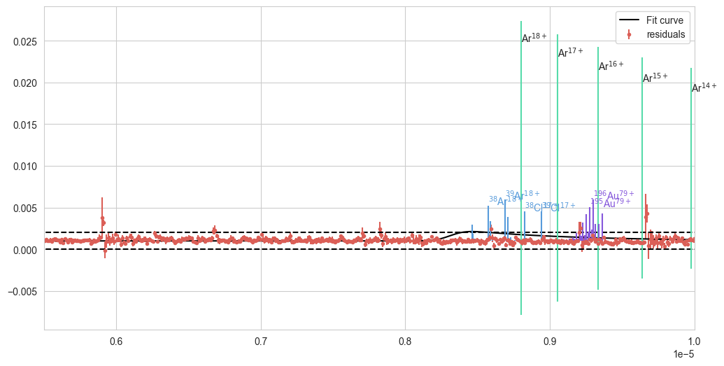
This is it. The residuals from the runs (as red points). The dashed line shows +/- 0.001, which is a threshold which needs to be passed to consider anything remotely a signal – in a very charitable approach (the standard deviation of the signal is 0.0007). In green, I indicated positions for different ionisation states of ⁴⁰Ar. The blue lines show the positions for fragments from antiproton annihilation on ⁴⁰Ar (the length of the line is proportional to the count of the given fragment). The purple lines show the fragments from annihilations on ¹⁹⁷Au. Given my criterion for signal, we have 6 peaks.
Peak 1
Peak 4
Peak 2
Peak 3
Peak 5
Peak 6

Slide 4
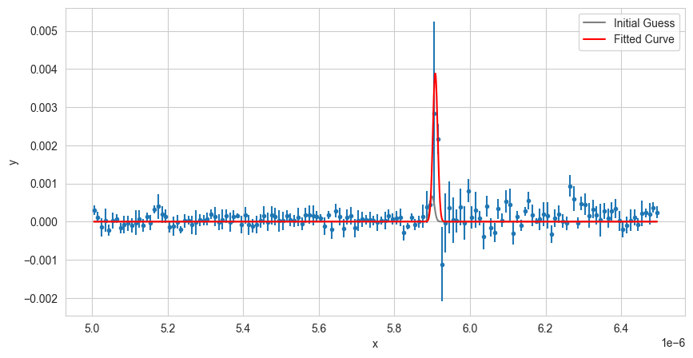
Fit peak 1
Ampl: 6.15434725450583e-11
mu: 5.908097345277863e-06
sigma: 6.281703478318256e-09
Condition number of the covariance matrix: 8.069502e+04
Diagonal values of pcov:
Cov of Ampl: 5.012561437588766e-22
Cov of mu: 3.2758166024778706e-18
Cov of sigma: 3.0934219219978937e-18
Chi-2: 153.76739989735324
dof: 147
Reduced Chi^2: 1.0460367339956003
Goodness-of-Fit: 0.3344965416688168
R-squared: 0.5344151597444738

Slide 5
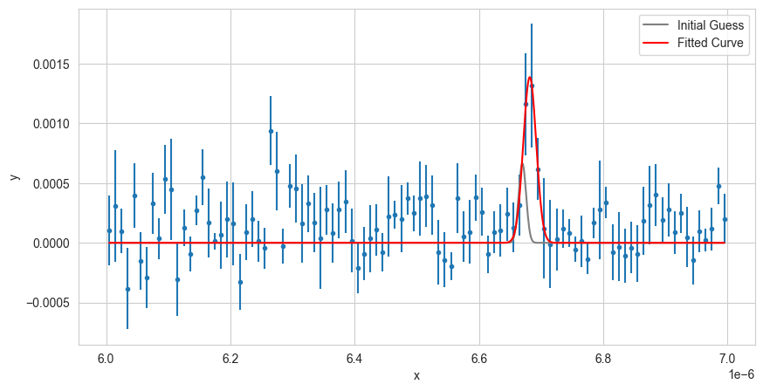
Fit peak 2
Ampl: 3.605581801989615e-11
mu: 6.6818602570441385e-06
sigma: 1.0372938789951286e-08
Condition number of the covariance matrix: 9.855740e+04
Diagonal values of pcov:
Cov of Ampl: 8.022288639965121e-23
Cov of mu: 7.313883043566039e-18
Cov of sigma: 7.694099368978375e-18
Chi-2: 126.42696410386797
dof: 97
Reduced Chi^2: 1.3033707639574017
Goodness-of-Fit: 0.024010614404013975
R-squared: 0.11971718204379511

Slide 6
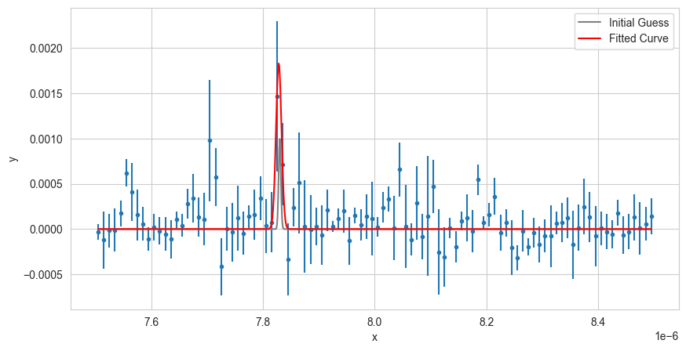
Fit peak 3
Ampl: 2.2571783350020673e-11
mu: 7.828205784278358e-06
sigma: 4.919566558231443e-09
Condition number of the covariance matrix: 2.653078e+05
Diagonal values of pcov:
Cov of Ampl: 9.918509434604418e-23
Cov of mu: 1.1099287629088822e-17
Cov of sigma: 1.675159946564001e-17
Chi-2: 100.75902125502019
dof: 97
Reduced Chi^2: 1.038752796443507
Goodness-of-Fit: 0.37668171442373555
R-squared: 0.24806923117657498

Slide 7
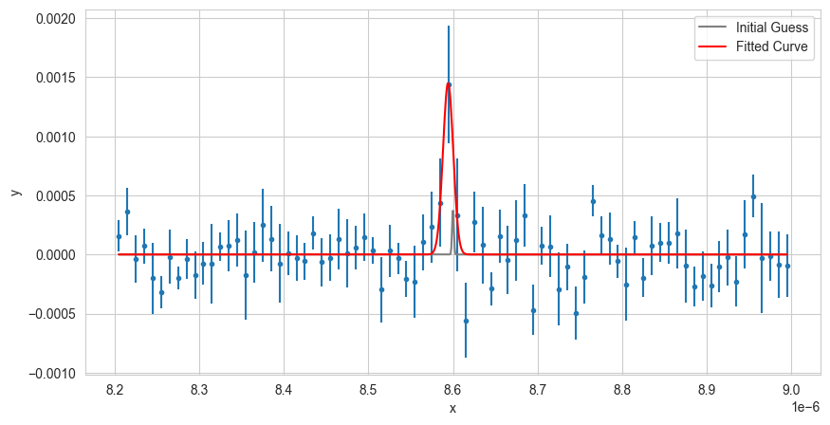
Fit peak 4
Ampl: 2.2022444375854298e-11
mu: 8.59424144958621e-06
sigma: 6.053167153929765e-09
Condition number of the covariance matrix: 2.201885e+05
Diagonal values of pcov:
Cov of Ampl: 6.904312349023149e-23
Cov of mu: 9.619922172172431e-18
Cov of sigma: 4.698948120480374e-18
Chi-2: 80.22716921116354
dof: 77
Reduced Chi^2: 1.0419112884566695
Goodness-of-Fit: 0.3782515895528433
R-squared: 0.43592900325018913

Slide 8
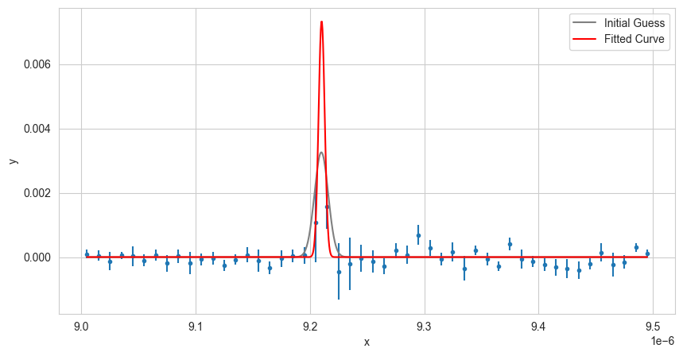
Fit peak 5
Ampl: 4.948678504554753e-11
mu: 9.210275803446027e-06
sigma: 2.6862397018008648e-09
Condition number of the covariance matrix: 1.472274e+12
Diagonal values of pcov:
Cov of Ampl: 1.0450983148418668e-12
Cov of mu: 2.2651142942187172e-11
Cov of sigma: 5.335298273378329e-10
Chi-2: 43.95222989651178
dof: 47
Reduced Chi^2: 0.935153827585357
Goodness-of-Fit: 0.5995605183798407
R-squared: 0.5944042576367041

Slide 9
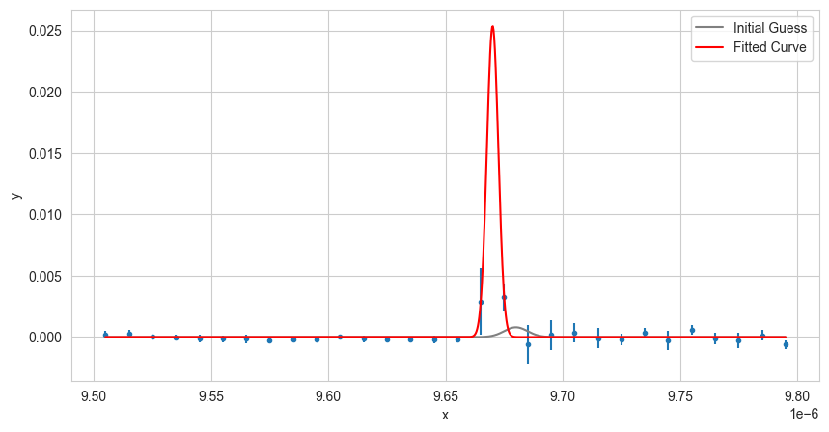
Fit peak 6
Ampl: 1.5489438673217272e-10
mu: 9.670075314615215e-06
sigma: 2.435860185246073e-09
Condition number of the covariance matrix: 3.730049e+12
Diagonal values of pcov:
Cov of Ampl: 1.813750205234067e-10
Cov of mu: 1.6855579518961853e-11
Cov of sigma: 4.400135104050403e-09
Chi-2: 14.629929003255612
dof: 27
Reduced Chi^2: 0.5418492223428004
Goodness-of-Fit: 0.9743086685755981
R-squared: 0.8993995736270128

Slide 10
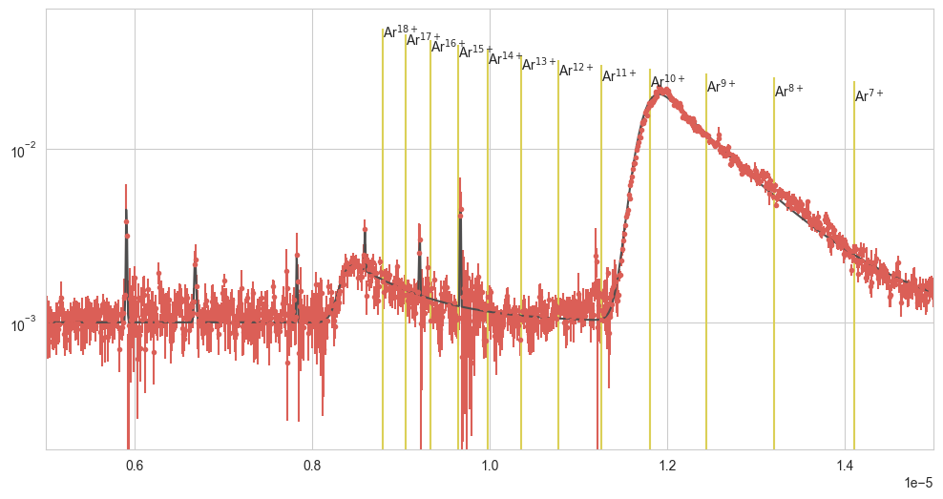
How does the fit look?

Slide 11
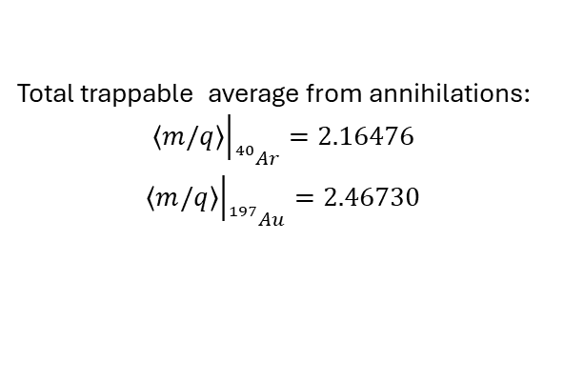
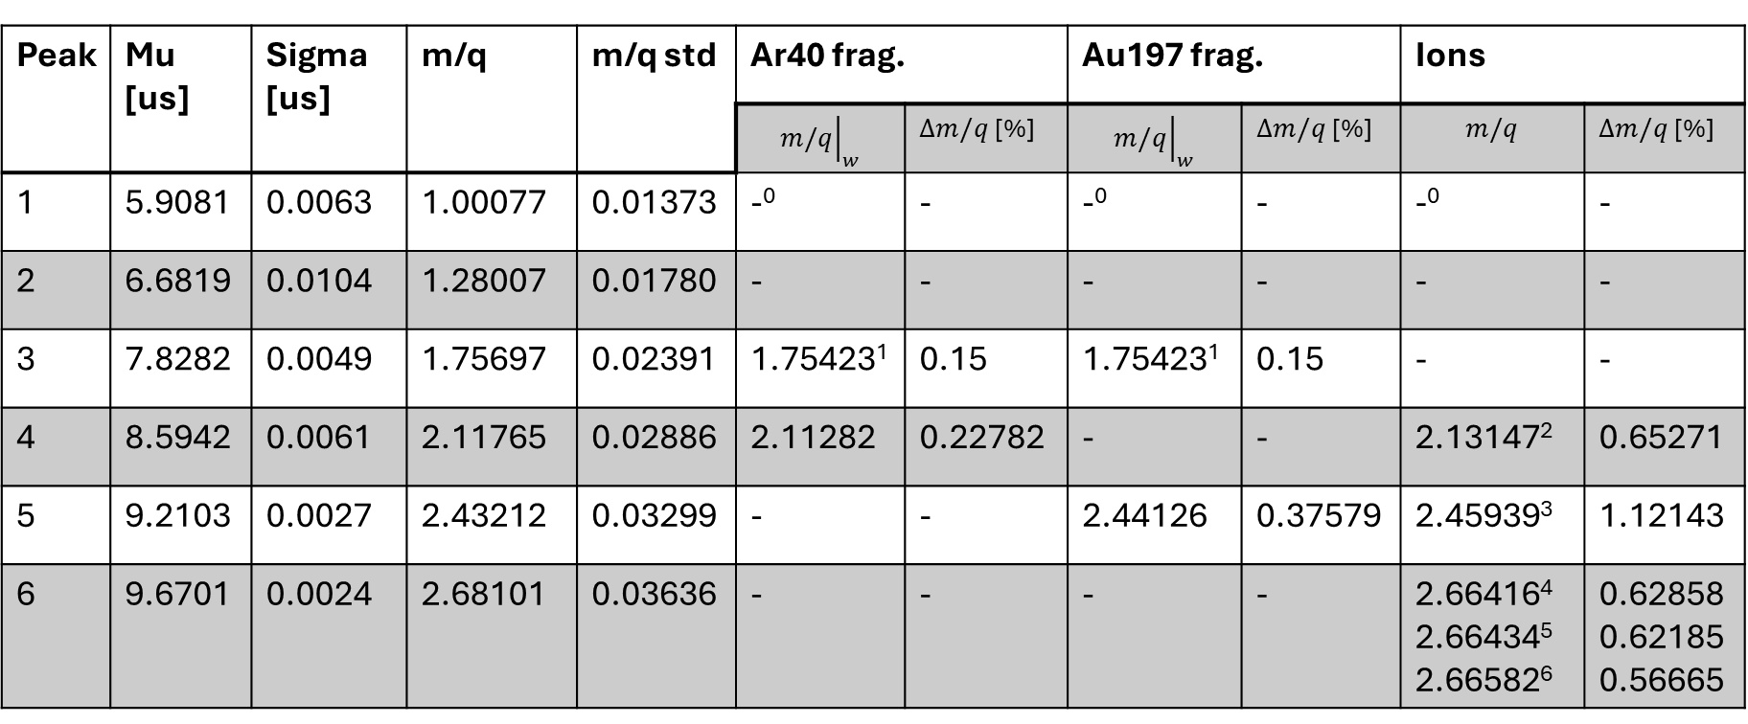
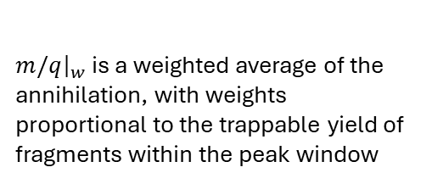
Peaks summary
${\left.m/q\right|}_{w}$ is a weighted average of the annihilation, with weights proportional to the trappable yield of fragments within the peak window
Total trappable average from annihilations:
$${\left.\left\langle m/q\right\rangle \right|}_{{}_{}^{40}{Ar}}=2.16476$$
$${\left.\left\langle m/q\right\rangle \right|}_{{}_{}^{197}{Au}}=2.46730$$
Peak | Mu [us] | Sigma [us] | m/q | m/q std | Ar40 frag. |  | Au197 frag. |  | Ions
 |  |  |  |  | $${\left.m/q\right|}_{w}$$ | $∆m/q$ [%] | $${\left.m/q\right|}_{w}$$ | $∆m/q$ [%] | $$m/q$$ | $∆m/q$ [%]
1 | 5.9081 | 0.0063 | 1.00077 | 0.01373 | -⁰ | - | -⁰ | - | -⁰ | -
2 | 6.6819 | 0.0104 | 1.28007 | 0.01780 | - | - | - | - | - | -
3 | 7.8282 | 0.0049 | 1.75697 | 0.02391 | 1.75423¹ | 0.15 | 1.75423¹ | 0.15 | - | -
4 | 8.5942 | 0.0061 | 2.11765 | 0.02886 | 2.11282 | 0.22782 | - | - | 2.13147² | 0.65271
5 | 9.2103 | 0.0027 | 2.43212 | 0.03299 | - | - | 2.44126 | 0.37579 | 2.45939³ | 1.12143
6 | 9.6701 | 0.0024 | 2.68101 | 0.03636 | - | - | - | - | 2.66416⁴ 2.66434⁵ 2.66582⁶ | 0.62858 0.62185 0.56665
⁰⁾ This is most likely an antiproton m/q=1.00782
¹⁾ This value is for ⁷Be⁴⁺, but it isn’t formed with low enough energy
²⁾ ³²S¹⁵⁺
³⁾ ³²S¹³⁺
⁴⁾ ⁴⁰Ar¹⁵⁺
⁵⁾ ³²S¹²⁺
⁶⁾ ¹⁶O⁶⁺
I have no idea what the peak 2 is. The closest I found was ³He²⁺ with m/q=1.5080, from produced by annihilations on ⁴⁰Ar or ¹⁹⁷Au

Slide 12
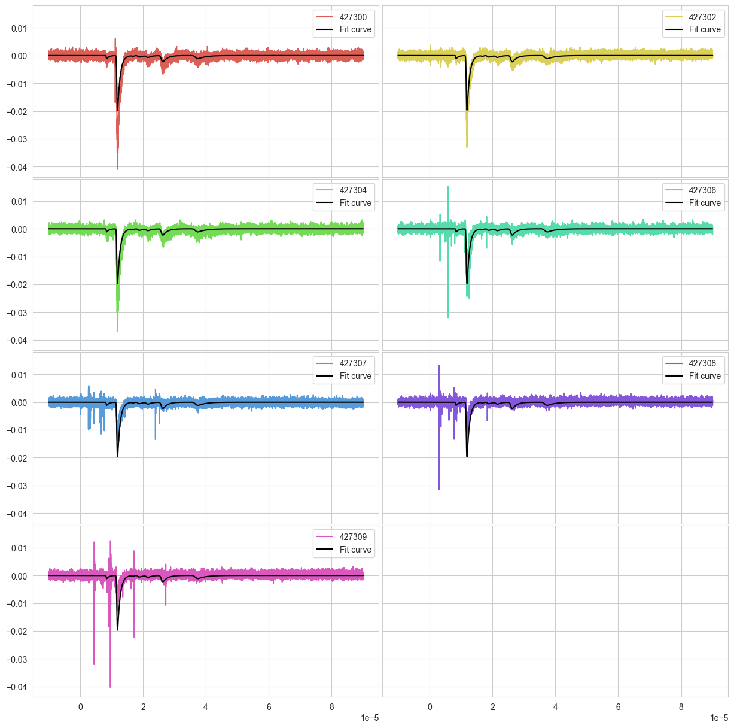
On the subject of background
The captorius signal suffers from a lot of “ringing” that is present after any spike on the MCP. In the fitting of the baseline, Marco deals with the ringing from the biggest peak and removes it by fitting an exponential suppressed sinusoidal function. In general, this can be done for any spike present in the signal.

Slide 13
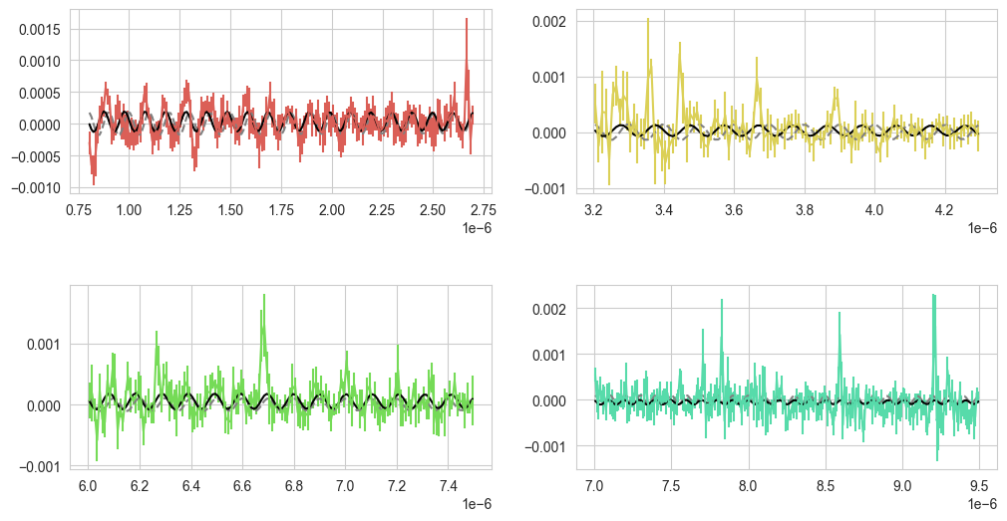
I have fitted the signal in the region just after the biggest peaks before the ⁴He¹⁺ peak, and below are the functions. After each fit, the signal is corrected so the next fit is done on the corrected signal.

Slide 14
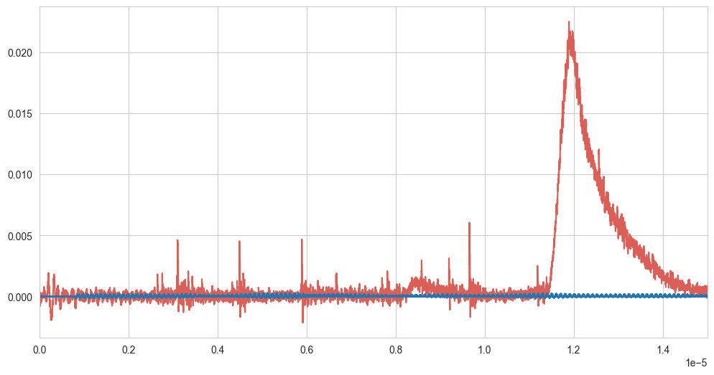
This is what the ringing signal from the fits looks like on top of the original data. This doesn’t change much. The peaks are best fitted with the same parameters. It would probably be best to remove the ringing in an earlier stage and perform the “ringing” fits on the run bases (before combining the 7 runs into one signal). I believe that this can yield a better result as the earlier peaks show up at different locations between the runs.

