Slide 1

How do we use data for good?
Jamie Zike

Slide 2
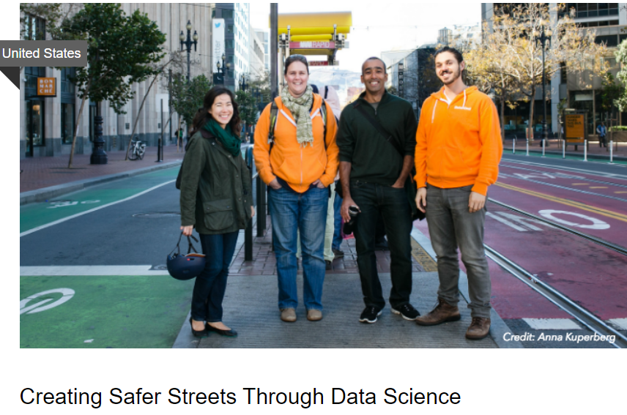
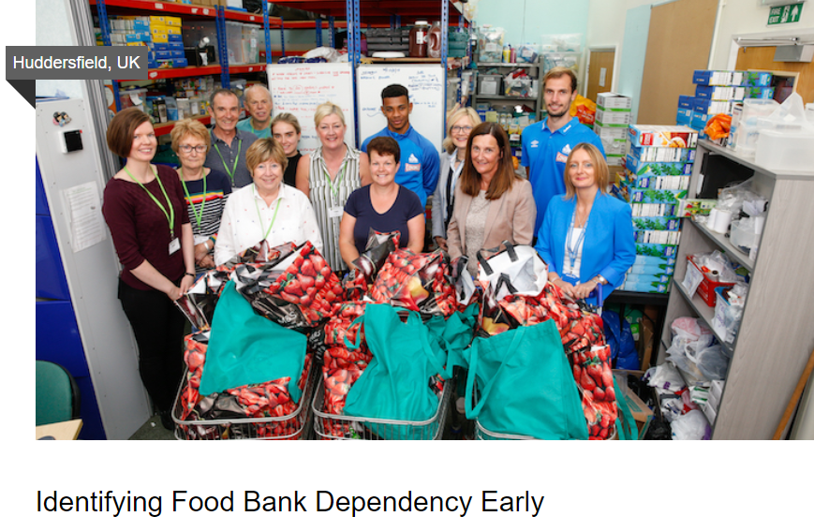
Summary
What do we mean by data for good?
“using data in meaningful ways to solve humanitarian issues” - (SAS website)
“make more data available for common good purposes” (Data for Good Foundation)
In what ways has data been used for good?
Companies collect equality, diversity and inclusion (EDI) data and use it to conduct equality impact assessments
DataKind
Notes:
Essentially, using data with the goal of benefiting humanity

Slide 3

Ethical challenges / ambiguities
“Good” / “Problem”
Consent / Privacy
Interpretation
Action / Inaction
Notes:
What is good? Who decides and defines it?
Who defines problems? Kevin Guyan highlights in his blogs that how problems are defined and which ones are worth solving is decided by those who are already in positions of power, many of whom have much to gain from maintaining the status quo
Meaningful consent - have people consented for their data to be collected and used in the way that it’s being used? Do they agree that their data is being used for “good”?
Interpretation - Once data is gathered, it’s analysed and we draw some interpretation from that analysis, which opens up the opportunity for bias. For example, in my PhD study, I had data about whether children had demonstrated a certain skill and had to decide what it meant if they hadn’t. Did that mean that they weren’t capable of that skill? The meaning that we attach to analyses is important
Action/Inaction – I’m going back again to Kevin Guyan here (can you tell how big a fan I am yet??) – in his blog dealing with his research on queer data, he says “Data is central to LGBTQ liberation but its use for action still requires evidence to fall upon the ears of individuals who wish to listen and take action in response.”

Slide 4
Suggestions
Data activism - “Those who hold the power are already using data as an excuse for inaction – we must reclaim this ground and ensure that data empowers the work of activists to bring about effective change.” (Guyan, 2019)
Consulting with the groups who will be impacted by the data collection, analysis and use.
Working in a team on data projects to combat bias

