Slide 1
Scottish Household Survey
Neighbourhood ratings, community belonging and access to green space
Notes:
Hi everyone, I’m Jamie and I did my final project on the Scottish household survey, specifically looking at neighbourhood ratings, community belong and access to green space.

Slide 2
Context
The Scottish household survey is an annual, cross-sectional survey providing information on a wide variety of topics including: demographics, housing, neighbourhoods, etc.
Green space is defined as “a park, countryside, wood, play area, canal path, riverside or beach” – not including private gardens (Scottish Household Survey, 2019)
Access to green spaces is important for physical and mental wellbeing (Dai, 2011; Nutsford et al., 2013) and may also “provide social benefits by promoting community integration” (Barbosa et al., 2007)
Studies suggest disparities in access to green space, although the groups who lack access to green space differ across studies (Dai, 2011; Barbosa et al., 2007).
Notes:
So I wanted to start out by giving some context around the project and around the importance of green spaces in general
Cross-sectional – meaning that it doesn’t follow the same people year after year, but chooses a random sample from the population

Slide 3
Questions
What differences in access to green spaces are evident in the data?
Who has more or less access? (demographics/ individual characteristics)
How do people in neighbourhoods with good access to green space differ from those who have no good access?
Feeling of belonging and neighbourhood ratings
Is there any way to predict which households would have higher ratings?
Notes:
I had a few questions that guided my analysis – unfortunately I don’t have time to cover them all, so I’ve chosen to cover these three questions in this presentation

Slide 4
Datasets and data quality
Four datasets were used to answer these questions
Access to green spaces, community belonging, neighbourhood rating, aggregate dataset.
Variables of interest:
Community belonging rating, neighbourhood rating, access to green space
Limitations in the datasets
No way to explore intersectional demographic aspects that may have been of interest (e.g. intersection between SIMD and ethnicity)
Large age ranges for age groups could mask some differences
Data for small groups not reported – e.g. no data for 20% least deprived in East Lothian, no data for people of “other” ethnicities outside Edinburgh and Glasgow
Ambiguity in Likert-style scales – how does “very strong” belonging differ from “fairly strong”?
Notes:
Before moving into my analysis and findings, I want to talk a bit about the datasets I used and the limitations in the datasets.

Slide 5
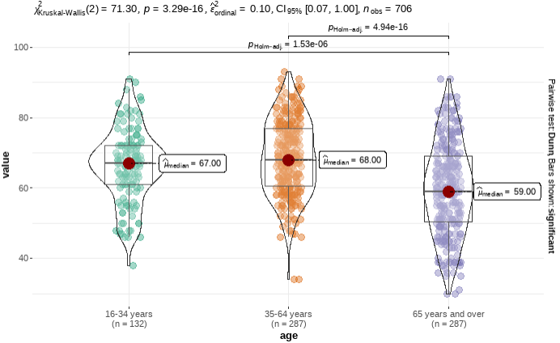
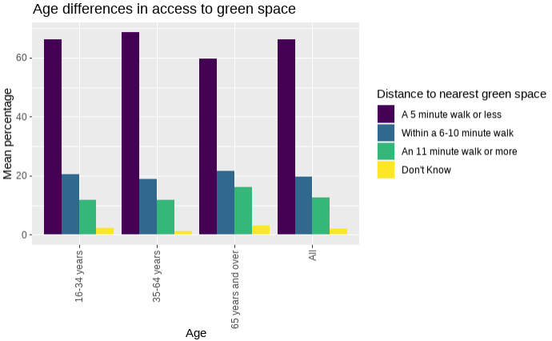
Demographic differences - age and household type
Older people and pensioners had less access to green space
Kruskal Wallis (age) and ANOVA (household_type) indicated that these differences were significant (p < 0.01)
Notes:
The first major difference in access to green space that I found was between different age groups.
Specifically, older people and pensioner households had less access to green space.
Here we can see that a smaller percentage of people in the 65+ age group reported that they could access a green space within a 5 minute walk from their residence when compared with other groups. There was a similar difference between pensioner households and the other household types.
I did a Kruskal Wallis test to see if the difference between age groups was significant and it showed that this difference was significant.

Slide 6
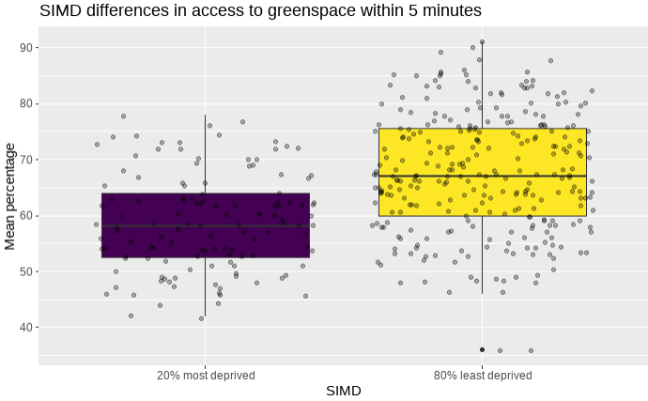
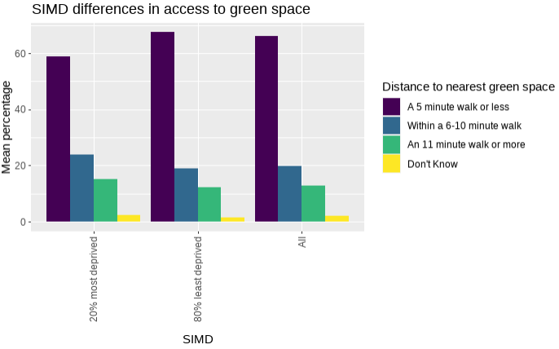
Demographic differences - SIMD
20% most deprived had less access to green space
67% of least deprived can access a green space within 5 min vs 59% of the most deprived
Bootstrapped 2-sample difference in means tests indicated that these differences were significant (p < 0.01)
Notes:
The next major difference in access to green space that I found was between SIMD groups.
Specifically, the 20% most deprived had less access to green space than the 80% least deprived.
67% of people in the 80% least deprived group can access a green space within 5 min vs 59% of the most deprived 20%.
I did a 2 sample difference in means test, which confirmed that these differences were significant.

Slide 7
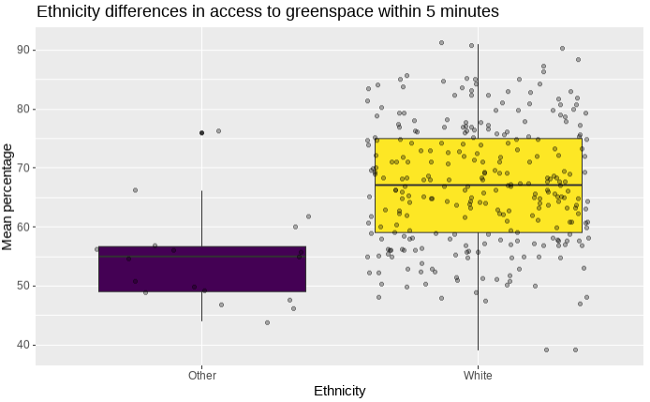
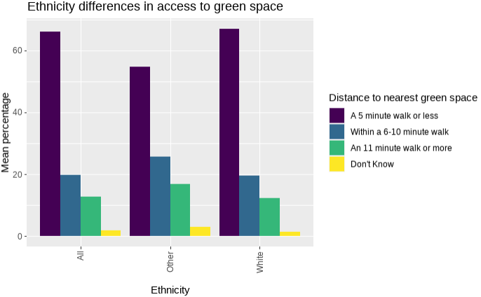
Demographic differences - ethnicity
There is a clear racial disparity in access to green spaces
54% of people of “other” ethnicities can access a green space within 5 min vs 67% of white people
Bootstrapped 2-sample independence tests indicated that these differences were significant (p < 0.01)
Notes:
The last major difference in access to green space that I found in this dataset was between ethnic groups.
Specifically, on average, people of other ethnicities had less access to green space than white people.
67% of white people can access a green space within 5 min vs 54% of people from other ethic groups
I did a 2 sample difference in means test, which confirmed that these differences were significant.

Slide 8
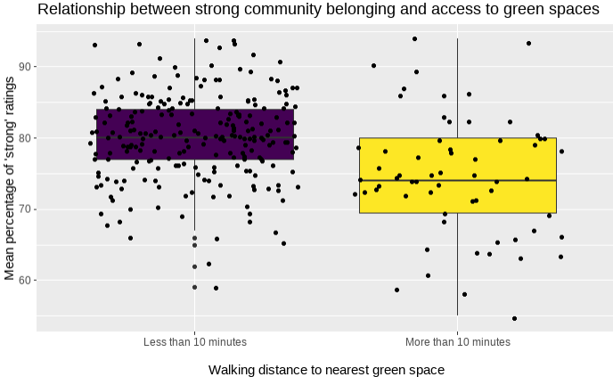
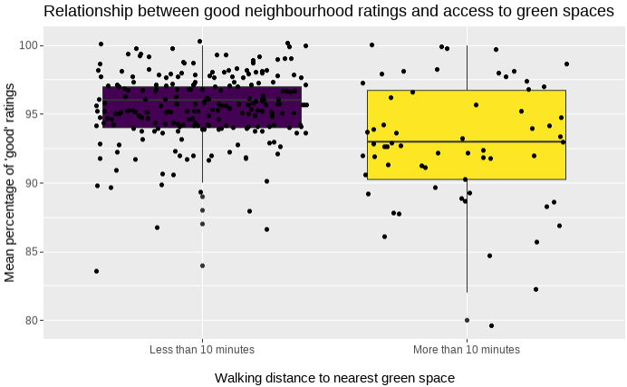
Access to green space and community ratings
People with better access to green space (less than a 10 min walk) are:
Significantly more likely to rate their neighbourhood as “very good” or “fairly good” (96% vs 93%)
Significantly more likely to rate their feeling of belonging to their community as “very strong” or “fairly strong” (80% vs 75%)
Access to public green space is important for community integration (Barbosa et al., 2007) → stronger feeling of belonging, higher neighbourhood ratings
Notes:
Additionally, as we will see later, neighbourhood rating and community belonging are associated with each other
East Lothian – good – 97%
West Dunbartonshire – good – 91%
East Lothian – strong – 79%
West Dunbartonshire – strong – 73%

Slide 9
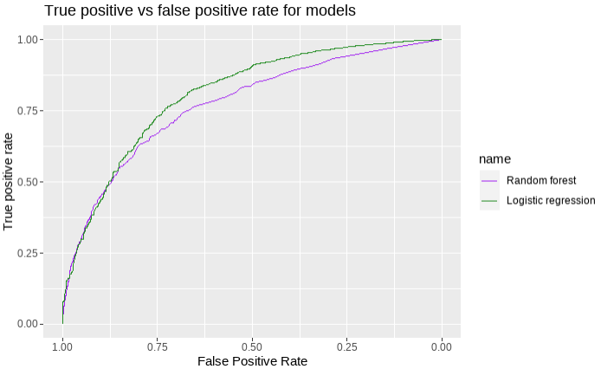
Predicting “good” neighbourhood ratings
Two models were tried - random forest vs logistic regression
Aim was to predict “very good” or “fairly good” neighbourhood ratings
AUC was calculated for both models to compare their success at predicting rating on the test data
0.81 (95% CI: 0.79 – 0.83) for logistic regression
0.77 (95% CI: 0.76 – 0.79) for random forest
Notes:
Two models were tried – random forest and logistic regression. Both are machine learning models that can be used to predict a categorical outcome (i.e. categories like weak/strong rather than numerical outcomes like weight or height). Both can be used with success on this kind of data, but usually one is more accurate than the other.
Therefore neighbourhood rating was transformed to a binary variable with two levels – good and poor. No opinion ratings were excluded from both models.
The data was split into train and test datasets and both models were trained on the train data and tested on the test data to compare their accuracy.
Two limitations:
There was a really big class imbalance here – there were a lot more “good” ratings than “poor”. If I had more time to work on these models, I would have tried to do more research into what I could do to correct for this bias.
There was a lot of missing data in some of the predictor variables. I chose to impute these by using random forests to predict the missing values based on the rest of the data – this works by finding observations that are very similar to the observation with missing data and filling the missing values with the most likely value based on similar observations in the dataset. I ran out of time, but I was originally planning to compare the models built using the imputed datasets to models built using only complete cases (excluding all NAs)

Slide 10
What matters for predicting “good” ratings?
96% reduction in odds for “not at all strongly” vs “very strongly”
 |  |  |  | 95% CI for Odds Ratio
 | B | SE B | P value | Lower | Odds Ratio | Upper
Included
Intercept | 64.37 (95% CI 28.93, 99.79) | 18.08
Communitybelonging = Not at all strongly | -3.16 (-3.30, -3.02) | 0.07 | <0.01* | 0.036 | 0.042 | 0.048
Satisfaction w/ green space = Very dissatisfied | -2.04 (-2.23, -1.86) | 0.09 | <0.01* | 0.101 | 0.130 | 0.156
Highest edu level = Degree / prof qual | 0.88 (0.78, 0.98) | 0.05 | <0.01* | 2.175 | 2.411 | 2.674
Year | -0.03 (-0.5, -0.01) | 0.009 | <0.01* | 0.954 | 0.971 | 0.989
Household size | 0.07 (0.36, 0.11) | 0.02 | <0.01* | 1.036 | 1.073 | 1.112
Community belonging,
Satisfaction with nearest greenspace
Highest education level
Year
Household size
87% reduction in odds for “very dissatisfied” vs “very satisfied”
141% increase in odds for degree vs standard
2.9% decrease in odds for each one year increase
7.3% increase in odds for each additional person in household
Notes:
It makes sense that people who feel a stronger sense of belonging in their community would be more likely to rate their neighbourhood as “good”
It also makes sense that is someone is dissatisfied with their nearest greenspace, they would also be less likely to rate their neighbourhood as “good”.
Since education level and socioeconomic status have been shown to be linked, it makes sense that people with higher education levels (and potentially higher socioeconomic status) can afford to live in better, more expensive neighbourhoods than people with lower education levels
This is where I ran out of time to investigate properly the potential reasons for decreasing odds of “good” neighbourhood ratings over time and increasing odds of “good” ratings for bigger households

Slide 11
Summary and recommendations
3 groups had significantly less access to green space
More deprived groups (SIMD 1)
People of “other” ethnicities
Older people (age 65+) and pensioner households
Both community belonging and neighbourhood ratings were significantly higher for people who had more access to green space (less than 10 min walk)
Improving the quality of green spaces could be helpful in increasing community belonging and through that, neighbourhood ratings
Additional investigation is needed to understand why the percentage of “good” neighbourhood ratings is decreasing over time
Notes:
Remind of social benefits to public green space use – community integration
In the logistic regression model, people with higher education were more likely to rate their neighbourhoods as good. Following on from this, improving green spaces and community belonging in neighbourhoods that have a high concentration of socioeconomically disadvantaged people could be especially important since there is a documented link between educational attainment and socioeconomic status.

