Slide 1

The traveling salesman problem

Slide 2
Content
The traveling salesman problem
Greedy algorithm
Christofides algorithm
Monte-Carlo-Optimisation
  Analysis of the parameters

Slide 3
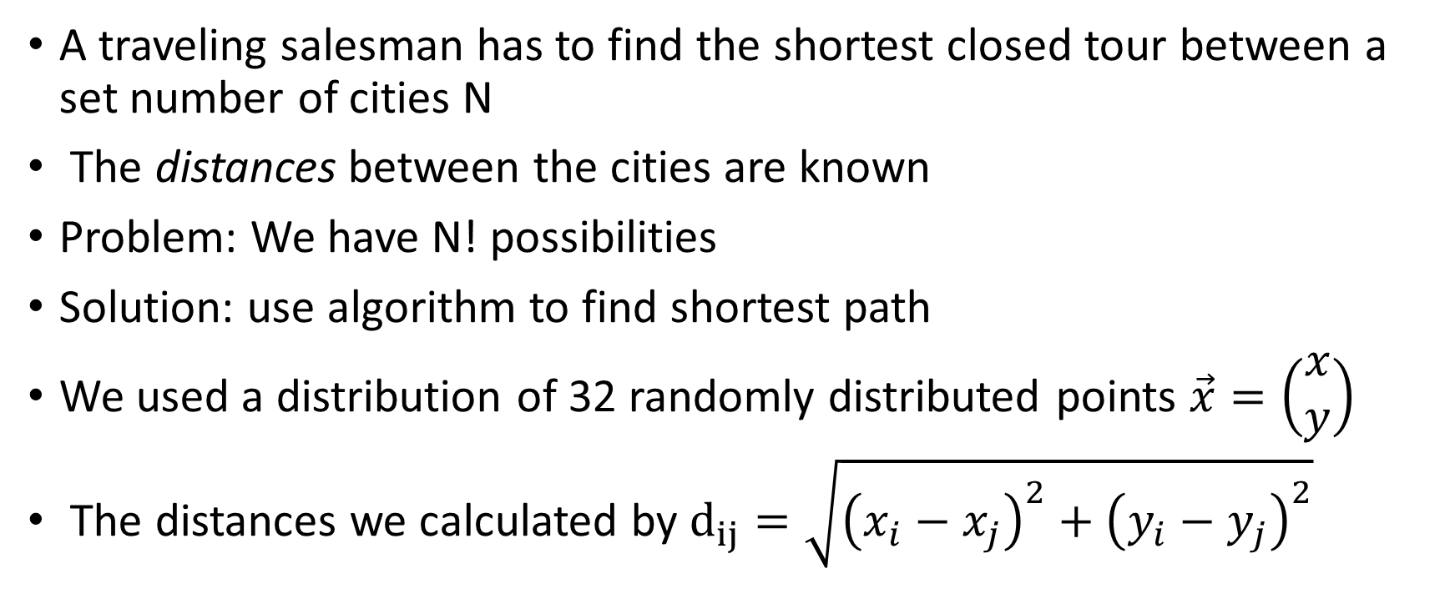
The traveling salesman problem
A traveling salesman has to find the shortest closed tour between a set number of cities N
The distances between the cities are known
Problem: We have N! possibilities
Solution: use algorithm to find shortest path
We used a distribution of 32 randomly distributed points $\vec{x}=\left(\begin{aligned}x \\ y\end{aligned}\right)$
The distances we calculated by $d_{ij}=\sqrt{{\left(x_{i}−x_{j}\right)}^{2}+{\left(y_{i}−y_{j}\right)}^{2}}$

Slide 4
Greedy Algorithm
problem-solving heuristic of making the locally optimal choice at each stage
Looking at three different approaches:
  Nearest Neighbor
  Double-sided nearest Neighbor
  Nearest Insertion

Slide 5
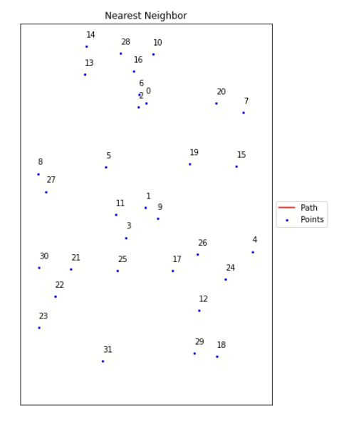
Nearest Neighbor
Start with a random startposition
Add always the cheapest edge to an unused vertex, until all vertices are visited once
Add the starting vertex
Do it for all startposition and choose the shortest

Slide 6
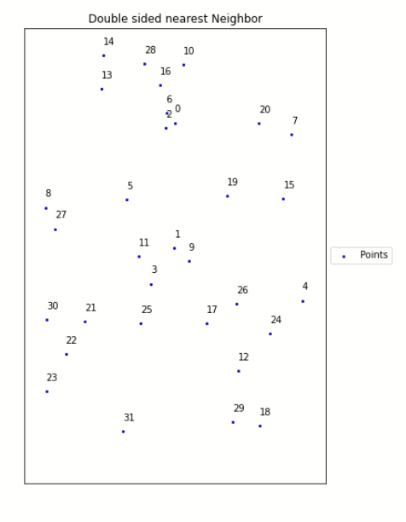
Double- sidedNearest Neighbor
Same algorithm as for nearest Neighbor, but go both ways
Start with the shortest edge in one direction and second shortest in the other

Slide 7
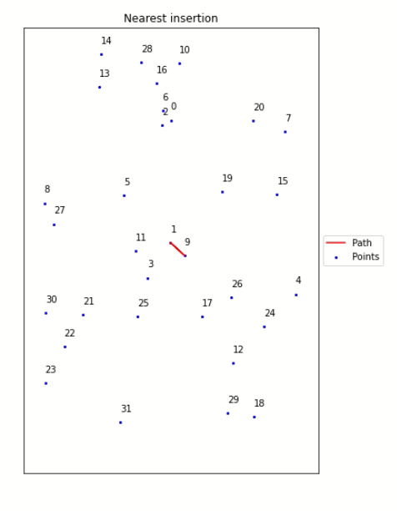
Nearest Insertion
Start with a circle
Add vertex, so that the circumference of the circle stays the lowest fo all possibilities

Slide 8
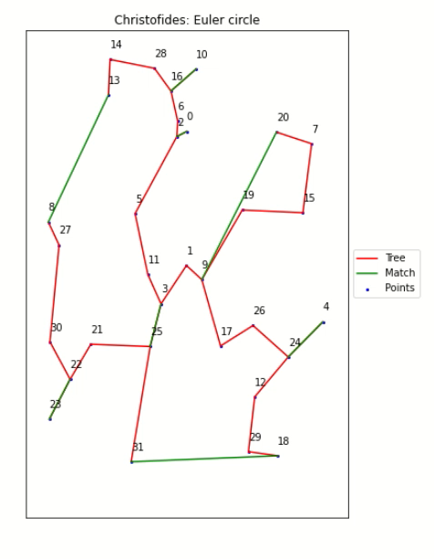
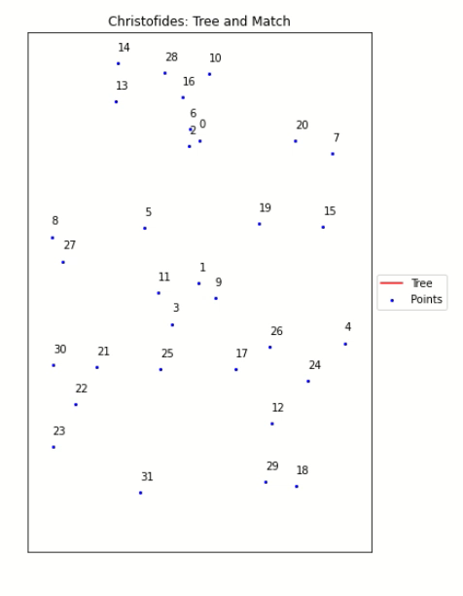
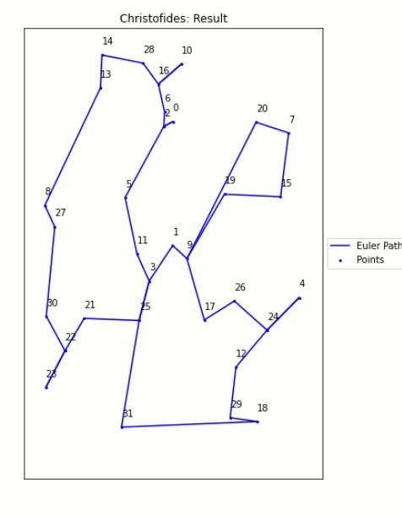
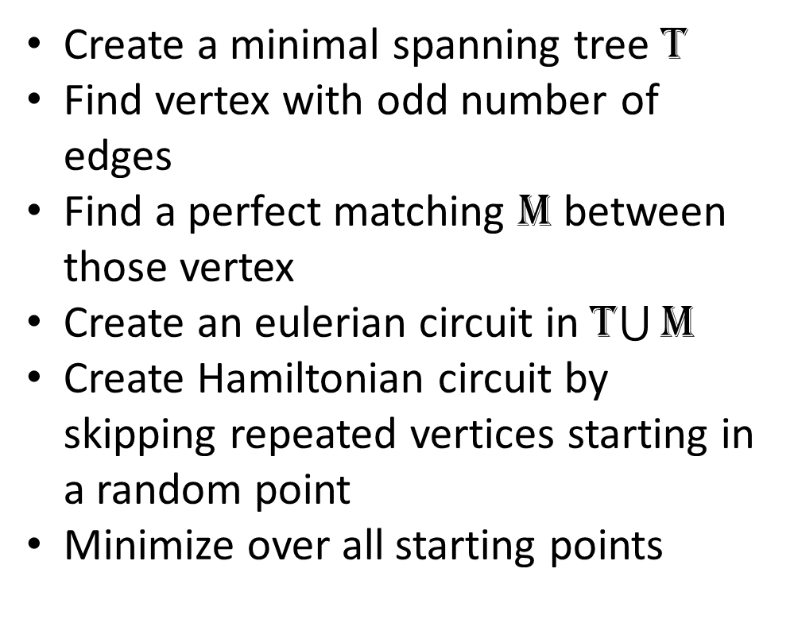
Christofides
Create a minimal spanning tree T
Find vertex with odd number of edges
Find a perfect matching M between those vertex
Create an eulerian circuit in T$\bigcup{\text{M} }$
Create Hamiltonian circuit by skipping repeated vertices starting in a random point
Minimize over all starting points
Hamiltonian circuit by skipping repeated vertices

Slide 9
Monte-Carlo Optimisation
Idea : Instead of creating a path using certain conditions, alter a previous path in a certain way.

Slide 10
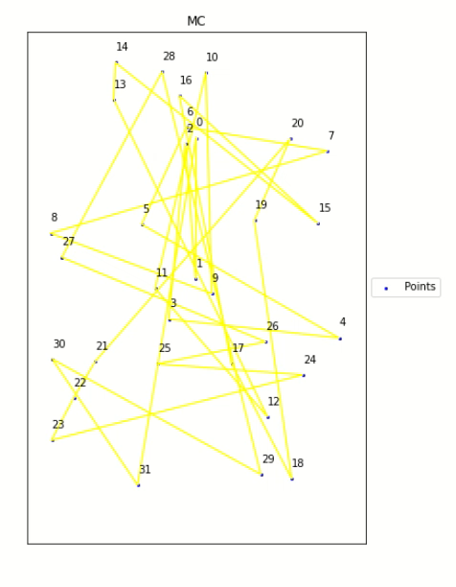

Slide 11
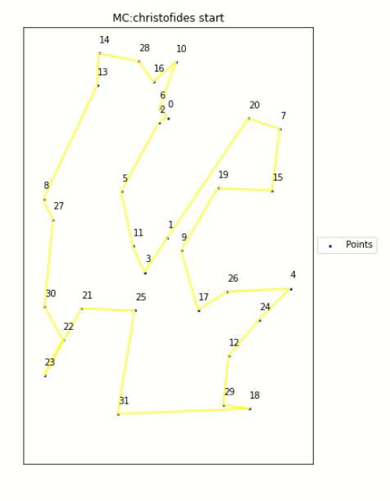

Slide 12
Comparison

Slide 13
Source for images
https://www.tue.nl/en/news-and-events/news-overview/19-12-2023-improving-optimization-efficiency-by-modifying-algorithms-in-tsp-variants

