Slide 1

The traveling salesman problem
(1)

Slide 2
Content
The traveling salesman problem
Greedy algorithm
Monte-Carlo-algorithm
  Algorithm
  Analysis of parameter
Comparison
Optimization of the result
Further more complex Problems
(2)

Slide 3
The traveling salesman problem

Slide 4
The traveling salesman problem
A traveling salesman has to find the shortest closed tour between a set number of cities N
All distances between the cities are known
Problem: (N-1)! possibilities
Solution: use algorithm
  Only quasi-optimal results

Slide 5
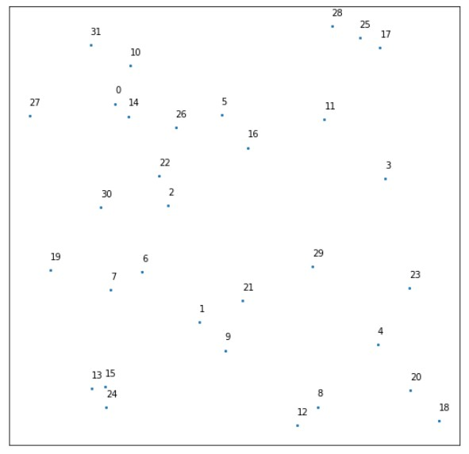
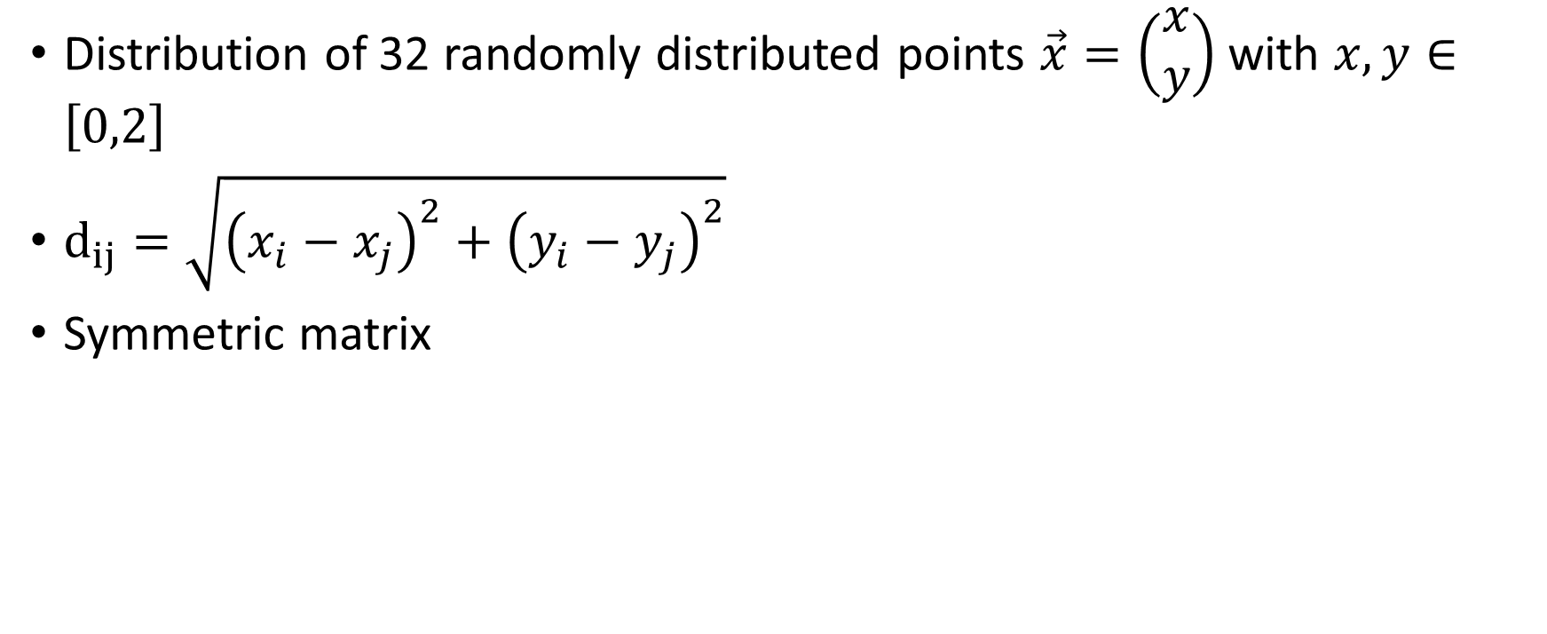
Our example
Distribution of 32 randomly distributed points $\vec{x}=\left(\begin{aligned}x \\ y\end{aligned}\right)$ with $x,y∈\left[0,2\right]$
$d_{ij}=\sqrt{{\left(x_{i}−x_{j}\right)}^{2}+{\left(y_{i}−y_{j}\right)}^{2}}$
Symmetric matrix

Slide 6
Greedy algorithm

Slide 7
Greedy Algorithm
problem-solving heuristic of making the locally optimal choice at each stage
Looking at three different approaches:
  Nearest Neighbor
  Double-sided nearest Neighbor
  Nearest Insertion

Slide 8
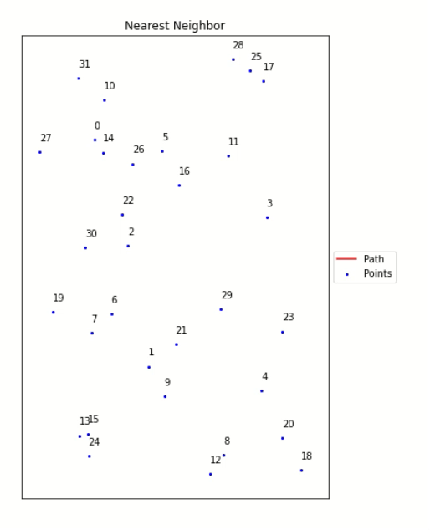
Nearest Neighbor
[1]
Start with a random start position
Add always the cheapest edge to an unused vertex, until all vertices are visited once
Add the starting vertex
Do it for all start positions and choose the shortest path

Slide 9
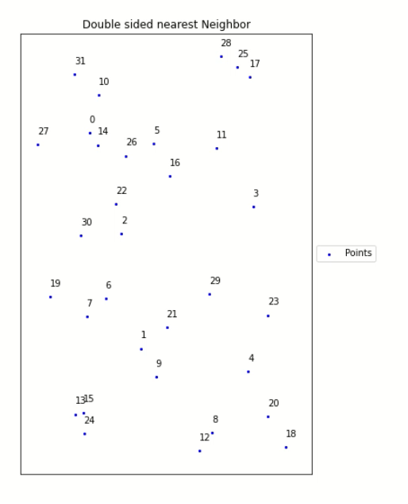
Double- sided Nearest Neighbor
[1]
Same algorithm as for nearest Neighbor, but go both ways
Start with the shortest edge in one direction and second shortest in the other

Slide 10
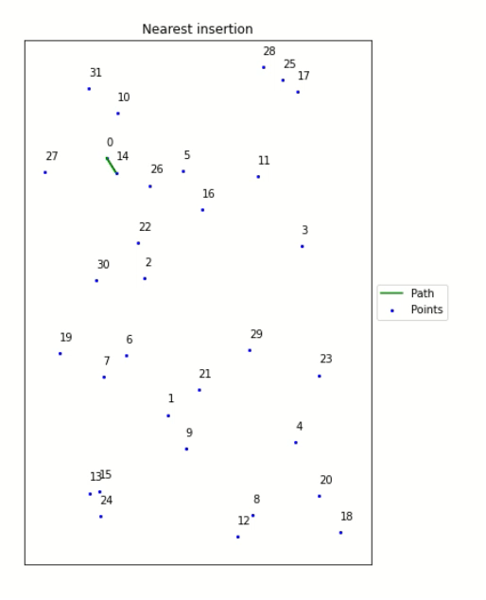
Nearest Insertion
[2]
Start with a circle
Add vertex, so that the circumference of the circle stays the lowest for all possibilities

Slide 11
Monte-Carlo Markov-Chain

Slide 12
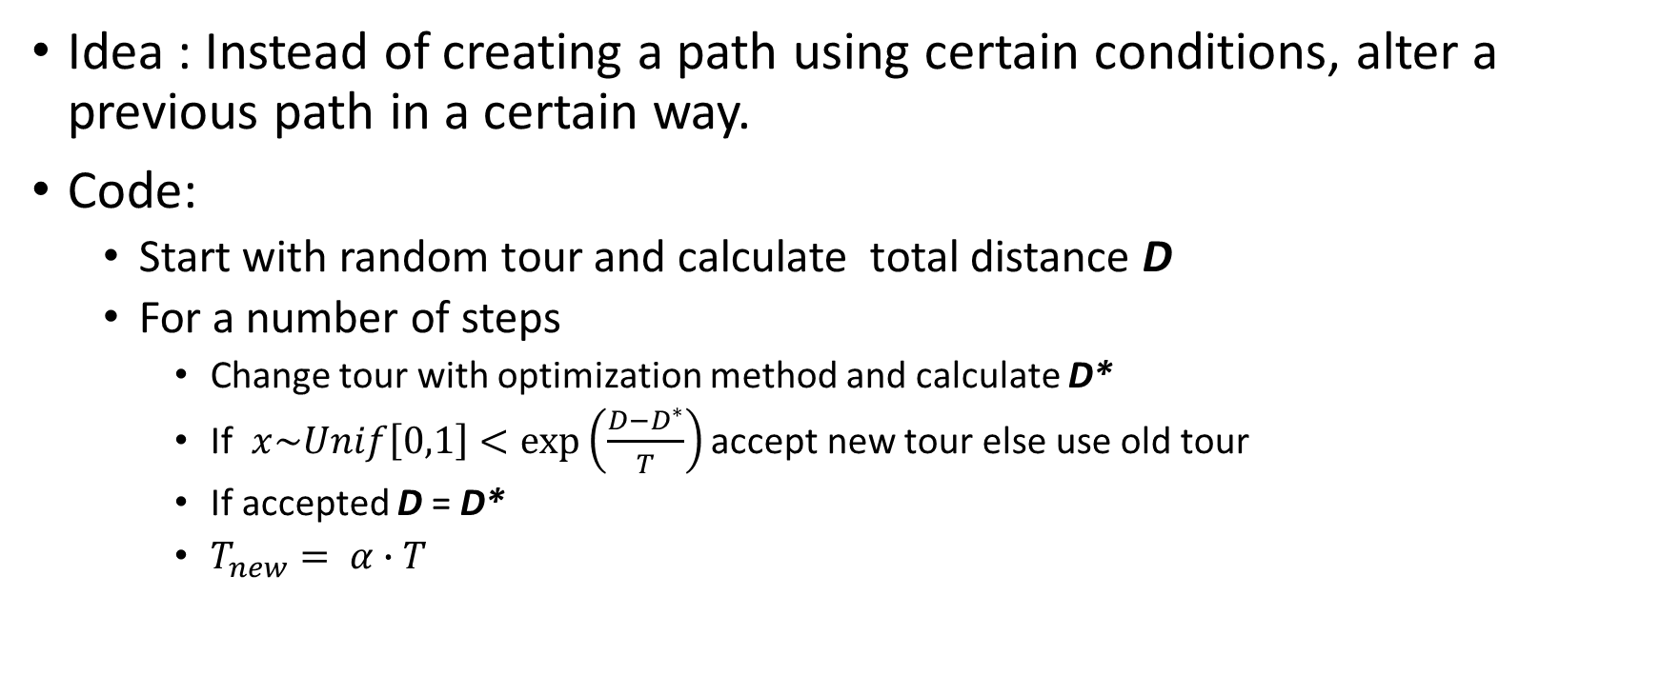
MCMC Algorithm
[3]
Idea : Instead of creating a path using certain conditions, alter a previous path in a certain way.
Code:
  Start with random tour and calculate total distance D
  For a number of steps
    Change tour with optimization method and calculate D*
    If $x\sim Unif\left[0,1\right]<exp\left(\frac{D−D^{∗}}{T}\right)$ accept new tour else use old tour
    If accepted D = D*
    $T_{new}= α∙T$

Slide 13
Optimization Method
[3]
Optimization method: randomly between 2-Opt and 3-Opt method
2-Opt method: remove 2 edges: reconnect subtour to opposite edge
3-Opt method: remove 3 edges: exchange connections between outer subtours

Slide 14
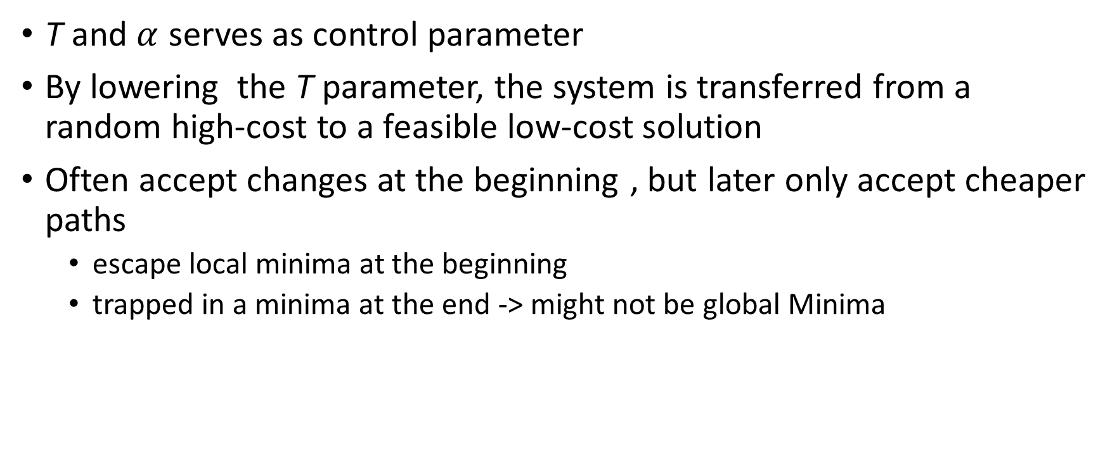

Role of T and $α$
T and $α$ serves as control parameter
By lowering the T parameter, the system is transferred from a random high-cost to a feasible low-cost solution
Often accept changes at the beginning , but later only accept cheaper paths
  escape local minima at the beginning
  trapped in a minima at the end -> might not be global Minima

Slide 15
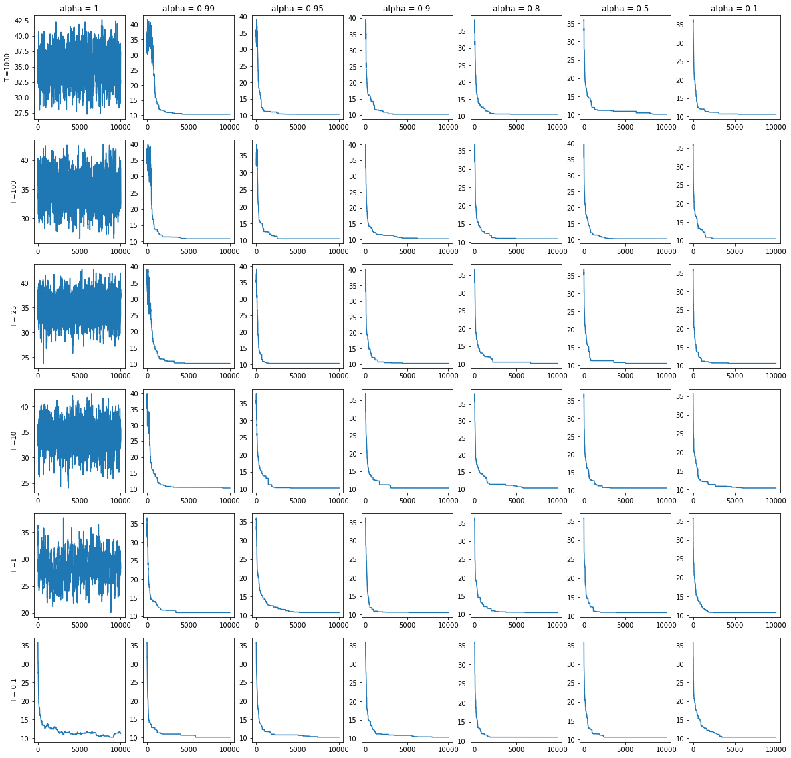




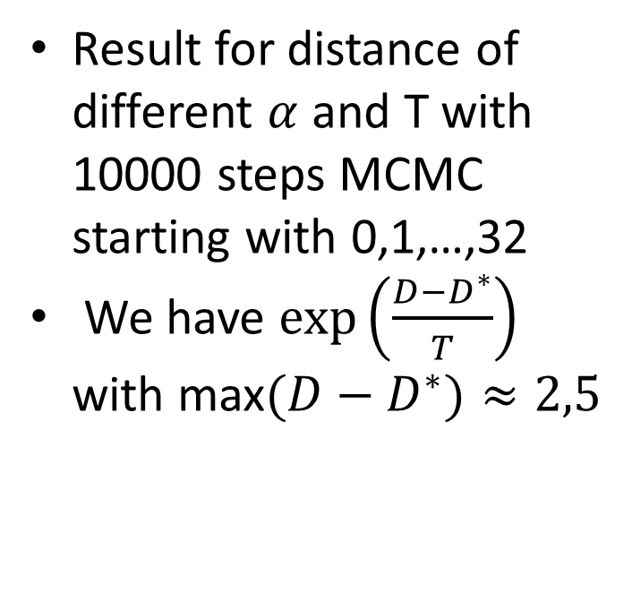


T and $α$ - non optimal start
$α$ = 1
$α$ = 0.99
$α$ = 0.5
Result for distance of different $α$ and T with 10000 steps MCMC starting with 0,1,…,32
We have $exp\left(\frac{D−D^{∗}}{T}\right)$ with max$(D−D^{∗})≈2,5$
T = 1
T = 1
T = 1
$α$= 0.99
$α$ = 0.5
T = 100
T = 100

Slide 16
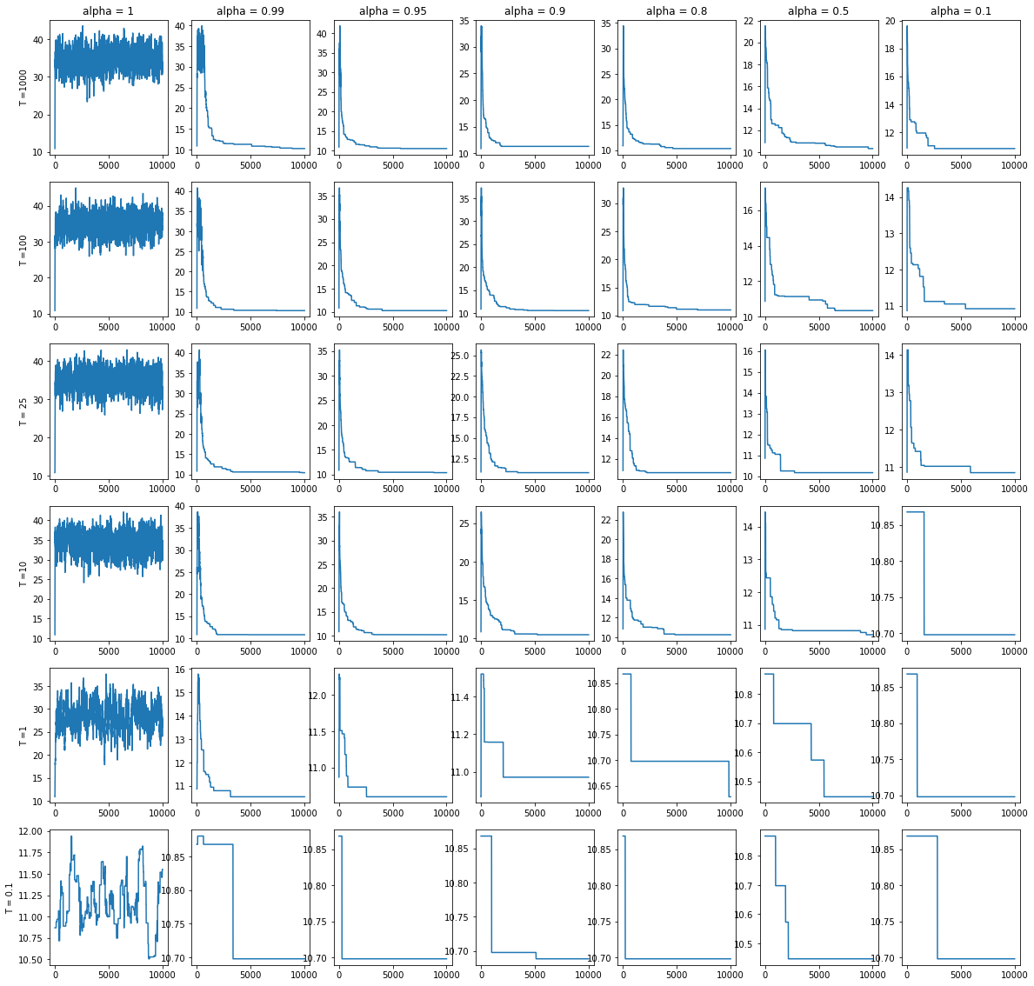






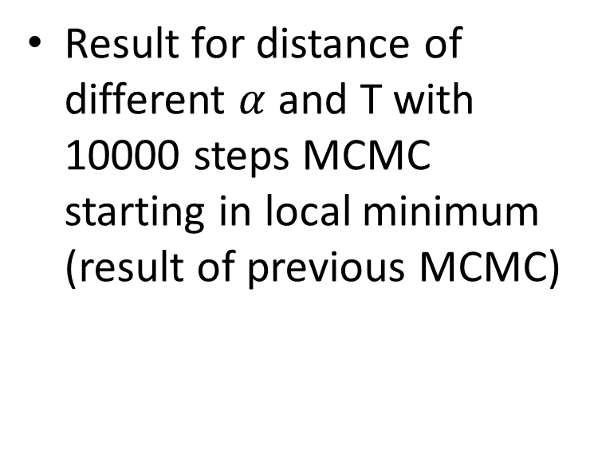
T and $α$ – start in local minimum
$α$= 0.99
$α$= 0.95
$α$= 0.5
T = 100
T = 100
T = 100
Result for distance of different $α$ and T with 10000 steps MCMC starting in local minimum (result of previous MCMC)
$α$= 0.99
$α$= 0.5
10.8
T = 1
T = 1
10.7
10.6
10.5

Slide 17
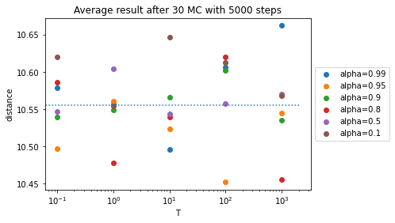
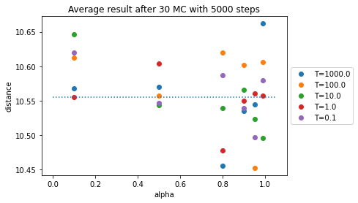


T and $α$ averages over 30 MCMC
In Average lower result for $α>0.8$

Slide 18
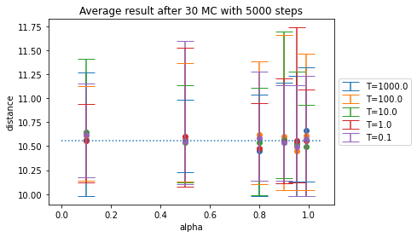
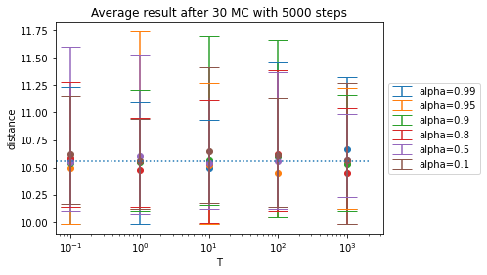

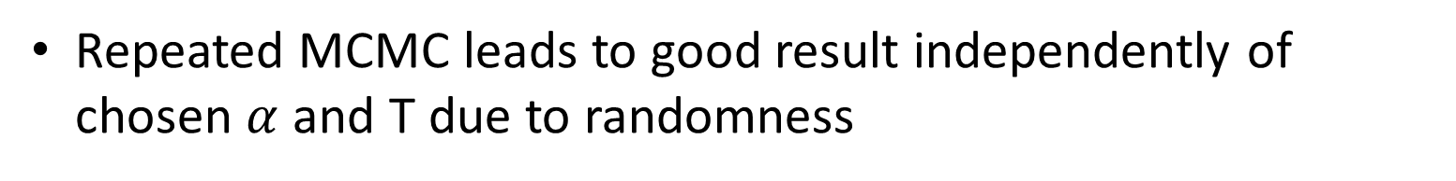
T and $α$ spread of result over 30 MCMC
Repeated MCMC leads to good result independently of chosen $α$ and T due to randomness

Slide 19

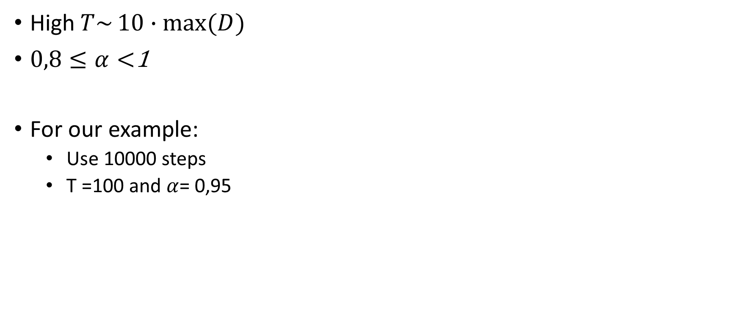
T and $α$ - Summarize
High$T\sim 10∙max{(D)}$
$0,8≤α<$1
For our example:
  Use 10000 steps
  T =100 and $α$= 0,95

Slide 20
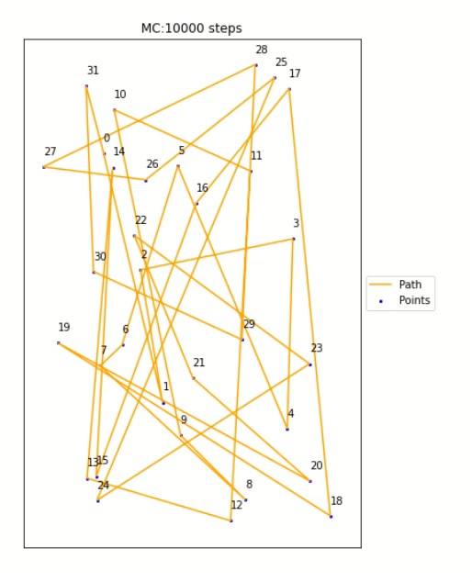
Monte-Carlo - Animation
Start with sequence 0,1,…,32
20 frames per animation step

Slide 21
Comparison

Slide 22
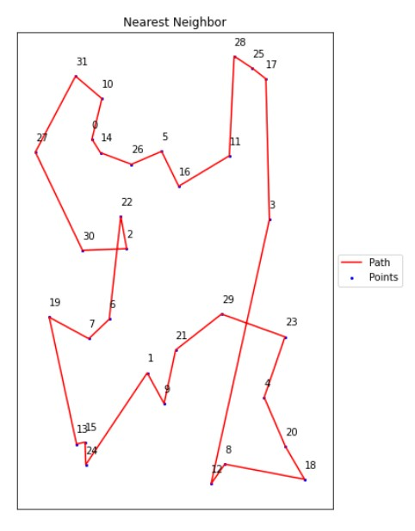
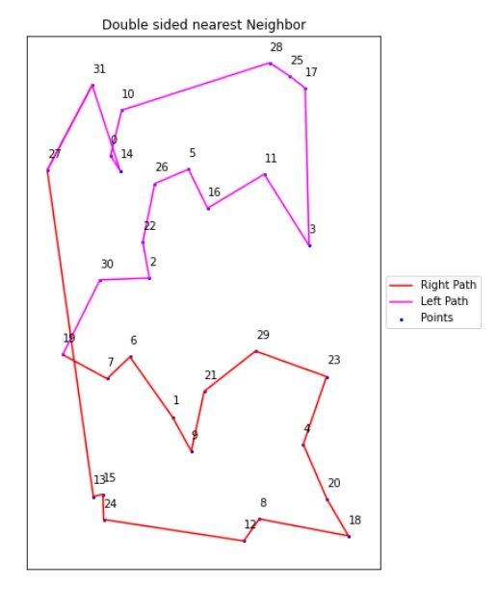
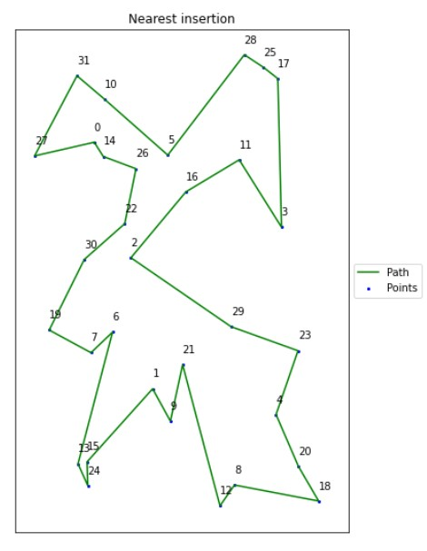
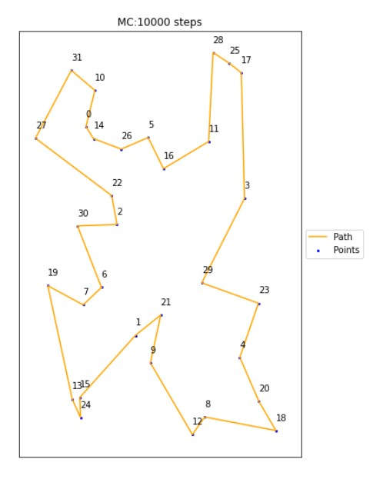
Comparison - Time
Nearest Neighbor
Double- sided nearest Neighbor
Time:
68.2 ms ± 2.63 ms
Time:
77.5 ms ± 5.04 ms
Nearest Insertion
MCMC
Time:
62 ms ± 1.11 ms
Time:
1.16 s ± 140 ms

Slide 23
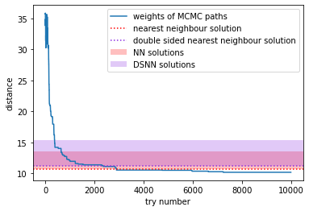
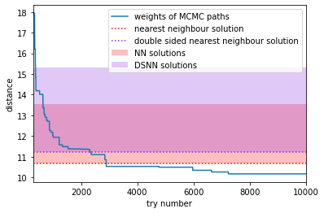
Comparison – Distances
After 300 steps

Slide 24
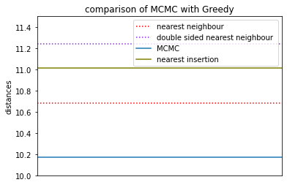
Comparison - Distances
Distance: 11.243
Distance: 11.012
Distance: 10.685
Distance: 10.171

Slide 25
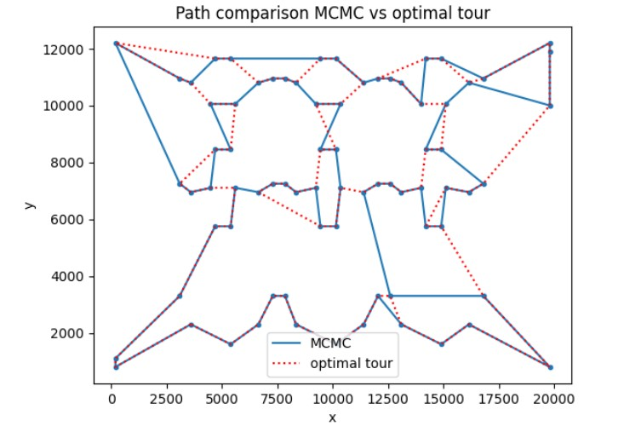
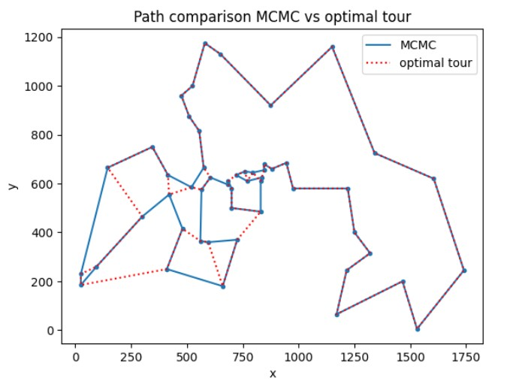
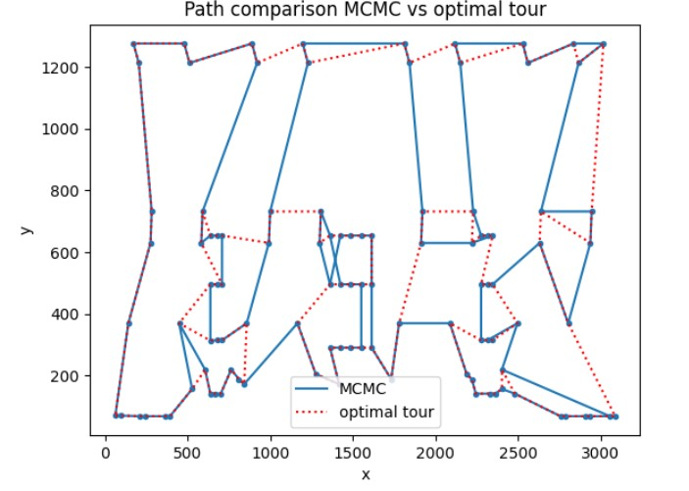
Comparison with known optimal solution
Optimal result from:
http://comopt.ifi.uni-heidelberg.de/software/TSPLIB95/tsp/
pr76
berlin52
lin105
Difference to optimal tour in %
5,98 | 7,53 | 9,72

Slide 26
Optimization of the result

Slide 27
MCMC – Optimization of the result
More steps -> Works until we land in local Minima
As seen before: Multiple tries of MCMC
Start in local Minima by reusing MCMC result
  Do this a couple of time and keep best result:
    For our example distance: 10.171 -> 10.046 (50 tries)
If group of points are clearly separated -> MCMC on subgroup and find cheapest connection between those

Slide 28
Further more complex Problems

Slide 29
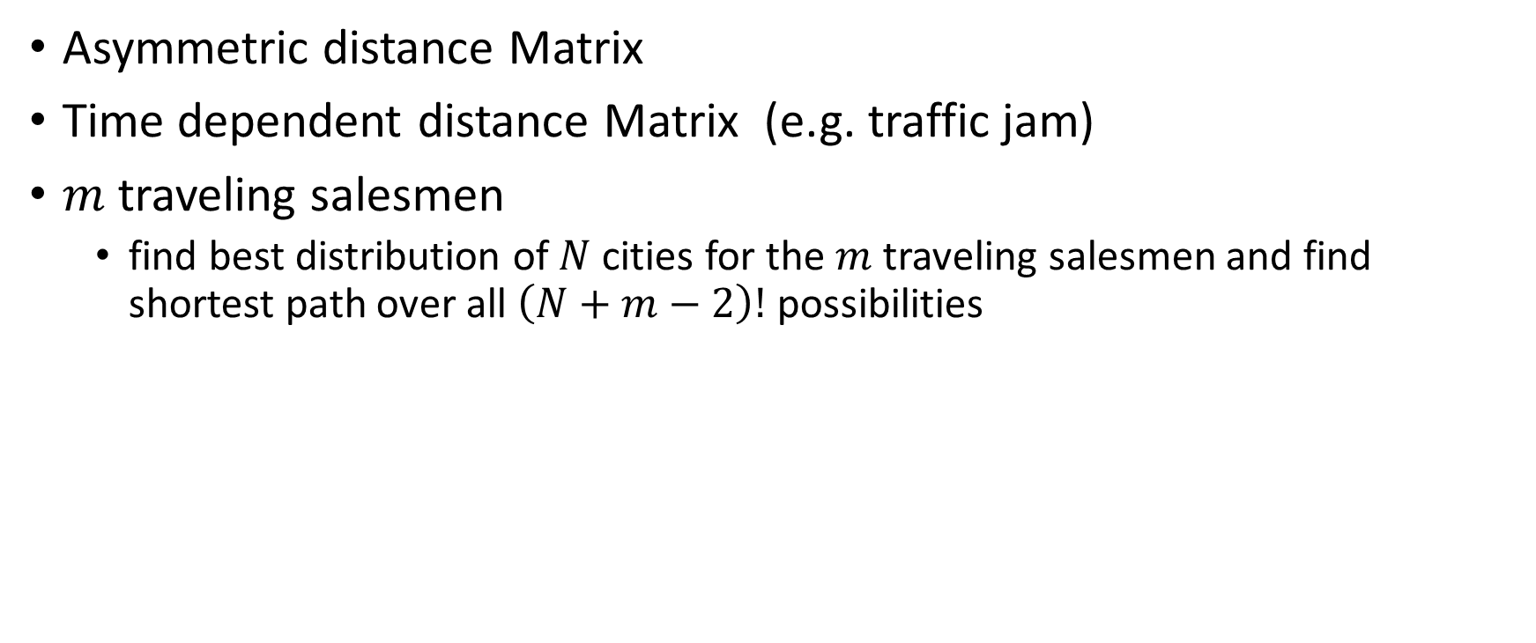
Further more complex Problems
Asymmetric distance Matrix
Time dependent distance Matrix (e.g. traffic jam)
$m$traveling salesmen
  find best distribution of $N$cities for the $m$traveling salesmen and find shortest path over all $\left(N+m−2\right)!$ possibilities

Slide 30
Literature
[1] “Double-ended nearest and loneliest neighbour – a nearest neighbour heuristic variation for the travelling salesman problem”, Fernando G. S. L. Pimentel https://www.researchgate.net/publication/258241208_Double-ended_nearest_and_loneliest_neighbour-a_nearest_neighbour_heuristic_variation_for_the_travelling_salesman_problem
[2] „TRAVELING SALESMAN PROBLEM -Insertion Algorithms“ https://www2.isye.gatech.edu/~mgoetsch/cali/VEHICLE/TSP/TSP009__.HTM
[3] “Optimization of the time-dependent traveling salesman problem with Monte-Carlo methods”,Bentner et al., Phys.Rev. E, 64, 036701

Slide 31
Source for images
(1) https://www.tue.nl/en/news-and-events/news-overview/19-12-2023-improving-optimization-efficiency-by-modifying-algorithms-in-tsp-variants

Slide 32
Back-up

Slide 33
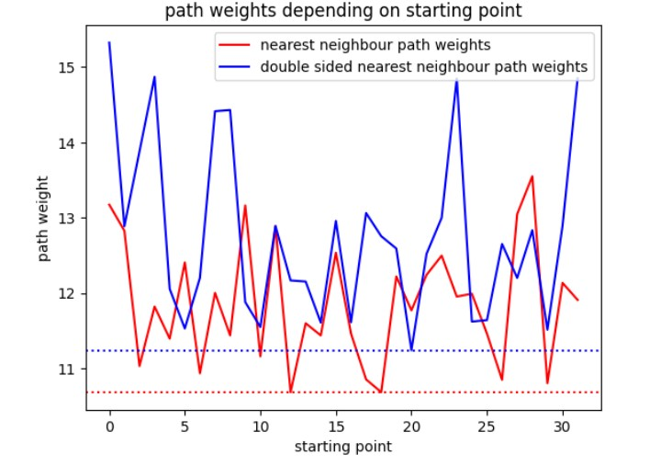
Comparison Nearest with double sided
Does startposition matter? Yes

Slide 34
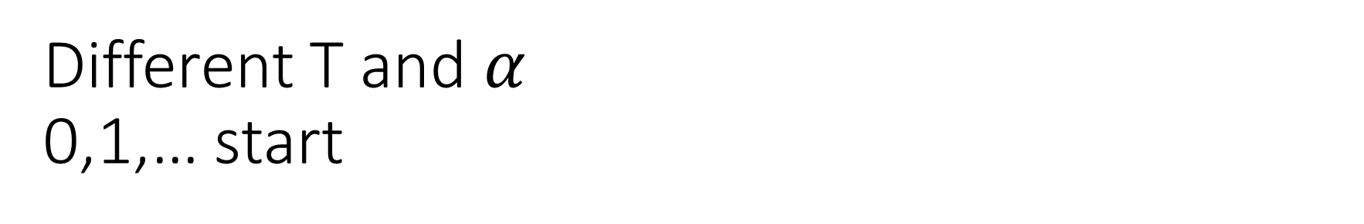
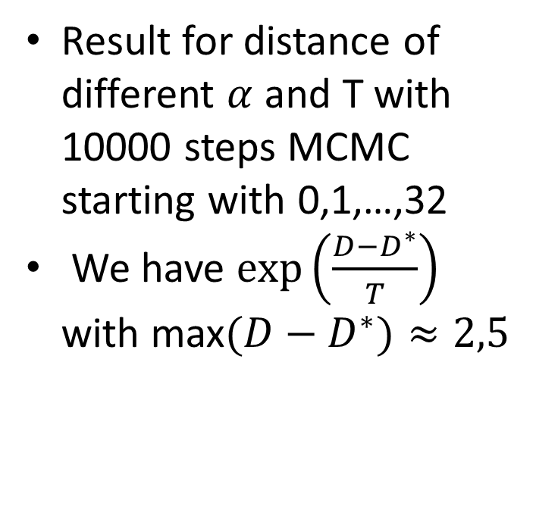
Different T and $α$
0,1,… start
Result for distance of different $α$ and T with 10000 steps MCMC starting with 0,1,…,32
We have $exp\left(\frac{D−D^{∗}}{T}\right)$ with max$(D−D^{∗})≈2,5$

Slide 35

Different T and $α$ start in local Minimum

Slide 36
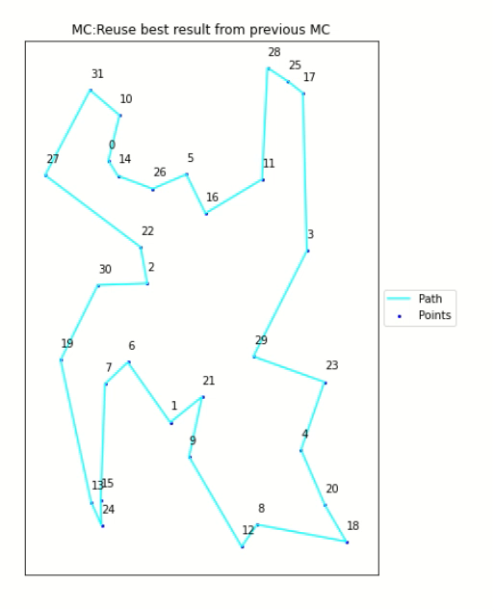
Time comparison local Minima/random start

Slide 37
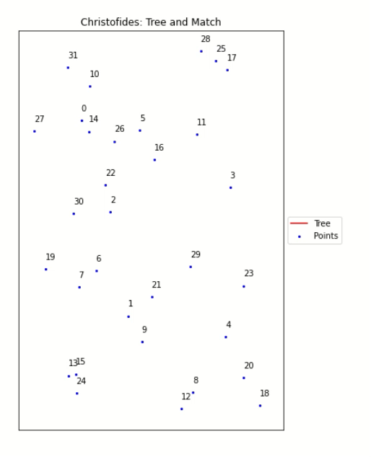
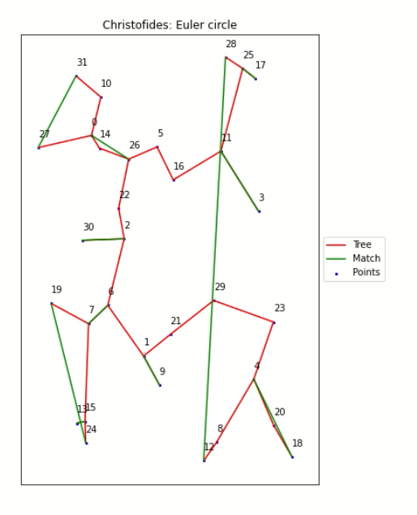
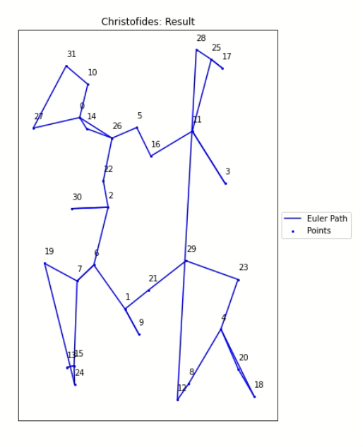
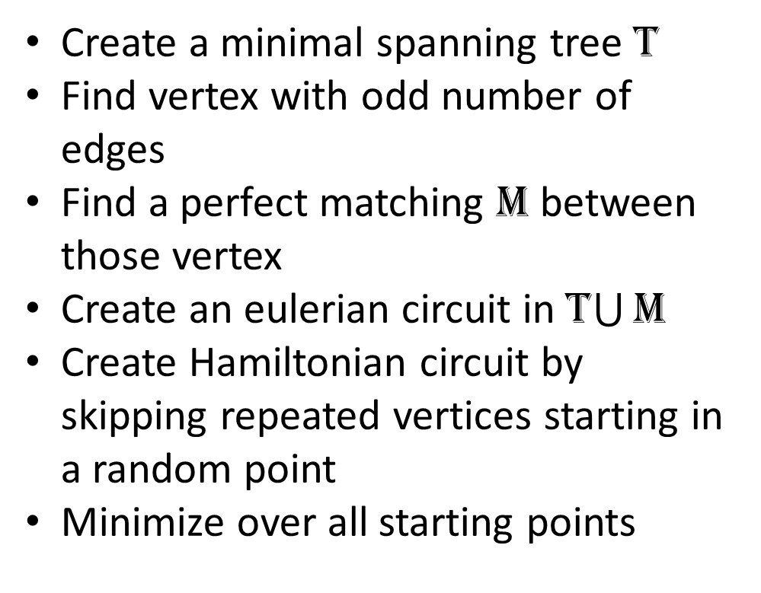
Christofides
Create a minimal spanning tree T
Find vertex with odd number of edges
Find a perfect matching M between those vertex
Create an eulerian circuit in T$\bigcup{\text{M} }$
Create Hamiltonian circuit by skipping repeated vertices starting in a random point
Minimize over all starting points

Slide 38
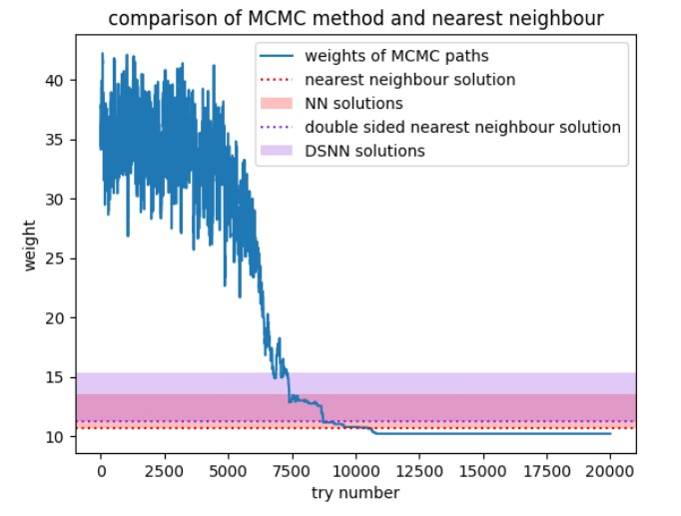
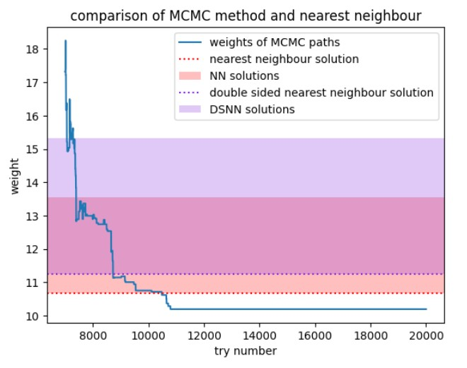
Comparison – Distances
T=100, alpha =0,99

Slide 39
Code- Greedy

Slide 40
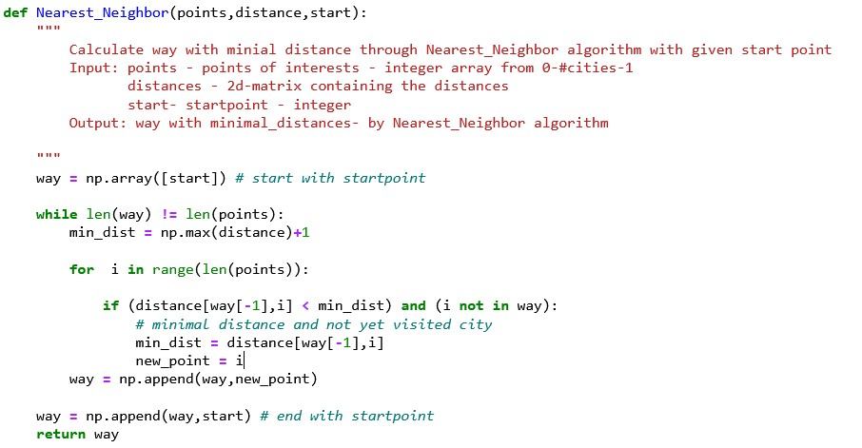

Slide 41
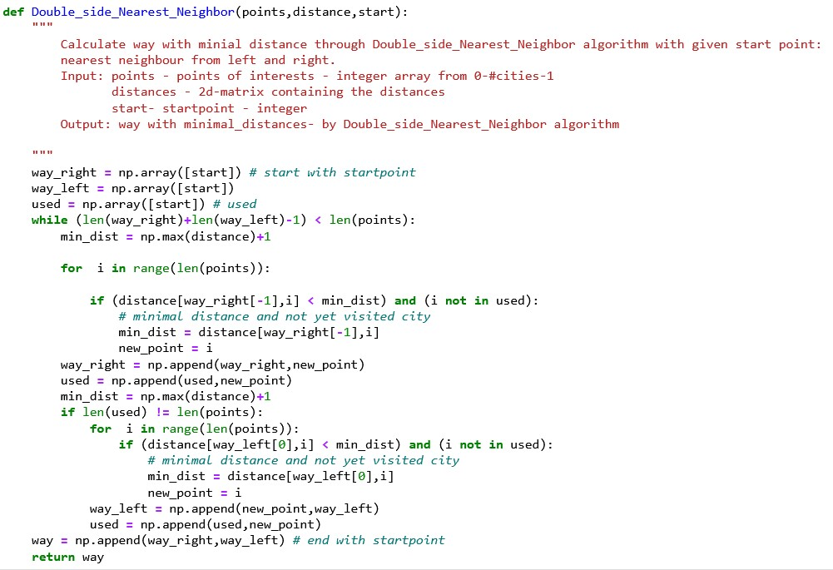

Slide 42
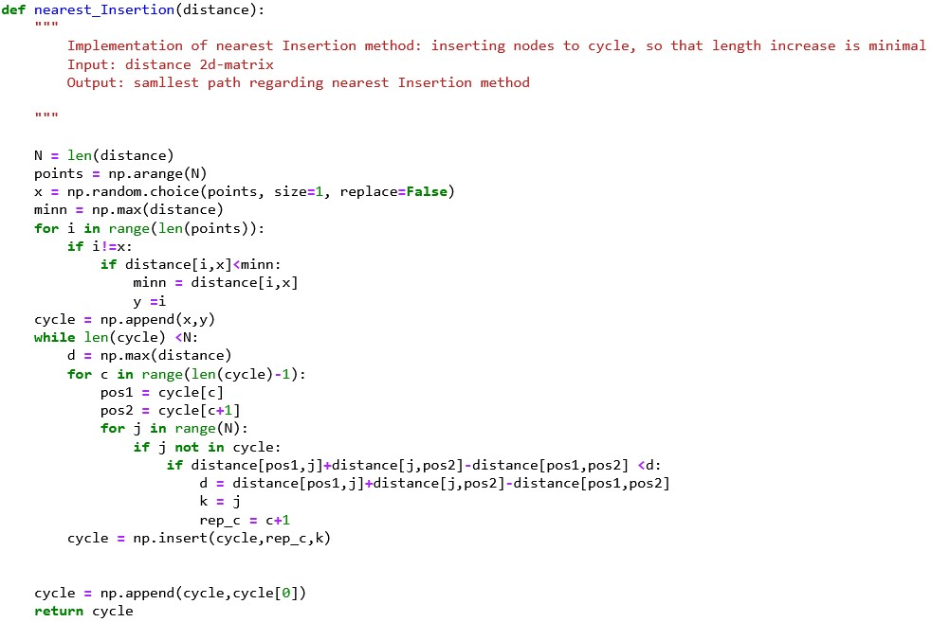

Slide 43
Code- MCMC

Slide 44
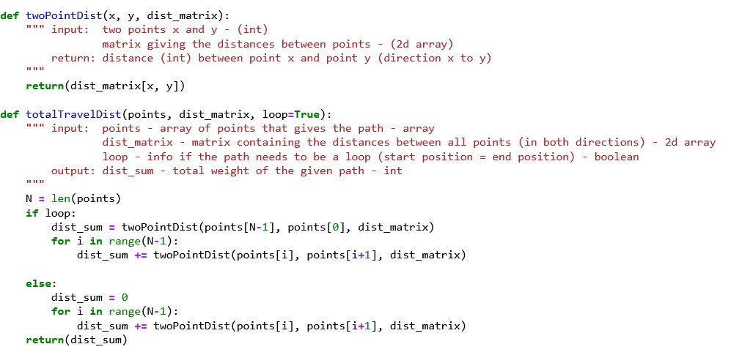

Slide 45
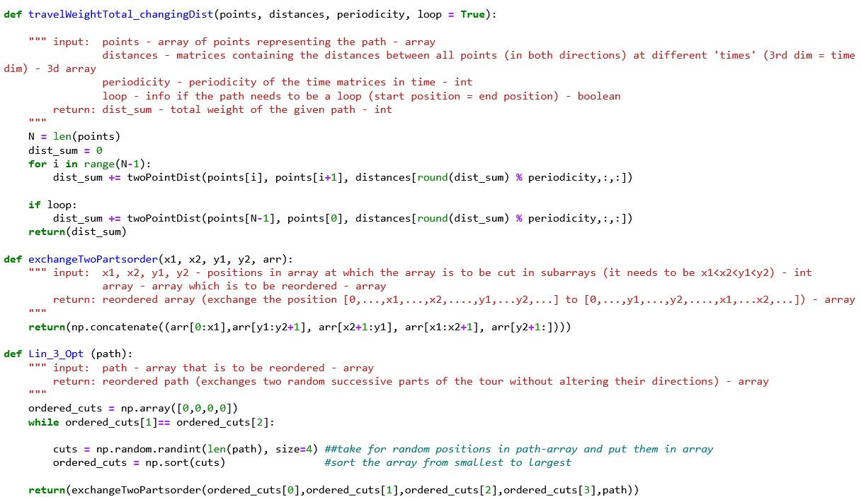

Slide 46
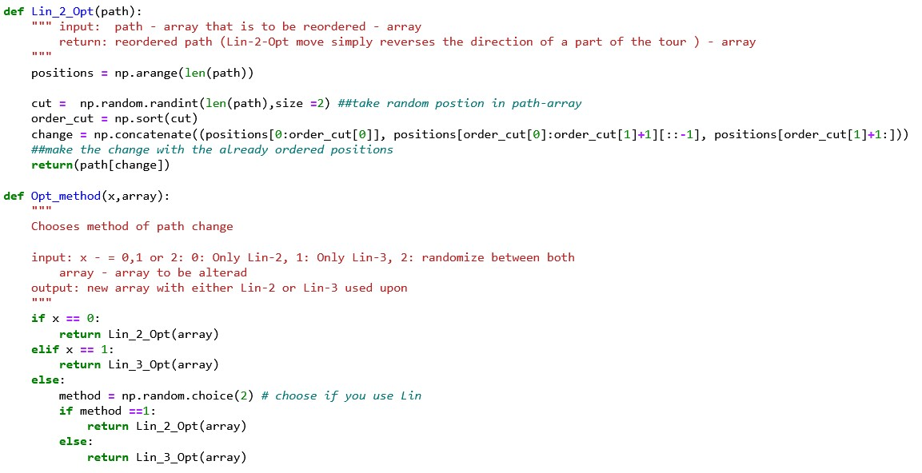

Slide 47
