Slide 1
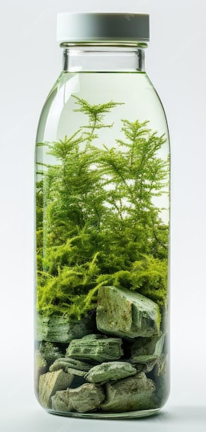
Control Group
Silence
Different Frequency
Different Loudness
Audible
Different Frequency
Different Timeframe
Ultra

