Slide 1
What Impacts Churn Rate?
Elijah Macneil and Jonathan Zluticky

Slide 2
Abstract
Goal: Determine what causes Telco customers to churn.
Data: We looked at data from a fictional Telecoms company that contained certain features such as gender, tenure, contract term, and charges for each customer and whether they renewed their contract.

Slide 3
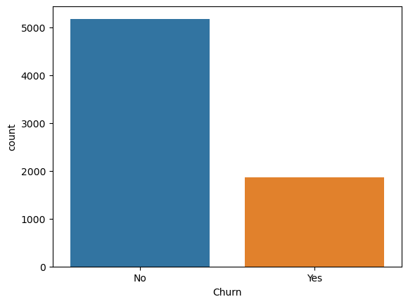
Churn
Churn means that a customer does or does not renew their services with a company.
From our Data we found that 27% of customers did not renew their contracts while 73% did renew.

Slide 4
Variable Selection from Analysis
Some of the features that effect churn rate are:
Scheduled Contract
Monthly Charges
Tenure
Internet Service
Added Services
A link to the full variable selection and EDA are in the appendix

Slide 5
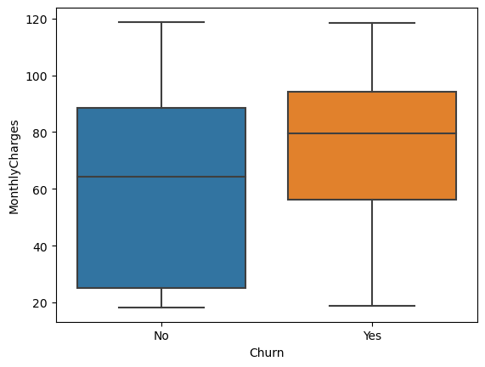
Monthly Charges
People with higher monthly charges are more likely to churn
Average Monthly Charge for Churners is $74
Average Monthly Charge for non-Churners is $61

Slide 6
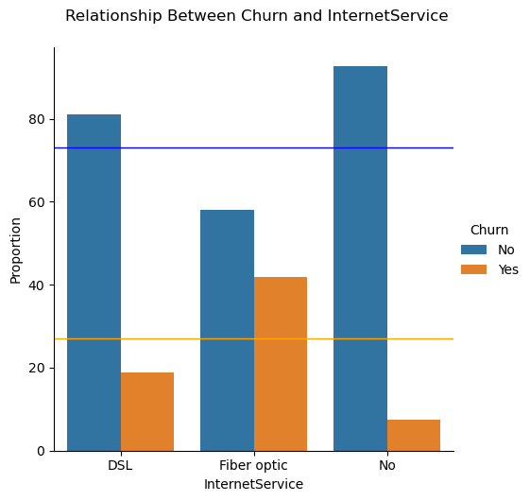
Internet Service
People with Fiber optics are more likely to churn
People with DSL or No internet Service are less likely to churn

Slide 7
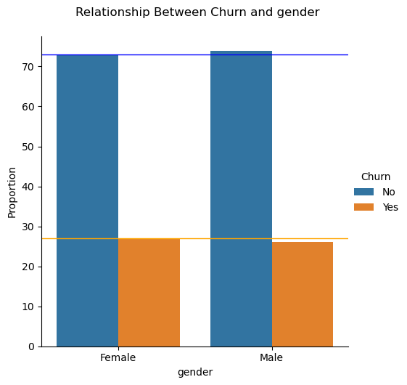
Gender
Gender is does not increase the risk of Churning

Slide 8

K Nearest Neighbor
The probability that an observation falls into a certain class is determined by its "k" nearest neighbors. Observations are usually classified by majority rule.
Our Model was built using 33 features selected from our EDA.
Pros | Cons
Easy to Implement Fits wide variety of Data (No Assumptions) High Accuracy | Computer Intensive and slow. Hard to Interpret Sensitive irrelevant features

Slide 9
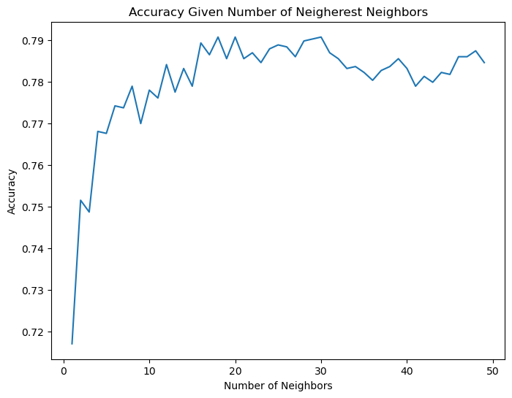
Choosing K
Choosing the 18 nearest neighbors yield the highest accuracy of 79%

Slide 10
CV and Accuracy
Using 10-fold Cross Validation yields an average accuracy of 78.7%
Accuracy : 78.7%
Sensitivity: 43.3%
accurately predict churn
Specificity: 91.1%
accurately predict non churns
 | Predicted Yes | Predicted No
Actual Yes | 243 | 318
Actual No | 138 | 1414

Slide 11
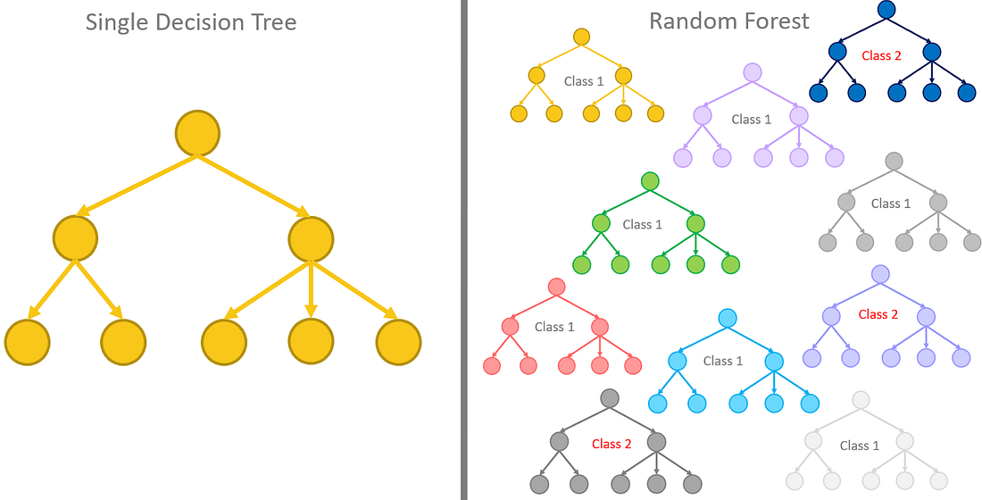
Random Forest
Image from https://towardsdatascience.com/from-a-single-decision-tree-to-a-random-forest-b9523be65147

Slide 12
Random Forest
The Random Forest method creates a many slightly different trees with slightly different features to make it prediction. New inputs are classified by majority rule.
Our model looked at 100 trees with 5 features.
Pros​ | Cons​
Low Risk of Over Fitting Decorrelates Trees Fits Variety of Data | ​Computationally Expensive to Train Hard to interpret

Slide 13
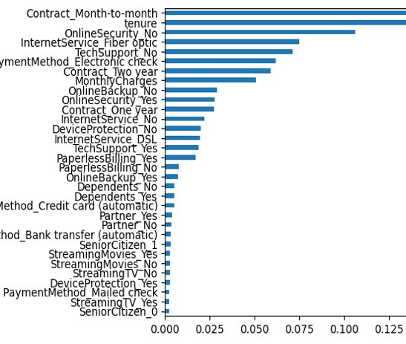
Important Variables
Removing Features such as Month to Month Contracts and Tenure from the model would decrease the accuracy the most .

Slide 14
RF Accuracy
Using 10-fold Cross Validation yields an average accuracy of 79.5%
Accuracy : 79.5%
Sensitivity: 44.3%
accurately predict churn
Specificity: 92.2%
accurately predict non churns
 | Predicted Yes | Predicted No
Actual Yes | 249 | 312
Actual No | 121 | 1431

Slide 15

Logistic Regression
Logistic Regression estimates the probability of an event by having the log odds of the event be represented as a linear combination of predictor variables.
Our Model was built using 10 predictors chosen from the random forest variable importance result.
Pros​ | Cons​
Easy to Interpret Computationally Efficient Modify Threshold to favor particular errors | ​Does not capture complex regions.

Slide 16
Accuracy
Using 10-fold Cross Validation yields an average accuracy of 79.6%
Accuracy : 79.6%
Sensitivity65.5%
accurately predict churn
Specificity: 83.9%
accurately predict non churns
 | Predicted Yes | Predicted No
Actual Yes | 294 | 158
Actual No | 267 | 1394

Slide 17
Coefficients
Beta Coefficients | Features
0.764 | Month to Month Contract
0.215 | No Online Backup
0.340 | No Online Security
0.685 | Fiber Optics
0.434 | No Tech Support
0.406 | Electronic check
0.008 | Monthly Charges
-0.027 | Monthly Tenure
-0.667 | Two Year Contract
-0.154 | Has Online Security
Positive Coefficients lead to an increased probability of churning.
Negative Coefficients leads to a decreased probability of churning

Slide 18
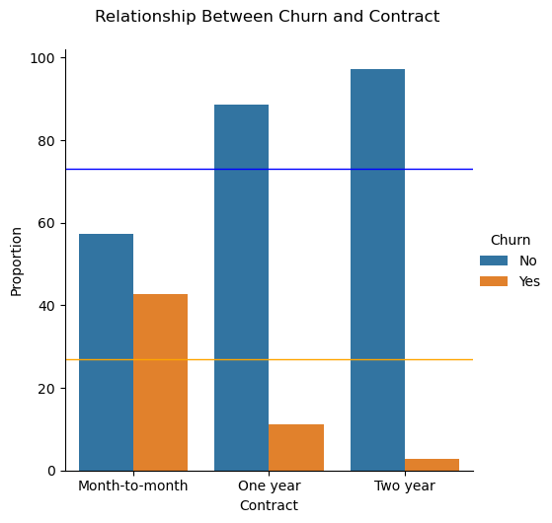
Results – Contract term
Beta Coefficients​ | Features​
0.764 | Month to Month Contract​
-0.667 | Two Year Contract
Incentivizing longer term contracts could lead to an increase in customer retention

Slide 19
Results – Added Services
Beta Coefficients​ | Features​
0.685 | Fiber Optics
0.340 | No Online Security
0.215 | No Online Backup
0.434 | No Tech Support
People with Fiber Optics internet are more likely to churn.
Pushing the added support services may increase their retention.

Slide 20

Future Work
Continue to refine our variable selection for the models
Check for Correlation in Variables
Survey Customers about their satisfaction with the company's internet service.
Construct LDA and QDA models

Slide 21
Appendix
Link to Data and Description:https://www.kaggle.com/datasets/blastchar/telco-customer-churn
Link to EDA and Model notebooks: https://github.com/jzluticky/churn_analysis_and_prediction

