Slide 1
Troubleshooting Reference for Common EMI Issues on Sophgo Hardware
Version: 0.2
Release date: 2022/05/05
Author: SOPHGO HW Team

Slide 2
Troubleshooting EMI Issues
Familiarize yourself with the function of each component
Double check for possible structural, routing and layout interferences
Evaluate frequency points where EMI occurs and the fundamental frequency - multiplier or frequency leakage?
Locate frequency source
Common measures (enhancing ground connections, shielding, wire wrapping, ground wrapping, RC, etc.)
Lower I/O drive strength and spread spectrum
Notes on PCB layout

Slide 3
Base Frequencies for Each Component
DDR3: 1066MHz, 933MHz, 800MHz
eMMC: HDR52 (50MHz), HS200 (187.5MHz/150MHz)
Sensor：MCLK(307/327:37.125MHz; 2053:27MHz)
MIPICSI CLK(307/327:230MHz; 2053:300MHz)
Panel: MIPIDSI 720P(220MHz)
SDIO: 2.0 (50MHz ),3.0 (200MHz )
It is recommended to probe and verify waveforms and frequency points on a spectrum analyzer.

Slide 4
Base Frequencies for Each Component
USB:2.0 (480Mbps ); 3.0 (5Gbps )
NFC: 13.56MHz
SPI: Common frequencies include 28MHz, 75MHz, 5MHz, 0.5MHz
RMII/RGMII CLK: 25MHz/50MHz
Class-D Amplifier: 1MHz, 744KHz, etc.
It is recommended to probe and verify waveforms and frequency points on a spectrum analyzer.

Slide 5
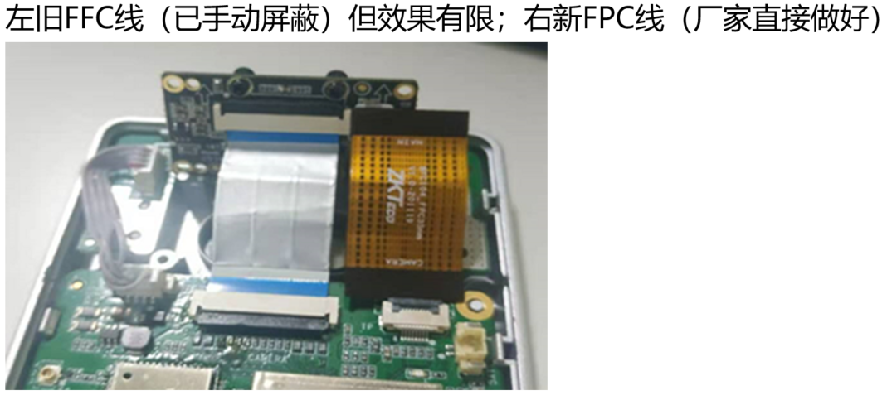
Ensure Structural, Routing and Layout Interferences
Avoid shared parallels between high-speed and low-speed flex cables.
Add electromagnetic shielding for crossing cables.
In the layout shown below, the wires to the sensor board and the LED board crosses. In this layout, radiation coupling would occur easily between sensor MCLK and LED board wires, causing EMI issues.
FFC wire to the left (manually shielded with liminal effect to EMI); FPC wire to the right (shielded from the factory)
LED Board
Sensor
Board
Mainboard

Slide 6
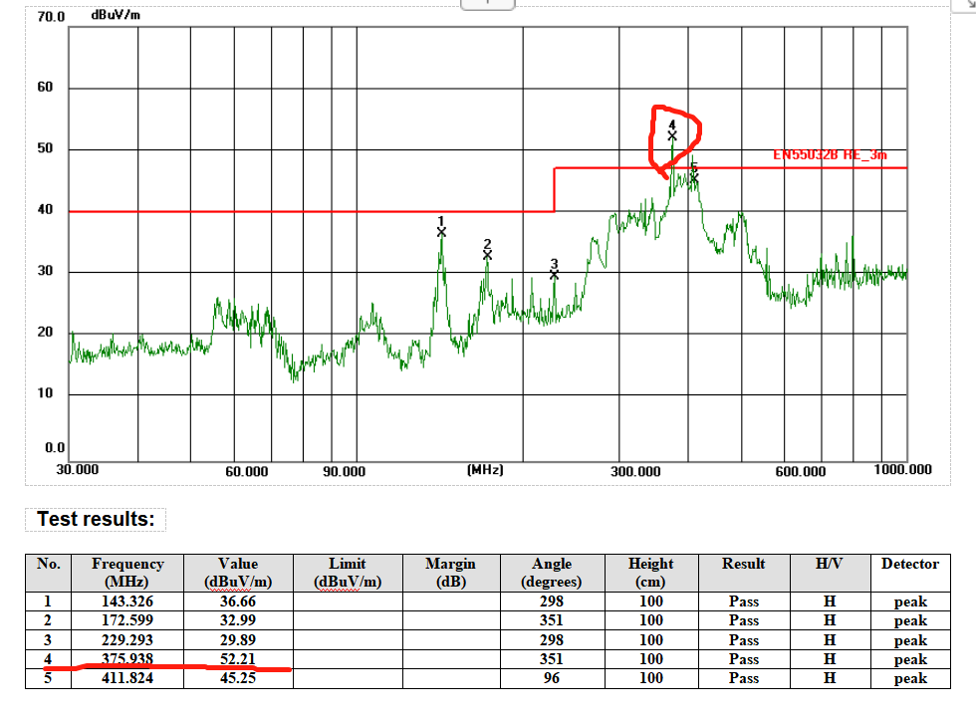
Evaluating EMI Frequency Points and Base Frequencies
187.5MHz的2倍
2x of 187.5MHz

Slide 7
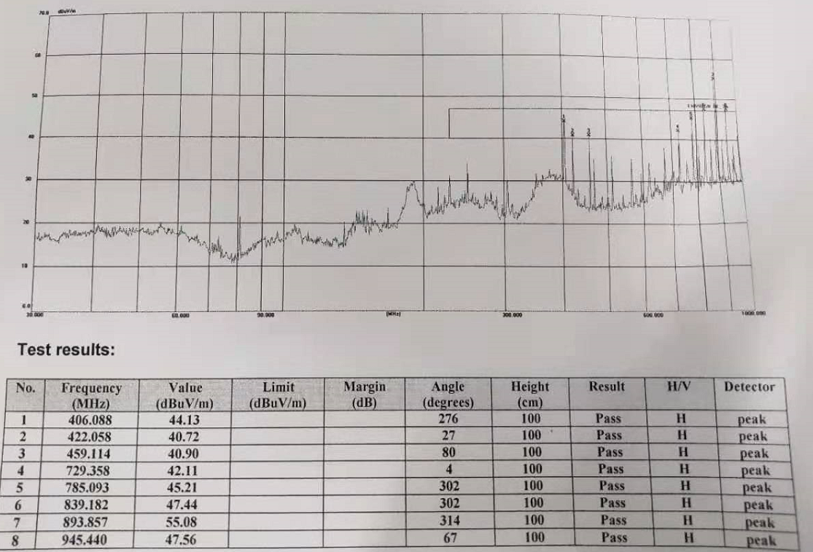
Evaluating EMI Frequency Points and Base Frequencies
893.857-839.182=54.675
是MCLK 27MHz的2倍
893.857-839.182=54.675
2x of MCLK (27MHz)
945.44-893.857=51.583
839.182-785.093=54.089
是MCLK 27MHz的2倍
945.44-893.857=51.583
839.182-785.093=54.089
2x of MCLK (27MHz)

Slide 8
Locating Frequency Source
To disable or disconnect this module:
Unplug, power off, or directly ground the module to check if the relevant frequencies associated with it disappear. Alternatively, toggle GPIO OUTPUT LOW mode register.
Use registers to switch the strong CLK signal to GPIO OUTPUT LOW mode.
To shield or isolate this module:
Use shielding covers, magnetic materials, or other means to isolate the module and observe whether the issue persists.
To change the operating frequency of this module:
For example, adjust MCLK, SDIO CLK, or other frequencies through software.
Please ensure that the above experiments are carried out thoroughly!

Slide 9
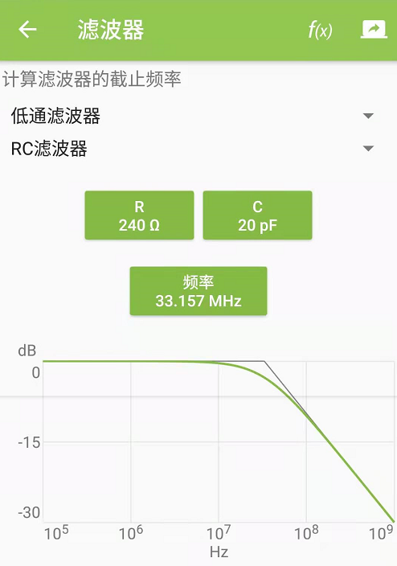
Lowering I/O and Spreading the Spectrum
Lowering I/O driving strength and wave slew rate with an RC circuit.
High-frequency signals like Sensor MCLK and SD card-related signals (such as SDIO CLK) on traces often causes EMI.
It is recommended to leave space for RC components (larger R than C); The filtered frequency should be approximately 3-5 times the original frequency.

Slide 10
Lowering I/O and Spreading the Spectrum
Lowering I/O driving strength via registers.
Lowering I/O slew rate via registers.
You may set the aforementioned registers referencing “3. Managing Pin Control Registers” in the Sophgo SG2000 PINOUT table.
CAM_MCLK0 | ioblk_G10_REG_CAM_MCLK0 | 0x0300_1C54 | ioblk_G10_REG_CAM_MCLK0_PU | 2 | 0x0 | 上拉電阻使能. 0=無效; 1=有效 | Pull up enable 0=disable; 1=enable
 |  |  | ioblk_G10_REG_CAM_MCLK0_PD | 3 | 0x1 | 下拉電阻使能. 0=無效; 1=有效 | Pull down enable 0=disable; 1=enable
 |  |  | ioblk_G10_REG_CAM_MCLK0_DS0 | 5 | 0x0 | 輸出驅動能力檔位 bit 0 | Output buffer Driving Strength bit 0
 |  |  | ioblk_G10_REG_CAM_MCLK0_DS1 | 6 | 0x1 | 輸出驅動能力檔位 bit 1 | Output buffer Driving Strength bit 1
 |  |  | ioblk_G10_REG_CAM_MCLK0_ST0 | 8 | 0x0 | 輸入施密特觸發器強度控制. bit 0 | Input buffer Schmitt trigger level bit 0
 |  |  | ioblk_G10_REG_CAM_MCLK0_ST1 | 9 | 0x0 | 輸入施密特觸發器強度控制. bit 1 | Input buffer Schmitt trigger level bit 1
 |  |  | ioblk_G10_REG_CAM_MCLK0_HE | 10 | 0x0 | 弱電平維持器(Bus holder) 使能 . 0=無效 ; 1=有效 | Bus holder enable 0=disable; 1=enable
 |  |  | ioblk_G10_REG_CAM_MCLK0_SL | 11 | 0x0 | 輸出電平轉換速率限制. 0=無效(較快) ; 1=有效(輸慢) | Output Buffer Slew Rate Limit 0=disable; 1=enable

Slide 11
Lowering I/O and Spreading the Spectrum
Via registers...
Switch frequency source or frequency points.
Enable SSC spread spectrum.
Example to the right switches frequency source from MCLK0 (CAM0) to CLK_AUX3 (XTAL_25MHz).
After applying DISPPLL 27+ SSC EMI, the 893MHz frequency point has been disrupted. EMI testing has been effective. Over a short period of one hour, the display remains stable. However, observations beyond one hour are pending. The customer will use register settings to further investigate.
This example is for demonstration only! Please use your judgment for your own scenarios during troubleshooting.
devmem 0x03000150 32 0x00000101
devmem 0x030011A0 32 2
# MCLK1 switch to CLK_AUX2 (xtal 25M)
devmem 0x0300014C 32 0x00000101
devmem 0x03001194 32 2
MCLK0(CAM0) switch to CLK_AUX3(DISPLL_1188/44=27MHz)
devmem 0x03000150 32 0x00001669
devmem 0x030011A0 32 2
# MCLK1 switch to CLK_AUX2 (disppll 27M)
devmem 0x0300014C 32 0x00001669
devmem 0x03001194 32 2
# disppll_ssc_syn_span
devmem 0x03002868 32 825
# disppll_ssc_syn_step
devmem 0x0300286C 32 14790
# en_ssc(bit 1)
devmem 0x03002860 32 $(($(devmem 0x03002860) | 0x02))
# bit 0 toggle
devmem 0x03002860 32 $(($(devmem 0x03002860) ^ 0x1))

Slide 12
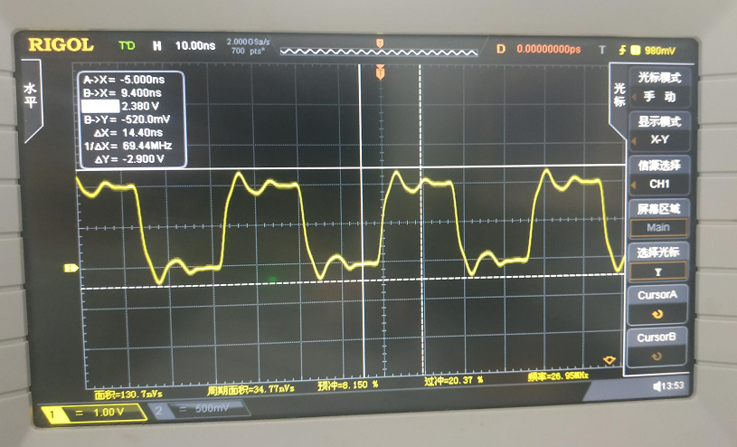
Lowering I/O and Spreading the Spectrum
Strong wave pulses before lowering I/O drive strength

Slide 13
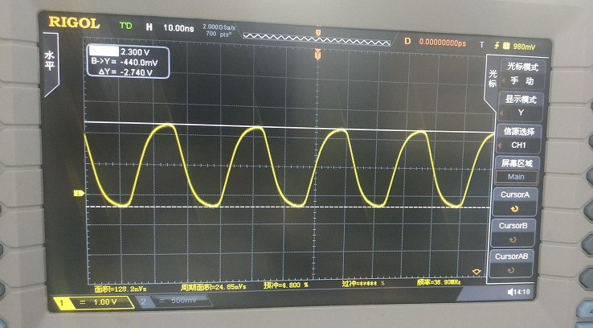
Lowering I/O and Spreading the Spectrum
Smooth waveforms after lowering I/O drive strength

Slide 14
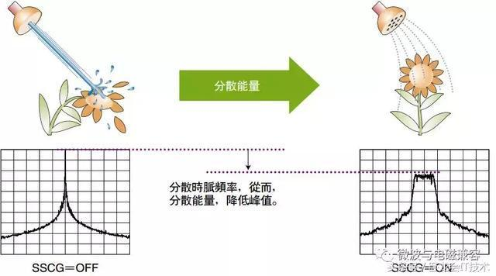
Lowering I/O and Spreading the Spectrum
Spreading wave frequencies to spread out energy pulses and smooth out peaks

Slide 15
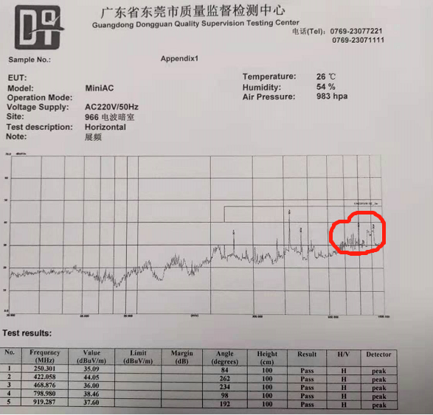
Lowering I/O and Spreading the Spectrum
Results from lowered I/O drive strength

Slide 16
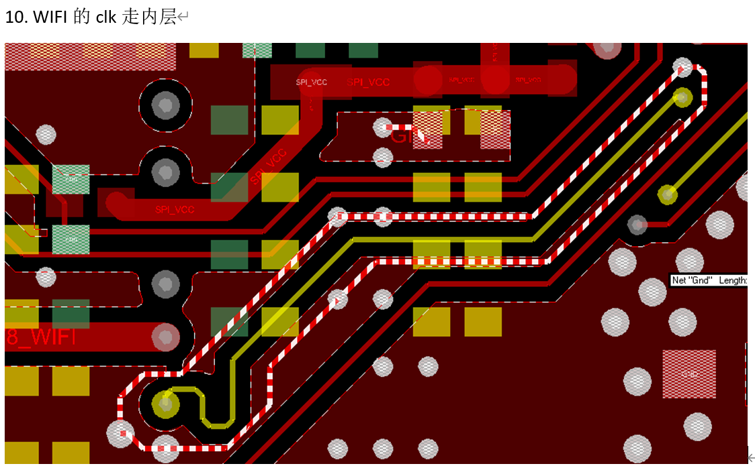
Notes on PCB Layout
High-speed I/O signals (TTL/CMOS)
Based on experience, Sensor MCLK is the primary concern, while eMMC CLK/SDIO CLK/RMII CLK/RGMII CLK/NFC, and similar signals, fall into the secondary concern category. It is recommended to route these signals in the inner layer with full GND wrapping and GND VIA. Allow 3W spacing with other signals.
Flex cables and stringing wires couple easily (causing EMI)!
Avoid using these types of cables and wires for high-speed and pulse signals.

Slide 17
We are happy to be at your service!

