Slide 1
LAB
ACTIVTY
#5
GITHUB
GROUP: LANAO, VIAN JAY // OCAMPO, GERALDINE // PADILLA, XAVIER // ZAMORA JENNY

Slide 2
INSTRUCTIONS
LAB Problems:
1. Create an account in GitHub, everyone needs to have an account, a member in your group needs to create a repository and invite your groupmates in your repository.
2. After the invitation every member should be in the repository and in the collaborator tab of the repository.
3. Add a new file in git and push it to GitHub.

Slide 3
GitHub
Creating your github account

Slide 4



Creating an Github Account
Enter your email
Create your password
Enter your desired username
Create Account
Confirm youre not a bot
Creating account screenshot by Lanao vian

Slide 5
Creating New Repository

Slide 6
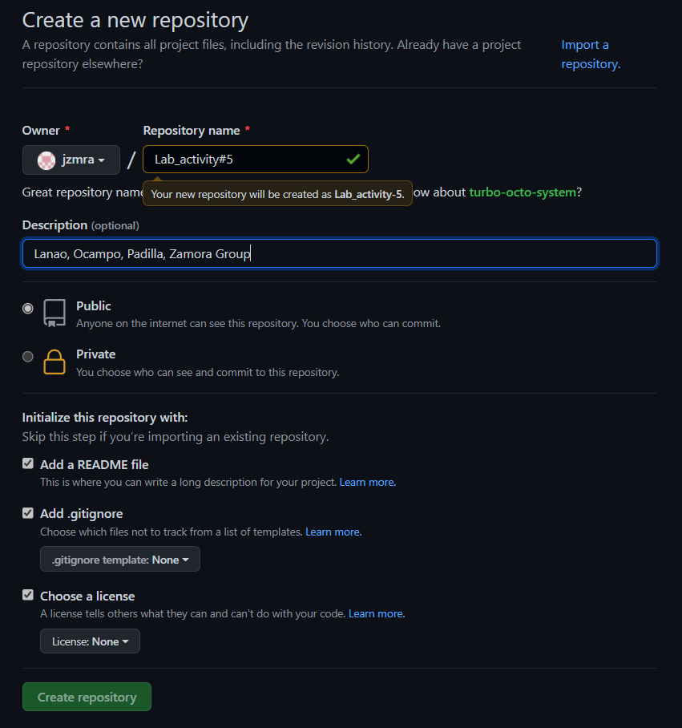
Create
New repository
Enter repository name
Add description of the repository
Make it public
Check readme file, add.gitinore then chose node
Choose a license to apache licence
Create repository

Slide 7
Github Collaborator
Inviting/adding collabortor

Slide 8
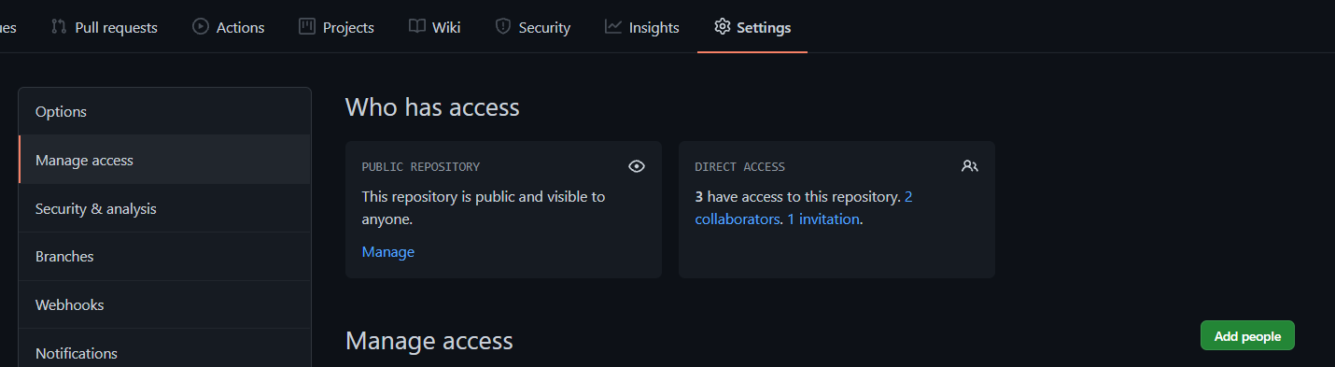
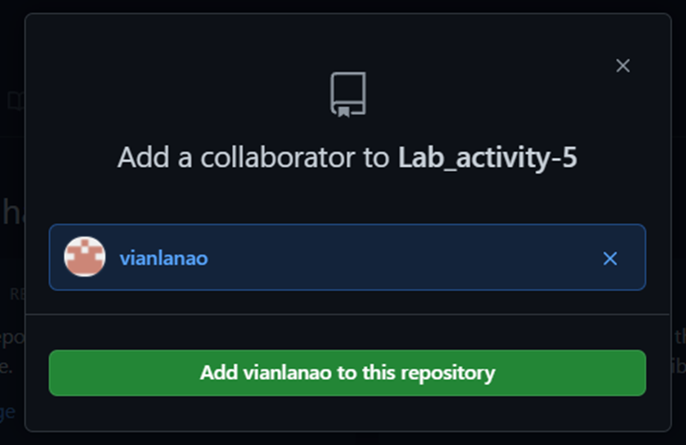
Adding
collaborator
Go to settings
Click manage access
You can add a collaborator on your repository so that he/she can have an access or edit
Click add people
Search user account
Click add user to the repository

Slide 9
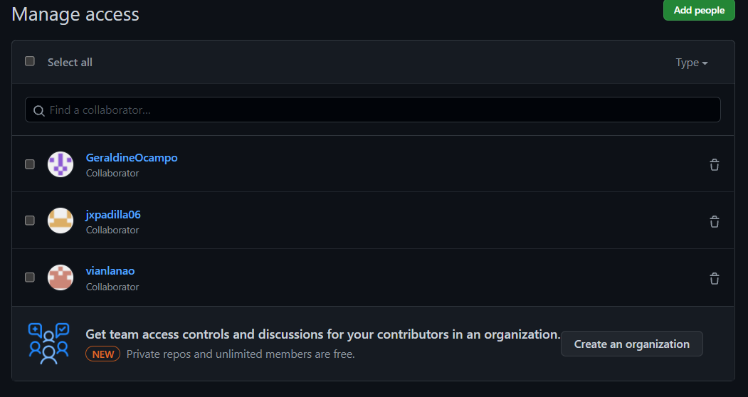
My collaborators

Slide 10
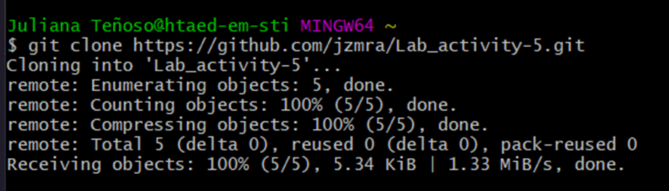
Connect git and github
Copy the https link on the github code
Use git clone link command

Slide 11
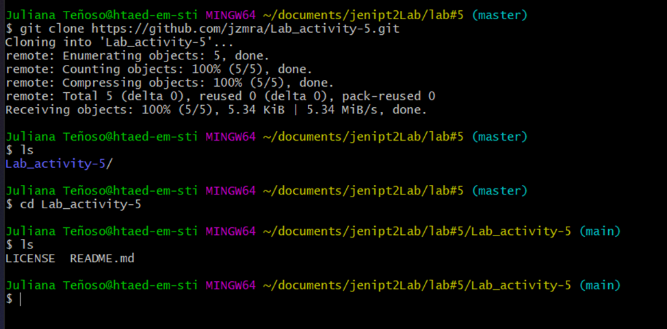
Check if git is connected to github
Use ls command to view files
Enter lab_activity-5
View files if you saw license and readme you are connected

Slide 12
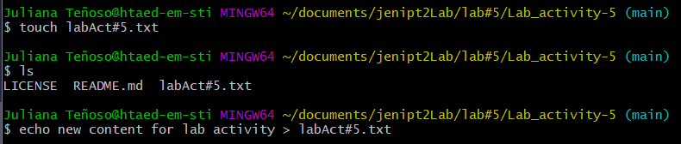
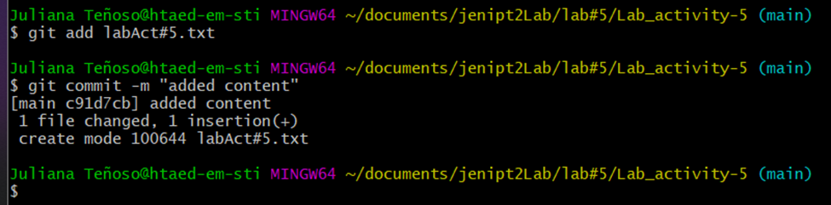
Add a file
Use Touch command to create a file
To check if file is created type ls
Use echo whatuwanttoinsertonthefile > labAct#5.txt to add content
Git add labAct#5.txt and git commit –m to save changes

Slide 13
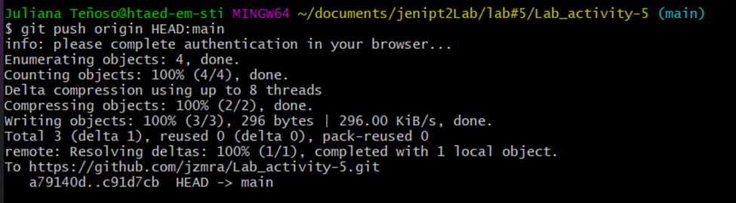
Git push
Use git push origin HEAD:main
To save your changes on the github
If your git is not connected on github login to git hub will appear

Slide 14
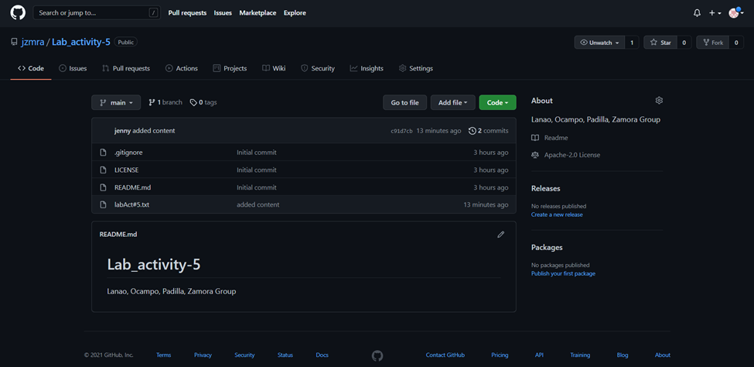
Checking….
Check on your github ccount if labAct#5.txt is successfully added

Slide 15
Thank you
Created by: Zamora

