Slide 1
Batch Reports for Audits - ElectionAudits and the Boulder 2008 Election
Neal McBurnett
NIST Common Data Formats Workshop
Oct 29 2009
Notes:
Not just an audit (and a great audit, if I do say so myself), but ... our government used open source software to do it!

Slide 2
Questions
Ask questions any time
Who has been involved with an audit?
Who knows of a jurisdiction where ballots are reconciled by ballot style as well as by precinct?

Slide 3
Effective audits are critical
Improve election processes
Attain software independence and confidence in elections

Slide 4
Humboldt County 2008
Paper ballots, optical scan
197 ballots deleted without a trace

Slide 5
Discovered later by Humboldt County Election Transparency Project audit
Kudos to Mitch Trachtenberg, Registrar of Elections Carolyn Cernich, and colleagues

Slide 6
Goal: software independence
(Rivest & Wack) via auditable paper records, good audits

Slide 7
Audit:
Compare system's reported results with the evidence
Take sample of detailed results by audit unit and compare to hand counts of those audit units

Slide 8
Auditing steps`
Produce report by audit unit (precinct or batch)‏
Reconcile number of ballots in each unit
Recalculate sum of subtotals
Randomly select audit units to audit
Count audit units by hand
Compare results
Continue auditing until statistical evidence meets goal (limit risk of wrong outcome)‏

Slide 9
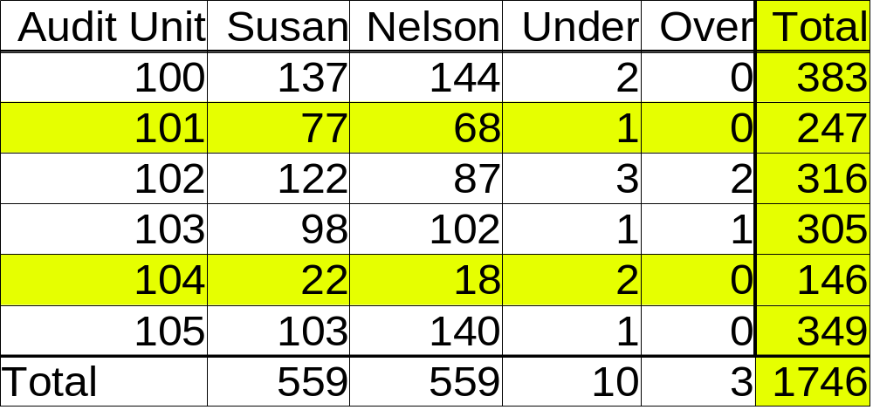
Report of Vote Counts by Audit Unit

Slide 10
Must include undervotes and overvotes in the results for each audit unit. For multiple-winner contests, undervotes are ambiguous, so also need a count of ballots on which the contest appears

Slide 11
Principles and Best Practices for
Post-Election Audits (2008) http://electionaudits.org/principles
League of Women Voters
Election Audit Report (2009)‏

Slide 12
Check out typical Hart precinct report
PDF
No under/over
By precinct
Big numbers
Not suitable for auditing in many places - vulnerable to many attacks!
Inefficient everywhere

Slide 13
From NIST's Call for Papers:
“Human-readable versus machine readable-human-readability matters for transparency and auditing”
Not true – auditing requires aggregation and summing subtotals to confirm totals.
The most effiecient audits involve analyzing vote-count data for all audit units
Standard format helps with targeting units

Slide 14
Current reports typically only by precinct
Auditing by precinct is outmoded, ineffecient and problematic

Slide 15
Agreement on need for standardized small-batch audit reporting from meeting hosted by American Statistical Association, October 2009

Slide 16
Batch reporting important:
Organization of the paper
Privacy of provisional ballots
Small batches more efficient to audit
Individual ballot interpretations needed for emerging methods that audit at the ballot level without breaching confidentiality

Slide 17
Organization of the paper:
Reports are by precinct
But often piles of paper aren't
- Mail in
- Early voting
- Provisional

Slide 18
Reporting by precinct before and after provisional ballots are included can compromise the privacy of the provisional voters
Instead, report provisionals in batches, and precincts only after all provisionals are in

Slide 19
Significance of the results driven by how many batches you audit, not how many ballots you count
Looking for incorrect vote counts
Don't care about total vote count for the sample

Slide 20
Typically, amount of work required to perform a vote-tabulation audit is roughly proportional to the batch sizes, with no reduction in statistical efficacy.

Slide 21
Getting batch data much more frustrating than it should be

Slide 22
Boulder County, 2008
170,000 ballots, 65 races
13 contests audited, 40000 choices
Thanks to Clerk Hillary Hall and staff!

Slide 23
Hart InterCivic system
No batch reports supported
Only 17% cast in precinct
67% mail-in, 16% early voting

Slide 24
Solution: run cumulative report 525 times
Once for each batch
Subtract each report from the previous report to get batch sub-totals

Slide 25
Like snapshots of election-night reporting through the night
But we want lots of them....

Slide 26
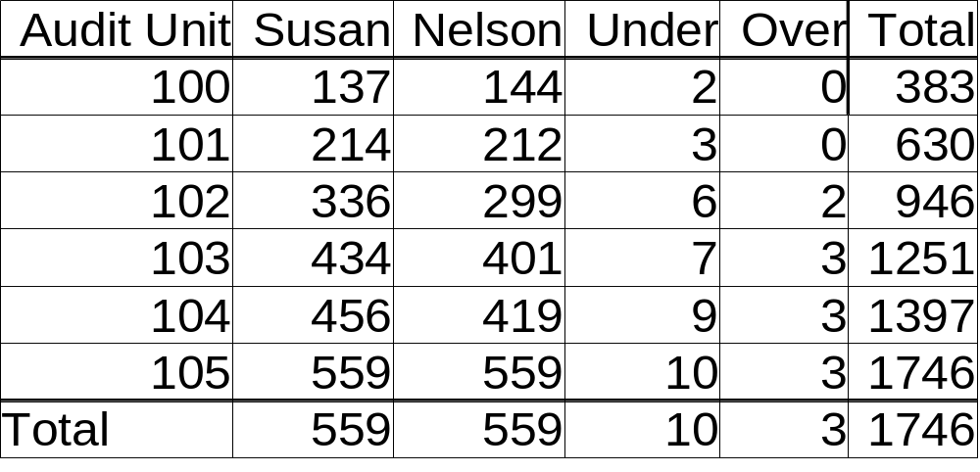
Report of Cumulative Vote Counts by Audit Unit

Slide 27
Report of Vote Counts by Audit Unit

Slide 28
No single Hart report had all the data we wanted in a reasonable format.
“Crystal Reports” XML schema reflected paper layout, not logical data
Didn't have ballot counts – dug those out of PDF reports
“CSV” reports didn't have columns that lined up

Slide 29
Sequoia reports are clean and complete
Good “text with headings” report (tab-separated)
Samples at http://bcn.boulder.co.us/~neal/electionaudits/formats/

Slide 30
Reports also frequently take a long time to produce – painful when doing hundreds of times.

Slide 31
Audit results also need to be published in a standard format, suitable for aggregation across jurisdictions
Include hand counts and discrepancies for all units audited, whether they were targeted or randomly selected, information needed to validate the selections (e.g. algorithms used, random seeds used as input) , results of the audit

Slide 32
Audit-related report objects
Auditable vote count report
Audit report
Random seed generation
Set of audit unit results
Audit unit result

Slide 33
Audit unit result
Audit unit id
Hand count time, personnel assigned
For each candidate or “under” or “over”
  System tally
  Hand count (multiple?)‏
  Discrepancies (Hand count - system)‏
  Resolution code
  Resolution text description

Slide 34
Audit report objects
audit report
random seed generation
could be for a series of selections
or an individual roll of dice for one audit unit

Slide 35
ElectionAudits software is open source, BSD license
Supports the Best Practices
Automates many steps of the audit
Enter the data, publish with statistics
Roll 15 dice, publish all the selections
To do: automate discrepancies, escalation

Slide 36
Look at some real data from Boulder 2008

Slide 37
Features of ElectionAudits
Imports standard election report files: Hart, Sequoia
Produces auditable reports for the public.
Protects voter anonymity by merging small audit units
Doesn't require that paper ballots be sorted into piles by precinct
Can produce batch reports from sequence of cumulative reports
Facilitates risk-limiting audits
Verifiably pseudo-random: dice + "Sum of Square Roots"

Slide 38
Biggest challenge: getting small-batch data out of election systems

Slide 39
Summary
Proper audits are critical
Risk-limiting audits in Colorado law
Small-batch reports help enormously
Standard, machine-readable format is needed
EML looks appropriate
http://launchpad.net/electionaudits

