Slide 1
ElectionAudits: a Django App for Good Election Auditing
Neal McBurnett
OSCON
July 22 2009
Notes:
Not just an audit (and a great audit, if I do say so myself), but ... our government used open source software to do it!

Slide 2
Boulder County used open source code to audit its 2008 election!

Slide 3
Share the story, share the code, and get you all involved where you live.

Slide 4
Questions
Clarifications? Anytime
“But what about...”? At the end

Slide 5
Why audit?

Slide 6
Elections can inspire us!
South Africa 1994
Paper ballots, hand counted

Slide 7
Or serve as a warning
Iran 2009

Slide 8
US problems with elections: black box voting systems

Slide 9
Not just a problem with touch screen devices (DRE)‏

Slide 10
Humboldt County 2008
Paper ballots, optical scan
197 ballots deleted by Diebold/Premier
Without a trace

Slide 11
Certified....

Slide 12
Discovered later by Humboldt County Election Transparency Project audit
“Ballot Browser”
(also open source Python code)
Kudos to Mitch Trachtenberg, brave Registrar of Elections Carolyn Cernich, and colleagues

Slide 13
Surprise!
Computers make mistakes
Sometimes whoppers!

Slide 14
Goal: software independence
(Rivest & Wack) via auditable paper records, good audits

Slide 15
Open Source voting systems
Important!

Slide 16
Good audits and clean chain of custody
Necessary

Slide 17
Boris Bazhanov's Memoirs of Stalin's Former Secretary - quote from Stalin
Loosely translated:
"I consider it completely unimportant who in the party will vote, or how; but what is extraordinarily important is this — who will count the votes, and how."

Slide 18
But what is an audit anyway?

Slide 19
Compare system's reported results with the evidence
Take sample of detailed results by batch and compare to hand counts of those batches

Slide 20
Auditing steps`
Produce report by audit unit (precinct or batch)‏
Reconcile number of ballots in each unit
Randomly select audit units to audit
Count audit units by hand
Compare results
Escalate audit if statistical evidence isn't good enough

Slide 21
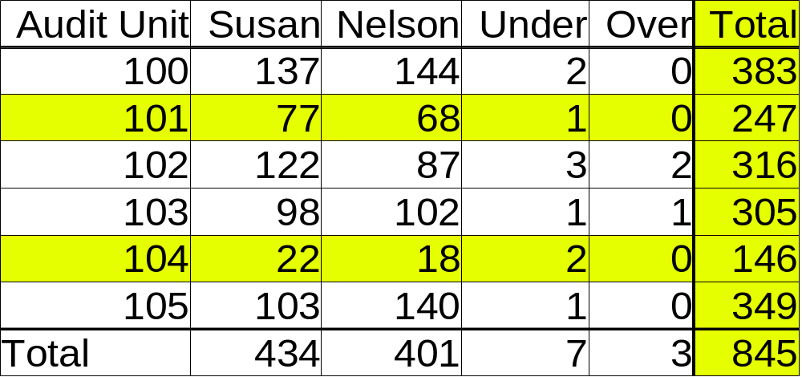
Report of Vote Counts by Audit Unit

Slide 22
Optical scanners arrived
Era of trusting computers too much
Few audits

Slide 23
Audit DREs without voter verified paper trail?
Can't do it....
Pushback – Can't Trust Computers!

Slide 24
“But we're doing audits”

Slide 25
Announcing “random selection” before results come out

Slide 26
Using software to select random numbers
No more software independence....

Slide 27
Wasting time auditing contests with a single candidate

Slide 28
Reports are by precinct
But often piles of paper aren't
- Mail in
- Early voting
- Provisional

Slide 29
Colorado rescans and recounts just the selected batches of mail-in ballots
Not an audit
Just a tiny post-election test that is unrelated to the actual election results

Slide 30
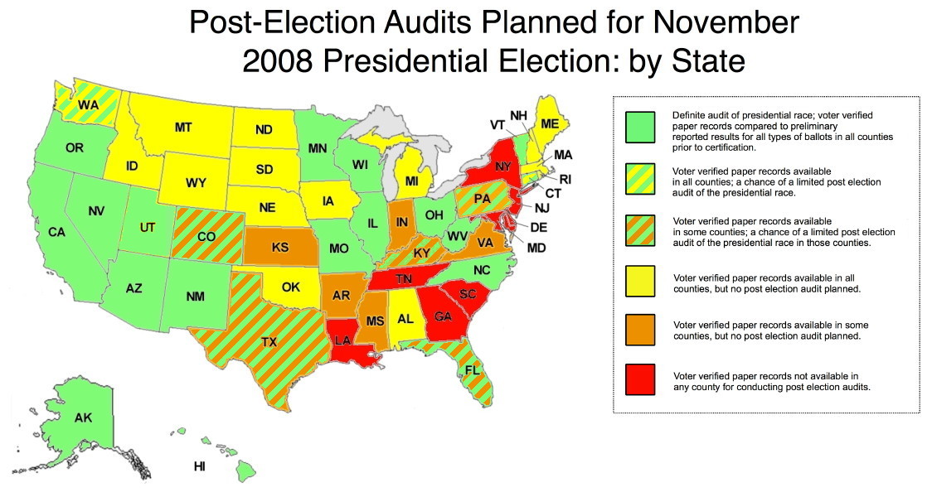

Slide 31
But no state yet does an efficient, “best practices” audit

Slide 32
Principles and Best Practices for
Post-Election Audits (2008) http://electionaudits.org/principles
League of Women Voters
Election Audit Report (2009)‏

Slide 33
Fixed percentage vs Risk-limiting audits

Slide 34
Fixed percentage:
Wasteful focus on landslide contests
Little confidence for tight contests

Slide 35
“Risk-limiting” audit chooses more audit units when margin of victory is small
Has a pre-specified minimum chance of requiring a full hand count whenever the apparent outcome of the contest is wrong

Slide 36
Time to look at some real data
In a real audit
ElectionAudits in action!

Slide 37
ElectionAudits automates many steps of the audit
Supports the Best Practices

Slide 38
Features of ElectionAudits
Imports standard election report files
Produces auditable reports for the public.
Protects voter anonymity by merging small audit units
Doesn't require that paper ballots be sorted into piles by precinct
Can produce batch reports from sequence of cumulative reports
Facilitates risk-limiting audits
Verifiably pseudo-random dice + "Sum of Square Roots"

Slide 39
Selecting batches to audit
Rivest's “Negexp”

Slide 40
Rivest's Sum of Square Roots pseudo random number generator

Slide 41
Django
Python
SQLite lxml

Slide 42
Rivest's varsize.py

Slide 43
Ubuntu Linux
Windows
Mac OS X? etc.

Slide 44
MIT license

Slide 45
Hosted at Launchpad
RSS feed of announcements
Bug tracking
Team mailing list
Bzr
Blueprints that I can mentor

Slide 46
Tip:
Django's Debug_toolbar for great debugging over the web

Slide 47
Help wanted!

Slide 48
Web presentation: css, layout

Slide 49
Logo

Slide 50
XML expertise, e.g. for reading and writing (and improving) Election Markup Language

Slide 51
Database design (pretty simple!)‏

Slide 52
Django/python insights

Slide 53
Implement features

Slide 54
Windows testing, installation, eggs and Django, etc

Slide 55
Help getting auditing laws passed

Slide 56
We're experts in interplay between security, privacy, transparency, and freedom
Remember Christine Peterson's challenge - pitch in!

Slide 57
Many thanks to Philip Stark, John McCarthy, Mark Lindeman, Mark Halvorson, Ron Rivest, Crystal Christman, Hillary Hall, Aaron D. Gerber, Mary Eberle, Holly Lewis, and the many other colleagues and friends that helped.

Slide 58
Biggest challenge: getting useful data out of election systems

Slide 59
At 1:45: Open Source and Democracy - Creating transparent, trustworthy voting systems

Slide 60
Code is Law
Write our own procedures into practice by providing the code!

Slide 61
Remember
Must look at our ballots!
Audits not done much, or right
Open Source audits seen in the wild!
Lots of room to improve
Open Source folks have great insights
Please help out!
http://launchpad.net/electionaudits

Slide 62
For transparent, trustworthy voting systems – we need open source

Slide 63
But who looks at the paper ballots later on?
Who audits their elections?
Not many
Not effectively

Slide 64
Even with open source voting systems, we still need to do audits

Slide 65
Election Quality
Picture of statue of liberty with floppy disk in her hand

Slide 66
Election Integrity
Picture of CPSR tshirt
Question Technology

