Slide 1
ElectionAudits: a Django App for Good Election Auditing
Neal McBurnett
OSCON
July 22 2009
Notes:
Not just an audit (and a great audit, if I do say so myself), but ... our government used open source software to do it!

Slide 2
Boulder County used open source code to audit its 2008 election!

Slide 3
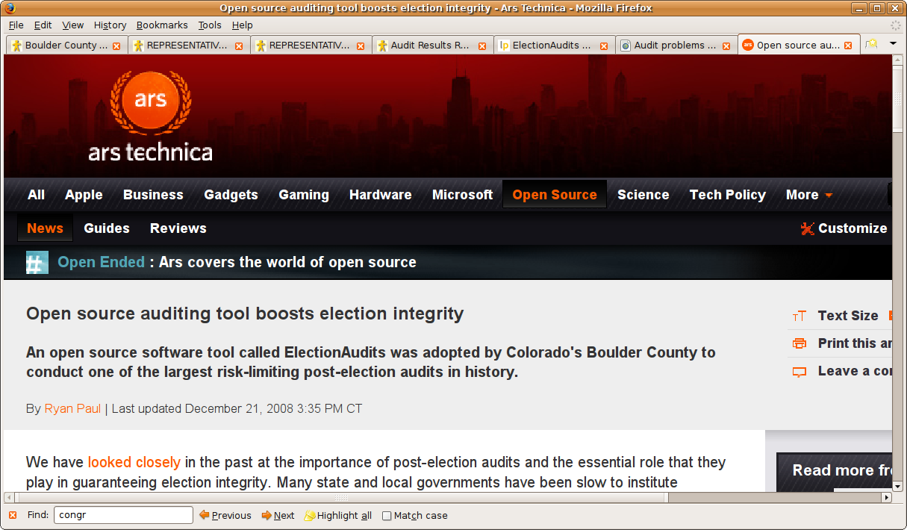

Slide 4
Share the story, share the code, and get you all involved where you live.

Slide 5
Questions
Clarifications? Anytime
“But what about...”? At the end

Slide 6
Why audit?

Slide 7
Elections can inspire us!
South Africa 1994
Paper ballots, hand counted

Slide 8
Or serve as a warning
Iran 2009

Slide 9
US problems with elections: black box voting systems

Slide 10
Not just a problem with touch screen devices (DRE)‏

Slide 11
Humboldt County 2008
Paper ballots, optical scan
197 ballots deleted by Diebold/Premier
Without a trace

Slide 12
Certified....

Slide 13
Discovered later by Humboldt County Election Transparency Project audit
“Ballot Browser”
(also open source Python code)
Kudos to Mitch Trachtenberg, brave Registrar of Elections Carolyn Cernich, and colleagues

Slide 14
Surprise!
Computers make mistakes
Sometimes whoppers!

Slide 15
Growing movement to require paper ballots
Not doing well at looking at them....
Not often required or well done

Slide 16
Goal: software independence
(Rivest & Wack) via auditable paper records, good audits

Slide 17
Open Source voting systems
Important!

Slide 18
Good audits and clean chain of custody
Necessary

Slide 19
Election Quality
FSF
Statue of liberty with floppy disk in her hand

Slide 20
Election Integrity
Computer Scientists for Social Responsibility
Question Technology

Slide 21
Boris Bazhanov's Memoirs of Stalin's Former Secretary - quote from Stalin
Loosely translated:
"I consider it completely unimportant who in the party will vote, or how; but what is extraordinarily important is this — who will count the votes, and how."

Slide 22
But what is an audit anyway?

Slide 23
Compare system's reported results with the evidence
Take sample of detailed results by batch and compare to hand counts of those batches

Slide 24
Auditing steps`
Produce report by audit unit (precinct or batch)‏
Reconcile number of ballots in each unit
Randomly select audit units to audit
Count audit units by hand
Compare results
Escalate audit if statistical evidence isn't good enough

Slide 25
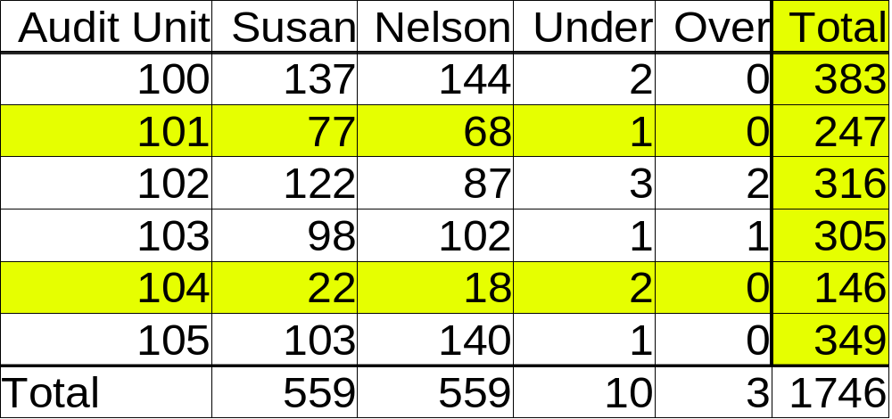
Report of Vote Counts by Audit Unit

Slide 26
Optical scanners arrived
Era of trusting computers too much
Few audits

Slide 27
Audit DREs without voter verified paper trail?
Can't do it....
Pushback – Can't Trust Computers!

Slide 28
“But we're doing audits”

Slide 29
Announcing “random selection” before results come out

Slide 30
Using software to select random numbers
No more software independence....

Slide 31
Wasting time auditing contests with a single candidate

Slide 32
Reports are by precinct
But often piles of paper aren't
- Mail in
- Early voting
- Provisional

Slide 33
Colorado rescans and recounts just the selected batches of mail-in ballots
Not an audit
Just a tiny post-election test that is unrelated to the actual election results

Slide 34
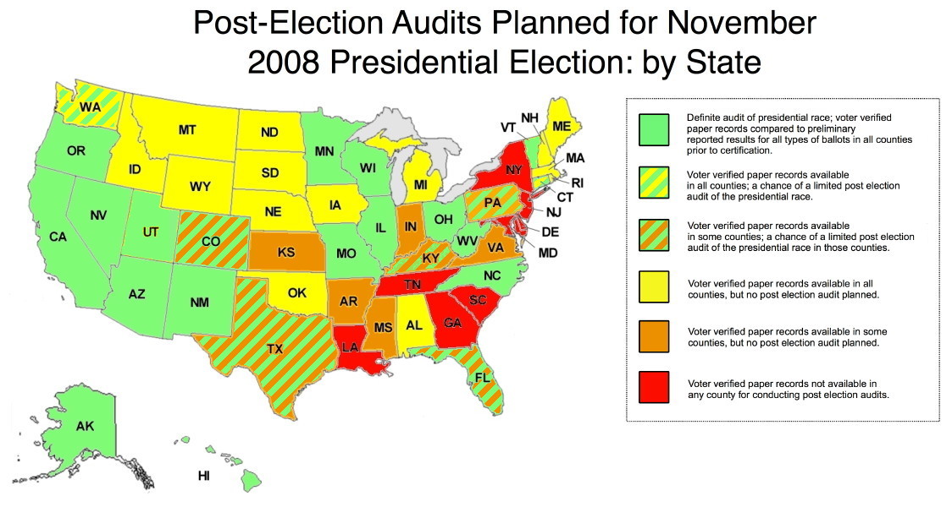

Slide 35
But no state yet does an efficient, “best practices” audit

Slide 36
Principles and Best Practices for
Post-Election Audits (2008) http://electionaudits.org/principles
League of Women Voters
Election Audit Report (2009)‏

Slide 37
Fixed percentage vs Risk-limiting audits

Slide 38
Fixed percentage:
Wasteful focus on landslide contests
Little confidence for tight contests

Slide 39
Significance of the results driven by how many batches you audit, not how many ballots you count
Looking for incorrect vote counts
Don't care about total vote count for the sample

Slide 40
20 samples out of 1000 batches much better than
2 samples out of 100 batches (2%) and easier than
20 samples out of 100 batches
More samples = more statistical significance
More audit units = smaller samples, less counting

Slide 41
“Risk-limiting” audit chooses more audit units when margin of victory is small
Has a pre-specified minimum chance of requiring a full hand count whenever the apparent outcome of the contest is wrong

Slide 42
Trying to audit in Boulder since 2002
Obstacles, cluelessness, politics

Slide 43
Elect new Clerk, Hillary Hall
3 good audits in 2008
The hard part - getting good data

Slide 44
Hart InterCivic system
Precinct reports
But only 15% cast in precinct
70% mail-in, 15% early voting

Slide 45
Solution: run cumulative report 500 times
Once for each batch
Subtract each report from the previous report to get batch sub-totals

Slide 46
Like snapshots of election-night reporting through the night
But we want lots of them....

Slide 47
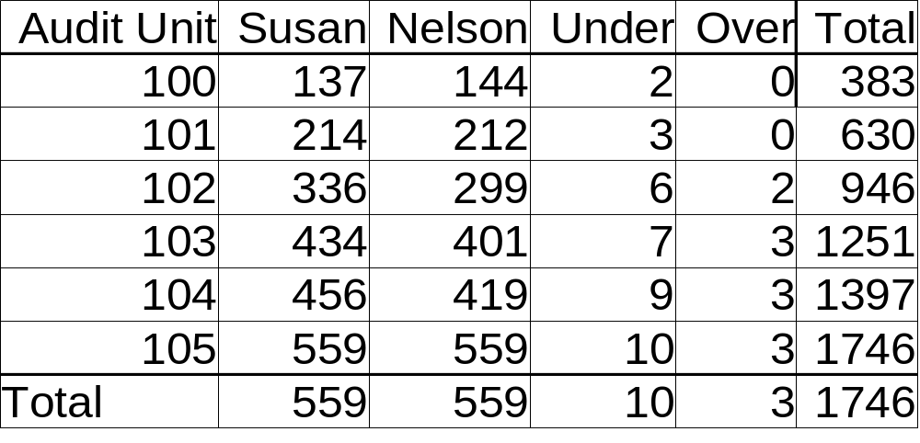
Report of Cumulative Vote Counts by Audit Unit

Slide 48
Report of Vote Counts by Audit Unit

Slide 49
ElectionAudits supports the Best Practices
Automates many steps of the audit
Enter the data, publish with statistics
Roll 15 dice, publish all the selections
To do: automate discrepancies, escalation

Slide 50
Time to look at some real data
In a real audit
ElectionAudits in action!
One of the first and most extensive
Best Practices audits

Slide 51
Features of ElectionAudits
Imports standard election report files
Produces auditable reports for the public.
Protects voter anonymity by merging small audit units
Doesn't require that paper ballots be sorted into piles by precinct
Can produce batch reports from sequence of cumulative reports
Facilitates risk-limiting audits
Verifiably pseudo-random dice + "Sum of Square Roots"

Slide 52
Future Plans
Add Stark's proper statistical methods for risk-limiting audits: deciding when discrepancies require escalation
Automate more steps
Support more vendors: Sequoia, etc.
Read and write Election Markup Language data
Hopefully use it in Denver and elsewhere in 2009
Hopefully use it for Colorado's audit pilots in 2010

Slide 53
Selecting batches to audit
Rivest's “Negexp”
Probability proportional to size

Slide 54
Rivest's Sum of Square Roots pseudo random number generator
Public can verify unpredictability of selections

Slide 55
Django
Python
SQLite lxml

Slide 56
Rivest's varsize.py

Slide 57
Ubuntu Linux
Windows
Mac OS X? etc.

Slide 58
MIT license

Slide 59
Hosted at Launchpad
RSS feed of announcements
Bug tracking
Team mailing list
Bzr
Blueprints that I can mentor

Slide 60
Tip:
Django's Debug_toolbar for great debugging over the web

Slide 61
Help wanted!

Slide 62
Web presentation: css, layout

Slide 63
Logo

Slide 64
XML expertise, e.g. for reading and writing (and improving) Election Markup Language

Slide 65
Database design (pretty simple!)‏

Slide 66
Django/python insights

Slide 67
Implement features

Slide 68
Windows testing, installation, eggs and Django, etc

Slide 69
Ask for 2008 precinct data in your county
Send it to me!
Try to parse it
Audit 2009 election

Slide 70
Help getting auditing laws passed

Slide 71
Biggest challenge: getting useful data out of election systems

Slide 72
We're experts in interplay between security, privacy, transparency, and freedom
Remember Christine Peterson's challenge - pitch in!

Slide 73
Many thanks to Philip Stark, John McCarthy, Mark Lindeman, Mark Halvorson, Ron Rivest, Crystal Christman, Hillary Hall, Aaron D. Gerber, Mary Eberle, Holly Lewis, and the many other colleagues and friends that helped.

Slide 74
1:45 today: Open Source and Democracy - Creating transparent, trustworthy voting systems
5:20 today: Hacking the Open Government
Sunlight Labs Hackathon 9-5 Tue-Thu, Room N

Slide 75
Code is Law
Write our own procedures into practice by providing the code!
Gov 2.0
DIY => DIO

Slide 76
Remember
Must look at our ballots!
Audits not done much, or right
Open Source audits seen in the wild!
Lots of room to improve
Open Source folks have great insights
Please help out!
http://launchpad.net/electionaudits

