Slide 1
Leveraging LDP for High-Trust OpenSearch UBI
Tuning search when you can't store the queries
Jeff Zemerick
OpenSearchCon NA
September 24, 2026
Notes:
Open by naming the tension. We need behavioural data to tune relevance, and we are increasingly not allowed to keep it. This talk is about doing both.

Slide 2
About me
- Independent consultant at Mountain Fog
- OpenSearch UBI and opensearch-migrations maintainer
- Apache Software Foundation member, OpenNLP PMC Chair
- Works in search, NLP, and privacy
jeffzemerick.dev
2
Notes:
Keep this to about 30 seconds. The redaction work is no longer a bullet but is still worth saying out loud, because it is why the privacy problem is familiar rather than academic. The UBI maintainership is why the OpenSearch half is credible. Do not read the list.

Slide 3
PART 1
The problem
3
Notes:
About 8 minutes. Goal is that everyone understands the problem before any code appears.

Slide 4
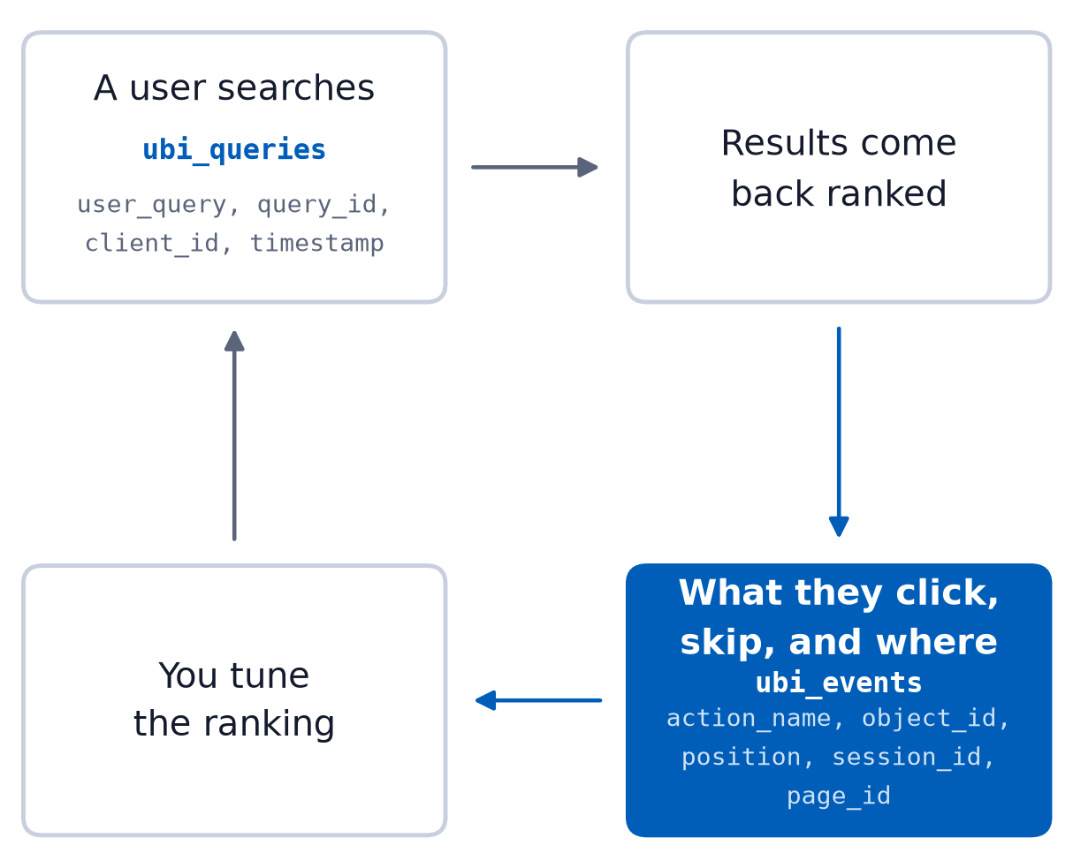
To tune search you have to see what users do
- Relevance is measured
- What queries, what's clicked, and where
- Without measurement you are guessing
- Learning-to-rank can't be trained on guesses
4
Notes:
Establish that behavioural data is not a nice-to-have. It is the input to the entire discipline. Everything after this depends on the audience accepting that.

Slide 5
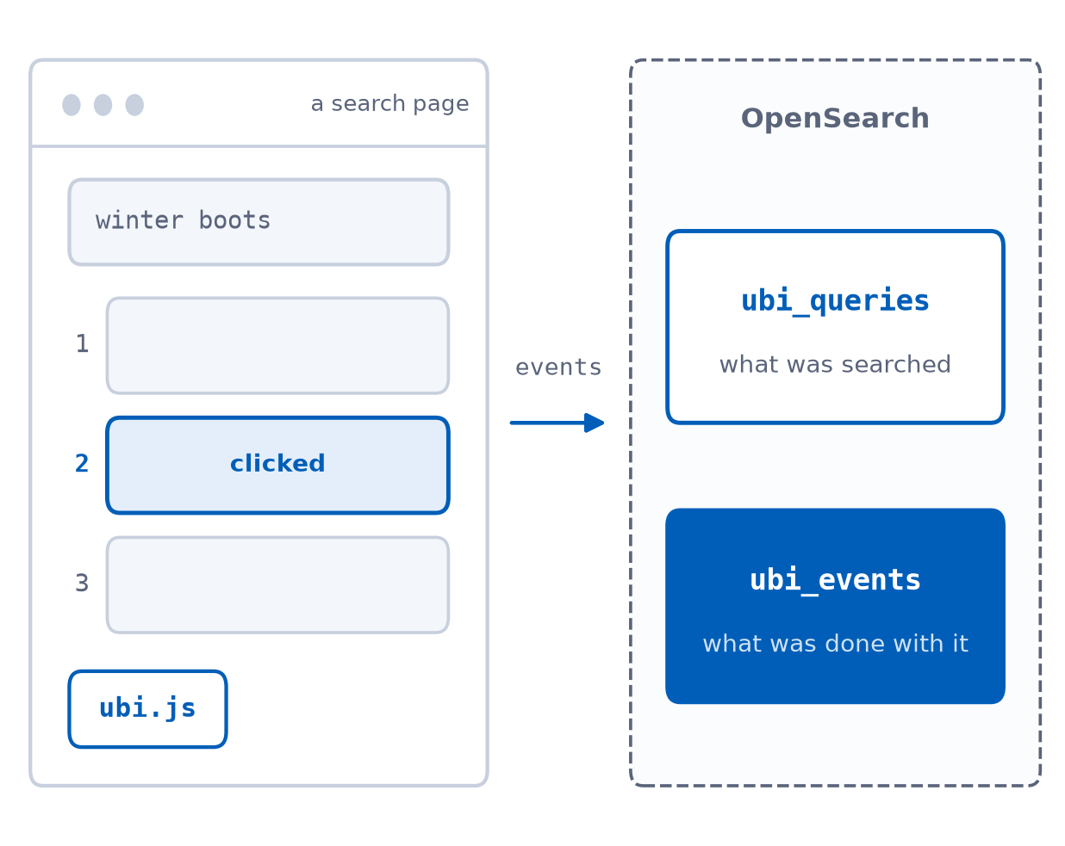
OpenSearch UBI exists for this
- ubi_queries: user_query, query_id, client_id, timestamp
- ubi_events: action_name, object_id, position, session_id, page_id
- ubi.js collects interactions in the browser and ships them to the cluster
- This is what we use to tune search
For examples and code, go to ubisearch.dev
5
Notes:
Keep this factual and quick. The audience needs the field names because the next slide points at three of them specifically.

Slide 6
But what about when we don't know the user queries?
- user_query is free text and can contain anything
- Telling users not to enter PII or PHI does not stop them
- client_id and session_id make it linkable across time
- Zero-trust becomes a blocker to relevance tuning
- This applies to any behavioral data, not just search tuning
6
Notes:
Be specific. Legal does not object to 'search data' in the abstract. They object to these fields. Naming them makes the rest of the talk concrete. Know which half you are about to solve: everything after this addresses user_query. The identifiers are dealt with on the limitations slide, so do not imply here that they go away too.

Slide 7
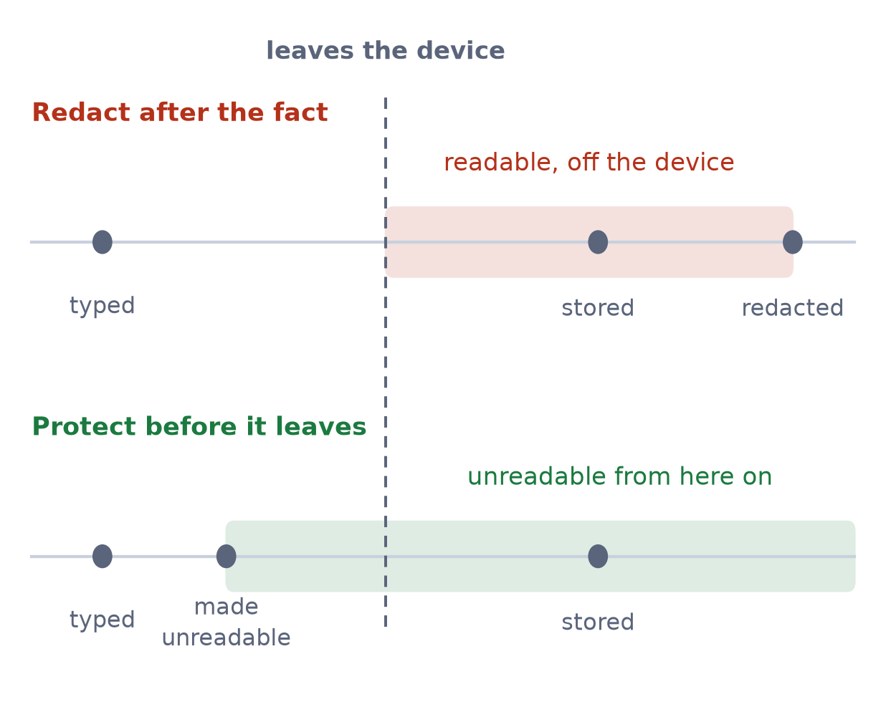
Redaction is reactive and sometimes too late
- You collect the PII first, then try to remove it
- Leaked PII is discovered later
- A free-text query has no schema to redact against
- The fix has to be that the sensitive value never leaves the device readable
Still need to redact data at rest? philterd.ai
7
Notes:
This is the 'move away from reactive data scrubbing' promise from the abstract. Say plainly that you build redaction tooling and that it is the right tool for documents at rest. That makes this a statement about ordering rather than a swipe at a technique, and it preempts the obvious 'what about redaction' question. Land it as a shape-of-solution argument, not a tooling argument.

Slide 8
PART 2
Embeddings are not anonymization
8
Notes:
About 5 minutes. This exists to kill the objection half the room is already forming.

Slide 9
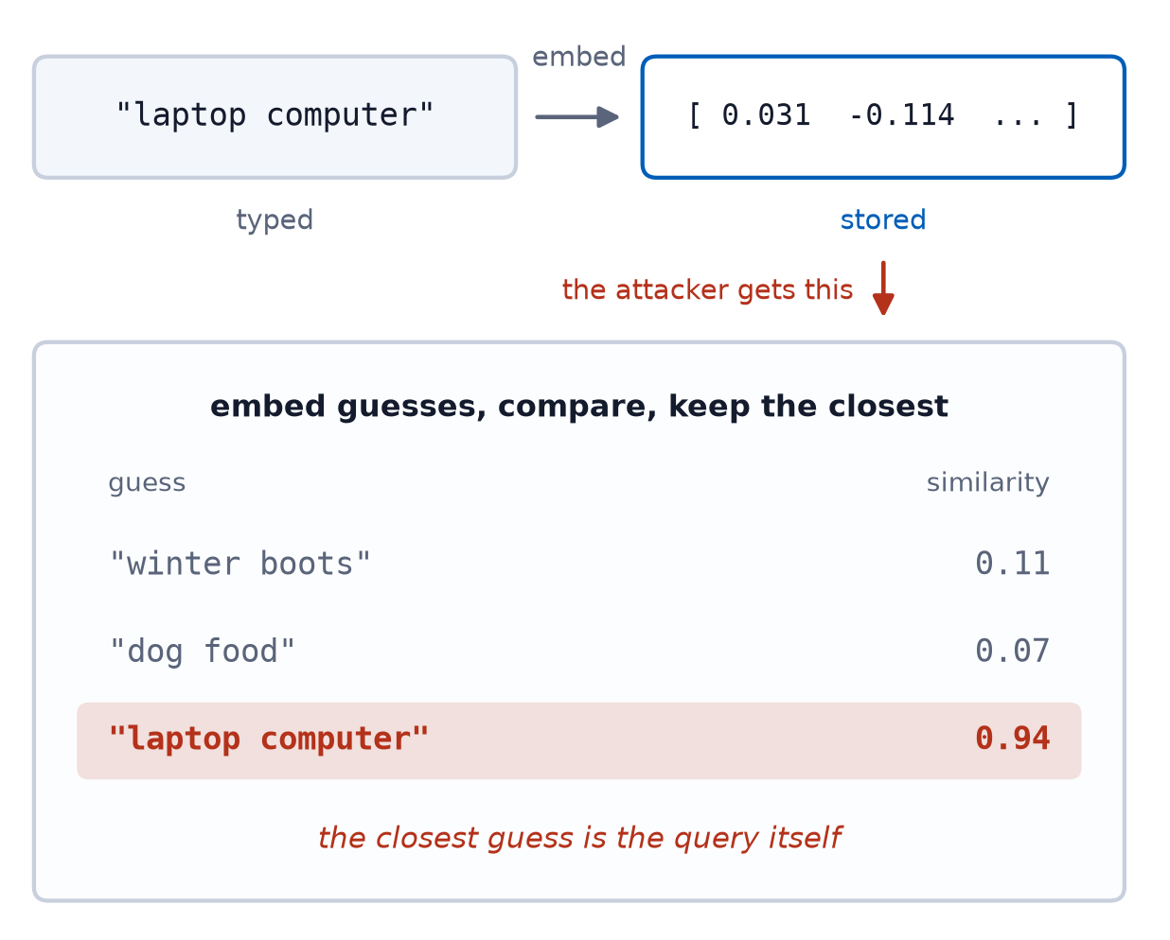
The obvious first idea
- "We will not store the text. We will store the embedding."
- It's numbers, not words
- It is not private, just a lossy encoding
- Intent can be recovered
Morris et al., Text Embeddings Reveal (Almost) As Much As Text: arxiv.org/abs/2310.06816
9
Notes:
Say the objection out loud in the audience's voice before you refute it. If you skip this, a good chunk of the room thinks the problem is already solved.

Slide 10
The same attack on both vectors
The attacker looks up the nearest documents to whatever vector they intercepted
Attacker intercepts | Their best guess | Distance
The raw vector | Laptop | 0.2092
The noised vector | Gaming Console | 4.8870
Query "laptop computer" at epsilon 1.2, from notebook section 9
10
Notes:
Notebook section 9, run beforehand rather than live. Read the 20 documents aloud first, they fit in one breath, so the room can hold the whole index in their heads. Then let the top row speak: the raw vector hands over the intent. Do not rush this, it is the hinge of the talk. The distance column is the part people miss, so point at it. The noised vector is not merely wrong, it is 4.9 away from everything, so which document wins is close to arbitrary. The number to have ready if someone wants it: its top five candidates all sit within 0.15 of each other, while real documents in this index are at least 0.89 apart, so the ranking is a tie rather than a wrong answer. Two things to be straight about if asked. This is a nearest-neighbour lookup against the index rather than literal text inversion, which is a weaker attacker than the Morris paper on the previous slide assumes, and it still succeeds. And epsilon 1.2 is the rigged setting the epsilon sweep later confesses to.

Slide 11
The raw vector gives up the intent
- Query: "laptop computer"
- Attacker inverts the raw vector, top hit: Laptop
- Intent was leaked even though no text was stored
- Storing embeddings is not a privacy control
11
Notes:
This is the result the rest of the talk builds on. Pause here.

Slide 12
PART 3
The fix: Local Differential Privacy
12
Notes:
The longest part by far, about 25 minutes, because it carries the mechanism, the evidence, the cost and the payoff. Three evidence slides in order of strength, the distribution audit, then the epsilon comparison, then the attacker. Then what the noise costs, then what survives it. No divider marks the payoff any more, so the turn from the epsilon sweep to the asymmetry slide is yours to make out loud.

Slide 13
Two places to add the noise
Differential privacy comes in two shapes, and the difference is who you trust
 | Central DP | Local DP
Noise is added | After collection | On the device
Who sees the raw data | A trusted curator | No one
Who uses it | The 2020 US Census | Apple emoji trends
The Census Bureau sees every raw response, then noises what it publishes.
Apple never sees your emoji, only a noised count from every phone.
Apple, Learning with Privacy at Scale, 2017: machinelearning.apple.com
13
Notes:
Give the technique a reference point before defining it. Most of the room has heard that the 2020 US Census used differential privacy, and that is the central flavour: the Bureau collects every raw response, holds it, and adds noise to the tables it publishes. The guarantee is about what leaves the building. That works because there is a curator everyone is willing to trust, backed by law. Part 1 was the argument that we do not have one. Legal will not let the cluster hold readable queries, so the noise has to go in before anything is sent, which is the local flavour. Be honest about the price, because it is the whole reason central DP exists: noising one aggregate needs far less noise than noising every record, so central DP is much more accurate at the same epsilon. Everything after this slide is the cost of removing the curator, and whether the numbers still work. Apple and Google are the credibility point if anyone thinks local DP is academic. Apple has shipped it on iOS for years to learn which emoji and which QuickType suggestions are popular, and Google ships RAPPOR in Chrome. The emoji case is worth spelling out, because it is our problem exactly: they learn which emoji are trending across everyone without learning which emoji you sent. Swap emoji for queries and that is this talk.

Slide 14
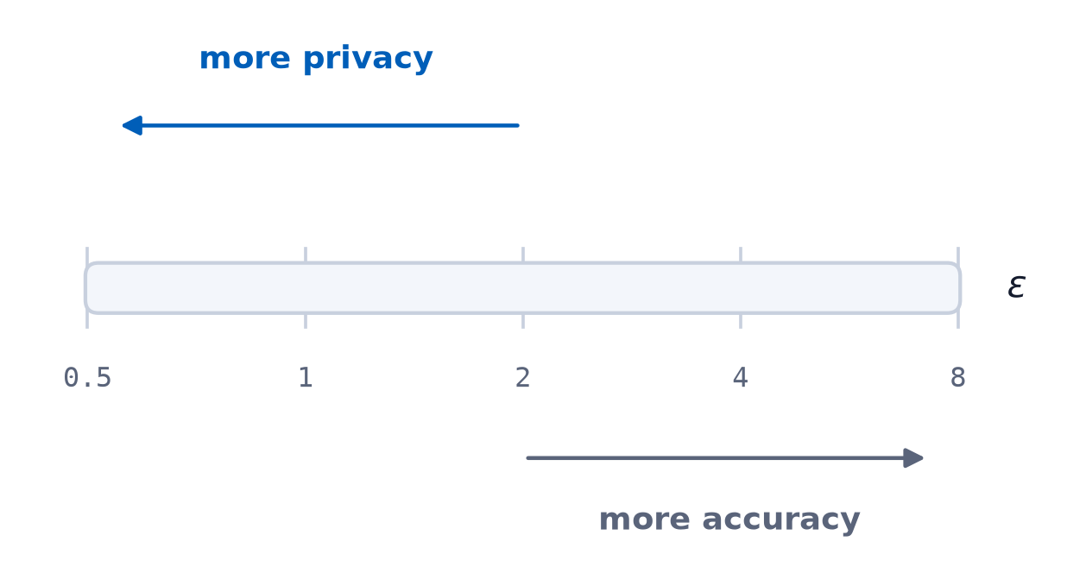
Local Differential Privacy
- The vector was never the problem, storing it readable was
- Add calibrated noise to the query vector on the device
- Epsilon is the dial, and lower epsilon means more noise and more privacy
- The user's query is not stored so there is nothing to redact
More on local differential privacy: en.wikipedia.org/wiki/Local_differential_privacy
14
Notes:
One slide only. Resist the urge to teach differential privacy properly, there is not time and it is not the point of the talk. The noise is Laplace, but the word appears on no slide, so leave it out unless asked. The shape on the next slide explains it. If someone asks here, one sentence: symmetric noise, equally likely to push the value up or down, centered on the truth. The formula is deliberately off the slide. If someone asks, the noise scale is sensitivity over epsilon, and sensitivity here is 1.0 per coordinate on vectors whose whole norm is 1, which is conservative rather than tight. The notes file has the longer answer. Do not volunteer the word, it is the only term in the deck with no definition behind it.

Slide 15
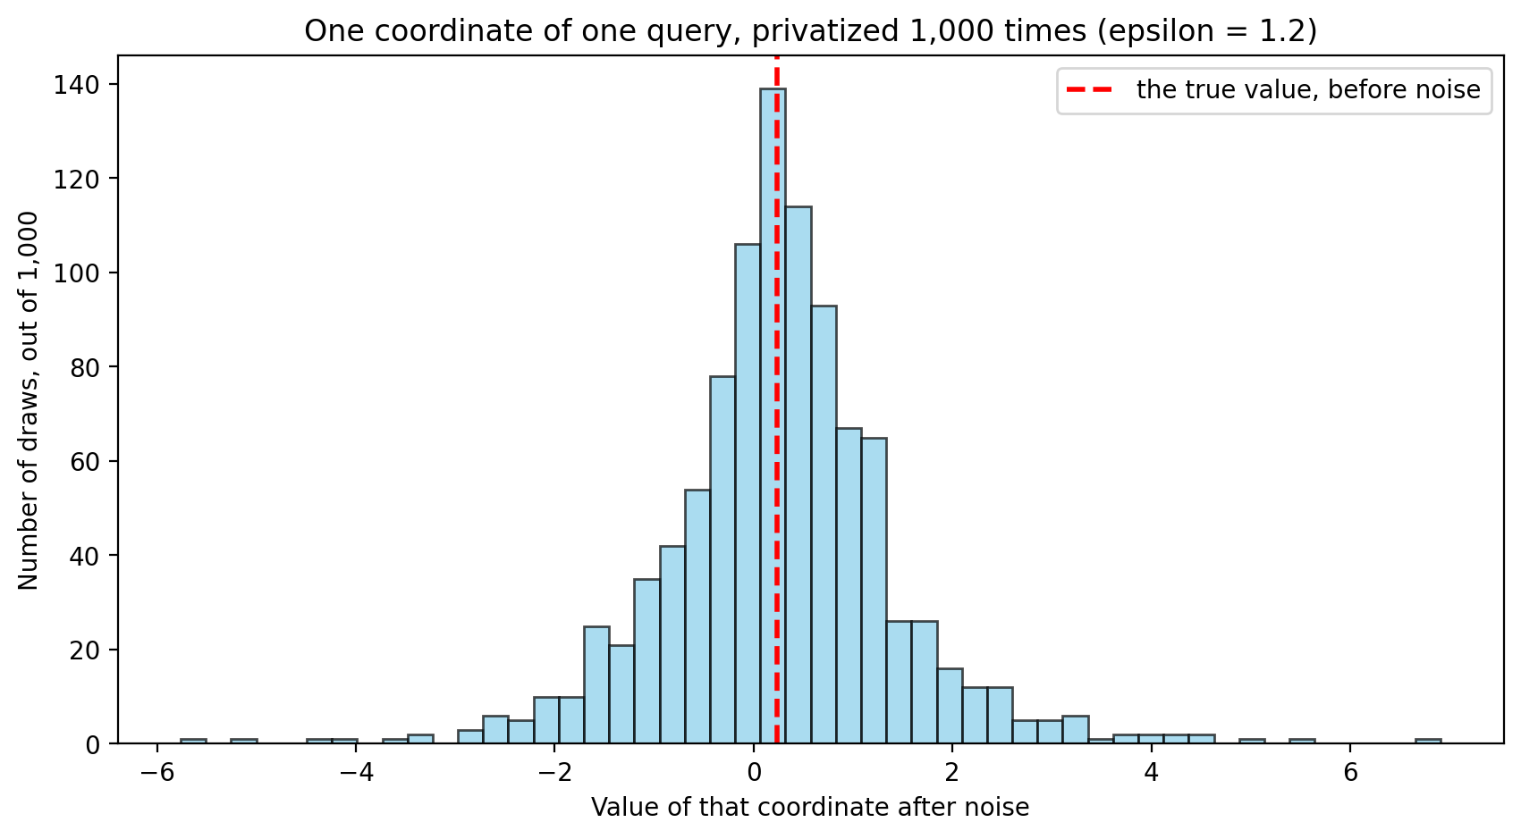
Verification 1: the noise
A biased mechanism would put the peak off the red line, and the spread is the privacy.
15
Notes:
This is the distributional check. It proves the mechanism is implemented correctly. It does not prove an attacker fails, which is why the attacker slide two on exists. Say what the thousand is, because the title does not: one query, one coordinate of its vector, and a thousand independent noise draws on that same true value. You cannot audit a random mechanism from one sample, so you repeat it until the shape shows. Then head off the objection someone in the room is already forming. Yes, averaging those thousand draws recovers the true value, which is exactly what the peak landing on the red line shows. That is the auditor's view rather than a usage pattern: a query is privatized once, on submit. The moment one person emits the same query a thousand times, an attacker can average it back, which is why the appendix says privatize on submit and never per keystroke. It is the asymmetry the payoff rests on, pointed the other way. Many draws from one person breaks privacy, one draw each from many people preserves it.

Slide 16
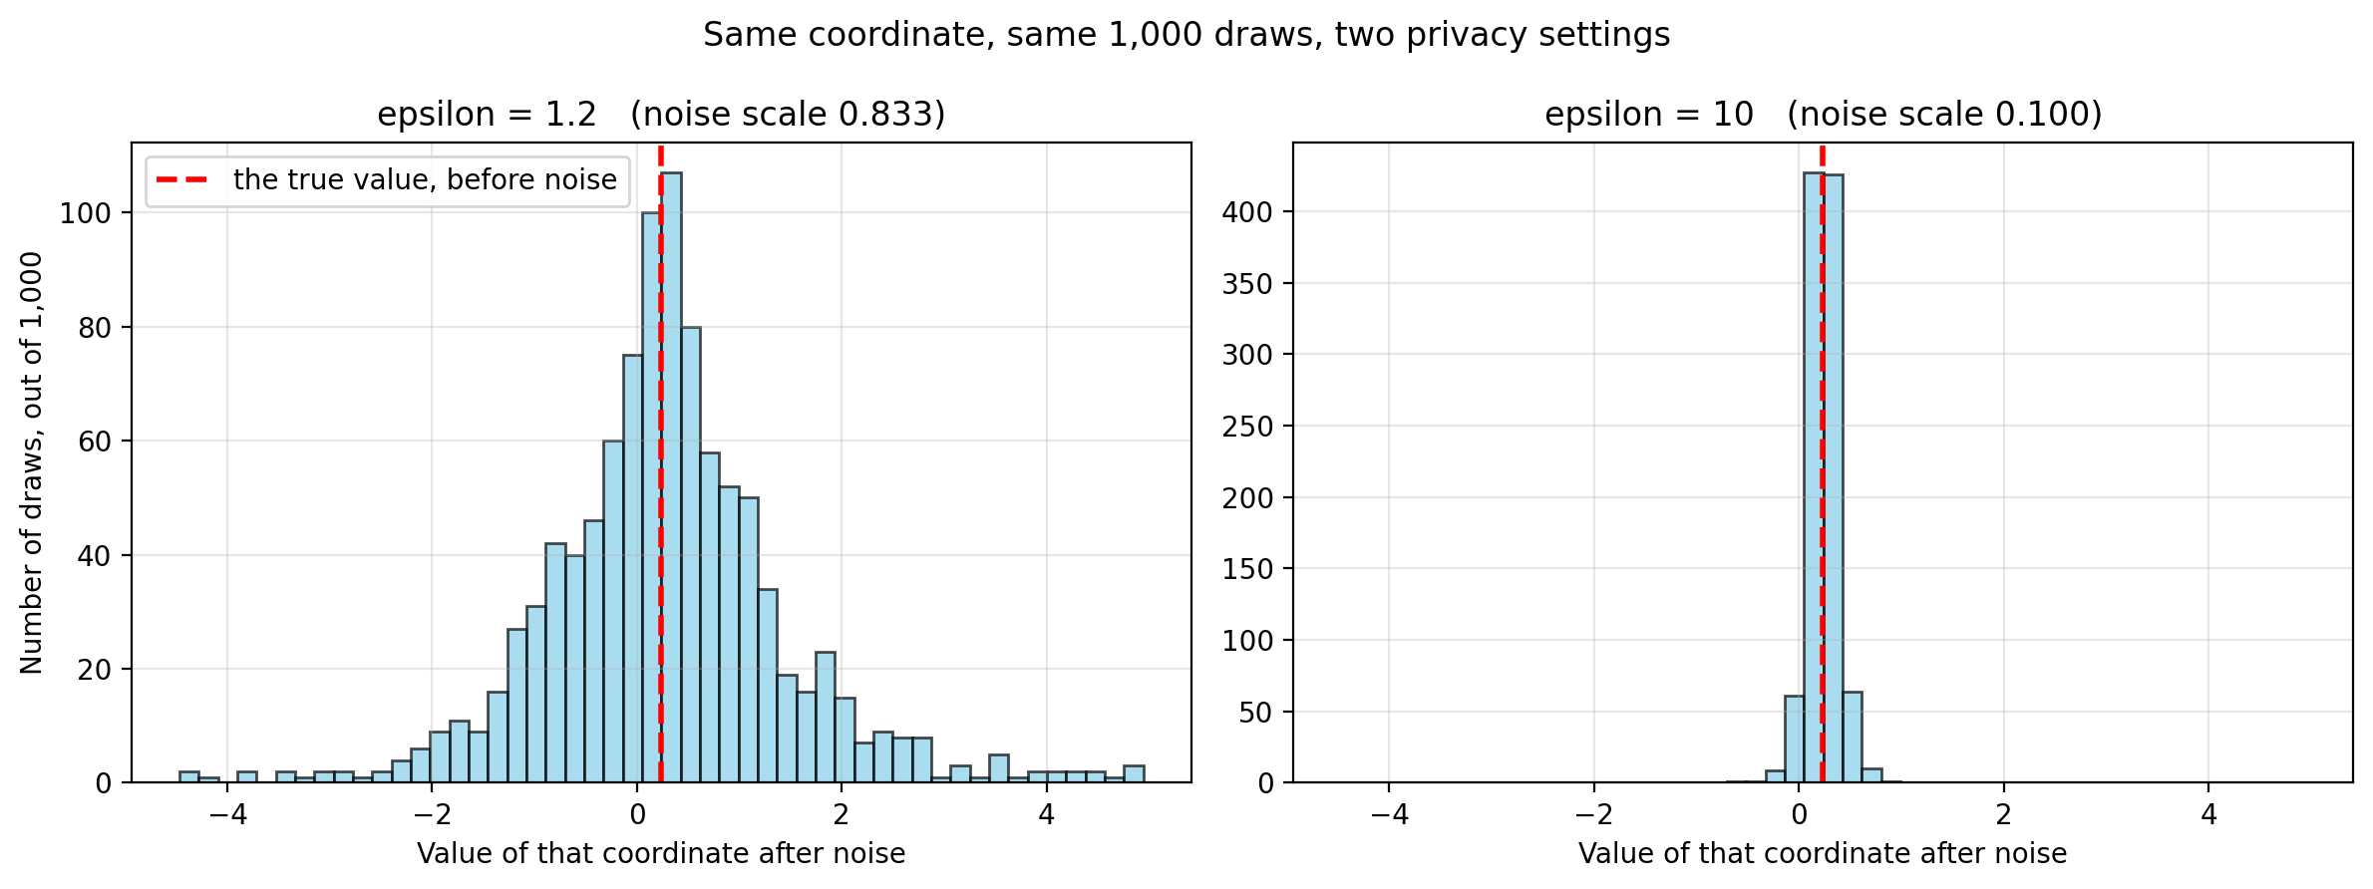
A higher epsilon is a narrower spread
Both panels share one x axis. At epsilon 10 almost every draw lands on the red line.
16
Notes:
The dial, made visible. Same query, same coordinate, same thousand draws. Only epsilon differs. The scale is one over epsilon, so 1.2 gives 0.833 and 10 gives 0.100, about eight times narrower. Say why the shared x axis matters: let each panel scale itself and they look identical, which is the opposite of the point. Then land both halves of the trade. At epsilon 10 the noise is finally smaller than the index itself, 0.141 against a coordinate spread of 0.171, which is why the epsilon sweep later shows utility jumping from 0.72 to 0.98 between epsilon 5 and 10. And that is also the cost: a spread this narrow means someone reading a single sample is reading the true value. There is no setting that is private and accurate for one query, which is what the payoff slides exist to answer.

Slide 17
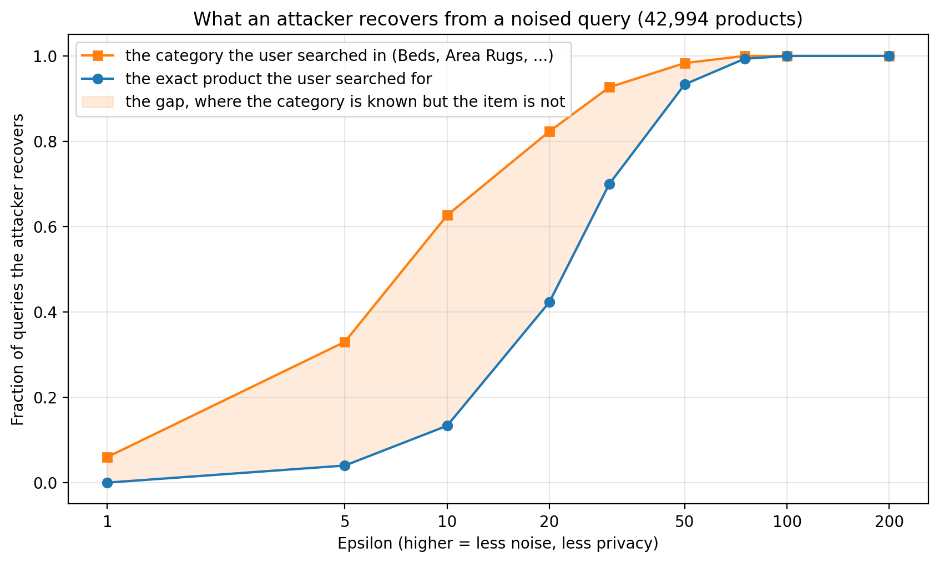
Verification 2: measure an actual attacker
The category leaks well before the item does.
17
Data: WANDS, Wayfair product search relevance (ECIR 2022), MIT licensed: github.com/wayfair/WANDS
Notes:
Stronger evidence than the histogram, because it measures an adversary rather than a distribution. This discharges the 'verify, do not hope' promise in the abstract. Head off the obvious confusion: the previous slide used epsilon 1.2 and this axis runs to 200. Epsilon is not portable between indexes, because what matters is the noise scale relative to the spread of the coordinates, and that spread differs between the 20-document PCA and this 43,000-document one. On the baselines: the query is 'solid wood platform bed', whose class Beds holds 1,112 of the 42,994 products, so class chance is 2.6 percent and item chance 0.002 percent. Class recovery of 6 percent at epsilon 1 is low but not nothing. Do not oversell the item curve either: 13 percent at epsilon 10 is still about 5,600 times chance, so the claim is that the category leaks first, not that the item is safe. This is where the limitations slide gets its first bullet, so it lands later as a callback rather than a new admission.

Slide 18
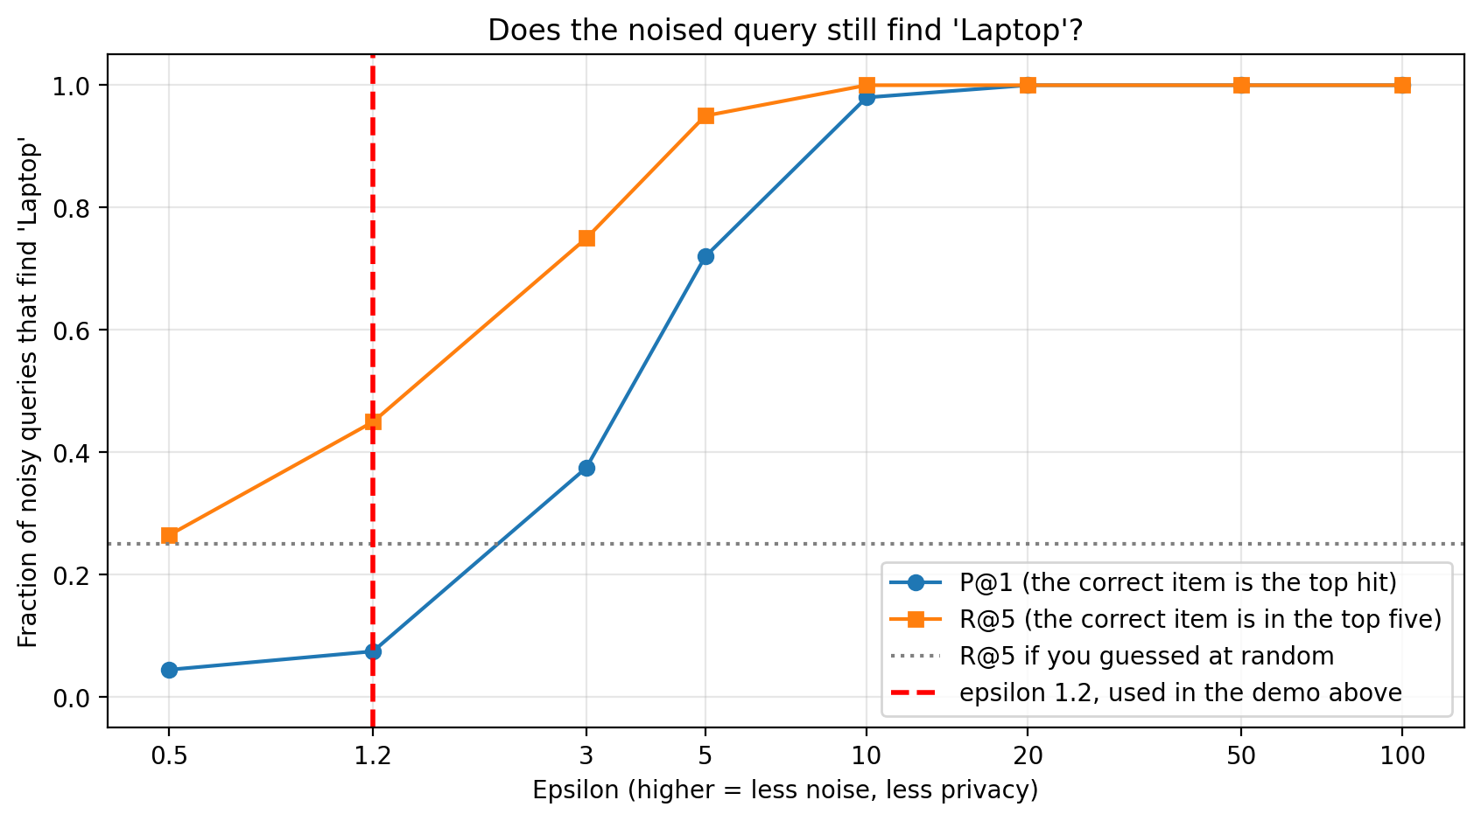
Epsilon 1.2 is barely better than guessing
The red line is where the Part 2 demo ran. Utility only comes back where the attacker wins too.
18
Notes:
Volunteer the confession here, because no slide makes it for you any more. That demo back in Part 2 was rigged: epsilon 1.2 on a twenty document index, where the attacker learned nothing and neither did the user. Say it yourself. If it comes out in Q&A instead, the talk loses, and volunteering it is what makes the payoff believable. Go to the red line first and stay there. That is the demo from Part 2, with the top hit correct 7 percent of the time against a 5 percent baseline, and the top five 45 against 25. Barely above guessing. Then sweep right to make the second point, that utility only returns as epsilon rises, and by then the attacker is reading the query too. Note the curves rise here where slide 17's rose for the attacker, so up means the search still works. Exact values if asked: at epsilon 1.2, P@1 0.07 and R@5 0.45; at 3, 0.38 and 0.75; at 5, 0.72 and 0.95; at 10, 0.98 and 1.00. Resist calling epsilon 3 to 5 a usable window. P@1 of 0.38 is eight times chance, so the attacker is already doing well there. The honest version of that argument needed the real index, which is the attacker curve you showed a slide ago.

Slide 19
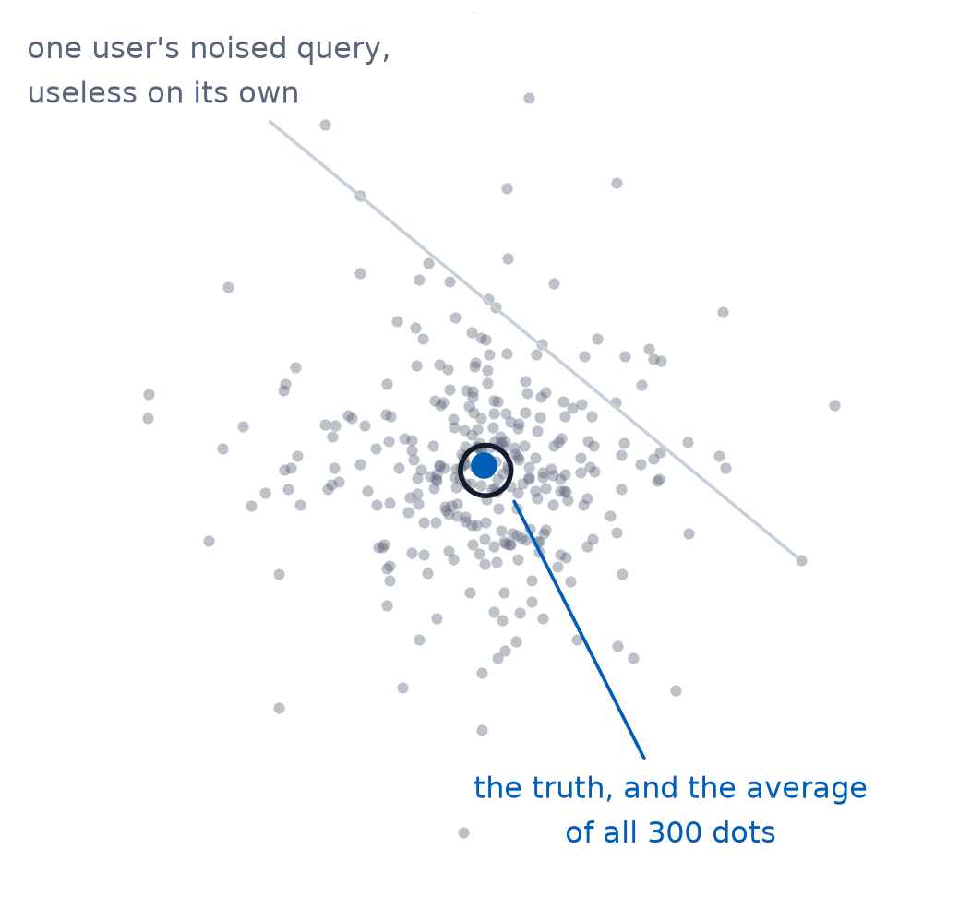
You lose the person and keep the pattern
- The noise cancels when you average over many users
- One person's query is unrecoverable
- The trend across ten thousand people is not
- That trend is all UBI needs to tune relevance
19
Notes:
This is the conceptual core of the talk. Everything before it was setup. LDP is not a privacy tax, it is a trade of individual resolution for population accuracy.

Slide 20
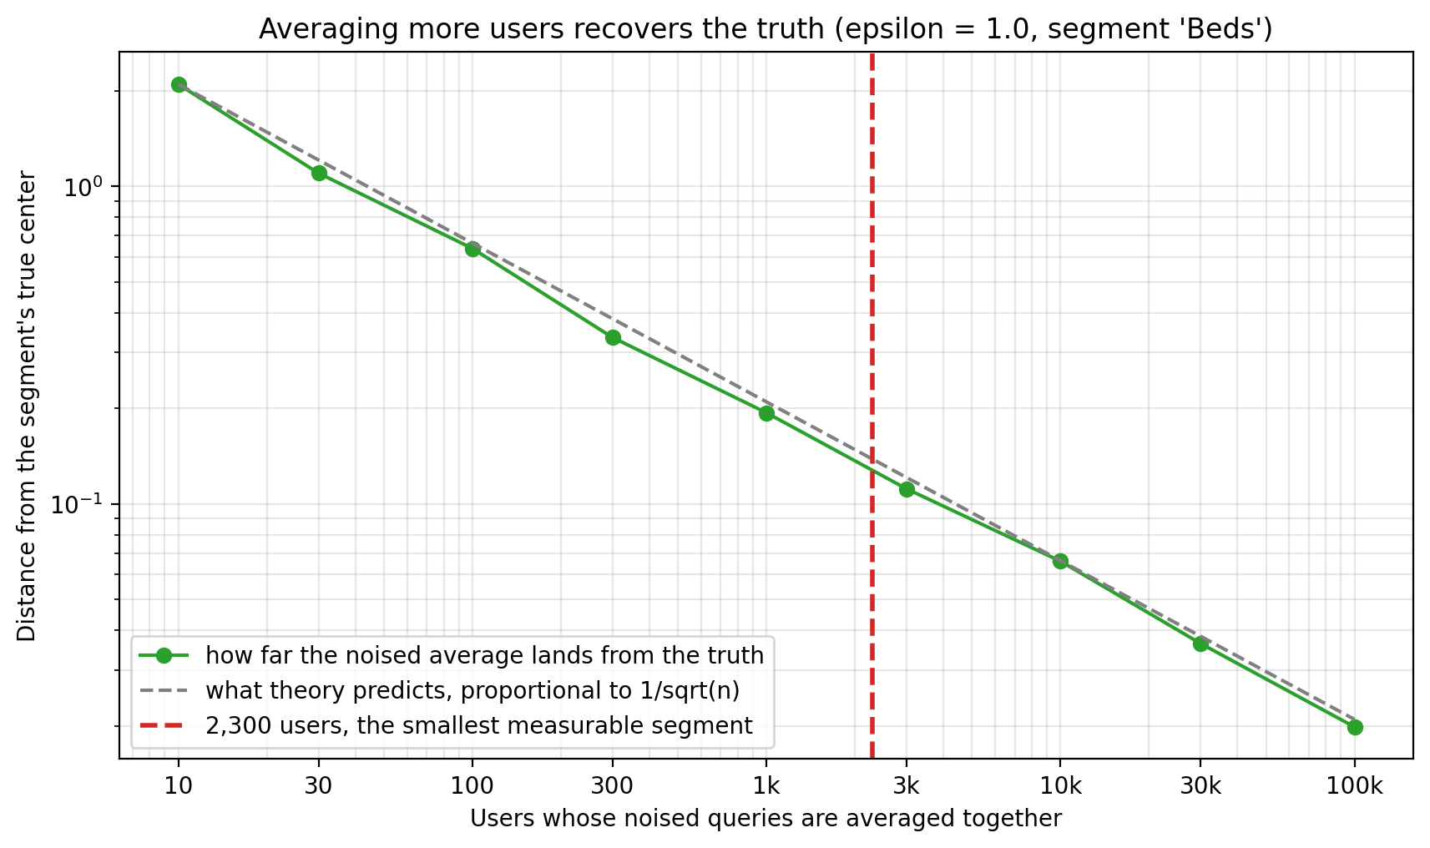
Error falls as 1 / sqrt(users)
Average the noised queries of n users in one segment, then see how far that average lands from the truth.
The red line is the smallest segment you can measure.
20
Notes:
The centerpiece, and now the only place section 11's result appears, so open with it. 480 real WANDS queries in five segments, every user privatizing independently on their own device, no readable query anywhere and no trusted intermediate step. Individual recovery per segment runs 0.020, 0.020, 0.063, 0.070 and 0.030 against chance of 0.014 to 0.031, roughly one to two and a half times chance, which is not usable. Segment identification is 5 of 5, exact. Same data, same epsilon of 1.0, two different questions. Then the plot. Take the shape first. More users, less error. The measured green line tracks the predicted grey one across four orders of magnitude. This is ordinary statistics, so say so: averaging n independent things shrinks the noise as one over root n, the same reason a poll of four thousand beats one of one thousand. Nothing here is special to privacy. Then the red line. Read it off the bottom axis: 2,300 users. That is the answer, and it is the next slide. If asked where 2,300 comes from, it is where the measured error drops under 0.128, the average spread of one coordinate across the index. That bar is strict on purpose. Two typical products sit about 0.82 apart, so the line is roughly six times stricter than just telling products apart.

Slide 21
How big a segment has to be
- Error drops below the spread of the index at roughly 2,300 users
- That is at epsilon 1, and halving epsilon needs four times the users
- Segments with thousands of users are measurable under LDP
- Segments with dozens are not measurable
- Your head terms work, but your long tail does not
21
Notes:
Give the audience one operational number they can apply on Monday. This is it. The 2,300 is where the measured error crosses the spread of the index, 0.128, on the convergence plot. It is not a constant: error goes as one over epsilon times one over root n, so the threshold scales as one over epsilon squared. At epsilon 0.5 it is about 9,200 users, at epsilon 2 it is about 575.

Slide 22
So how do you pick epsilon
- Start at epsilon 1, then measure
- Pick it for the privacy you need, because utility also depends on the number of users
- Segments too small? Add users or widen them, and leave epsilon alone
22
Notes:
The question everyone is holding, answered now that they have seen the evidence for every step. Step one is the reframe: there is no epsilon that is private and accurate for one query, so stop looking for it on the tradeoff curve. Point back to the attack curve for step two, because that is how you measure what an epsilon buys on an index you actually run. Step three is the convergence plot and the previous slide. Step four is the whole talk in one line: error goes as one over epsilon times one over root n, so privacy rides on epsilon alone while accuracy has two dials, and n is the one that costs nothing. If someone wants a starting number, say epsilon 1 on an index like this one and then measure, rather than giving them a figure to carry home unexamined.

Slide 23
LDP does not cost you your analytics.
It costs you the ability to ask about one person.
23
Notes:
The reframe. Every input relevance tuning actually needs is a population statistic. Let this sit on screen for a beat before moving on.

Slide 24
PART 4
Back in OpenSearch
24
Notes:
About 7 minutes. Land the integration, then be honest about what does not work.

Slide 25
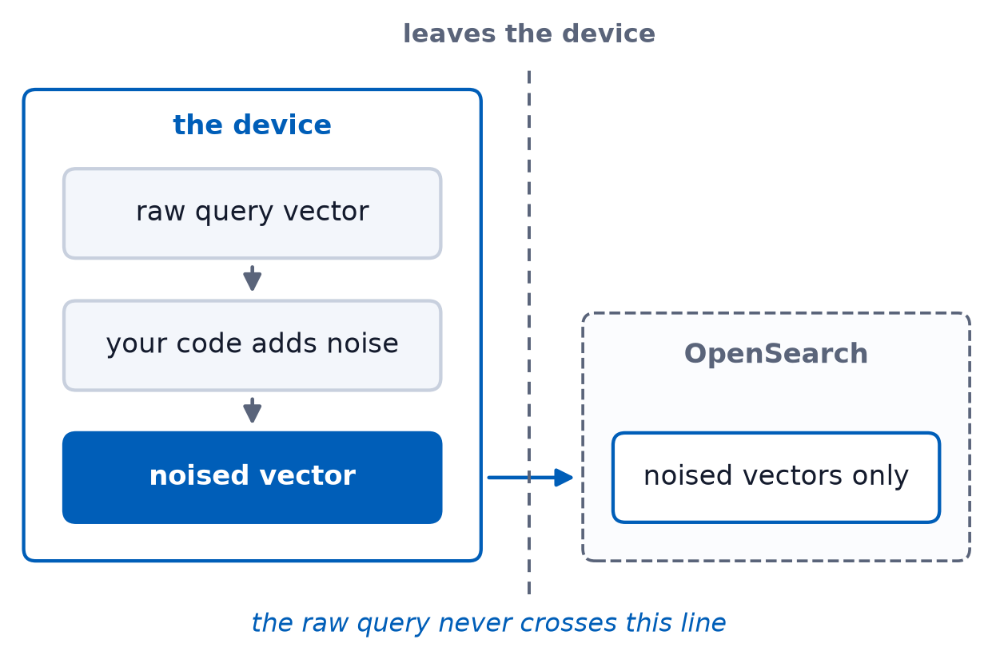
Where the noise gets injected
- On the device, before ubi.js sends the event
- Aggregation happens at query time over the noised data
- Nothing downstream needs to be trusted, because nothing downstream has the original
- You set epsilon in the client you ship
An upcoming UBI RFC will bring this capability into ubi.js
25
Notes:
Say up front that none of this is built into UBI today. ubi.js is a serializer, and the embedding, the projection and the noise are code the adopter writes and runs before handing the request to trackQuery. The notes file has the call shape and the two ways to get it wrong. The architectural payoff. The trust boundary moves to the device, which is the only place the raw query legitimately exists. The last bullet answers the obvious objection, that the people collecting the data are the ones choosing how much privacy users get. True, and the standing critique of deployed LDP. The web deployment is the answer: because the mechanism ships as JavaScript, a user, an auditor or a regulator can open devtools and check the epsilon. A server-side pipeline or a native app cannot make that claim. It turns trust us into check us, which is the same promise as the rest of the talk.

Slide 26
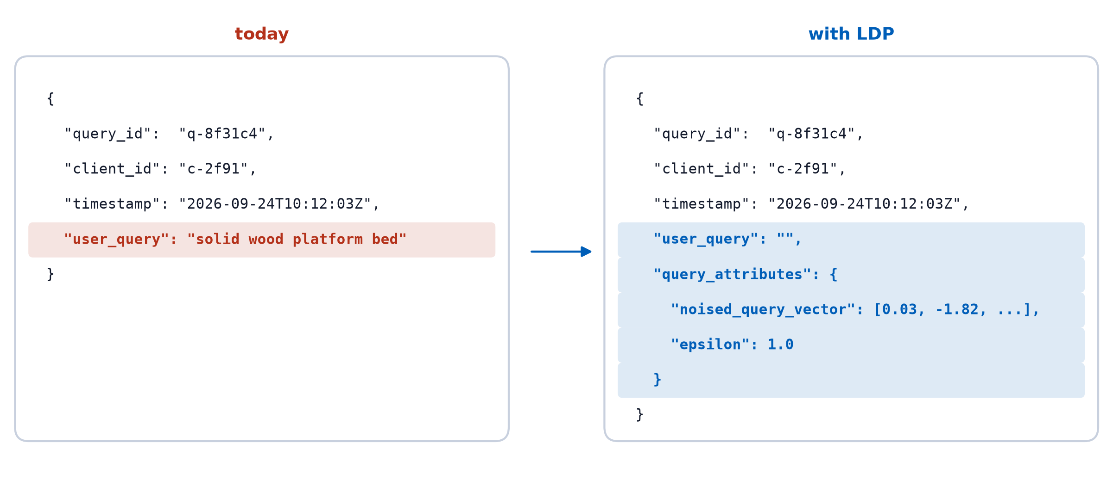
What changes in ubi_queries
UBI supports this today through query_attributes, and the RFC will propose making it first-class
26
Notes:
The integration question, answered concretely, and it needs no change to the UBI spec. query_attributes is typed as a free-form object for exactly this kind of thing, and the epsilon travels with the record so a reader knows the budget it was collected under. user_query is emptied rather than dropped because the published schema lists it as required. Worth knowing if someone asks: the schema contradicts itself there, since the field also carries a comment saying it is not required, for recommendation systems with no typed query. Two things to volunteer: the identifiers are deliberately identical on both sides, which is the limitation two slides later, and every dashboard that reads user_query breaks, which is the real migration cost. A float array in an object is not a knn_vector either, so averaging these at query time needs a scripted aggregation or an explicit vector mapping.

Slide 27
What your dashboards can still compute
- Aggregate query intent per segment
- Demand trends and shifts over time
- Segment-level training signal for learning-to-rank
- What they cannot do is show you one user's session
27
Notes:
Tie back to the abstract's promise about LTR and query-intent analysis. Then name the thing that genuinely goes away. If anyone presses on the learning-to-rank bullet, be straight: LTR judgments come from clicks, and this mechanism does not touch clicks, so that signal survives because it was never protected rather than because LDP preserved it. The next slide shows how that training actually works, and the limitations slide after it says what does not.

Slide 28
Training learning-to-rank on noised queries
The labels were never protected, so what changes is what you key them on
 | Classic LTR | Under LDP
Labels | Clicks | Clicks
Keyed on | The query | The segment
Query features | BM25 and term matches | The segment centroid
ubi_events still shows which results were clicked
Intent-based ranking profiles: for bed shoppers, boost these attributes
28
Notes:
This expands the learning-to-rank bullet on the previous slide, and it is the one place to be careful, because it is a recipe rather than a result. Nothing in this talk trains a ranker. Say so if asked. What is measured is the inputs: clicks were never touched by the mechanism, and the segment centroid is accurate above roughly 2,300 users. The labels are therefore exactly what they are today. What moves is the key. You cannot read a query, so you cannot build judgment lists per query string, and you cannot recompute BM25 against words you do not have. You group by segment instead and use its centroid as the query representation, which suits an embedding ranker and suits a term-based feature set badly. Walk the example slowly, it is the whole slide: a few thousand people search for beds, every one of them privatizes on their own device, and the server averages what arrives into a centroid that is accurate but belongs to nobody. The clicks sitting next to it were never noised. That pair, the centroid and the clicks, is a training example. Beds is the cohort behind the convergence plot, so this is the same segment they have already seen measured. Name the category honestly: this is closer to intent-based ranking profiles than to per-query learning-to-rank, and it is coarser, because every query in a segment collapses to one key. If someone asks how much that costs, say it has not been measured and that the two losses separate: keying on segments instead of queries is a modelling choice you can evaluate on clean data with no privacy involved, while the noise itself costs almost nothing above 2,300 users, which is what the convergence plot showed. Everything inherits the segment constraint from earlier: head segments train, the long tail does not reach the user count.

Slide 29
The limitations
- The category leaks and that is worse for healthcare than furniture
- Epsilon values don't transfer between indexes
- Long tail queries stay unmeasurable
- This protects user_query but ubi_events still holds clicks and ids in the clear
29
Notes:
Every one of these is a question someone will ask. Answering them first is cheaper than answering them under pressure. Also mention that a formal epsilon-DP claim needs sensitivity calibrated to the true coordinate range. Here the vectors are L2-normalized before PCA, so the whole 20-dimensional vector has norm 1, which makes sensitivity 1.0 per coordinate conservative rather than tight. That is the answer if someone asks how sensitivity was set. Two follow-ups come off that bullet. Asked how often epsilon needs re-tuning, say when you re-embed or refit PCA, because routine additions to a large index do not move the coordinate spread, and normalizing before PCA keeps sensitivity itself stable whatever the catalogue holds. Asked whether privacy decays over time, say yes but not through epsilon: one user's repeated queries compose, and an attacker who averages that one user's own noised draws recovers the intent, which is the asymmetry of the payoff turned around. Epsilon is a budget per release rather than a standing property, so the fix is rotating or dropping client_id and session_id, not a smaller epsilon. On the long tail, which someone will ask about: the workarounds are coarser segments and longer time windows, and both are the same trade at lower resolution, because they only raise n. The genuinely different answer is shuffle DP or secure aggregation, which buys far more utility at the same epsilon but changes the architecture rather than the parameter. Worth adding that tail relevance is usually improved by retrieval work rather than behavioural signal anyway. On the last bullet, be direct: this is scoped work, not a finished privacy story for all of UBI. The query text is covered. Clicks are counts rather than vectors and want randomized response, and client_id and session_id would need rotating or dropping. That is the honest answer to the linkability half of the problem raised in Part 1.

Slide 30
Takeaways
- Storing embeddings instead of text is not privacy
- Keeping sensitive data out of the index beats redacting it later
- Verify the mechanism by testing it, not by trusting it
- You trade individual resolution for population accuracy but that's what relevance tuning needs
30
Notes:
Four sentences. If someone remembers only one, it should be the last.

Slide 31
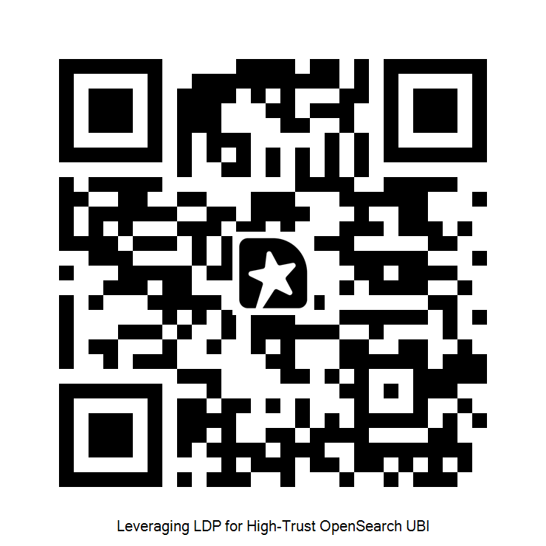
Questions
github.com/jzonthemtn/ldp-for-search
Session feedback
Jeff Zemerick
OpenSearchCon NA
September 24, 2026
31
Notes:
Have the notebook open on the convergence plot behind you during Q&A. Likely questions: formal DP guarantee, why PCA, composition across repeated queries from one user, why not just hash the query, and how you actually test the mechanism. That last one is the takeaway slide's promise, so have the four checks ready, each catching something different. One, audit the distribution, section 8: privatize one coordinate a thousand times and confirm the peak sits on the true value and the spread is sensitivity over epsilon. That catches a mechanism that is not what you claim, a wrong scale or a sign error, and it is cheap. Two, run an actual attacker, section 10: noise a query, do nearest neighbour against your real index, and score item and class recovery against chance across an epsilon sweep. That catches correctly implemented but still leaking, which is the one that matters. Three, measure the utility cost, section 7, so you know what the epsilon test two approved leaves you. Four, check the convergence, section 11: confirm error falls as one over root n. That catches noise that is not independent across users, a reused seed or a per-session draw, because correlated noise does not cancel and the measured line flattens away from theory. Two things worth saying: none of this needs production data, and tests two and four are the ones people skip and the ones that find real problems.

