Slide 1
Week 2: Control Flow
TA: Jennifer Zou
LA: Arabelle Siahaan

Slide 2
Updates
I will be out of town 10/15-10/20. You will be assigned a different section at the same time for next week. Trevor Hackett will take over my office hours that week, and I will take over his office hours the next. Discussion sections meeting at the same time:
1G: Rolfe Hall 3134
1H: Boelter Hall 5436
2G : Boelter Hall 5419
Github repository is now on the class website
More permanent solution to DNS spoofing error

Slide 3
DNS Spoofing Error
If there is a weird DNS spoofing warning when using scp or ssh, try one of the following.
Set of instructions on CS31 website (doesn’t always work)
Remove line starting with “cs31.seas.ucla.edu….” from ~/.ssh/known_hosts
Login to one of the 3 specific computers that make up cs31 (Should always work)
ssh yourSEASaccount@lnxsrv06.seas.ucla.edu
ssh yourSEASaccount@lnxsrv07.seas.ucla.edu
ssh yourSEASaccount@lnxsrv09.seas.ucla.edu

Slide 4
Github Helpful Commands
Installation for command line
Installation for desktop
Copy the repository to your computer
git clone https://github.com/jzou1115/CS31_code.git
Sync your repository with what I have put on the internet
git pull origin master
Make your own repository

Slide 5
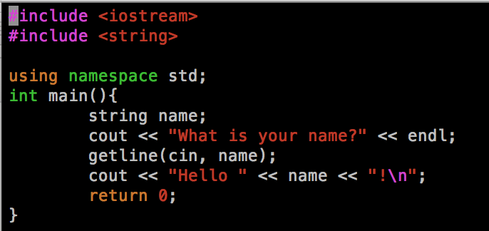
Strings
Notes:
Don’t use cin >> stringVar
cin.ignore(10000, ‘\n’)
Emphasize that the *only* time they'd be using cin.ignore(...) is after they read a number when the next thing they'll be reading will be a string.

Slide 6
Good coding practices
Use indentation to clarify meaning
Have descriptive variable names
Have short, descriptive comments
Incremental development

Slide 7
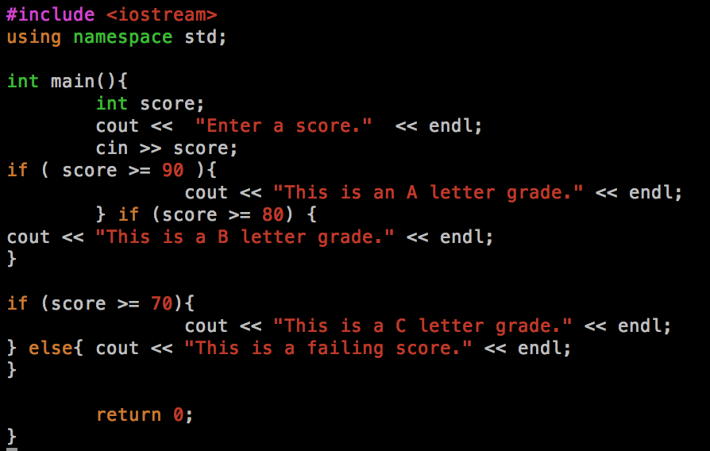
Use indentation to clarify meaning
Notes:
Make if and else statements at same level
Put chunks of code inside the if blocks at same level

Slide 8
Have descriptive variable names
In Homework #2, you have to write a program that calculates the cost of a car rental. You need to create variables to store these values:
the number of miles on the odometer at the start
the number of miles on the odometer and the end
the number of rental days
the customer’s name
the luxury status
The month rented
What are examples of good variable names for these?

Slide 9
Have short, descriptive comments
Do not just describe what each line is doing
It is helpful to describe the input and output of each function
If you do some complicated arithmetic/manipulation of variables, it can be helpful to explain the logic
Examples: conditionals.cpp, conditionals_bad_comments.cpp

Slide 10
Incremental development tips
Write small blocks of code at a time and test them with multiple types of input
If you have multiple errors, test them sequentially and recompile as you fix mistakes. Sometimes fixing one mistake will also fix later ones.
Save often!

Slide 11
if/else if/else Syntax
if (condition 1) {
//if code
}
else if (condition 2) {
//else if code
}
else{
//else code
}
Notes:
Practice coding juice

Slide 12
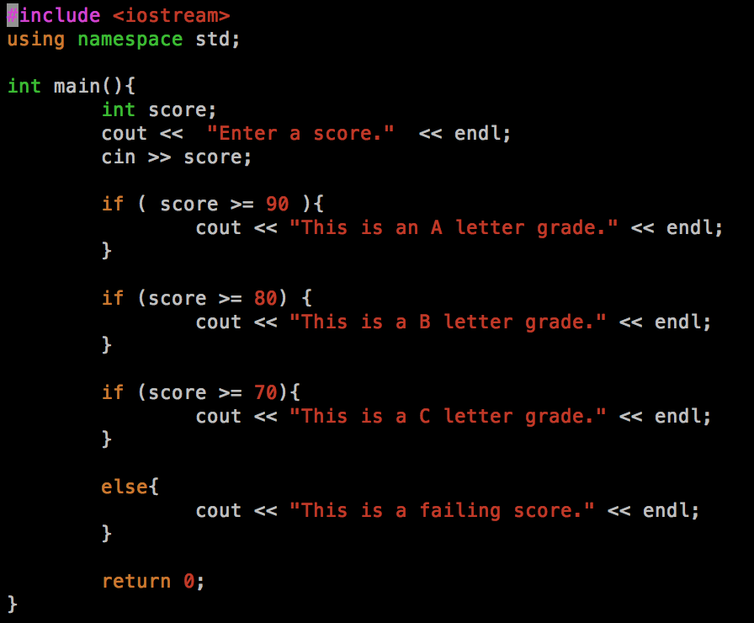
Question 1 (conditionals.cpp)
Notes:
This code is supposed to take in a score from 0-100 and say whether it is A/B/C/failing. Does it work correctly?

Slide 13
For Loops Syntax
for ( initial_value ; ending_condition ; increment ){
//Stuff to do in each iteration of the loop
}
initial_value: initialize variable(s) used in ending_condition and increment
ending_condition: keep doing for loop until this condition is met
increment: how the variable(s) change in each iteration of the loop

Slide 14
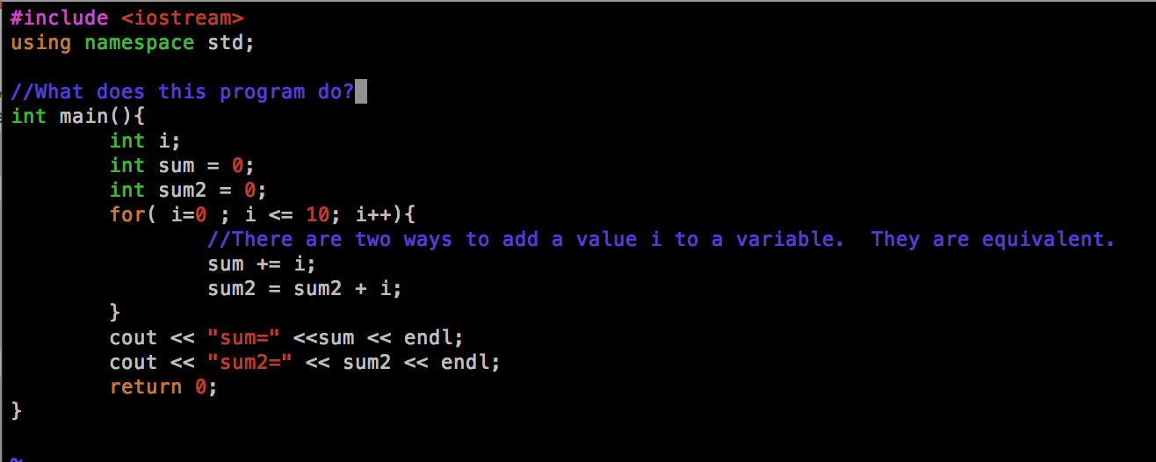
Question 2 (sumInteger.cpp)
Notes:
What does this code do? At the end, does sum have the same value as sum2?

Slide 15
Additional reminders for homework 2
Get input in exact order/manner specified in instructions
Output “---” for all cases
No loops
If multiple bad inputs, only write error message for earliest erroneous input (do not write others). You can keep assigning variables.
Do not print the rental charge if the input is invalid

