Slide 1
Natural language understanding of residential voice command
Represented as Thai text recognition.

Slide 2
Review Scopes.
Turning on-off the light of a particular room or a scene. (A scene is a set of commands set up by the resident.)
Scheduling the light switch to turn on-off in a specific time in future.
Detect and recognize invalid commands.

Slide 3
I am going to demonstrate the output first, to make it clear.

Slide 4
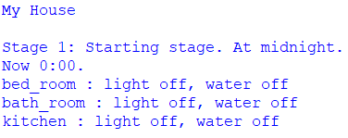
Stage 1
Command line output for all.
Start at midnight.
Everything started as “off”.
The next stages will progress every 1 hour.

Slide 5
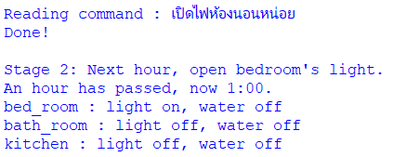
Stage 2
Execute command to open light in bedroom.
The light turned on immediately
Meanwhile, it is now 1:00 AM, nothing to do with the recent command.

Slide 6
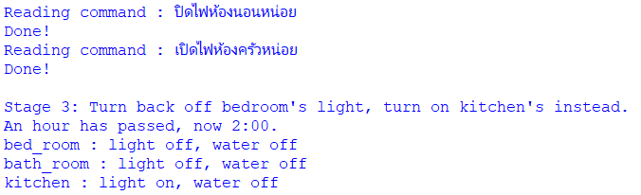
Stage 3
Turn off the bedroom light.
Turn on the kitchen light.
Now 2:00 AM.

Slide 7
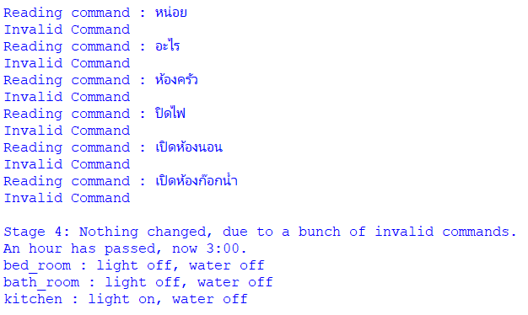
Stage 4
Invalid commands demonstration.
Now 3:00 AM.

Slide 8
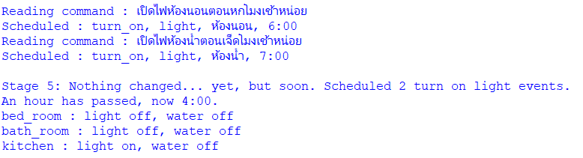
Stage 5
2 scheduling commands executed, one is turn on the bedroom light at 6:00 AM, another for bathroom light at 7:00 AM.
Now 4:00 AM, nothing physically changed yet.

Slide 9
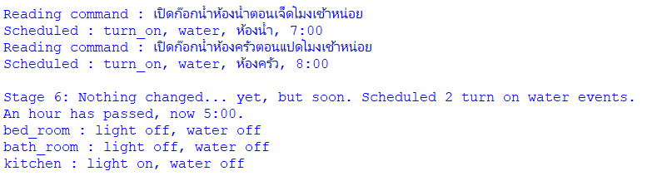
Stage 6
2 scheduling commands executed, one is turn on the bathroom water at 7:00 AM, another for kitchen water at 8:00 AM.
Now 5:00 AM, nothing physically changed yet.

Slide 10
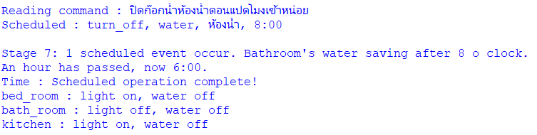
Stage 7
1 scheduling command executed, it is to turn off the bathroom water at 8:00 AM
Now 6:00 AM, the bedroom light has been turned on by a scheduled command.

Slide 11
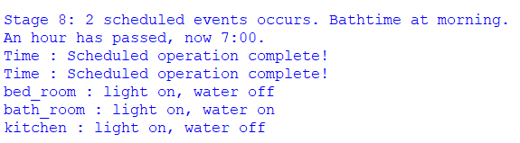
Stage 8
No commands executed.
Now 7:00 AM, both the bathroom’s light and water are turned on due to previous scheduled commands.

Slide 12
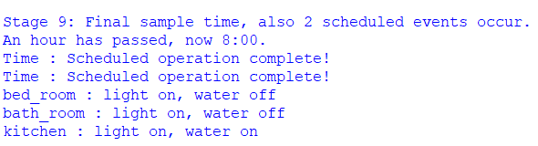
Stage 9
No commands executed.
Now 8:00 AM, the bathroom water is now turned off, but the kitchen water is now on, both by scheduled commands.

Slide 13
The codes behind the scene.

Slide 14
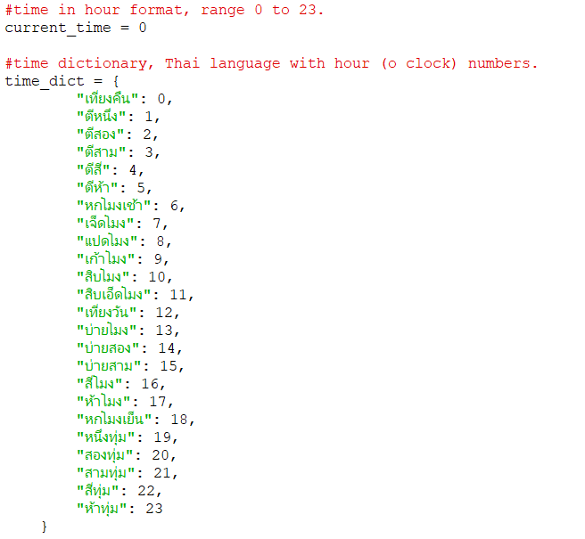
Code : Global
Time value, told in hour, ranged 0 to 23
Thai Natural Language key value pair with hour numbers.
Will be used later for possibly all objects.

Slide 15
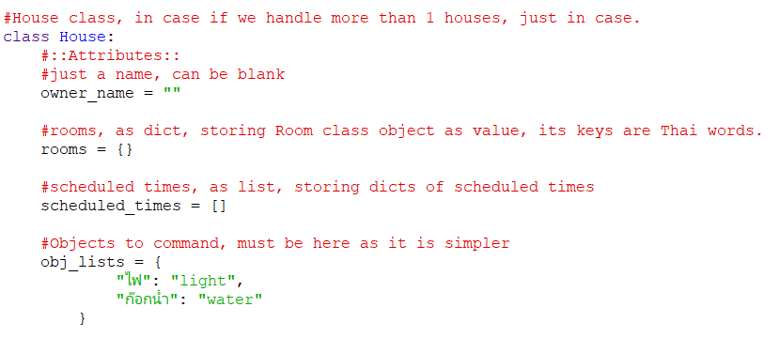
Code: House Class (Part 1)
Define House Object, in case if we need > 1 houses, we can be flexible with it like this.
House Object’s attributes

Slide 16
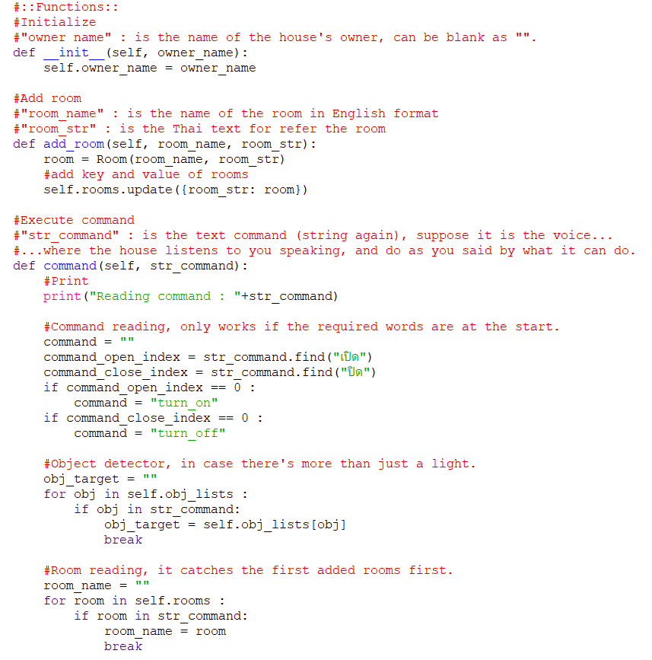
Code: House Class (Part 2)
Initialization
Add room by resident.
Command reading function Part 1.
On or Off?
Process here
Which object?
Process here
Which room?
Process here

Slide 17
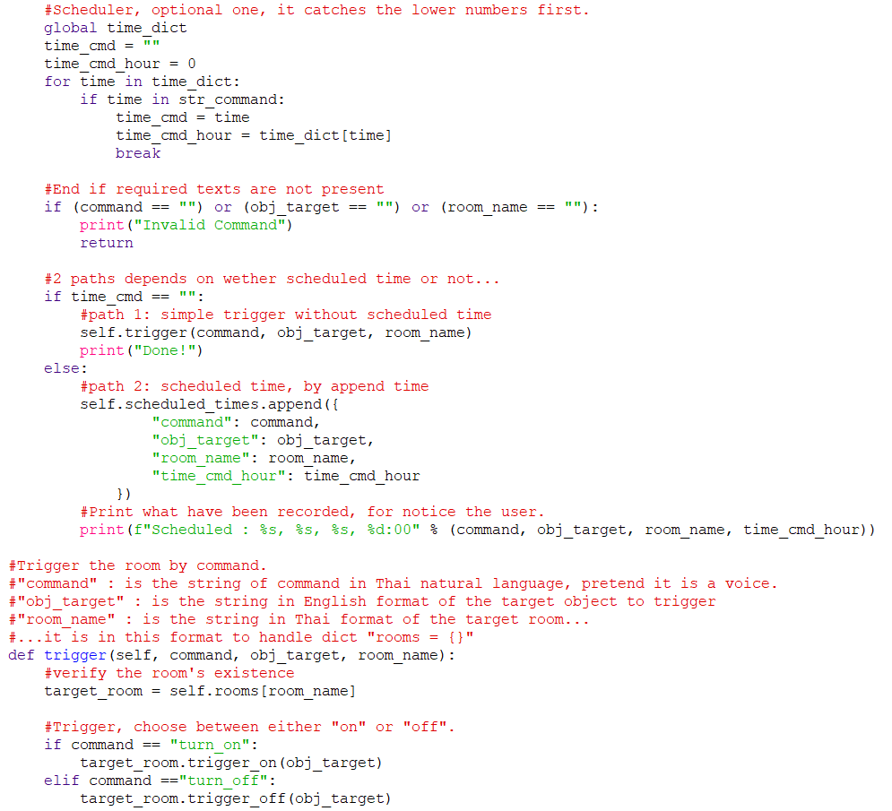
Code: House Class (Part 3)
Command reading function Part 2.
When or now?
Process here
Screen invalid commands.
If now. Trigger now
If scheduled later. Trigger later
Get room obj.
Trigger on off for each room function.
Trigger on or off.

Slide 18
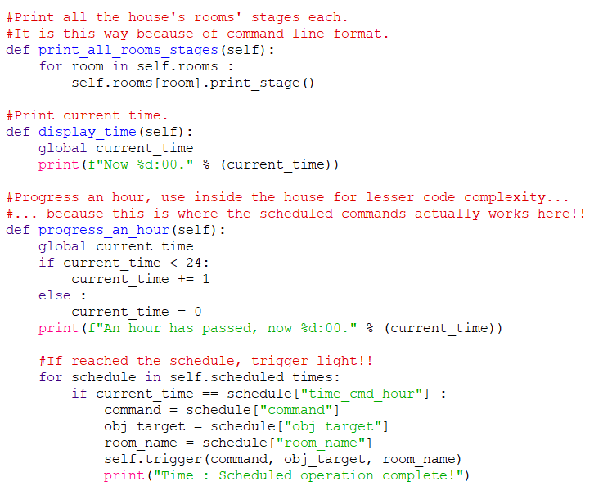
Code: House Class (Part 4)
Display functions.
Print rooms’ stages.
Print time
Progress time, each hour per this function calls.
Time progress
Always check for scheduled event just in case, if found, trigger it.

Slide 19
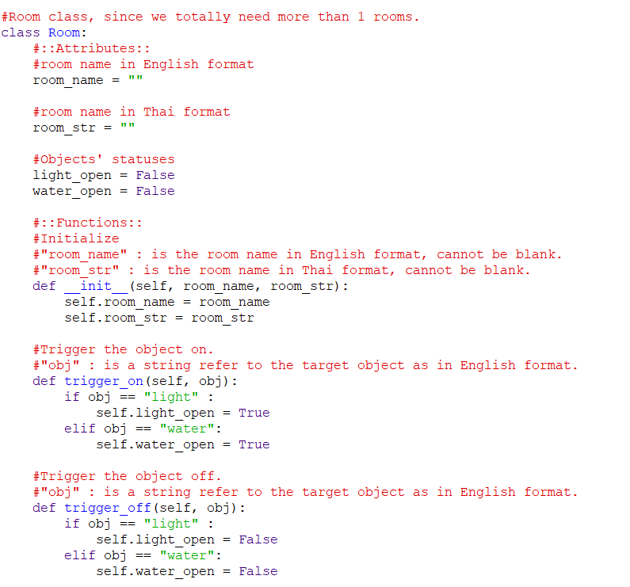
Code: Room Class (Part 1)
Define Room Object, strictly required as we will need to handle > 1 rooms.
Handles multiple different rooms.
Class name
Attributes
Initialize, the name of the room is important
Trigger functions, they are very simple here.

Slide 20
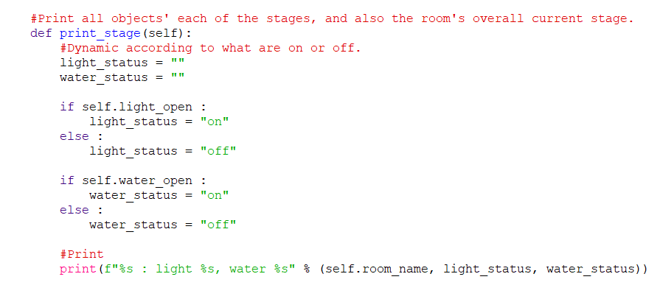
Code: Room Class (Part 2)
Find which objects are on and off for correct display.
Print it.
Print each room’s status.

Slide 21
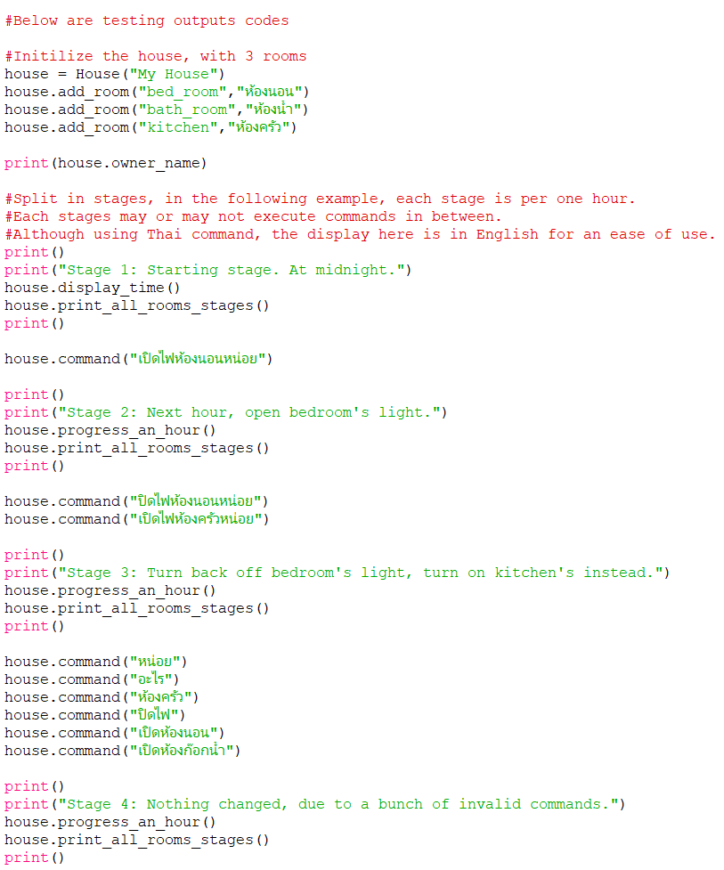
Code: Testing Stages (Part 1)
Initialize
Add 3 rooms
Stage 1
Stage 2
Stage 3
Stage 4

Slide 22
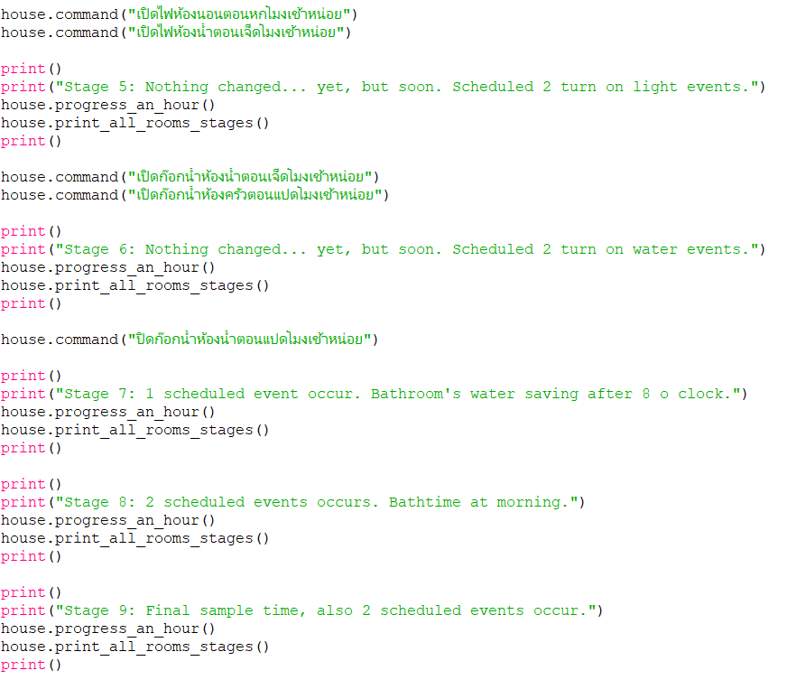
Code: Testing Stages (Part 2)
Stage 5
Stage 6
Stage 7
Stage 8
Stage 9

Slide 23
Github Link.
https://github.com/jzrlza/SmartHomePrototype
(File : smart_home_command.py)

