Slide 1
Natural language understanding of residential voice command
Represented as Thai text recognition.

Slide 2
Review Scopes.
Turning on-off the light of a particular room or a scene. (A scene is a set of commands set up by the resident.)
Scheduling the light switch to turn on-off in a specific time in future.
Detect and recognize invalid commands.

Slide 3
I am going to demonstrate the output first, to make it clear.

Slide 4
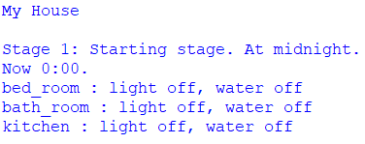
Stage 1
Command line output for all.
Start at midnight.
Everything started as “off”.
The next stages will progress every 1 hour.

Slide 5
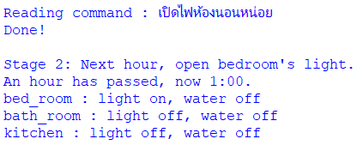
Stage 2
Execute command to open light in bedroom.
The light turned on immediately
Meanwhile, it is now 1:00 AM, nothing to do with the recent command.

Slide 6
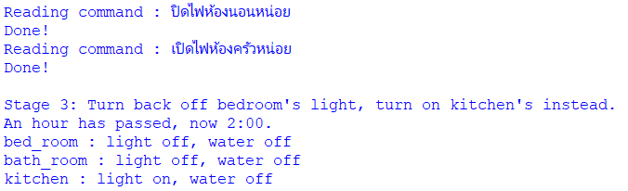
Stage 3
Turn off the bedroom light.
Turn on the kitchen light.
Now 2:00 AM.

Slide 7
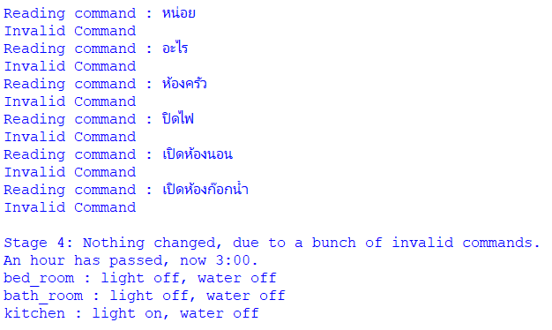
Stage 4
Invalid commands demonstration.
Now 3:00 AM.

Slide 8
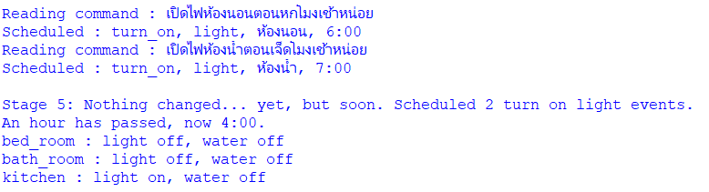
Stage 5
2 scheduling commands executed, one is turn on the bedroom light at 6:00 AM, another for bathroom light at 7:00 AM.
Now 4:00 AM, nothing physically changed yet.

Slide 9
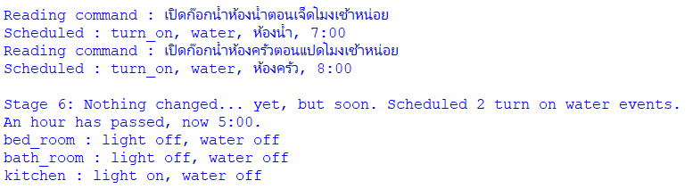
Stage 6
2 scheduling commands executed, one is turn on the bathroom water at 7:00 AM, another for kitchen water at 8:00 AM.
Now 5:00 AM, nothing physically changed yet.

Slide 10
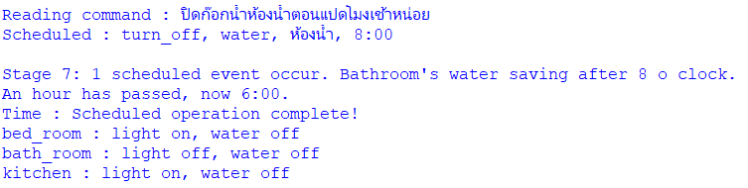
Stage 7
1 scheduling command executed, it is to turn off the bathroom water at 8:00 AM
Now 6:00 AM, the bedroom light has been turned on by a scheduled command.

Slide 11
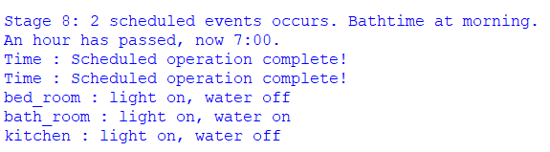
Stage 8
No commands executed.
Now 7:00 AM, both the bathroom’s light and water are turned on due to previous scheduled commands.

Slide 12
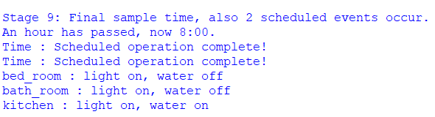
Stage 9
No commands executed.
Now 8:00 AM, the bathroom water is now turned off, but the kitchen water is now on, both by scheduled commands.

Slide 13
The codes behind the scene.

Slide 14
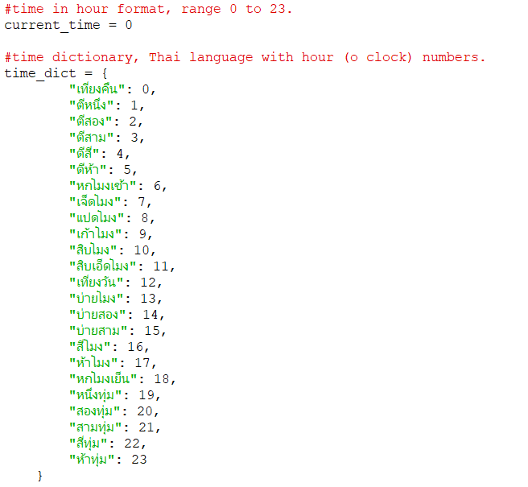
Code : Global

Slide 15
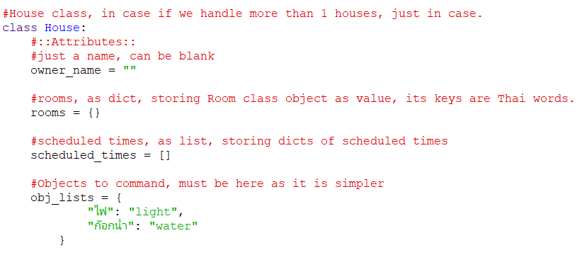
Code: House Class (Part 1)

Slide 16
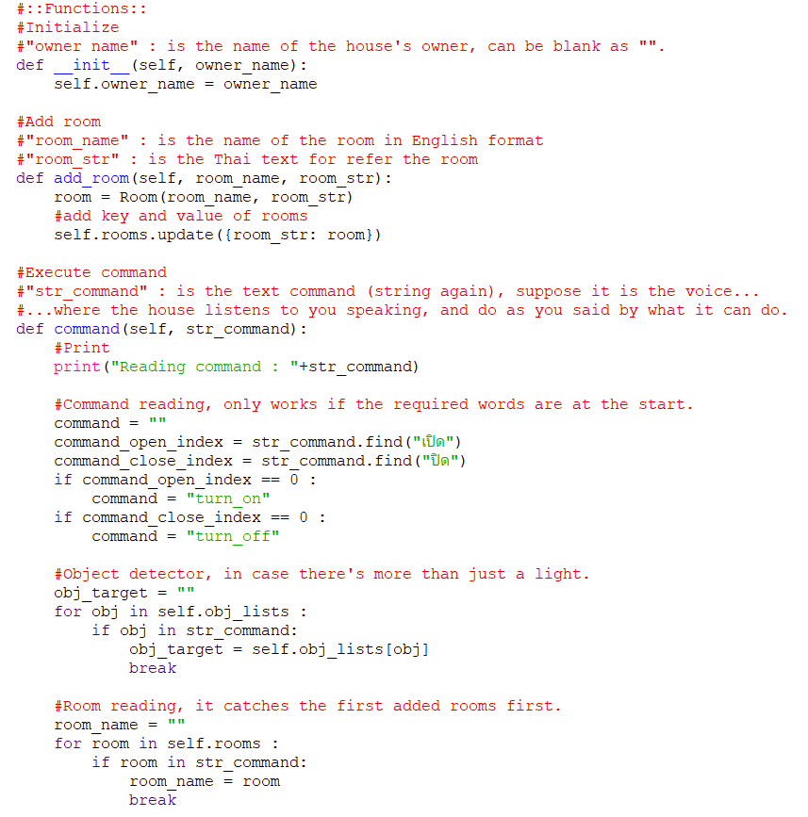
Code: House Class (Part 2)

Slide 17
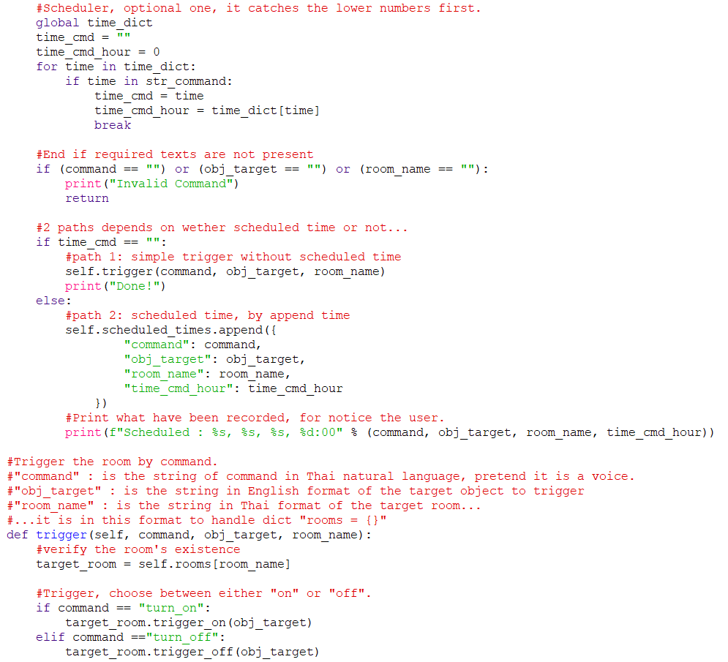
Code: House Class (Part 3)

Slide 18
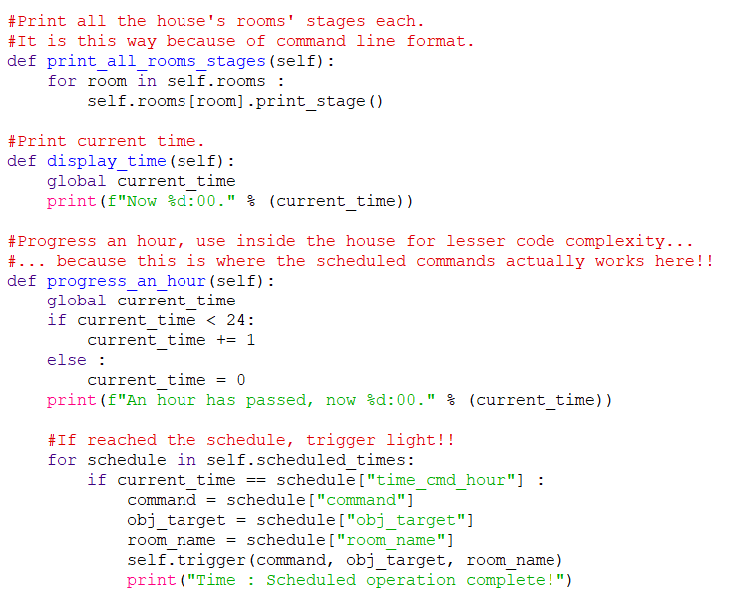
Code: House Class (Part 4)

Slide 19
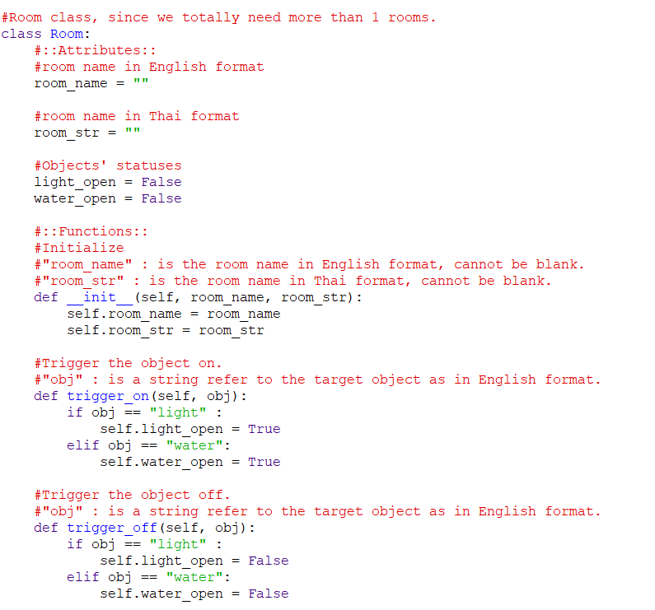
Code: Room Class (Part 1)

Slide 20
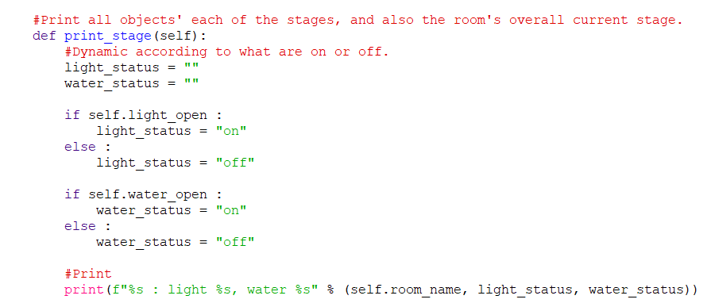
Code: Room Class (Part 2)

Slide 21
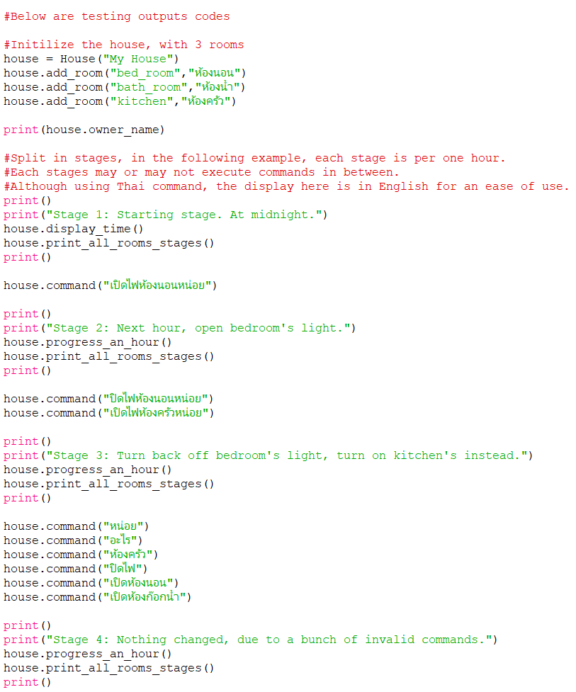
Code: Testing Stages (Part 1)
Initialize
Stage 1
Stage 2
Stage 3
Stage 4

Slide 22
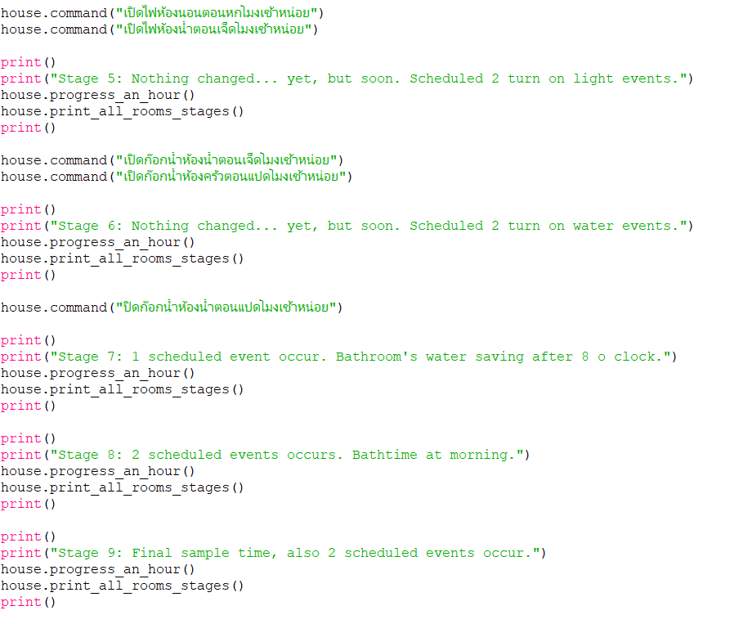
Code: Testing Stages (Part 2)
Stage 5
Stage 6
Stage 7
Stage 8
Stage 9

Slide 23
Github Link.

