Slide 1
Natural language understanding of residential voice command
Represented as Thai text recognition.

Slide 2
Review Scopes.
Turning on-off the light of a particular room or a scene. (A scene is a set of commands set up by the resident.)
Scheduling the light switch to turn on-off in a specific time in future.
Detect and recognize invalid commands.

Slide 3
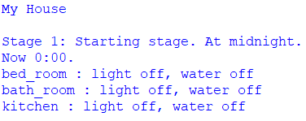
Stage 1

Slide 4
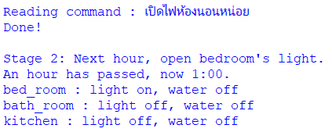
Stage 2

Slide 5
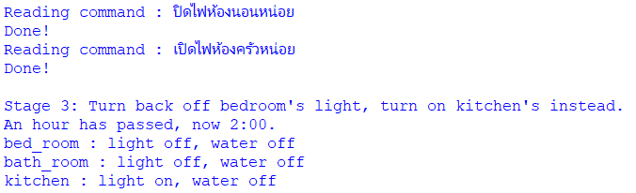
Stage 3

Slide 6
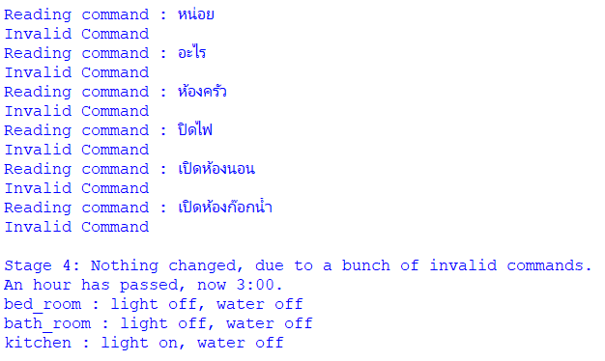
Stage 4

Slide 7
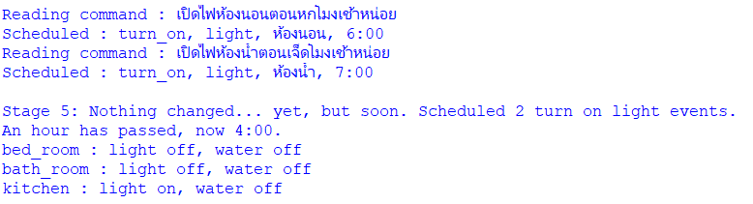
Stage 5

Slide 8
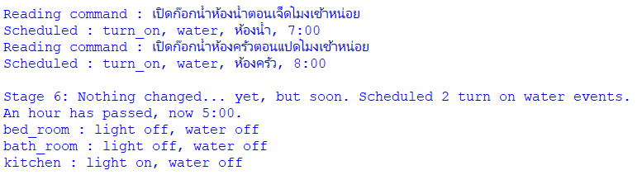
Stage 6

Slide 9
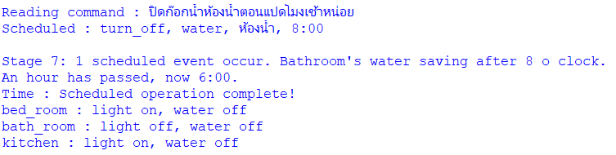
Stage 7

Slide 10
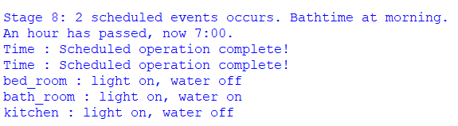
Stage 8

Slide 11
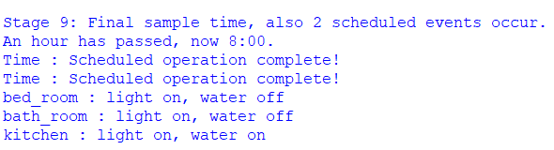
Stage 9

Slide 12
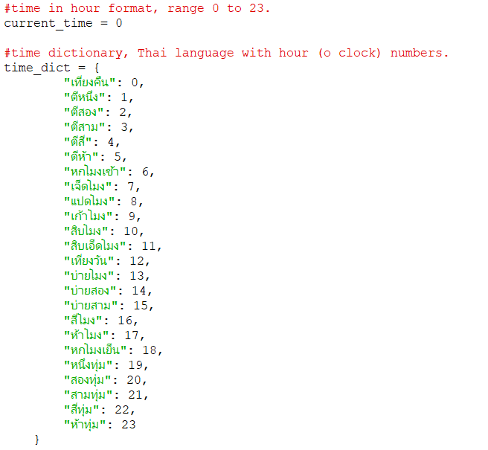
Code : Global

Slide 13
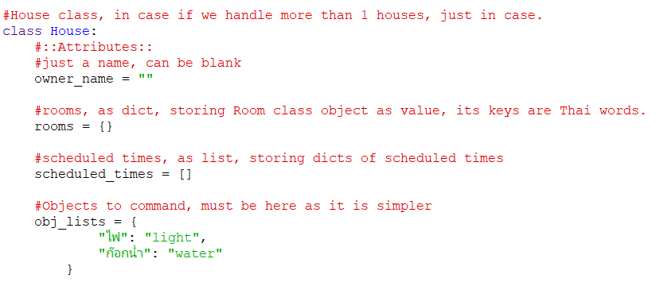
Code: House Class

Slide 14
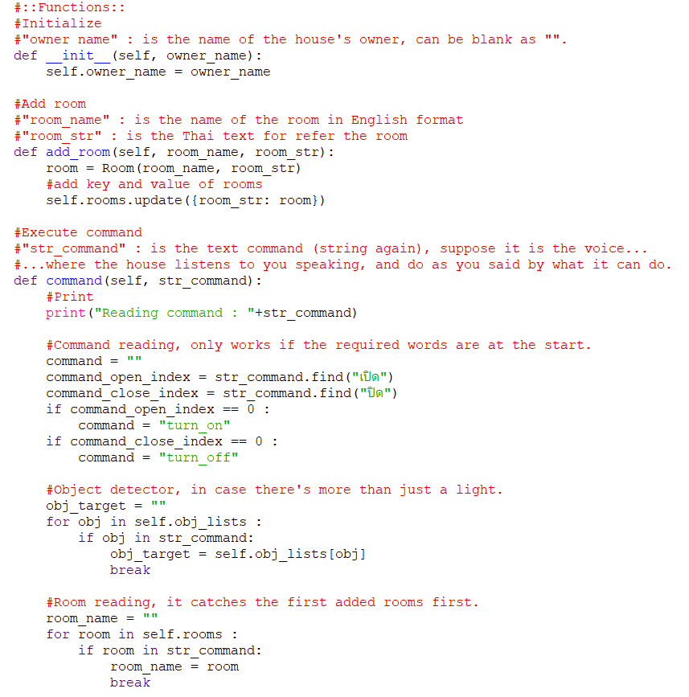
Code: House Class

Slide 15
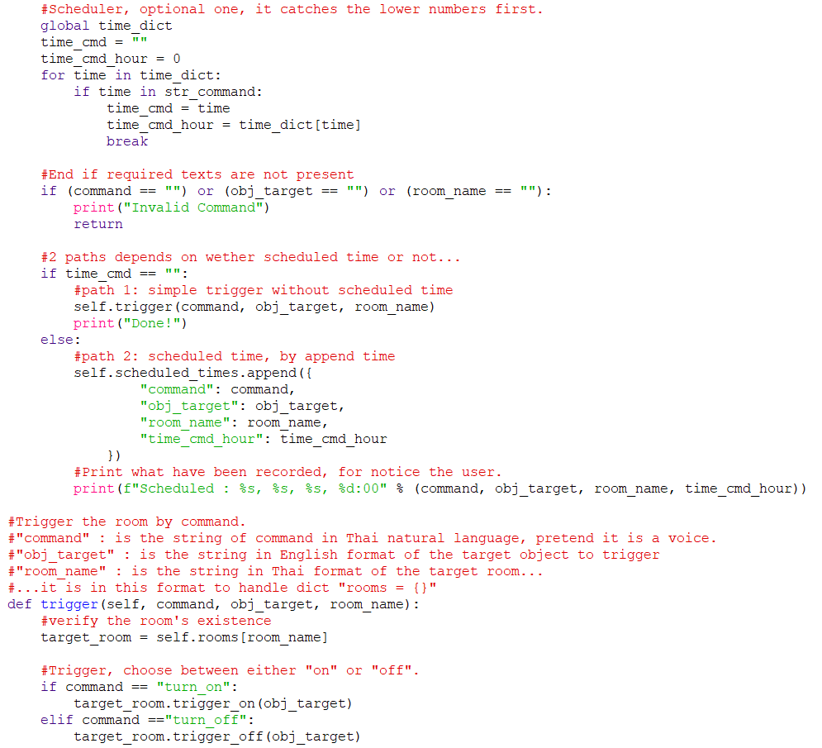
Code: House Class

Slide 16
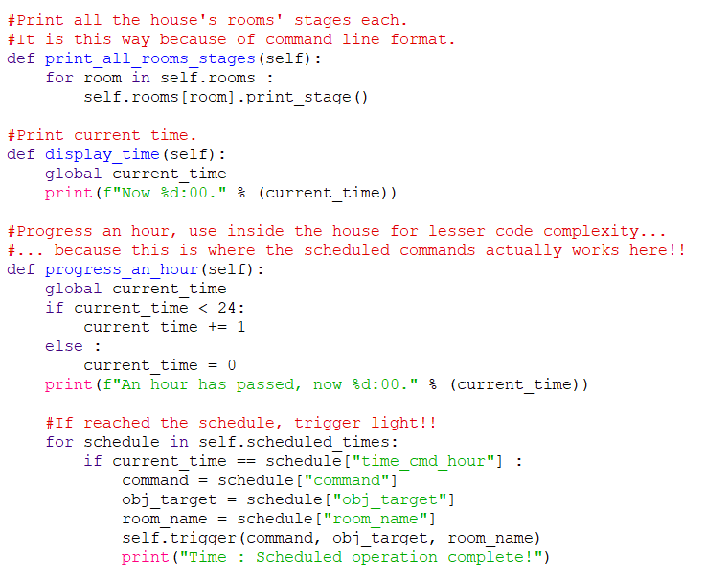
Code: House Class

Slide 17
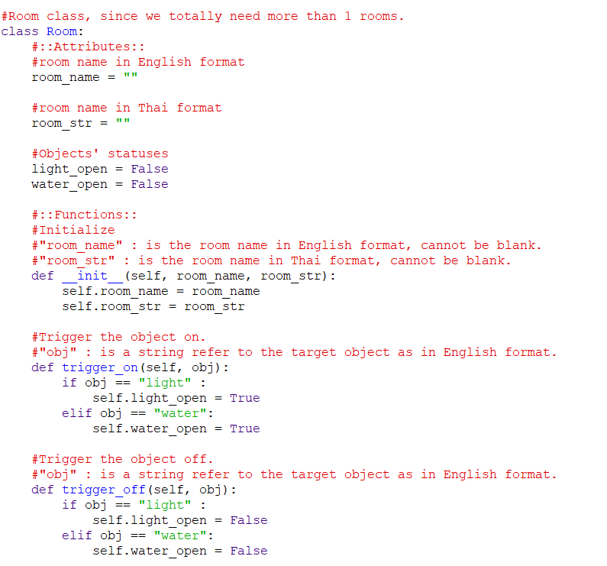
Code: Room Class

Slide 18
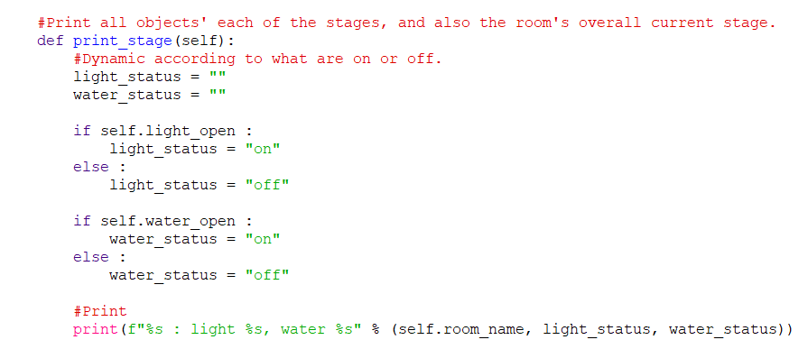
Code: Room Class

Slide 19
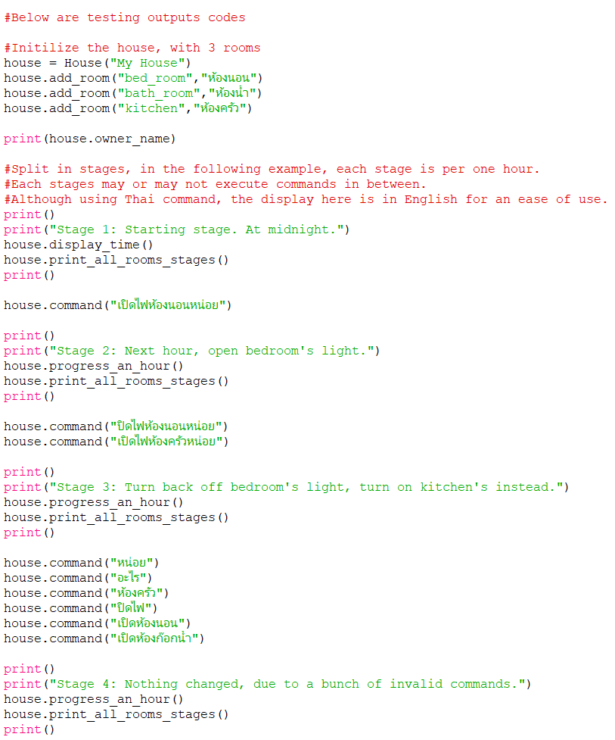
Code: Testing Stages

Slide 20
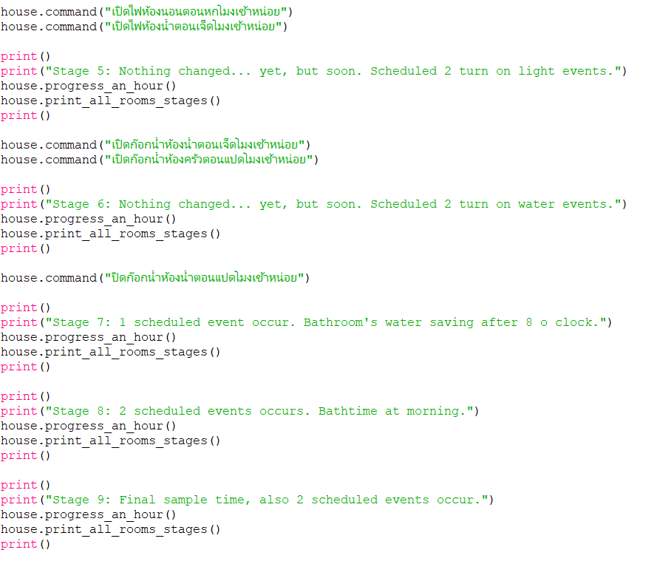
Code: Testing Stages

